Slide 1
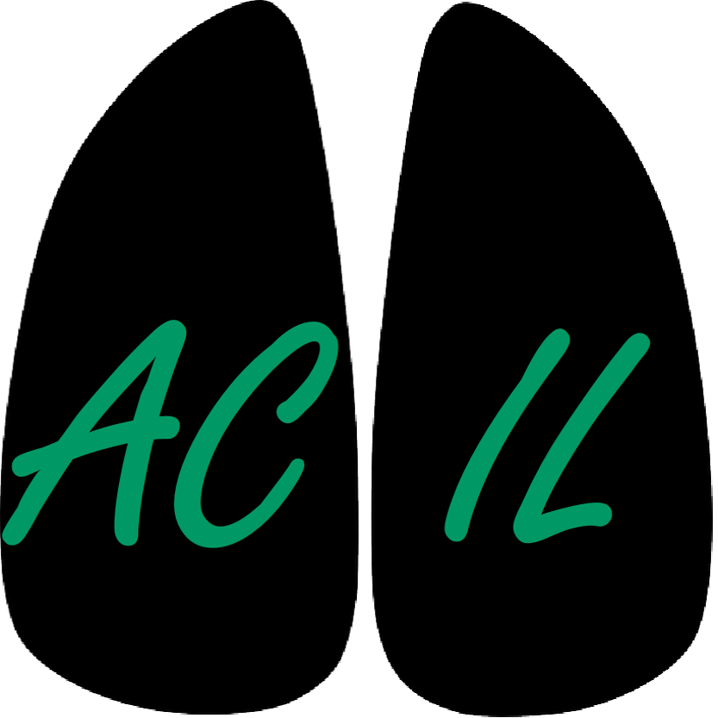
Chest Imaging Platform (CIP)
Applied Chest Imaging Laboratory
Boston, Massachusetts. USA
Command Line Tools

Slide 2
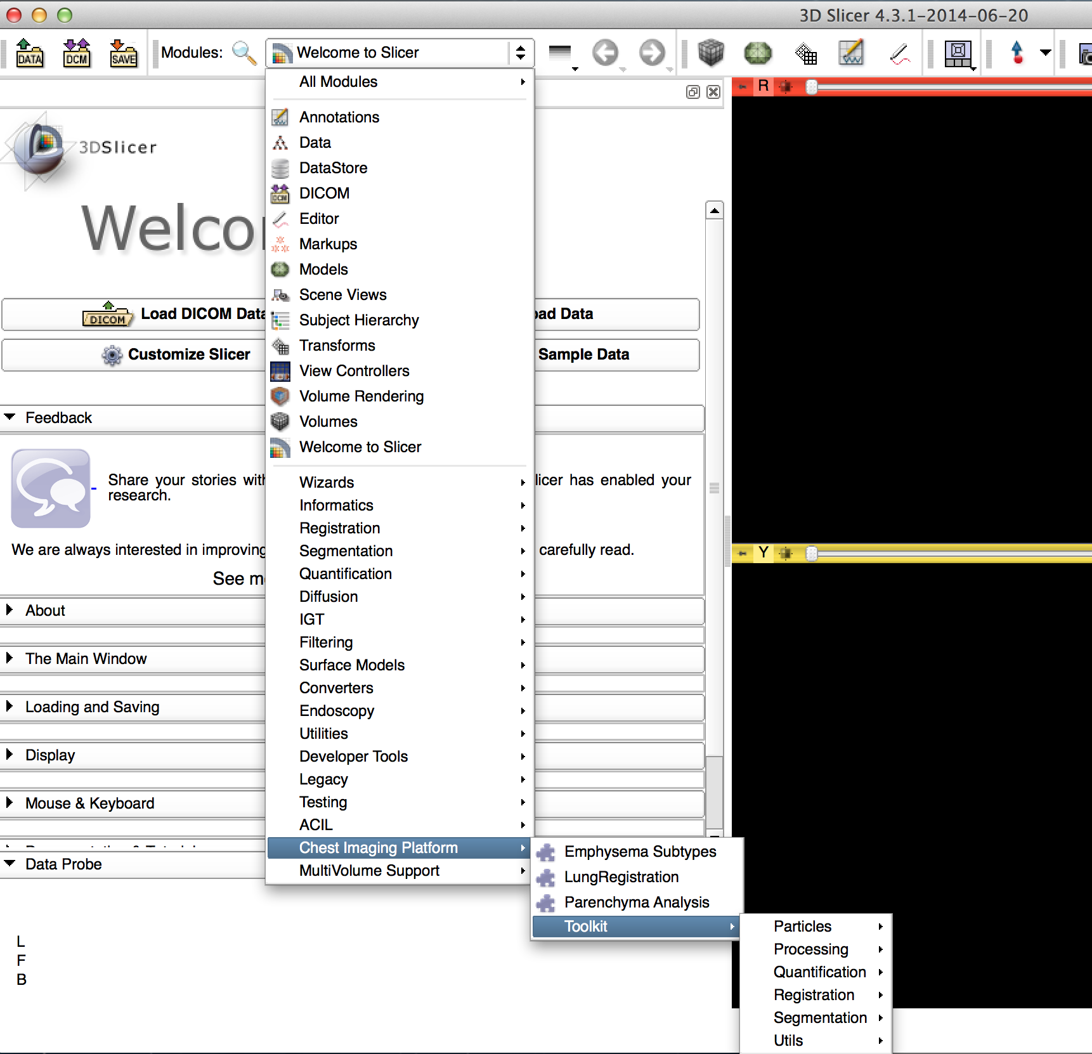
CIP Command line toolkit
A suite of command line tools for the processing and analysis of Chest CT images
6 categories
Particles
Processing
Quantification
Registration
Segmentation
Utils

Slide 3
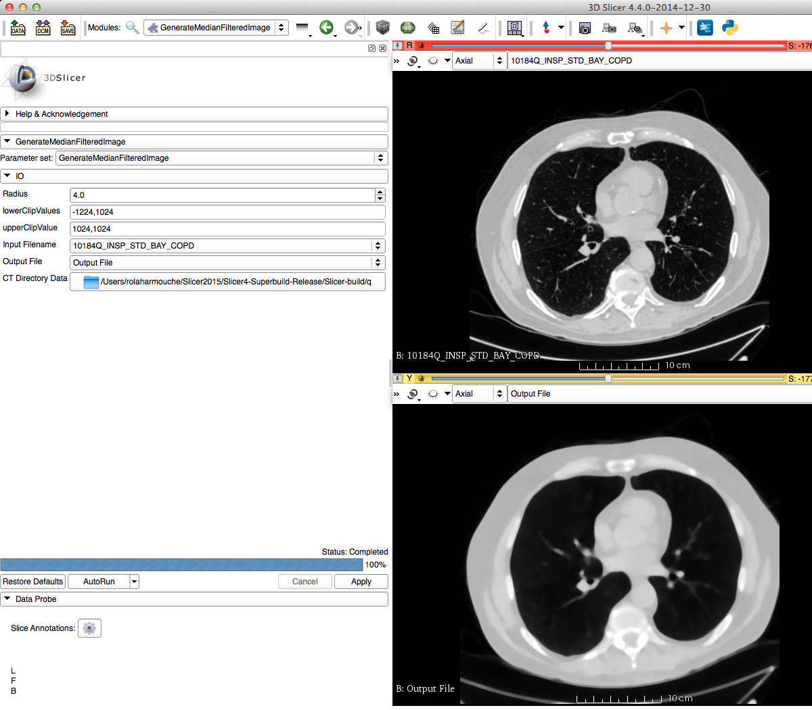
CIP Toolkit: Processing
A set of tools to process CT images and label maps
Filtering
Resampling
File conversion
Lung Cropping
Extracting Chest
label map given
specified regions
…
Ex. Median filtering. The CT on the bottom is the filtered version of the top CT

Slide 4
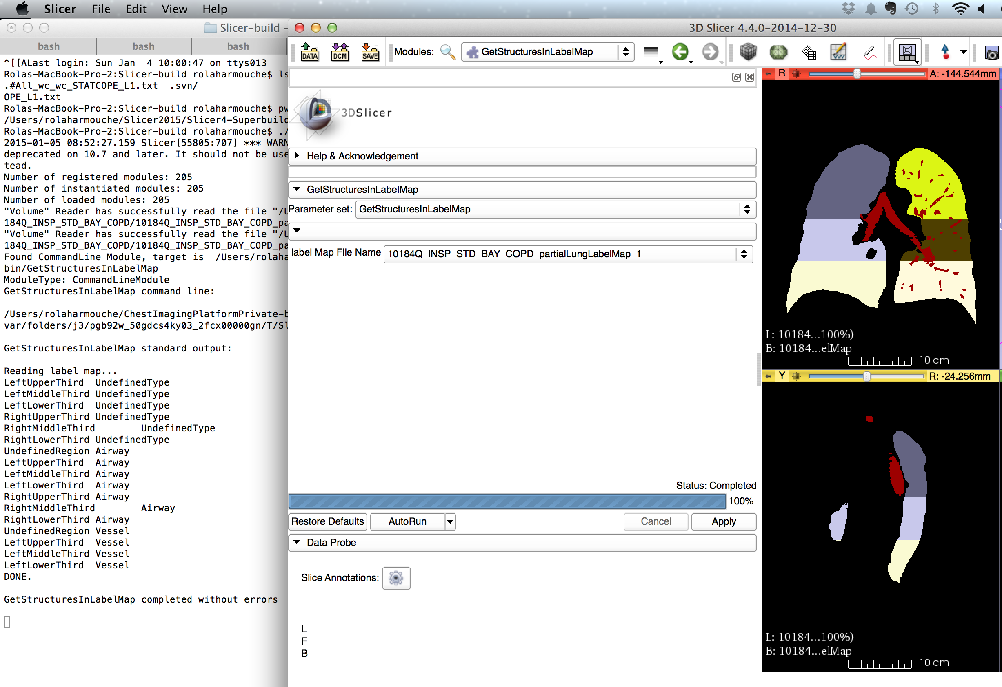
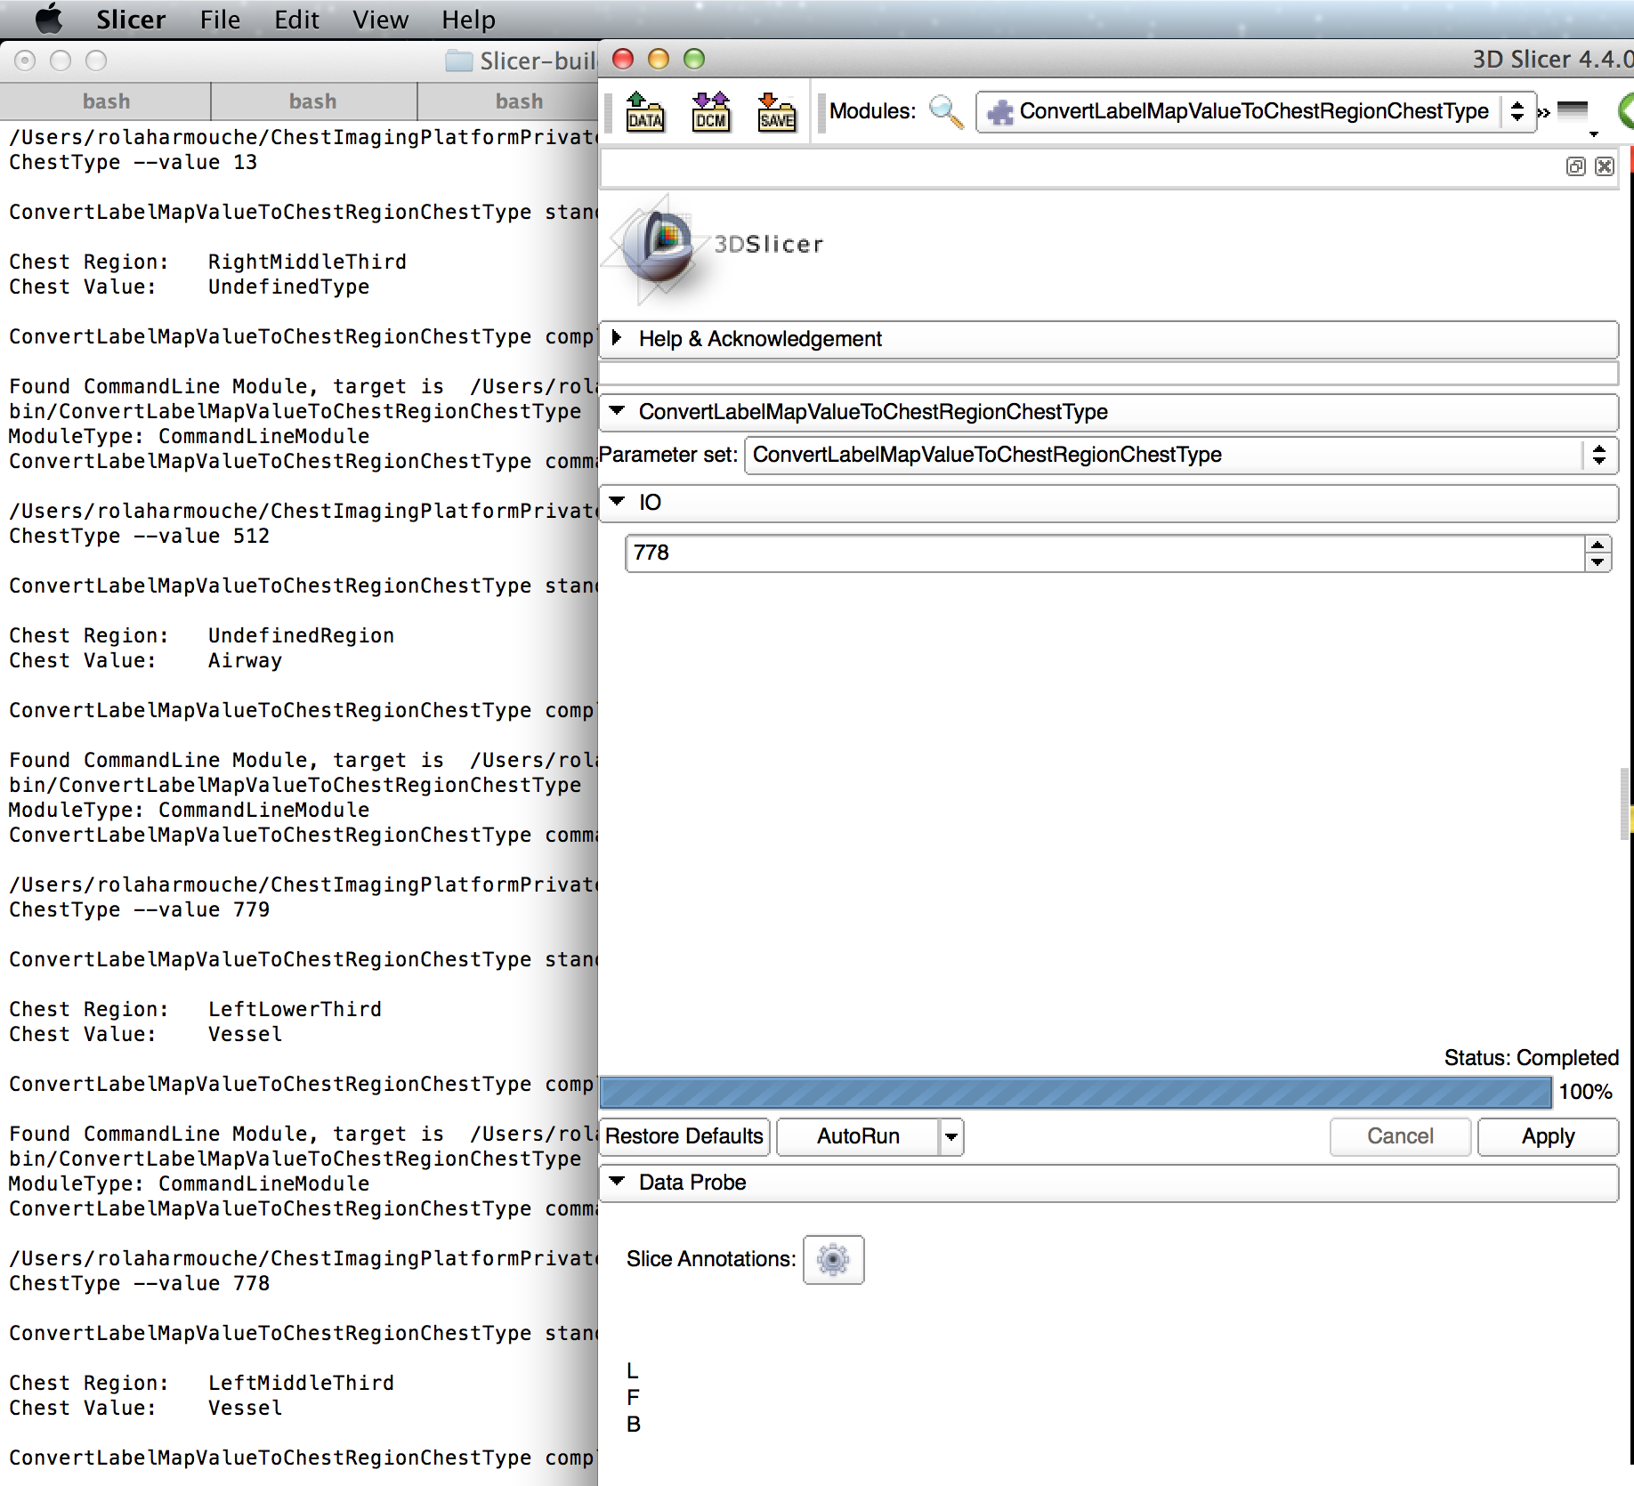
CIP Toolkit: Utils
A set of utilities for generating QC images, interfacing to our conventions, getting the available structures from a labelmap (given our label conventions),…
Ex. List available structures in the labelmap
Ex. Convert label map value to chest region & type

Slide 5
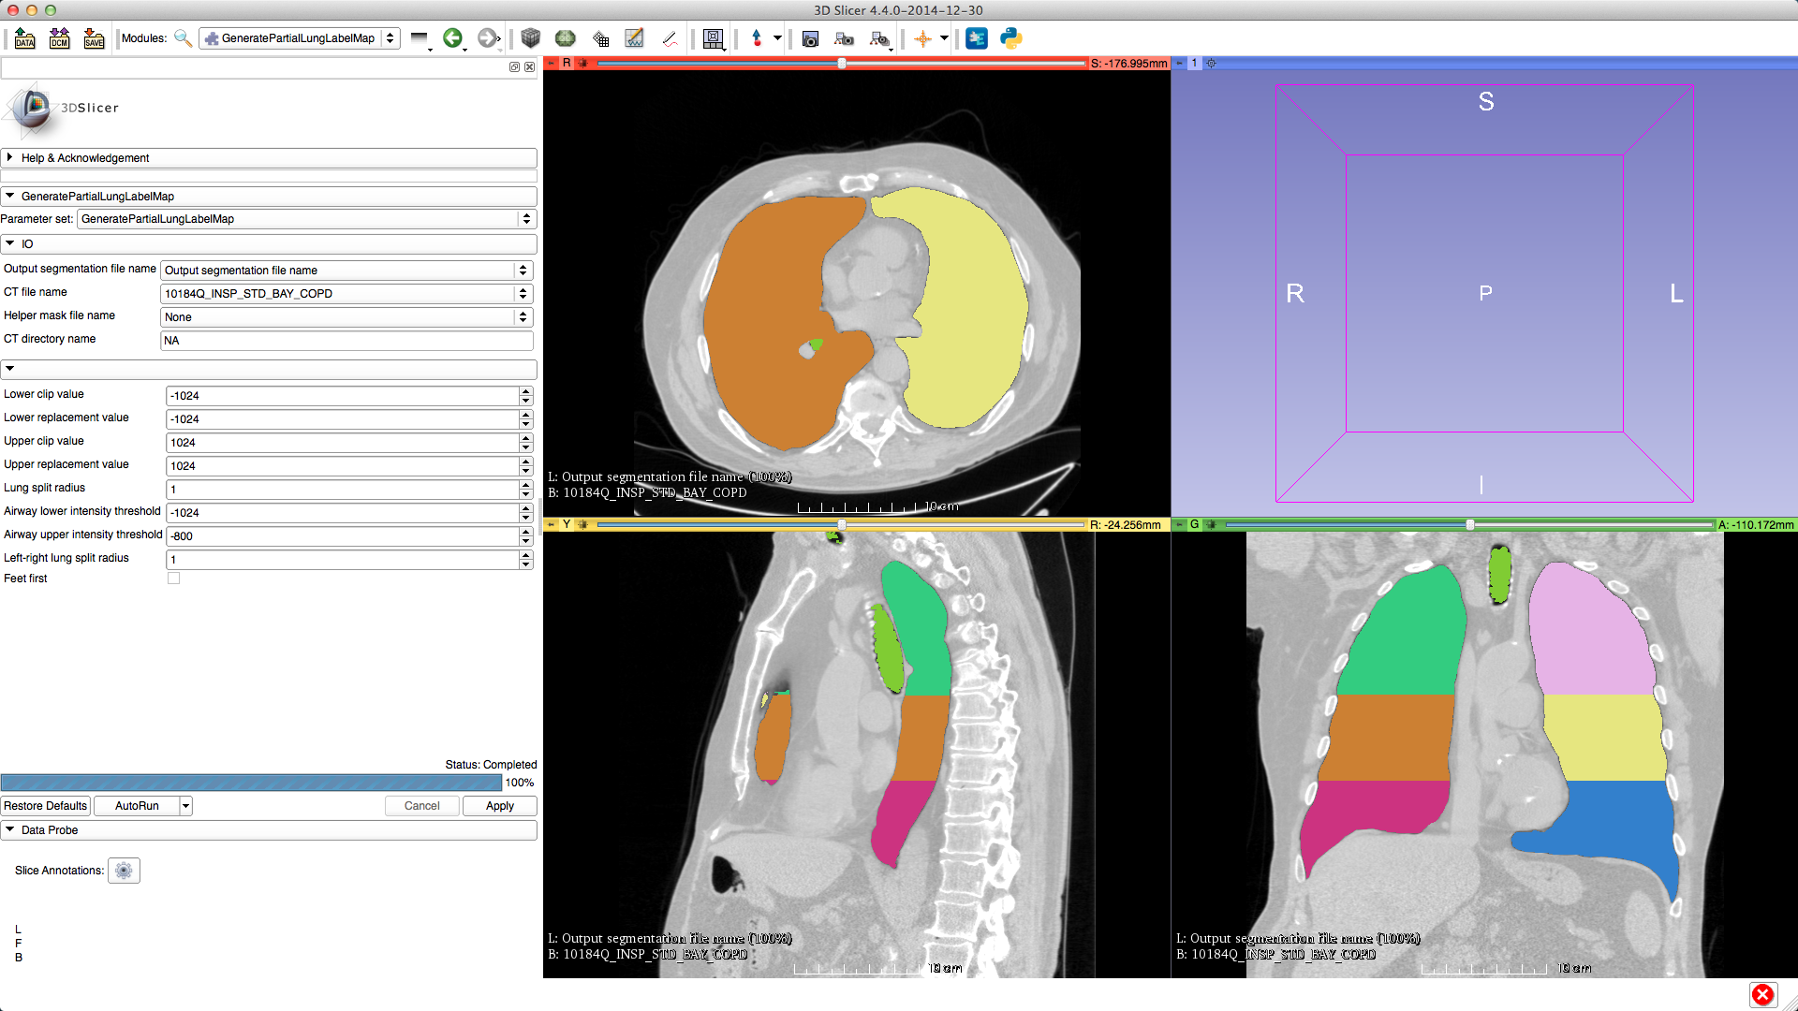
CIP Toolkit: Segmentation
Segmenting lungs, lung lobes, lungs by thirds, separating left and right lung
Ex. Generating a partial lung labelmap that separates the lungs by thirds

Slide 6
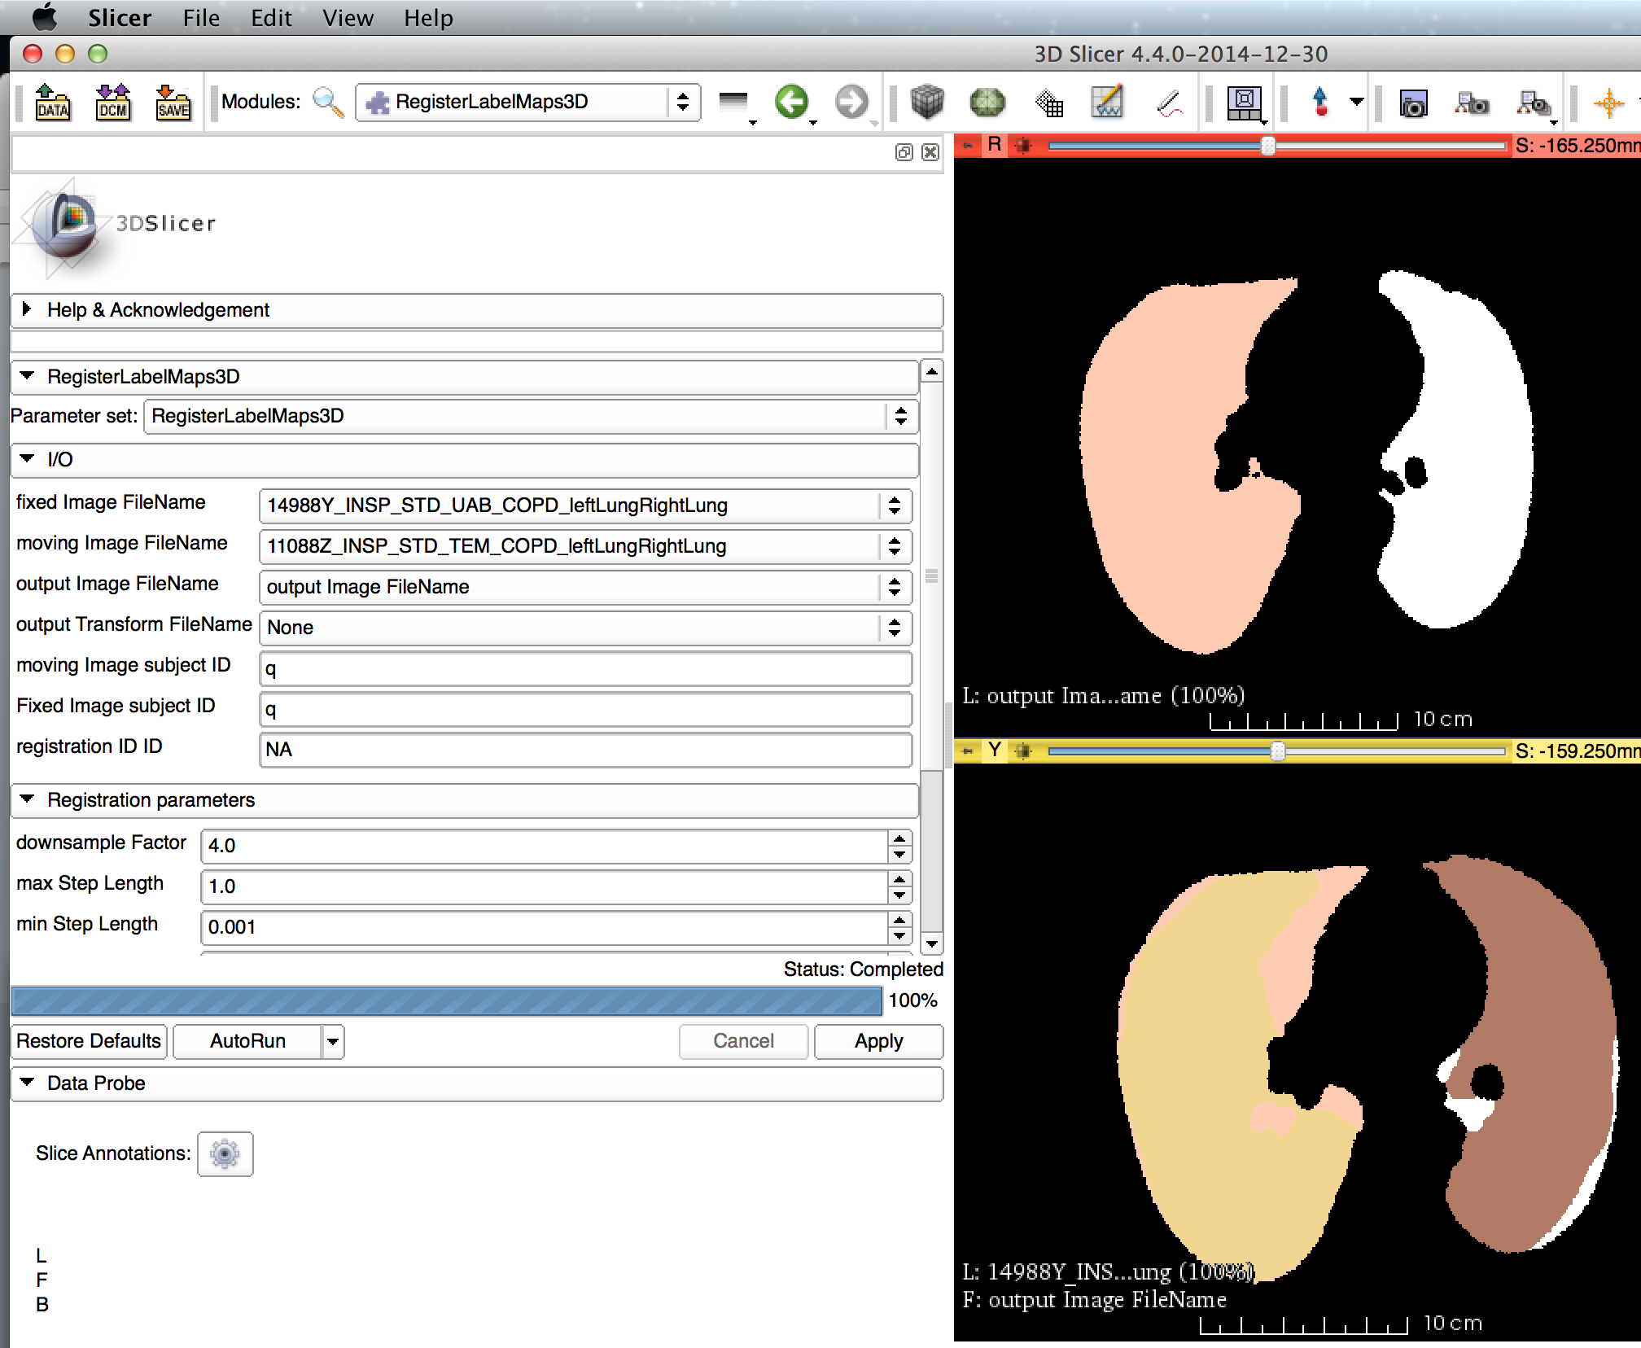
CIP Toolkit: Registration
Affine Registration between
2 CT images
2 LabelMaps
An atlas and a CT
Ex. Registration between a fixed (bottom pane) and a moving labelmap.

Slide 7
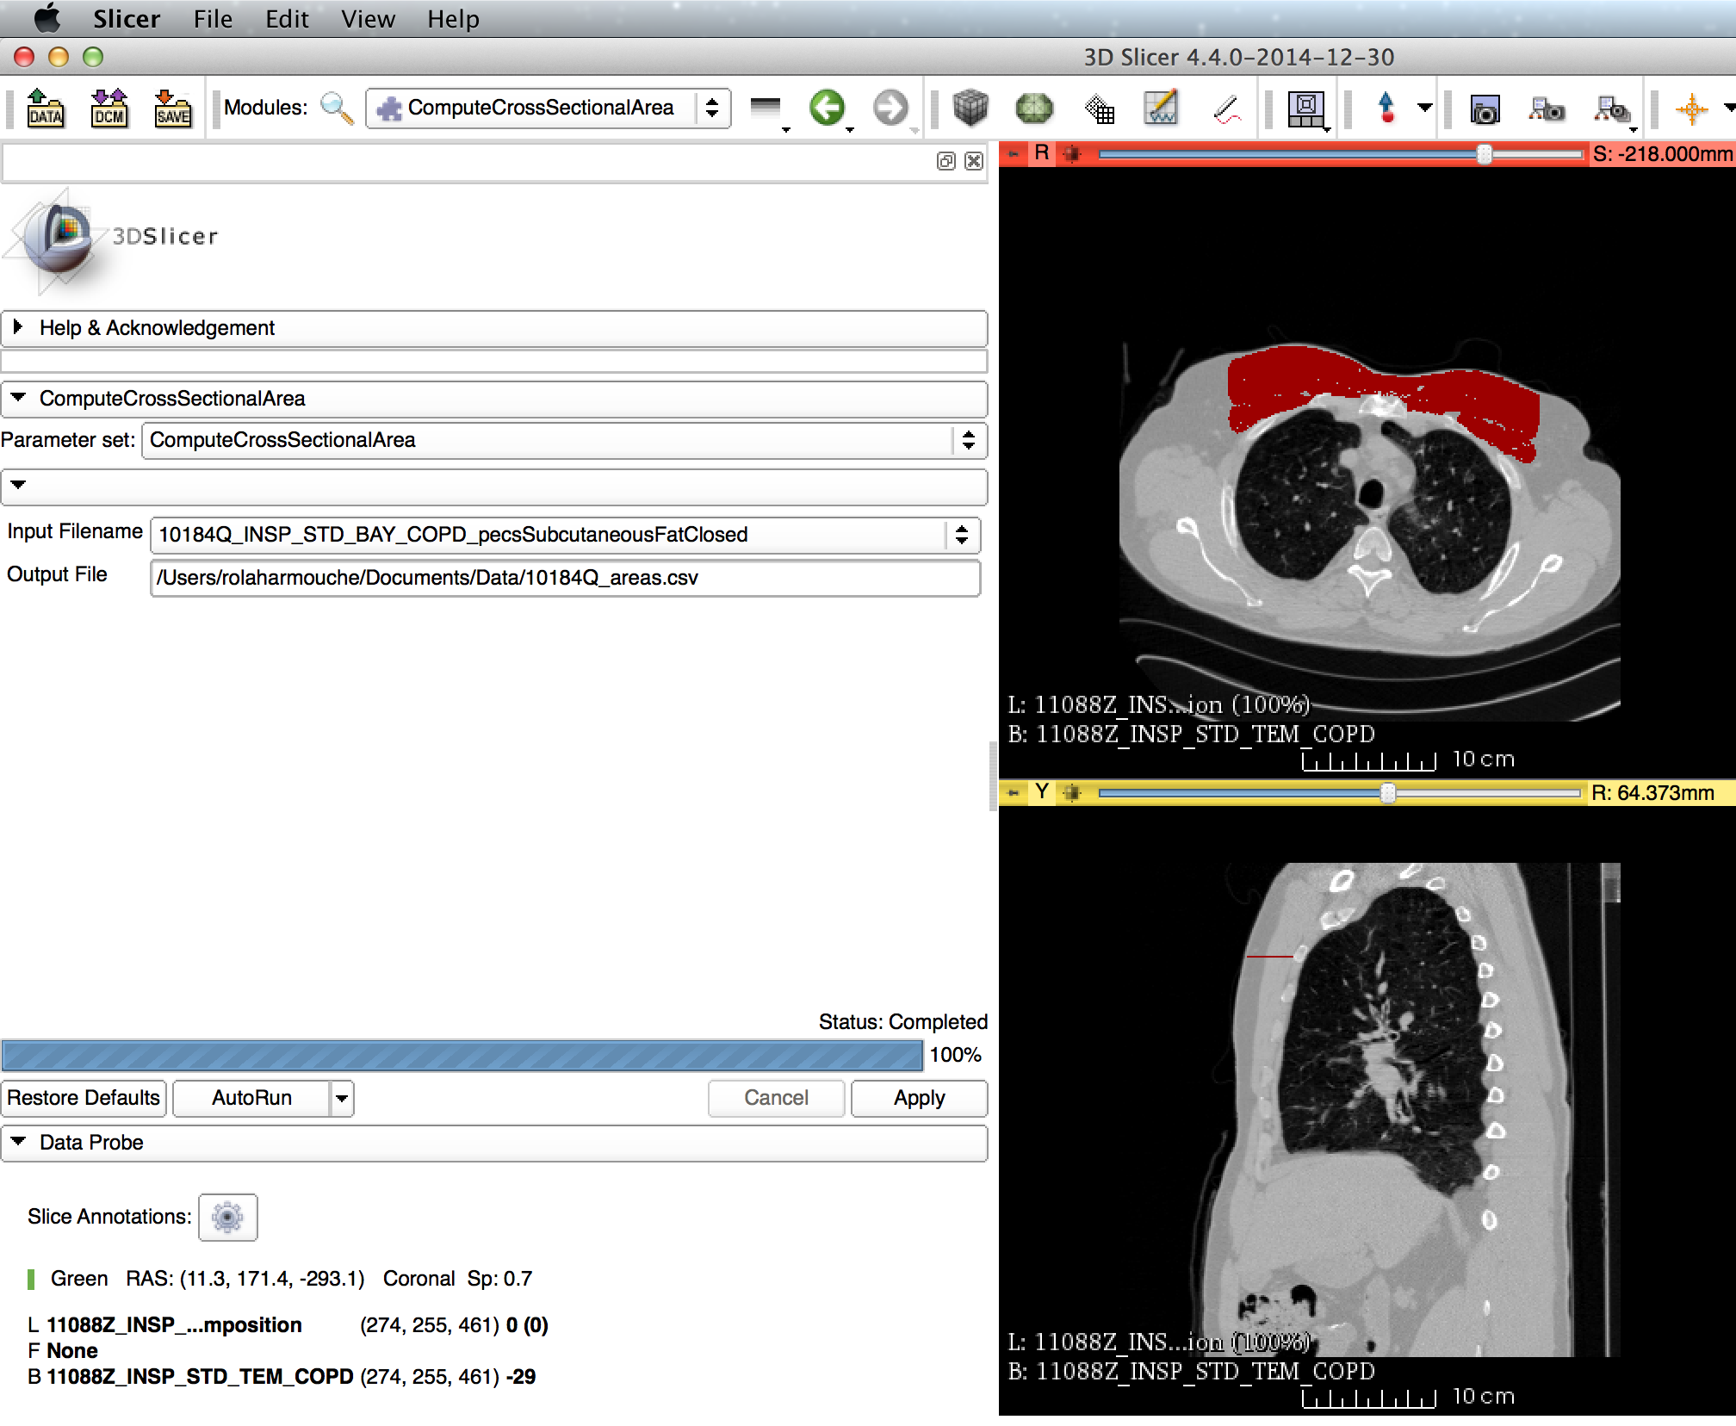
CIP Toolkit: Quantification
Computing clinical quantities from chest CT data and associated label maps
Lung phenotypes
Extra pulmonary
muscle and fat
areas and intensity
statistics
File,Region,Type,Area (mm^2)
FJAFA_vtkMRMLScalarVolumeNodeB.nrrd,Left, PectoralisMinor,451.303
FJAFA_vtkMRMLScalarVolumeNodeB.nrrd,Right, PectoralisMinor,460.717
FJAFA_vtkMRMLScalarVolumeNodeB.nrrd,Left, PectoralisMajor,1192.77
FJAFA_vtkMRMLScalarVolumeNodeB.nrrd,Right, PectoralisMajor,991.759
FJAFA_vtkMRMLScalarVolumeNodeB.nrrd,Left, SubcutaneousFat,2863.97
FJAFA_vtkMRMLScalarVolumeNodeB.nrrd,Right, SubcutaneousFat,2845.15
Ex. Computing cross sectional Areas for each label present in in a label map

Slide 8
CIP Toolkit: Moving forward
The tools can be combined in order to generate clinically meaningful workflows
As an example : Computing lung parenchymal phenotypes from CT images
Load CT image
GeneratePartialLungLabelMAP
Compute Lung Phenotypes

