Slide 1
Utah II: Methods and Tools for Longitudinal Image Analysis
Guido Gerig, Marcel Prastawa, Sylvain Gouttard, Clement Vachet, Stanley Durrleman, Bo Wang, James Fishbaugh, Anuja Sharma
SCI Institute, University of Utah
Jack van Horn, Paul M. Vespa, Andrei Irimia, Micah Chambers
UCLA LONI, Neurosurgery, Neurology
Hans Johnson, University of Iowa
Joseph Piven, Heather Hazlett, John H. Gilmore, UNC Chapel Hill

Slide 2
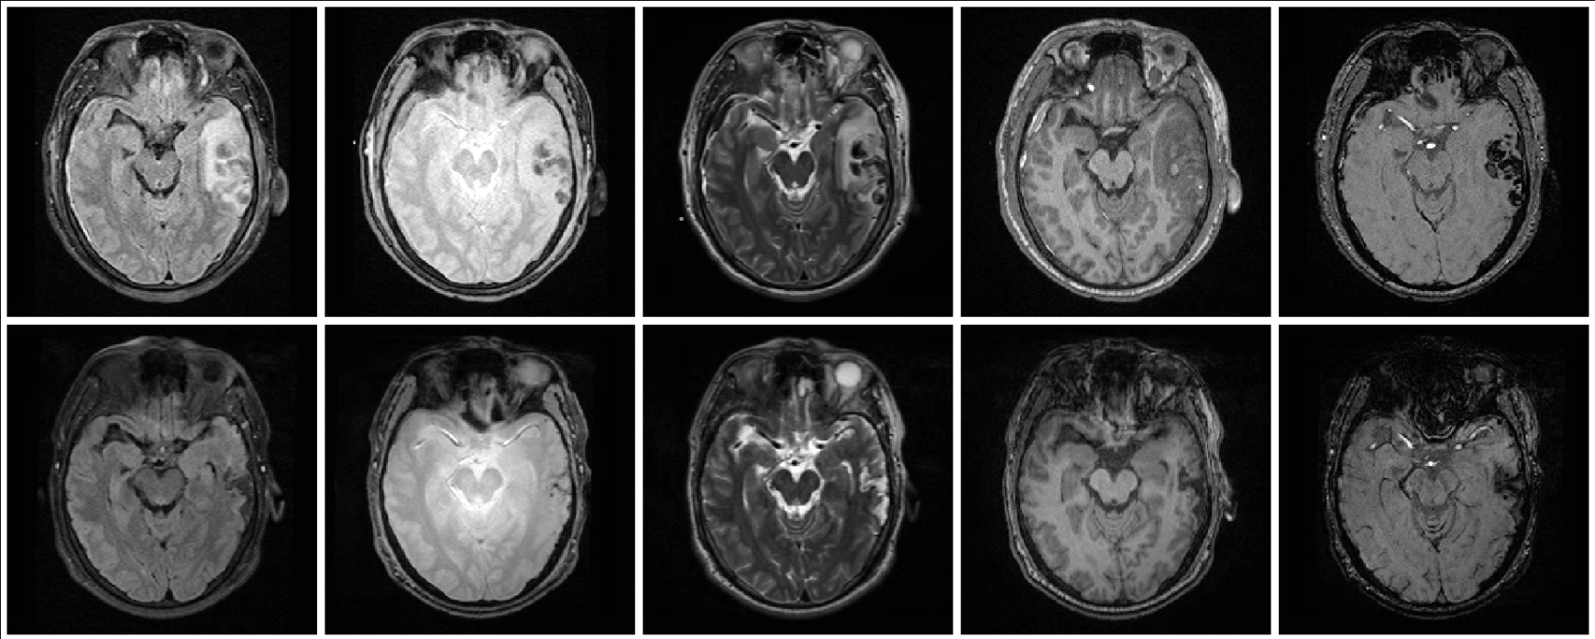
Patient-Specific 4D Modeling in TBI
FLAIR GRE T2 T1 SWI
acute
chronic (+3-6 months)
Acute images
- Non-hemorrhagic lesion/edema
- Hemorrhagic lesion/bleeding
- Extracerebral lesion
- Diffuse axonal injury
Chronic images
- Lesion (Non-hemorrhagic)
- Necrosis
- Bleed

Slide 3
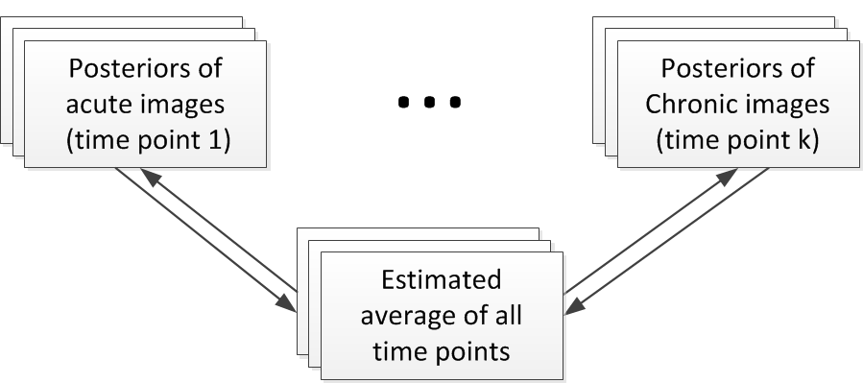
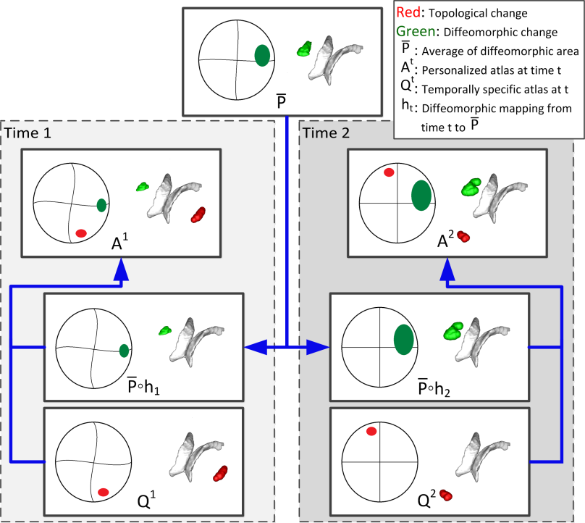
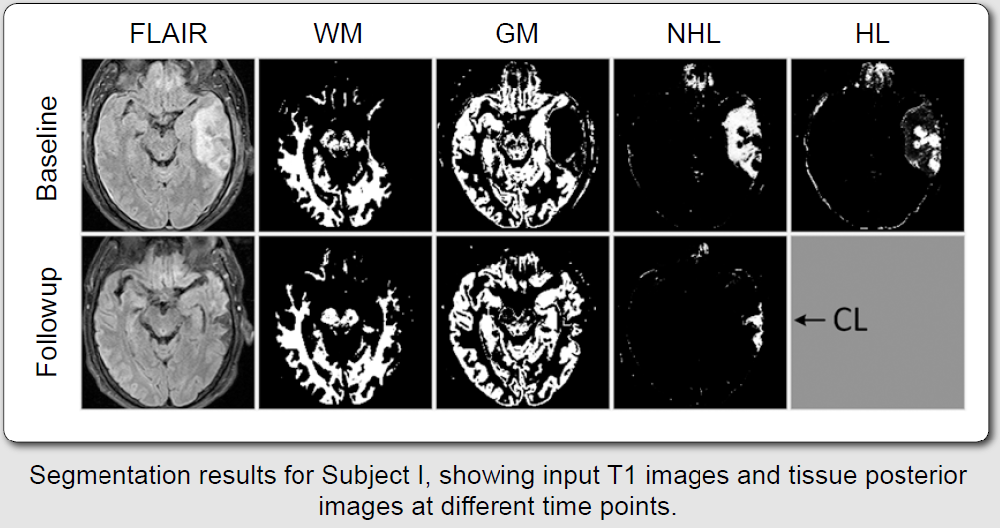
Method: Joint segmentation/ registration
Challenge: Lesions deform, disappear & appear.
Construction of personalized spatiotemporal atlas using diffeomorphic and non-diffeomorphic components.
Wang et al., SPIE’12, ISBI’12, Irimia et al., Neuroimage Clinical ’12, No.1

Slide 4
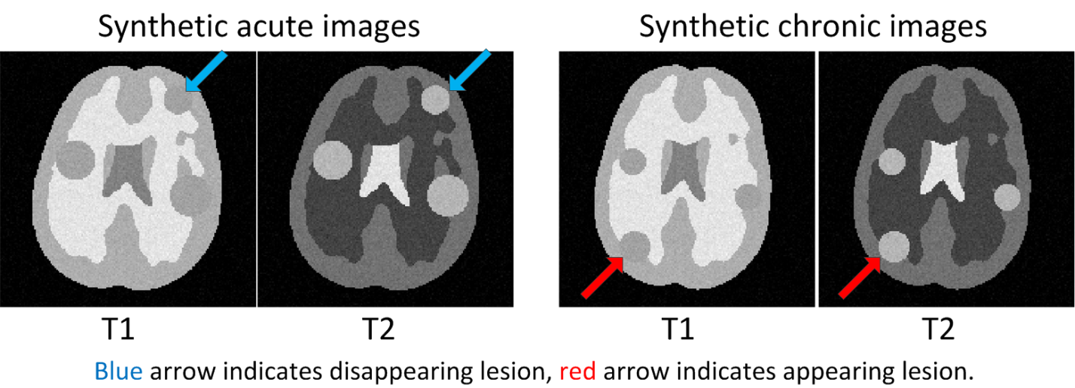
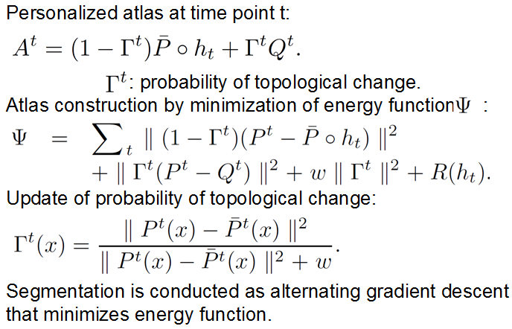
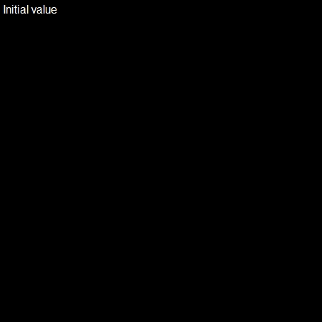

Personalized 4D atlas with modeling of topology changes
Γ acute
Γ chronic

Slide 5
Correlation of longitudinal imaging features with clinical scores
Glasgow Coma Scale (GCS) at acute,
Glasgow Outcome Scale (GOS) at acute,
GOS at the chronic phase
Spearman Rank Correlation

Slide 6
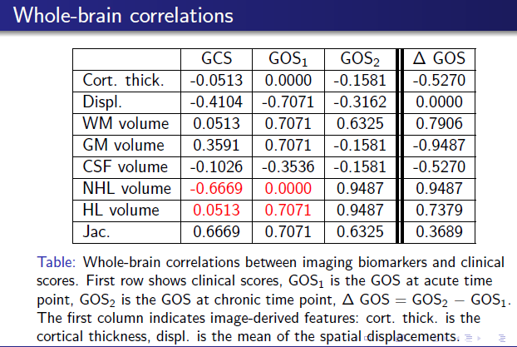
Correlation of longitudinal imaging features with clinical scores

Slide 7
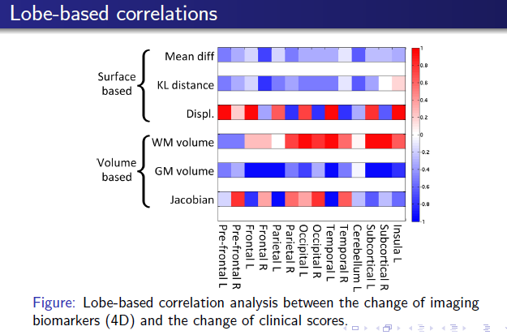
Correlation of longitudinal imaging features with clinical scores

Slide 8
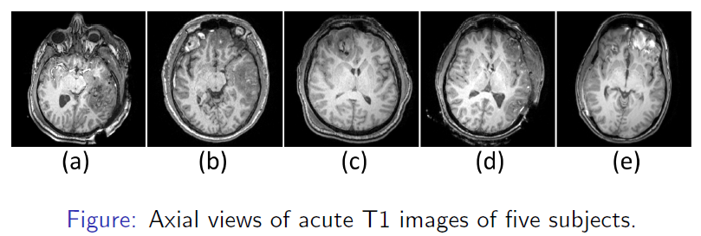
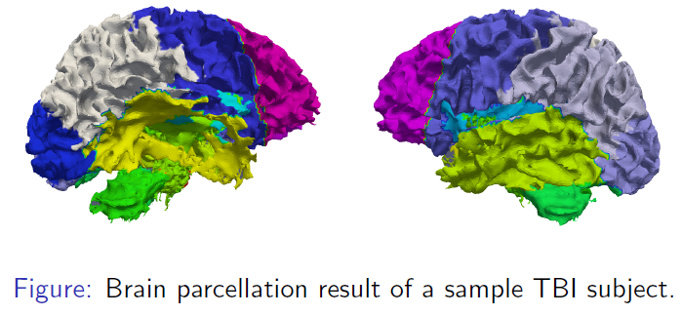
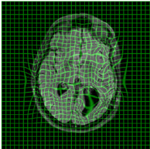
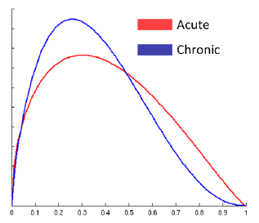
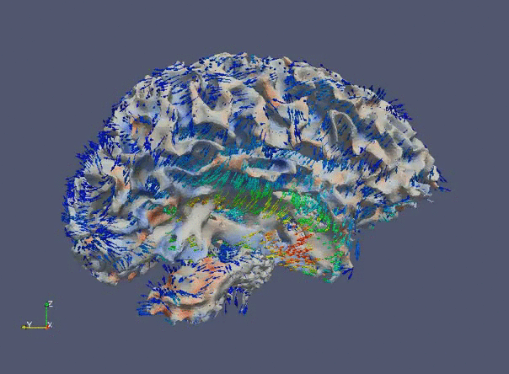
Results: 5 longitudinal TBI cases (UCLA)
Spatiotemporal features/biomarkers: Deformation, cortical thickness change, tissue and lesion volume changes.
Correlation with GCS and GOS scores: Submitted ISBI’13

Slide 9
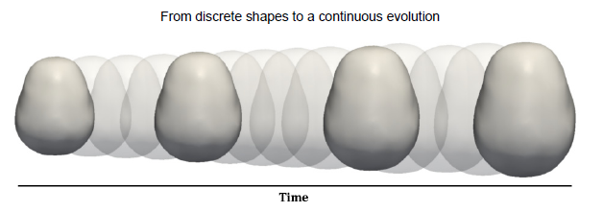
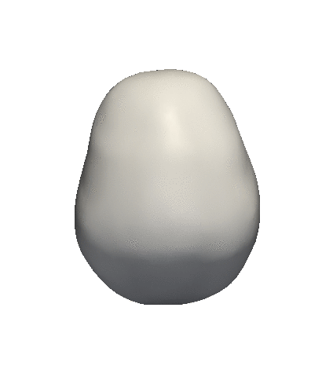


Longitudinal Shape Modeling
Concept: Time-indexed discrete shapes → continuous growth model
Temporally smooth evolution based on controlled acceleration: [Fishbaugh et al., MICCAI’11, SPIE ‘12]
New 2012:
  Analysis of Longitudinal shape variability via subject-specific growth modeling: [Fishbaugh et al., MICCAI 2012]
  Statistics on diffeomorphisms: Scheme for hypothesis testing of growth trajectories between groups.
  ExoshapeAccel: C/C++ NAMIC toolkit SW for estimating continuous evolution from a discrete collection of shapes.

Slide 10
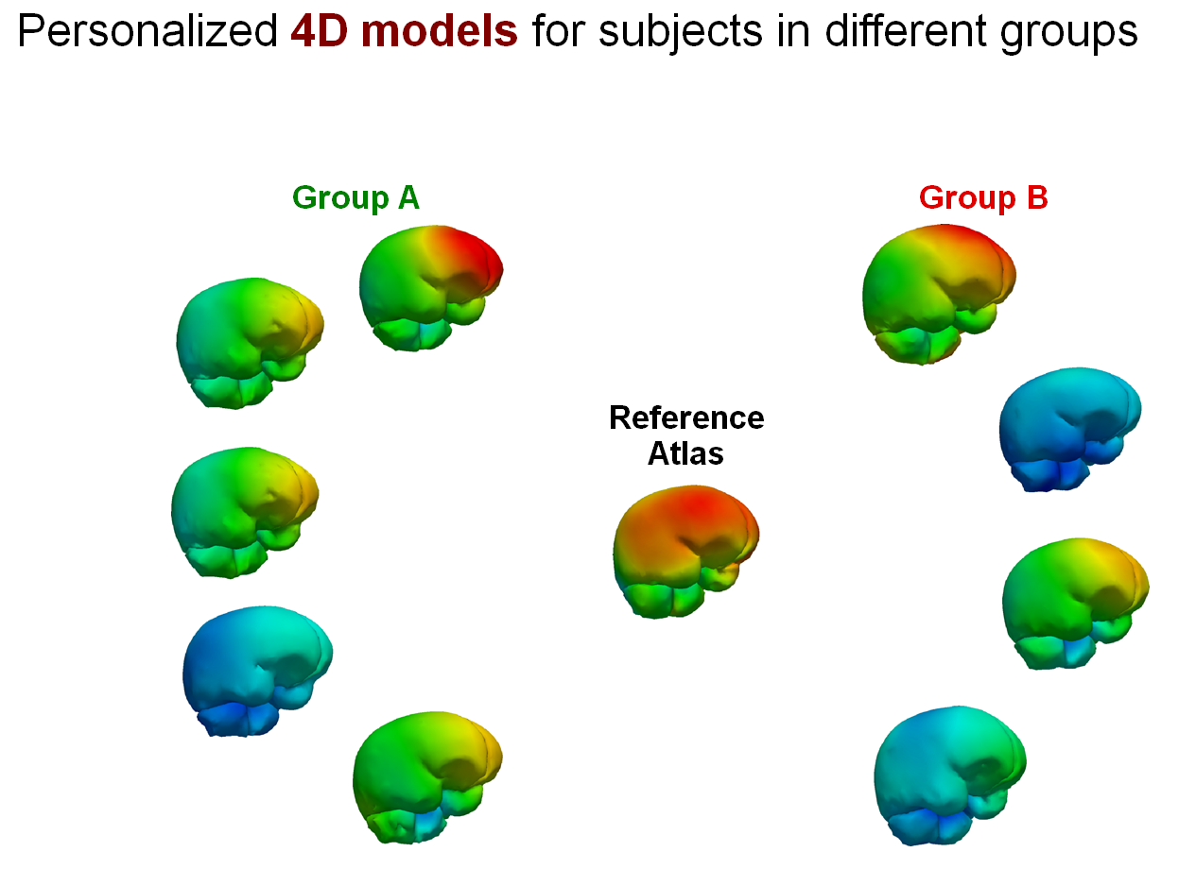
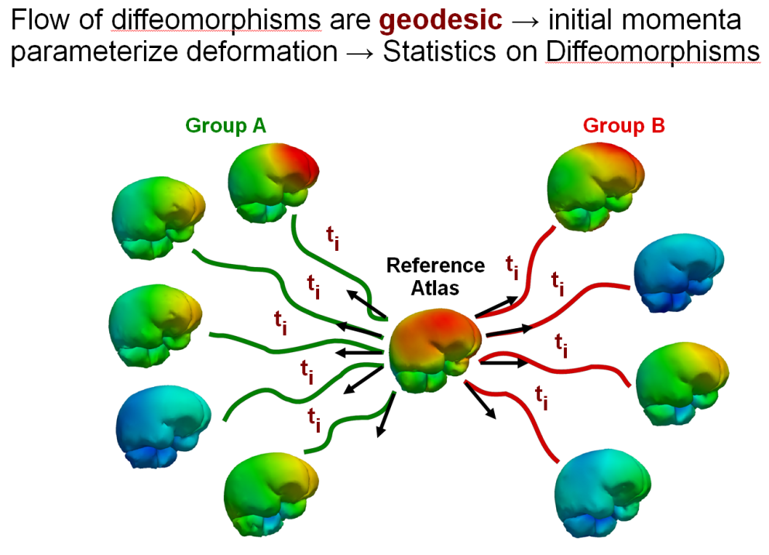
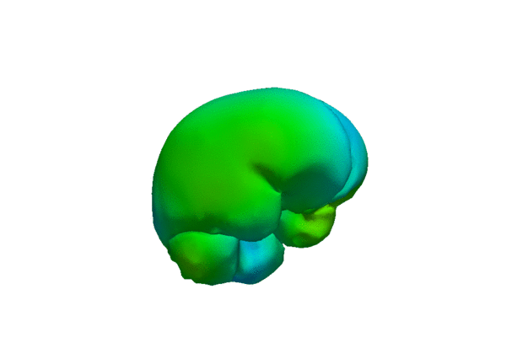
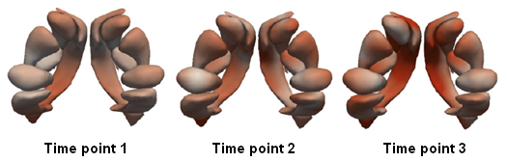
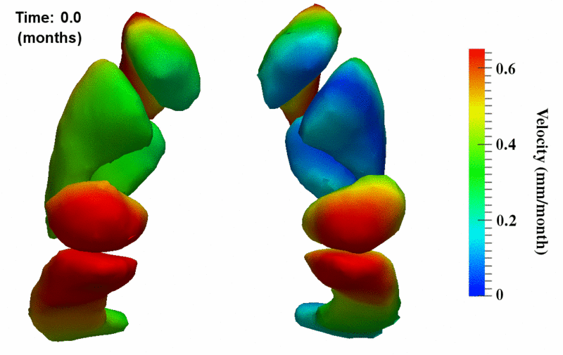

Longitudinal Shape Modeling
Current NAMIC Application: Shape changes in HD
Individual 4D model

Slide 11
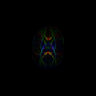
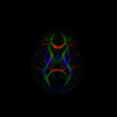
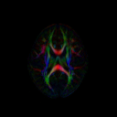
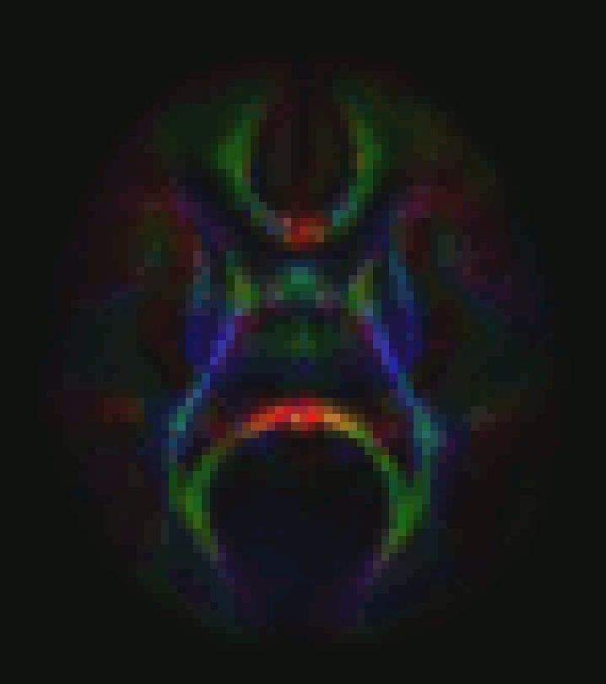
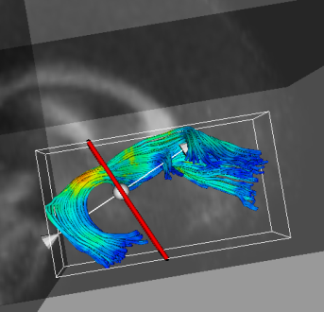
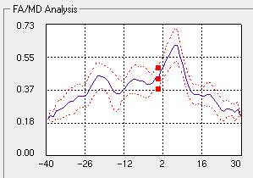
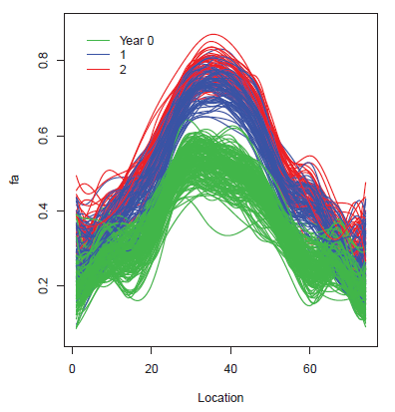
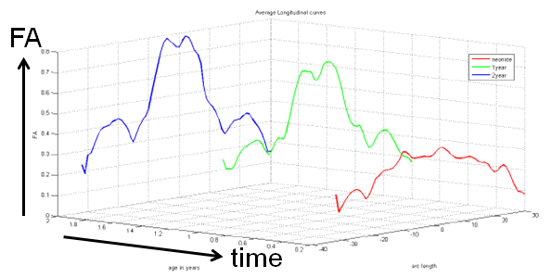
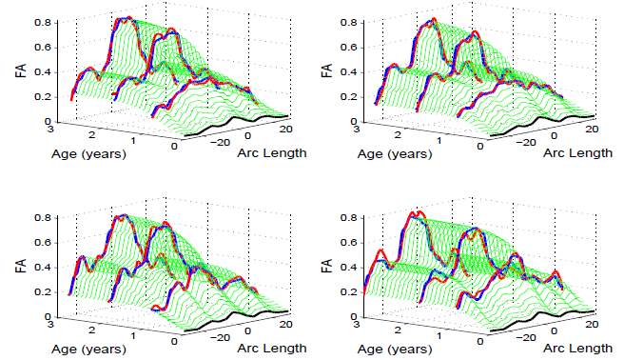
Tract-Based Longitudinal Modeling of DWI/DTI data
Neonate
1 year
2 years
Cine
Tract with FA
Subject-specific spatio-temporal tract diffusion model: FA(s,t)
Sadeghi et al., Neuroimage 2013, Sharma et al., ISBI’12

Slide 12

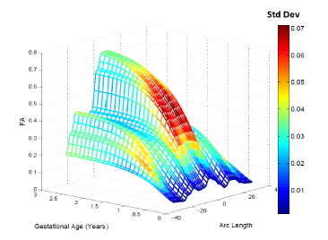
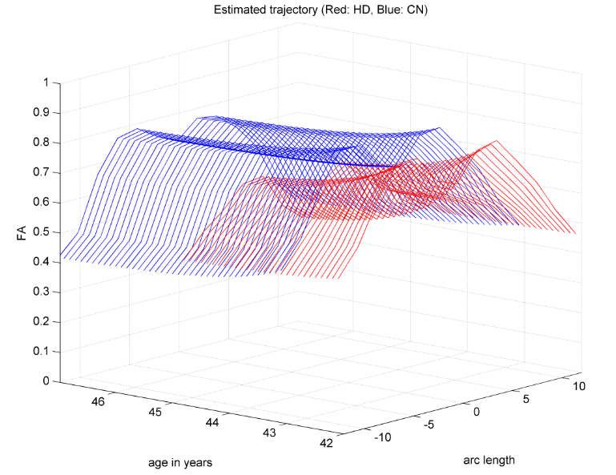
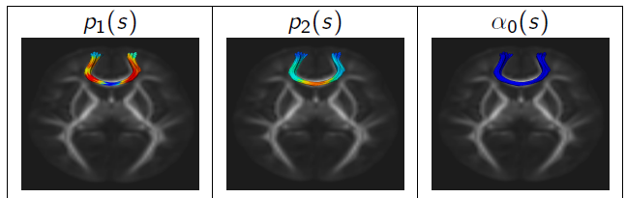
Tract-Based Longitudinal Modeling of DWI/DTI data
Modeling FA (AD, RD) as function of time.
Non-parametric kernel regression along tracts.
Temporal changes: logistic function.
Joint estimation of parameters for group.
Logistic equation with α_{i} as the population value at a given time, p1 the growth rate and p2 being the carrying capacity (asymptote).
Early infant brain development: Population statistics of FA(s,t) of corpus callosum tract.
Genu tract
NAMIC HD DBP: Control (blue) versus HD subject (red), showing FA decrease w age.
CTL
HD

Slide 13
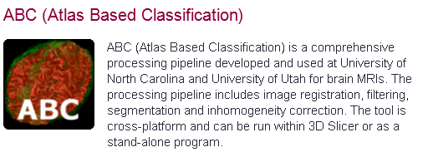

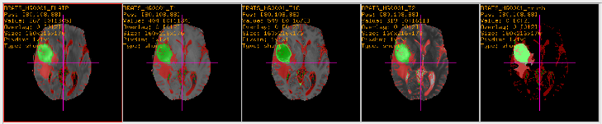
Technical Contributions
ABC Slicer 4 Extension Module
  ExoshapeAccel: C/C++ NAMIC toolkit SW for estimating continuous evolution from a discrete collection of shapes.
  Public download, tested by Iowa DBP.
  MRIWatcher: ITK SW for quick viewing of large #3D datasets, with coupled zoom/scroll, overlays, info: Quick QC, reviewing, comparison.
MRIWatcher

