Slide 1



DICOM to NRRD Conversion Tutorial
Martin Styner
University of North Carolina
Neuro Image Research and Analysis Lab

Slide 2

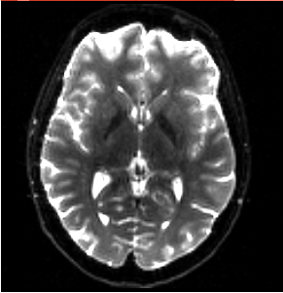
DICOM to NRRD Tutorial
This tutorial guides you through the process of converting DICOM files from a DWI acquisition into a NRRD volume, load that DWI volume into 3D Slicer for further processing.

Slide 3
Dataset
For this tutorial you will need some DICOM data files that can be found on this link :
http://hdl.handle.net/1926/1759

Slide 4
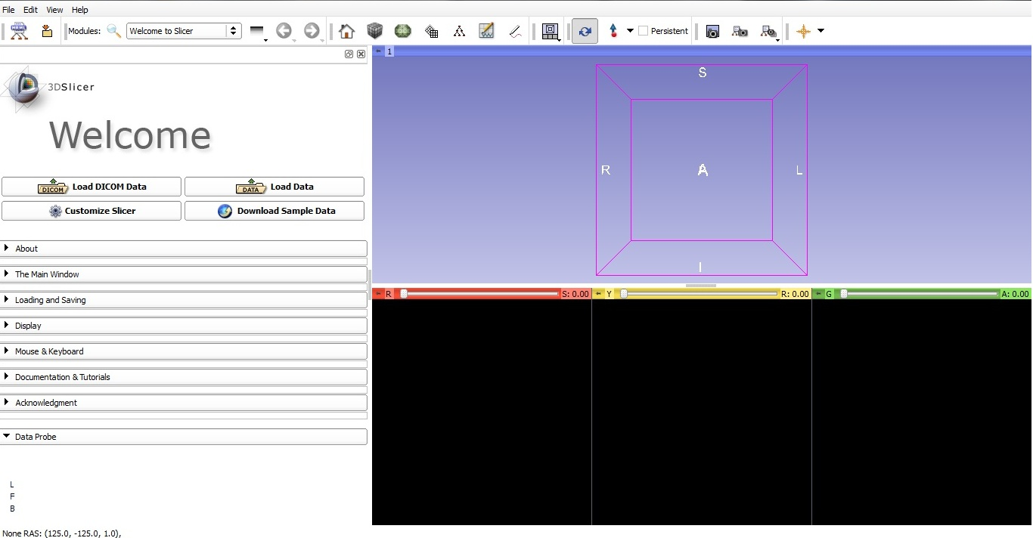
Start Slicer 4
Linux/Mac users :
Launch the Slicer
executable located in
the Slicer4 directory
Windows users :
Select Start→All Programs→Slicer4.2.1.1→Slicer
Or launch the Slicer executable from Slicer4 directory

Slide 5

Welcome Module
The Slicer Welcome module is the
module displayed by default.
This module gives an overview of the
GUI of Slicer4, and data loading & saving
functionality.

Slide 6
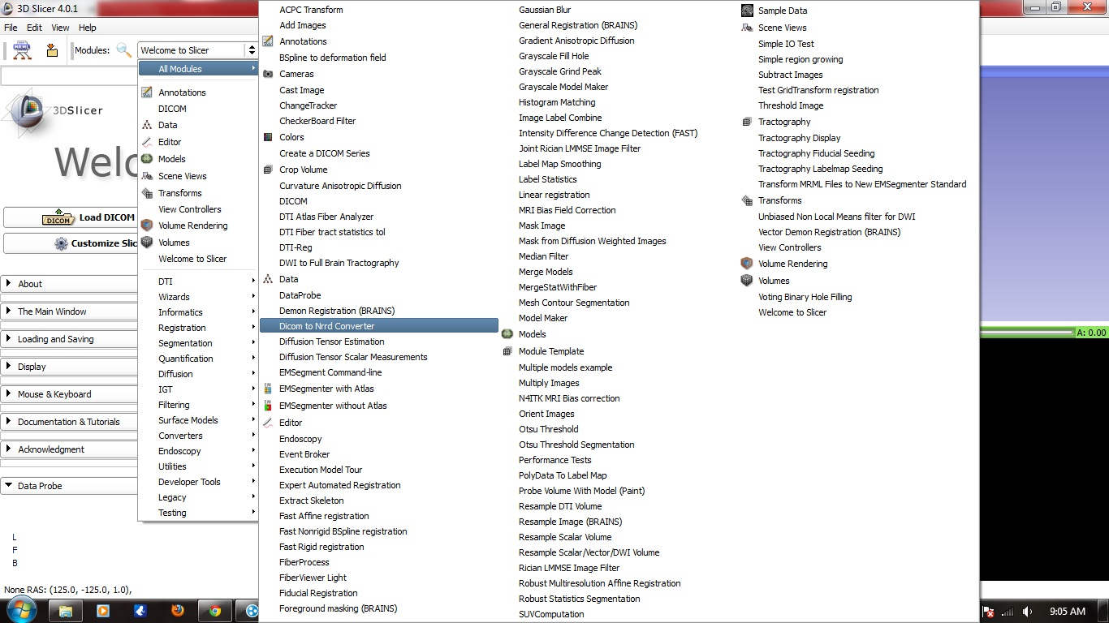
DICOMtoNRRD Module
Left click on the menu Modules and
select All Modules to display the list
of modules available for image
analysis and 3D visualization.
Select the module Dicom to Nrrd converter

Slide 7
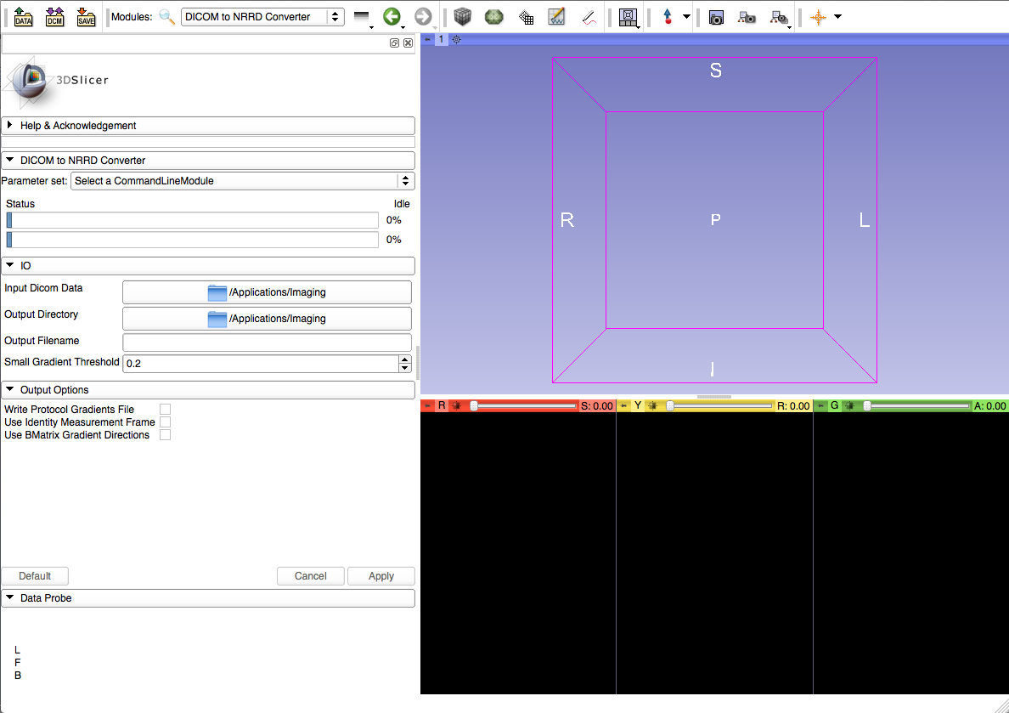
DICOMtoNRRD Module
Select the Input DICOM directory
Select the Output directory
Choose an Output name for your Nrrd file

Slide 8
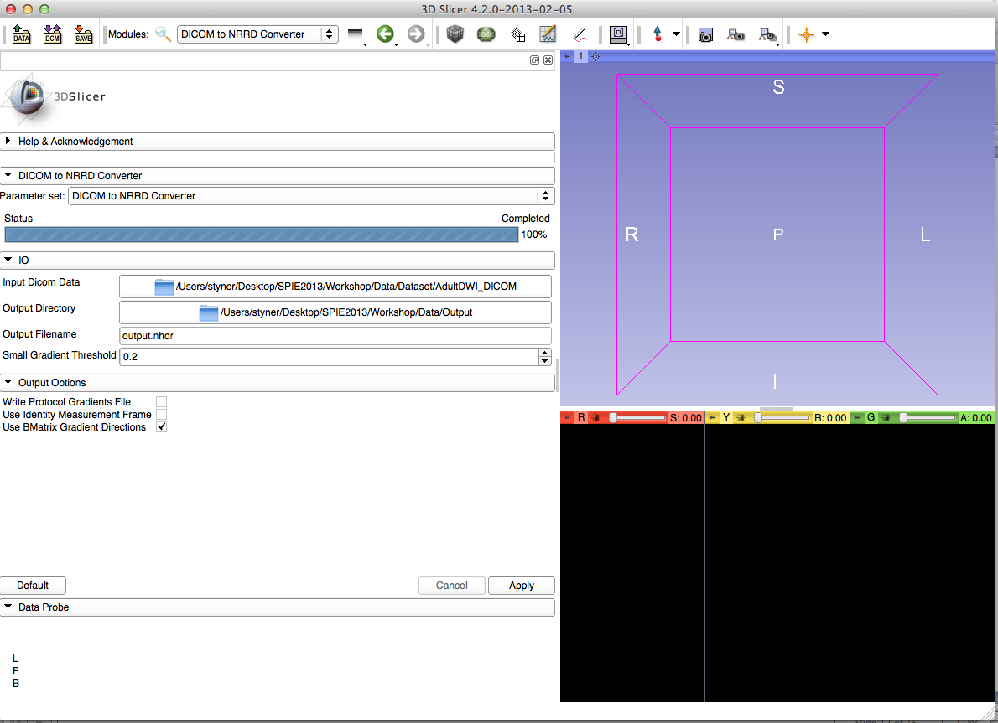
DICOMtoNRRD Module
Left click on Output Option to get it extended
Left click on the 3rd check box (Use Bmatrix Gradient Directions)
Left click on Apply button

Slide 9
What does Bmatrix Box do?
Uses B-matrix to compute the diffusion gradient information
  B-Matrix is the actual diffusion matrix applied during acquisition
  Principal eigenvector of B-Matrix is the diffusion gradient direction
Potential for incorrect/inadequate information in the diffusion gradient direction
  B-Matrix use is safest, if present
  Siemens DICOM provide B-Matrix information

Slide 10
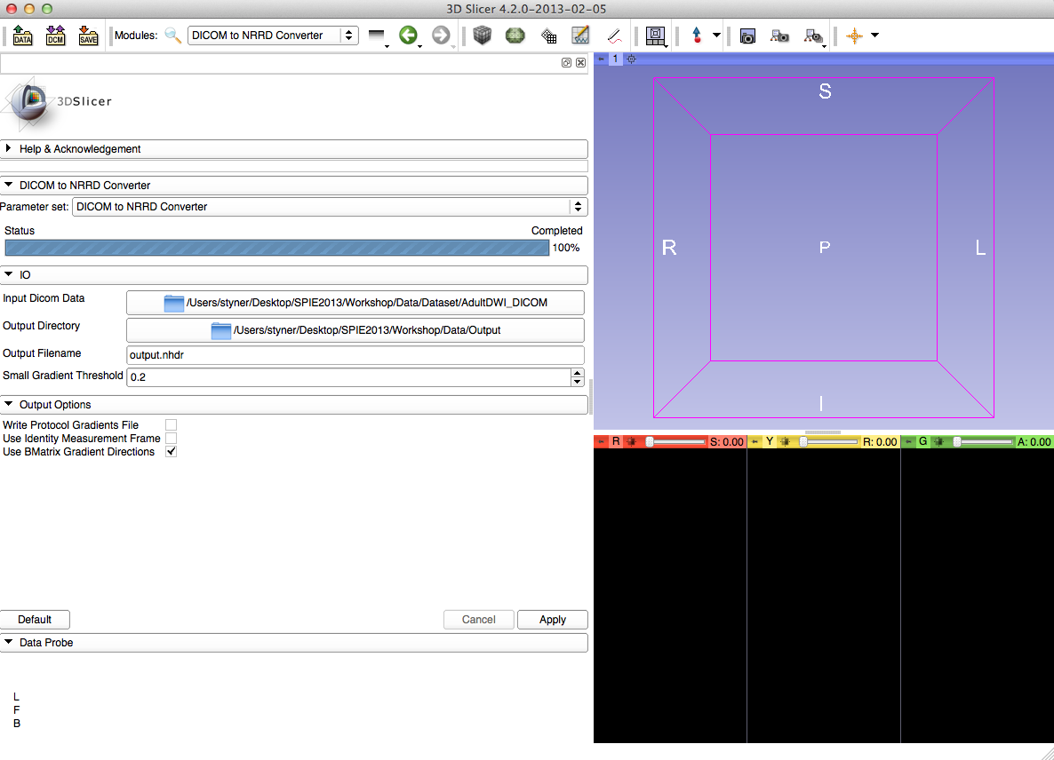
Loading DWI NRRD Volume
Click on Data icon

Slide 11
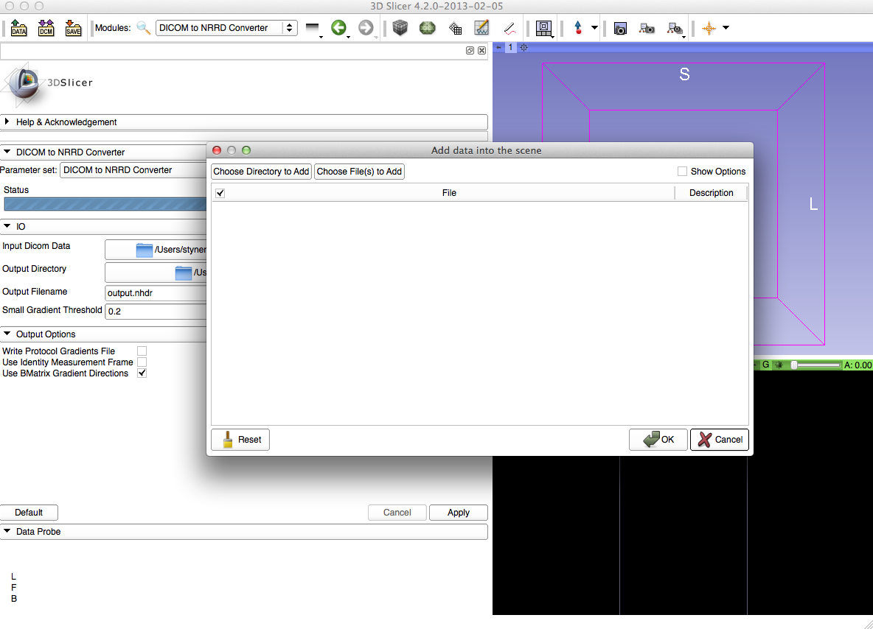
Choose File to Add
Select Choose Files to Add

Slide 12
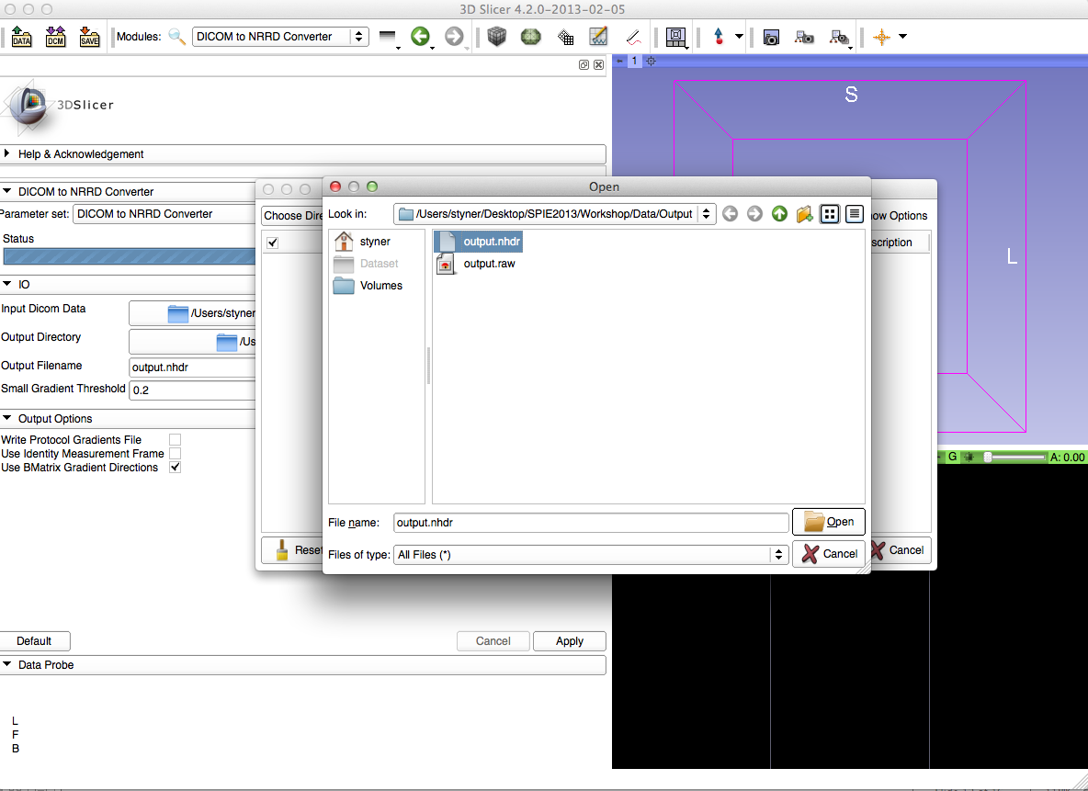
Choose File to Add
Select your previously created Nrrd volume

Slide 13
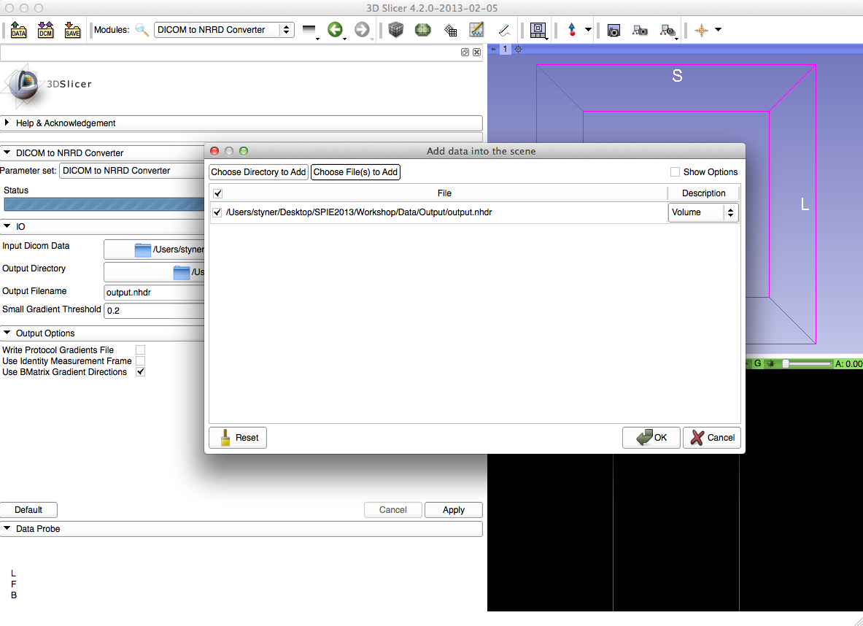
Choose File to Add
Select “OK”

Slide 14
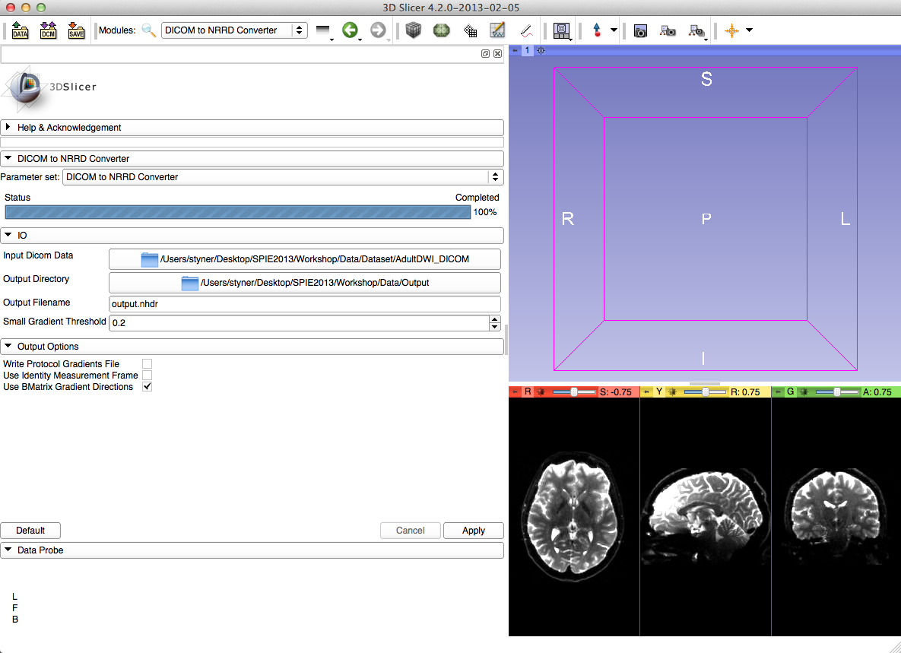
Volumes
Left click on the volume icon

Slide 15
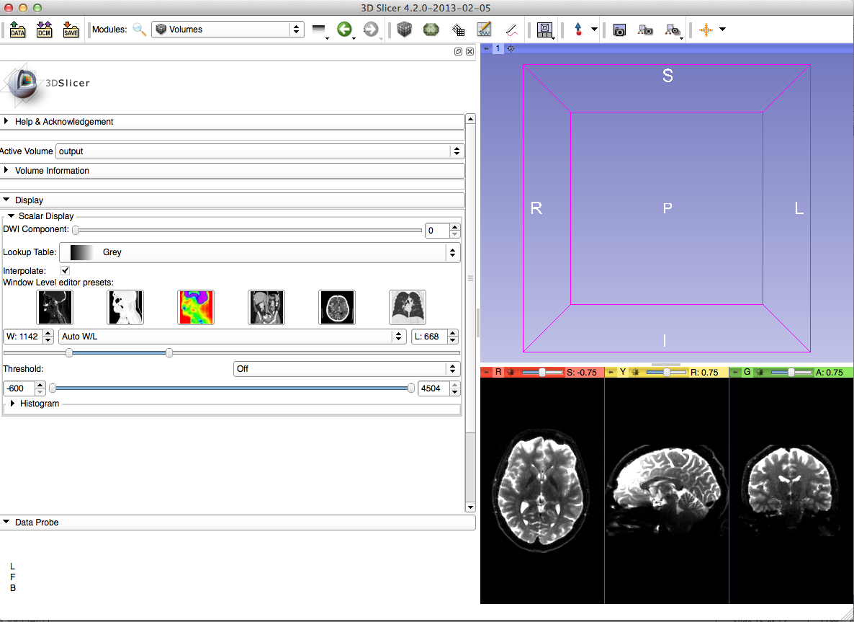
Volumes
Select volume you just opened in “Active Volume” Section
Adjust viewed DWI Component

Slide 16
Conclusion
This tutorial guided you through the conversion from DICOM to NRRD file using Slicer 4 Software

Slide 17
Acknowledgment
National Alliance for Medical Image Computing
NIH U54EB005149
Contributors: Jean-Baptiste Berger, Clement Vachet, Zhexing Liu, Guido Gerig, Sylvain Gouttard

