Slide 1
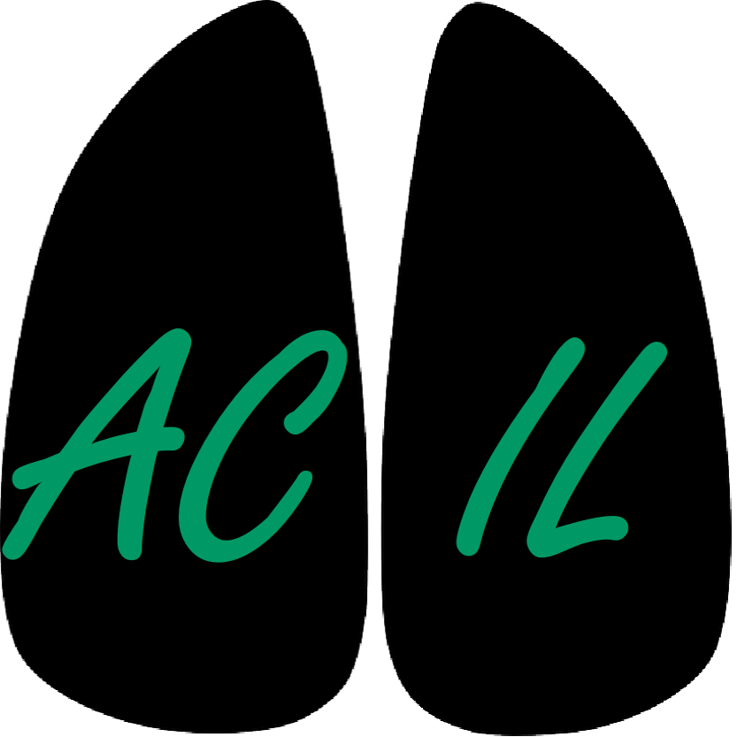
Chest Imaging Platform (CIP)
Applied Chest Imaging Laboratory
Boston, Massachusetts. USA
Next Developments

Slide 2
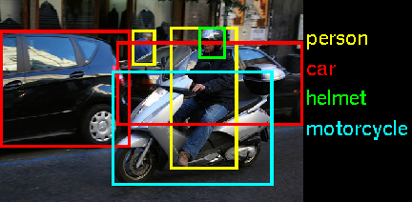
Next steps: object detection
There has been a large improvement in object detection during the last decade
Some examples:
http://pascallin.ecs.soton.ac.uk/challenges/VOC/
http://www.image-net.org/challenges/LSVRC/2014/
Can we do this with medical images?

Slide 3
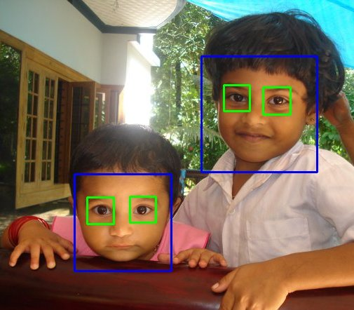
Object detection: OpenCV
OpenCV has a good implementation of a simple and robust object detector
Adaboost + haar wavelets + cascade of classifiers
Robust enough, easy to train, available open-source code
C++ optimized - python wrappings
Your phone has a version of it!
http://docs.opencv.org/trunk/doc/py_tutorials/py_objdetect/py_face_detection/py_face_detection.html

Slide 4
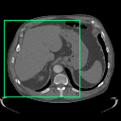
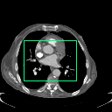
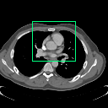
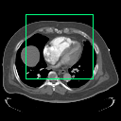
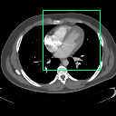
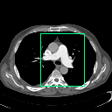
Object detection: OpenCV (2)
And it works! (sssh, under development)
Liver
Pulmonary Vein
Coronary Start
Right ventricle
Left ventricle
Pulmonary artery

Slide 5
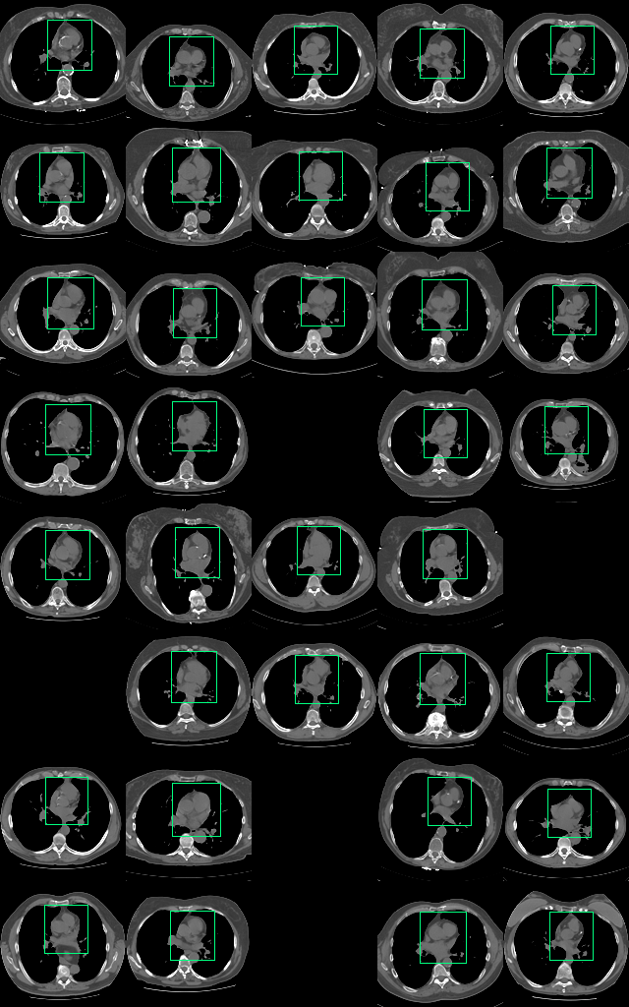
Object detection: OpenCV (3)
Why would we want to do that?
Initialization of segmentation algorithms
Automated feature extraction
In our case:
Automated coronary artery calcification analysis (Agatston score)
Automated Right Ventricle to Left Ventricle diameter ratio

Slide 6
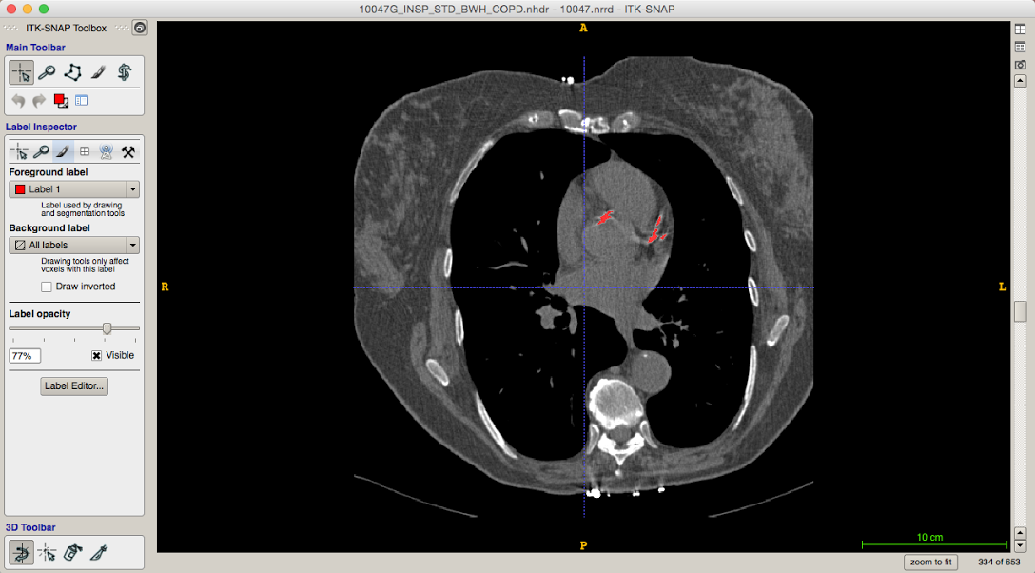
Object detection: OpenCV (4)
Detection of coronary arteries beginning
Calcified coronary artery

Slide 7
Object detection: OpenCV (5)
Slicer development challenges:
OpenCV is not currently integrated in Slicer
Should it be??
How do we interact with the algorithm otherwise?
Interface to navigate quickly between the detected landmarks (similar approach to Body Composition module)
Can we create an easy method for labeling-training-analyzing results?

