Slide 1
Using fCal for Freehand Ultrasound Calibration
Csaba Pinter, Andras Lasso, Tamas Heffter, Tamas Ungi, Adam Rankin, and Gabor Fichtinger
Laboratory for Percutaneous Surgery School of Computing, Queen’s University, Canada

Slide 2
Introduction to PLUS
PLUS – Public software Library for UltraSound imaging research https://www.assembla.com/spaces/plus/wiki
History: implementation is based on two SynchroGrab versions
QueensOpenIGTLibs in Queen’s repository Last commit: October 7, 2008 (Revision: 30)
4D Ultrasound module in NAMIC sandbox repository Last commit: August 16, 2009 (Revision: 4993)
Open sourced November 2011
Development team: PerkLab (Laboratory for Percutaneous Surgery), Queen’s University Andras Lasso, Csaba Pinter, Tamas Heffter, Tamas Ungi, Adam Rankin
Users and contributors at: UBC; Robarts; Kitware; GE Research; Hospital General Universitario, Gregorio Maranon, Madrid, Spain; Universidad de la República, Montevideo, Uruguay

Slide 3
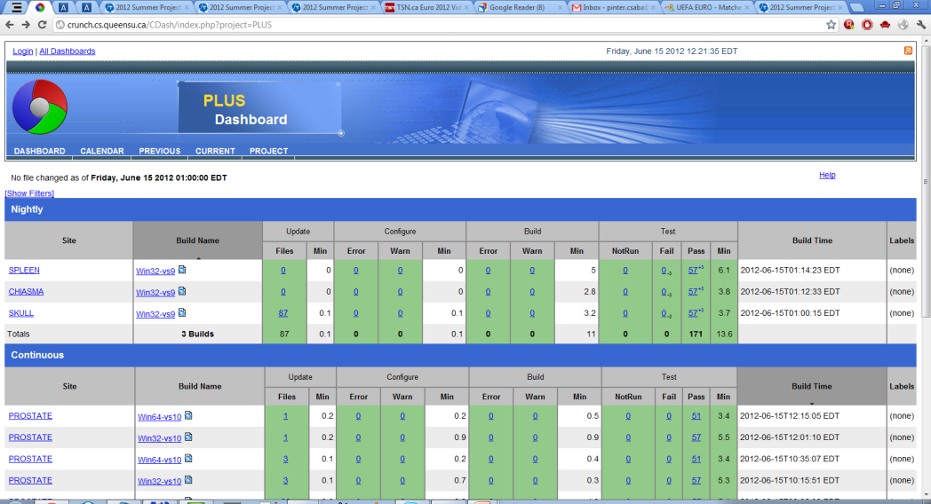
Software platform
Language: C++
Build system: CMake
Automatic testing and dashboard: CTest, CDash
External libraries:
Required: ITK, VTK
Optional: OpenIGTLink (for communication with 3D Slicer and IGSTK), device drivers, Qt
Supported operating systems:
Windows XP, Windows 7 – regularly tested
32 bit: Most drivers are usable
64 bit: Some drivers work
Linux – builds, but not tested; everything should work except Windows drivers

Slide 4
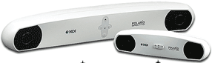
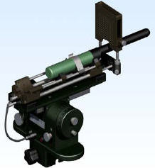
Supported hardware: Tracking
Optical
NDI Certus
NDI Polaris
Claron MicronTracker – under testing
Electromagnetic
NDI Aurora
Ascension 3DG (Sonix GPS)
Flock of birds tracker – not tested
Brachytherapy steppers/stabilizers (Windows only)
Burdette Medical Systems target guide
CMS Accuseed DS-300
CIVCO
Accelerometer
Phidget Spatial 3/3/3 sensor (accelerometer, magnetometer, gyroscope)
Simulator / from file
OpenIGTLink support
Any openigtlink compatible device (all devices through IGSTK, ...)

Slide 5
Supported hardware: Imaging
Ultrasound SDK
Ultrasonix via Ulterius SDK (Windows only): SDK versions 1.2, 2.0, 5.6, 5.7 (latest)
RF data capturing – planned
Ultrasonix US capture via Porta SDK (Windows only)
BK ProFocus – in progress
TeleMed (low-cost ultrasound, work in progress at Kitware)
Framegrabber
ImagingControl USB (Windows only)
Epiphan USB, PCI, Ethernet)
Video for Windows generic framegrabber (Windows only)
Simulator
Replay saved image sequences from metafile (for testing without hardware)
Ultrasound simulator (3D model + tracking data) – in progress
Not integrated (source code is in the repository, but not used):
Linux video (Linux only)
Matrox imaging library
OpenIGTLink support – any openigtlink compatible device

Slide 6
PLUS architecture
Option A: Standalone PLUS application (not using 3D Slicer)
Option B: PLUS application communicates with 3D Slicer through OpenIGTLink
3D Slicer
PLUS Applications
CommonWidgets
fCal
…
3D Slicer plug-in modules
PLUS library
Option C: 3D Slicer plug-in directly uses PLUS library
Device SDKs and drivers
VTK
ITK
CTK
Open
IGTLink
QT

Slide 7
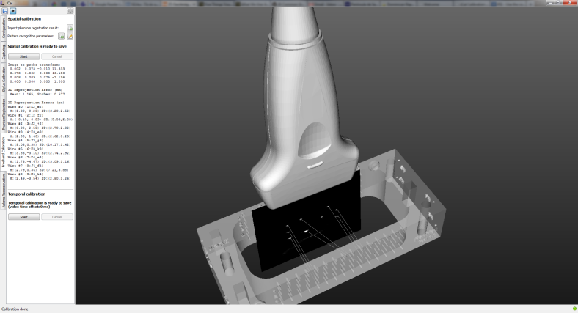
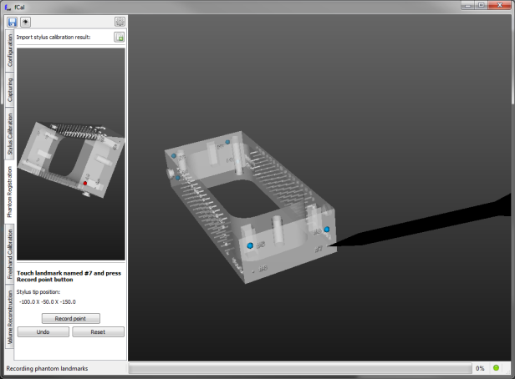
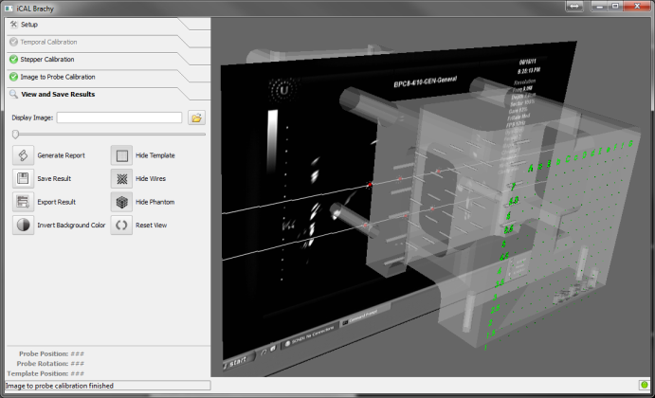
PLUS Applications
fCAL
fCAL
Free-hand calibration (compute image plane to marker transform), using triple-N calibration phantom, with GUI
Tracked ultrasound capturing, synchronized image and position acquisition, with GUI
Volume reconstruction
Volume reconstruction From tracked ultrasound capture files, console app
iCAL Calibration and diagnostics of brachytherapy stepper, with GUI
PlusServer Live data transfer (streaming) to 3D Slicer, console app
Image acquisition and tracking diagnostic
iCAL

Slide 8
Device set configuration XML file
Different hardware setups are defined single config files
DataCollection: tracker, image acquisition and OpenIGTLink properties
CoordinateDefinitions: transforms, aliases
Rendering: visualization settings
Segmentation: image segmentation parameters
PhantomDefinition: phantom geometry
Other application and algorithm specific settings
https://www.assembla.com/spaces/plus/wiki/Configuration_file_structure
Notes:
Mention supported hardware devices
Advantages of the single XML configuration file

Slide 9
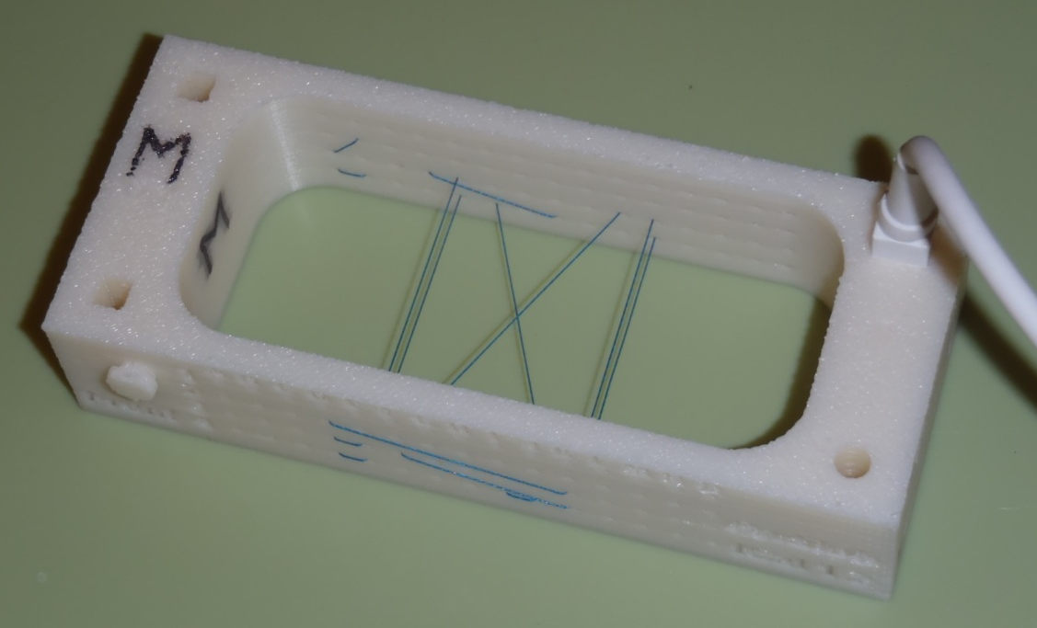
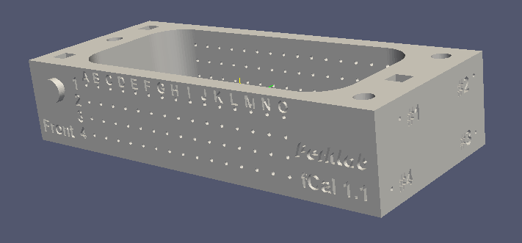
Freehand ultrasound calibration: Calibration phantom
Producible using a 3D rapid prototyping printer
Fiducial lines inserted manually

Slide 10
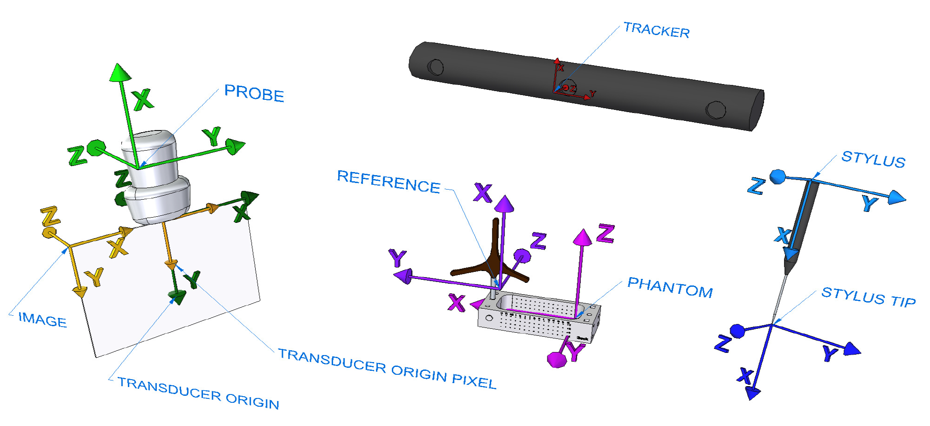
Freehand ultrasound calibration: Coordinate systems

Slide 11
Freehand ultrasound calibration
Goal: determine the IMAGE to PROBE transform
Spatial calibration Steps:
( https://www.assembla.com/spaces/plus/wiki/System_calibration )
Temporal calibration (measure delay between imaging and position tracking)
Determine STYLUS to STYLUS TIP transform (pivot calibration)
Determine PHANTOM to REFERENCE transform (landmark registration)
Determine the IMAGE to PHANTOM transform (fiducial line segmentation)
Determine IMAGE to PROBE transform (using N-wire phantom)
PHANTOM
STYLUS TIP
PROBE
IMAGE
REFERENCE
STYLUS
TRACKER

Slide 12
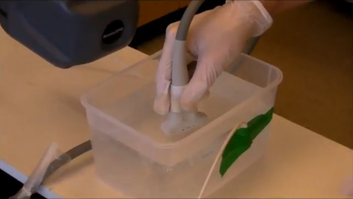
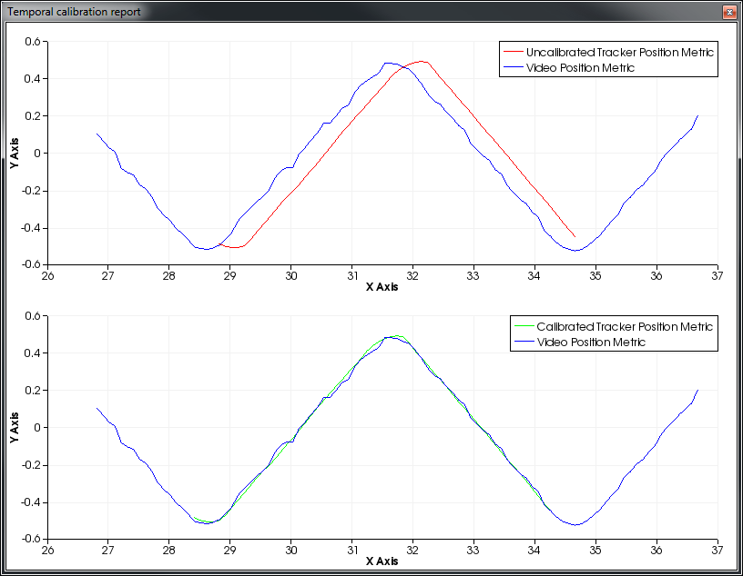
Freehand ultrasound calibration Step 1: Temporal calibration
On the Freehand Calibration tab in fCal
Correlation-based algorithm
Input: Tracker and video streams taken from periodical vertical movement of the probe in a tank of water
Output: tracker lag in relation to the video in seconds

Slide 13
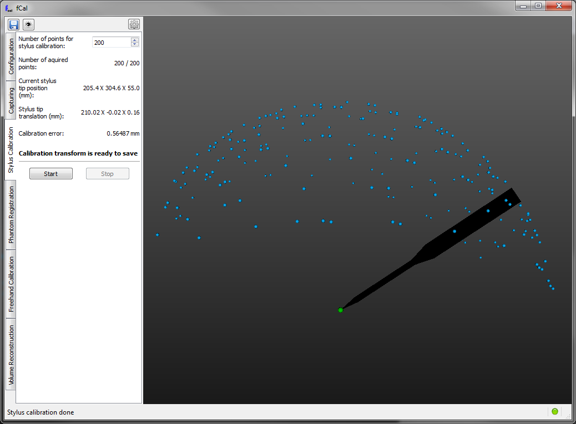
Freehand ultrasound calibration Step 2: Stylus calibration
On the Stylus Calibration tab in fCal
Pivot calibration algorithm
Stylus tip is fixed to the reference while pivoting the sensor
Number of points collected forming a sphere surface

Slide 14
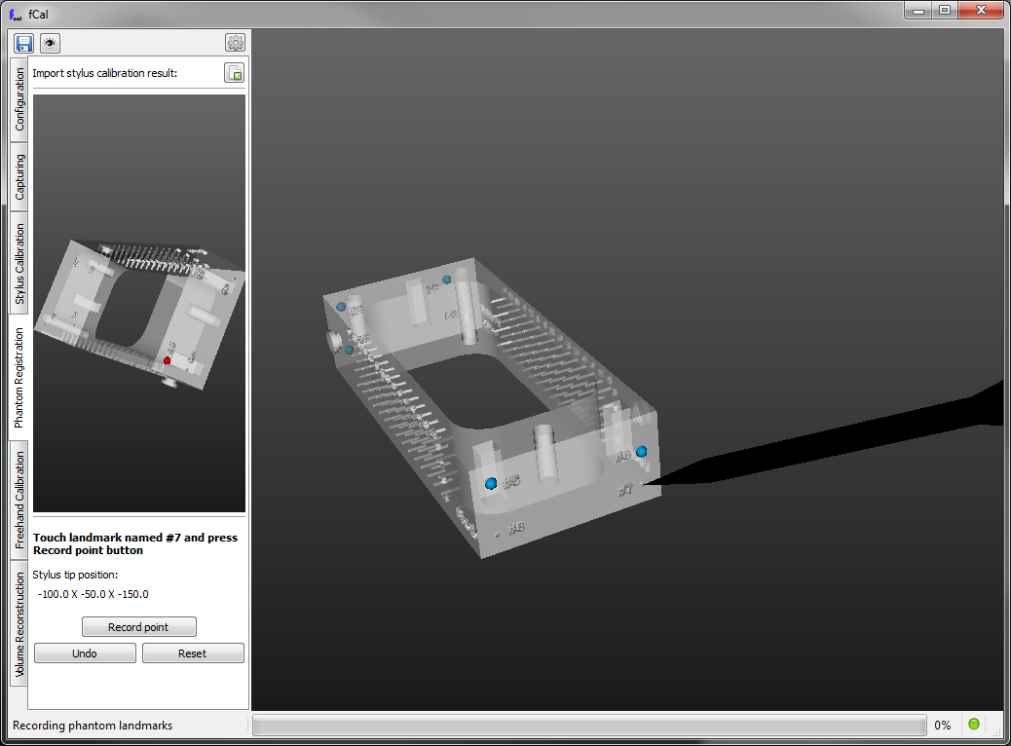
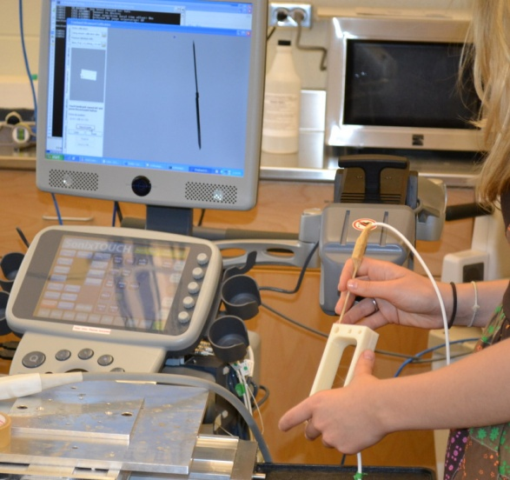
Freehand ultrasound calibration Step 3: Phantom registration
On the Phantom registration tab in fCal
Landmark registration algorithm
Record phantom landmarks in succession by touching them with the stylus

Slide 15
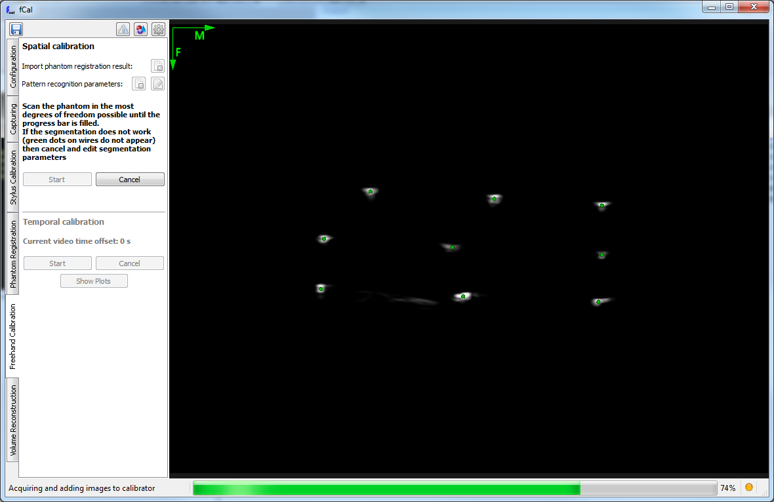
Freehand ultrasound calibration Step 4-5: Spatial calibration
On the Freehand Calibration tab in fCal
Algorithm recognizes wire pattern in images
Determines position of middle wires in Phantom coordinate system based on the known phantom geometry
Least squares algorithm finds ImageToProbe transformation

Slide 16
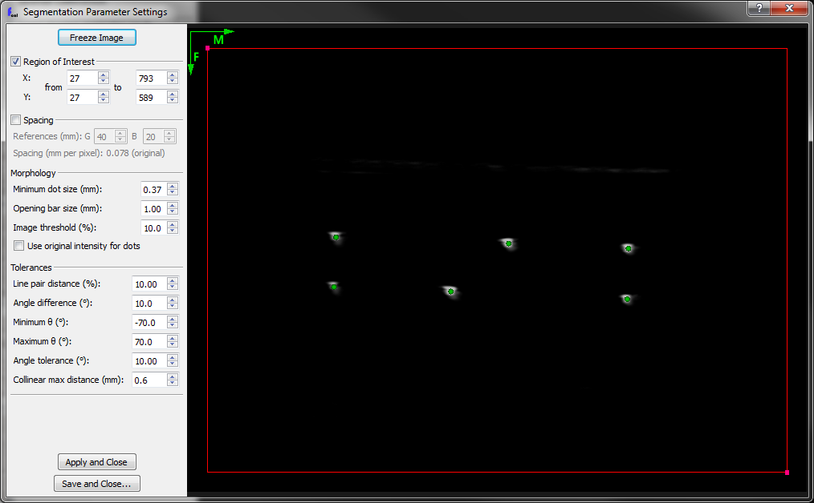
Pattern recognition parameters
Needed when the green dots do not appear over the wires in course of spatial calibration
Open dialog:
Edit parameters:

Slide 17
Checking the result
Partial or final results can be saved in configuration file:
Change to 3D view:

Slide 18
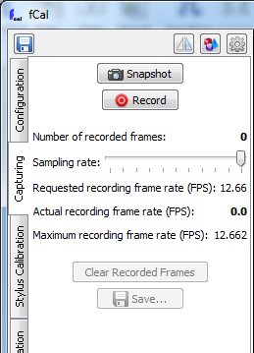
Tracked ultrasound capturing
On the Capturing tab in fCal
Tracked frame list can be saved in MHA file
Transforms
Timestamps
Image data
Used configuration file is saved with the same name automatically

Slide 19
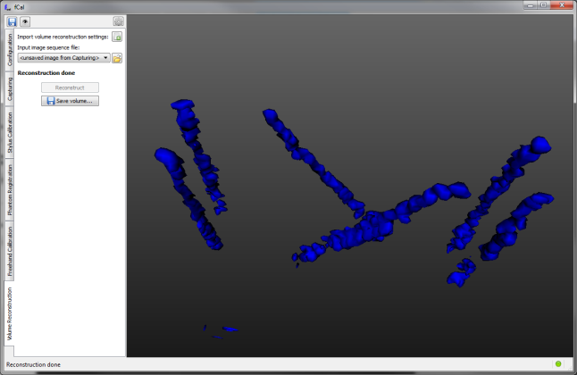
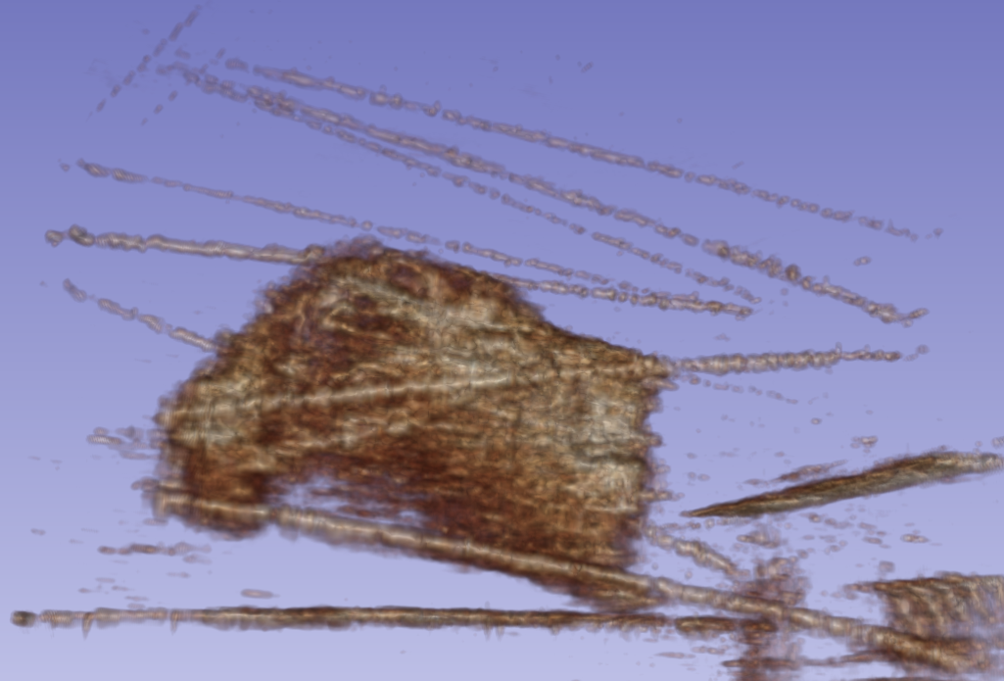
Volume reconstruction
Double-N wires
On the Volume Reconstruction tab in fCal
Works using the unsaved tracked frame list or a file
Animal muscle tissue ablation phantom with fiducial wires
Notes:
* Improvements: threshold

Slide 20
Thank you! Information about the PLUS project and fCal: https://www.assembla.com/spaces/plus/wiki

Slide 21
Appendix

Slide 22
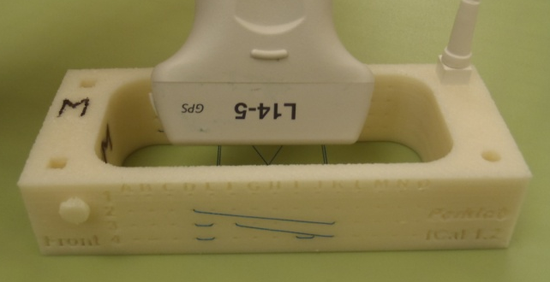
Troubleshooting: Big calibration error
Needed when the calibration error reported on the Freehand Calibration tab appears in red
The marked side of the probe has to be on the marked side of the phantom
Marking on the probe
A
1
Front
Notes:
* New version of fCal phantom includes imprinted mark

