Slide 1
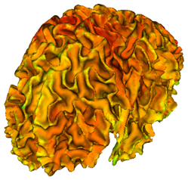
Cortical Thickness Analysis with Slicer
Martin Styner
UNC - Departments of Computer Science and Psychiatry
NIRAL, UNC IDDRC
Guido Gerig, Ipek Oguz, Josh Cates, Clement Vachet, Cedric Mathieu, Marc Niethammer

Slide 2
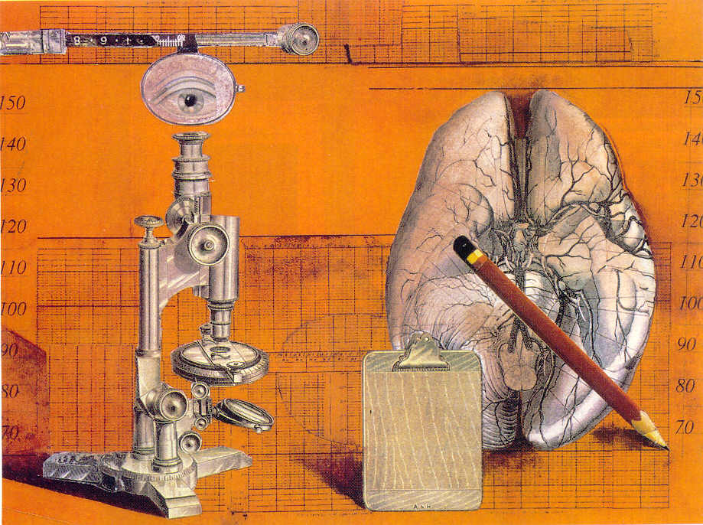
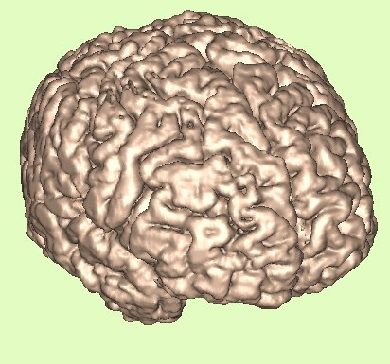
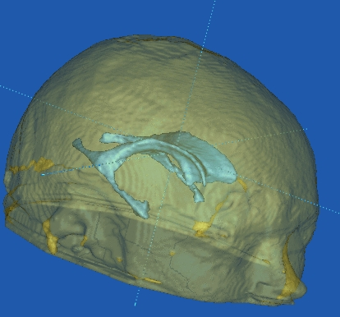
Motivation Neuroimaging
Brain imaging in healthy & pathology
Morphometry, Connectivity ⇔ Pathology
Schizophrenia
Autism, Fragile-X
MPS, Krabbe
Normal Development
High risk offspring
Fitness & Aging

Slide 3
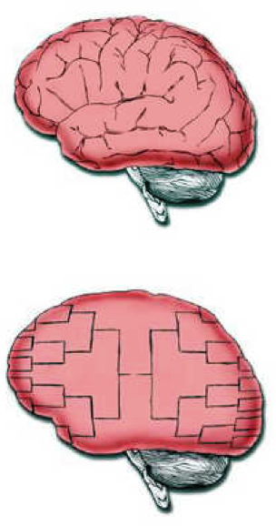
TOC
Cortical thickness examples
Existing methods for cortical thickness
NAMIC methods & modules
Future work
Normal Brain
March Madness Brain

Slide 4
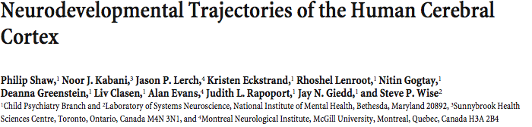

Slide 5
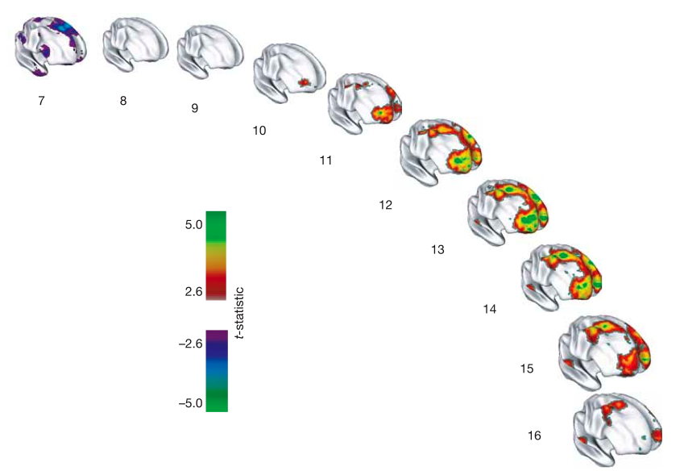
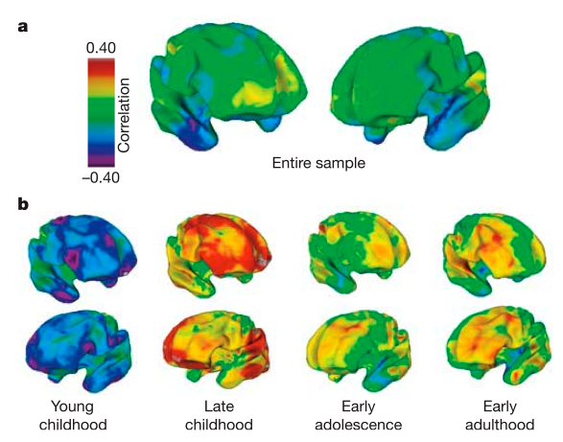

Slide 6
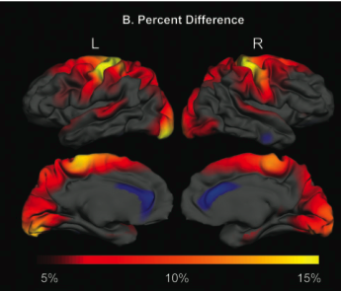
Cortical thinning
Correlation with cortical thinning

Slide 7
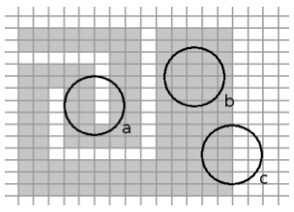
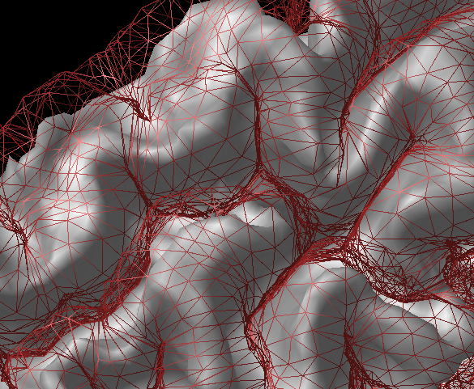
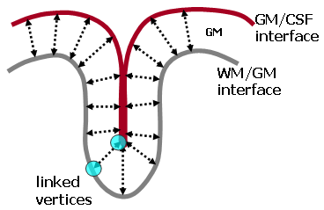
Existing Methods
Cortical thickness ≠ Graymatter density
M Chung, TMI 2007, negatively correl.
Major methods
BrainVoyager, Goebel
Commercialized, Brain Innovation
CLASP, Evans et al (MNI)
FreeSurfer, Fischl et al (MGH)
CRUISE, Tosun et al (JHU,UCLA,UCSF)

Slide 8
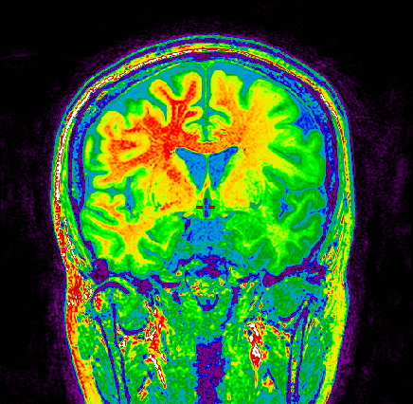
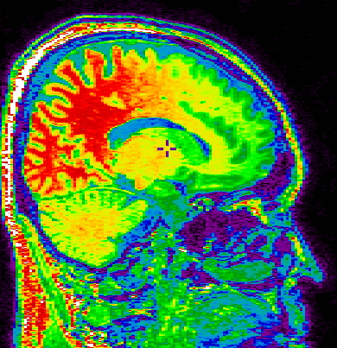
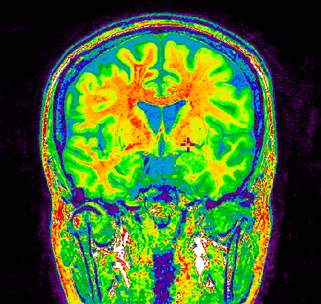
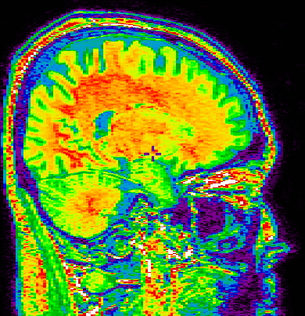
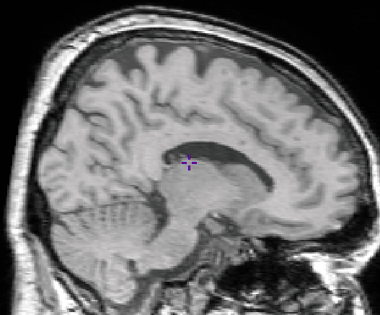
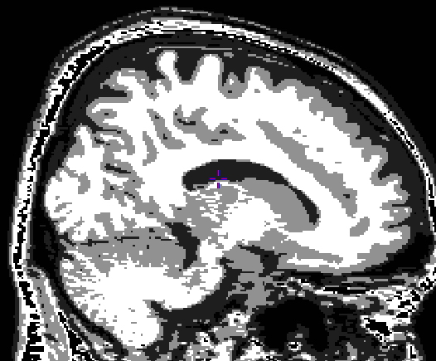
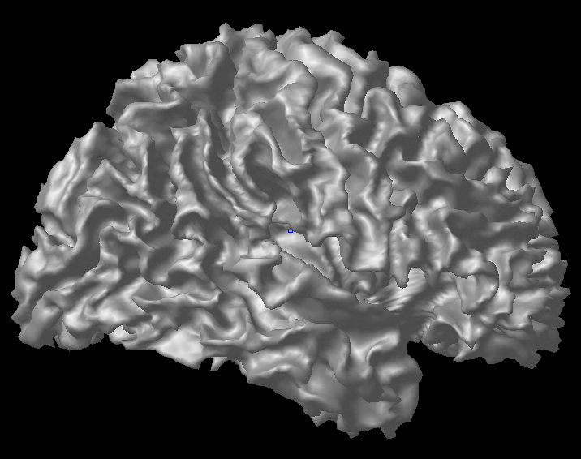
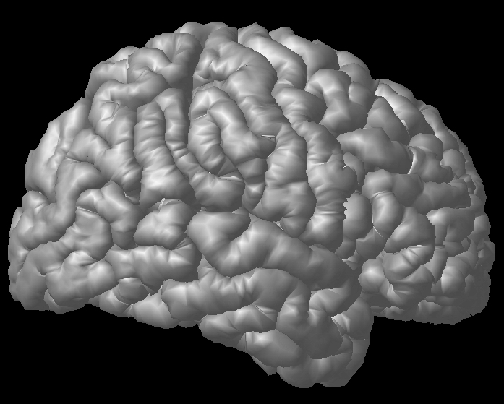
Image preprocessing & Cortical surface extraction
CLASP - MNI
Native
MR image
Intensity Non-uniformity
Correction
Spatial Normalization
to stereotaxic space
Tissue Classification
Cortical Surface Extraction
(CLASP algorithm)
Cortical thickness measurement
Notes:
Now, I talk about my second theme, cortical thickness analysis. This slide shows briefly procedure of cortical thickness measurement, it is made by Dr. Alan Evans in Montreal. Firstly, this pipeline got the raw brain image and corrected the intensity non-uniformity, because the image including intensity non-uniformity is able to get misclassifications such as thick or thin gray matter. Then, N3 program is able to correct the intensity non-uniformity. Then, Corrected image was registration to stereotaxic space. In this space, skull stripping and tissue classification was performed.
And next step, generate cortical surface. Firstly, the surface was made in white matter and gray matter interface. This white matter and gray matter interface surface expand to gray matter and CSF interface following with Laplace flow. Finally, I can measure the cortical thickness by subtracting between the vertex on outer boundary and on inner boundary. This thickness is measured in Stereotaxic space. Of course, I can obtain the native cortical thickness using inverse matrix.

Slide 9
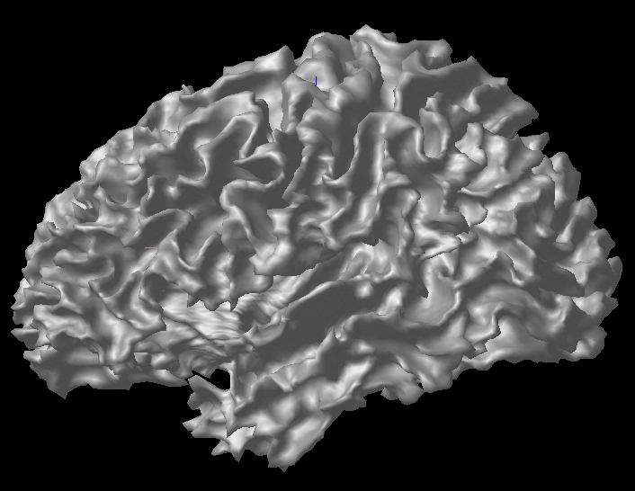
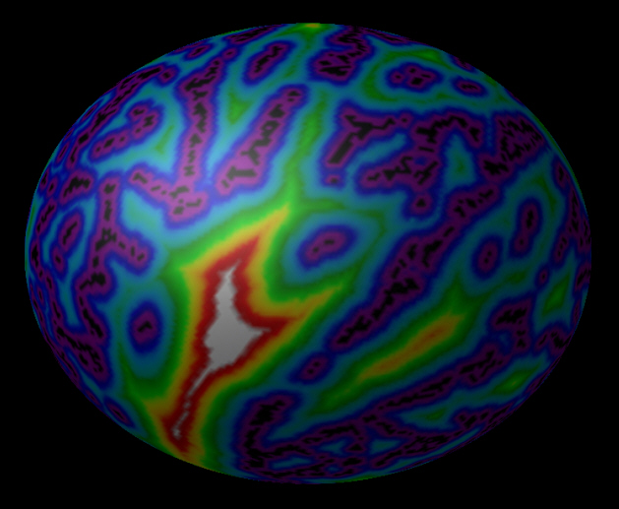
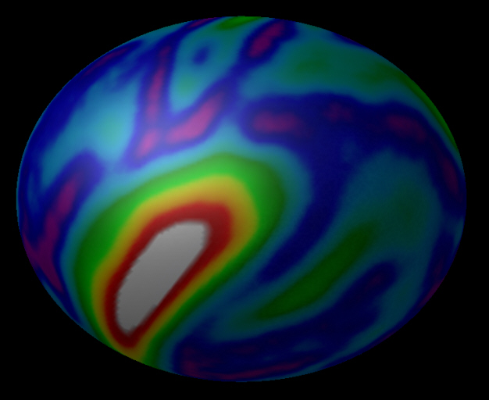
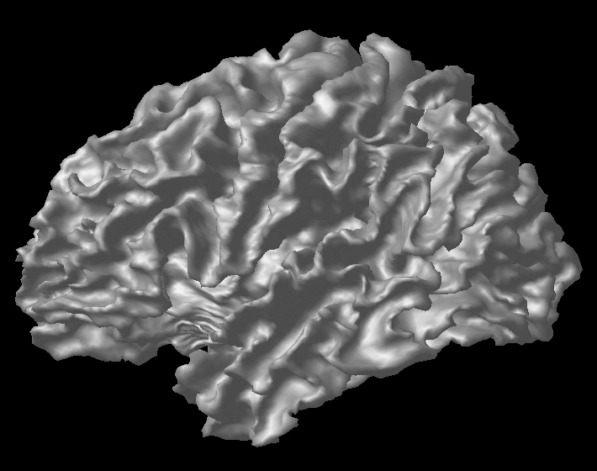
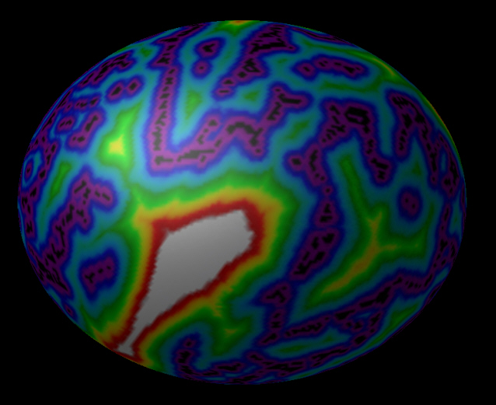
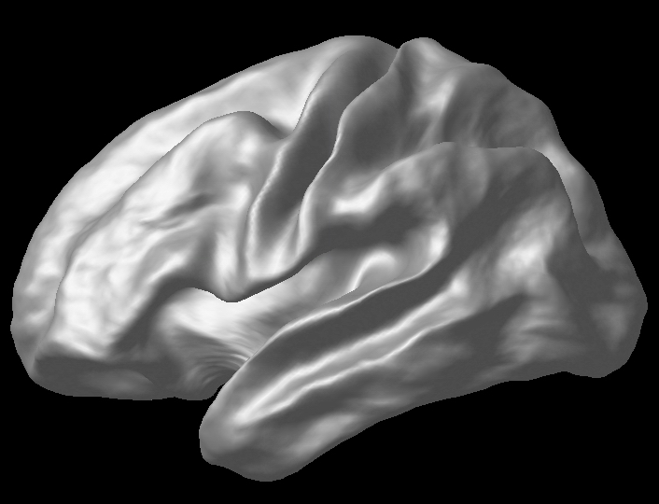
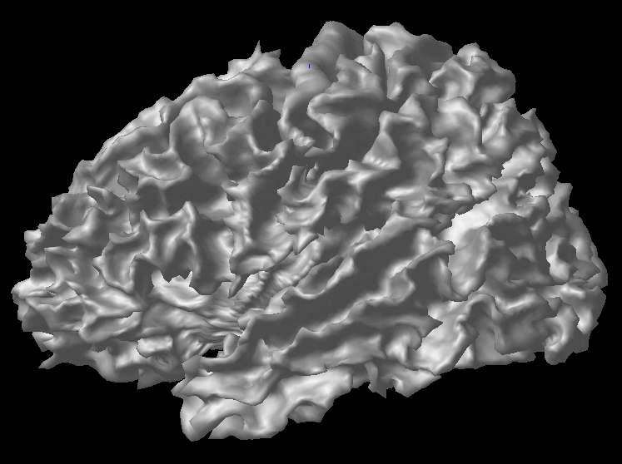
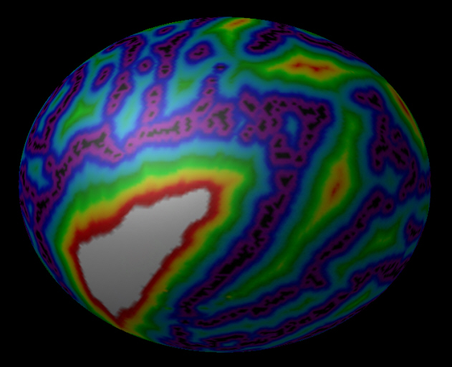
CLASP Correspondence
Nonlinear registration on 2D sphere surfaces
Spherical surface registration with sulcal depth map
Sulcal geodesic depth
Average sulcal depth
…
…
Notes:
Though I can obtain the cortical thickness, there is no correspondence between inter-subjects. So, sulcal pattern matching is able to make the correspondence. It is non-linear registration on 2D sphere surface using geodesic depth. The depth is geodesic distance between the sulcal top and sulcal fundus. After this non-linear registration step, I can have the correspondence among inter-subjects.

Slide 10
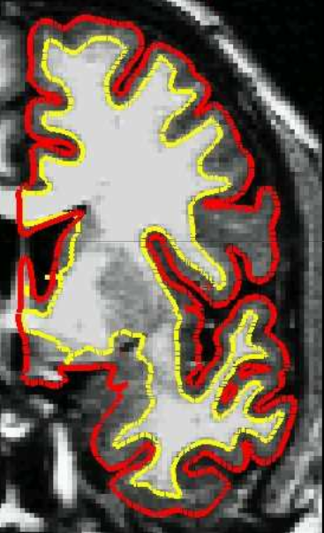
FreeSurfer
Similar preprocessing
Different order of steps
WM from segmentation and topology correction
GM surface from evolution along T1 intensity gradient

Slide 11
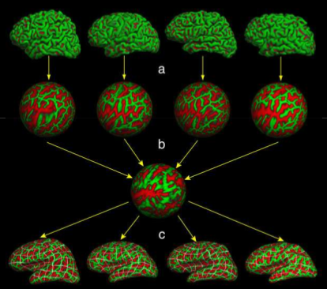
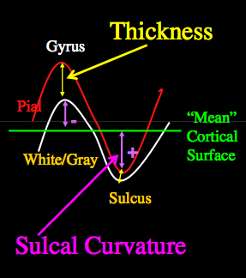
FreeSurfer Correspondence
Sulcal depth
Surface registration
to atlas

Slide 12
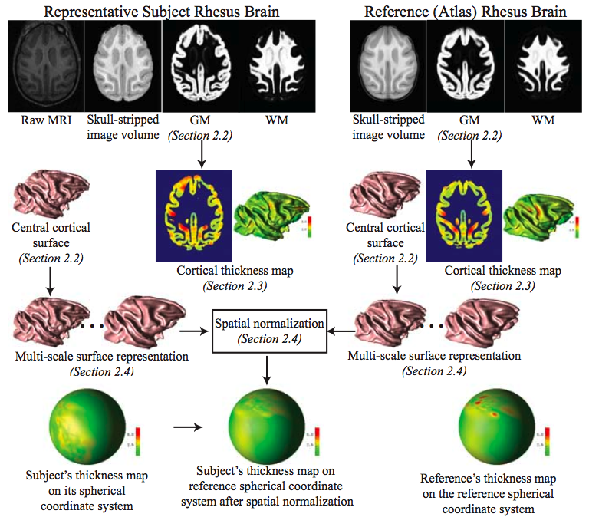
CRUISE Cortical Reconstruction Using Implicit Surface Evolution
Laplacian based
Cortical Thickness
Notes:
Can you talk a bit more here about Duygu’s method. Add the overview picture from the MICCAI paper in here.
Uses topology preserving tissue segmentation -> no need for costly topological corrections a la Freesurfer
Uses Koenderink shape/curvature features to compute correspondence
Make a full slide talking about Gaussian Kernel regression, maybe add some illustrations

Slide 13
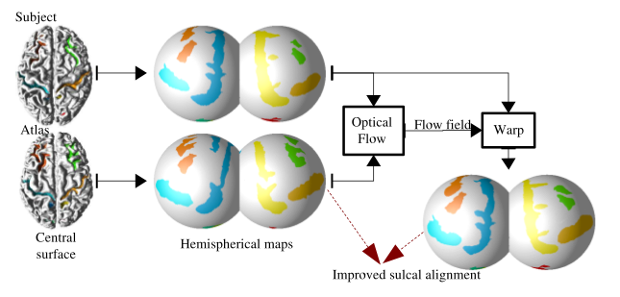
CRUISE Correspondence
Koenderink Shape Measures

Slide 14
Major Differences
Cortical topology
Spherical topology needed?
During or After WM/GM segmentation
Thickness measurement
Closest point, skeleton based, deformation based and laplacian solution based
Cortical correspondence
Many based on sulcal depth based
But template? Population based? Parametrization? Uni vs Bi-hemispheric?

Slide 15
NAMIC Approach for CT
2 separate module pipelines
Regional/image based CT analysis:
Template based registration, simple but stable, good for regional analysis
Local/surface based CT analysis
Spherical topology, but tolerance against violations
Group-wise correspondence
Extensible generic framework that easily incorporates landmarks, connectivity, vessels, functional
Full framework in open source, NAMIC Kit

Slide 16
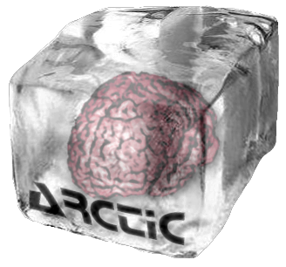
Regional CT – Pipeline
Slicer external module (loadable via extension manager)
ARCTIC (Automatic Regional Cortical ThICkness)
Input: raw data (T1-w, T2-w, PD-w images)
Three steps in the pipeline:
1. Tissue segmentation
2. Regional atlas deformable registration
3. Cortical Thickness

Slide 17
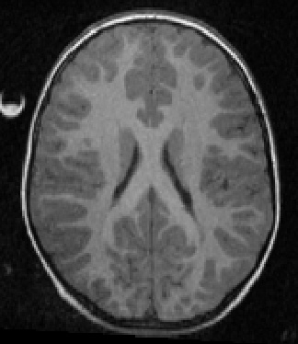
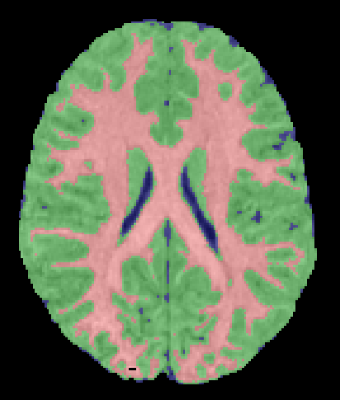
ARCTIC pipeline
Step 1: Tissue segmentation
Probabilistic atlas-based automatic tissue segmentation via an Expectation-Maximization scheme
Tool: itkEMS or ABC (Automatic Brain Classification on NITRC, UNC & UUtah)

Slide 18
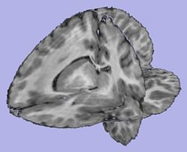
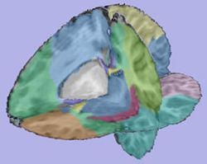
ARCTIC pipeline (2)
Step 2. Regional atlas deformable registration
2.1 Skull stripping using previously computed tissue
segmentation label image
Tool: SegPostProcess (UNC Slicer3 external module)
2.2 T1-weighted atlas deformable registration using a B-spline pipeline registration
Tool: RegisterImages or BrainsFit (Slicer3 modules)
2.3 Applying transformation to the parcellation map
Tool: ResampleVolume2 (Slicer3 module)

Slide 19
ARCTIC pipeline (3)
Step 3. Cortical Thickness
Sparse asymmetric local cortical thickness
Uses distance map based local maxima to correct for CSF/GM errors (akin to skeleton based CT)
Tool: CortThick (UNC Slicer3 module)
Note: All the tools used in the pipeline are Slicer3 modules, some of them being UNC external modules. All can be run as command line and thus are scriptable

Slide 20
ARCTIC Validation
ARCTIC vs. Freesurfer:
FreeSurfer’s tutorial dataset consisting of 40 healthy subjects, ranging in age from 18 to 93, Pearson correlation of the mean lobar CT’s
As is: Good correlation for parietal lobe, other lobes r < 0.7
When using Freesurfer’s WM/GM segmentation: all lobes r > 0.75
Also using Fressurfer’s parcellation: all lobes r > 0.85
Longitudinal autism study of 86 subject aged 2-4 years.
FreeSurfer low success: <40% without, <70% manual intervention
ARCTIC: 98% success rate

Slide 21
GAMBIT: local CT analysis
Group-wise Automatic Mesh-Based Analysis of Cortical Thickness(GAMBIT)
Similar processing to other local approaches
Input image
Tissue segmentation & skull-stripping
ROI segmentation
Cortical thickness computation
WM cortical image creation
Group-wise particle-based shape correspondence on inflated surfaces
GenusZero WM cortical image and surface creation
WM Image fixing
Individual post-processing pipeline:
- Re-meshing
- Cortical thickness interpolation
Genus Zero WM cortical surface inflation
Sulcal depth computation
Group-wise statistical analysis
Particles initialization

Slide 22
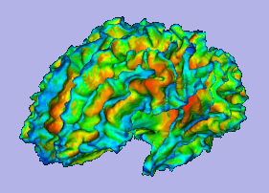
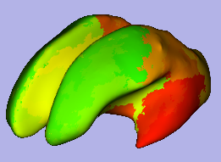
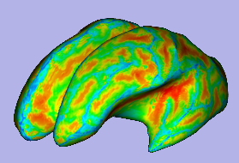
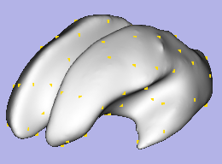
Inflation, Sulcal Depth and Particle Initialization
Sulcal Depthmap
Particle Placement
WM surface
96 Regions
Inflated surface
98 Particles at COG

Slide 23
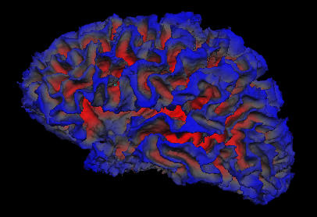
Group-wise Correspondence
Template free
Correspondence over all surfaces
Minimum Description Length
Davies et al
Parametric framework
Entropy: Oguz & Cates
UNC & Utah

Slide 24
Particle Approach (Cates)
Point-based sampling of the surface
Same number of particles per shape
Very different from all other parametric approaches
Particles are ordered
Ordering implies correspondence

Slide 25
Entropy Tradeoff
Simultaneously maximize both the geometric accuracy and the statistical simplicity of the model
k: shape id
P: particle locations
Z: ensemble distribution
Ensemble entropy
(small = simple)
Surface entropy
(large = accurate)

Slide 26
Surface Entropy
High surface entropy
⇔ uniform sampling of the surface
⇔ high geometric accuracy
Low surface entropy
Surface entropy
High surface entropy

Slide 27
Ensemble Entropy
Low ensemble entropy
⇔ high similarity of corresponding points
⇔ statistically compact model
Low ensemble entropy
Ensemble entropy
High ensemble entropy

Slide 28
Generic Local Model (Oguz)
Allowing correspondence to depend on more than just position
Examples of “attributes” f(x)
Local curvature
Sulcal depth
DTI - probabilistic connectivity
MRA - distance to vessel
Notes:
Traditional/generalization

Slide 29
Incorporating attributes
remains the same
Corresponding particles across surfaces should have similar attribute values f(x)
Particles should be evenly distributed on each surface

Slide 30
Ensemble entropy with attributes
P = x
Y is the matrix of particle locations minus the ensemble’s sample mean
P = f(x)
Y is the matrix of the function values at the particle points minus the means of those functions at the points
by the chain rule
becomes

Slide 31
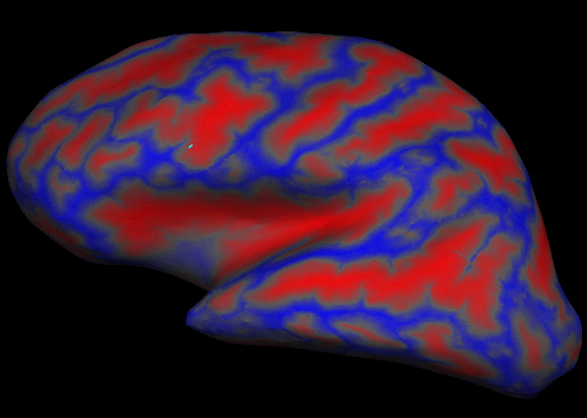
Dealing with Cortical Geometry
Highly convoluted surface is a problem
Solution: Inflate the brain
Convex move inwards, concave move outwards
Minimizes metric distortion
Color map: sulcal depth (integral of the motion along the normal)

Slide 32
Experiments
9 healthy subjects
Correspondence metric: sulcal depth
Reduction of sulcal depth variance

Slide 33
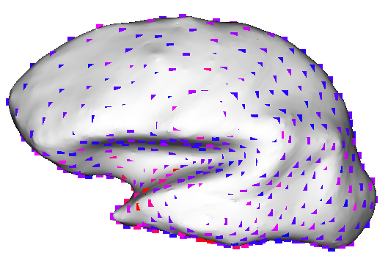
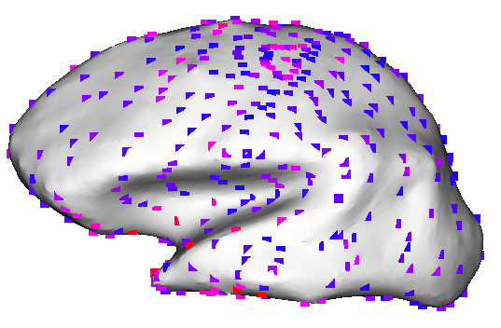
Localization of variance
Sulcal Depth Entropy
FreeSurfer
Color map: Local variance of cortical thickness
Entropy method has high error only in small patch

Slide 34
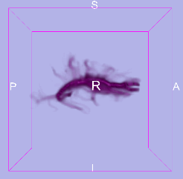
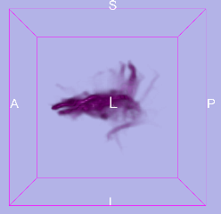
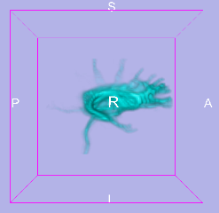
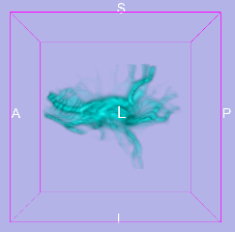
DTI Incorporation
Add probabilistic connectivity to ROI’s
Incorporating fiber structure from DWI
Projecting tractography results to the white matter surface
Multiple cortical connectivity maps
CC, caudate, brainstem…

Slide 35
Open Source Framework
All BSD style open source
Slicer external modules for all individual steps
Slicer external “super” module
Generates and run BatchMake script that calls steps
Can be run local or on grid
Brand-new, methods paper published
Regional CT: First study papers in review

Slide 36
Discussion & Future Work
Cortical thickness
Important for neuroimaging studies
Critical gray matter development
Many tools, get better and better
NAMIC cortical thickness
Next steps
Full Framework, testing, tutorials
Lots of studies
Cortical thickness in rodents

