Slide 1

integrating Data for Analysis, Anonymization, and Sharing
Lucila Ohno-Machado, UCSD
NA-MIC All Hands Meeting 1/12/12

Slide 2
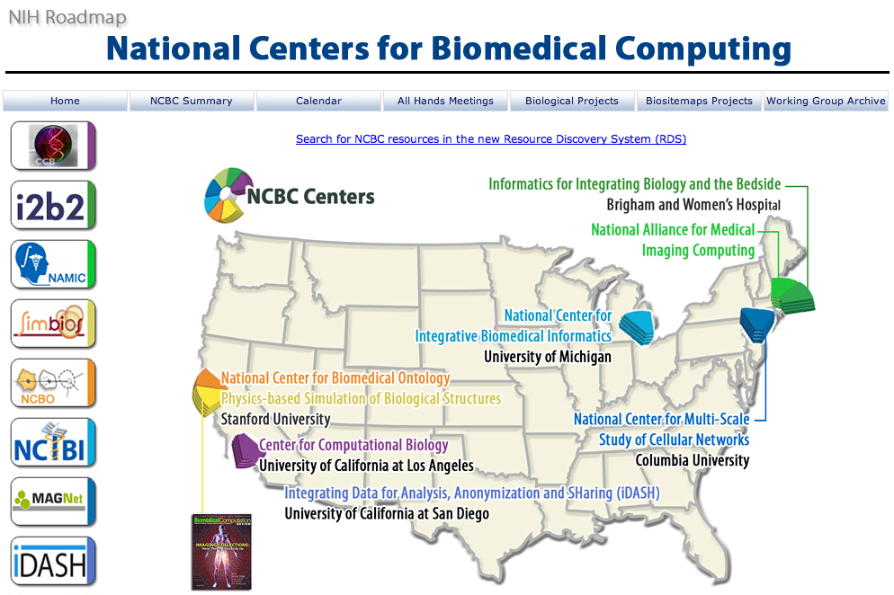
iDASH

Slide 3
Algorithms
Controlled vocabularies
Ontologies
Data management
Information retrieval
Pharmacogenomics
Personalized
Medicine
Pharmacy
Informatics
Biomedical
Informatics
Bioinformatics

Slide 4
Sharing Data
  Today
    Public repositories (mostly non-clinical)
    Limited data use agreements
  Tomorrow
    Annotated public databases
    Informed consent management system
    Certified trust network
    Incentives for sharing

Slide 5
Sharing Computational Resources
  Today
    Computer scientists looking for data, biomedical and behavioral scientists looking for analytics
    Duplication of pre-processing efforts
    Massive storage and high performance computing limited to a few institutions
  Tomorrow
    Processed de-identified, ‘anonymized’ data shared
    Secure biomedical/behavioral cloud

Slide 6
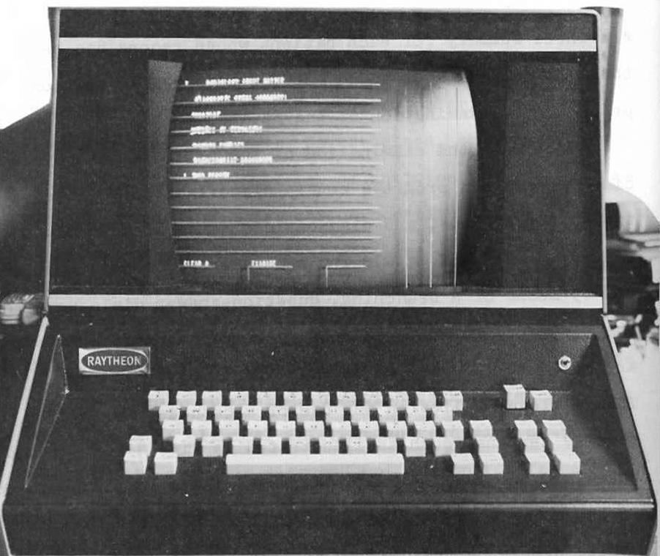
Biomedical Informatics: the Early Years
Touch screen terminal
Laboratory for Computer Science, Massachusetts General Hospital, Boston
1960’s

Slide 7
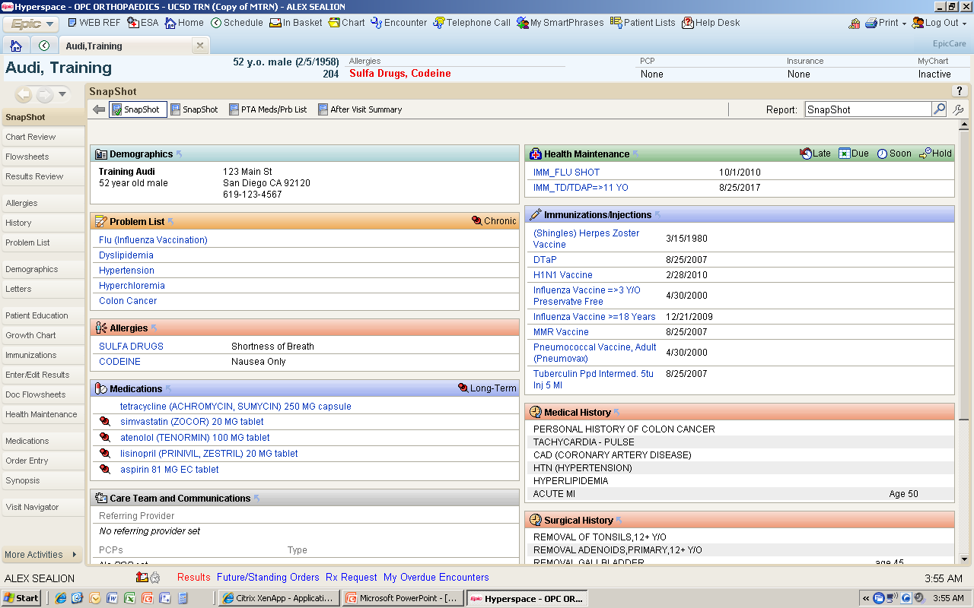
Electronic Health Record
Courtesy Dr. Lee

Slide 8
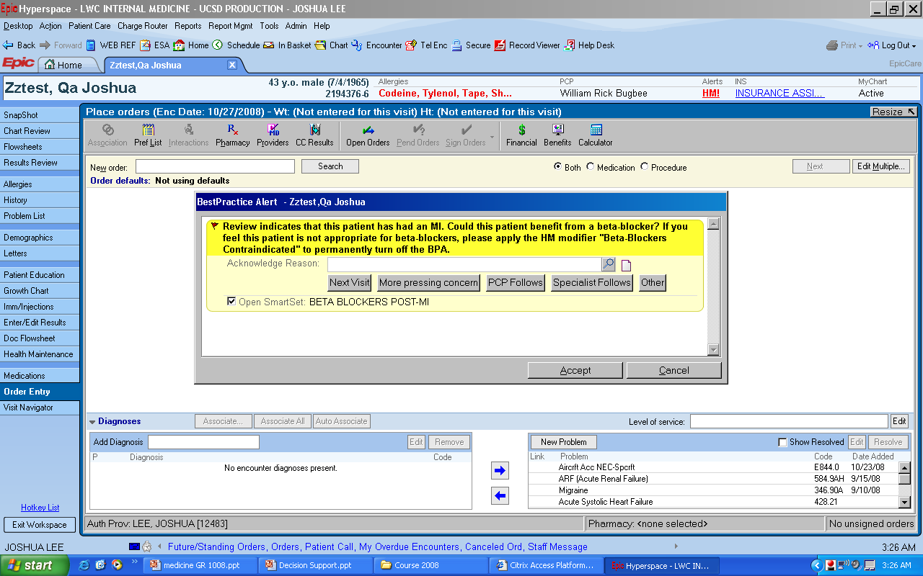
Clinical Decision Support
Courtesy Dr. Lee

Slide 9
Case Presentation
(Modified from contribution by Dr. Resnic, BWH)

Slide 10
65 y.o. obese (BMI=38) hypertensive, diabetic male presents to ED with chest pain and nausea x 2hrs
Pulse = 95
BP=148/88
pale
sweaty

Slide 11
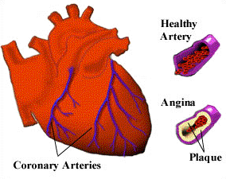
Initial cardiac troponin T (cTnT):
  1.14 µg/L (> 99% percentile)
Diagnosis: Myocardial Infarction

Slide 12
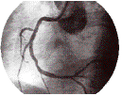
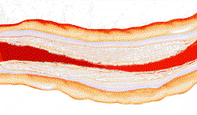
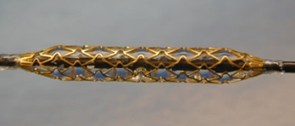
In Emergency Department treated with unfractionated heparin, aspirin, Plavix 300mg (loading dose), and started on Integrillin (gp2b3a antagonist)
Taken emergently to cardiac catheterization laboratory for “primary Percutaneous Coronary Intervention”

Slide 13
4 hours later, patient in CCU suddenly develops nausea and tachycardia
BP: 85/62 mmHg; exam unremarkable
EKG: T-wave inversions in anterior leads – no recurrent ST elevation

Slide 14
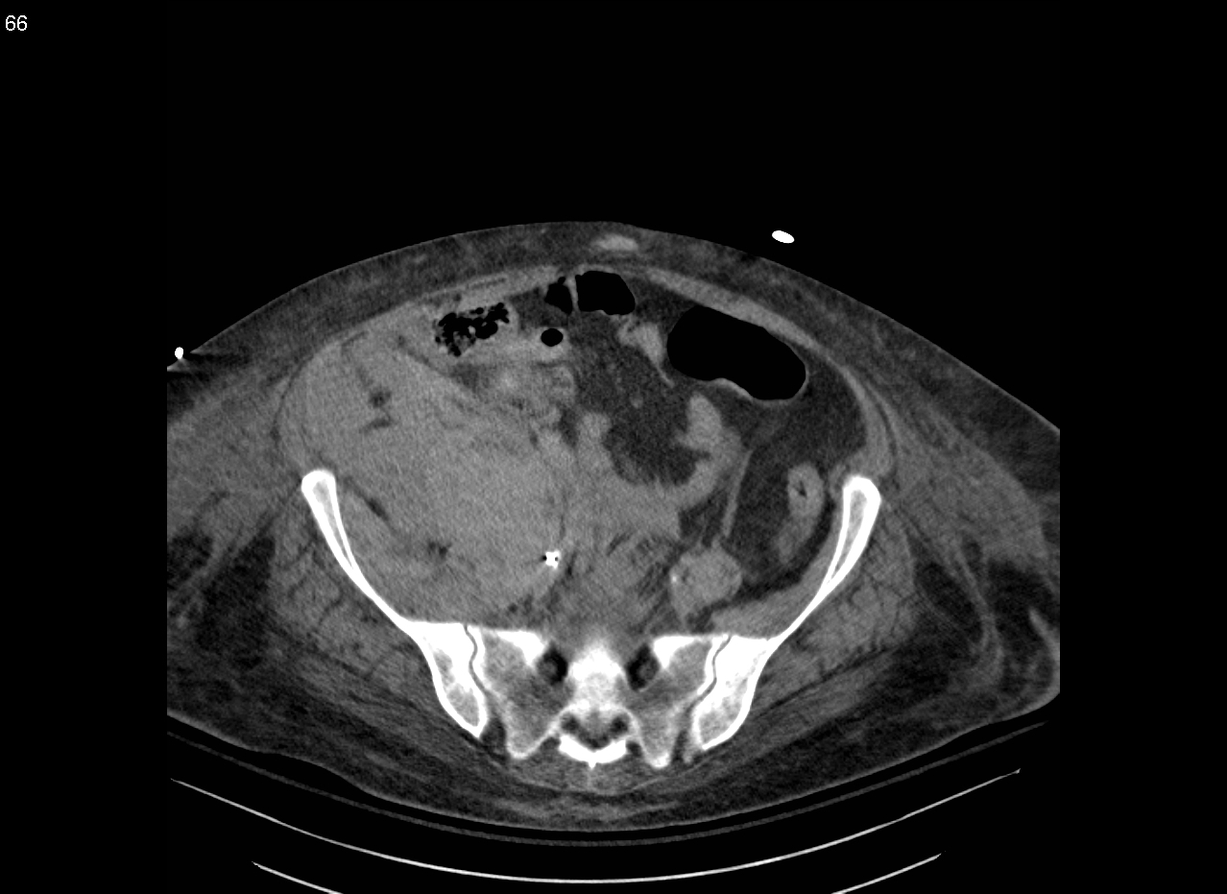
CT abdomen: Retroperitoneal hemorrhage
Gp2b3a discontinued, fluid bolus administered, RBC transfused

Slide 15
Retroperitoneal Hemorrhage (RPH)
Major vascular complications are among most common precipitants of morbidity and mortality following PCI
Emergent procedures have high risk of vascular complications
Obesity is a risk factor for RPH
Sensitivity to anticoagulants is highly variable
Vascular closure device speculated as increasing risk for RPH

Slide 16
Retroperitoneal Hemorrhage (RPH)
What was the cause?
Could it be avoided?
How many complications like this occurred?
  With closure devices
  With same medication
  With same co-morbidities

Slide 17
Pharmacogenetics
Cardiology
  Antiplatelets
    Clopidrogrel
    Prasugrel
  Antithrombotic
    Warfarin
    Dabigatran
Oncology
  Breast Cancer
  Prostate Cancer
  Colon Cancer
Others
  Immunosupressors
  HIV medication
  Epilepsy

Slide 18
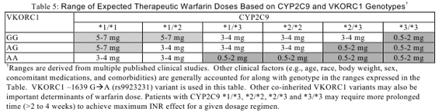
Warfarin Label

Slide 19
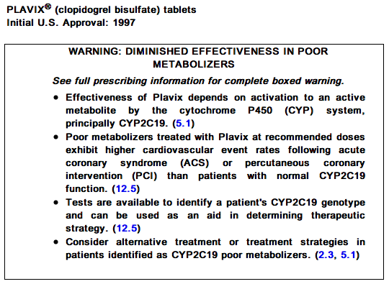
Clopidrogrel Label

Slide 20
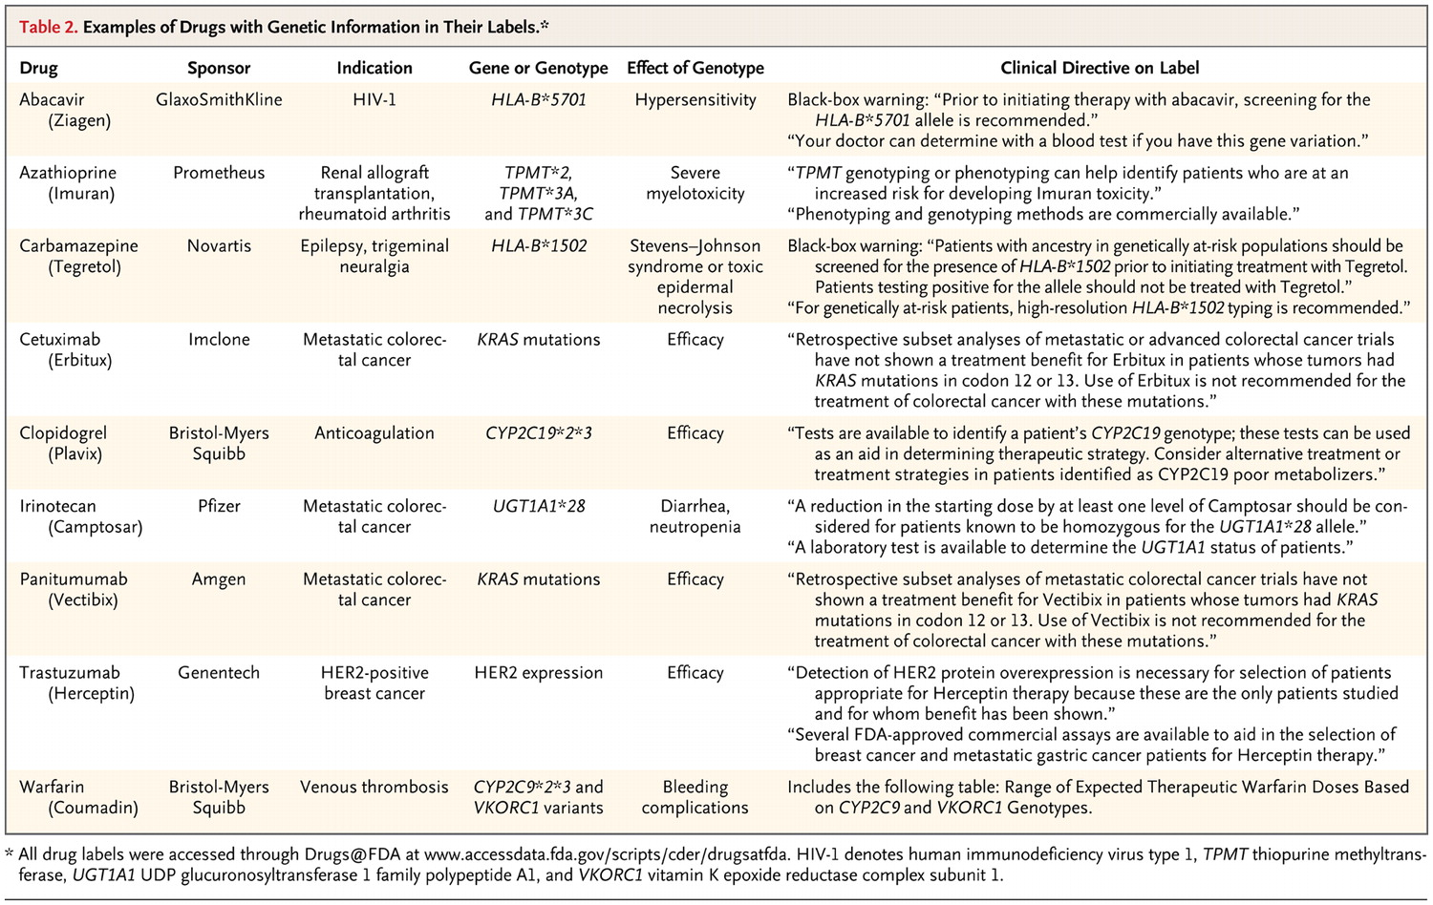

Examples of Drugs with Genetic Information in Their Labels
Hudson KL. N Engl J Med 2011;365:1033-1041.
Hudson KL. N Engl J Med 2011

Slide 21
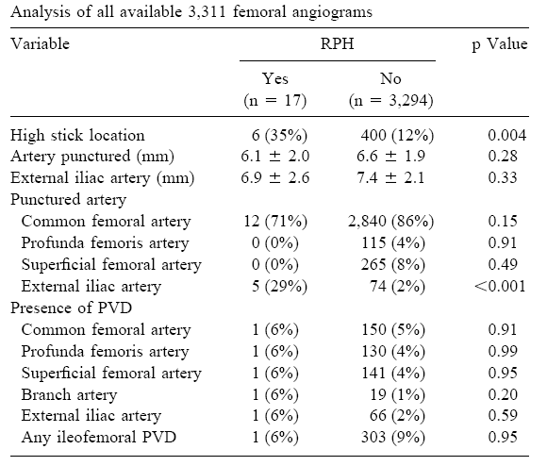
Technique-Related Complication
Tiroch KA, Arora N, Matheny ME, Liu C, Lee TC, Resnic FS. Risk predictors of retroperitoneal hemorrhage following percutaneous coronary intervention. Am J Cardiol. 2008 Dec 1;102(11):1473-6.

Slide 22
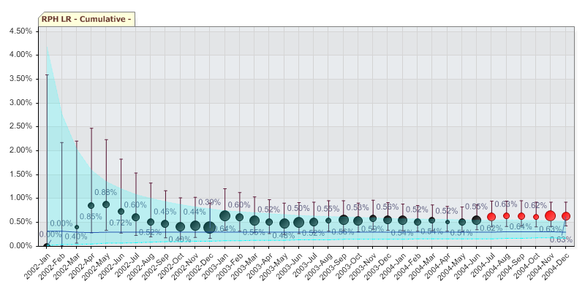
Patient Safety Process Out of Control
Matheny ME, Arora N, Ohno-Machado L, Resnic FS. Rare adverse event monitoring of medical devices with the use of an automated surveillance tool. 2007

Slide 23
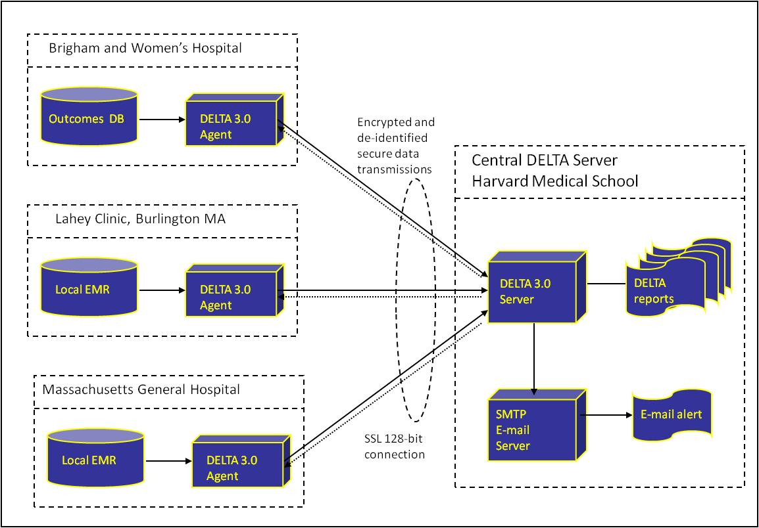
Monitoring Clinical Data Warehouses
Courtesy of Fred Resnic

Slide 24
Multivariate Models
Logistic Regression
Prognostic Risk Score
Other
Odds
Ratio
beta
Risk
p-value
coefficient
Value
Age > 74yrs
2.51
0.02
0.921
2
B2/C Lesion
2.12
0.05
0.752
1
Acute MI
2.06
0.13
0.724
1
Class 3/4 CHF
8.41
0.00
2.129
4
Left main PCI
5.93
0.03
1.779
3
IIb/IIIa Use
0.57
0.20
-0.554
-1
Stent Use
0.53
0.12
-0.626
-1
Cardiogenic Shock
7.53
0.00
2.019
4
Unstable Angina
1.70
0.17
0.531
1
Tachycardic
2.78
0.04
1.022
2
Chronic Renal Insuf.
2.58
0.06
0.948
2

Slide 25
Risk Adjustment
Unadjusted Overall Mortality Rate = 2.1%
62%
Number of Cases
Mortality Risk
26%
1.4%
7.6%
2.9%
0.4%
1.6%
1.3%
Resnic FS, Ohno-Machado L, Selwyn A, Simon DI, Popma JJ. Simplified risk score models accurately predict the risk of major in-hospital complications following percutaneous coronary intervention. Am J Cardiol. 2001;88(1):5-9.

Slide 26
Safety of New Medications
Clopidogrel vs Prasugrel
Warfarin vs Dabigatran
Major and minor bleeding
BWH, VA, UCSD
New methods for distributed computing, propensity matching

Slide 27
Data Retrieval Service for Research
Complex Initial Condition
Complex case example
  For not terminally ill live patients who has been newly (in or after Jan 2010) diagnosed with Atrial Fibrillation (AF), who has never taken Warfarin or Dabigatran prior to the AF diagnosis but on Dabigatran, provide
    Major bleeding event after Dabigatran use and the bleeding type
    Worst results among the labs done 3 months prior to the latest clinic visit
    Latest reading of the vital signs done 3 months prior to the latest clinic visit
    Medication adherence
    Total number of medications that the patient is on
    Non-medication treatment
    Present history of illness (ICD-9 Codes)
Requires Quantifiable Definition
Complex join and aggregation
Clarification
on data sources

Slide 28
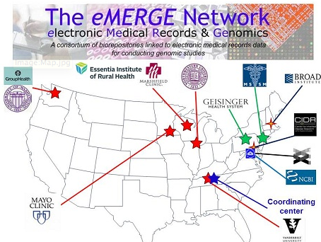
Example of Research Network
Research project funded by the NIH
Private institutions
5 diseases Long QT
  Cataract
  Dementia
  PAD
  DM
8 year project
$27 million

Slide 29
University of California Research Exchange
UC Davis
  2M patients in CDW, full EMR (in- and out-patient)
UC Irvine
  1.5M patients in CDW, full EMR (in- and partial out-patient)
UC SD
  2M patients in CDW, full EMR (in- and out-patient)
UC SF
  2.7M patients in IDR, EMR under implementation
UC LA
  > 2M, CDW under construction, EMR under implementation
Notes:
Need updated information

Slide 30
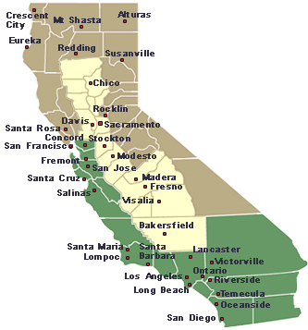


Data + Ontologies + Tools
UCSF
UC Davis
UC Irvine
UCLA
UCSD
Complications associated with a new drug or device?
Extraction Transformation Load
(even with same vendor, the EMRs are configured differently)
Semantic Integration
Query
Information
Notes:
I will quickly hint to the problem of data harmonization without getting into details, speak about how difficult it is to find A1ATD patients despite ICD-9 codes.

Slide 31
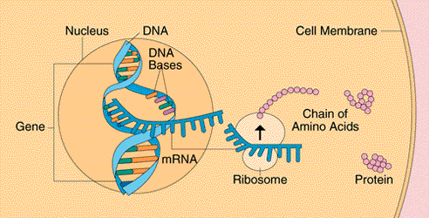
Integrating Different Types of Data
Genotype
genome
RNA
transcriptome
transcription
translation
Protein
proteome
Phenotype
physical exam, imaging, monitoring systems
Physiology
tests
Metabolites
laboratory

Slide 32
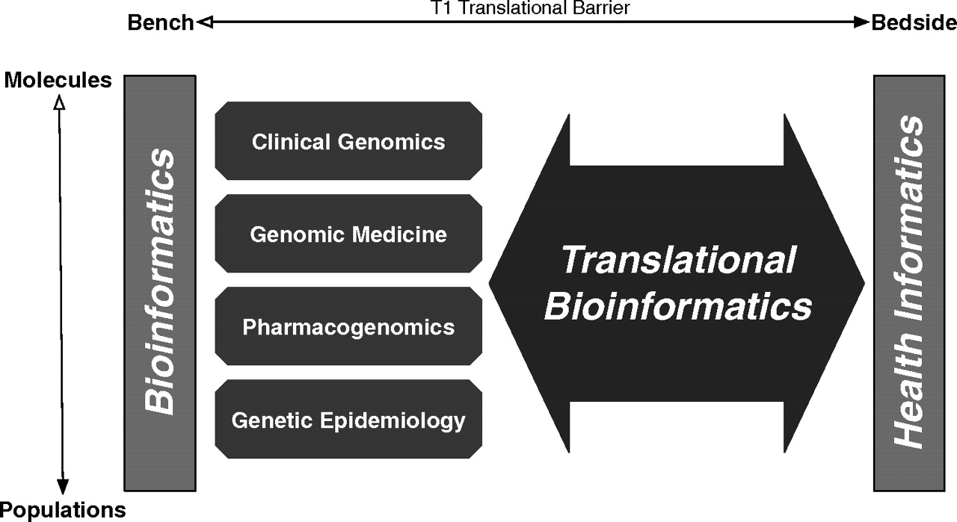

Bridging Biological and Clinical Knowledge
Sarkar I N et al. JAMIA 2011;18:354-357
Notes:
Bridging biological and clinical knowledge using translational bioinformatics. Bioinformatics approaches, focused on areas from molecules to populations (eg, clinical genomics, genomic medicine (‘personalized medicine’), pharmacogenomics, and genetic epidemiology), form the foundation of approaches that are used by translational bioinformatics (TBI; large bidirectional arrow). TBI thus bridges knowledge acquired from both the biological (using bioinformatics) and health (using health informatics) domains. Accordingly, the success of TBI will result in the crossing of the T1 translational barrier, and thus link innovations from bench to bedside.

Slide 33
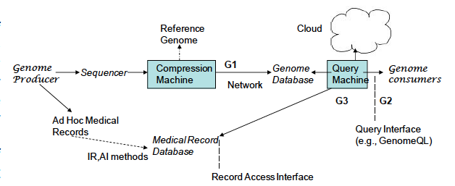
Genome Query Language
Compression
Query language
NLP
Bafna & Varghese, 2011

Slide 34
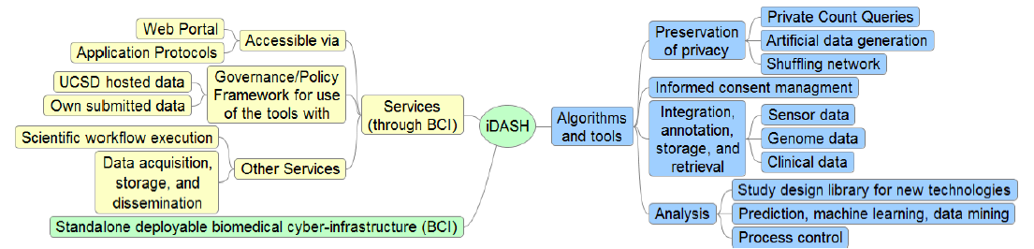
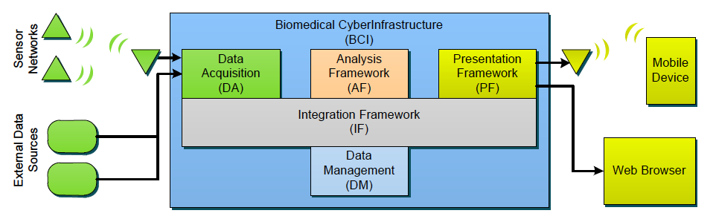
Biomedical CyberInfrastructure

Slide 35
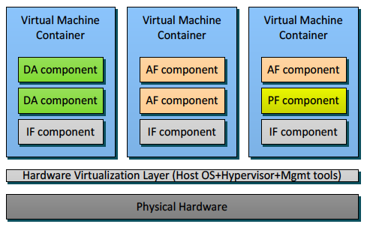

315TB Cloud and project storage for 100s of virtual servers
54TB high-speed database and system storage; high-performance parallel databases
10Gb redundant network environment; firewall and IDS to address HIPAA requirements
Multiple-site encrypted storage of critical data
CMS Data Hosting, UC Clinical Data Hosting
FISMA, HIPAA certified facility

Slide 36
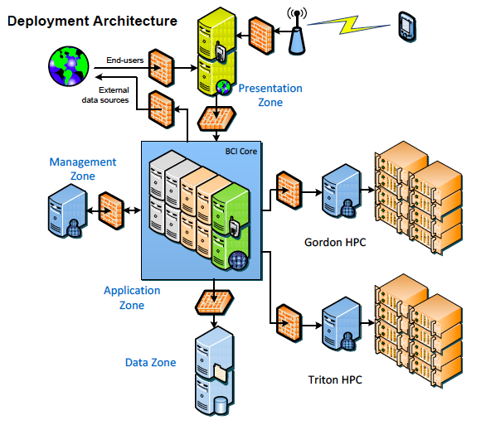
4 petabytes of disk storage
64 terabytes of random access memory
280+ teraflops of compute power
300 terabytes of flash memory
supports 36,000,000 IOPS

Slide 37
UC ReX - Research eXchange
Clinical Data Warehouses from 5 Medical Centers and affiliated institutions exchange (>10 million patients)
Aggregate and individual-level patient data according to data use agreements, internal review boards
Integration with local, regional, state, and federal patient registries and data from collaborators
Cross-checking for patient safety practices, quality improvement, translational research
Studies of cost-effectiveness across systems

Slide 38
2ary Use of Clinical Data for Research
Biological sample
  Informed consent
Data
  Informed consent if data are identified
  What about limited (de-identified) data sets?
  What does de-identification mean?

Slide 39
Should Individual Data Get Disclosed?
Only for mandatory, public health or quality monitoring reasons?
Only when risk of re-identification is low?
  How low?
    Whose low?
De-identification
  individuals
  institutions

Slide 40
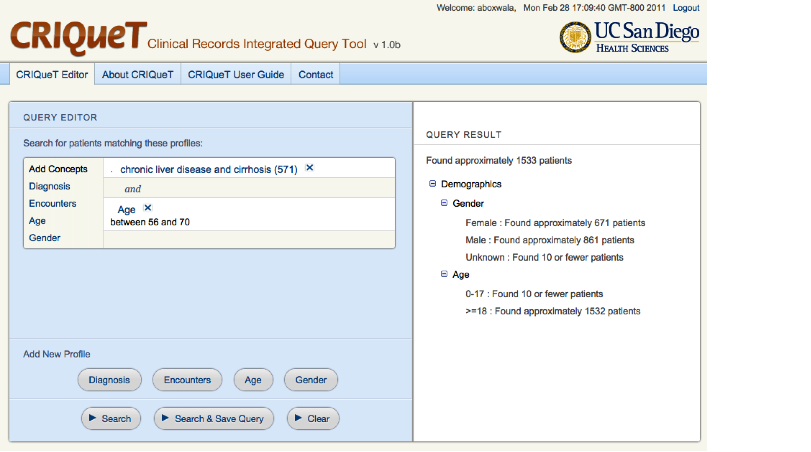
Precise Counts Could Compromise Identity

Slide 41
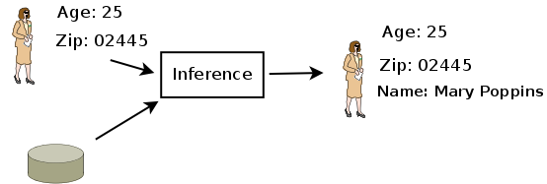
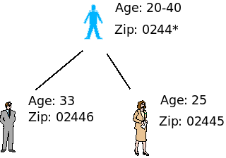
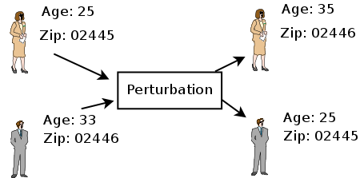
De-Identification vs. Anonymization
De-identification: removal of explicit identifiers (e.g., SSN, Names)‏
Anonymization: manipulating data to prohibit inference
Generalization
How?
Examples
Perturbation
K-ambiguity ‏(Vinterbo 2004, Vinterbo 2007)‏
K-anonymity (Sweeney 1998, Aggarwal 2005)‏
Spectral Swapping (Lasko & Vinterbo 2009)‏
Staal Vinterbo, March 2009
Notes:
41

Slide 42

Multi-Center Data: “Anonymizing” the Institution
Trusted Environment
User
Query
Data
Warehouse
Query
Result
Trusted Environment
Query
Data
Warehouse
Combined Result
Trusted Environment
Result
Query
Protocol for distributed global artificial identifiers and combination of results from different sources: the user cannot tell which part of the results comes from which source.
Data
Warehouse
Result
Staal Vinterbo, March 2009
Notes:
42

Slide 43


Respecting Privacy and Getting the Job Done
?
Provider P requests Data D on individual I for Reason R
Does the law, Regulation require D to be sent?
No
Yes
Trusted Broker(s)
Identity Management
Security Entity
Healthcare Entity

Slide 44



Closing the Loop for Decision Support
Provider P needs Data D on individual I for Clnical Decision Making
Informed Consent Management System
Do I wish to disclose data D to P?
Does the law
require D to be sent?
No
Yes
Preferences
Trusted Broker(s)
Yes
No
Identity Management
Trust Management
Information Exchange Registry
Patient I
Inspection
Security Entity
I can check who or which entity looked (wanted to look) at the data for what reasons
Home
Healthcare Entity
NIH U54HL10846
AHRQ R01 HS19913
Privacy Registry

Slide 45

Goals
  Bring together researchers and decision makers who
    Use biomedical data
    Protect privacy in disclosed data
    Regulate dissemination of data
  Promote lively discussion on
    Privacy technology: what it is, how it works
    Privacy policy: what it is, who it affects, how it is implemented
    Different data protection requirements across borders

Slide 46
Models for Sharing
  iDASH cloud
    Data exported for computation elsewhere
      Users download data from iDASH
    Computation comes to the data
      Users query data in iDASH
      Users upload algorithms into iDASH
  iDASH exportable cyberinfrastructure
      Users download infrastructure

Slide 47

Privacy
  Use of clinical, experimental, and genetic data for research
    not primarily for clinical practice (i.e., not for HIE)
    not primarily for quality improvement (i.e., not for IRB exempt activities)
  Hosting and disseminating data according to
    Consents from individuals
    Data owner requirements
    Rules and regulations

Slide 48

Preventing Obesity by Monitoring Behavior
Phase 1
  physical activity behavior pattern recognition and feedback test
Phase 2
  efficacy testing with iterative improvement/ retesting in sedentary adults with outcomes of accelerometer measured activity and sedentary time evaluated against controls
Greg Norman, PhD

Slide 49
Kawasaki Disease Data Integration
Identify rare genetic variants that may play a functional role in disease susceptibility and outcome
Discover miRNAs associated with KD
Create a KD data warehouse and web-based data analysis system aimed at facilitating discoveries using molecular, clinical, environmental data
Jane Burns, MD

Slide 50
Diabetes Monitoring
Goal: Integrate emerging genomics, informatics, and consumer technologies to better understand blood glucose dynamics (individual & general)
Type 1 Diabetes Mellitus subjects (n=18)
  wore monitoring devices continuously for several days,
  kept a photographic nutrition journal, and
  provided blood samples for clinical labs and -omics analyses
Heintzman et al, 2011

Slide 51
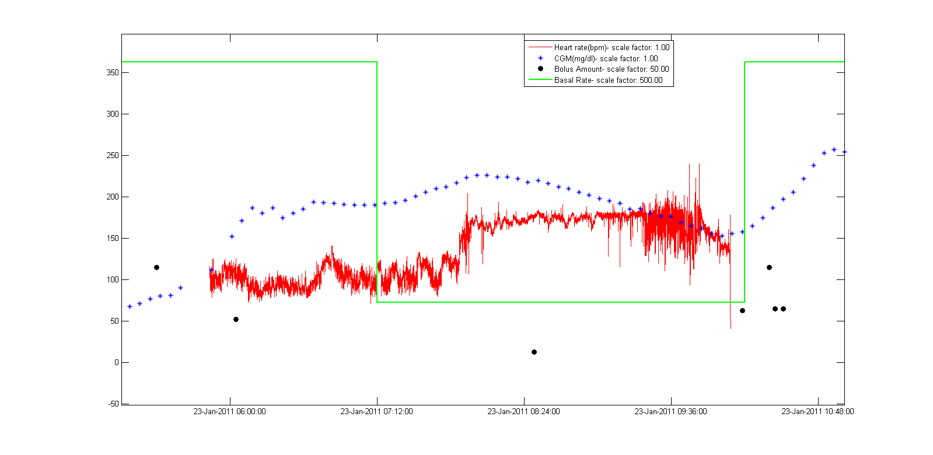
Preliminary graph of CGM, HRM, insulin (basal/bolus) during 13.1mi morning run
wake
start run
end run
Heintzman et al, 2011

Slide 52
What can we do?
Build large data repositories to improve research
  Enhance policy and technological solutions to the problem of individual and institutional privacy
Aggregate data from different countries and use for new analyses
  Provide tools to integrate and analyze data

Slide 53
Computer Science & Engineering
Challenges
Data compression
Dimensionality reduction
Information retrieval
Data annotation
Visualization
Genotype-phenotype associations
Temporal associations

Slide 54
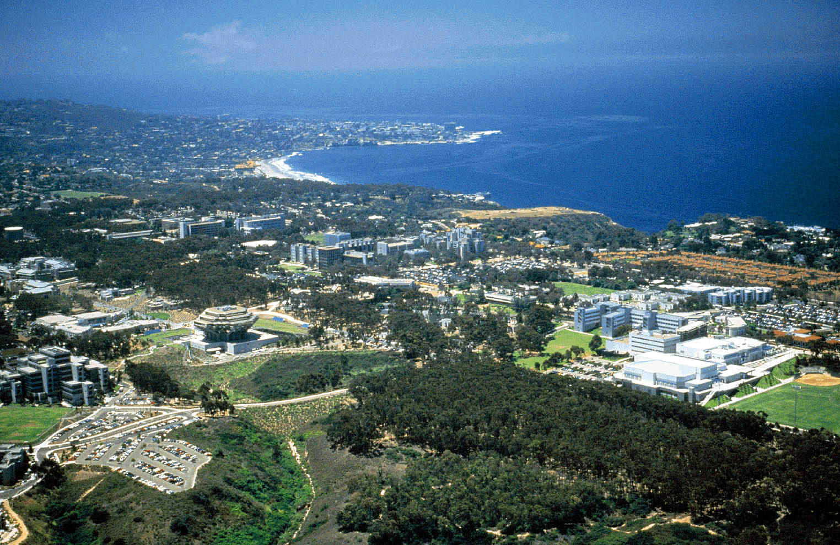
  Research
  Service
  Education
  Change

