Slide 1

DTI Atlas Registration via 3D Slicer and DTI-Reg
Martin Styner, UNC
Clement Vachet, UNC
Jean-Baptiste Berger, UNC

Slide 2
DTI Registration
This tutorial teaches you how
  What fiber tract analysis is
  How to perform a fiber tract measurements via DTIAtlasFiberAnalyzer in Slicer
DTIAtlasFiberAnalyzer
  On NITRC, works also as standalone
  Works on population/groups of datasets

Slide 3

Dataset
For this tutorial you will need DTI and fiber data files that can be found on this link :
http://hdl.handle.net/1926/1759

Slide 4
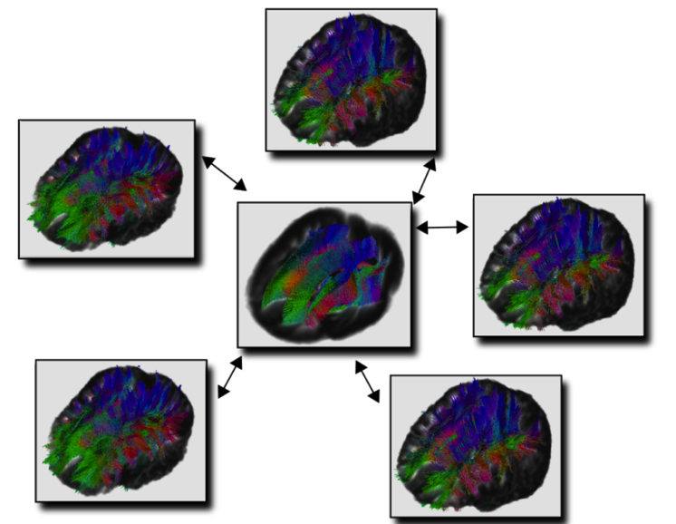
Needed Ingredients
A DTI atlas with fiber tracts
  Create your own atlas
    Track in Slicer, process with FiberViewerLight
      Separate Tutorial
    Atlas building in Slicer in progress
DTI datasets mapped into the atlas
  Directly mapped DTI data
  DTI & Deformation field data

Slide 5
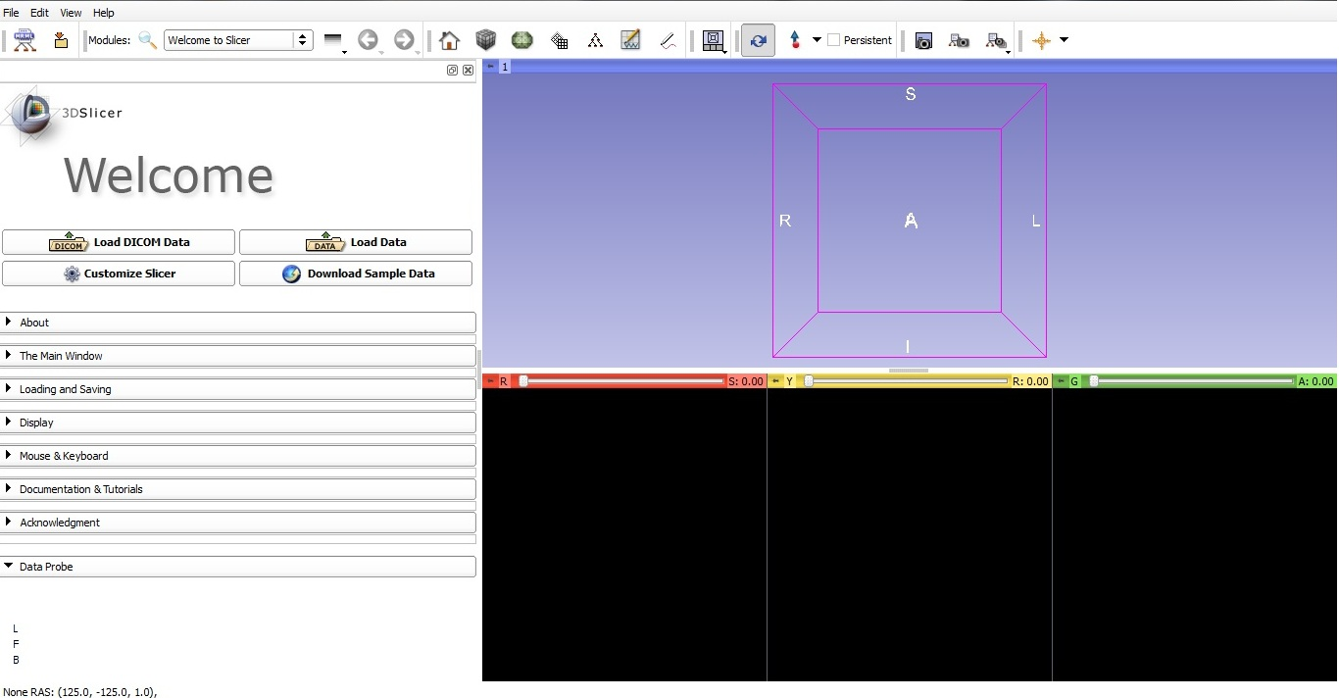
Let’s get started: Slicer 4
Linux/Mac users :
Launch the Slicer
executable located in
the Slicer4 directory
Windows users :
Select Start→All Programs→Slicer4.0.1→Slicer
Or launch the Slicer executable from Slicer4 directory

Slide 6
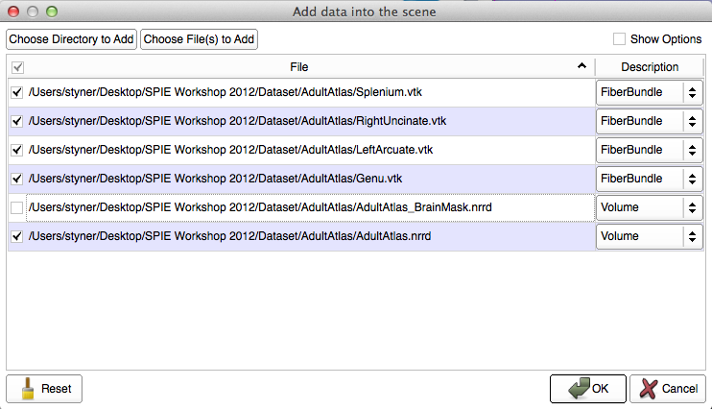
Load Atlas & Fibers
Add Data in File Menu
  Select all files in DTI atlas folder
  Change description to FiberBundle for fibers
  No mask
  Okay!

Slide 7
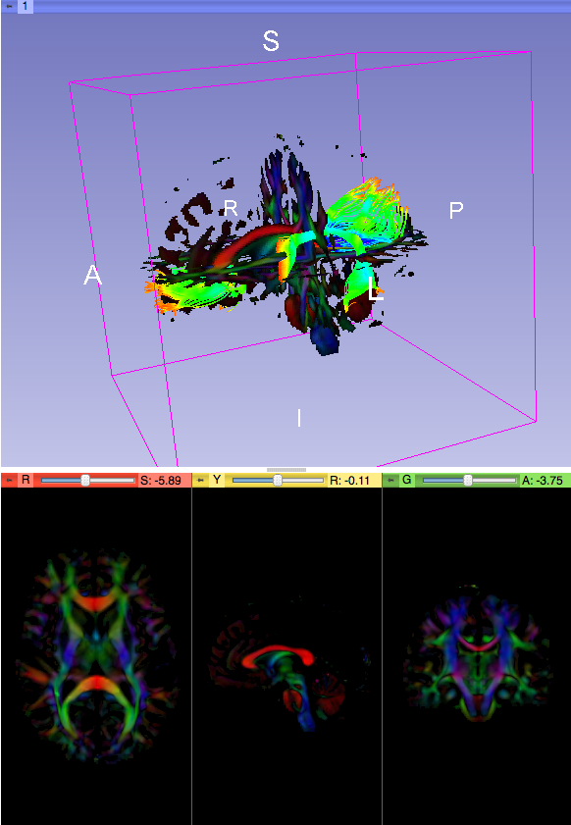
DTI Atlas & Fibers
Link slices
Enable threshold in Volume module
Example tracts:
  CC Genu
  CC Splenium
  Uncinate right hemi
  Arcuate left hemi
Not anatomically verified!!

Slide 8
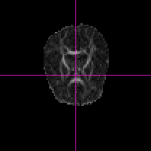
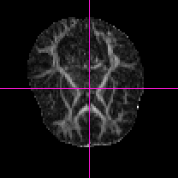
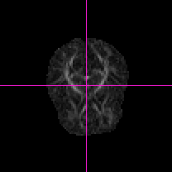
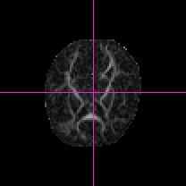
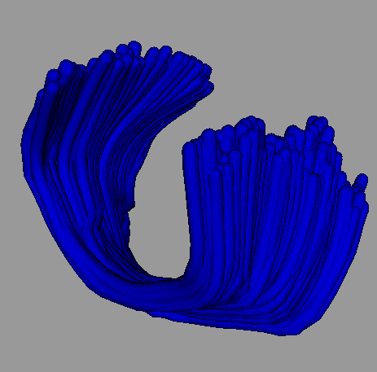
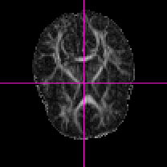
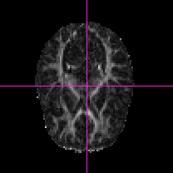
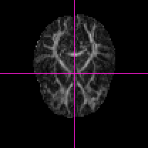
Fiber based Analysis
Analyze corresponding fiber locations across datasets via atlas
  Mapping into atlas
  Inverse map to sample fibers
  Compute fiber profiles
    FA, MD, AD, RD…
  Analyze the profiles
Atlas Fiber

Slide 9
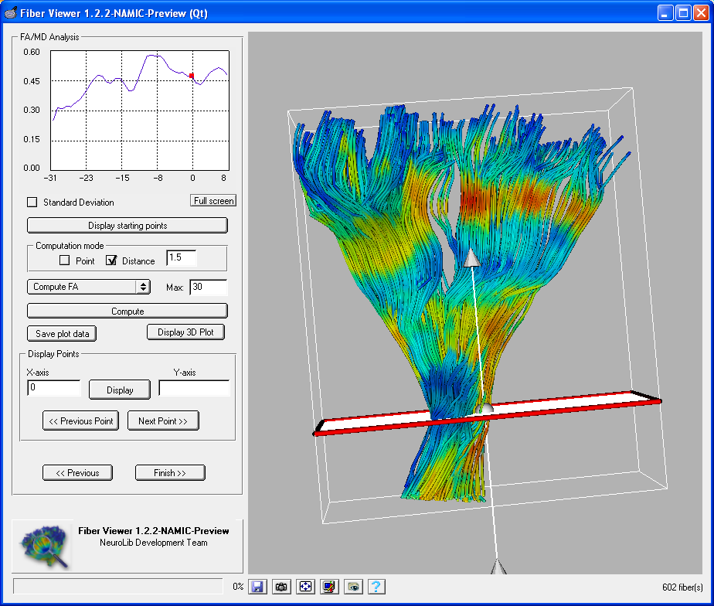
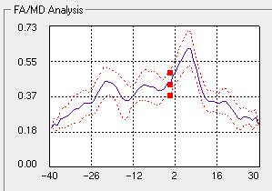
DTI Property Fiber Profiles
Profile = Distribution of DTI values across fiber bundle
  Average & deviation
Parameterization of each fiber along fiber bundle
  Uniform stepsize
  Origin definition
    Manual
    Automatic (2 ways)
-L
0
+L

Slide 10
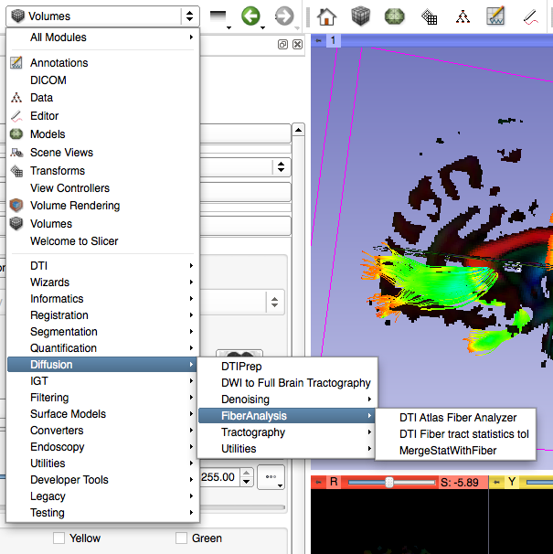
DTI Atlas Fiber Analyzer
Separate tool called from Slicer
  Diffusion
  FiberAnalysis
  DTI Atlas Fiber Analyzer
Create new command line module
Apply!

Slide 11
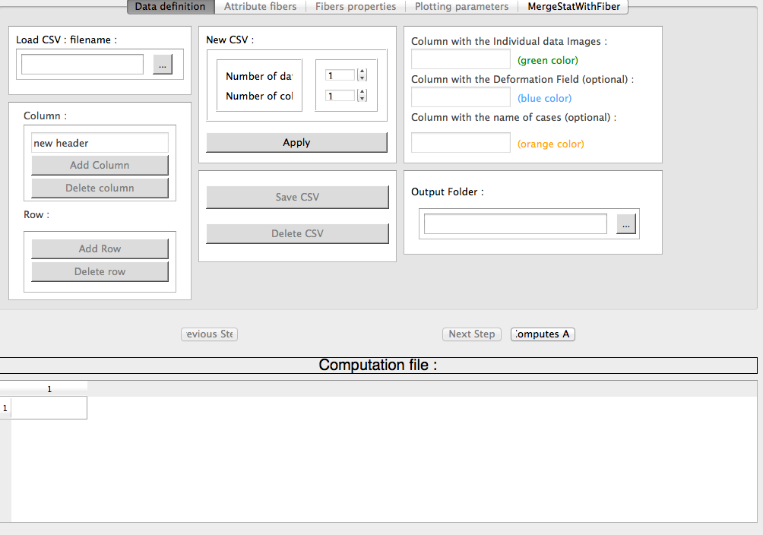
DTI Atlas Fiber Analyzer
Made for analyzing many datasets at once
.csv = comma separated value
Data can be prepared with Excel or other editors
Load prior csv file
Tabs for the 4 main steps
DataTable Area

Slide 12
Step 1: Data Definition I
Create your datatable from scratch
1 row for 1 dataset
3 columns
  SubjectID
  Path to volume
  Path to Deformation
“Apply” to create the datatable

Slide 13
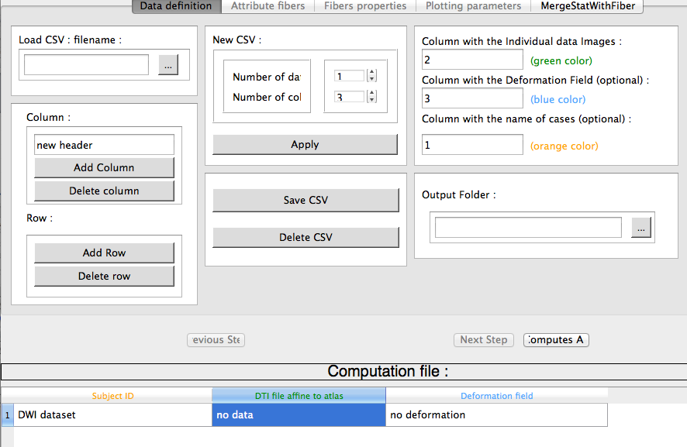
Step 1: Data Definition II
Double click headers to edit
Set Subject Column to 1
Set dataset column to 2
Set deformation column to 3
Double click on “no data” to browse for datafile
Double click on “no deformation” to browse for deformation file

Slide 14
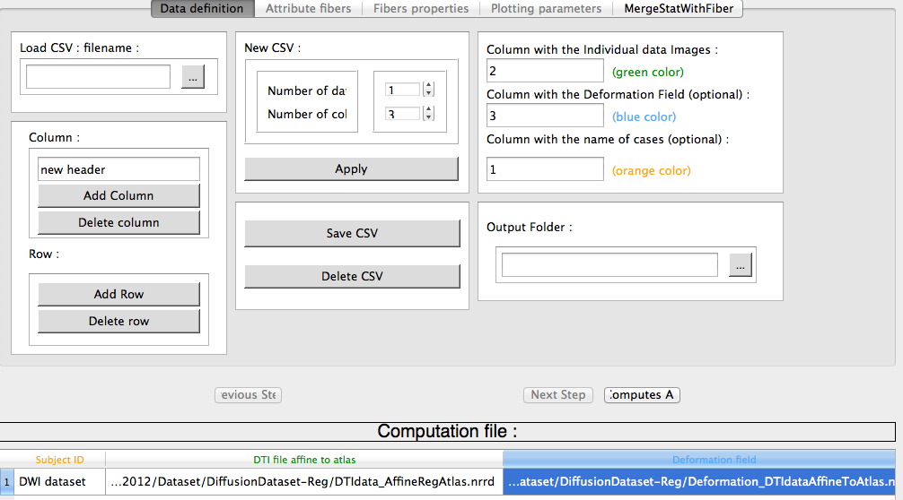
Save the CSV Data
Save CSF File
Set Output folder for processing data
Next Step

Slide 15
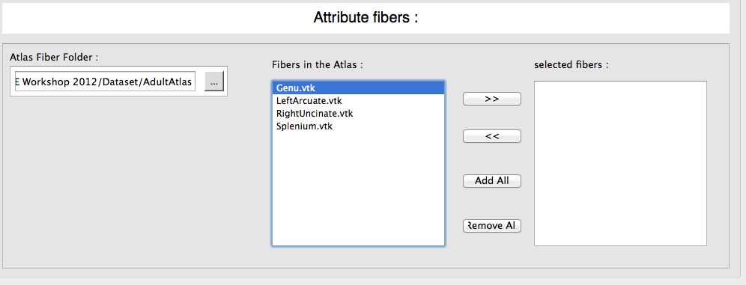
Step 2: Atlas Definition
Set Atlas to tutorial atlas
  Available fibers are automatically detected
Select fibers to be analyzed
  Add Genu or Add All
“Apply” to run, if data exists, asks about rerun
“Next”

Slide 16
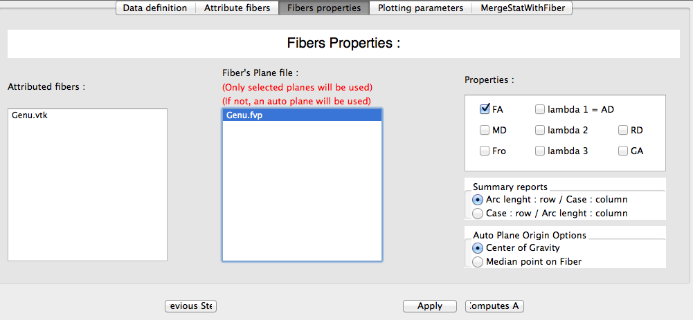
Step 3: Fiber Profiles
Manual vs Auto origin
  Autodetect if in atlas
    None here
Properties
  Select FA
“Apply” to run & wait, then “Next”

Slide 17
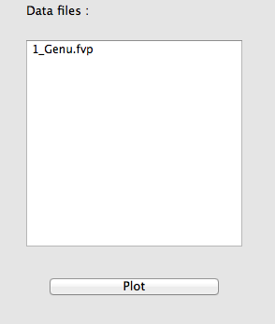
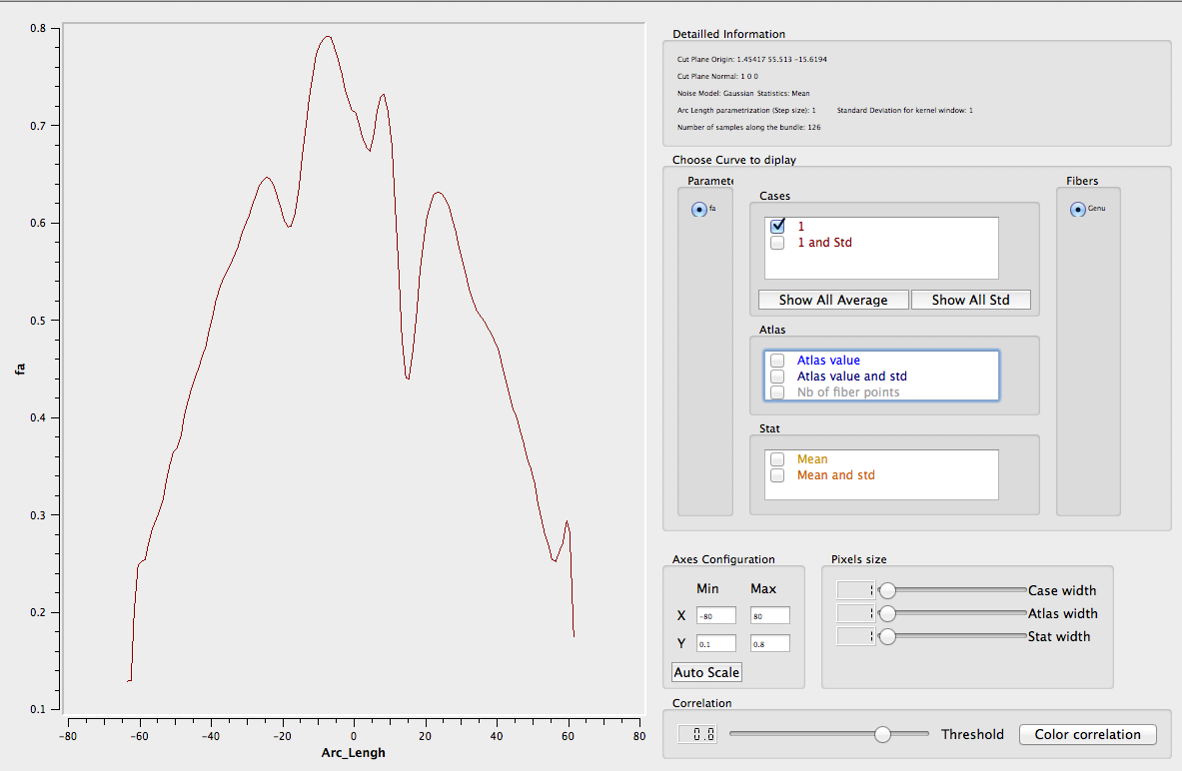
Step 4: QC with Plots
Select Genu stat
And “Plot”
Fiber Parametrization
Plot-Window

Slide 18
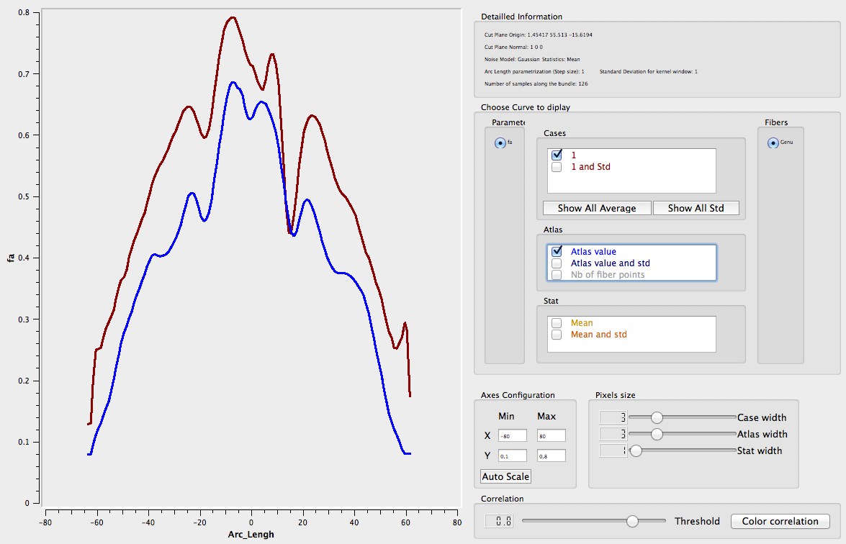
Step 4: QC with Plots II
Enable Atlas
  Profile should have similar shape

Slide 19
Stats in Summary CSV
Fiber profiles are all gathered in single CSV
Use Excel for plotting
Use your favorite stats tool for analysis
  FADDTS: Zhu et al
You can merge results back with parametrized fiber
  Last Step: MergeStatWithFiber

Slide 20
Example: Profiles in Excel

Slide 21
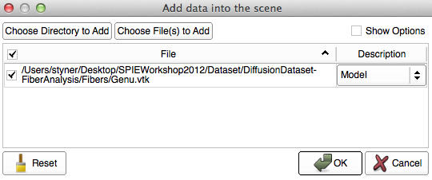
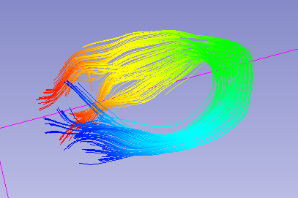
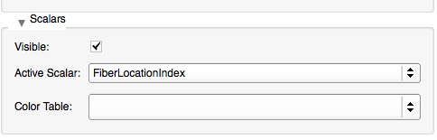
Taste of Visualization
Load parameterized genu fiber
  Add Data => Model
Enable scalars and use FiberLocationIndex

Slide 22
Example: Visualization of fiber tract statistics
Visualization in Slicer or ParaView
Add a model of brain surface for effect

Slide 23
Conclusions
Fiber profile analysis with Slicer
  DTI Atlas Fiber Analyzer
  Registration to atlas needed
Future: An easy-to-use stats tool

Slide 24
Acknowledgment
National Alliance for Medical Image Computing
NIH U54EB005149
UNC: Jean-Baptiste Berger, Clement Vachet
Utah: Guido Gerig, Sylvain Gouttard

