Slide 1
Integrating DICOM RT Import into Slicer 4
Csaba Pinter¹, Andras Lasso¹, Kevin Wang²
¹Laboratory for Percutaneous Surgery School of Computing, Queen’s University, Canada ²UHN Toronto, Canada

Slide 2
Background - SlicerRT
Common software platform for adaptive radiotherapy
Built upon existing open-source visualization and analysis tools
Funded by the SparKit project (CCO ACRU) http://www.assembla.com/spaces/sparkit
Address common needs of OCAIRO investigators
Support collaboration through sharing valuable algorithms and datasets, and address shortcomings of existing proprietary RT toolsets
Notes:
SlicerRT = Common software platform for adaptive radiotherapy, built upon existing open-source visualization and analysis tools to support collaboration through sharing valuable algorithms and datasets, and address shortcomings of existing proprietary RT toolsets
CCO ACRU = Cancer Care Ontario, Applied Cancer Research Unit

Slide 3
First step: DICOM RT import in Slicer4
RT Structure Set IOD
Import
Visualization (contours)
Edit (editor, transform)
RT Dose IOD
Dose grid
Import
Visualize (color coded image)

Slide 4
First step (cont.): DICOM RT import in Slicer4
RT Dose IOD
Isodose curve
Import
Compute
Visualize (isodose curves, points)
DVH
Import
Compute
Visualization (histogram)

Slide 5
Design – Fundamental question
Create new loadable module with GUI
Use Plastimatch CLI modules
Use DICOM module in Slicer
Extend CTK
Create hidden loadable module that acts as a plugin for the DICOM module
Use DCMTK containing DCMRT
Minor changes in CTK and the DICOM module

Slide 6
Create a new loadable module
User perspective
Different module for non-RT and data containing RT
More clicks
Design
Use Slicer’s DICOM Database
Libraries to use
DCMTK (including DCMRT)?
Plastimatch?
Notes:
- Creating something new always increases complexity and takes more workload

Slide 7
Use Plastimatch CLI modules
User perspective
Different module for non-RT and data containing RT
More clicks
Design
Use Slicer’s DICOM Database from CLI module?
Used library
DCMTK (including DCMRT)?

Slide 8
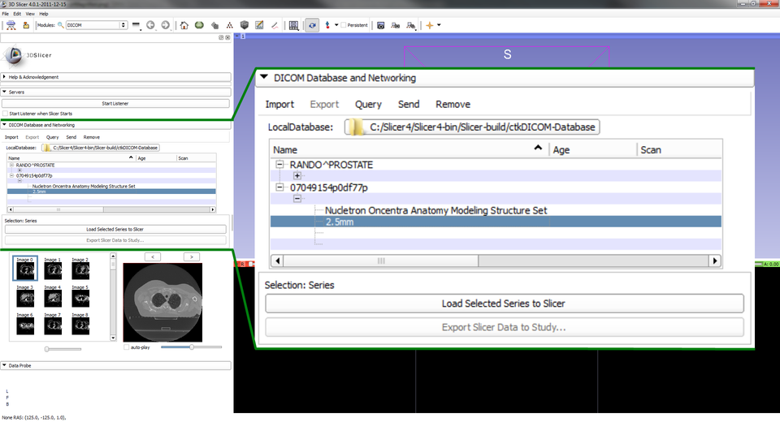
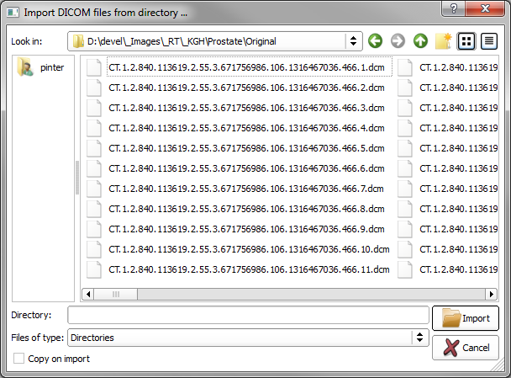
Extend Slicer’s DICOM module
User perspective
Existing module
Design
RT-specific code is added in CTK classes
Could grow uncontrollably
Used libraries
DCMTK - already used
Notes:
No extra clicks
Load one file instead of a directory may be necessary (minor GUI change in the DICOM module)

Slide 9
Create hidden loadable module as a plugin for the DICOM module
User perspective
Use the DICOM module in Slicer
Design
Use Slicer’s DICOM Database
Called by DICOM module when encountering RT
Improve DICOM tree to show RT entity names
Used library
DCMTK (including DCMRT)
Notes:
No extra clicks
Load one file instead of a directory may be necessary (minor GUI change in the DICOM module)

Slide 10
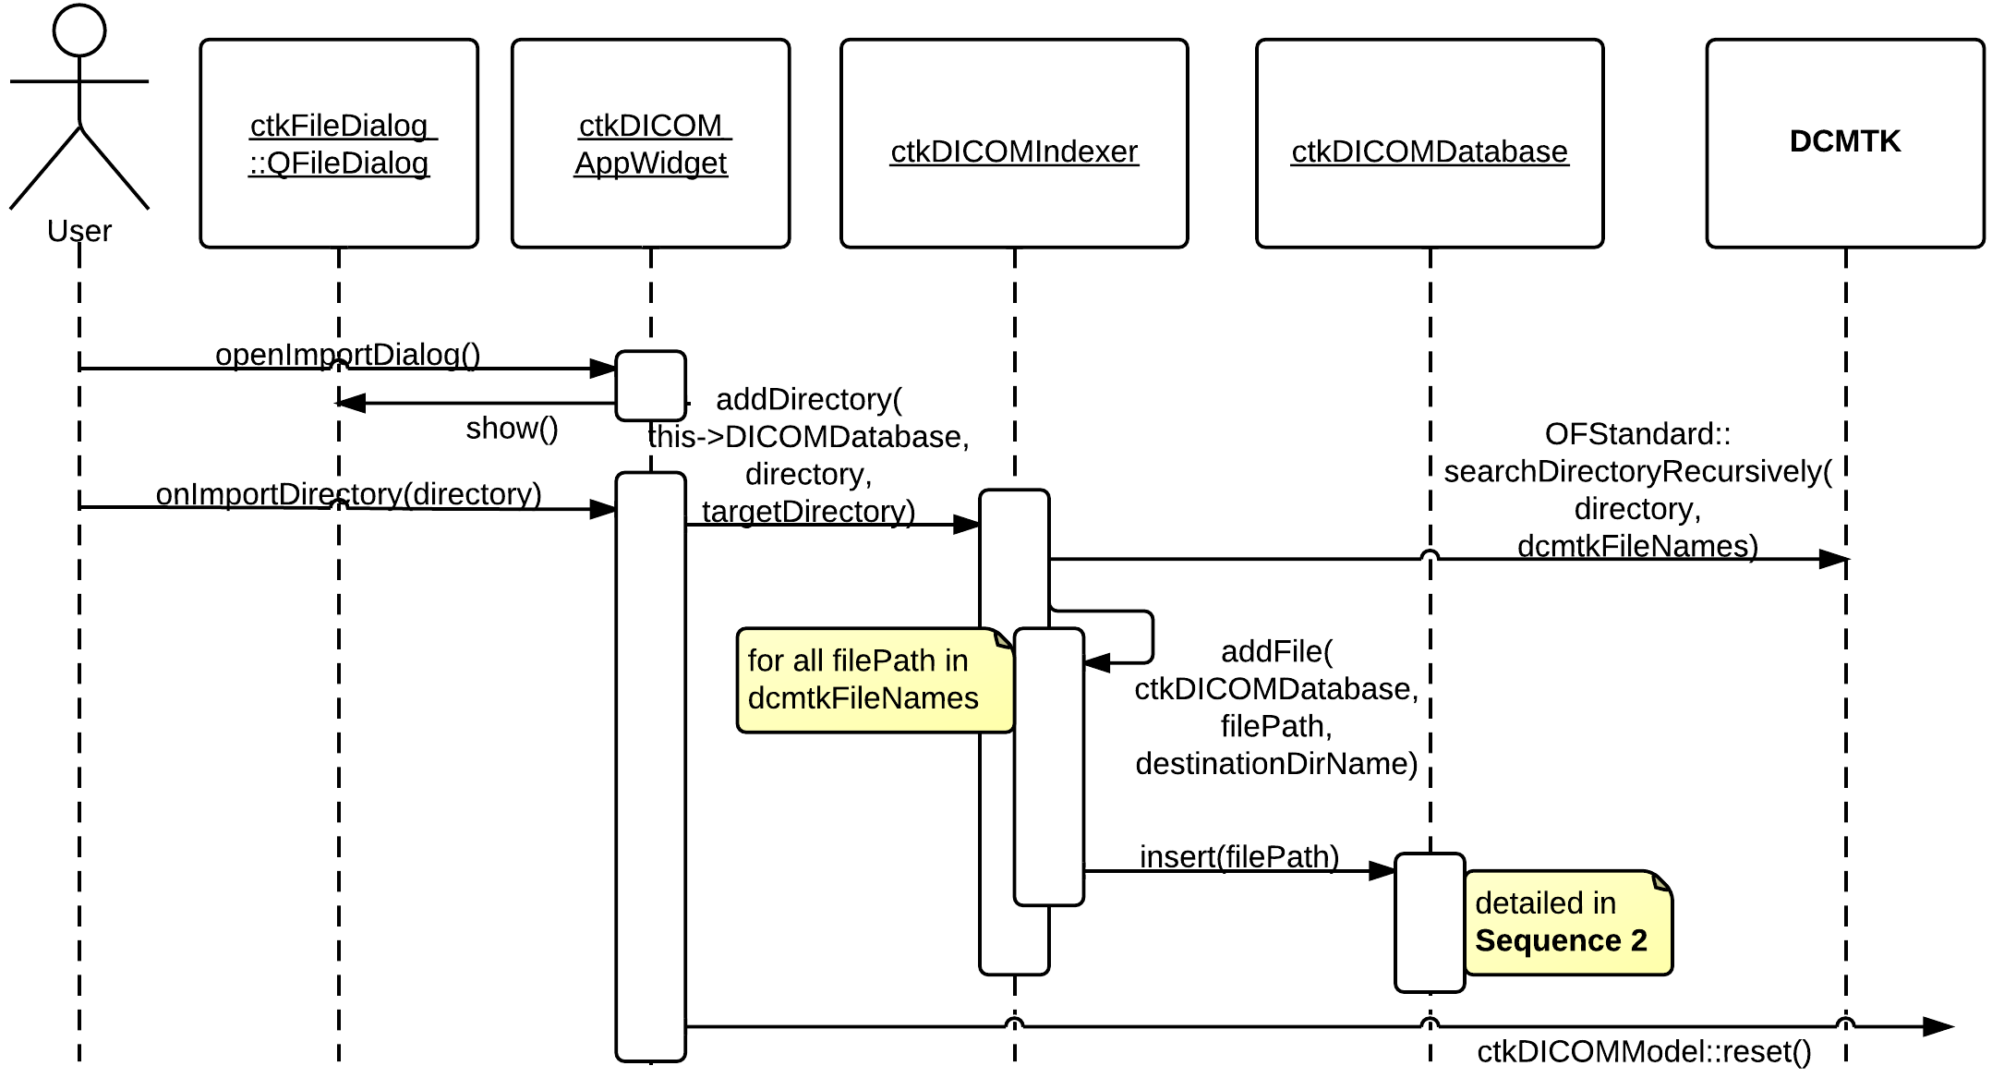
Slicer DICOM module – Sequence 1/3

Slide 11
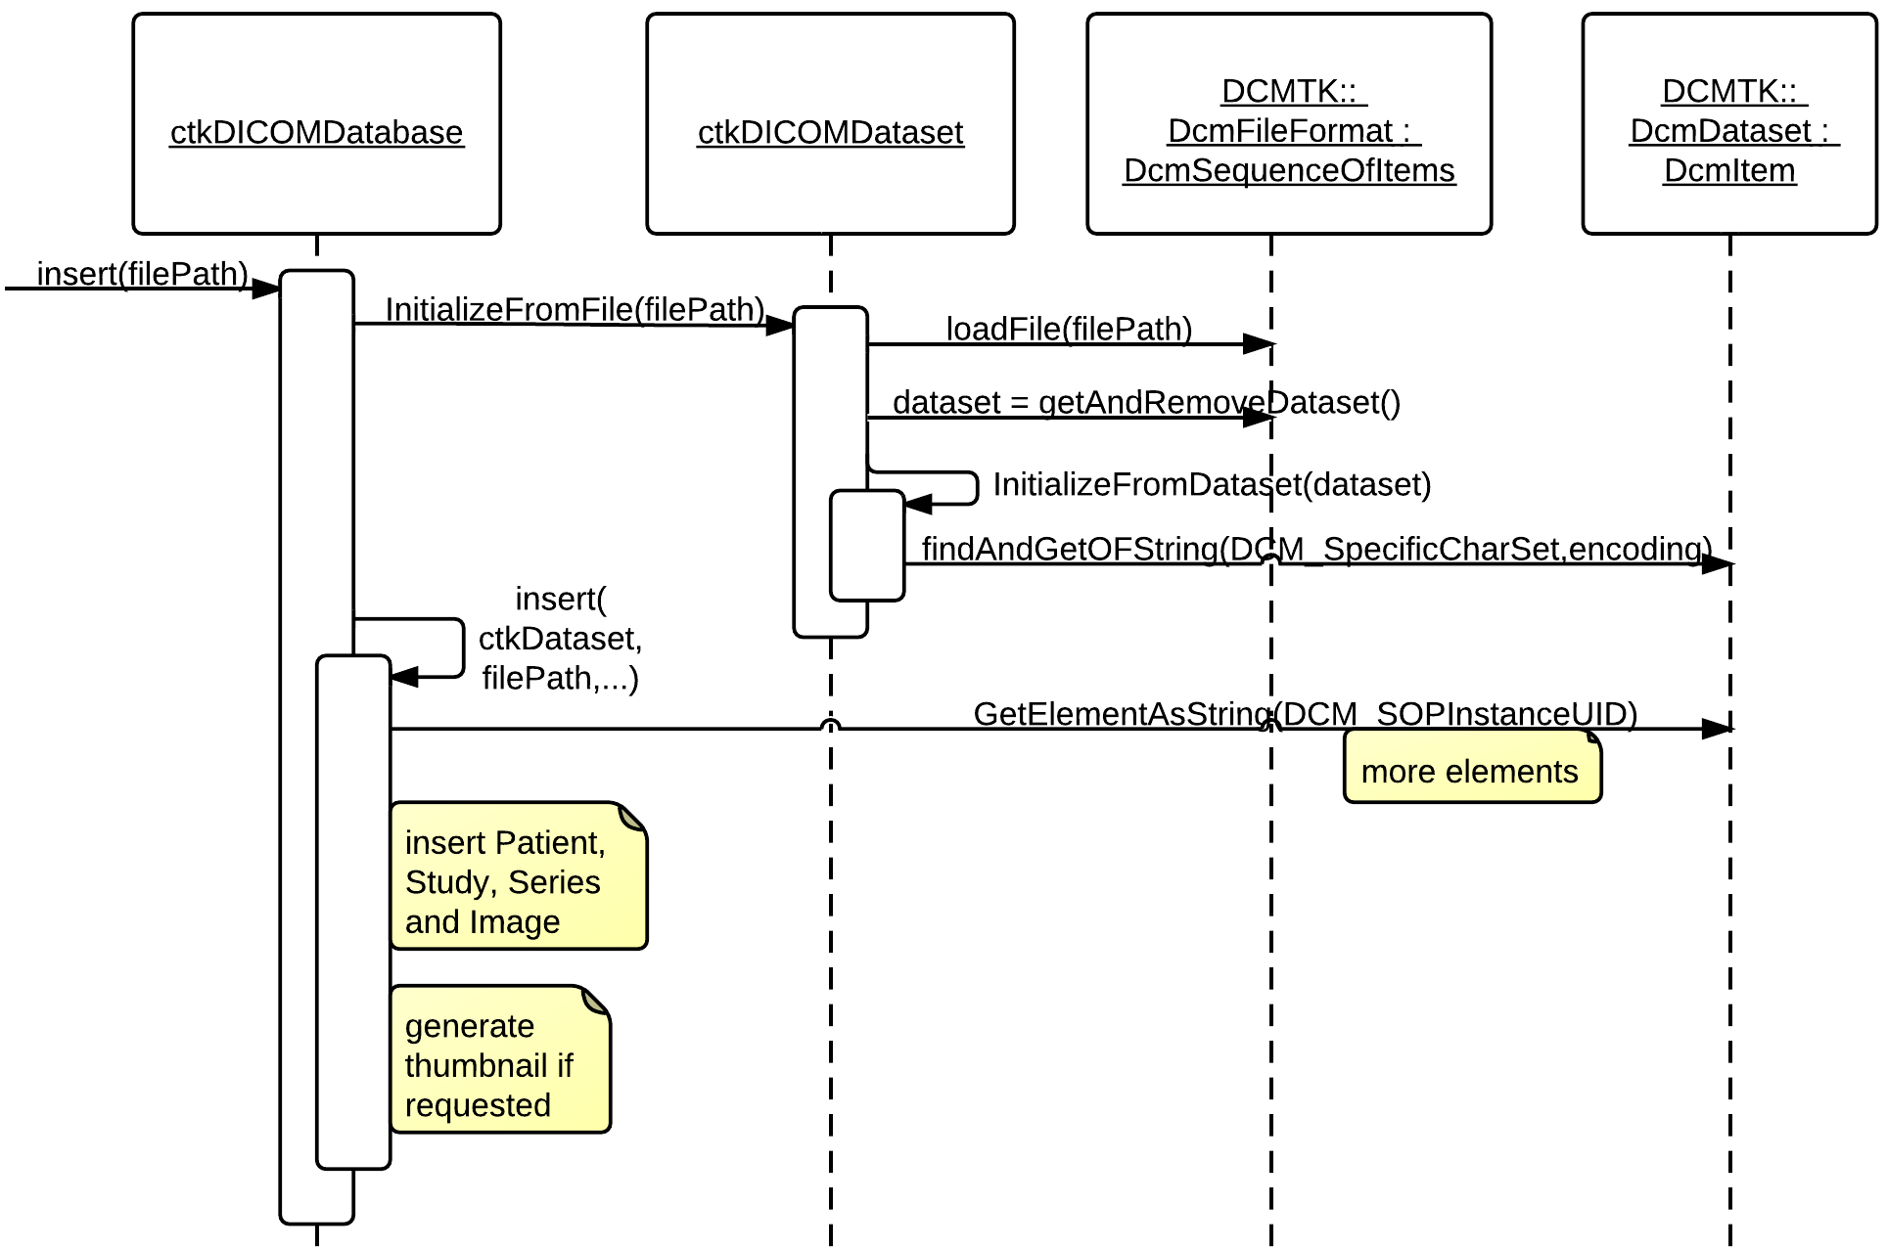
Slicer DICOM module – Sequence 2/3
Add RT Entities?
Notes:
Entity = Information Entity: that portion of information defined by a Composite IOD which is related to
one specific class of Real-World Object

Slide 12
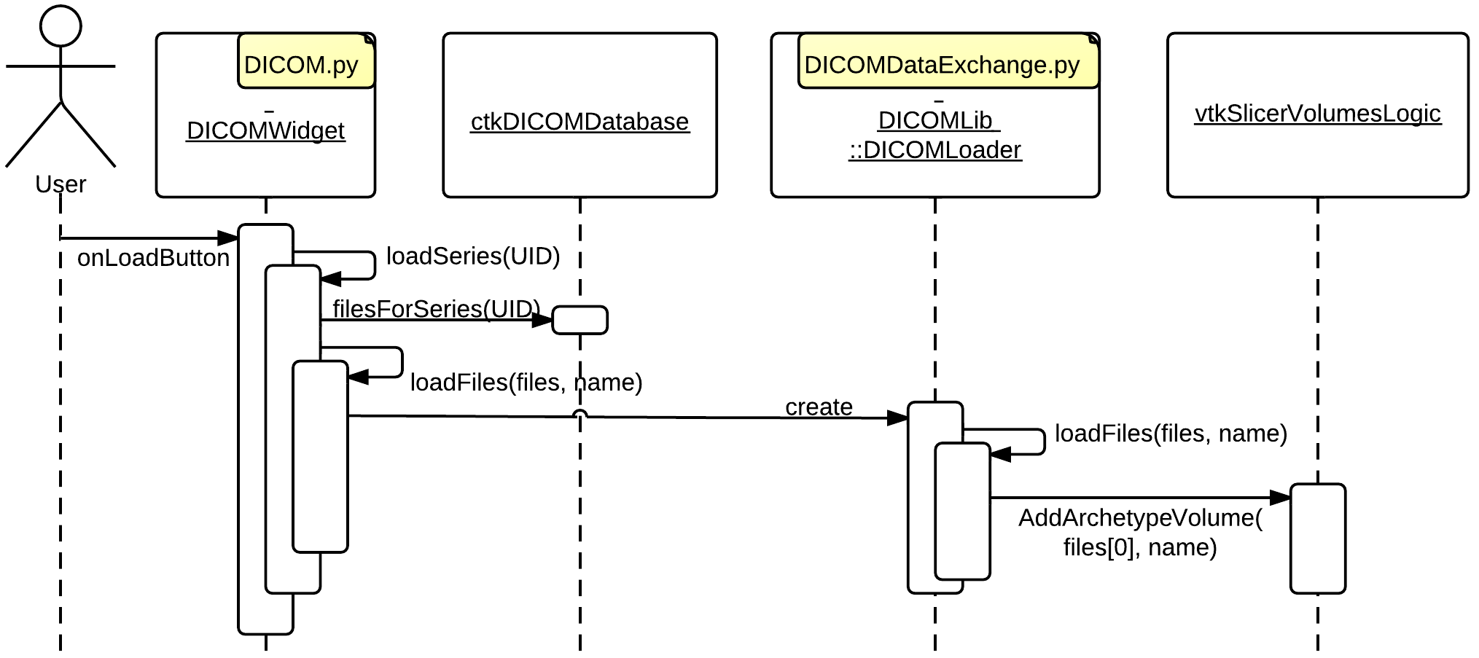
Slicer DICOM module – Sequence 3/3
Handle other types
Notes:
Other type = non-volume

Slide 13
Design - Data representation
RT Structure set
Option 1: Label map vtkMRMLVolumeNode
Option 2: Surface vtkMRMLModelNode
Option 3: Series of contours vtkMRMLAnnotationContourNode?
Option 4: Co-existing multiple representation Conversion is necessary among them
Notes:
Structure set representation might be optional with the possibility of conversion (slow + contour->surface/labelmap is very difficult)

Slide 14
Design - Data representation (cont.)
RT Dose
2D or 3D dose grids: vtkMRMLVolumeNode
Groups of named or unnamed dose points: vtkMRMLAnnotationFiducialNode?
Dose-volume histograms (DVH) New generic chart MRML node?
Isodose curves
vtkMRMLModelNode
vtkMRMLAnnotationContourNode?

Slide 15
Discussion
How to add handling of the new entities in CTK?
Notifyable loadable module?
How to represent the data in Slicer? (which MRML nodes to use)
Conversion issues between the representations
Contour → Volume/Surface
Manual or automatic
Are RT specific modules expanded during import or just on load in the treeview?

Slide 16
Thank you!

