Slide 1
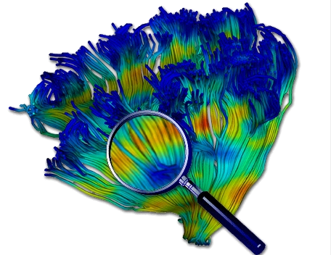
Diffusion Tensor Processing and Visualization
Guido Gerig
University of Utah
NAMIC: National Alliance for Medical Image Computing

Slide 2
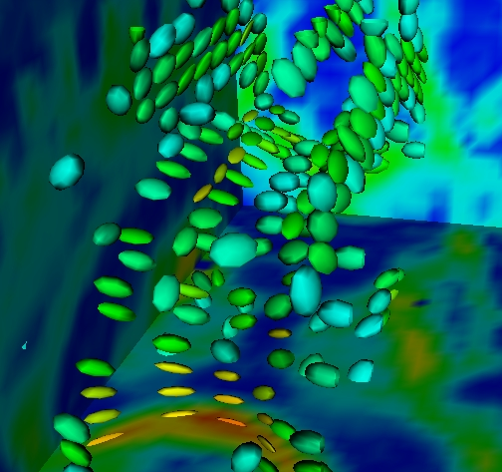
Acknowledgments
Contributors:
C-F. Westin
A. Alexander
G. Kindlmann
L. O’Donnell
C. Goodlett
J. Fallon
R. Whitaker
R. McKinstry
National Alliance for Medical Image Computing (NIH U54EB005149)

Slide 3
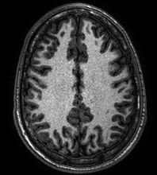
Diffusion Tensor Imaging (DT MRI) reveals White Matter Structure
Gray matter
White matter
DT MRI
Courtesy of Susumu Mori, JHU

Slide 4
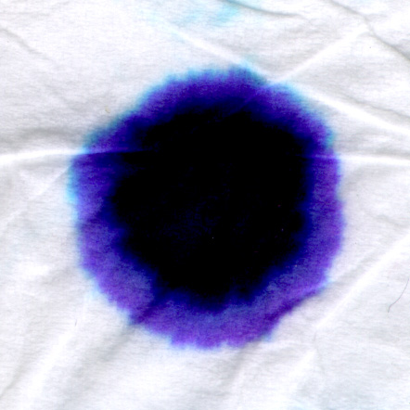
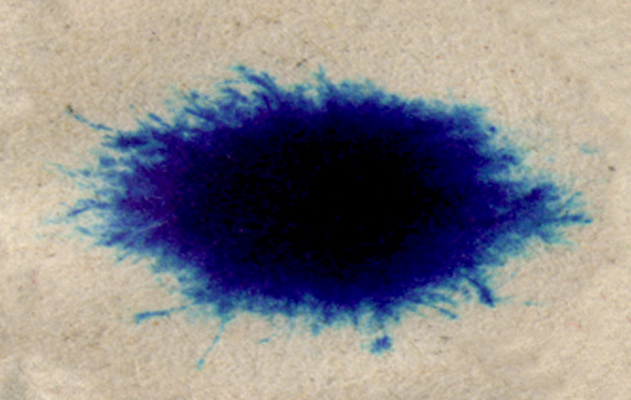
Diffusion in Biological Tissue
Motion of water through tissue
Sometimes faster in some directions than others
Kleenex
newspaper
Anisotropy: diffusion rate depends on direction
isotropic
anisotropic
G. Kindlmann
Notes:
A basic characteristic of biological tissue is that water molecules move through and within it,
in a process called diffusion
Some materials have the interesting property that diffusion happens faster in some directions that others.
I’m demonstrating that here with some scans of inkblots I made on two kinds of materials, kleenex, and newspaper.
In kleenex- the ink spreads at same rate in all directions,
But newspaper has a preferred direction where the ink moveks faster.
The name for this phenemon is “anisottropy”.
The wider the variation in diffusion rate as a function of direction, the more “anisotropic” a material is,
This one-dimensional family of ellipses represents some of the different levels of anisotropy which can occur in 2D

Slide 5
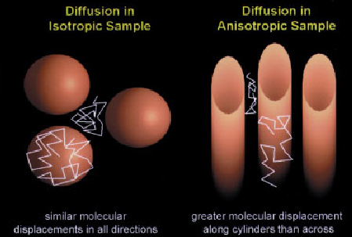
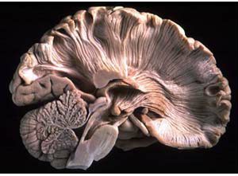
Diffusion in White Matter
Diffusion of water molecules
Reflects the underlying structure of the tissues
Faster diffusion along fibers than perpendicular to them
Water diffusion anisotropy used to track fibers, estimate white matter integrity
Tensor model [Basser]
Determine the whole tensor to estimate diffusion anisotropy
From Beaulieu[02]

Slide 6
The Physics of Diffusion
Density of substance changes (evolves) over time according to a differential equation (PDE)
Change in density
Derivatives (gradients) in space
Diffusion – matrix, tensor
(2x2 or 3x3)

Slide 7
Solutions of the Diffusion Equation
Simple assumptions
Small dot of a substance (point)
D constant everywhere in space
Solution is a multivariate Gaussian
Normal distribution
“D” plays the role of the covariance matrix
This relationship is not a coincidence
Probabilistic models of diffusion (random walk)

Slide 8
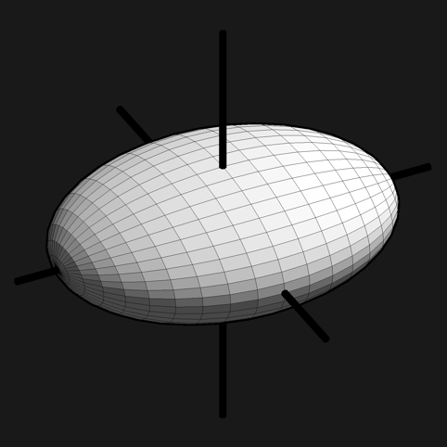
Eigen Directions and Values (Principle Directions)
v₃
v₁
λ₃
λ₁
λ₁
λ₂
λ₂
v₁
v₂
v₂

Slide 9
Tensors From Diffusion-Weighted Images
Big assumption
At the scale of DW-MRI measurements
Diffusion of water in tissue is approximated by Gaussian
Solution to heat equation with constant diffusion tensor
Stejskal-Tanner equation
Relationship between the DW images and tensor D
Physical constants
Strength of gradient
Duration of gradient pulse
Read-out time
k^{th} DW Image
Base image
Gradient direction

Slide 10
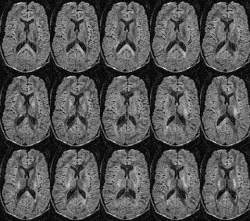
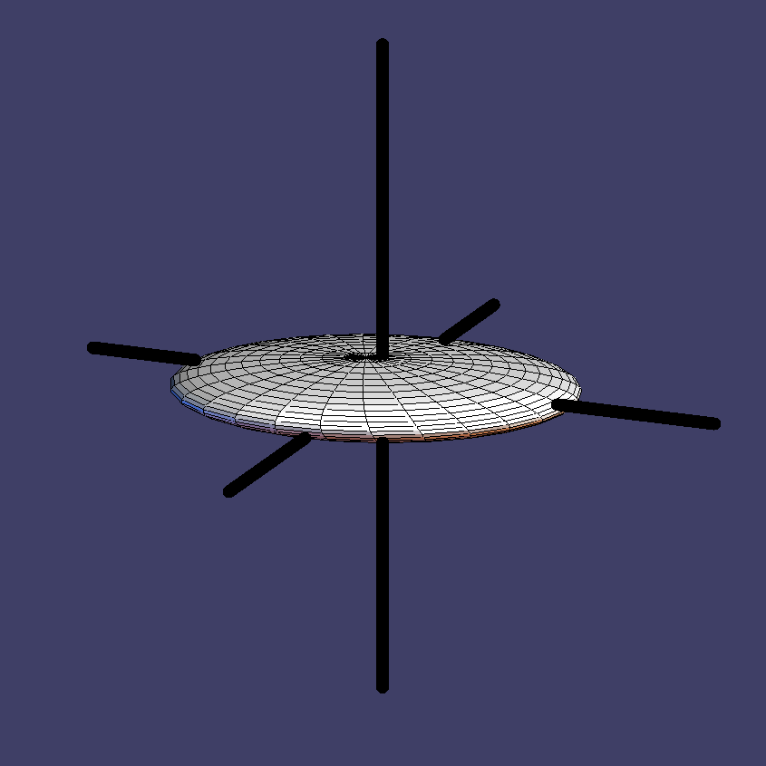
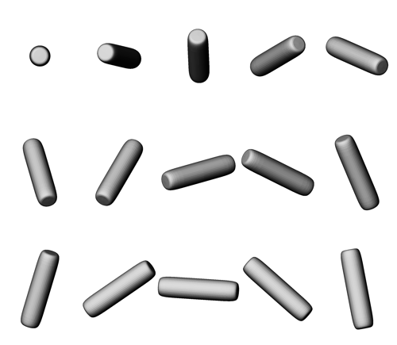
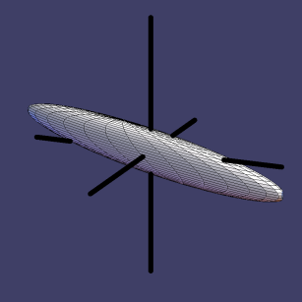
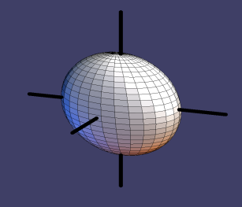
DWI summary: Model
Single Tensor Model (Basser 1994)
A_{i}
Tensor
estimation
Dxx
Dxy
Dxz
D
A₀
Dyy
Dyz
Dzz
g_{i}

Slide 11
Shape Measures on Tensors
Represent or visualization shape
Quanitfy meaningful aspect of shape
Shape vs size
Different sizes/orientations
Different shapes

Slide 12
Measuring the “Size” of a Tensor
Length – (λ₁ + λ₂ + λ₃)/3
(λ₁² + λ₂² + λ₃²)^{1/2}
Area – (λ₁ λ₂ + λ₁ λ₃ + λ₂ λ₃)
Volume – (λ₁ λ₂ λ₃)
Sometimes used.
Also called:
“Root sum of squares”
“Diffusion norm”
“Frobenius norm”
Generally used.
Also called:
“Mean diffusivity” <MD>
“Trace”

Slide 13
ADC versus Mean Diffusivity
Apparent diffusion coefficient (ADC) measures diffusivity in a specific direction.
Mean diffusivity (<MD>) is the trace of the diffusion tensor.
Terms often not properly used, papers often cite ADC but actually mean <MD>
b0 g1 g2 g3 g4 g5 g6 FA MD
ADC in gradient directions
Trace

Slide 14
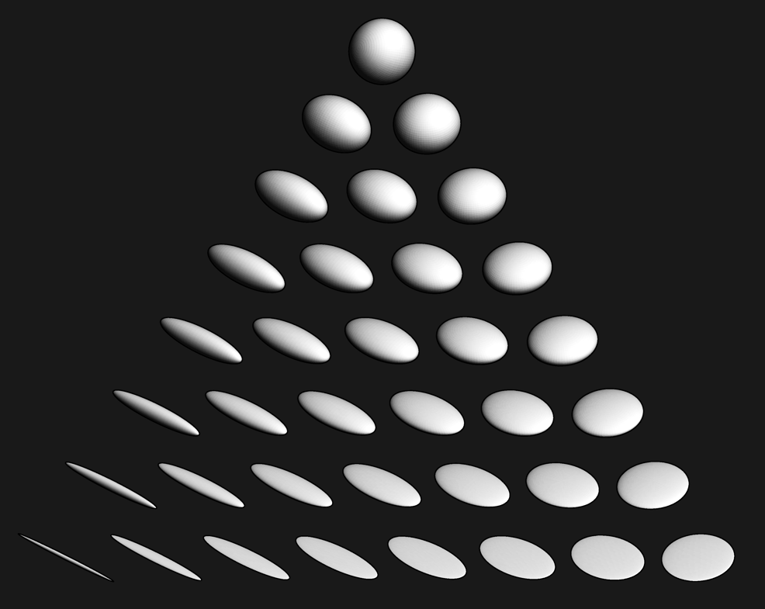
Reducing Shape to One Number Fractional Anisotropy
Properties:
Normalized variance of eigenvalues
Difference from sphere
Invariant to size
FA does not uniquely characterize shape
FA increasing

Slide 15
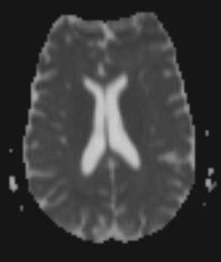
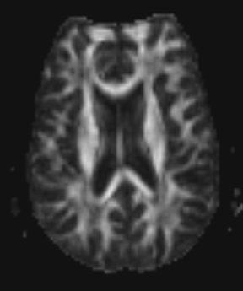
Tensor size (MD) and shape (FA)
Mean diffusivity (MD)
Fractional anisotropy (FA)
Highly
directional diffusion
White
matter
Cerebrospinal
fluid
Isotropic
diffusion
Low
High
0
1

Slide 16
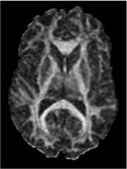
FA as an Indicator for White Matter
Visualization – ignore tissue that is not WM
Registration – Align WM bundles
Tractography – terminate tracts as they exit WM
Analysis
Axon density/degeneration/integrity
Myelin
Big question
What physiological/anatomical property does FA measure?

Slide 17
Visualizing Tensors: Direction and Shape
Color mapping
Glyphs

Slide 18
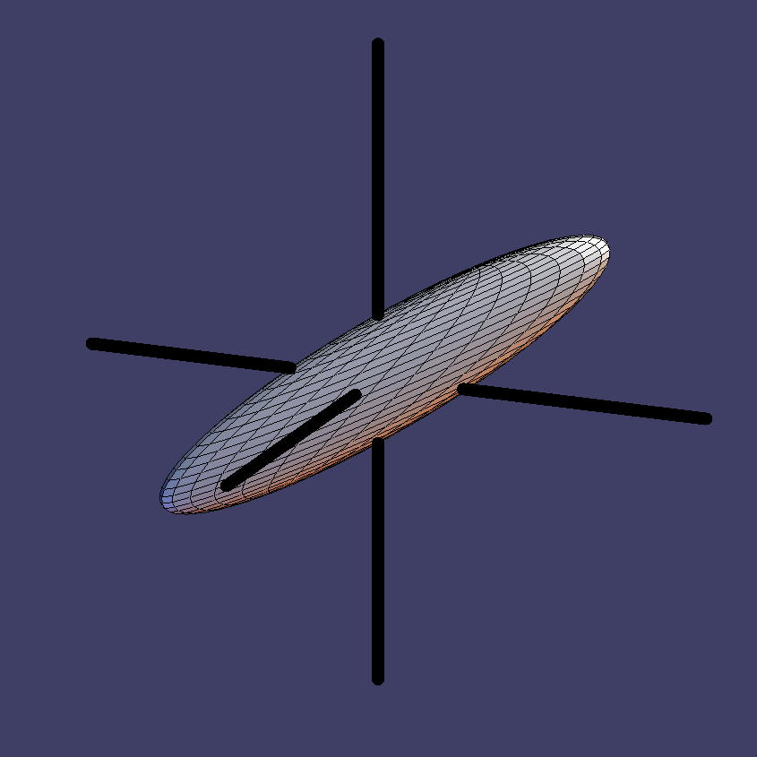
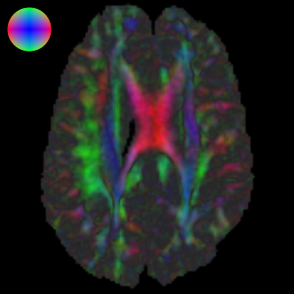
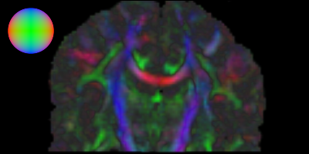
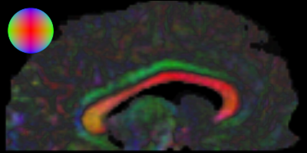
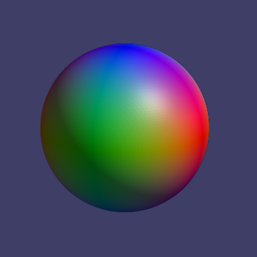
Coloring by Principal Diffusion Direction
Principal eigenvector, linear anisotropy determine color
e1
Coronal
Axial
Sagittal
R=| e₁.x |
G=| e₁.y |
B=| e₁.z |
C. Pierpaoli, 1997
Slide G. Kindlmann
Notes:
Okay, some previous work on this specific problem of diffusion tensor visualizatoin.
There has been a lot of work in the medical community in how to look at SLICES of tensor data,
One popular way is based on simplifiying the whole tensor down to a single vector, specifically,
By looking only at the tensor’s principal eigenvector.
You use that direction as a lookup into some spherical colormap, like this one.
There’s a second step, which is to darken or desaturate the color where the anistoropy is low,
and then you can pretty clearly see the various structures inside the white matter.

Slide 19
Issues With Coloring by Direction
Set transparency according to FA (highlight-tracts)
Coordinate system dependent
Primary colors dominate
Perception: saturated colors tend to look more intense
Which direction is “cyan”?
Coloring is not unique

Slide 20
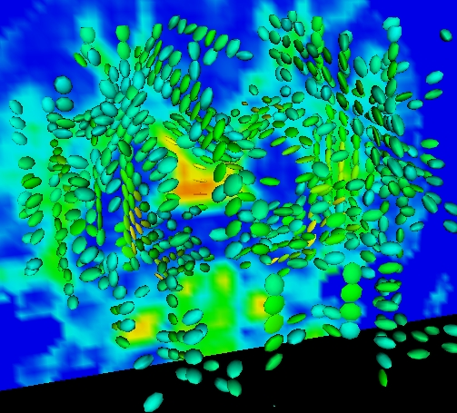
Visualization with Glyphs
Density and placement based on FA or detected features
Place ellipsoids on regular grid

Slide 21
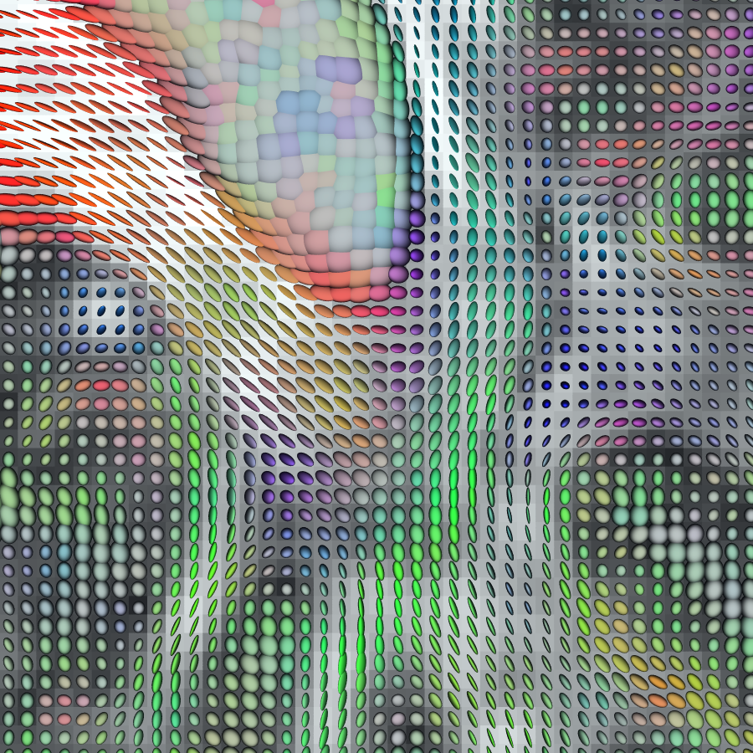
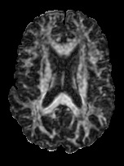
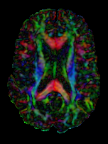
Backdrop: FA
Color: RGB(e₁)
G. Kindlmann
Notes:
Combining these, we’re using ellipsoidal glyphs to indicate the tensors in this one small region around the splenium of the corpus callosum.

Slide 22
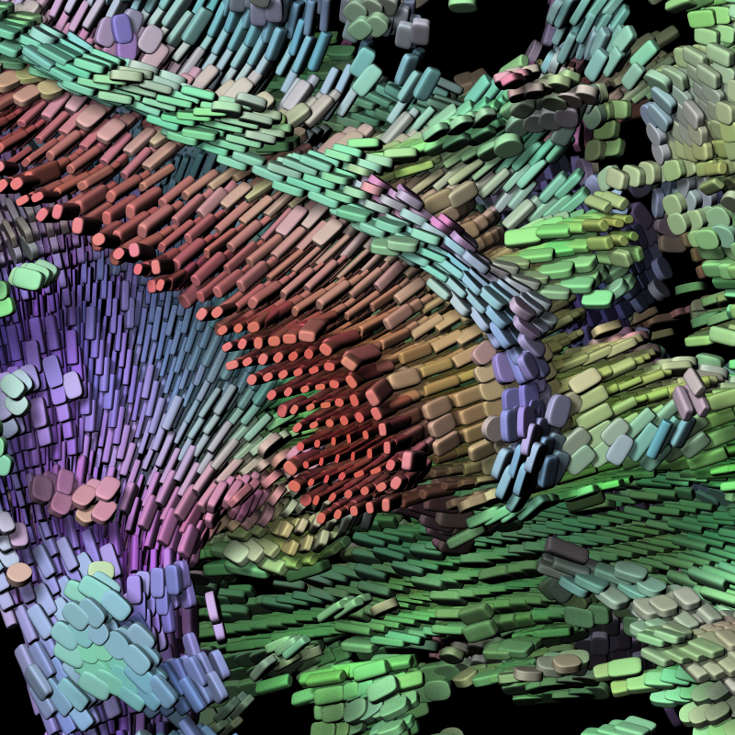

Slide 23
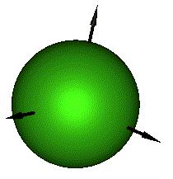
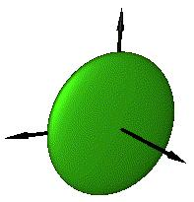
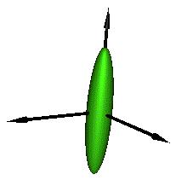
Prolate vs. oblate: Why do we care?
Free diffusion (ventricles) shown as spheres.
Intersecting tracts can’t be properly modeled by a single tensor: Simplified to disks in rank-1 tensors.
Large tracts can be locally modeled by single tensors.
e₁
λ₁≈ λ₂≈ λ₃ - Isotropic
Prevalent in CSF and gray matter regions of the brain.
e₂
e₃
e₁
λ₁≈ λ₂>> λ₃ - Oblate
Arise in white matter regions.
e₂
e₃
e₁
λ₁>> λ₂≈ λ₃ - Prolate
Prevalent in white matter regions.
e₂
e₃

Slide 24
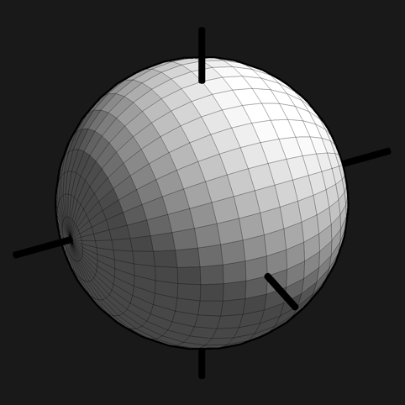
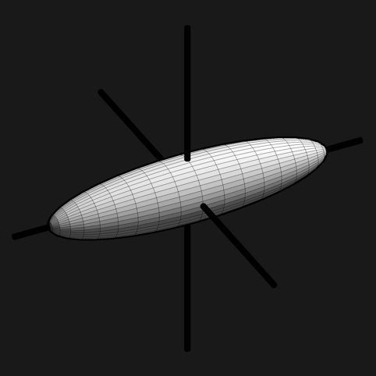
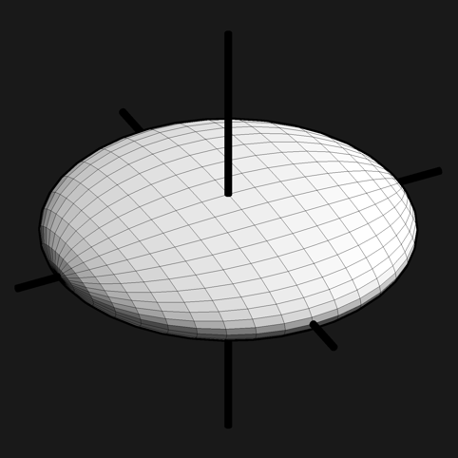
Shape Other Than Size
λ₃
Barycentric
shape space
λ₂
λ₁
l₁ >= l₂ >= l₃
(C_{S},C_{L},C_{P})
Westin, 1997
G. Kindlmann

Slide 25
Shape Characterization: Westin
Westin et al., MICCAI’99

Slide 26
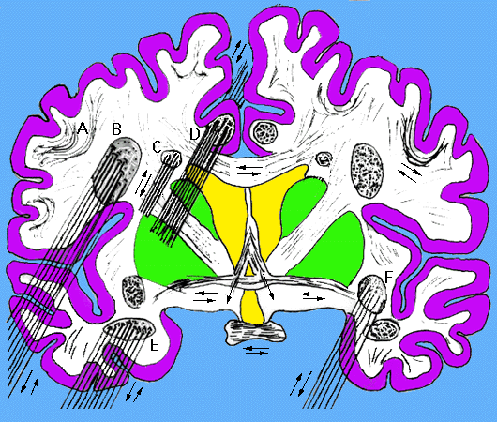
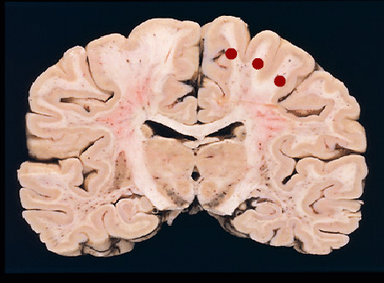
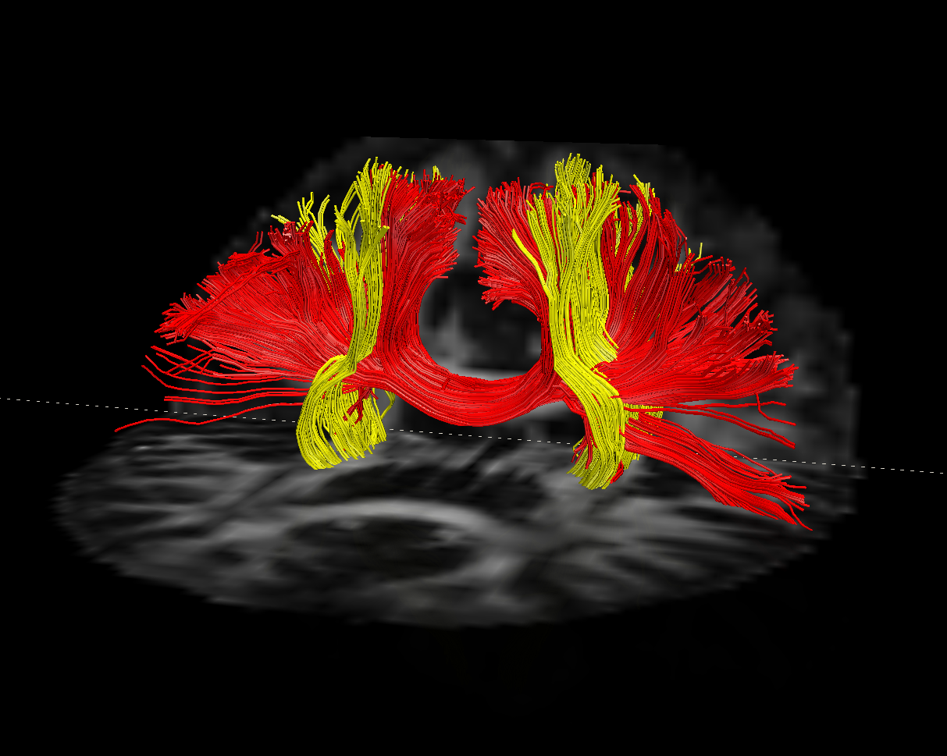
Dream: Connectivity?
Source: Duke NeuroAnatomy Web Resources (Ch. Hulette)
Forebrain Fiber Bundles: General idea of where various fiber bundles are and regions they interconnnect or project to.
Tractography: Coronal view (Dell’Acqua et al. NeuroImage ‘10

Slide 27
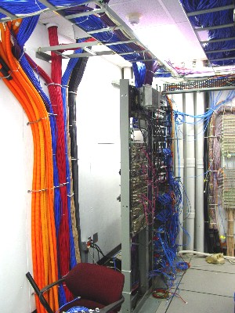
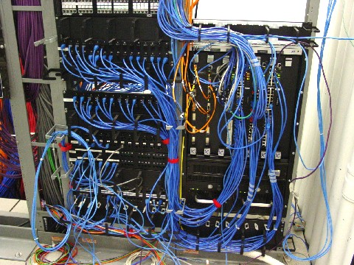
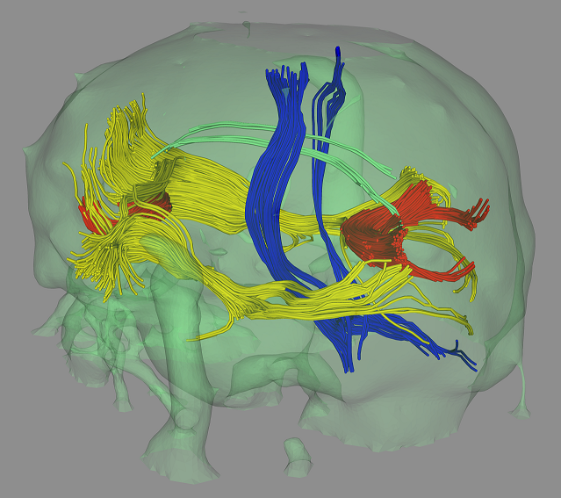
Networking and Brain Connectivity
Major Fiber Tracts extracted from DT MRI
UNC Computer Science: Network wire cabinets

Slide 28
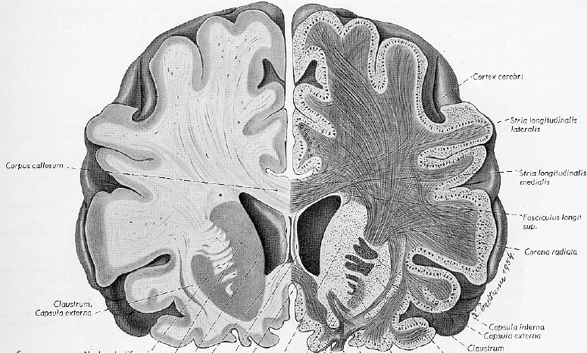
White Matter Tracts
In tractography fibers are traced, with the aim to visualize white matter tracts.
The word “tractography” is not related to “tracking”, but to “tract”.
White matter tract, white matter fasciculus
Courtesy Carl-Fredrik Westin, MICCAI 2008 workshop

Slide 29
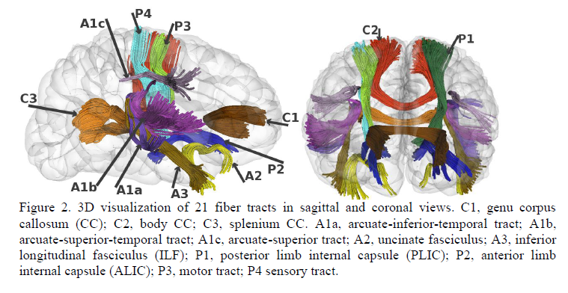
Fiber Bundles via Tractography
Geng, Gilmore, Gerig et al., submitted

Slide 30
From Tensors to Connectivity?
Study diffusivity in 3D tensor field
Propagate principal diffusion direction originating at user-selected seed point
Display paths as streamlines
Measurement of FA and MD along path

Slide 31
DTI Tractography
Seed point(s)
Move marker in discrete steps and find next direction
Direction of principle eigen value

Slide 32
Going Beyond Voxels: Tractography
Method for visualization/analysis
Integrate vector field associated with grid of principle directions
Requires
Seed point(s)
Stopping criteria
FA too low
Directions not aligned (curvature too high)
Neighborhood coherence
Leave region of interest/volume
Many methods have been published during the past decade (Basser, Mori, Westin, Vermuri, Kindlmann, Lenglet, etc.)

Slide 33
White Matter Fiber Tract Atlases
Catani et al., Occipito-temporal connections in the human brain, Brain 2003

Slide 34
The Problem with Tractography How Can It Work?
Integrals of uncertain quantities are prone to error
Problem can be aggravated by nonlinearities
Related problems
Open loop in controls (tracking)
Dead reckoning in robotics
Wrong turn
Nonlinear: bad information about where to go

Slide 35
Alternative methods for tractography
Tracking in vector-field of largest eigenvector
Tracking in tensor field
Probabilistic tractography
Optimal path analysis
Fiber tract by volumetric diffusion
….
Variety of methods developed by NAMIC developers
Georgia Tech: Opt. Path between source & target

Slide 36
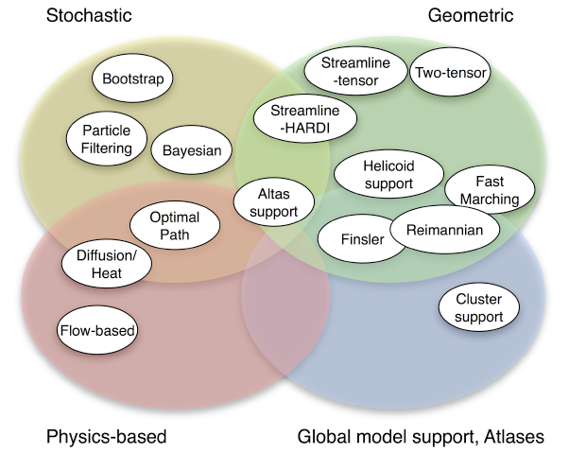
Diffusion MRI Tractography
Courtesy Carl-Fredrik Westin, MICCAI 2008 workshop

Slide 37
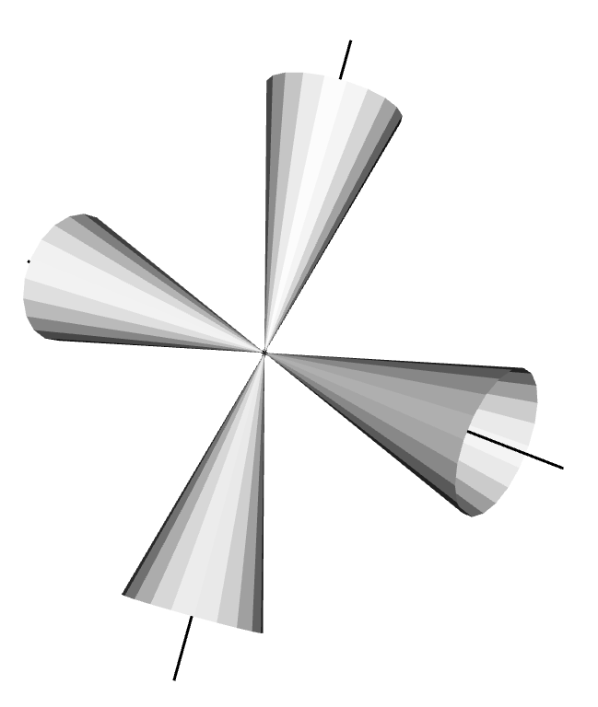
Tractography Incorporating Uncertainty
Courtesy of Bruce Pike, MNI

Slide 38
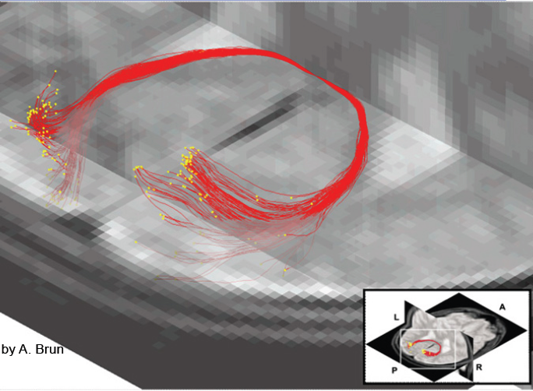
Stochastic Tractography
Lazar, Alexander, White Matter Tractography using Random Vector (RAVE) Perturbation, ISMRM 2002
D. Tuch, Diffusion MRI of complex tissue structure, Ph.D. dissertation, Harvard-MIT, 2002
Brun, Westin, Regularized Stochastic White Matter Tractography Using Diffusion Tensor MRI: Monte Carlo, Sequential Importance Sampling and Resampling. MICCAI 2002.
Zhang, Hancock, Goodlett and Gerig, Probabilistic White Matter Fiber Tracking using, Particle Filtering and von Mises-Fisher Sampling, Med Image Anal. 2009 Feb;13(1):5-18
Courtesy Carl-Fredrik Westin, MICCAI 2008 workshop

Slide 39
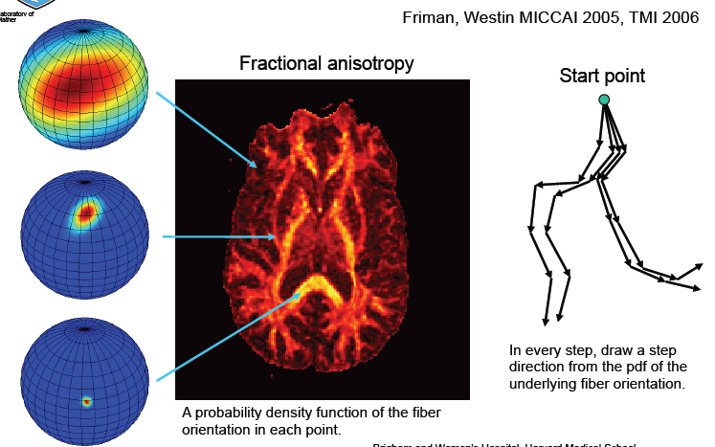
Stochastic Tractography
Courtesy Carl-Fredrik Westin, MICCAI 2008 workshop

Slide 40
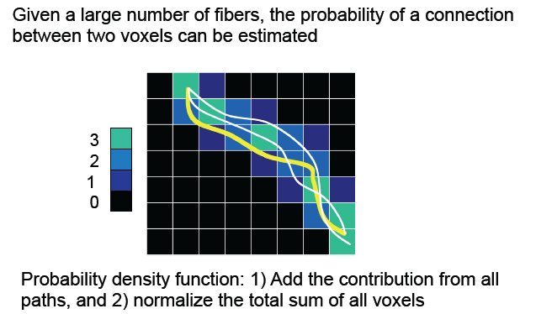
Probability of Connection
Courtesy Carl-Fredrik Westin, MICCAI 2008 workshop

Slide 41
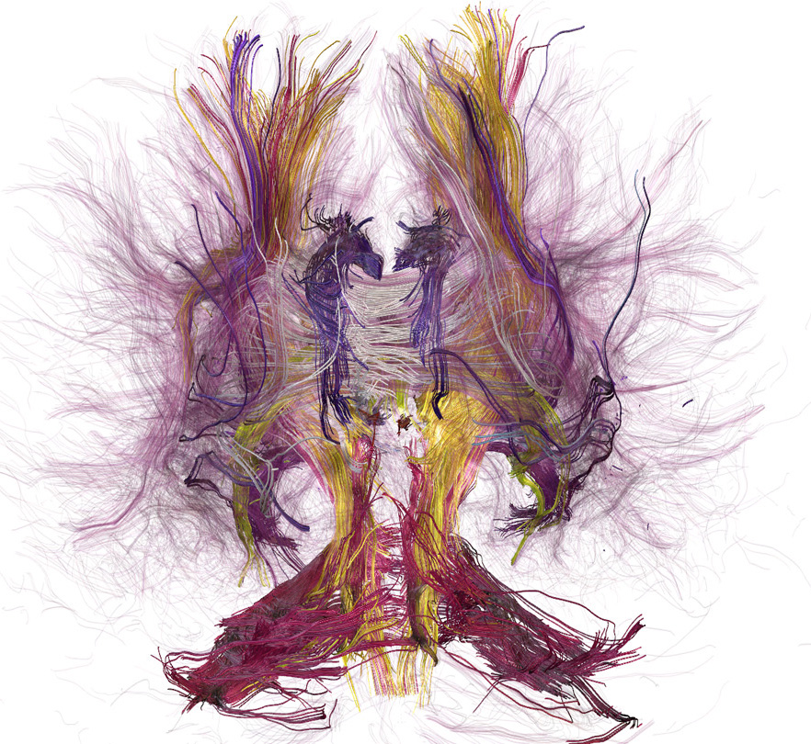
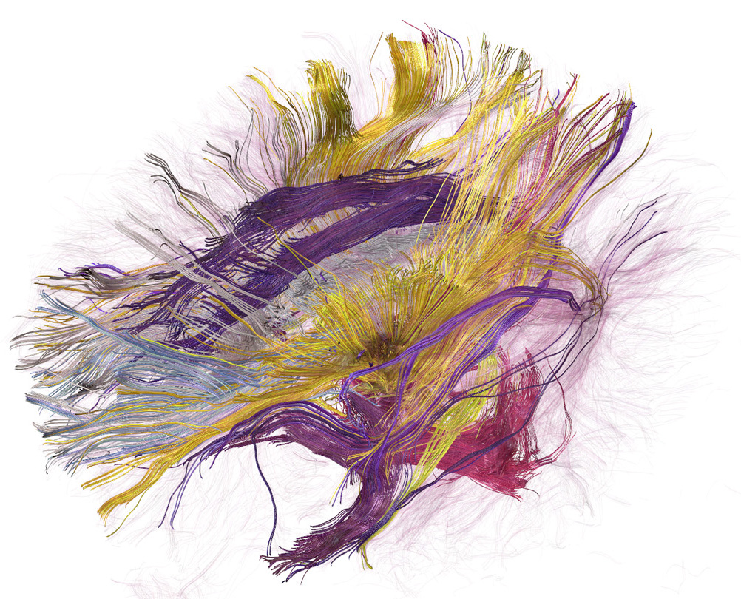
Tractography
J. Fallon

Slide 42
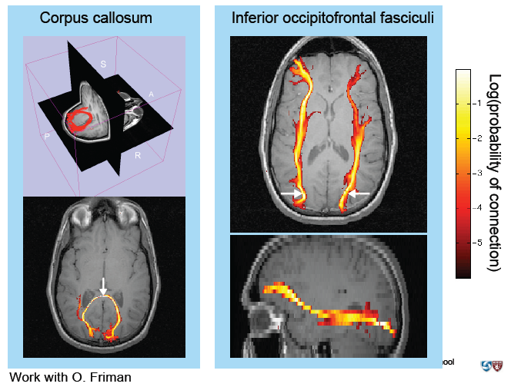
Probability of Connection
Courtesy Carl-Fredrik Westin, MICCAI 2008 workshop

Slide 43
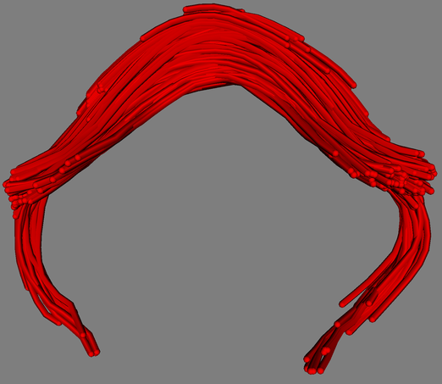
Modeling of fiber tracts
Origin (anatomical landmark)

Slide 44
Example Uncinate Fasciculus
Corouge et al. Fiber tract-oriented statistics for quantitative diffusion tensor MRI analysis. Medical Image Analysis 2006.
FiberViewer software - http://www.ia.unc.edu/dev/

Slide 45
Quantitative Tractography
Tract ROIs
FA along tracts
Tensors statisics along spines
FA motor tract
MD motor tract
- Tractography for ROI definition
- Tensor-math. for statistics along tracts

Slide 46
Group testing of FA along motor tracts (Downs Syndrome vs. HC)
Center: Left and right motor tracts, color-coded with FA (0 to 1 in blue to red)
Left and right: FA as function of arc- length for HC (red) and DS (blue)
p < 0.0017
DS .47 < HC .52
p < 0.03
DS .42 < HC .46

Slide 47
Summary: What do we measure?
DWI measures local diffusivity pattern.
Local diffusivity pattern is shaped by tissue type, axon structuring, myelination etc.
Curves and streamlines from tractography are NOT AXONS but possible paths in vector/tensor field.
“Fiber counting” scientifically questionable, # is method specific.
DWI DOESN’T MEASURE AXONS or GLOBAL CONNECTIVITY !

Slide 48
Limitation of Tractograpy: Infer global structures from local estimates
We measure diffusion structure of local elements (2x2x2mm3) and make inference/guess about road network → axonal bundles.
Voxel size: cubic mm
Axon diameter: micrometers
Courtesy Carl-Fredrik Westin, MICCAI 2008 workshop

Slide 49
Ermerging New Techniques: HARDI, DSI, Q-Ball
Wendell JS Krieg, 1963
DSI, 2008
VJ Wedeen, R Wang, T Benner
MGH-Martinos Center,Harvard Medical School

Slide 50
Simplification and assumption
Orientational Diffusion Fct
Diffusion ellipsoid
Courtesy of Susumu Mori, JHU

Slide 51
Limitations of the Diffusion Tensor Model
Courtesy B. Vemuri, MICCAI 2008 workshop

Slide 52
DTI with 12 directions & 2 averages Crossing Fibers Dropout on FA
Courtesy R. McKinstry

Slide 53
Motivation: Why higher order?
Courtesy Baba Vemuri, MICCAI 2008 workshop

Slide 54
Orientation Distribution Function ODF
Courtesy Rachid Deriche, MICCAI 2008 workshop

Slide 55
Two Tensor Model (C-F Westin, S Peled, G Kindlmann)
Courtesy Carl-Fredrik Westin, MICCAI 2008 workshop

Slide 56
Centrum Semiovale corpus callosum (red) & corticospinal tract (blue)
DTI DSI
Wedeen / Wang /AGS / MGH - HST

Slide 57
DTI
MGH / DT

Slide 58
QBI
MGH / DT

Slide 59
Spherical Deconvolution Tractography
60 DW directions, Cardiac Gated, Scan time = 20 min, b = 3000 s/mm²
Dell’Acqua et al. NeuroImage 2010

Slide 60
Spherical Deconvolution Tractography
DTI Tractography
Spherical Deconvolution Tractography
Close to standard DTI protocols
60 DW dir, Cardiac Gated, b=1500 s/mm²
Dell’Acqua et al. NeuroImage 2010

Slide 61
Q-Ball DTI
Delineation of Motor Tract
in Adult Brain Tumor
Patient
J.I. Berman, Diffusion MR Tractography as a Tool for Surgical Planning.
Mag. Res. Imag. Clinics of North America. 2009

Slide 62
Brain Tumor Case
Tractography based on higher-order tensor models and modeling of crossings and disperging bundles is vital for neurosurgical applications.
Courtesy Carl-Fredrik Westin, MICCAI 2008 workshop

Slide 63
Acknowledgments
Contributors:
C-F. Westin
A. Alexander
G. Kindlmann
L. O’Donnell
C. Goodlett
J. Fallon
R. Whitaker
R. McKinstry
National Alliance for Medical Image Computing (NIH U54EB005149)

