Slide 1
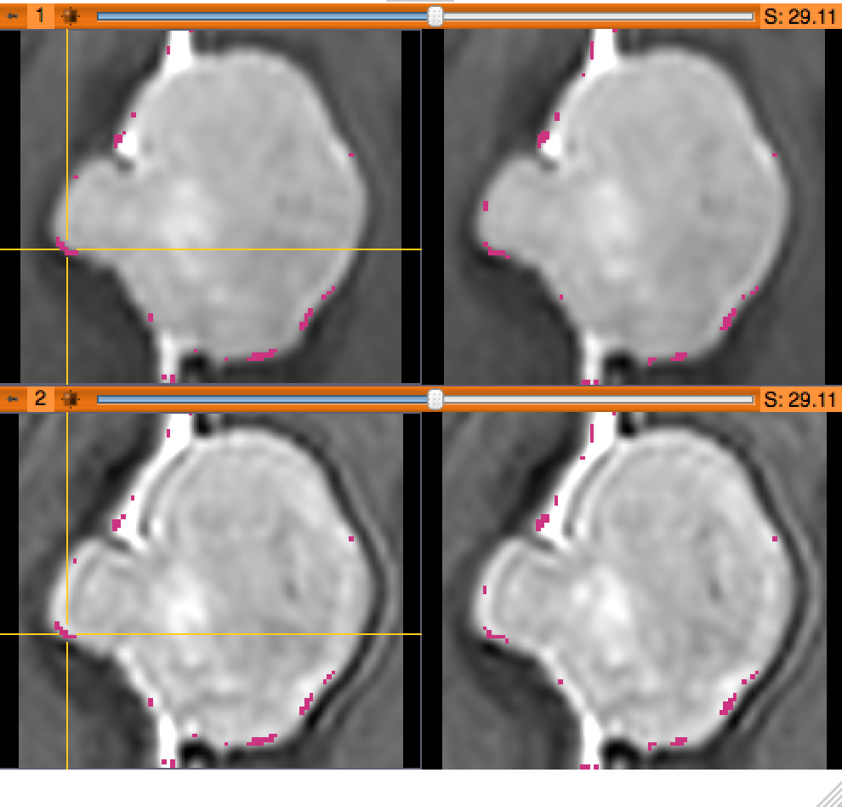
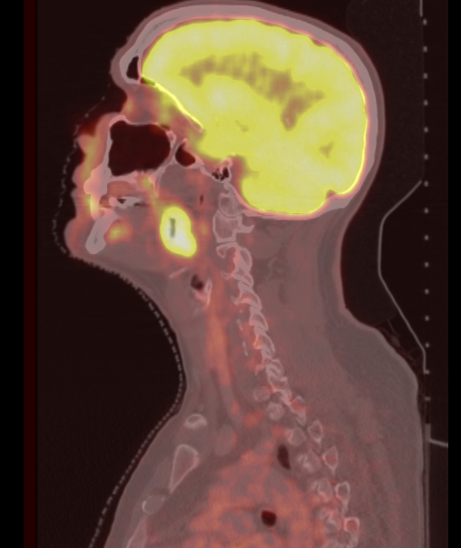
Quantitative Medical Imaging for Clinical Research and Practice
Sonia Pujol, PhD, Katarzyna Macura MD, PhD, Kitt Shaffer, MD, PhD, Ron Kikinis, MD
Brigham and Women’s Hospital, Harvard Medical School,
Johns Hopkins University
Boston University Medical Center

Slide 2
Quantitative Imaging Tutorial
Quantitative imaging is the extraction of quantitative measurements from medical imaging.
This tutorial is built upon a series of examples of quantitative imaging analysis:
Morphology: small volumetric changes in slow growing tumors
Function: metabolic activity in squamous cell carcinoma

Slide 3
Tutorial Materials
Software:
3D Slicer open-source software for medical imaging research
www.slicer.org
Datasets:
SlicerData directory located on the Desktop
- 3DVisualization_Tuesday_Dec3
- QuantitativeImaging_Sunday_Dec1

Slide 4
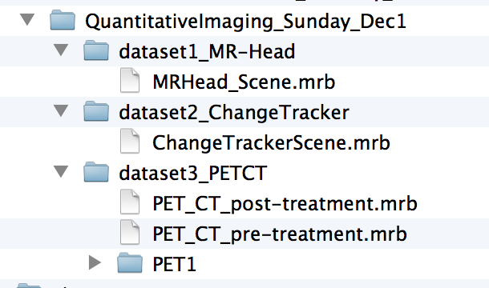
Course Datasets
The QuantitativeImaging_Sunday_Dec1 directory contains three datasets located in the sub-directories:
dataset1_MR_Head
dataset2_ChangeTracker
dataset3_PETCT
Each dataset is in .mrb file format.

Slide 5
Slicer mrb file format
A Slicer mrb file is an archive file that contains all data for loading into Slicer4.
The .mrb file is a .zip file with a different file extension.

Slide 6
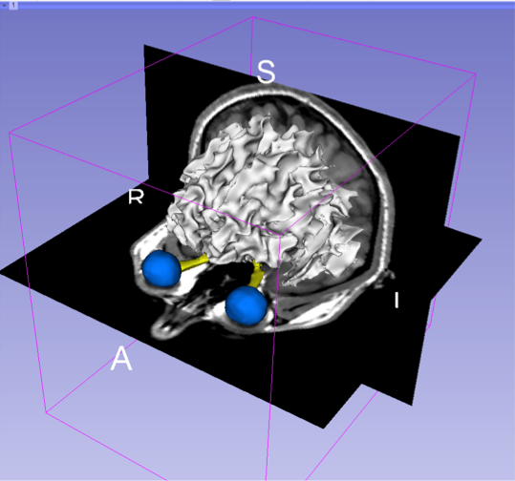
Tutorial Overview
Part 1: Introduction to 3D Slicer
Part 2: Basics of data loading and 3D interactive visualization
Part 3: Measurement of volumetric changes
- large volumetric change: breast tumor case
- small volumetric change: meningioma case
Part 4: Measurement of metabolic activity
- squamous cell carcinoma case

Slide 7
3DSlicer
3DSlicer is a freely available open-source platform for segmentation, registration and 3D visualization of medical imaging data.
3DSlicer is a multi-institutional effort supported by the National Institute of Health.

Slide 8
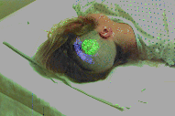
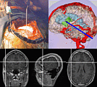
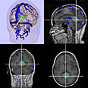
3DSlicer History
1997: Slicer started as a research project between the Surgical Planning Lab (Harvard) and the CSAIL (MIT)
Image Courtesy of the CSAIL, MIT

Slide 9
3DSlicer History
1997: Slicer started as a research project between the Surgical Planning Lab (Harvard) and the CSAIL (MIT)
2013: Multi-institution effort to share the latest advances in image analysis with clinicians and scientists

Slide 10
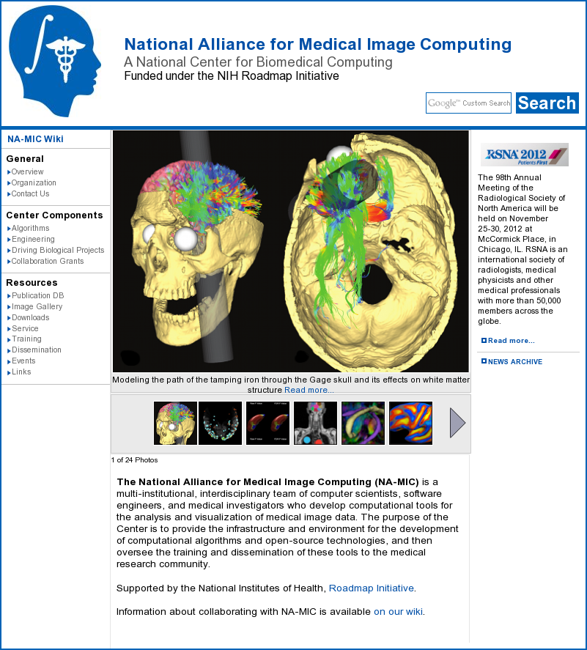
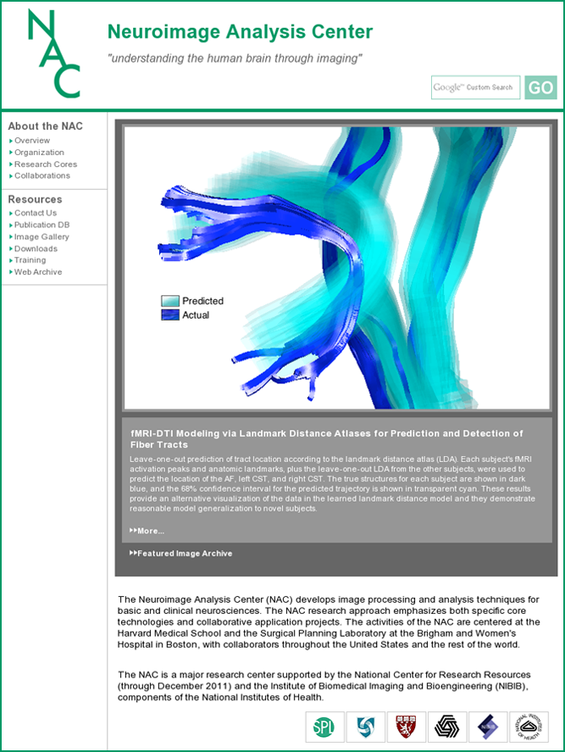
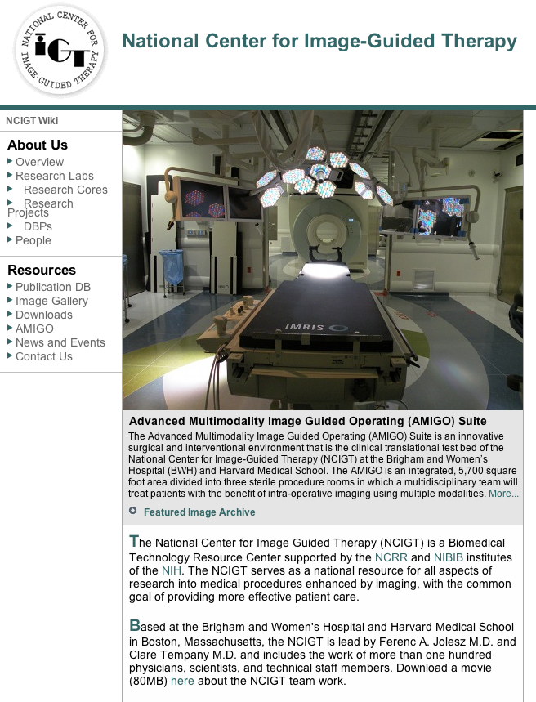
A multi-institution: NA-MIC, NAC, NCIGT
PIs: Ferenc Jolesz, M.D., Clare Tempany, M.D.
PI: Ron Kikinis, M.D.

Slide 11
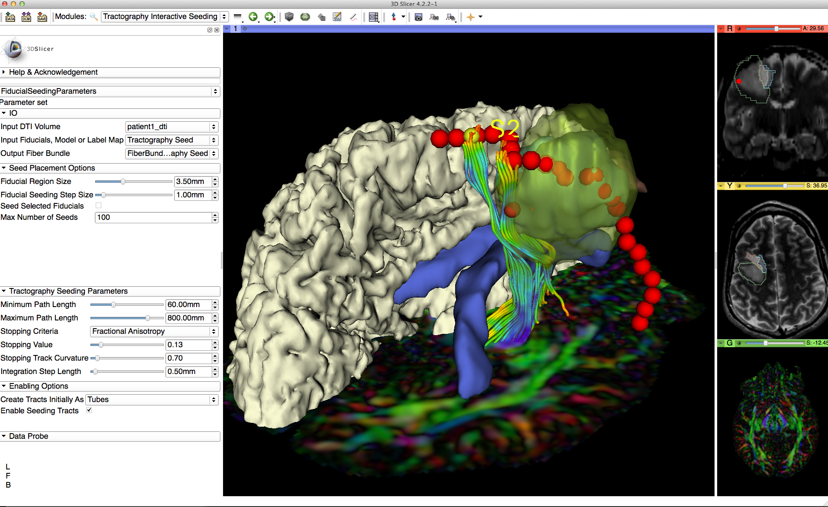
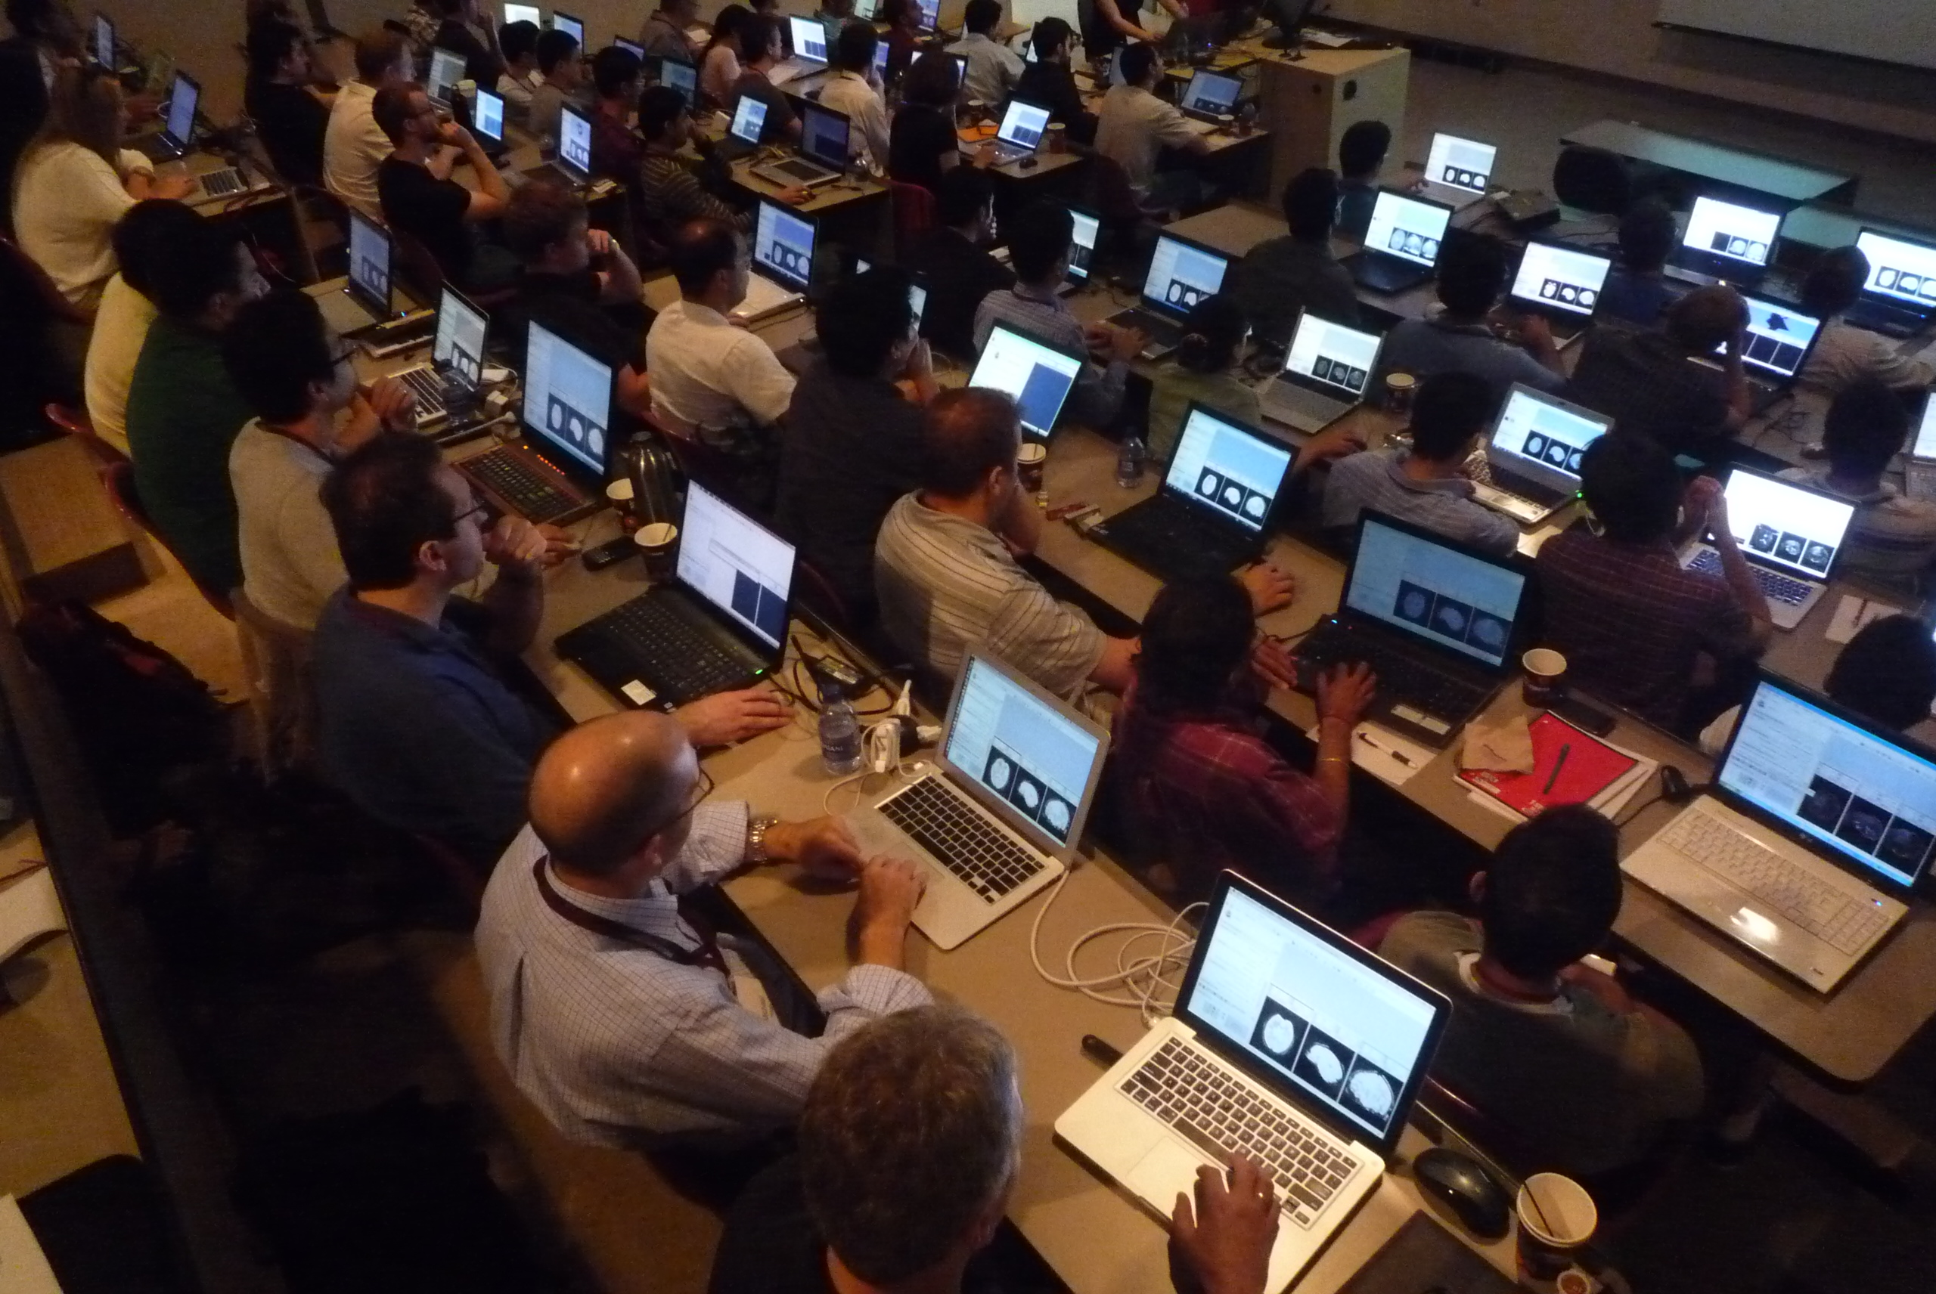
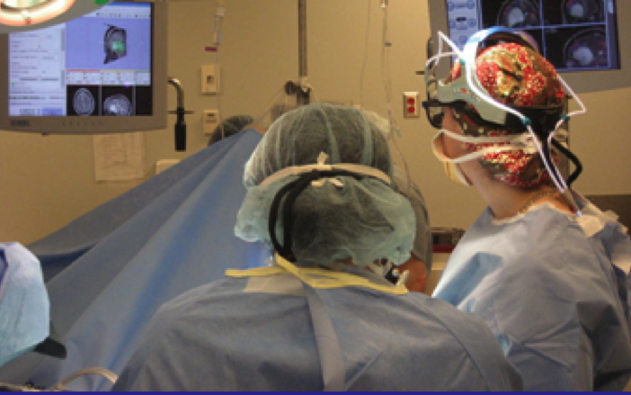
An interdisciplinary platform
An open-source environment for software developers
An end-user application for
clinical investigators and scientists
A software platform that is both easy to use for clinical researchers and easy to extend for programmers

Slide 12
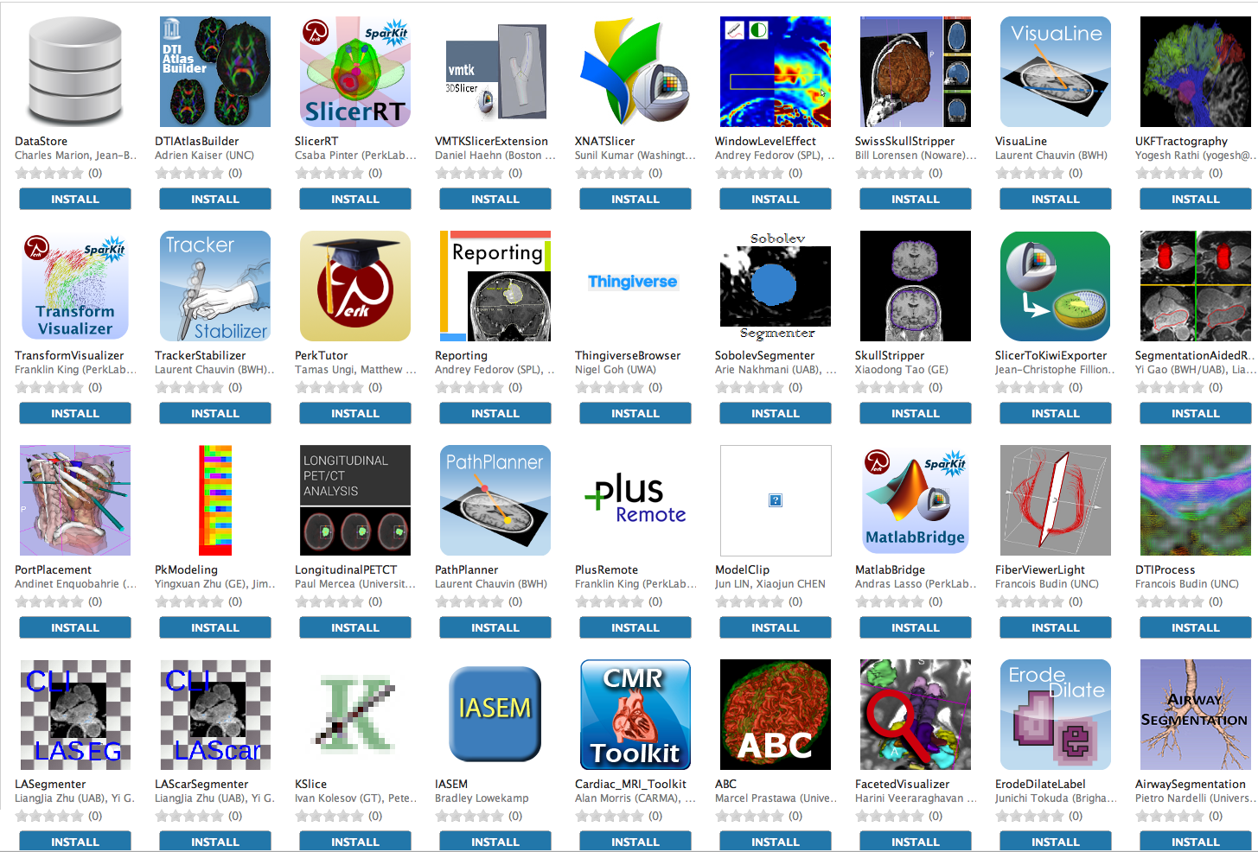
An extensible platform
3D Slicer supports plug-ins called Slicer extensions available from the Extension Manager
Allows end-users to select extensions useful to them, without having to download the entire extension archive.
Built Nightly with Slicer

Slide 13
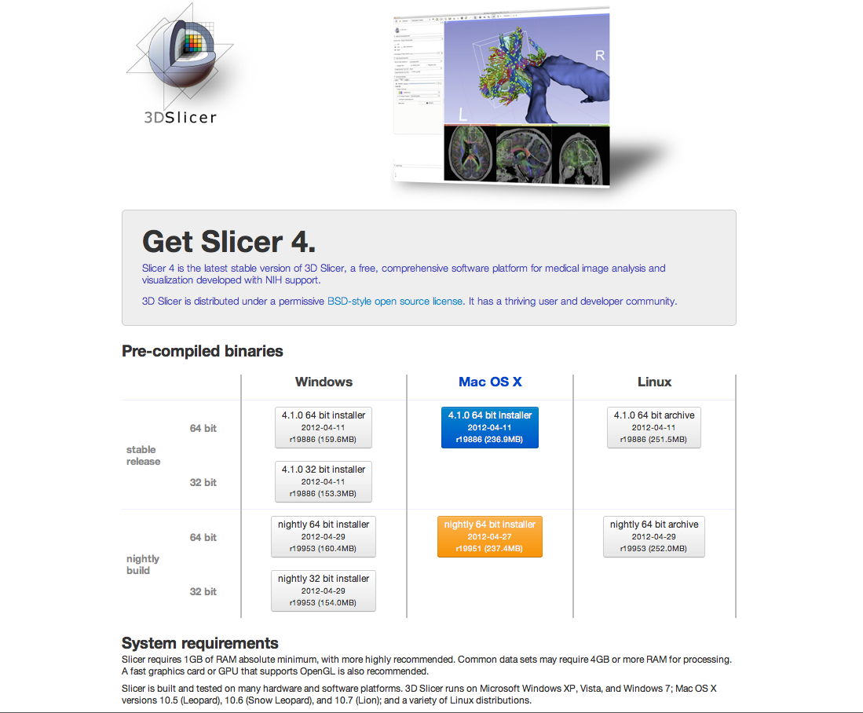
3D Slicer in practice
Slicer works on Windows, Linux, and Mac
Slicer is distributed under a BSD-style license agreement with no restriction on use

Slide 14
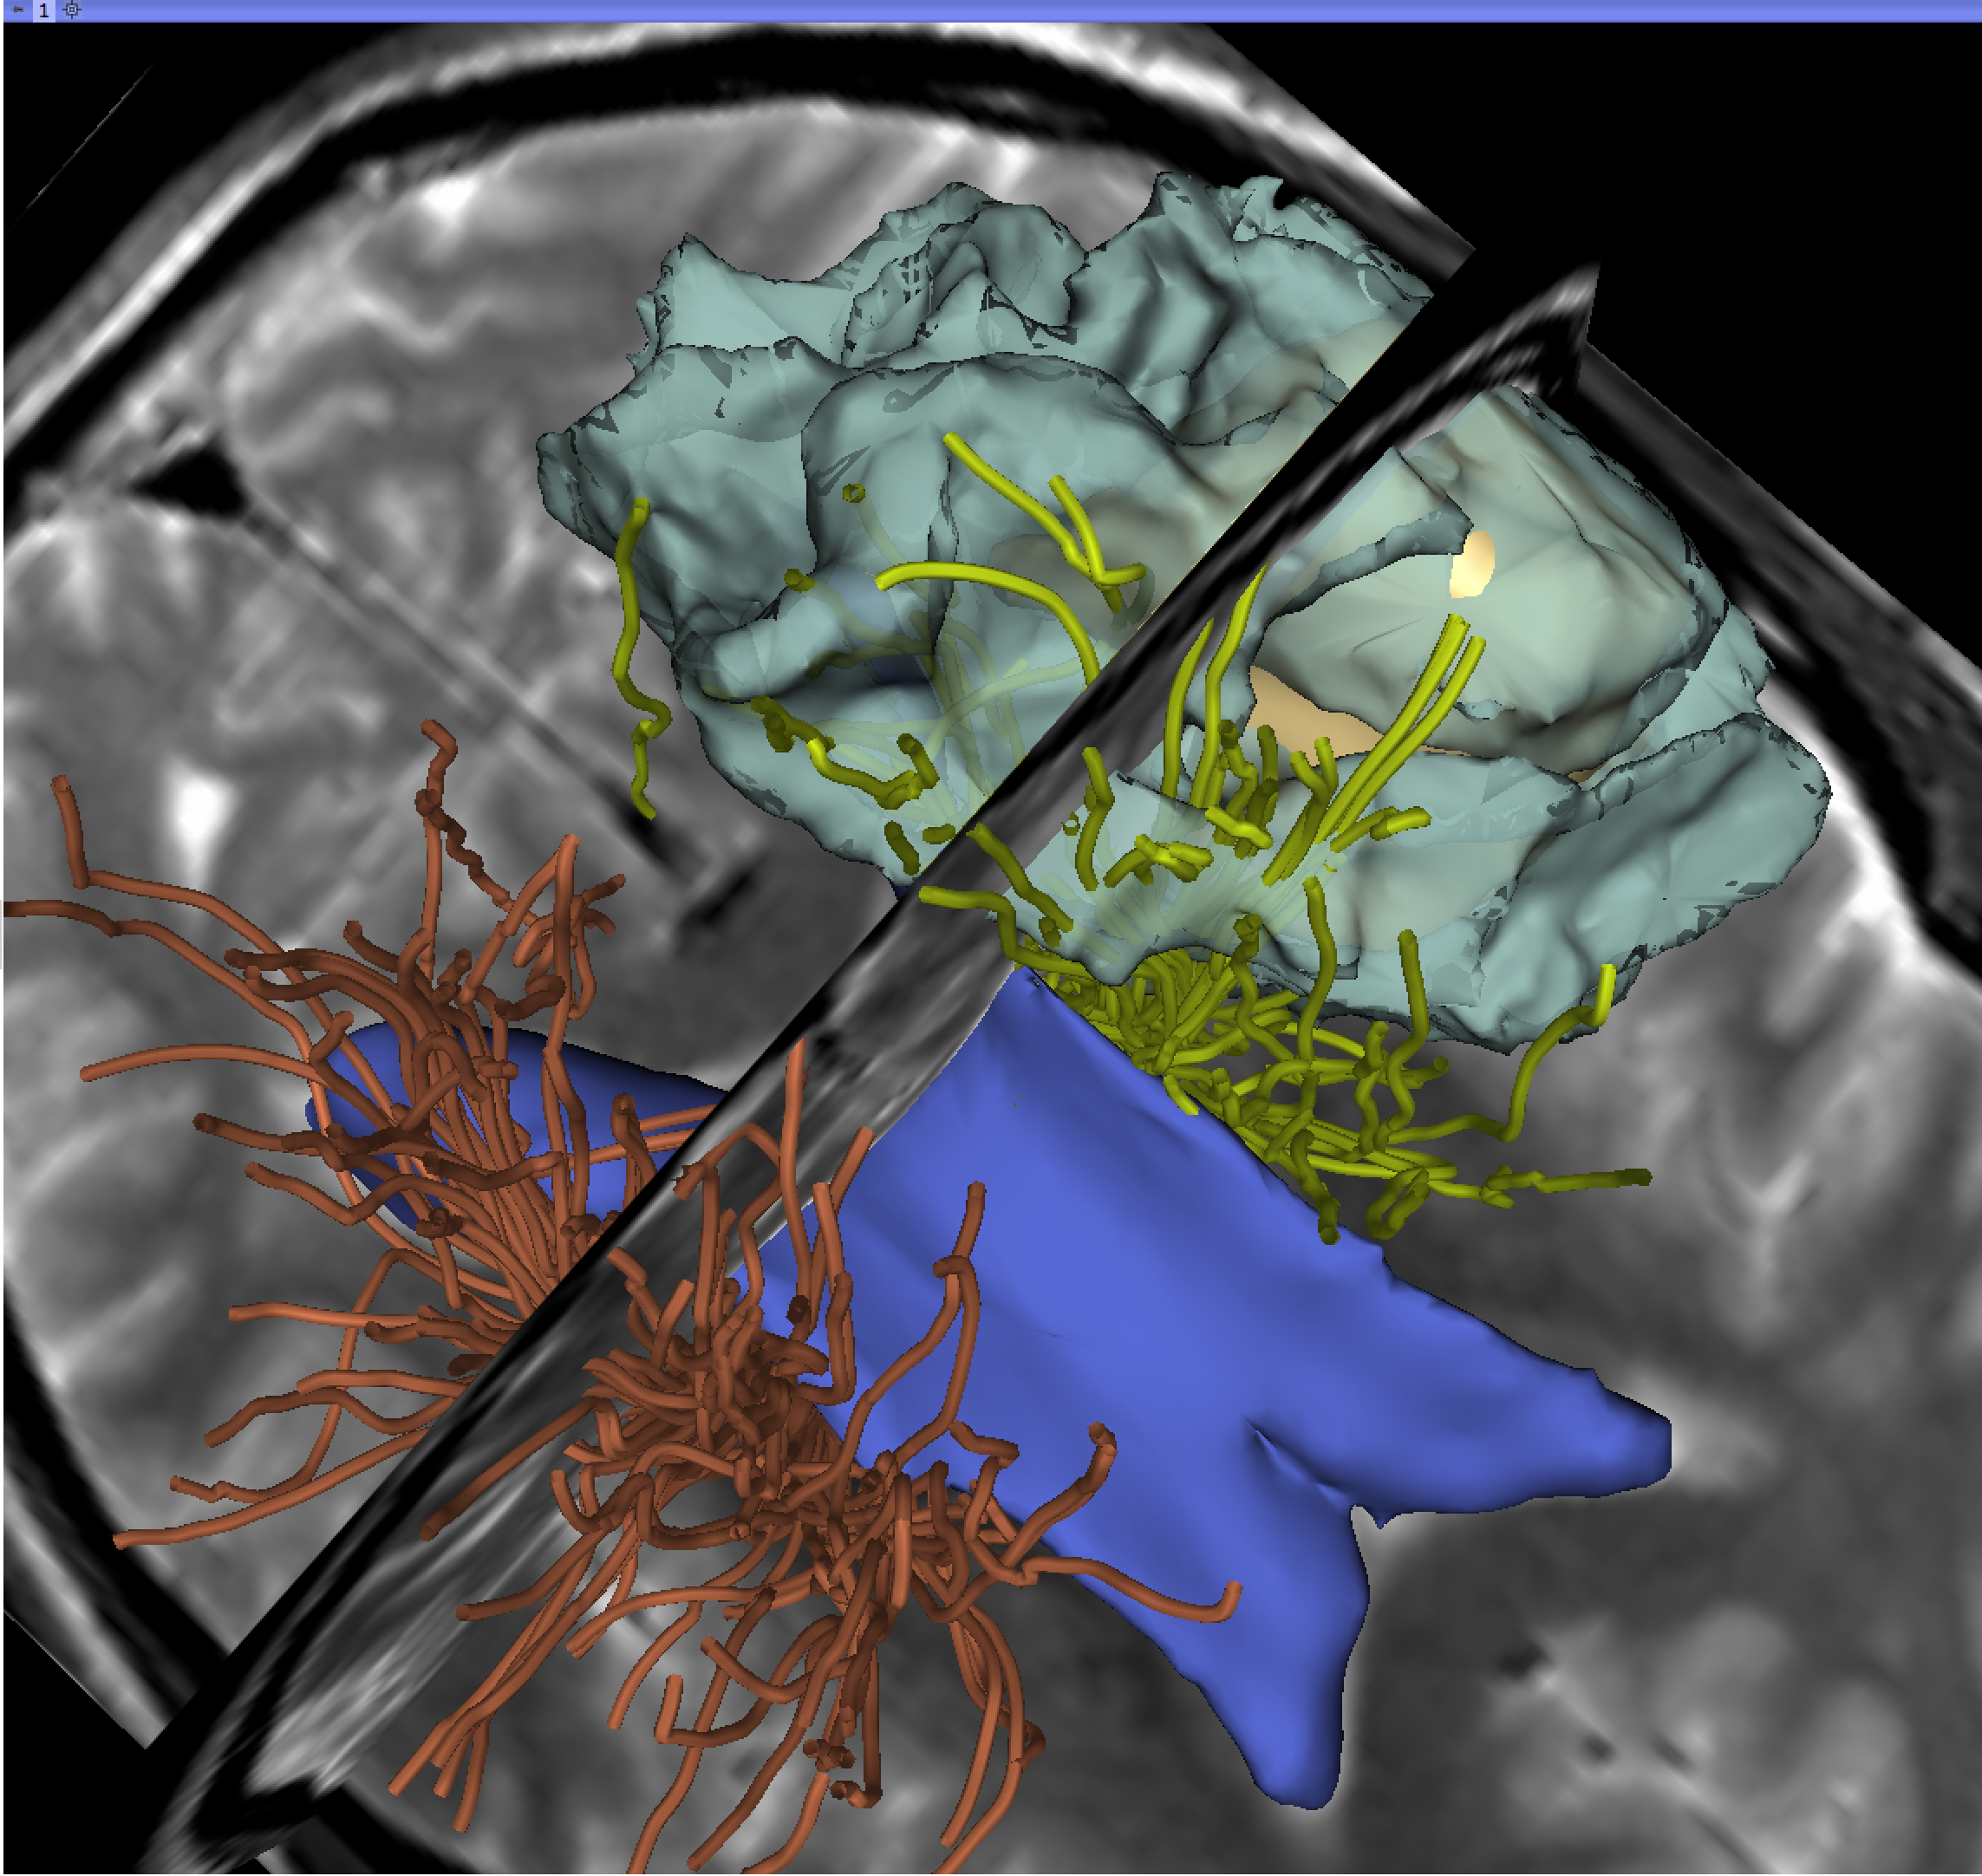
3D Slicer in practice
Slicer works on Windows, Linux, and Mac
Slicer is distributed under a BSD-style license agreement with no restriction on use
3D Slicer is for clinical research use only, and is not FDA approved or CE-marked.

Slide 15
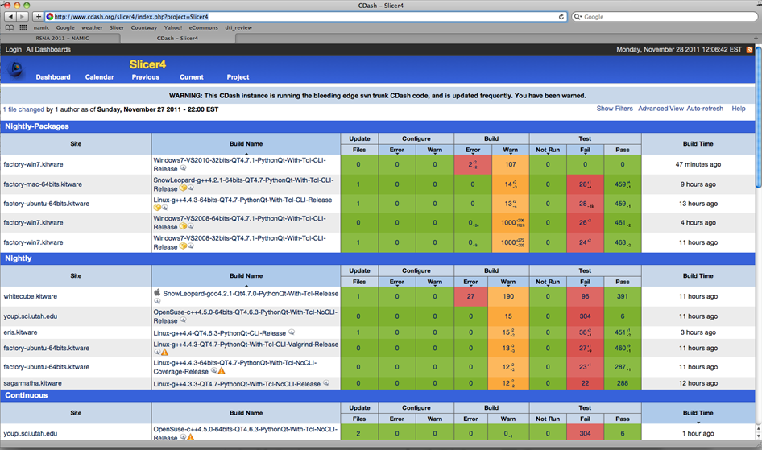
Slicer: Behind the scenes
Slicer is built every night on Windows, Mac and Linux platforms

Slide 16
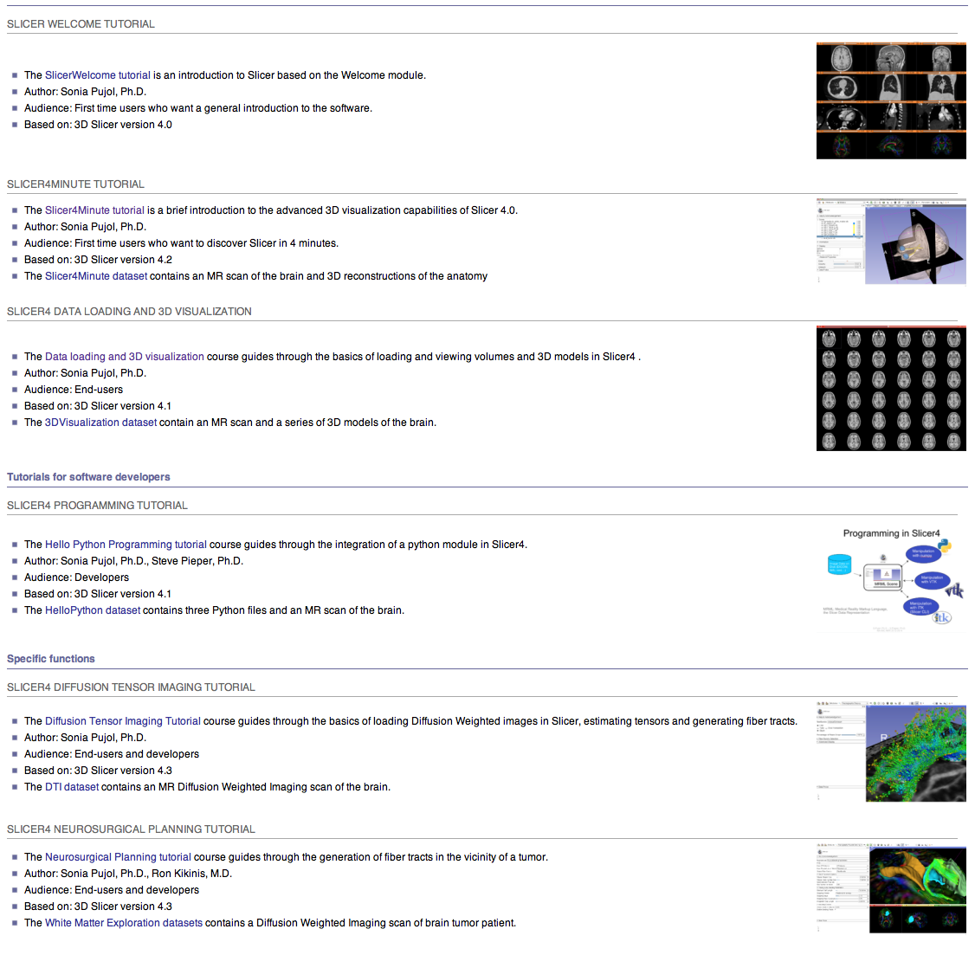
Training Portfolio
Modular multi-level training for expert and non-expert community
Tutorials and anonymized datasets for end-users and developers
Cross platform testing for quality control

Slide 17
Slicer Training
Hands-on training workshops at national meetings and and international conferences
RSNA 2008, 2009, 2010, 2011, 2012, 2013
MICCAI 2008, 2009, 2010, 2011, 2012, 2013
SfN 2009, 2011
SPIE 2012, 2013
CARS 2010, 2012, 2013
RSNA 2013

Slide 18
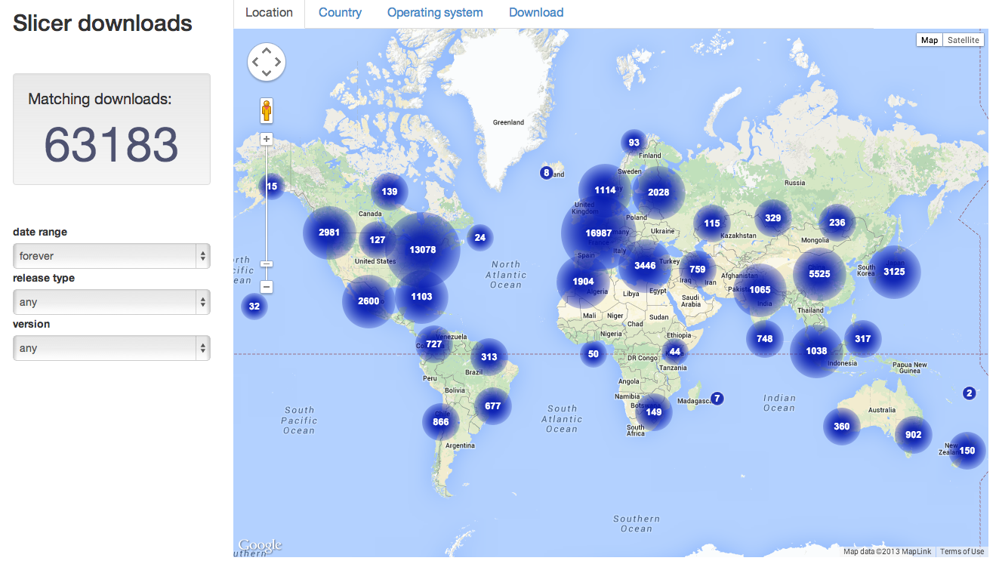
Slicer Downloads

Slide 19
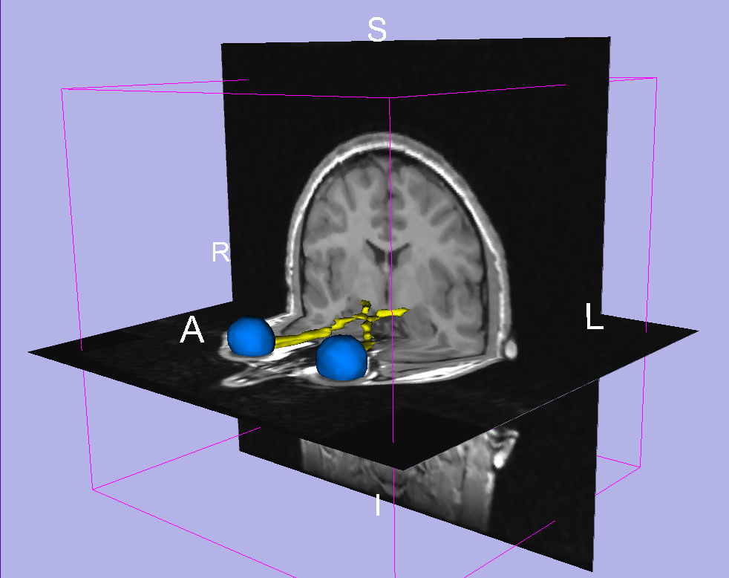
Part I:
3D Data Loading and Visualization
Sonia Pujol, PhD
Wendy Plesniak, PhD

Slide 20
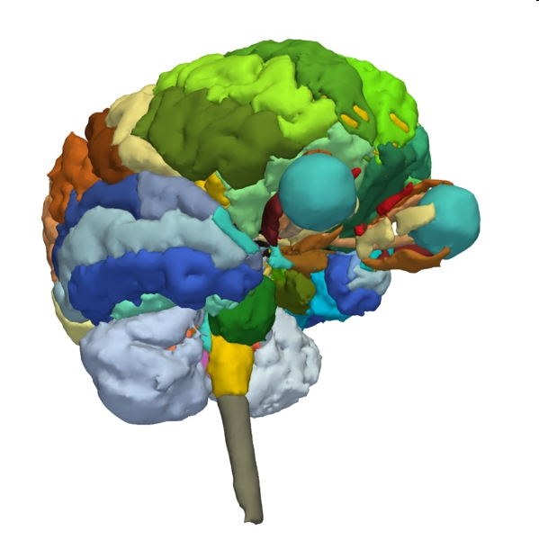
3D Data Loading and Visualization
This section is a short introduction to the advanced 3D visualization capabilities Slicer
The MR_Head dataset is composed of an MR scan of the brain and 3D surface reconstructions of anatomical structures.
The data are part of the SPL-PNL Brain Atlas developed by Talos, Jakab, Kikinis et al. The atlas is available at:
http://www.spl.harvard.edu/publications/item/view/2037

Slide 21
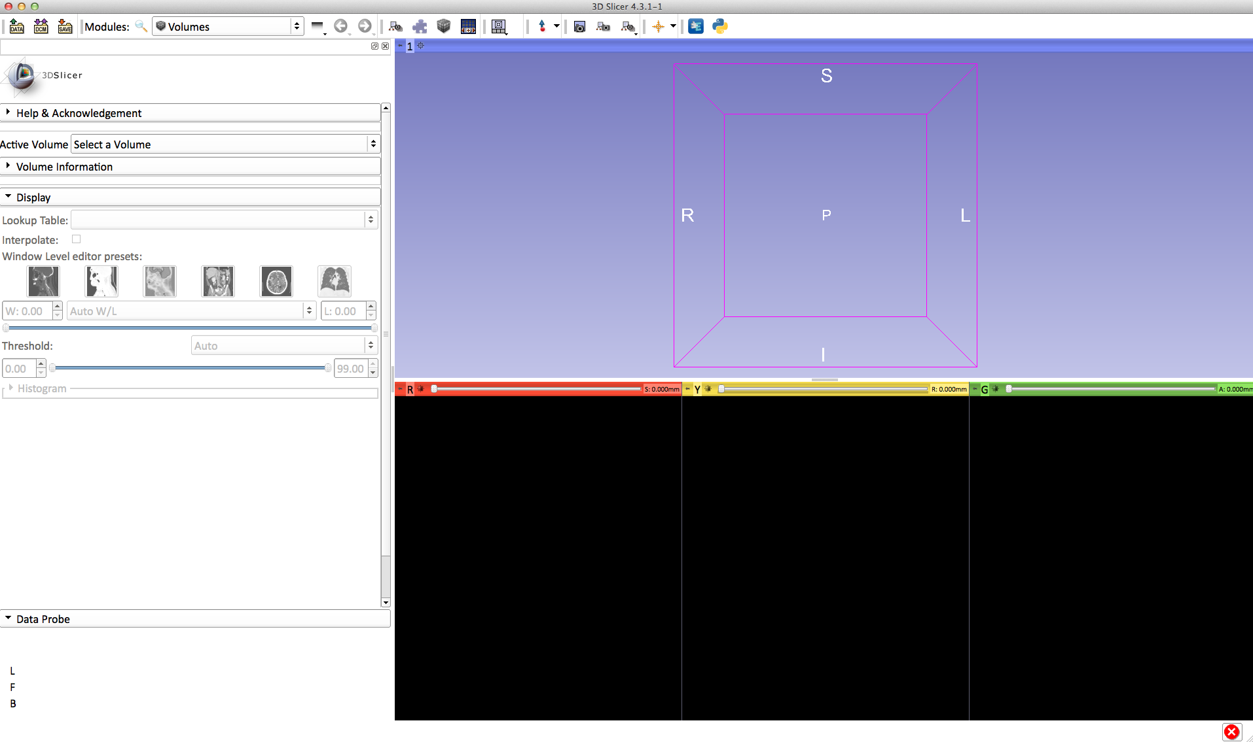
Welcome to Slicer4
To start Slicer, double click on the Slicer icon on the Desktop

Slide 22
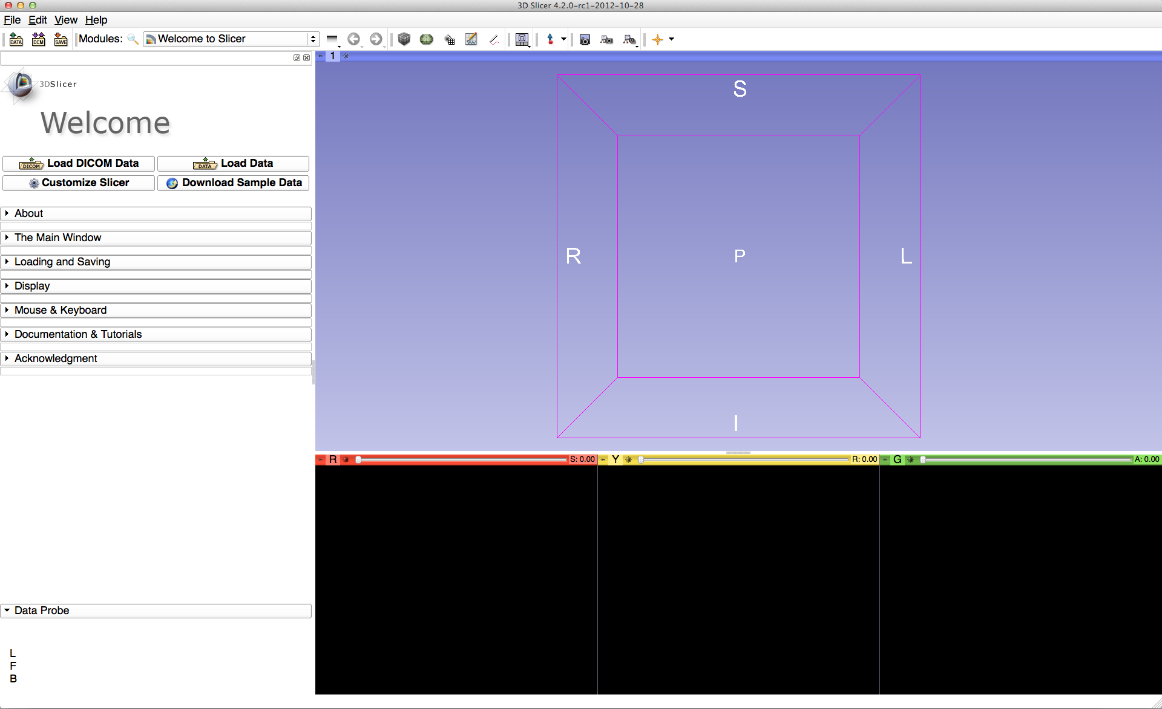
Slicer4 Minute Tutorial: Navigating the Application GUI
Menu & Toolbar
The Graphic User Interface (GUI) of Slicer4 integrates four components:
the Menu Toolbar
the Module GUI Panel
the 3D Viewer
the Slice Viewer
3D Viewer
Module GUI Panel
Slice Viewers

Slide 23
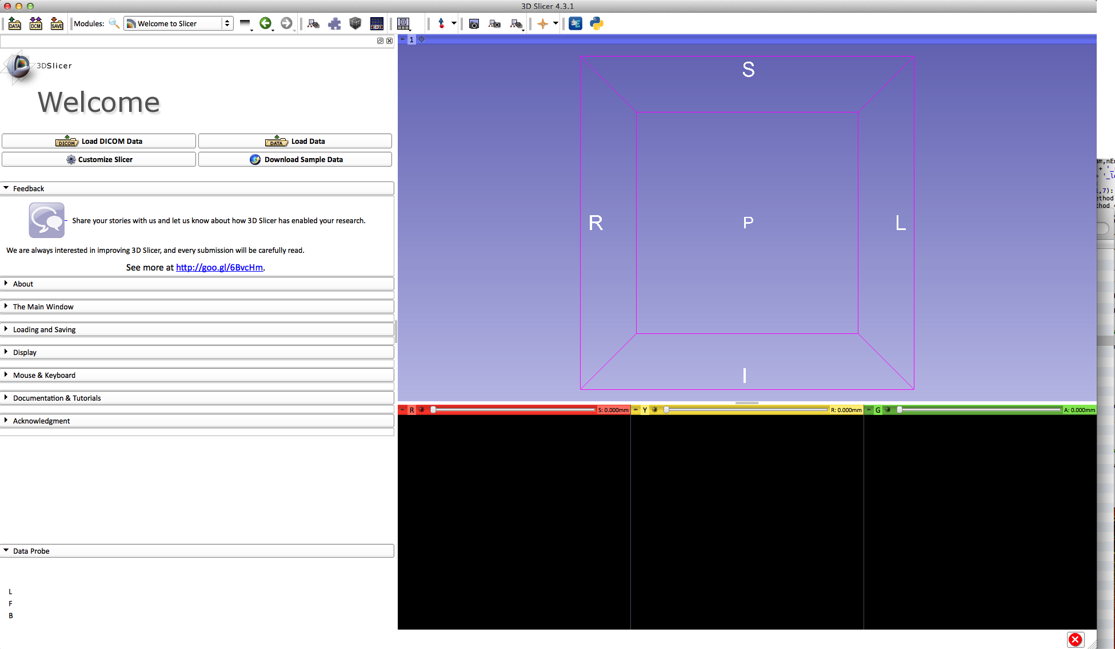
Slicer4 Minute Tutorial: Welcome Module
The Welcome to Slicer module is the module displayed by default.
This module gives an overview of the GUI of Slicer4, and data loading & saving functionalities.

Slide 24
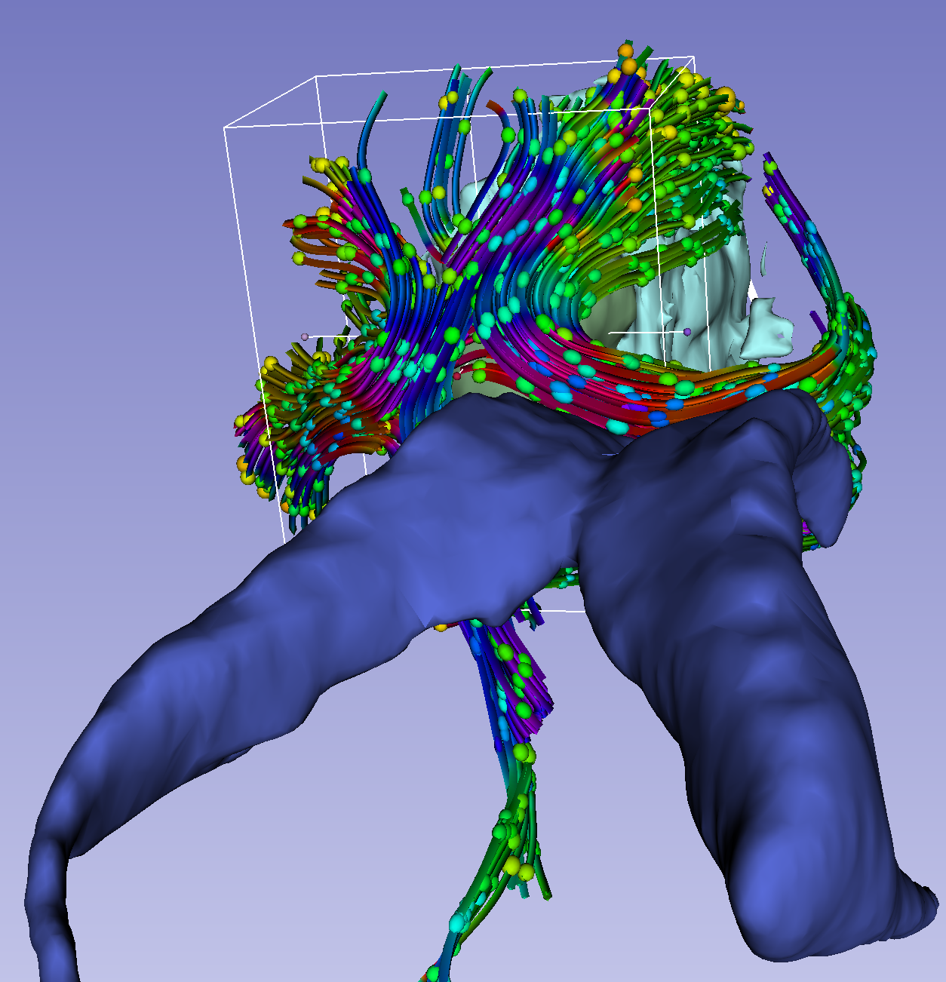
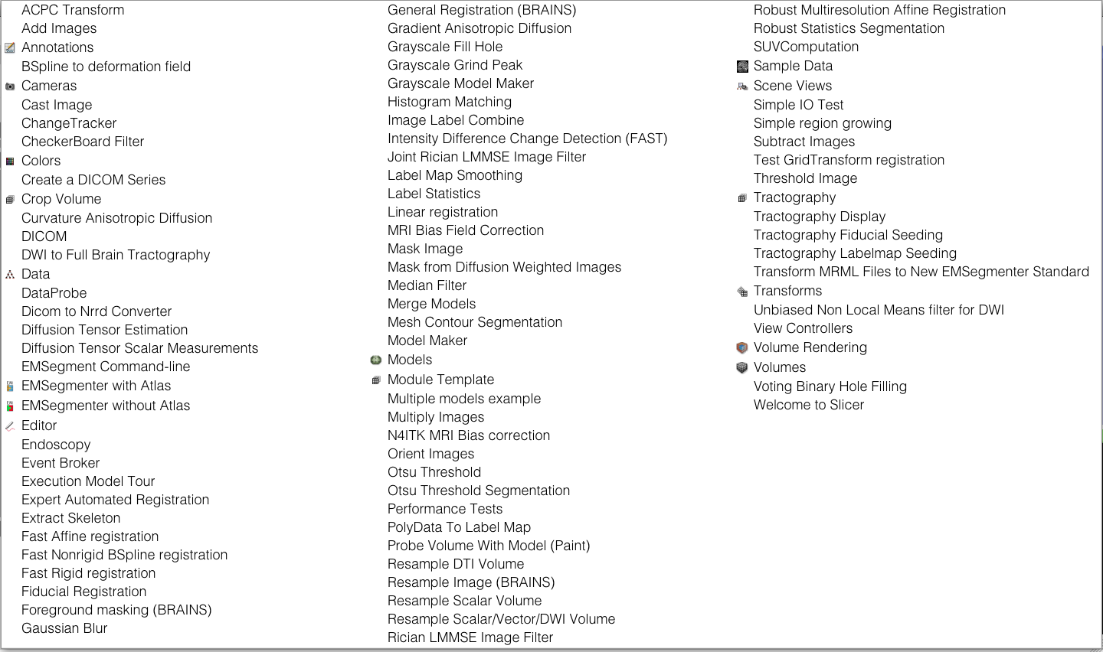
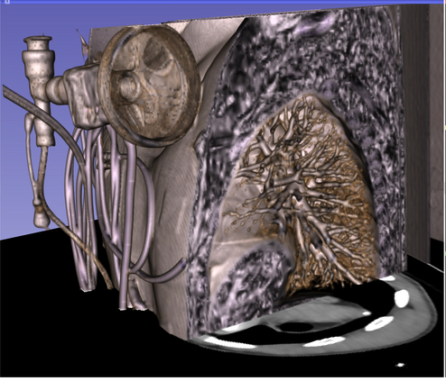
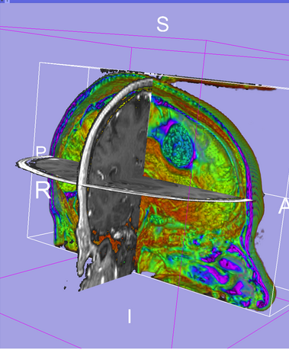
Welcome to Slicer4.3
Slicer4.3.1 contains more than 100 modules for image segmentation, registration and 3D visualization of medical imaging data

Slide 25
Welcome to Slicer4.3
Click on Welcome to Slicer in the Modules menu to display the list of modules of Slicer

Slide 26
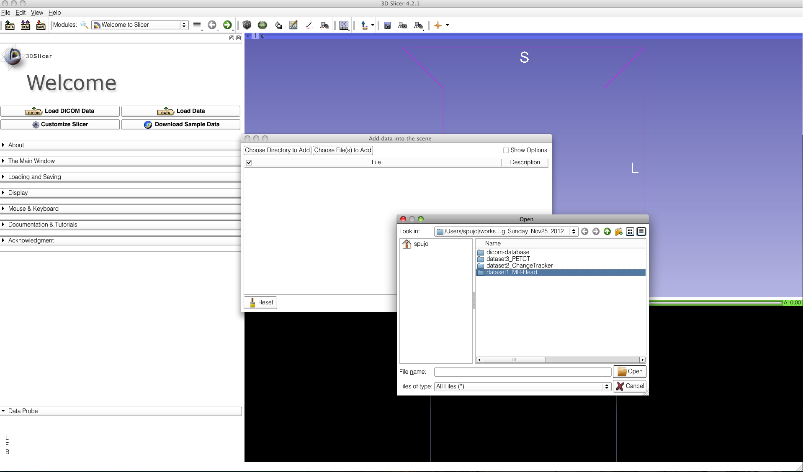
Slicer4 Minute Tutorial: Load a Scene
Select the directory SlicerData\QuantitativeImaging_Sunday_Dec1
on the Desktop
Select the subdirectory dataset1_MR-Head
Drag and drop the file MRHead_Scene.mrb

Slide 27
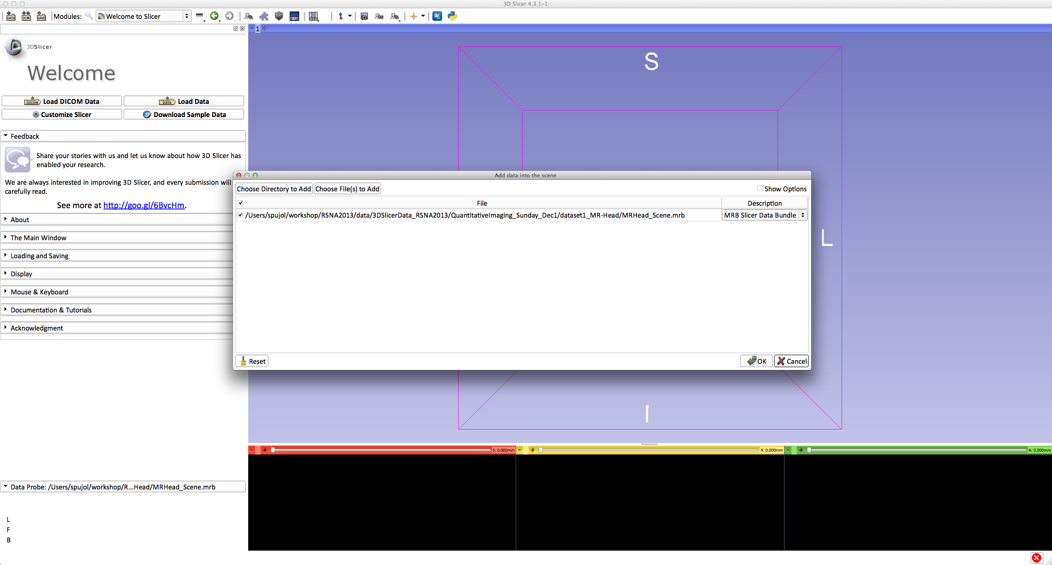
Slicer4 Minute Tutorial: Load a Scene
Click on OK to load the data to Slicer

Slide 28
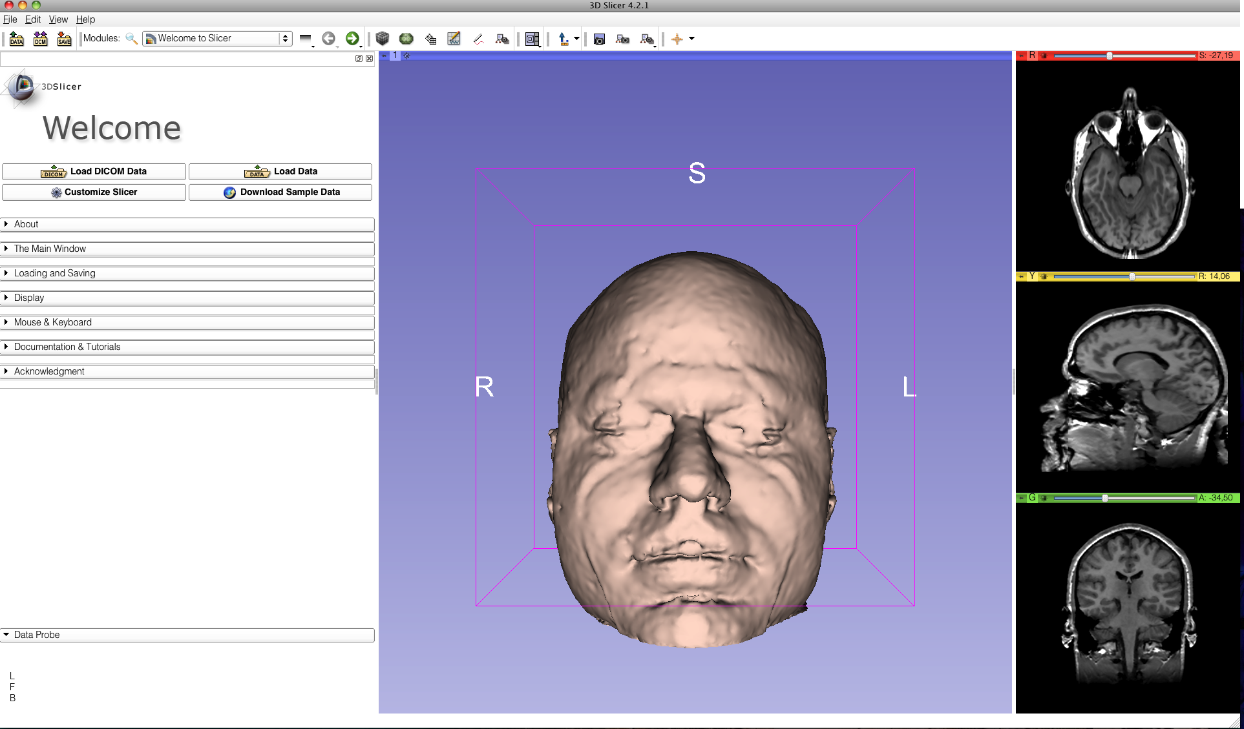
Slicer4 Minute Tutorial: Viewing the Scene
When the scene is finished loading, Slicer displays:
a 3D model of the head in the 3D Viewer, and
anatomical MR slices of the brain in the 2D Slice Viewers.

Slide 29
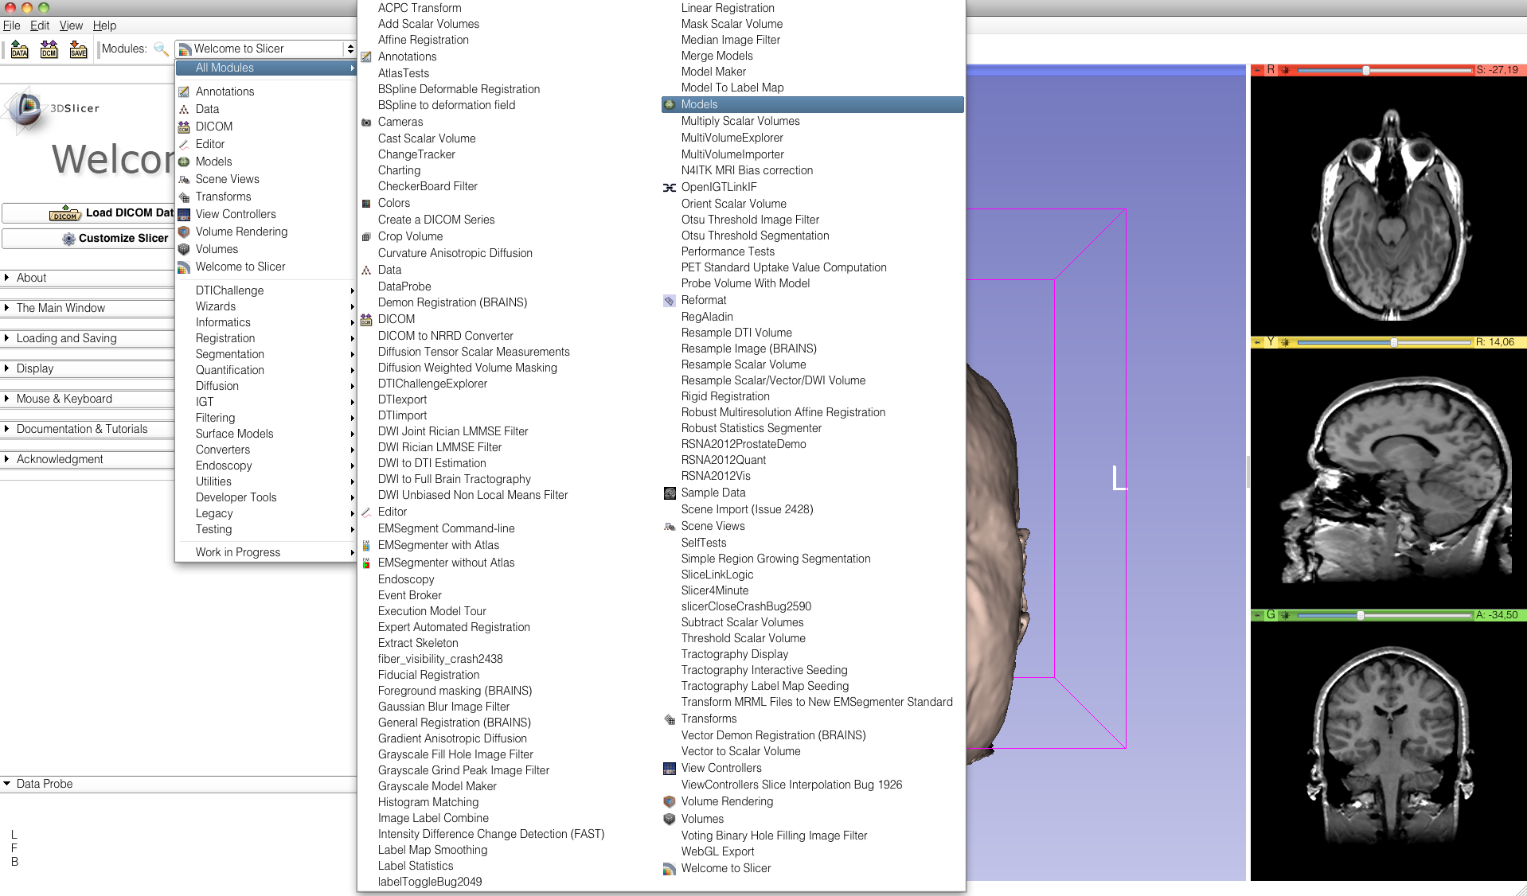
Slicer4 Minute Tutorial: Exploring Slicer’s functionality
To access the Models module, browse through the list of modules...
...or click on the models icon in the toolbar

Slide 30
Slicer4 Minute Tutorial: Switching to the Models Module
Slicer displays the GUI of the Models module.

Slide 31
Slicer4 Minute Tutorial: Basic 3D Interaction
Left-click & drag
Position the mouse in the 3D Viewer.
Hold down the left mouse button and drag to rotate the model.

Slide 32
Slicer4 Minute Tutorial: Viewing Slices in the 3D Viewer
Click on the Slice Visibility icon
to display the Axial Slice in the 3D Viewer

Slide 33
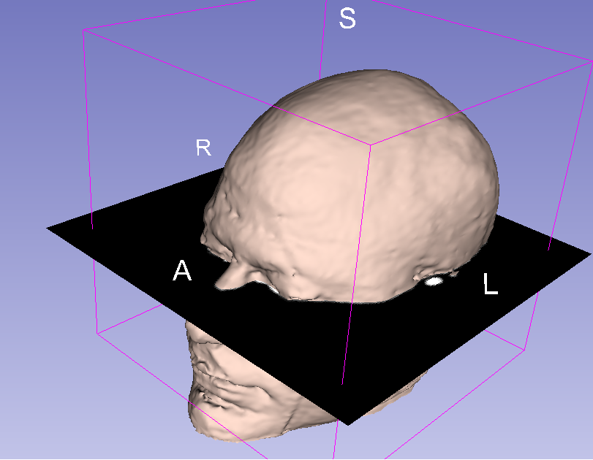
Slicer4 Minute Tutorial: 3D Visualization
Slicer adds a view of the Axial slice in the 3D View.

Slide 34
Slicer4 Minute Tutorial: Viewing Slices in the 3D Viewer
Click on the layout menu in the toolbar, and select the Conventional layout

Slide 35
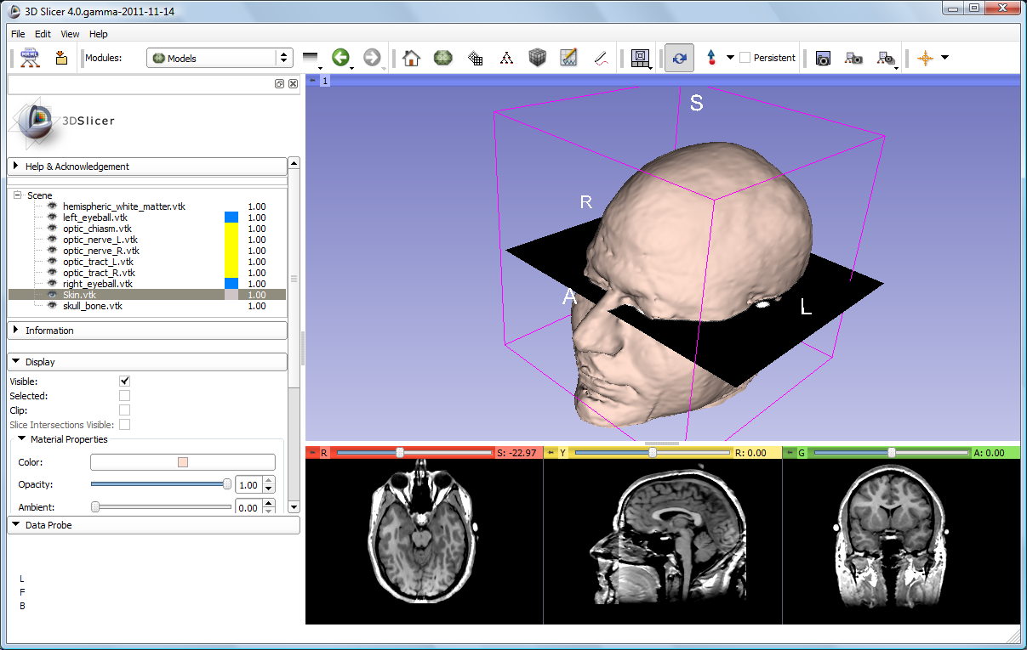
Slicer4 Minute Tutorial: 3D Visualization
Select the Skin.vtk
Change the opacity of the model from 1.0 to 0.0.

Slide 36
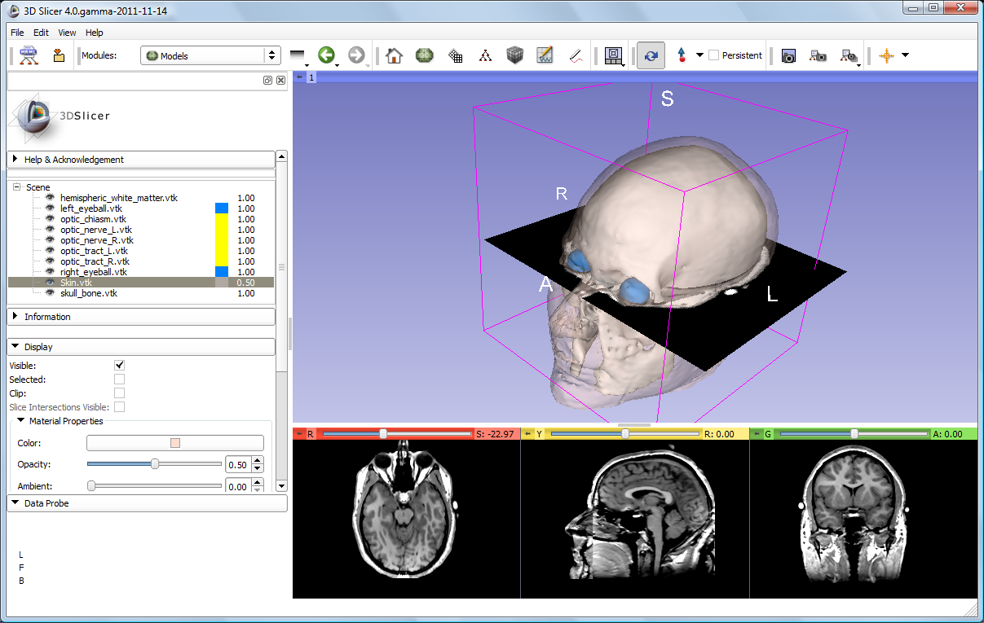
Slicer4 Minute Tutorial: 3D Visualization
The model of the skull bone and eyeballs become visible through the model of the skin in the 3D viewer.
(skin model opacity = 0.5)

Slide 37
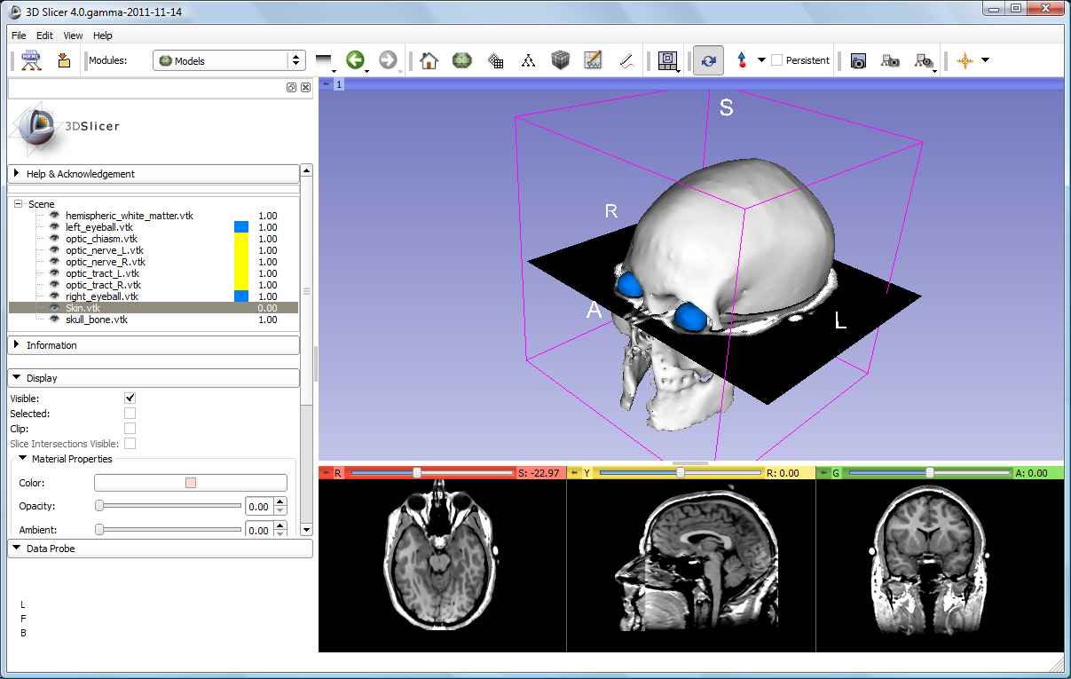
Slicer4 Minute Tutorial: 3D Visualization
The model of the skin becomes invisible in the 3D viewer.
(skin model opacity = 0.0)
(skull model opacity = 1.0)

Slide 38
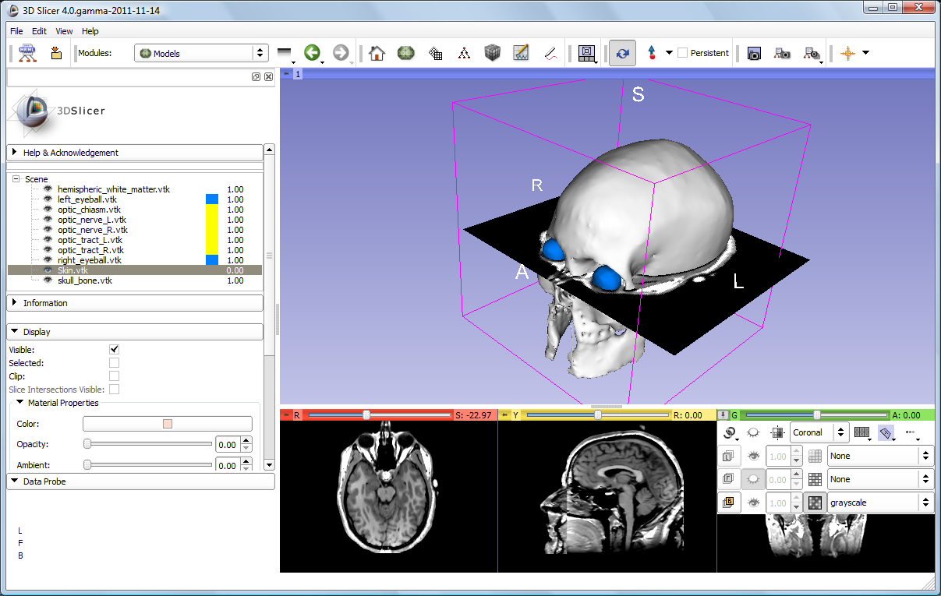
Slicer4 Minute Tutorial: 3D Visualization
Click on the Slice Visibility icon in the Green Slice Viewer
to display the Coronal Slice in the 3D Viewer.

Slide 39
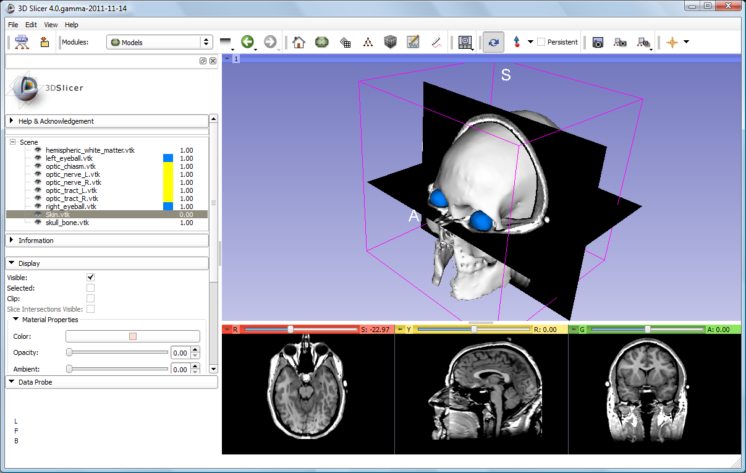
Slicer4 Minute Tutorial: 3D Visualization
The Axial and Coronal Slices are displayed in the 3D Viewer.

Slide 40
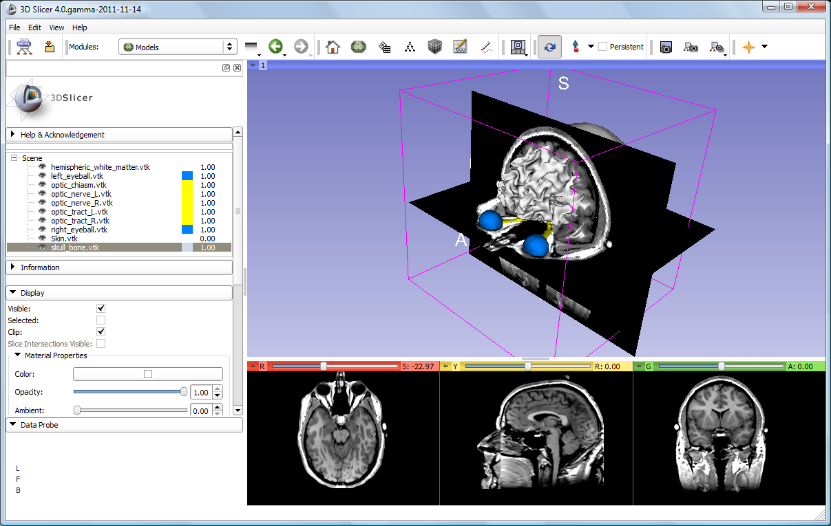
Slicer4 Minute Tutorial: 3D Visualization
Select the 3D model skull_bone.vtk in the Model Hierarchy.
Turn on the Clip option in the Display Panel

Slide 41
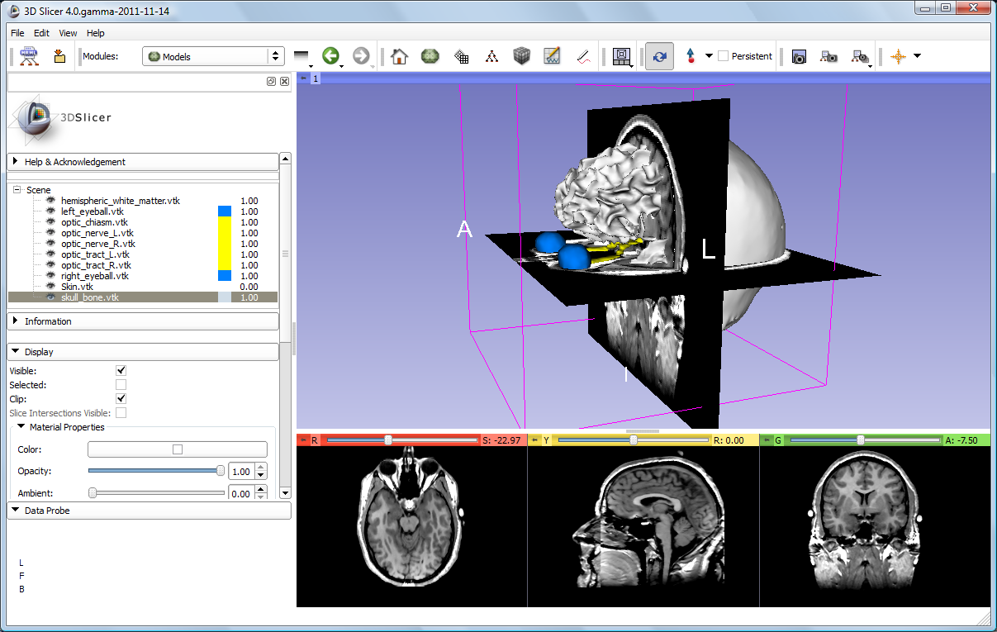
Slicer4 Minute Tutorial: 3D Visualization
Browse through the coronal slices to expose the 3D model of the white matter, and the left and right optic nerves.

Slide 42
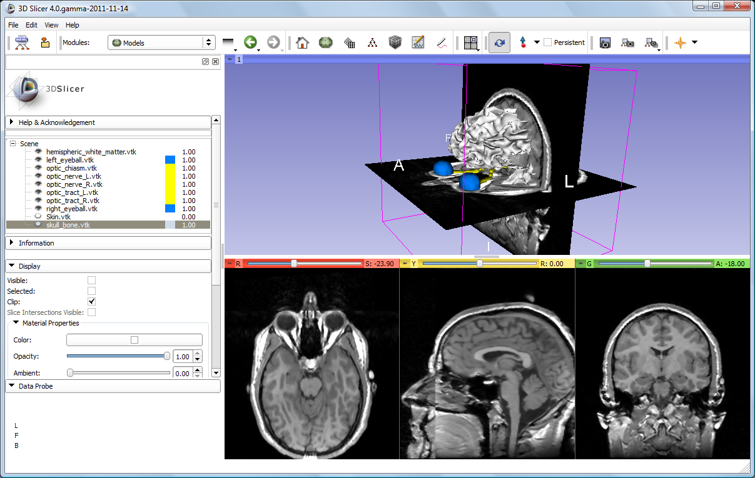
Slicer4 Minute Tutorial: 3D Visualization
Now make the skull invisible.

Slide 43
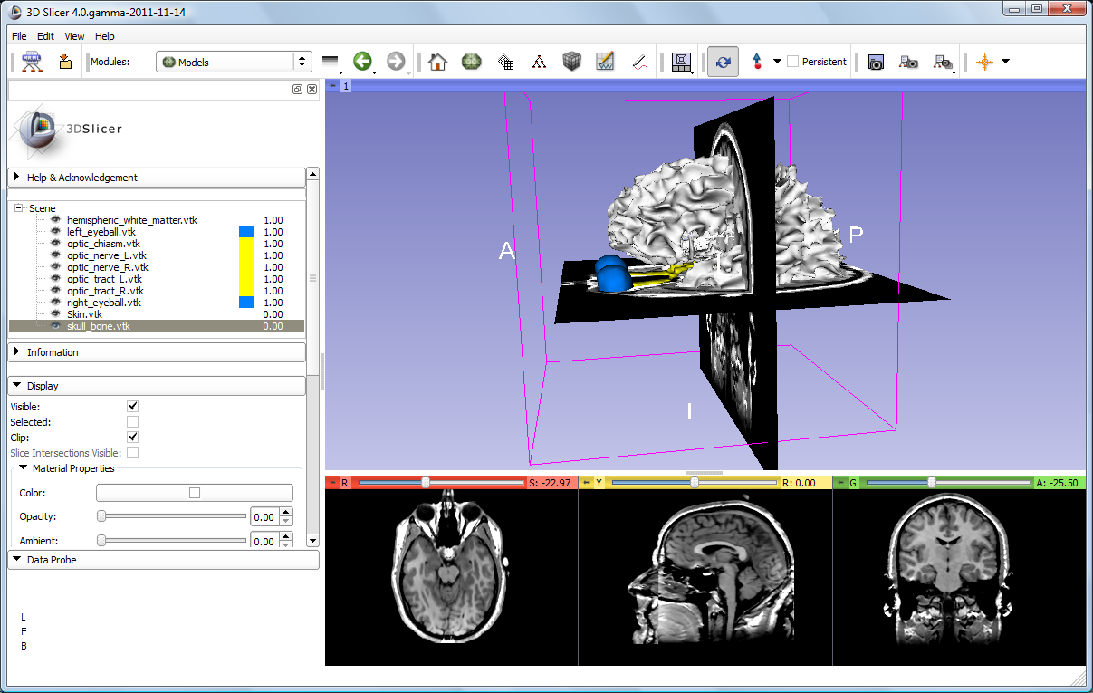
Slicer4 Minute Tutorial: 3D Visualization
Scroll the Coronal Slices to display the hemispheric white matter model in the context of the image data in the 3D Viewer.

Slide 44
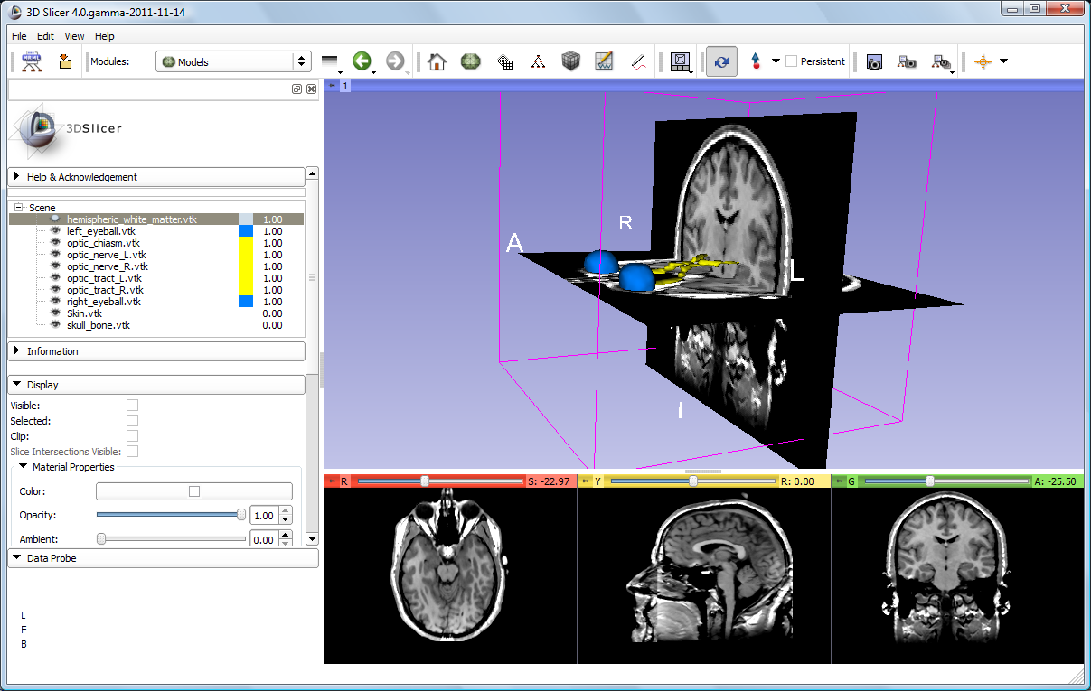
Slicer4 Minute Tutorial: 3D Visualization
Select the hemispheric white matter model called
hemispheric_white_matter.vtk
Turn off its visibility.

Slide 45
Slicer4 Minute Tutorial: 3D Visualization
Slicer displays the optic nerve, optic chiasm and optic tracts overlaid on the MR images of the brain.

Slide 46
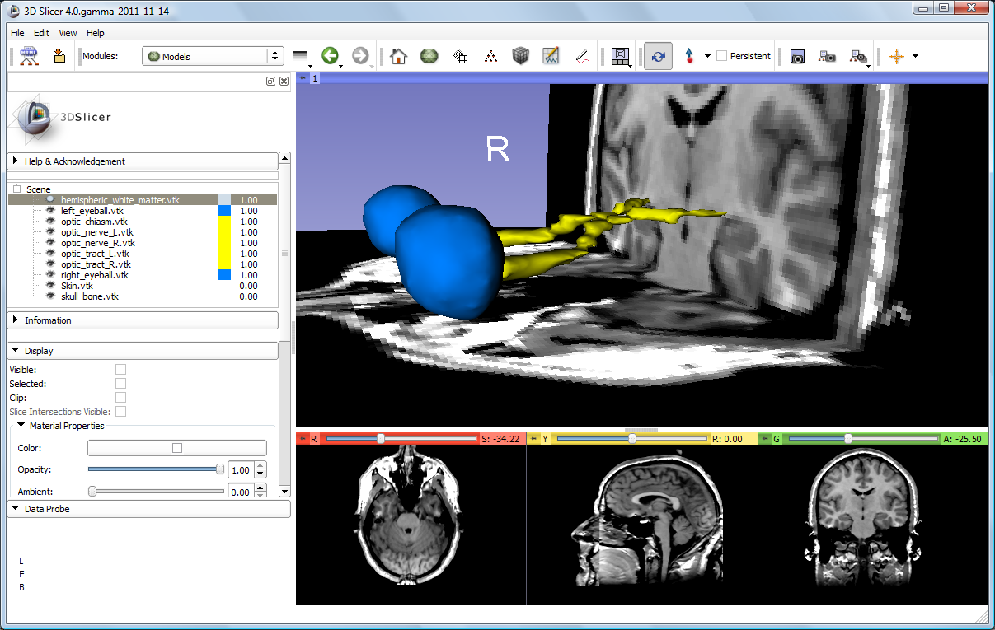
Slicer4 Minute Tutorial: 3D Visualization: Zoom the view
Windows/Linux users: Position the mouse in the 3D Viewer, hold down the right mouse button and move the mouse down to zoom in.
Mac users: Position the mouse in the 3D Viewer, hold down the apple button and the mouse button and move the mouse down to zoom in
(or use two fingers on the touch pad).

Slide 47
Slicer4 Minute Tutorial: 3D Visualization: Zoom the view
Slicer displays a closer view of 3D anatomical structures overlaid on 2D MR slices

Slide 48
Close the existing scene and all its data
Select File->Close Scene
This removes any dataset previously loaded into Slicer.
Select File→Exit to exit the software

Slide 49
Summary
This first part of the tutorial has demonstrated:
Basic description of the Slicer4 Application Interface
How to load a .mrb file containing volumes and models
How to visualize these different datasets together
Next, we will use these building blocks to perform image analysis and visualize quantitative results.

Slide 50
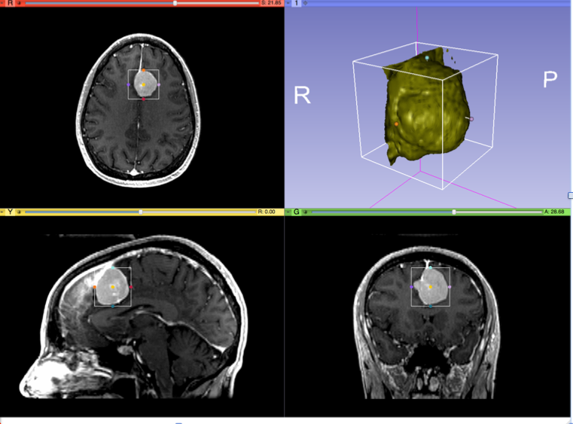
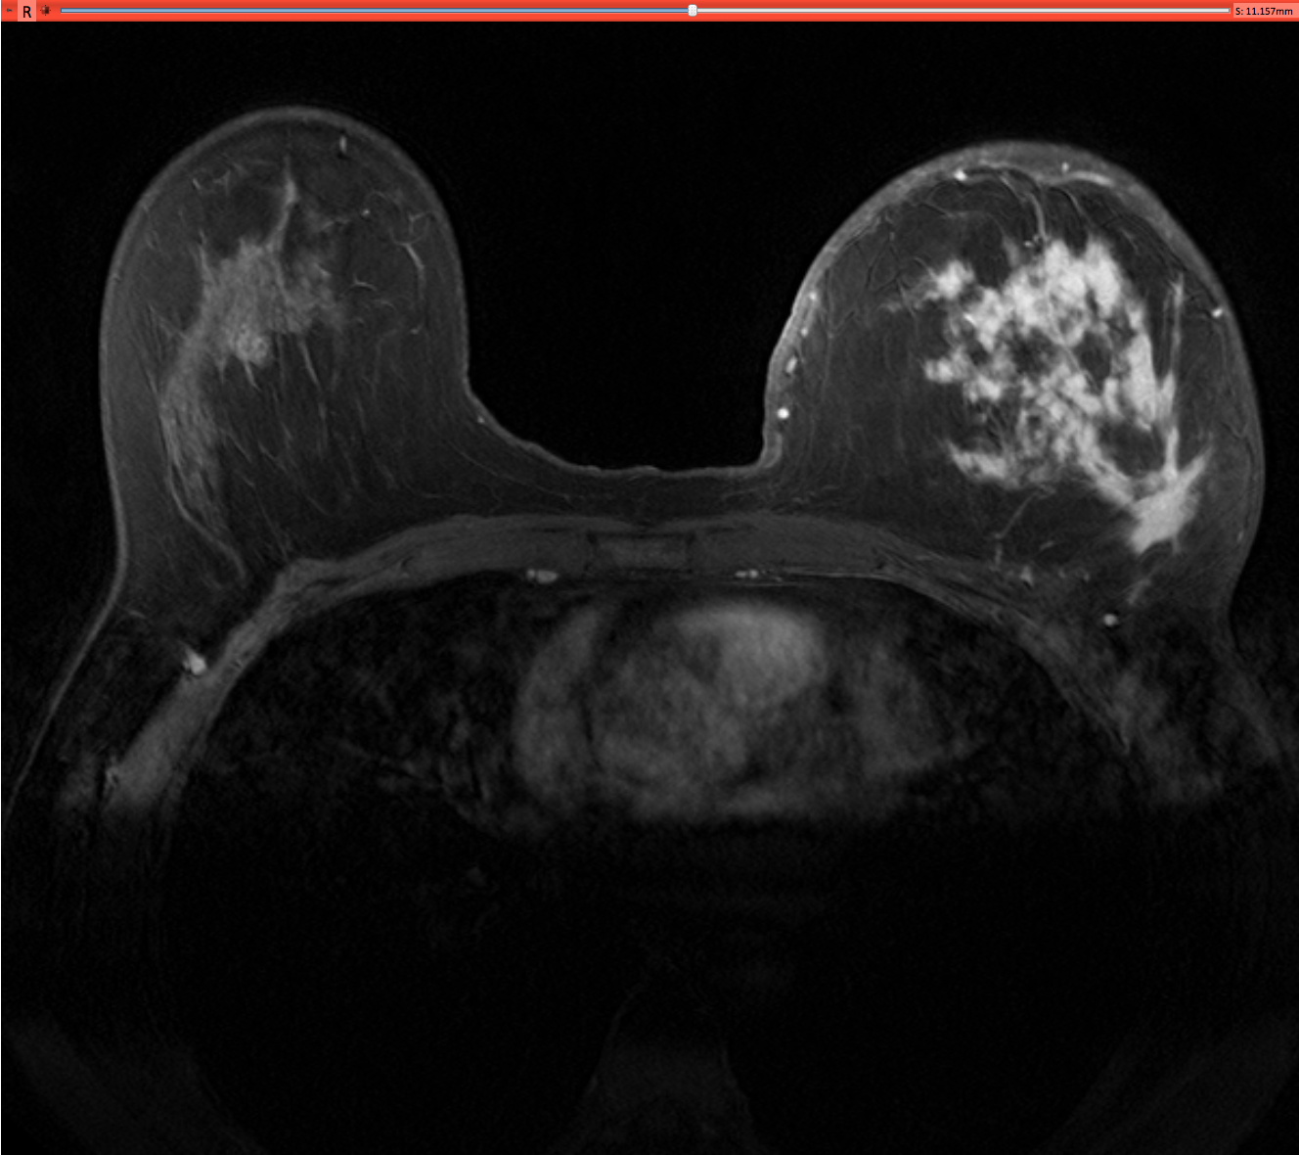
Part II: Analyzing Volumetric Changes

Slide 51
Example1: Large volumetric change
Clinical case: 45 y-o woman presenting with an infiltrating ductal carcinoma in left breast
Pre- and post-treatment imaging shows large volumetric difference in tumor size
Data Courtesy of Dr. Katarzyna Macura, JHU

Slide 52
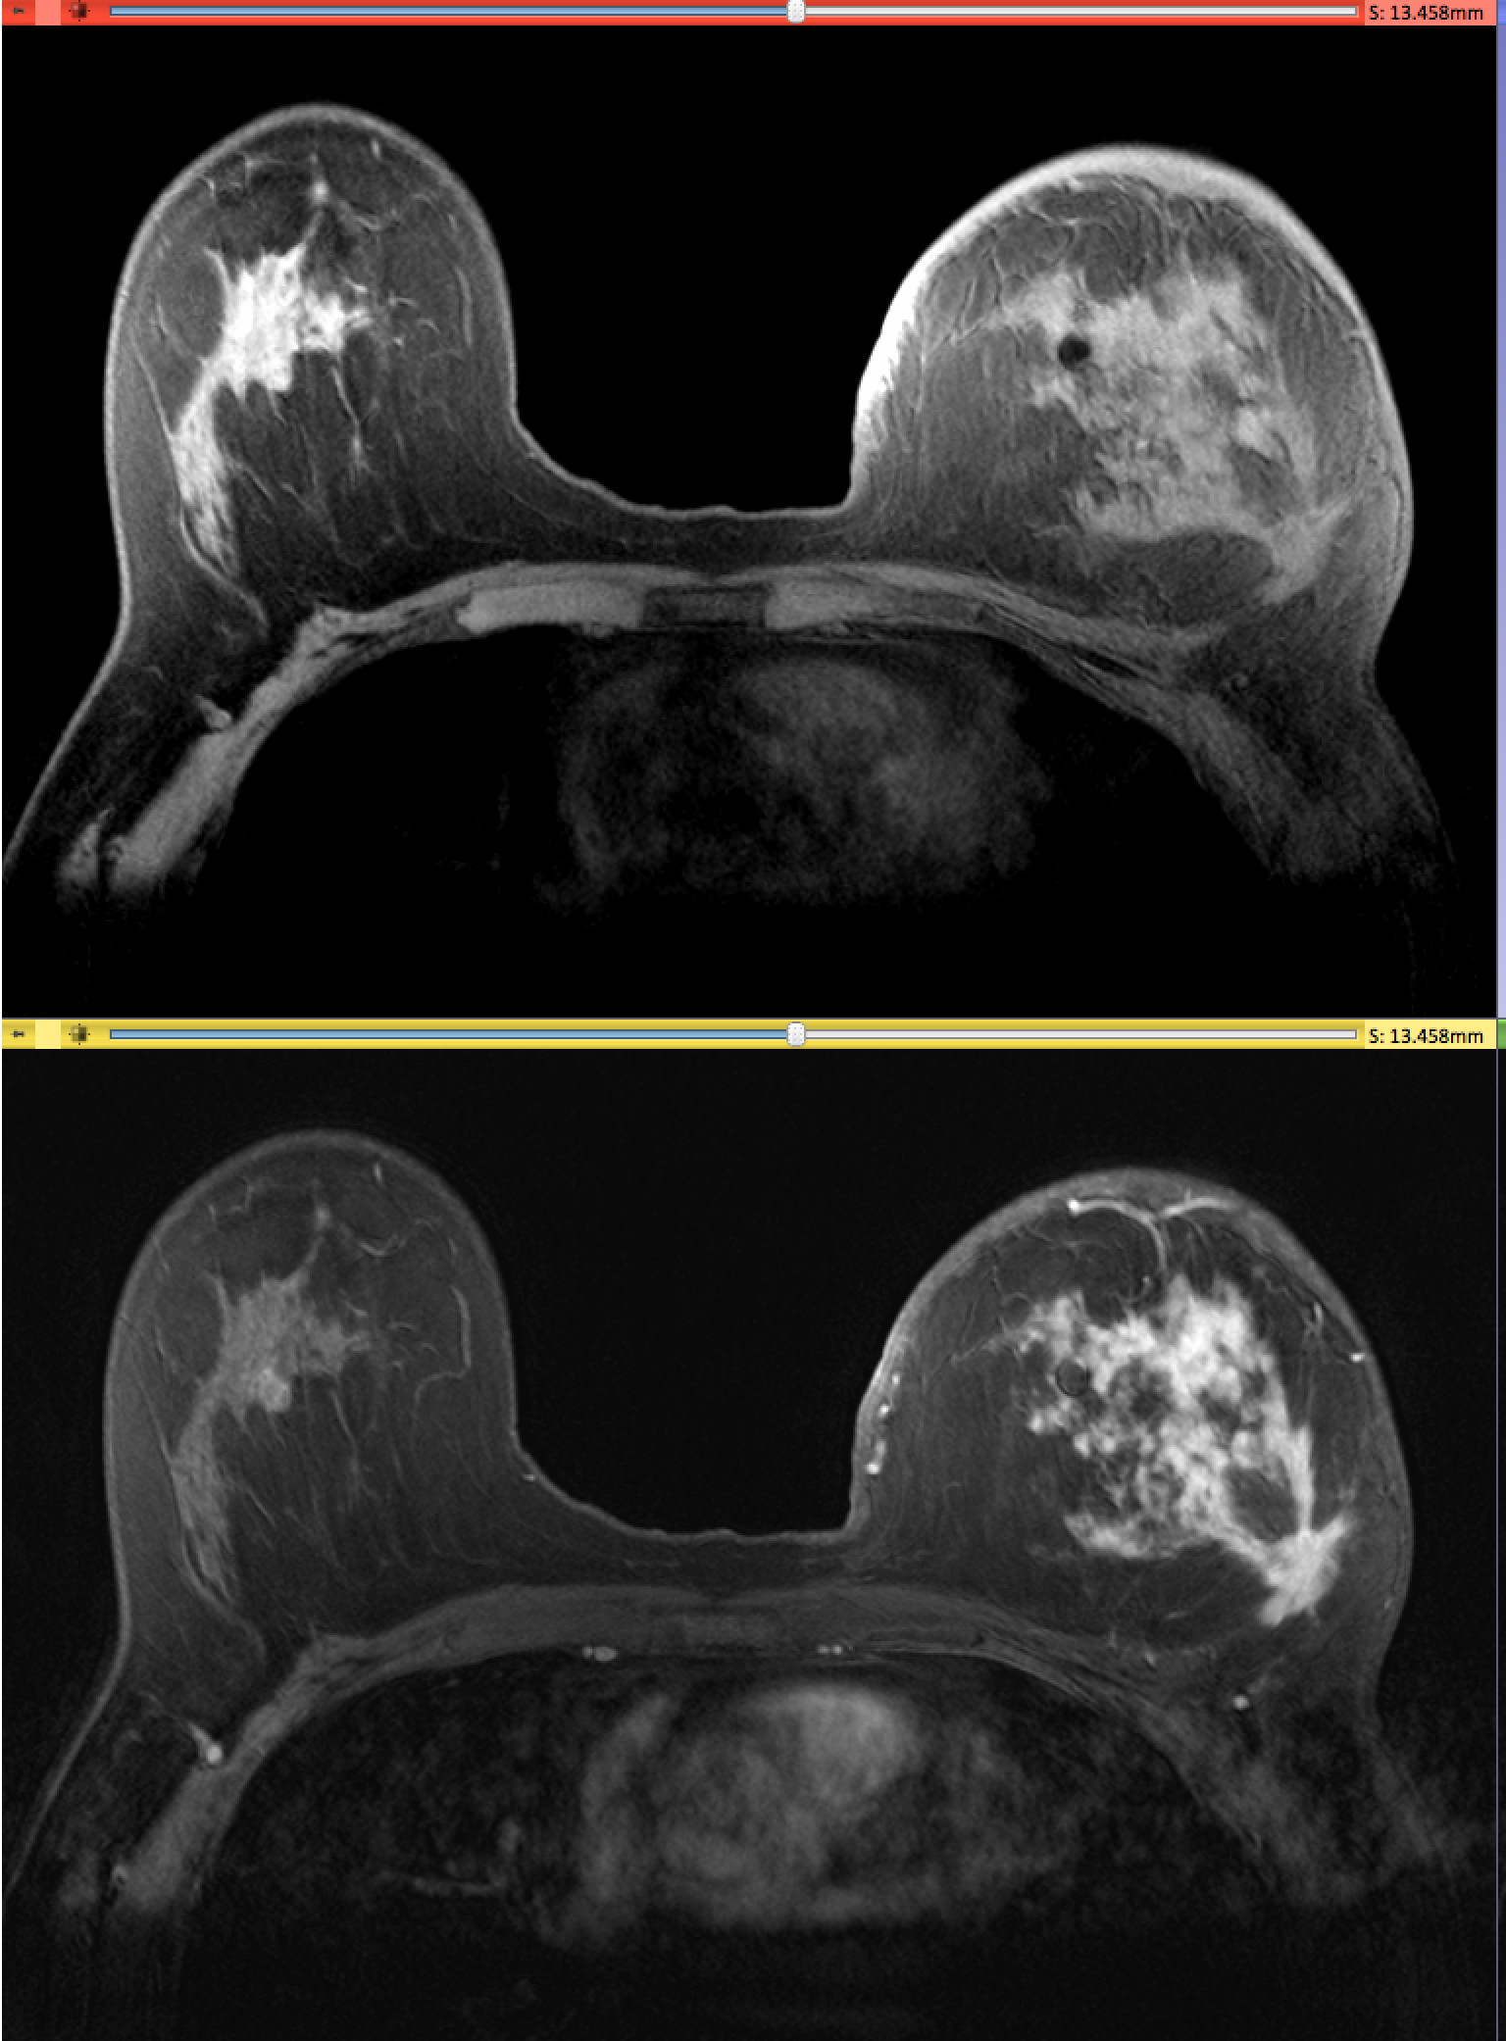
PreTherapy acquisition
Pre-Gad Highres
Post-Gad Highres

Slide 53
Breast tumor case: 3D Slicer processing pipeline
Step #1: Non-rigid Registration of pre-Gad image to post-Gad image (Editor module)
Step #2: Subtraction of registered pre-Gad image to the post-Gad image (Subtract Scalar Volumes module)
Step #3: Semi-automated segmentation of the subtracted image (Editor Module)
Step #4: 3D model creation (Model Maker module)
Step #5: Tumor volume computation (Models module)
Processing time ~5-7 min

Slide 54
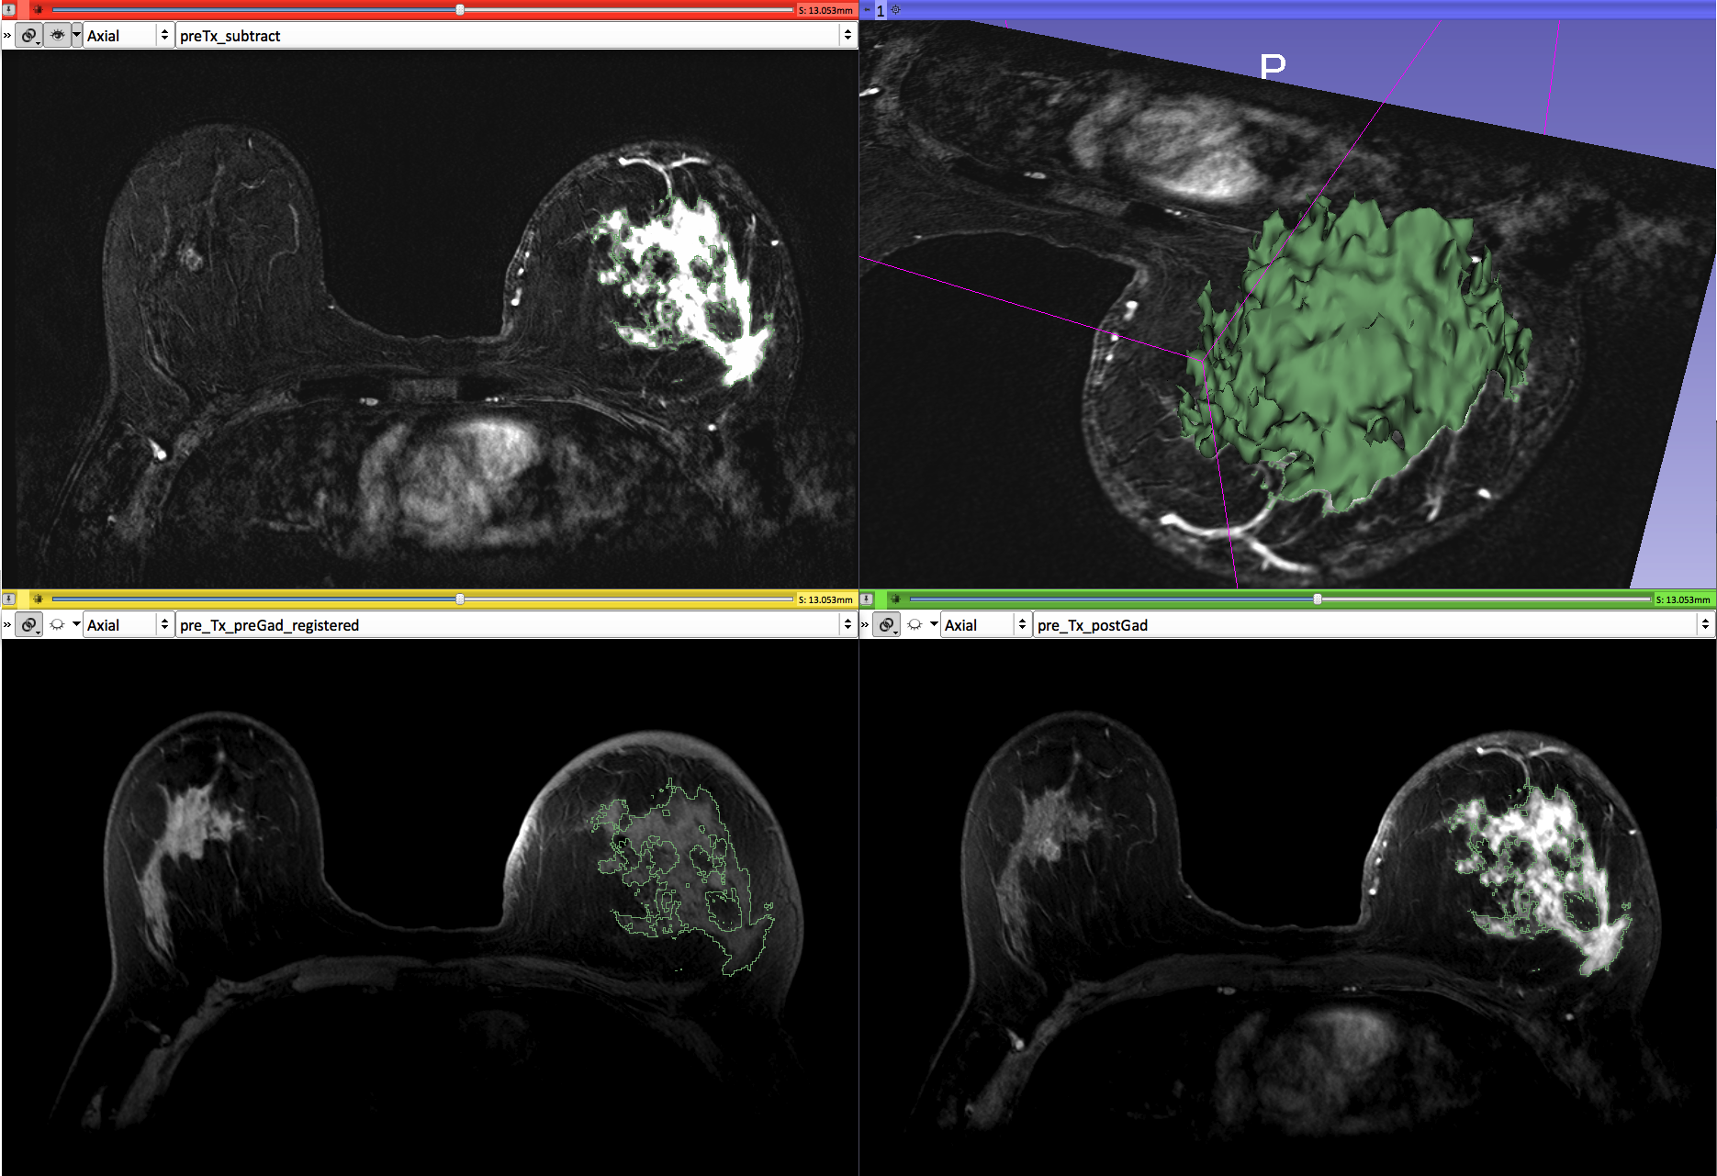
Pre-therapy analysis (May 2013)
Subtract
Pre-Gad
Post-Gad
Tumor volume (May): 75 cm3

Slide 55
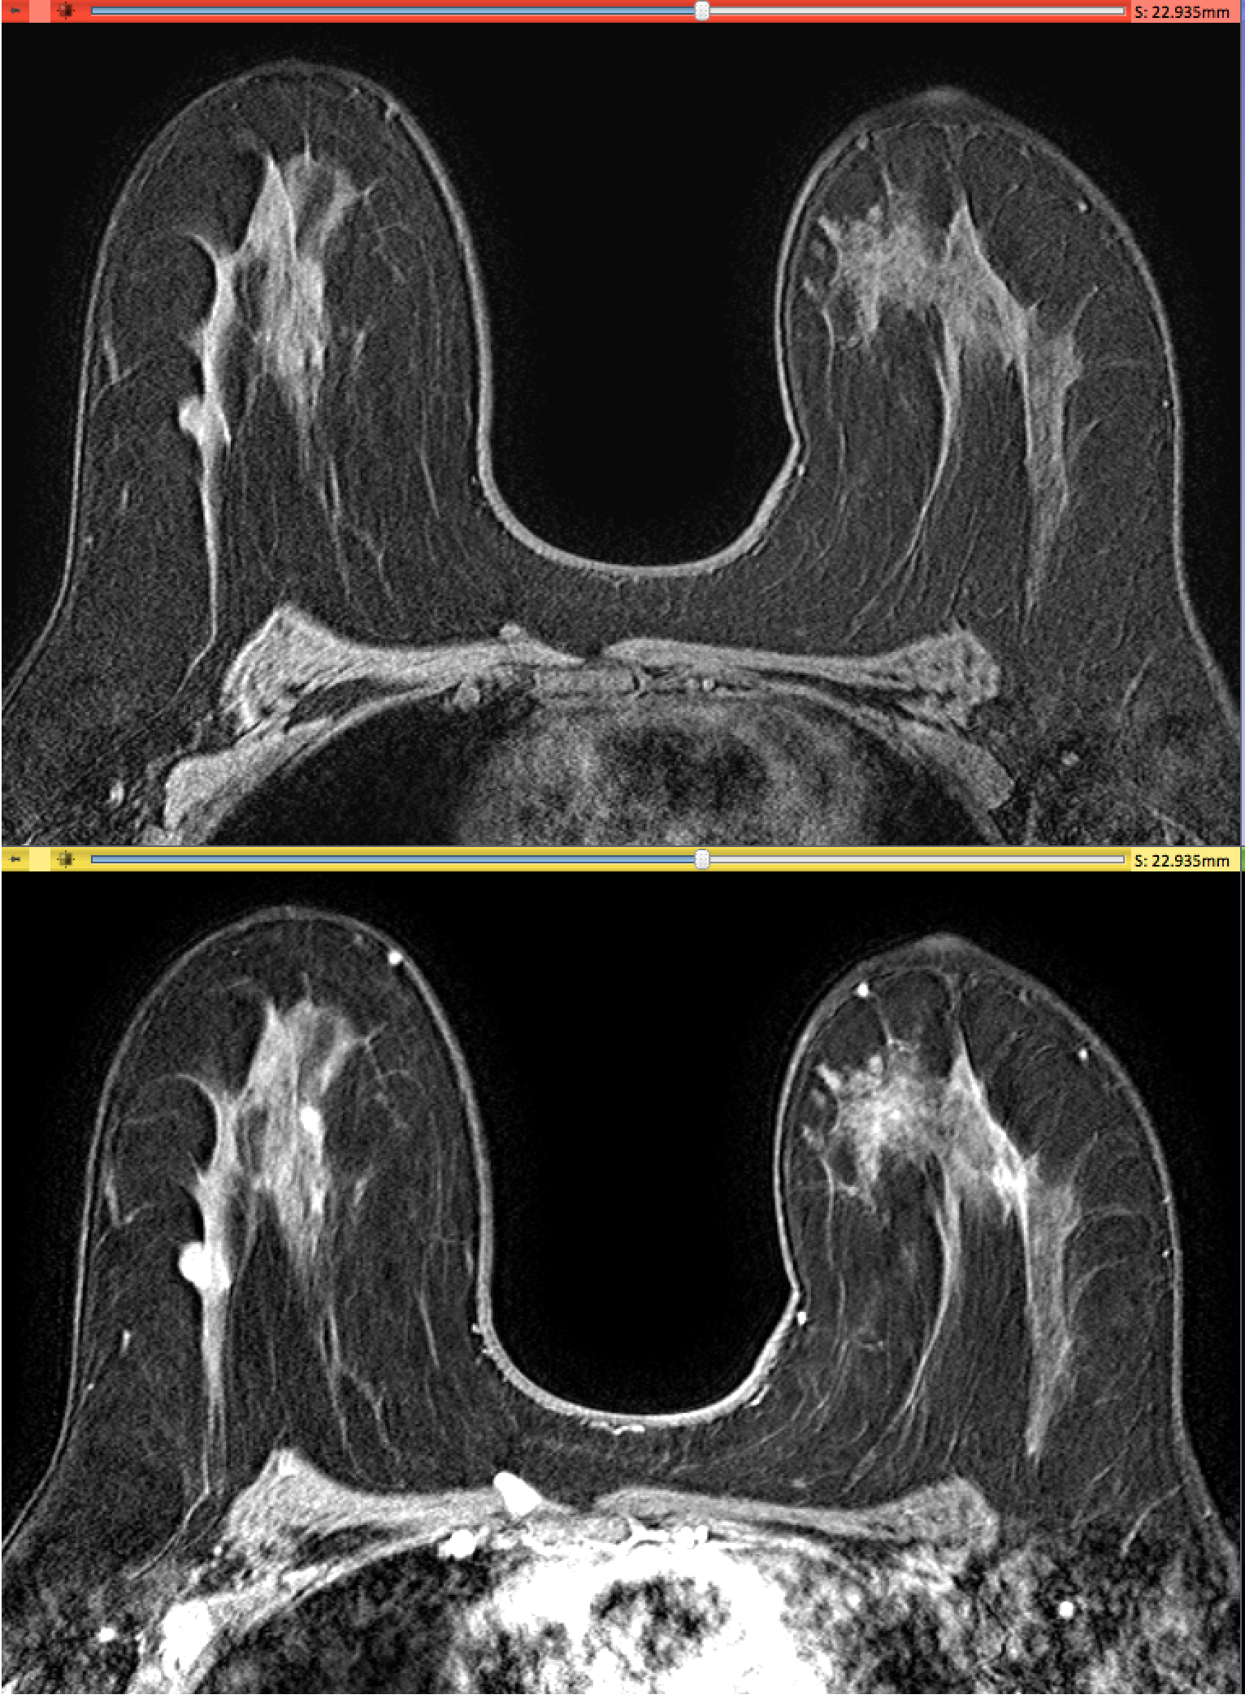
PostTherapy acquisition
Pre-Gad Highres
Post-Gad Highres

Slide 56
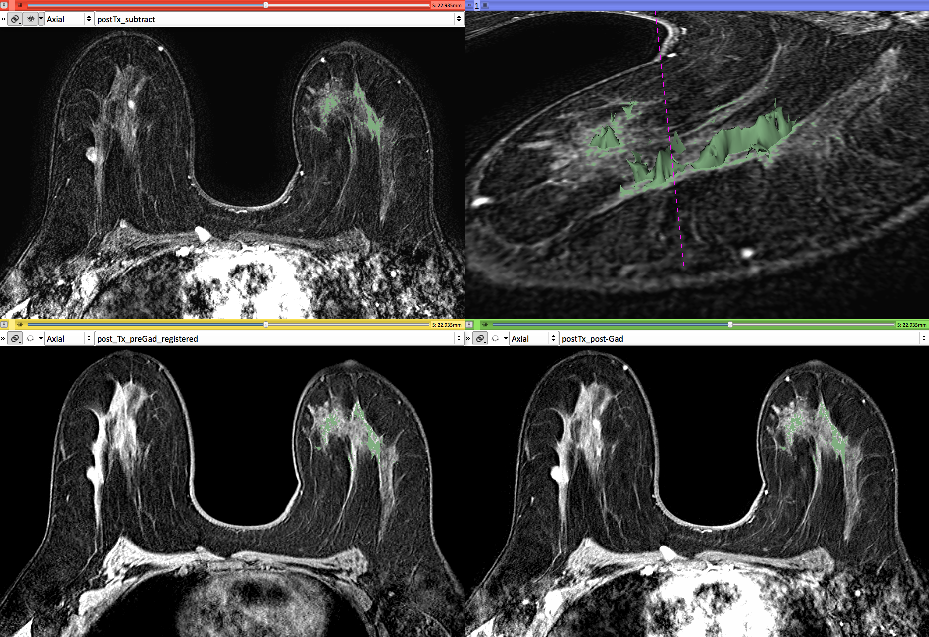
Post-therapy analysis (Oct. 2013)
Subtract
Pre-Gad
Post-Gad
Tumor volume (Oct): 0.9 cm3

Slide 57
Example2: Small volumetric change
MR Scan1 June 2006
The following section will guide you step-by-step through the computation of small volumetric changes in a slow growing tumor.
This tutorial is built upon two scans (Axial 3D SPGR T1 post Gadolinium) of a patient with meningioma, and uses the Change Tracker module of Slicer.
MR Scan2 June 2007
(Voxel dimension: 0.94mm x 0.94mm x 1.20mm, FOV: 240mm, Matrix: 256 x 256)

Slide 58
Conventional measures of tumor response
Conventional anatomic imaging using CT or MRI are often used to evaluate tumor size and shape
Most clinical trials that evaluate new chemotherapeutic drugs use changes in uni-dimensional or bi-dimensional measurements to assess response (e.g. RECIST)
Slicer has several tools for applying RECIST methodologies

Slide 59
Conventional measures of tumor response
3D Slicer Annotations measure diameters in a tumor cross section, and to provide interactive numerical annotations.

Slide 60
Clinical case: baseline scan
Baseline radiologist’s clinical impression:
large falcine lesion is identified.
measures 3.10 cm anteroposteriorly and 3.51 cm in height.
enhances moderately on post gadolinium imaging.
Notes:
Falx cerebris: strong arched form of dura matter that descends vertically in the longitudinal fissure between the cerebral hemispheres

Slide 61
Clinical Case: follow-up scan
Follow-up radiologist’s clinical impression:
left frontal lobe mass appears unchanged on all series.
measures 3.3 x 3.2 cm in maximum dimension.
enhances moderately on post gadolinium imaging.

Slide 62
Clinical Case: follow-up scan
Follow-up radiologist’s clinical impression:
left frontal lobe mass appears unchanged on all series.
measures 3.3 x 3.2 cm in maximum dimension.
enhances moderately on post gadolinium imaging.
→ How has the tumor changed?

Slide 63
ChangeTracker: rationale for new approaches
More accurate and precise methods for understanding volume changes may be useful when:
benign tumor change is being monitored, or
where small changes may be clinically significant but difficult to assess with RECIST

Slide 64
ChangeTracker: Load the dataset
Drag and drop the file ChangeTrackerScene.mrb located in
QuantitativeImaging_Sunday_Dec1\dataset2_ChangeTracker
Click OK to load the .mrb file into Slicer

Slide 65
Loading the data
The datasets of the ChangeTrackerScene appear in the anatomical viewers.

Slide 66
Loading the data
The Slicer scene contains two scans 2006-spgr1 and 2007-spgr1.

Slide 67
ChangeTracker: exploring small volumetric changes
Using the Modules Menu button, select the ChangeTracker Module.

Slide 68
ChangeTracker: a note about the Workflow wizard
The Workflow Wizard guides the user through a sequence of steps and has the following components:
the Step Panel
the User Panel
the Navigation Panel
Step Panel--
User Panel--
Navigation Panel--

Slide 69
Step1: Select input scans
Click to expand the tab ‘1.Select input scans’
- Set the Baseline scan to 2006-spgr1
- Set the Follow up scan to 2007-spgr1
Click on the green arrow to the next step of the workflow

Slide 70
Step2: Define Region of interest
A Volume of Interest (VOI) Box Widget appears in the anatomical viewers, and in the 3D viewer.

Slide 71
Step2: Define Region of interest
Browse through the Axial, Sagittal and Coronal slice viewers to get a close-up view of the tumor
Zoom in (Right mouse down and push/pull).
Pan (Middle mouse down and move)
Hold the shift button down to display the same location in all three viewers

Slide 72
Step2: Define Region of interest
Center the VOI first:
Position the square in the center of the tumor in the slice viewer.

Slide 73
Step2: Define Region of interest
Next, resize the VOI:
Use the colored handles to change the VOI extent

Slide 74
Step2: Define Region of interest
The VOI box and volume rendering of tumor in yellow appear in the 3D Viewer

Slide 75
Step2: Define Region of interest
Fine-tune the VOI using the VOI Widget range sliders or by moving the VOI Widget handles in 3D view
Note: VOI Widget range sliders are color-coded to match VOI box Widget handles in 3D Viewer

Slide 76
Step2: Define Region of interest
Select the viewing mode ‘Conventional Widescreen’

Slide 77
Step2: Define Region of interest
Slicer shows a closer view of the volume rendered tumor region.

Slide 78
Step2: Define Region of interest
Zoom in and out, and rotate the volume rendered image to explore the tumor region in 3D.

Slide 79
Step2: Define Region of interest
Select ‘Four-Up Quantitative’ to return to the initial view mode
Click on the green arrow to move to the next step

Slide 80
Step3: Segment the tumor
Click on the pin icon in the top left corner of the red slicer viewer to display the names of the two volumes that Slicer has generated automatically: baselineROI and baselineROI_segmentation

Slide 81
Step3: Segment the tumor
‘baselineROI ‘(background viewer) is the subvolume that corresponds to the previous VOI
‘baselineROI_segmentation’ (labelmap viewer) is the current segmentation of the tumor.
In the current settings, Slicer displays the segmentation overlaid on the spgr volume
The 3D Viewer shows the corresponding 3D volume-rendered image of the tumor

Slide 82
Step3: Segment the tumor
Select the layout FourUp in the layout menu to display the volume rendered segmentation
Modify the segmentation of the tumor by moving the threshold range slider

Slide 83
Step3: Segment the tumor
Scroll through the slices until the segmentation appears optimal.
Click on the green arrow to move to the next step

Slide 84
Step4: Select the Analysis Method
Select the ROI Analysis Method :
‘Intensity Difference Change Detection (FAST)’
Click on the green arrow to move to the next step

Slide 85
Step4: Select the Analysis Method
Left click on the slice menu to display the volumes that have been generated:
- followupROI correspond to the subvolume that has been extracted around the tumor in the 2007-spgr_1 dataset
- changesVolume_IntensityDifferenceMetric corresponds to the change between the 2006 and 2007 scans

Slide 86
Step4: Select the Analysis Method
Click on links icon in the Red Slice Viewer menu to link all three viewers.
Click on the icon to adjust the size of the image to the size of the window, and browse through the slices to display the images

Slide 87
Final Step: Change Tracker Results
The change in volume is shown overlaying the tumor image and in the 3D Viewer: magenta = growth green = shrinkage

Slide 88
Visualization of the change in pathology
The results of the analysis are displayed in the “Compare View” layout
Six consecutive slices for the VOI in Scan1 (top row), and
Six corresponding consecutive slices for the VOI in Scan2 (bottom row).
A zoomed view of the axial slice in the red slicer viewer

Slide 89
Visualization of the change in pathology
The Crosshairs in Compare View show corresponding voxels in Scan1 and Scan2 for voxel-wise comparison.

Slide 90
Change Tracker Results
The metrics calculated indicate the volume and percentage of tumor growth between the two time points.

Slide 91
Change Tracker module
This tutorial demonstrated the use of the change tracker module in Slicer on axial 3D SPGR T1 post Gadolinium scans
Tumor boundary should be clear
Only for contrast enhanced images
Need homogenous enhancement across timepoints.
The Change Tracker module has not been tested for tumors with changing necrosis.

Slide 92
ChangeTracker: Exploring small volumetric changes
This tutorial demonstrated:
a method to quantify small volumetric changes in pathology.
visualization of these changes in the anatomical context
use of Slicer’s “Compare Viewer” to simultaneously explore baseline and followup studies.
Next, we will demonstrate combined visualization of PET/CT studies and SUV computation.

Slide 93
Clear the scene and its data
Clear the previous scene.
Select File->Close Scene
Select File→Exit and restart Slicer

Slide 94
PET/CT Visualization and Analysis
Part III: PET/CT Analysis
Sonia Pujol, PhD
Kitt Shaffer, MD, PhD
Hatsuho Mamata, MD, PhD
Ron Kikinis, MD

Slide 95
Goal of the tutorial
The goal of this tutorial is to guide you step-by-step through the SUV computation of PETCT data of a squamous cell carcinoma case pre- and post- treatment

Slide 96
FDG-PET SUV
Standardized Uptake Value (SUV) is a semi-quantitative measure derived from the determination of tissue activity obtained from a clinical PET study
SUV = Tissue Concentration of Radioactive Tracer x
Patient Weight / Injected Dose
Under certain circumstances, 18-F Fluorodeoxyglucose (FDG) SUV correlates with metabolic rate of glucose and/or the number of viable tumor cells

Slide 97
Tutorial Case
Pathology: poorly differentiated squamous cell carcinoma
Treatment: radiotherapy and chemotherapy (weekly cis-platin)
Two 18F-FDG PET and CT scans acquired within a 5-month interval.

Slide 98
PETCT tutorial: Clinical Case and Data
The datasets are located in
\dataset3_PETCT
The directory contains two .mrb files
- PET_CT_pre-treatment.mrb corresponds to the baseline
- PER_CT_post-treatment.mrb corresponds to the follow-up scan.

Slide 99
Loading the PETCT scene
Drag and drop the file PETCT_pre-treatment.mrb located in
QuantitativeImaging_Sunday_Dec1\dataset3_PETCT
Click OK to load the .mrb file into Slicer

Slide 100
Loading the PETCT scene
The CT dataset appears in the anatomical viewer

Slide 101
Loading a PETCT dataset
Left click on the pin icon in the top left corner to display the red slice viewer menu.
The CT1 volume is displayed in the Foreground viewer
The PET1 volume is displayed in the Background viewer
The PET1-Label is displayed in the Labelmap viewer
Use the slider to fade between the Bg viewer and the Fg viewer to display the PET volume overlaid on the CT volume

Slide 102
Visualization of PETCT data
Change the opacity of the CT1 volume to 0.50 to display the CT images overlaid on the PET images

Slide 103
Visualization of PETCT data
Hold the left mouse button down, and move the mouse cursor up/down and left/right to adjust the window and level of the PET images

Slide 104
Visualization of PETCT data
Check on the slice visibility icon in the red and yellow viewers to display the axial and sagittal slices in the 3D viewer

Slide 105
PET uptake findings
Note an intense uptake in 1) left oropharyngeal mass involving the base of tongue and left glossotonsillar fossa (Axial -139 mm)
2) in left level IIA/III lymph nodes as well as a small adjacent left level III node (Coronal 65 mm)
3) a possible small metastasis in the left retropharyngeal region at level of C1 (Sagittal -19 mm)
1
3
2
3

Slide 106
PET SUV Computation
For the purpose of this tutorial, we have pre-segmented the lymph nodes uptake region. In the next section, we will compute the SUV for this area.
Select the module PET Standard Uptake Value Computation in the category Quantification in the modules’ menu

Slide 107
PET SUV Computation
Step1: Input volumes selection
Select Input PET Volume ‘PET1’
Select Input VOI Volume ‘PET1-label’

Slide 108
PET SUV Computation
Step2: Path to the DICOM PET header
Click on Applications in the PET DICOM volume path
Select the PET1 subdirectory located under
C:/Pujol2013/QuantitativeImaging_Sunday_Dec1/dataset3_PETCT/PET1
Click on Choose to select the PETDICOM volume path

Slide 109
PET SUV Computation
Step3: SUV Computation
Click on Apply to compute the SUV in the segmented region

Slide 110
PET SUV Computation
SUV Computation Results:
SUVmax = 7.53385 mg/ml
SUVmin = 5.01805 mg/ml
SUVmean = 3.39015 mg/ml

Slide 111
PET SUV Computation
Select File→ Close Scene in the main menu

Slide 112
Loading the PETCT scene
Drag and drop the file PETCT_post-treatment.mrb located in
C:\SlicerData\QuantitativeImaging_Sunday_Dec1\dataset3_PETCT
Click OK to load the .mrb file into Slicer

Slide 113
PET uptake findings
Set the opacity of the CT2 images to 0.5 in the anatomical viewers, and use the left mouse button to adjust the Window and Level of the images.

Slide 114
PET uptake findings
Observe a mild uptake in larynx and pharynx that are likely due to radiation effect.

Slide 115
PET uptake findings
Note that there is no remaining uptake in the area of the primary tumor or nodes after treatment

Slide 116
Conclusion
This tutorial has demonstrated how to do 3D data visualization, quantitative measurement of small changes in tumor size, and PET CT SUV computation in Slicer
3DSlicer is for research use only, and is not FDA approved
3DSlicer is a free open-source software for medical image computing and supported by the NIH

Slide 117
Acknowledgments
National Alliance for Medical Image Computing (NA-MIC)
NIH Grant U54 EB005149
Neuroimage Analysis Center (NAC)
NIH Grant P41 RR013218
Kitt Shaffer, MD, PhD, Boston University Medical Center
Hatsuho Mamata, MD, PhD, Brigham & Women’s Hospital
Tobias Penzkofer, MD, Brigham & Women’s Hospital, RWTH Aachen University
Marianna Jakab, MS, Brigham & Women’s Hospital

Slide 118
3DSlicer at RSNA 2013
Quantitative Imaging Reading Room Exhibit QIRR 1028
Sun. Dec.1-Fri. Dec.6, 8:00-6:00
3DSlicer: An Open Source Platform for Segmentation, Registration, Quantitative Imaging, and 3D Visualization of Multi-Modal Image Data.
Sonia Pujol, PhD, Steve Pieper, PhD, Andriy Fedorov, PhD, Ron Kikinis, MD,

Slide 119
Additional Related Hands-on courses
All courses are in this Advanced Imaging Classroom: S401CD (except Monday when it is in S401AB)
Sunday 4:00 pm – Structured Annotation and Image Markup (AIM) Template and Toolsets (ICIW12)
Monday 4:30 pm – Clinical Trials Software for Clinical Trials and Research (ICIW24)
Wed 10:30 am – Open Access Imaging Data Resources: NIH Cancer Imaging Archive (ICIA41)
Wed 12:30 pm – Correlating Imaging with Human Genomics (ICIA42)

Slide 120
3DSlicer at RSNA
Questions: spujol@bwh.harvard.edu

