Slide 1
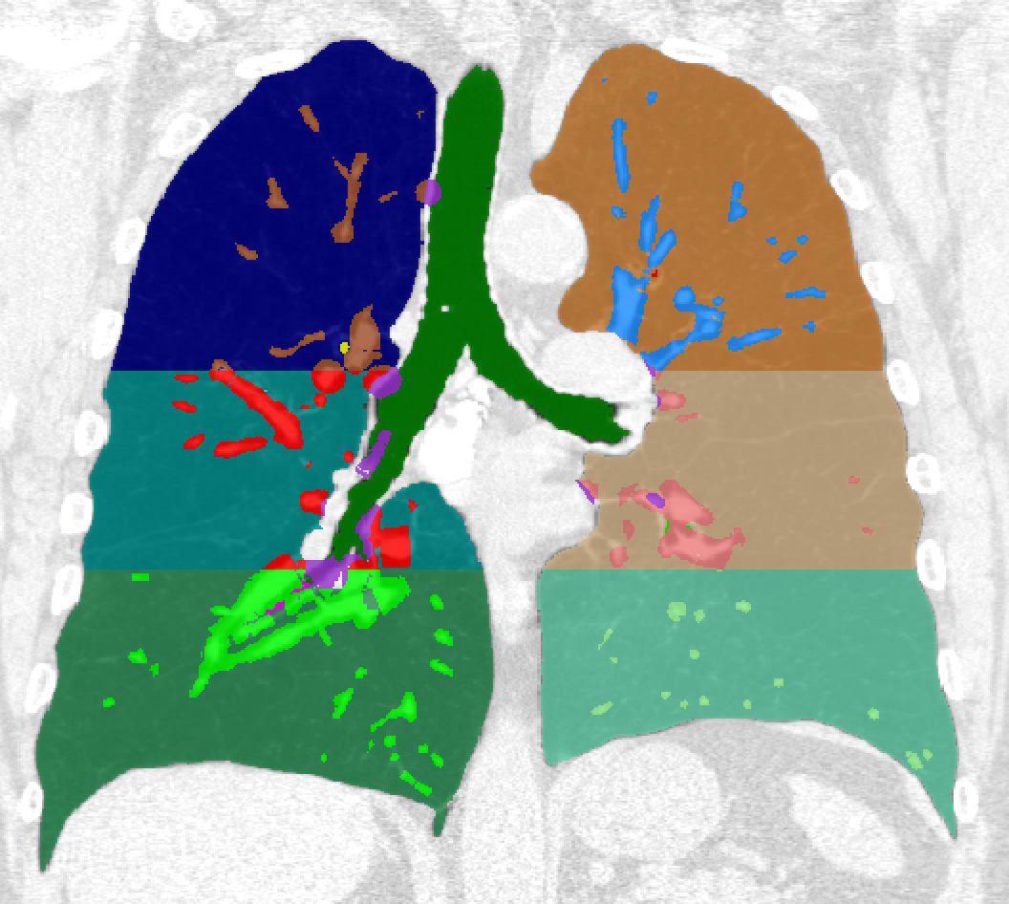
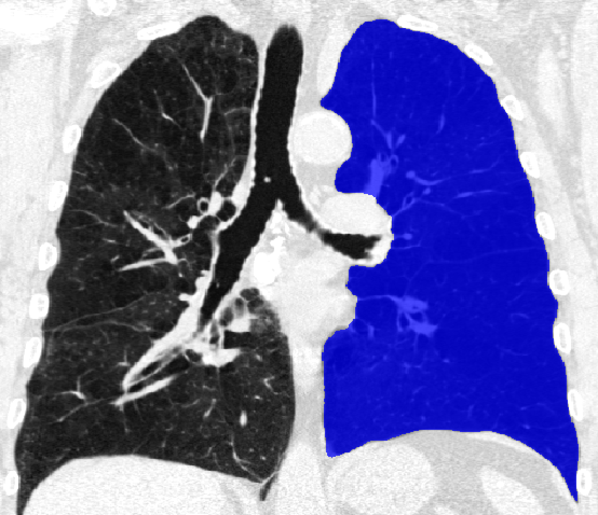
~/CommandLineTools/GeneratePartialLungLabelMap
~/CommandLineTools/ExtractChestLabelMap

Slide 2
~/cip_python/particles/vessel_particles.py

Slide 3
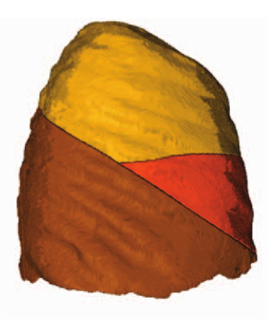
~/CommandLineTools/GenerateLobeSurfaceModels
~/CommandLineTools/FilterFissureParticlesData
~/CommandLineTools/FitLobeSurfaceModelsToParticleData
~/CommandLineTools/ClassifyFissureParticles
~/CommandLineTools/SegmentLobeLobes

Slide 4
~/cip_python/phenotypes/body_composition_phenotypes.py

