Slide 1



Chest Imaging Platform (CIP)
Applied Chest Imaging Laboratory
Boston, Massachusetts. USA
COPD Intor

Slide 2
Chronic Obstructive Pulmonary Disease (COPD)
Definition: “Airflow limitation that is not fully reversible. The airflow limitation is usually progressive and associated with an abnormal inflammatory response of the lung to noxious particles or gases.”
Causes:
Notes:
Chronic obstructive pulmonary disease (COPD) is currently simply defined as chronic airflow limitation that is not fully reversible; however, in reality COPD is a complicated group of disorders with a range of pathological changes in the lung, extra-pulmonary effects, and comorbidities, which all may contribute to the severity of the disease [1 –5 ]. In the lungs, parenchymal destruction (emphysema), small airways disease, large airways disease,and possibly other factors contribute to the airflow limitations in varying degrees. Unraveling of this heterogeneity is challenging but important, because early detection of these pathologies might enable more accurate and earlie rdiagnosis and might lead to more specific therapeutic options.

Slide 3
COPD: A growing disease
Percent Change in Age-Adjusted Death Rates, U.S., 1963-2010
Coronary
Heart
Disease
Stroke
Other CVD
COPD
All Other
Causes
Proportion of 1963 Death Rate
–76%
–78%
–46%
+156%
–11%
COPD is the third leading cause of death in the US and is projected to be the fourth leading cause of death worldwide by 2020
Source: www.nhlbi.nih.gov/about/factbook/chapter4.htm
Notes:
Between 1970 and 2002, death rates due to stroke and heart disease decreased (63% and 52%, respectively), while death rates due to COPD increased 100% (13)
Jemal A, Ward E, Hao Y, Thun M. Trends in the leading causes of death in the United States, 1970–2002. JAMA 2005;294:1255–1259.
----- Meeting Notes (12/6/13 14:17) -----
Mortality rate

Slide 4
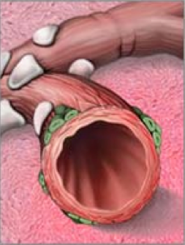
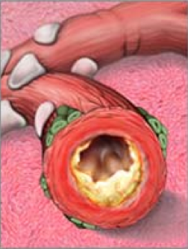
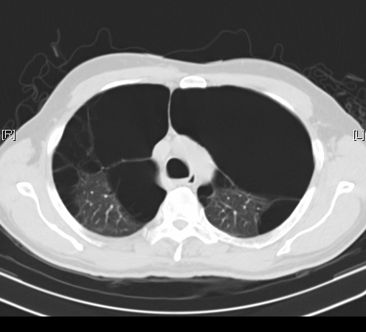
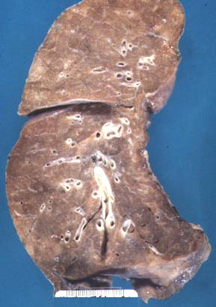
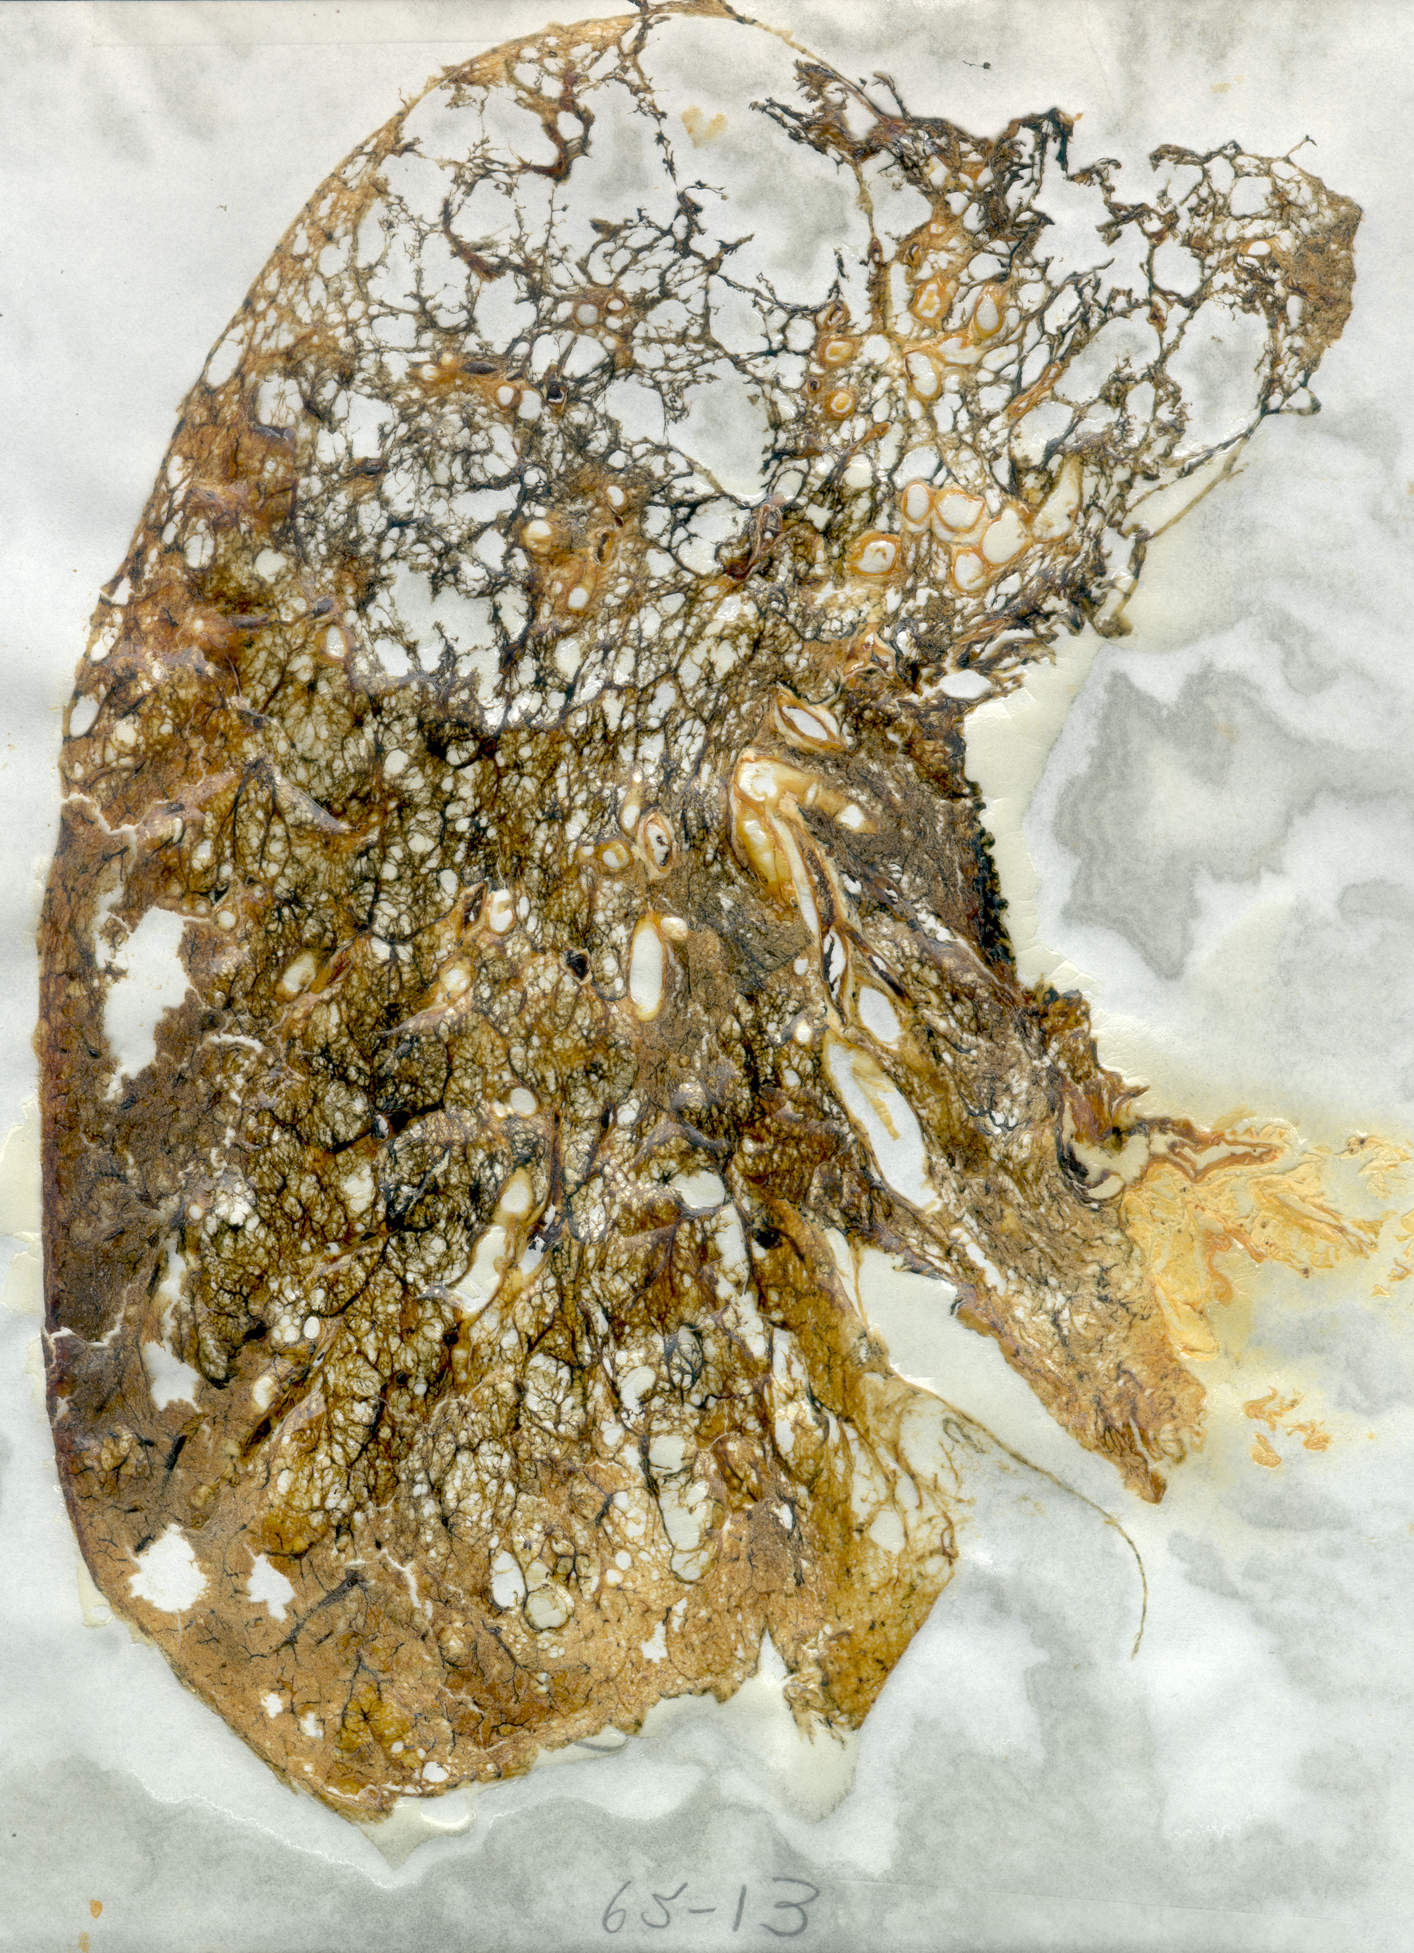
COPD: A Heterogeneous Disease
Airway Diseases
Chronic remodeling of the airways.
Lumenal obstruction due to wall inflammation, thickening and smooth muscle constriction
Emphysema Disease
Progressive destruction of the lung alveolar tissue
Notes:
COPD is recognized to be a heterogeneous condition
both in its manifestations as well as responses to therapy. Because of this there is
great interest in developing new tools to further define more homogeneous subsets of
patients for genetic, epidemiological and therapeutic investigation
Changes in mucus gland thickness, air flow limitation due to:
Mechanical obstruction
2) Loss of pulmonary elastic recoil
3) Reduction of alveolar attachment around the walls small airways

Slide 5
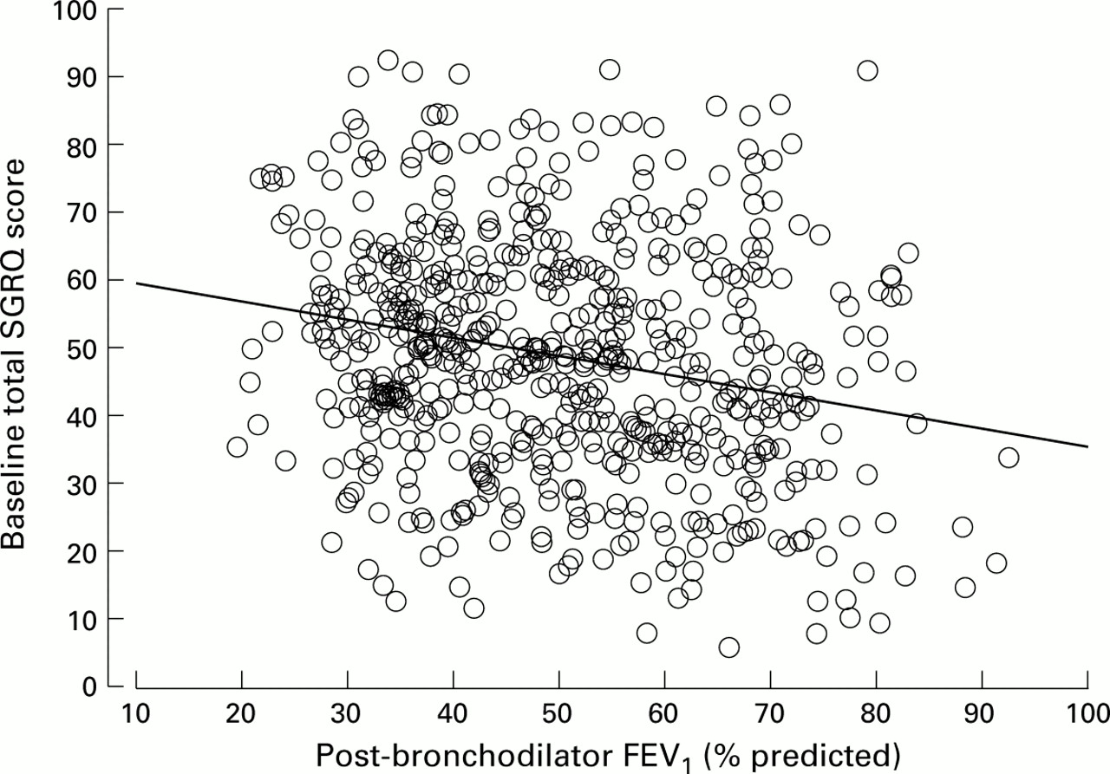
Why Do we need new Biomarkers in COPD?
Jones et al. Thorax, 2001

