Slide 1
Chest Imaging Platform (CIP)
Applied Chest Imaging Laboratory
Boston, Massachusetts. USA
Infrastructure, testing and related Slicer modules

Slide 2
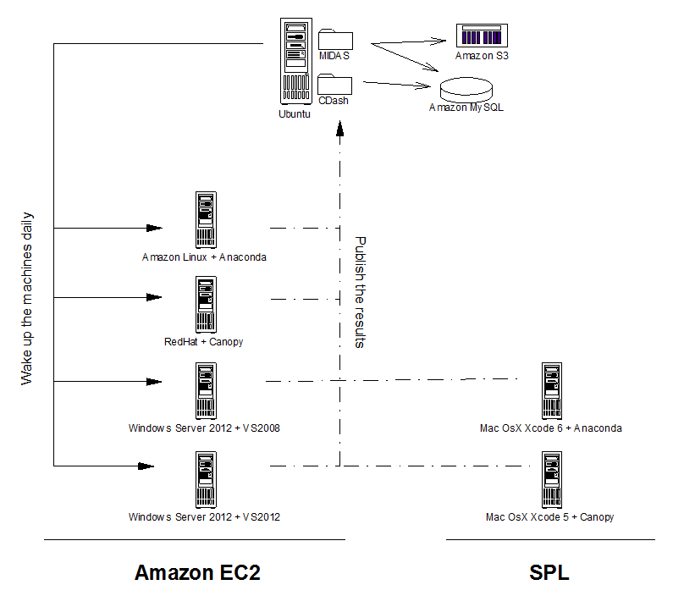
Cloud testing infrastructure

Slide 3
Test types in CIP
By purpose:
Unit → small tests in a reduced scope
Regression → to check that things still work in the same way (usually small images)
Acceptance → real world cases when the algorithm produces a valid output (usually large tests)
By size (configurable from Cmake settings):
Common
Large → require MIDAS data
By language
Python
C++

Slide 4
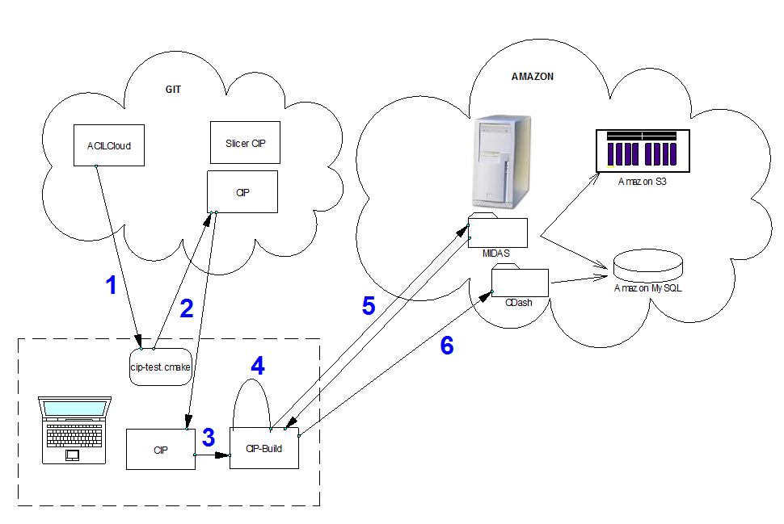
Testing process
Download last version of test scripts
Get CIP source code last version
Compile CIP
Run tests
For large tests, request for MIDAS images (not cached)
Publish the results to CDash
Step 1 is executed manually (GIT pull) or scheduled in Amazon machines
Steps 2-6 are executed via
“cip-test.cmake” file

Slide 5
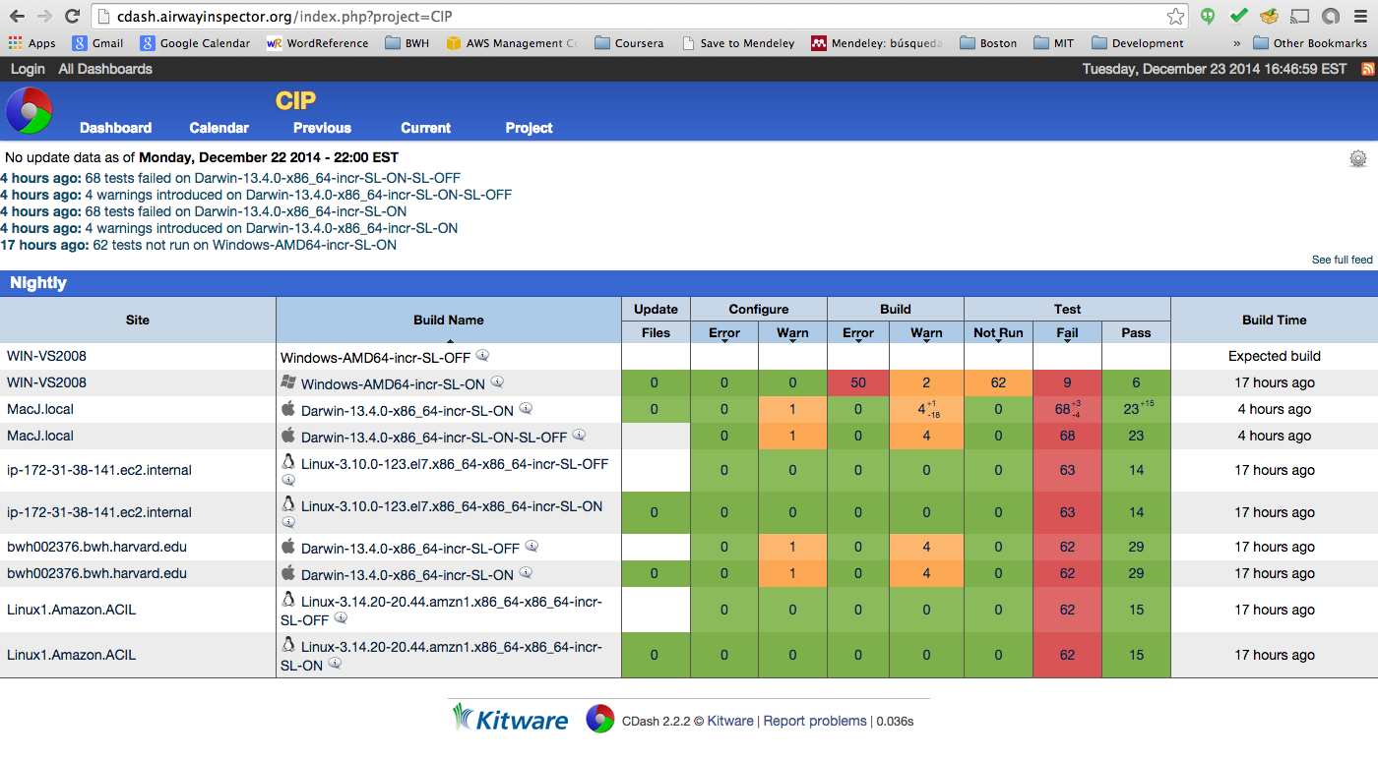
CDash results

