Slide 1
Tutorial Contest Project Week 2017
Simple Multi-shell Diffusion Gradients
Information Extractor
Laurent Chauvin, PhD Student, ETS Montreal

Slide 2
Presentation
Simple Python script parsing multi-shell sensitizing gradients information from nifti file format (separated bvecs, bvals files)

Slide 3
Presentation
Several commands:
help : Display the help message
info : Print information about the number of gradients in each shell
symmetry : Find symmetrical gradients (given a certain error) with similar b-values
print : Print all gradient vectors (or a single one if specified with option –bvec #bvec_id)
show : Display a graphical representation of the gradient vector distribution

Slide 4
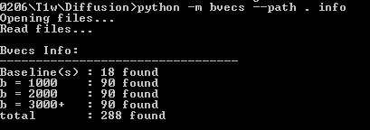
Info Command
Info command will print information about the number of gradient vectors within each shell

Slide 5
Symmetry Command
Symmetry command will ask users to provide an error range for the dot product and output all symmetrical gradient vectors within this range and within the same shell

Slide 6
Print Command
If command specfied with –bvec option, followed by gradient vectors id, such as –bvec 22 for example, only the information about this specific vector

Slide 7
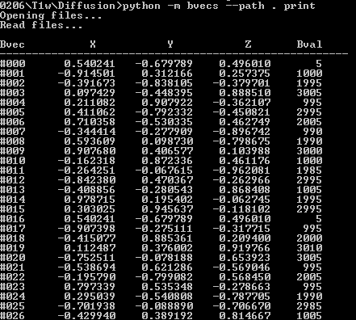
Print Command
Or we could output information about all gradient vectors without specifying a –bvec option

Slide 8
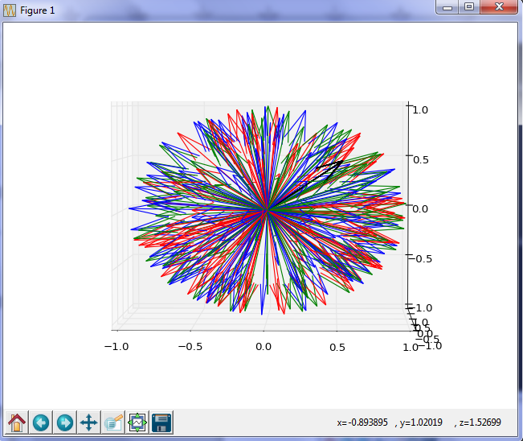
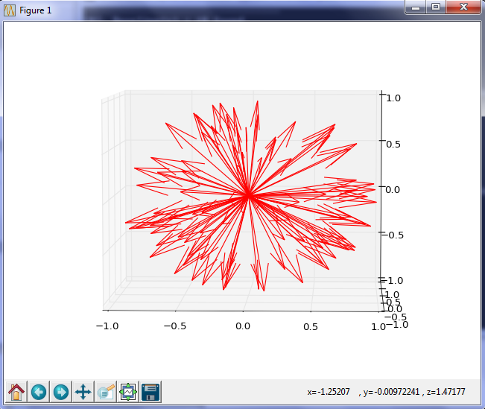
Show Command
Show command will ask users which shell they want to visualize and then provide a graphical representation of the vector distribution of that shell
b = 0
b = 1000
b = 2000
b = 3000
b = 1000

