Slide 1
Lessons in Multi-site DTI Acquisition- the BIRN experience
Randy L. Gollub, MD, PhD
Massachusetts General Hospital
Departments of Psychiatry & Radiology
41st Annual meeting of the Society for Neuroscience
Washington, DC
November 11, 2011

Slide 2
Acknowledgements
Morphometry BIRN
Susumu Mori
Allen Song
Jorge Jovicich
Karl Helmer
Carlo Pierpoli (External Advisor to NAMIC)
Tonya White and the Mind Research Network Clinical Imaging Consortium team

Slide 3
Morphometry BIRN: DTI acquisition
See:
https://xwiki.nbirn.org:8443/bin/view/Morphometry-BIRN/mBIRN_DTI_protocols

Slide 4
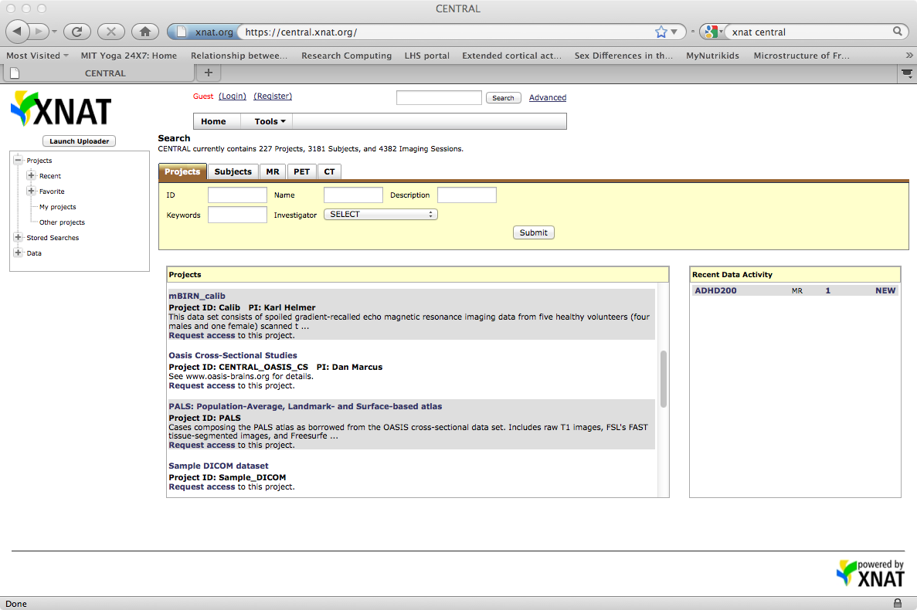
Image Data Repository

Slide 5
Notes:
ic = internal capsule; fw = frontal white matter ; cs = centrum semiovale; gp = globus pallidus; put = putamen; scc = splenium of the corpus callosum

Slide 6
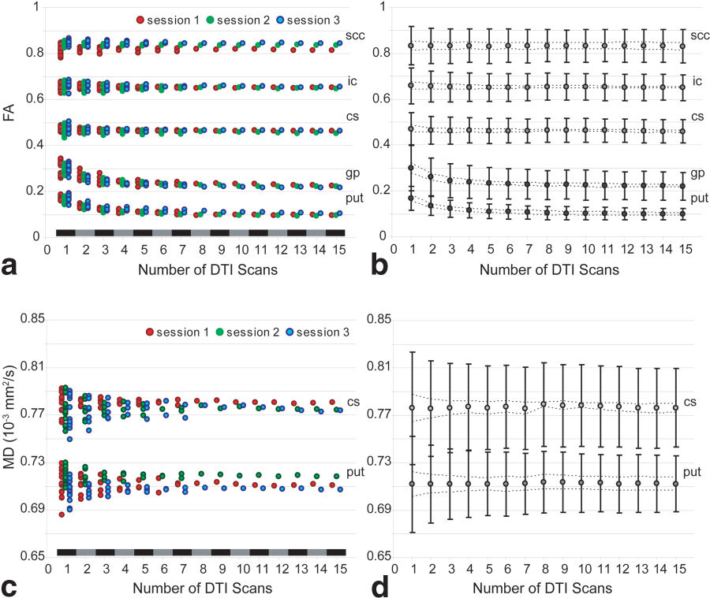
Optimal DTI scan parameters are dictated by the ROI
Farrell et al; 2007
Notes:
One subject scanned repeatedly within and across days. For each of the ROIs the mean FA and MD is fairly reliable once sufficient data is acquired. The higher the FA/MD, the less data is required to achieve reliability

Slide 7
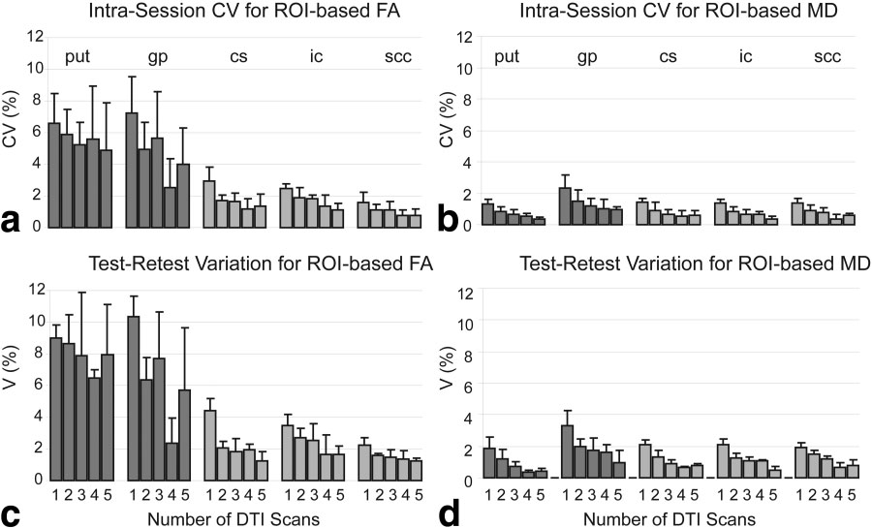
Optimal DTI scan parameters produce reliable results within and across sessions
Farrell et al; 2007
Notes:
One subject scanned repeatedly within and across days. For each of the ROIs the mean FA and MD is fairly reliable once sufficient data is acquired. The higher the FA/MD, the less data is required to achieve reliability

Slide 8
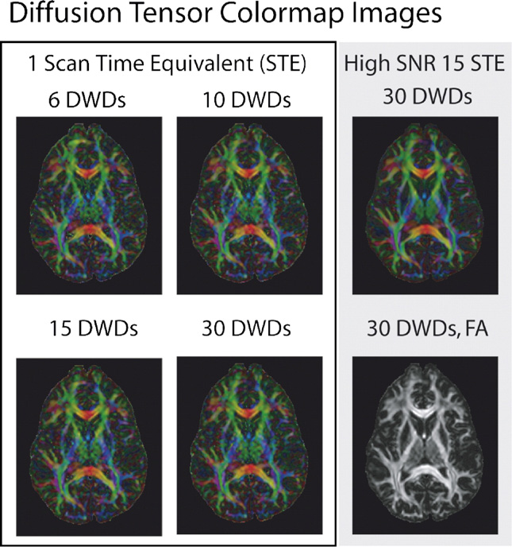
Differences in DTI contrasts due to different DW schemes are small relative to intra-session variability.
Notes:
Conclusion is that similar protocols with different well-balanced DW schemes are readily comparable

Slide 9
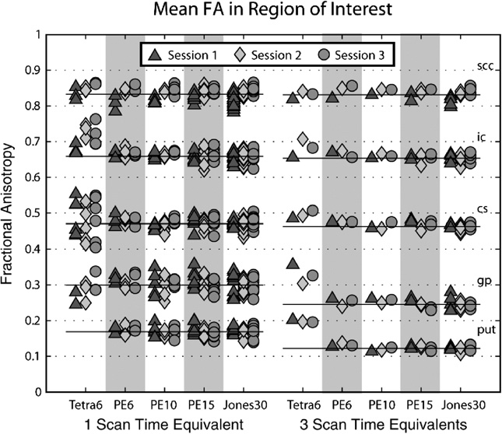
Well balanced DW schemes give comparable results across sessions
Landman et al; 2007
Notes:
Note also that more data = less noise in measure.

Slide 10
DTI processing steps that have to be matched across sites or performed at a central site
DTI Data transfer - storage – tracking
Initial quality control
Processing pipeline:
Importing data and transforming to common format
Motion and eddy-current distortion correction
Registration to template
EPI distortion correction
Rotation of b-matrices
Production of “corrected” raw images (interpolation)
Tensor computation (correct weighting)
Robust tensor estimation
Computation of tensor derived variables
Production of tensor data in stereotaxic space
Upload of processed data into shared database
Unpublished presentation from Carlo Pierpoli, 2007

Slide 11
Examples of commonly occurring DWI acquisition problems
incomplete dataset
incorrect slice thickness
incorrect in plane resolution
incorrect gap between slices
subject motion
cardiac pulsation
EPI ghosting
image acquisitions have different starting location
spurious labels in background
insufficient brain coverage
b matrix problems
replicates averaged
Unpublished presentation from Carlo Pierpoli, 2007

Slide 12
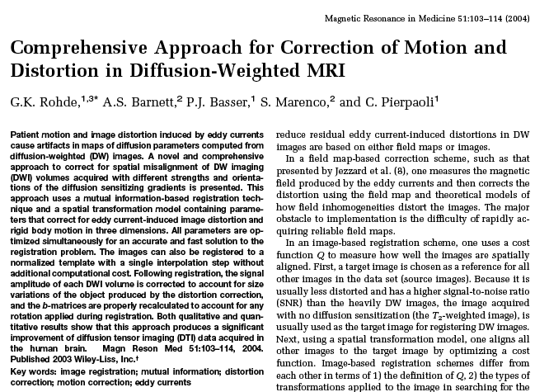

Slide 13
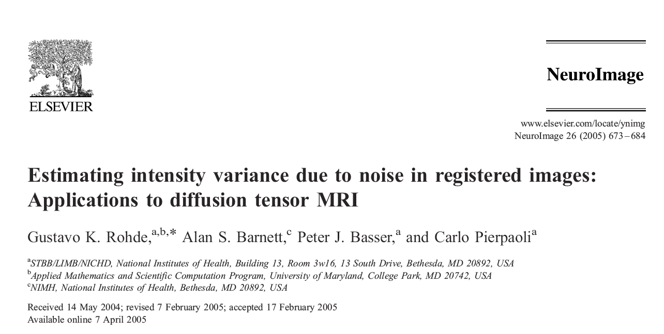

Slide 14
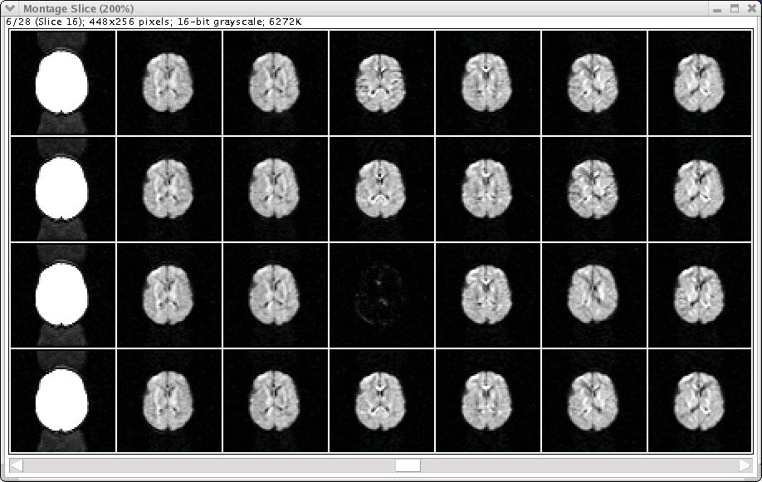
Data set with a corrupted image
Unpublished presentation from Carlo Pierpoli, 2007

Slide 15
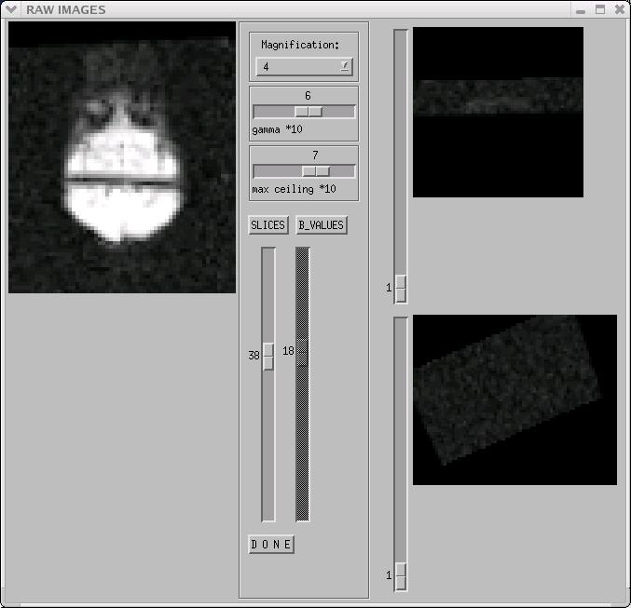
Artifact after registration
Unpublished presentation from Carlo Pierpoli, 2007

Slide 16
DEC MAP
Conventional tensor fitting
Robust tensor fitting using RESTORE
Unpublished presentation from Carlo Pierpoli, 2007

Slide 17
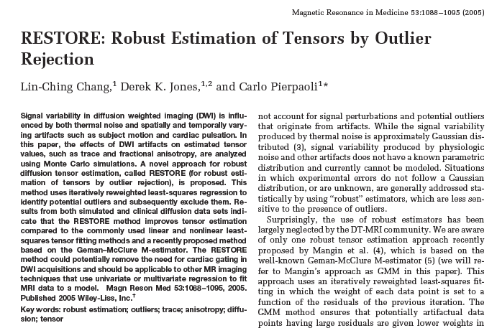

Slide 18
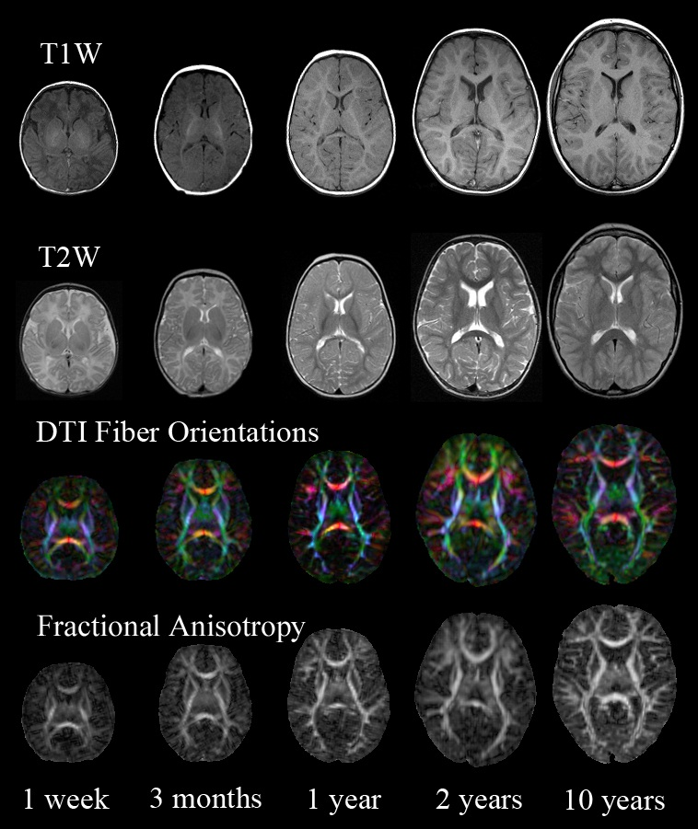
NIH MRI Study of Normal Brain Development
Public Website:
http://www.brain-child.org/
Unpublished presentation by
Carlo Pierpoli, 2007

Slide 19
Lessons learned
No matter how carefully the study is planned expect relatively large variability in the quality of the acquired data
Run a pilot study with all the sites involved prior to starting data collection
Use strict quality control criteria
Set up a robust data processing pipeline to reduce variability across sites

Slide 20
The University of Iowa
Nancy C. Andreasen, M.D. Ph.D.
Beng C. Ho, M.D.
Vincent A Magnotta, Ph. D.
Thomas Wassink, M.D.
Massachusetts General Hospital
Randy Gollub, M.D., Ph.D.
Dara Manoach, Ph.D.
Don Goff, M.D.
Larry Siedman, Ph.D.
Laura Kunkel, M.D.
The University of Minnesota
Kelvin O. Lim, M.D.
Bryon Mueller, Ph.D.
S. Charles Schulz, M.D.
Tonya White, M.D.
The University of New Mexico / MIND Institute
Jeremy Bockholt
Juan Bustillo, M.D.
Vince Calhoun, Ph.D.
Vince Clark, Ph.D.
John Lauriello, M.D.

Slide 21
White Matter Abnormalities in Schizophrenia Summary of 50+ Studies
White, Nelson, Lim (2009)

Slide 22
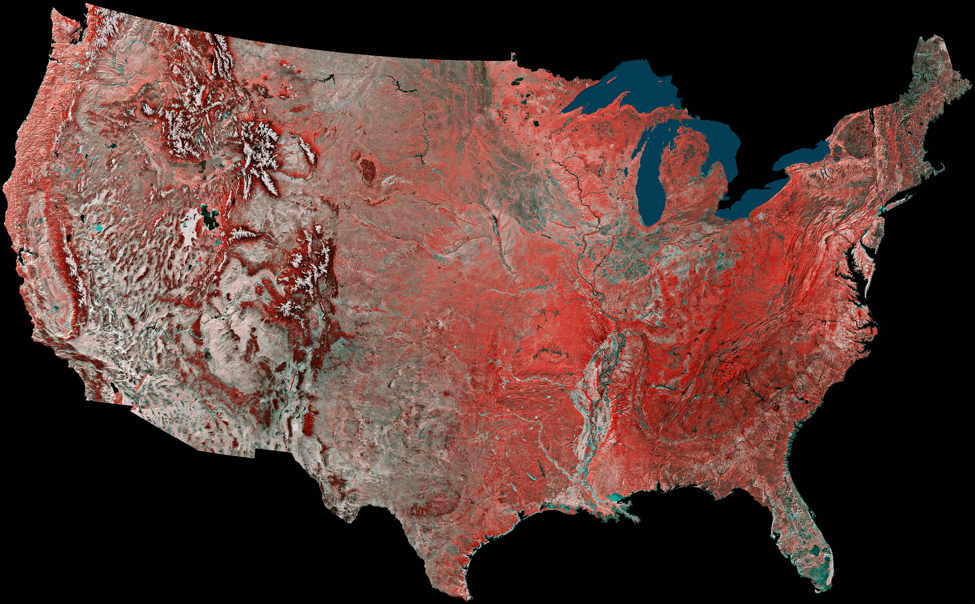
University of Minnesota
Massachusetts General Hospital
Patients n = 27
Controls n = 22
Patients n = 28
Controls n = 21
University of New Mexico
University of Iowa
Patients n = 41
Controls n = 43
Patients n = 19
Controls n = 52

Slide 23
 | Patients (n = 114) |  | Controls (n = 138)
 | Chronic (n = 83) | First-Episode (n = 31) | Chronic Control (n = 95) | First-Episode Control (n = 43)
Age (years, SD) | 36.4 (11.0) | 25.2 (6.7) | 34.0 (11.3) | 25.2 (6.6)
Sex (M / F) | 62 / 21 | 22 / 9 | 57 / 38 | 24 / 19
Hand (R / L / Both) | 73 / 3 / 6 | 26 / 3 / 1 | 86 / 5 / 3 | 41 / 2 / 0
WRAT 3rd (Reading) | 46.8 (6.2) | 47.1 (6.6) | 50.8 (4.5) | 50.2 (3.9)
Father’s Education | 14.3 (3.3) | 13.9 (4.7) | 15.0 (3.7) | 14.6 (2.3)
Mother’s Education | 13.3 (3.6) | 14.1 (3.2) | 13.8 (2.9) | 14.1 (2.3)
BMI | 28.9 (6.7) | 24.9 (3.0) | 26.4 (5.3) | 24.1 (4.2)

Slide 24
Acquisition Parameters at Four sites

Slide 25
Initial Report:
White T, Magnotta VA, Bockholt HJ, et al. Global white matter abnormalities in schizophrenia: a multisite diffusion tensor imaging study. Schizophrenia Bulletin. Jan 2011;37(1):222-232.
Currently under review:

Slide 26
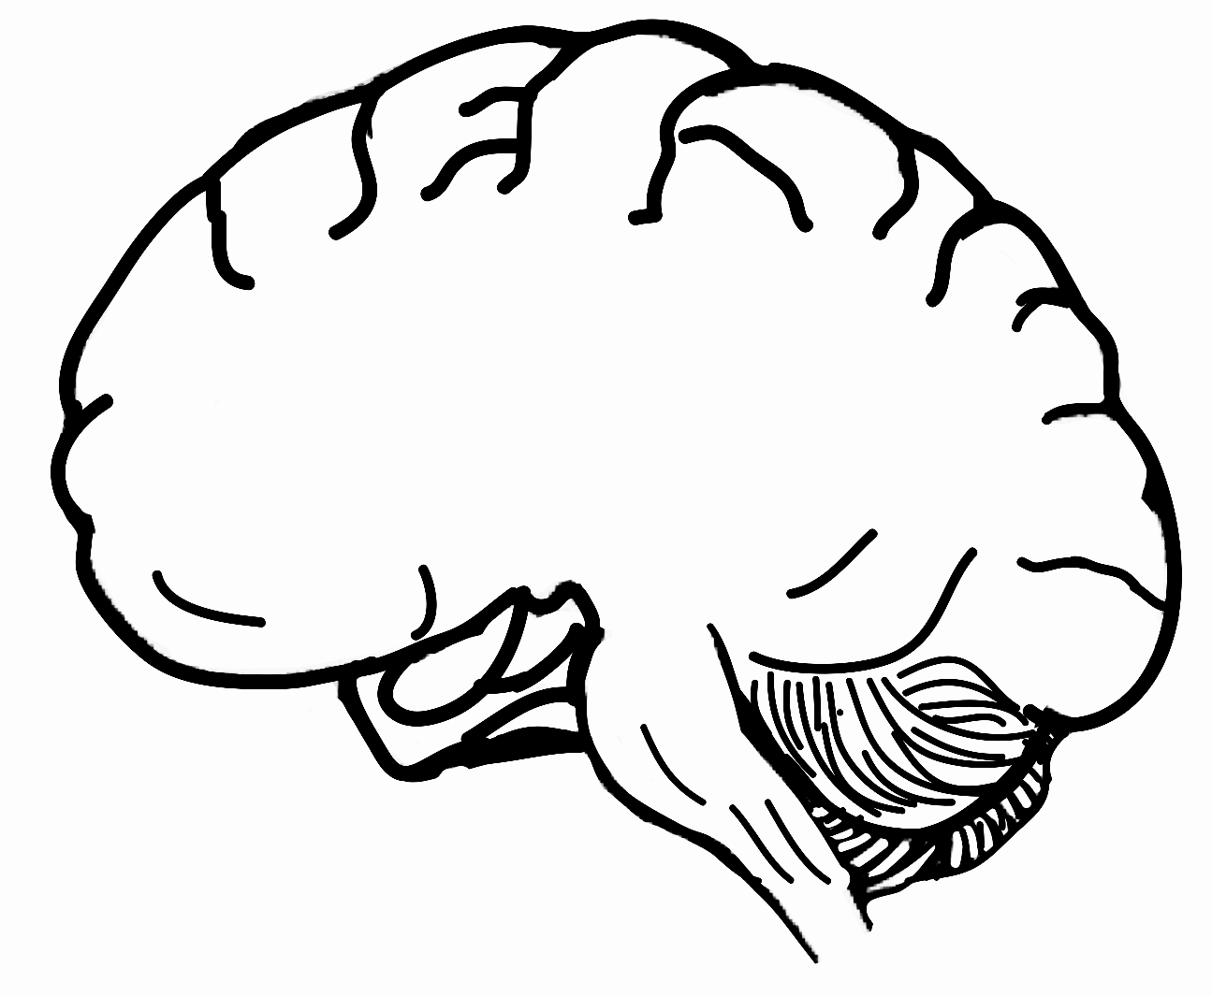
z-score
Talairach Slice
This is the brain
z-score
This is the brain

Slide 27
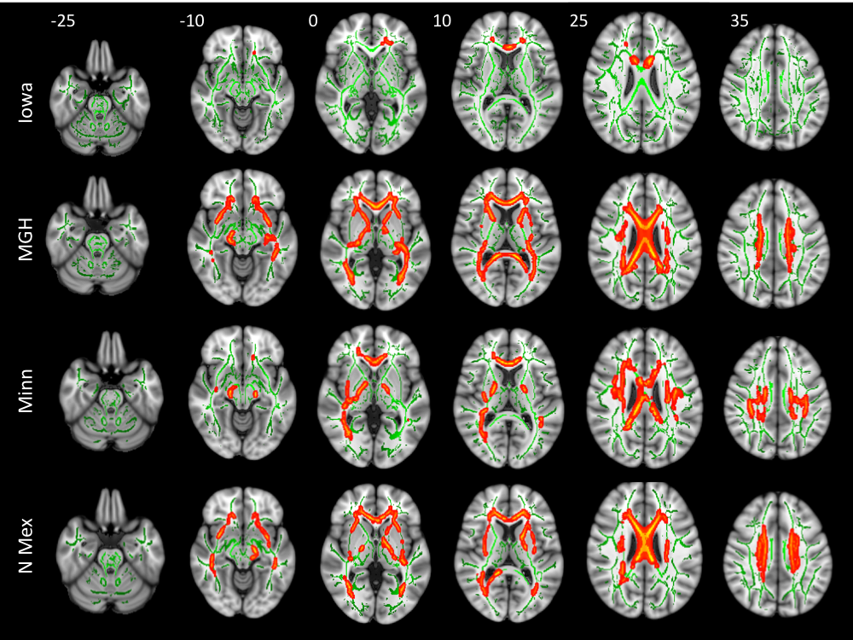

Slide 28
Number of Potholes
>50 >100 >150 >200 >250 >300 >350 >400 >450 >500
>50 >100 >150 >200 >250 >300 >350 >400 >450 >500
Number of Potholes
>50 >100 >150 >200 >250 >300 >350 >400 >450 >500
>50 >100 >150 >200 >250 >300 >350 >400 >450 >500
Number of Contiguous Voxels
Number of Contiguous Voxels

Slide 29
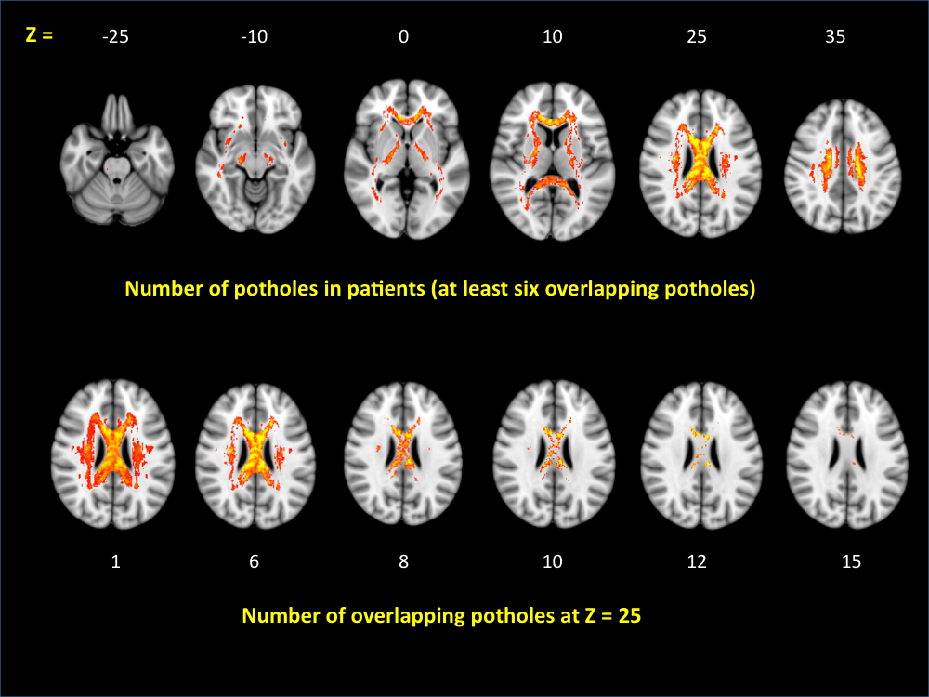
z =
A
Spatial Location of at Least Six Overlapping Potholes in Patients
B
Number of Overlapping Potholes at z = -25

Slide 30
Conclusions
There is considerable evidence that abnormalities in white matter play a significant role in the neuropathology of schizophrenia
There is considerable heterogeneity in the spatial location of white matter abnormalities in schizophrenia
First-episode and early-onset patients have more focal abnormalities
It is possible that the heterogeneity in clinical symptoms parallels the heterogeneity in white matter abnormalities.

