Slide 1
Tutorial
on 3D Slicer module programming

Slide 2
Agenda
Part 1
Overview of the APIs used
Use python console in Slicer
Simple scripted module example
Part 2
Write simple scripted module individually

Slide 3






Overview of API’s accessible from python
Notes:
Questions to attendees:
Who has Linux / C++ / python / Slicer / VTK / ITK / Qt experience?

Slide 4
Qt
Main page:
http://www.qt.io
Slicer uses version 4.8.6
Features
  User interface
  Run-time control (signal-slot mechanism)
Class list (bible)
http://doc.qt.io/qt-4.8/classes.html
Qt Assistant (desktop application)
Notes:
Questions to attendees:
Who has Linux / C++ / python / Slicer / VTK / ITK / Qt experience?

Slide 5
VTK
Visualization Toolkit (by Kitware)
Main page:
http://www.vtk.org
Slicer uses version 6.2.0
Features
  Visualization
  Data handling
  Simple image processing functions
Class list (your bible when you use the API)
http://www.vtk.org/doc/release/6.2/html/classes.html
Notes:
Questions to attendees:
Who has Linux / C++ / python / Slicer / VTK / ITK / Qt experience?

Slide 6
ITK / SimpleITK
Insight Toolkit (by Kitware)
Main page: http://www.itk.org, http://www.simpleitk.org
Slicer uses version 4.7.2
Features: Complex image processing functions for segmentation, registration, etc.
Class list (bible) for SimpleITK: http://www.itk.org/SimpleITKDoxygen/html/classes.html
Tutorial:
http://www.na-mic.org/Wiki/images/a/a7/
SimpleITK_with_Slicer_HansJohnson.pdf
Notes:
Questions to attendees:
Who has Linux / C++ / python / Slicer / VTK / ITK / Qt experience?

Slide 7
CTK
Common Toolkit
Main page: http://www.commontk.org
No releases, Slicer uses trunk
Features
  User interface elements used in medical imaging
  DICOM interface
Class list (bible):
http://www.commontk.org/docs/html/classes.html
Notes:
Questions to attendees:
Who has Linux / C++ / python / Slicer / VTK / ITK / Qt experience?

Slide 8
NumPy
Main page: http://www.numpy.org
Slicer uses version 1.4.1
Features: fundamental package for scientific computing with Python (arrays, lin. alg., Fourier, etc.)
Reference (bible):
http://docs.scipy.org/doc/numpy/reference
Notes:
Questions to attendees:
Who has Linux / C++ / python / Slicer / VTK / ITK / Qt experience?

Slide 9
MRML (Slicer API)
Features: Slicer data management and processing pipeline
Slicer developers manual: http://www.slicer.org/slicerWiki/index.php/Documentation/Nightly/Developers
Class list (bible):
http://www.slicer.org/doc/html/classes.html
Notes:
Questions to attendees:
Who has Linux / C++ / python / Slicer / VTK / ITK / Qt experience?

Slide 10
Next item on agenda
Part 1
Overview of the APIs used
Use python console in Slicer

Slide 11
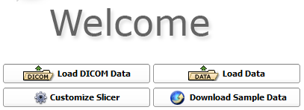
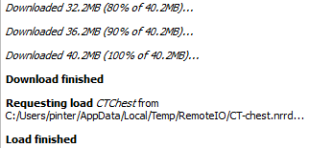
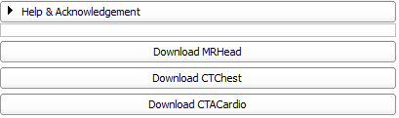
Launch Slicer and load data
  Run Slicer.exe
Notes:
Open new terminal tab: Ctrl+Shift+T
Switching between tabs: Alt+[tab#]

Slide 12
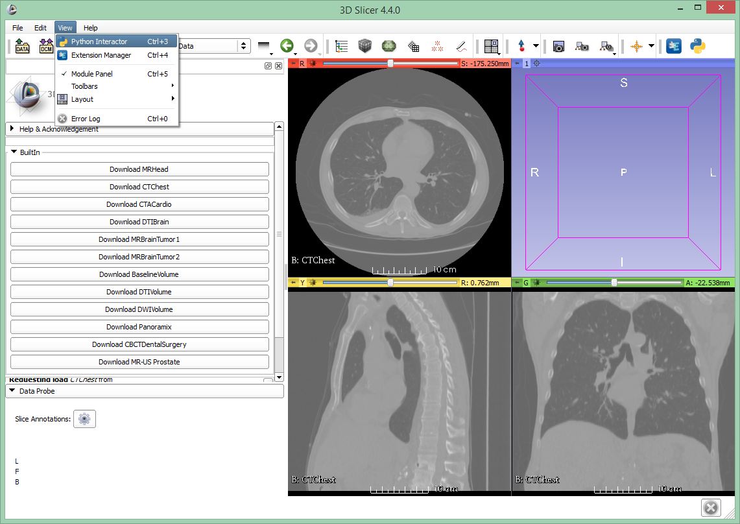

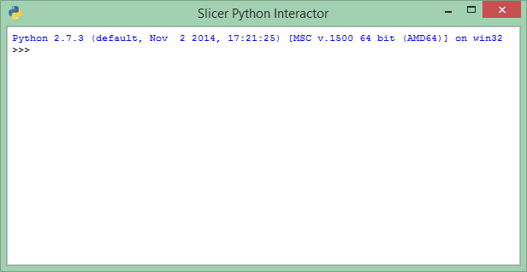
Introducing the python console

Slide 13
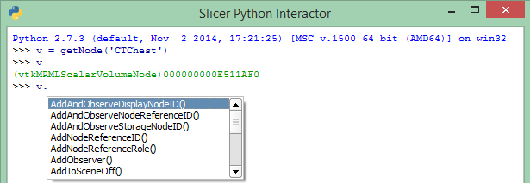
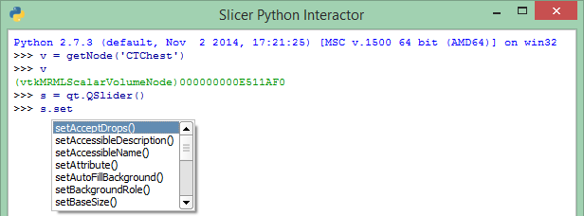
Auto-completion feature
Essential tool that provides API information
Press TAB to bring up auto-complete window to
  Explore available functions of a certain object
  Save typing

Slide 14
Accessing the MRML scene and nodes
Accessing MRML scene directly
  c = slicer.mrmlScene.GetNodesByName('CTChest')
  c.GetNumberOfItems()
  v = c.GetItemAsObject(0)
  Also useful: slicer.mrmlScene.GetNodeByID(…)
Using utility functions
  v = getNode('CTChest') (function in package slicer.util)
  OR
  v = getNode('CT*')
  Also useful (returns a list!): getNodes('CT*')
Notes:
Press tab to get suggestions
Verify object by giving its name;

Slide 15
Manipulating MRML objects
Setting window/level values programmatically
  d = v.GetDisplayNode()
  d.SetAutoWindowLevel(0)
  d.SetWindowLevel(350,40)
Setting color palette programmatically
  c = getNode('Ocean')
  d.SetAndObserveColorNodeID(c.GetID())
Slicer classes reference
http://www.slicer.org/doc/html/classes.html
Notes:
Press tab to get suggestions
Verify object by giving its name
Mention similar VTK and ITK references

Slide 16
Next item on agenda
Part 1
Overview of the APIs used
Use python console in Slicer
Simple scripted module example
Download this presentation from the bootcamp page:
http://perk.cs.queensu.ca/contents/bootcamp-course-2015

Slide 17
Python in general
Blocks defined by indentation: 2 spaces
Case sensitive
Comments
  # This whole row is a comment
  ”””This is a potentially multi-line comment”””
Blocks defined by indentation
An object refers to itself as self (in C++: this)
Namespaces: slicer, ctk, vtk, qt
Blocks … indentation … spaces!

Slide 18
Text editor
Using a proper text editor is essential
  Replace all, Easy comment/uncomment, indent, …
  Syntax highlighting
  Multi-entry clipboard
  Keyboard shortcuts
Examples
  Windows: Notepad++
  Mac: Xcode
  All platforms: Atom, Sublime Text, LiClipse

Slide 19
Assembla and version control
Everyone should be in the project by now:
  https://www.assembla.com/spaces/perklab-bootcamp
Check out the trunk
  TortoiseSVN: Create folder -> SVN Checkout…
  https://subversion.assembla.com/svn/perklab-bootcamp/trunk/
Create folder with your name in src/2015/
Create ticket
  “[Name]: Slicer programming tutorial”
  Assign to yourself, set to Accepted

Slide 20
Create module skeleton
Extension/module templates
  Wizard script available if Slicer built from source
  More information here:
  http://www.slicer.org/slicerWiki/index.php/Documentation/Nightly/Developers
Use module template file without wizard
http://svn.slicer.org/Slicer4/trunk/Extensions/Testing/ScriptedLoadableExtensionTemplate/ScriptedLoadableModuleTemplate/ScriptedLoadableModuleTemplate.py
  Create new folder MyScriptedModule, copy the template script there, and rename to MyScriptedModule.py
  Find and replace all occurrences of ScriptedLoadableModuleTemplate to MyScriptedModule
Notes:
Questions to attendees:
Who has Linux / C++ / python / Slicer / VTK / ITK / Qt experience?

Slide 21
Add new module to the paths
Start Slicer
Add modules to the additional module paths
  Go to Edit / Application settings / Modules
  Click the “>>” button next to the Additional module paths section
  Add your scripted module folder to the list
  Click OK, restart Slicer
  Observe the new module under Examples
Notes:
The CLI module appears to be built in the Slicer-build directory

Slide 22

Set developer mode
Allows reloading of the module file on the fly
Add following line in
MyScriptedModuleWidget::setup
just below the function definition:
self.developerMode = True
Restart Slicer
Reload can be used to check progress
Unexpected results -> check python window

Slide 23
Write our scripted module #1
Open MyScriptedModule/MyScriptedModule.py
Rename the module and put it in our extension category
Create widgets to specify inputs:
Under def setup(self) look for input volume selector, change
and
Create second input selector
  Rename outputSelector to input2Selector everywhere
  setUp and onApplyButton and onSelect functions
  Set the same settings as for the first one, label is “Input Volume 2”
def __init__(self, parent):
ScriptedLoadableModule.__init__(self, parent)
self.parent.title = "Center of Masses"
self.parent.categories = ["MyExtension"]
self.inputSelector.nodeTypes = ( ("vtkMRMLLabelMapVolumeNode"), "" )
self.inputSelector.selectNodeUponCreation = False
self.inputSelector.setToolTip( "Pick the first input to the algorithm." )
parametersFormLayout.addRow("Input Volume 1: ", self.inputSelector)
Notes:
Explain the module: Center of Masses
Emphasize that when creating a real module, then more things have to be changed: file and class names, comments, error handling

Slide 24
Commit your changes regularly
Use your SVN client to commit your changes
New files need to be added explicitly
Commit message should look like this:
"Re #7: Description of why I did what I did"
(do not describe what you did, it's obvious from the diff)
When you think you're done
"Test #7: Description of why I did what I did"
When everybody agrees you're done
"Fixed #7: Description of why I did what I did"
Update before each commit!

Slide 25
Write our scripted module #2
Look for class MyScriptedModuleLogic towards the bottom
Insert this code above the Run function
def getCenterOfMass(self, volumeNode):
centerOfMass = [0,0,0]
numberOfStructureVoxels = 0
sumX = sumY = sumZ = 0
volume = volumeNode.GetImageData()
for z in xrange(volume.GetExtent()[4], volume.GetExtent()[5]+1):
for y in xrange(volume.GetExtent()[2], volume.GetExtent()[3]+1):
for x in xrange(volume.GetExtent()[0], volume.GetExtent()[1]+1):
voxelValue = volume.GetScalarComponentAsDouble(x,y,z,0)
if voxelValue>0:
numberOfStructureVoxels = numberOfStructureVoxels+1
sumX = sumX + x
sumY = sumY + y
sumZ = sumZ + z
if numberOfStructureVoxels > 0:
centerOfMass[0] = sumX / numberOfStructureVoxels
centerOfMass[1] = sumY / numberOfStructureVoxels
centerOfMass[2] = sumZ / numberOfStructureVoxels
print('Center of mass for \'' + volumeNode.GetName() + '\': ' + repr(centerOfMass))
return centerOfMass
Notes:
Take extra care of the indentation! 2 spaces before the whole thing and 2 spaces before each sub-block

Slide 26
Write our scripted module #3
Change the Run function to look like this:
def run(self,inputVolume,input2Volume):
"""
Run the actual algorithm
"""
center1 = self.getCenterOfMass(inputVolume)
center2 = self.getCenterOfMass(input2Volume)
self.translation = []
for i in [0,1,2]:
self.translation.append(center2[i] - center1[i])
return True

Slide 27
Write our scripted module #4
Validating button state and displaying the output into
MyScriptedModuleWidget
Intentation wrong to help you copy-paste the code
Please pay attention to right indentation
def onSelect(self):
self.applyButton.enabled = self.inputSelector.currentNode() and self.input2Selector.currentNode()
def onApplyButton(self):
logic = MyScriptedModuleLogic()
print("Run the algorithm")
logic.run(self.inputSelector.currentNode(), self.input2Selector.currentNode())
self.outputLabel.setText('(' + repr(logic.translation[0]) + ', ' + repr(logic.translation[1]) + ', ' + repr(logic.translation[2]) + ')')

Slide 28
Write our scripted module #5
Create the text field under the Apply button, above connections
Delete or comment out imageThresholdSliderWidget and enableScreenshotsFlagCheckBox because we don’t need those widgets in our module
self.outputLabel = qt.QLabel()
parametersFormLayout.addRow(self.outputLabel)

Slide 29
Try our scripted module
Load test data found in [BootcampSVN]/data/CenterOfMasses
  Drag&drop or Add data button ( )
  When "Add data ..." dialog pops up, check Show Options and select "LabelMap" for the two labelmaps
Go to our module in MyExtension / Center of Masses
Set the two labelmaps as input
For example Orbit_Left_Labelmap and Orbit_Right_Labelmap
Press Apply
  1. Display displacement vector (takes a while, be patient)
  2. Displays nothing → error can be seen in the Python interactor

Slide 30
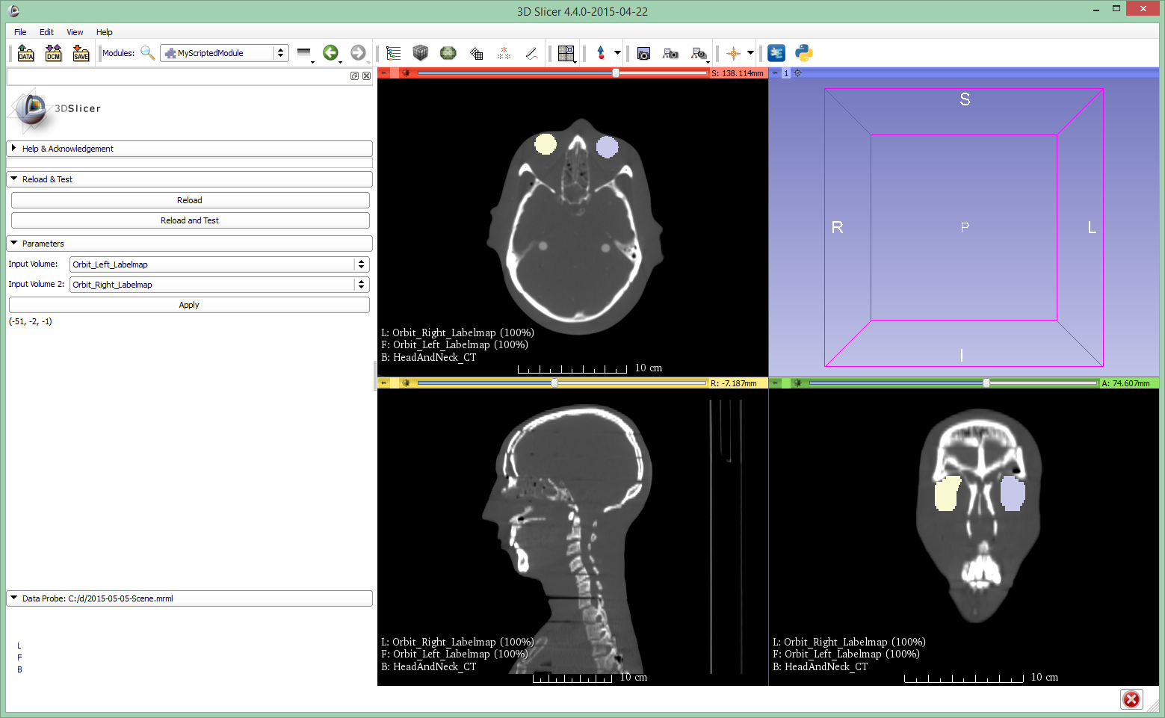
What you should see...

Slide 31
Last item on agenda
Part 1
Overview of the APIs used
Use python console in Slicer
Simple scripted module example
Part 2
Write simple scripted module individually
Notes:
Questions to attendees:
Who has Linux / C++ / python / Slicer / VTK / ITK / Qt experience?

Slide 32
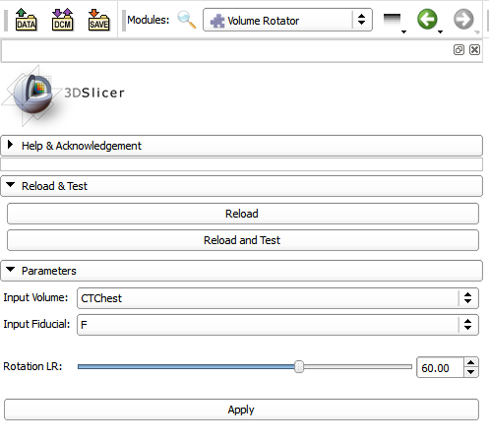
Scripted module task description
Rotate a volume around a given fiducial using parameters for the transformation
Create user interface:
use QSlider or ctkSliderWidget
Markup fiducial object: vtkMRMLMarkupsFiducialNode
Create transform nodes: (vtkMRMLLinearTransformNode, vtkTransform, and vtkMatrix4x4)
P_{RotatedRAS} = T_{RotatedFiducial2RotatedRAS} ∙ T_{Fiducial2RotatedFiducial} ∙ T_{RAS2Fiducial} ∙ P_{RAS}
Apply a transform by setting it as parent transform for objects:
transform.SetMatrixTransformToParent
volume.SetAndObserveTransformNodeID

Slide 33
Scripted module FAQ
Class lists and descriptions in "bibles", see beginning of this presentation
Assembling transformation matrices, see Tamas' presentation about coordinate systems
Get node from MRML scene
node = slicer.util.getNode(nodeName)
(but use proper variable names!)
Add transformation (or any) node to MRML scene:
slicer.mrmlScene.AddNode(nodeObject)
Set matrix to transform node
transformNode.SetMatrixTransformToParent(m)

Slide 34
Congratulations!
Thanks for attending!

