Slide 1
Core 1b – Engineering 2014
Stephen Aylward and Jean Christophe Fillion-Robin (“JC”)
Kitware, Inc.

Slide 2


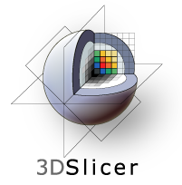



Slicer Highlights in 2014
Data Store
Extensions
(App Store)
DICOM: MRB
Documentation
Python Scripting

Slide 3
Slicer Highlights in 2014
Data Store
Extensions
(App Store)
DICOM: MRB
Documentation
Python Scripting

Slide 4
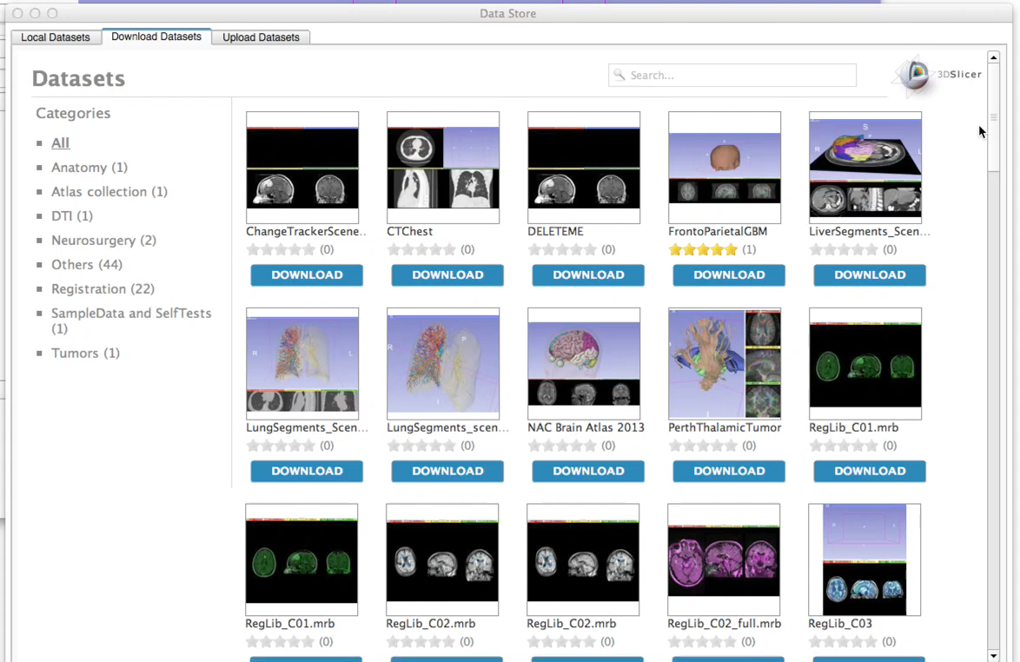
Data Store
Browse
Download
Rate
Upload
Private and public repositories
71 public datasets and rapidly growing

Slide 5

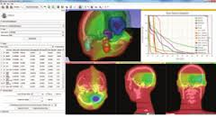

Medical Reality Bundle (MRB)

Slide 6
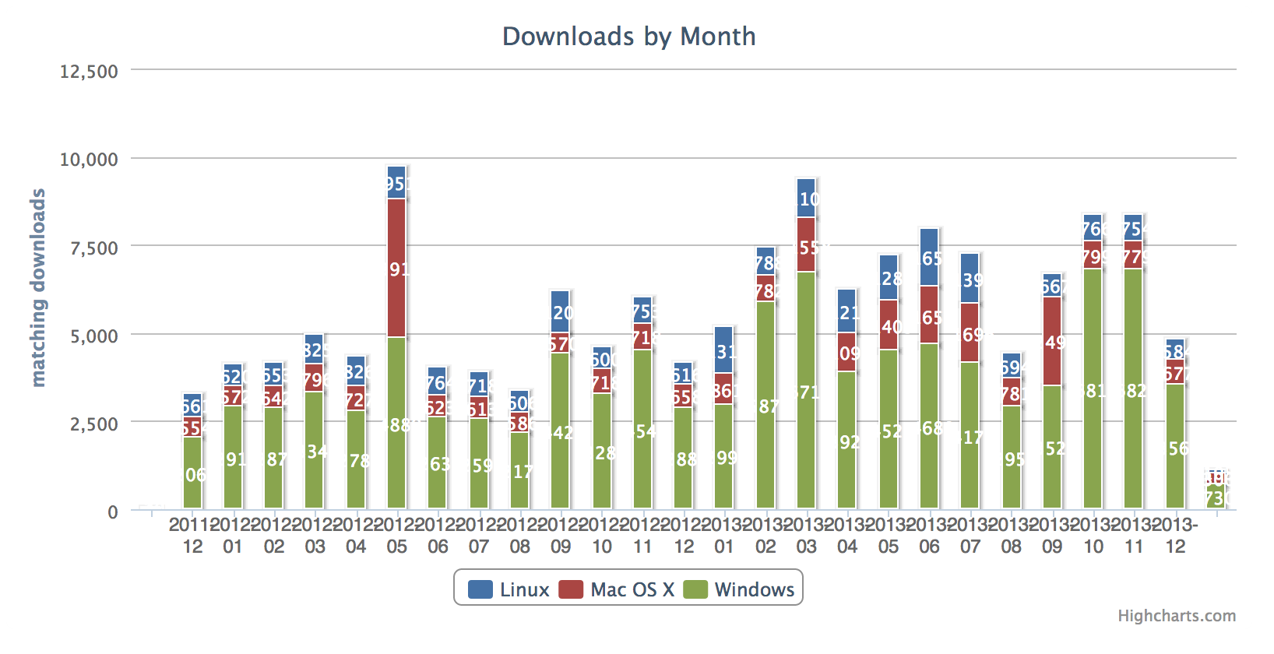
Impact
Over 61,000 downloads in 2013 (27% increase over 2012)

Slide 7
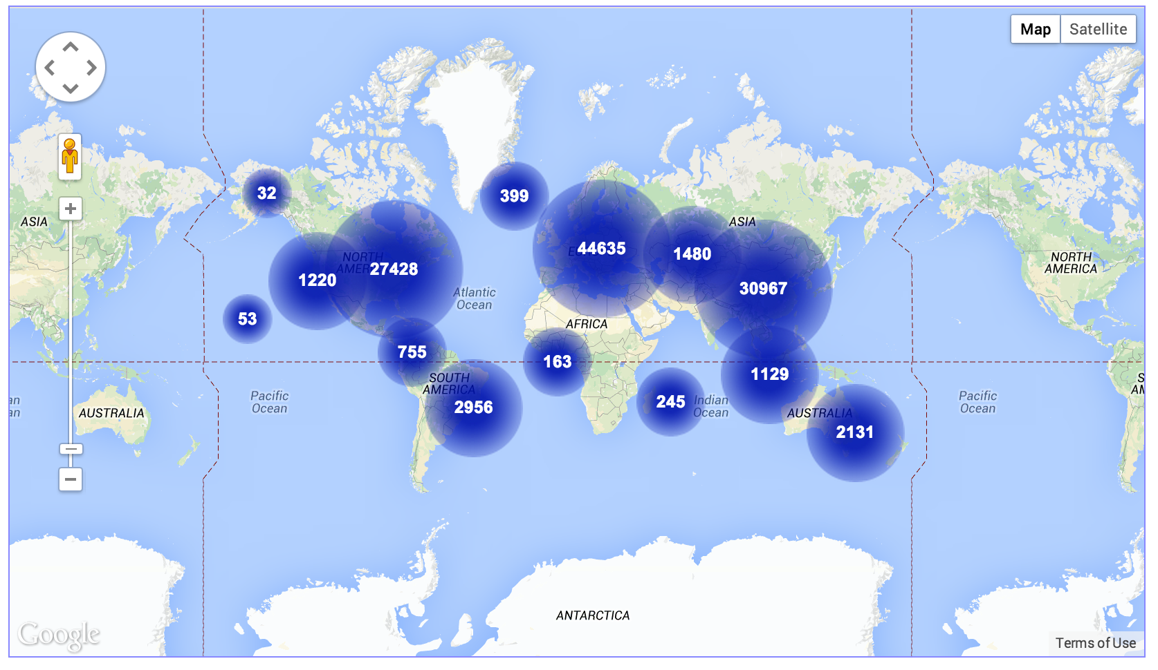
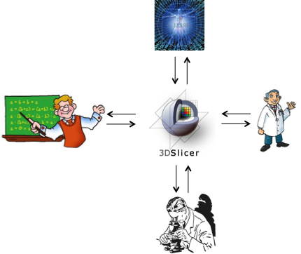
Outcome
THE most capable open-source medical image processing platform.
At the heart of THE most capable open-source medical image processing community.

