Slide 1


The Basic Concepts Behind Neural Nets
Mohsen Ghafoorian
Jan 10, 2017
Materials partly taken from
Stanford’s Convolutional Neural Networks for Visual Recognition course Geoffrey Hinton’s Neural networks course on Coursera

Slide 2

Multi-class problem
CNN
10 numbers
indicating class
scores
[32x32x3]
Array of numbers in 0…1

Slide 3
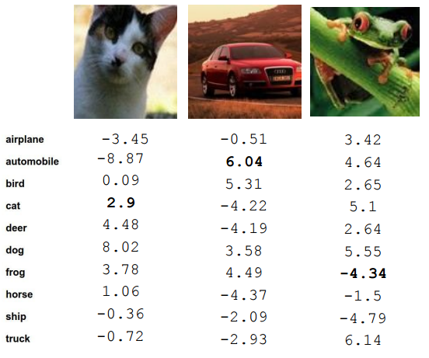
Multi-class problem
What we have is:
A mapping from images to numbers
What we need:
An estimation describing how happy we are (loss function)
A strategy to move towards happier states (optimization strategy)

Slide 4
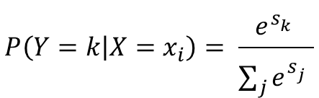
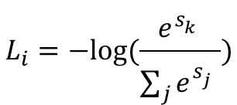
Loss function
$$P\left(Y=k | X=x_{i}\right)= \frac{e^{s_{k}^{}}}{\sum_{j}{e^{s_{j}^{}}}}$$
Softmax
Likelihood ≡ log likelihood ≡ -log likelihood
$$L_{i}=−log⁡(\frac{e^{s_{k}^{}}}{\sum_{j}{e^{s_{j}^{}}}})$$
Cross Entropy
unnormalized probabilities
Cat
Car
Frog
3.2
5.1
-1.7
24.5
0.13
0.87
0.00
exp
164.0
normalize
0.18
probabilities

Slide 5
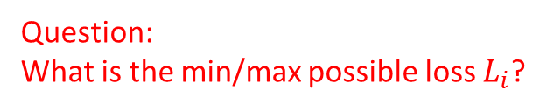
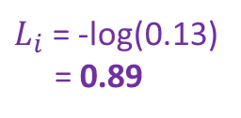
Loss function
Question:
What is the min/max possible loss $L_{i}$?
$$P\left(Y=k | X=x_{i}\right)= \frac{e^{s_{k}^{}}}{\sum_{j}{e^{s_{j}^{}}}}$$
Softmax
Likelihood ≡ log likelihood ≡ -log likelihood
$$L_{i}=−log⁡(\frac{e^{s_{k}^{}}}{\sum_{j}{e^{s_{j}^{}}}})$$
Cross Entropy
unnormalized probabilities
Cat
Car
Frog
3.2
5.1
-1.7
24.5
0.13
0.87
0.00
$L_{i}$= -log⁡(0.13)
= 0.89
exp
164.0
normalize
0.18
probabilities

Slide 6
Loss function
Question: Usually at initialization Ws are small
numbers, so all s ≈ 0. What is the loss then?
$$P\left(Y=k | X=x_{i}\right)= \frac{e^{s_{k}^{}}}{\sum_{j}{e^{s_{j}^{}}}}$$
Softmax
Likelihood ≡ log likelihood ≡ -log likelihood
$$L_{i}=−log⁡(\frac{e^{s_{k}^{}}}{\sum_{j}{e^{s_{j}^{}}}})$$
Cross Entropy
unnormalized probabilities
Cat
Car
Frog
3.2
5.1
-1.7
24.5
0.13
0.87
0.00
$L_{i}$= -log⁡(0.13)
= 0.89
exp
164.0
normalize
0.18
probabilities

Slide 7
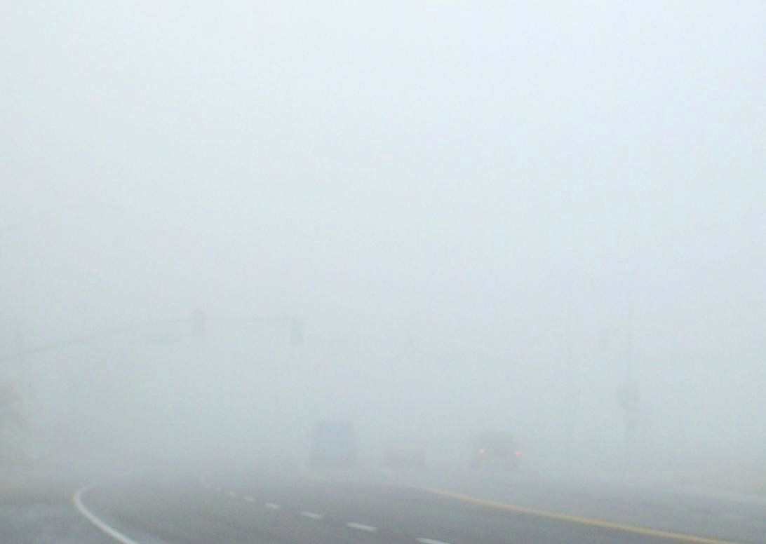

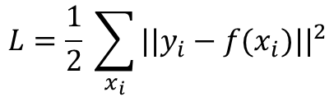
Loss function
What if we are dealing with a regression problem?
$$L_{i}={\frac{1}{2}||y_{i}−f(x_{i})||}^{2}$$
Squared Error
$$L=\frac{1}{2} \sum_{x_{i}}{{||y_{i}−f(x_{i})||}^{2}}$$
Mean Squared Error (MSE)

Slide 8

Optimization

Slide 9
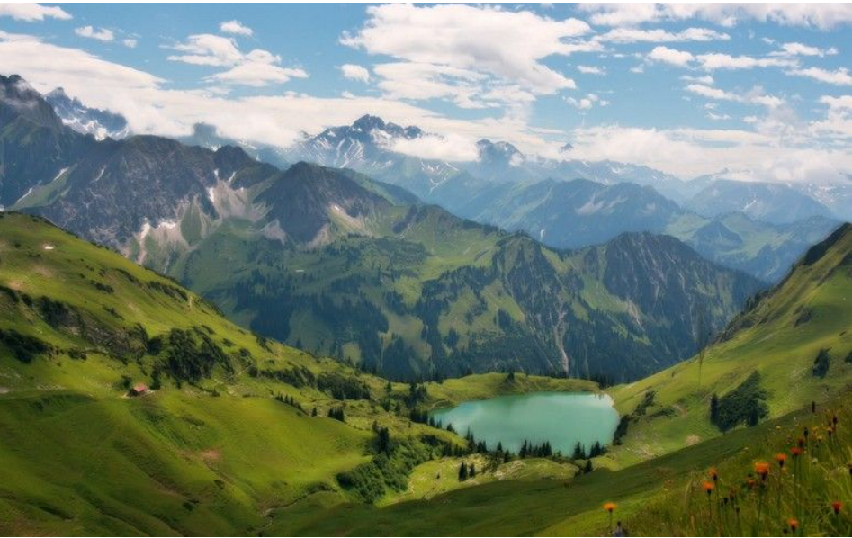

Optimization

Slide 10

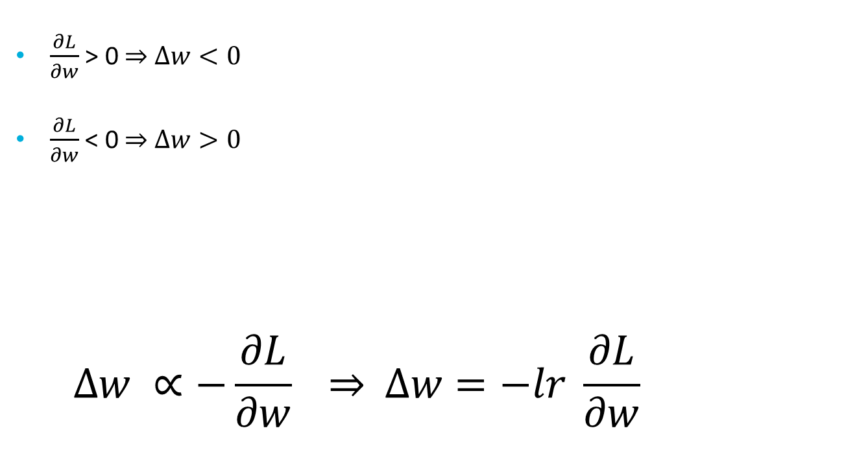
Gradient descent
$\frac{∂L}{∂w}$ > 0 $Δw<0$
$\frac{∂L}{∂w}$ < 0 $Δw>0$
$$Δw ∝−\frac{∂L}{∂w} \overset{⇒}{ } Δw=−lr \frac{∂L}{∂w}$$

Slide 11
Full-batch vs Mini-batch Gradient Descent
Full-batch:
Compute the gradient on the full batch of samples for each update
Mini-batch: (stochastic gradient descent)
Motivation: datasets are often highly redundant.
Compute the gradient on a small mini-batch of samples (e.g 64)
Much faster computationally
Online (mini-batch size=1)
Not as common as mini-batch learning
Too noisy gradients
No computational advantage over mini-batch
Parallel computation of whole mini-batch gradients using GPUs

Slide 12
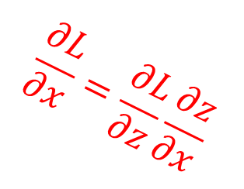

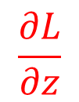




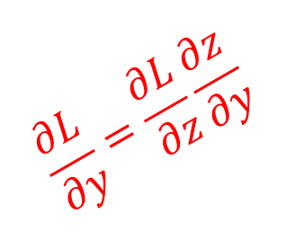
Backpropagation
f
$$x$$
f
“local gradients”
$$\frac{∂L}{∂x}=\frac{∂L}{∂z}\frac{∂z}{∂x}$$
$$\frac{∂z}{∂x}$$
$$z$$
$$\frac{∂z}{∂y}$$
$$\frac{∂L}{∂z}$$
f
$$y$$
$$\frac{∂L}{∂y}=\frac{∂L}{∂z}\frac{∂z}{∂y}$$

Slide 13
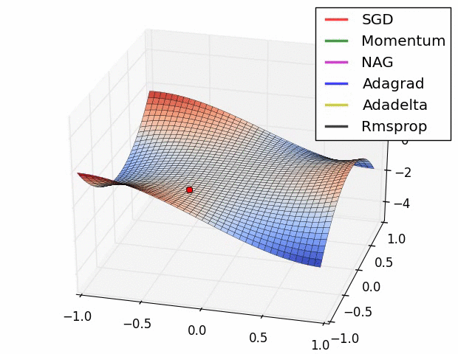
Update Rules

Slide 14
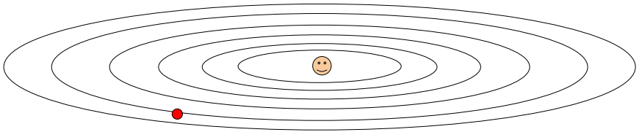
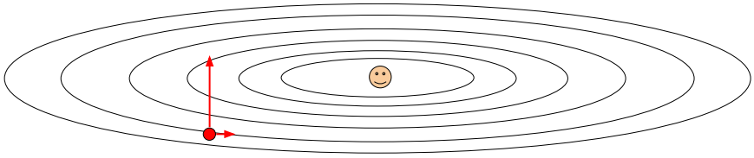
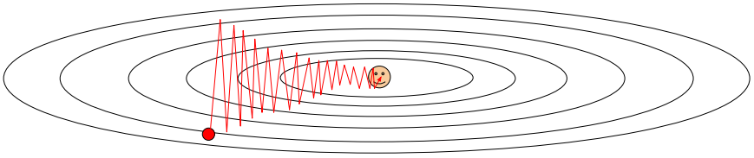


Normalizing the data
Question: Why SGD does poorly in elliptical loss structures?
$$w_{2}$$
$$w_{1}$$

Slide 15


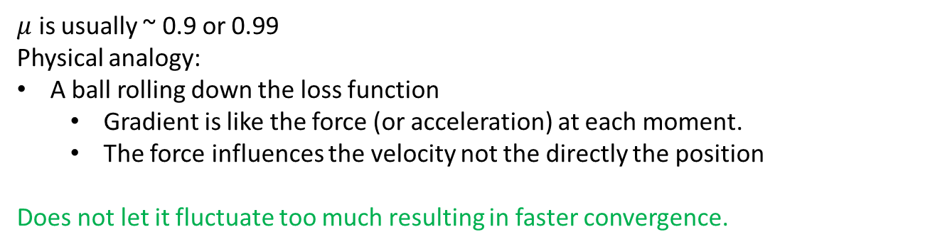
Momentum update
$μ$ is usually ~ 0.9 or 0.99
Physical analogy:
A ball rolling down the loss function
Gradient is like the force (or acceleration) at each moment.
The force influences the velocity not the directly the position
Does not let it fluctuate too much resulting in faster convergence.

Slide 16
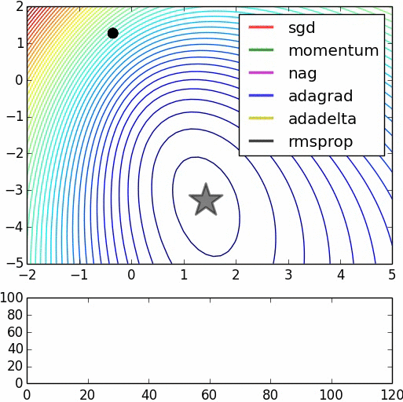

Momentum vs SGD
Notice that momentum
Overshoots optimum a bit!
But still converging faster!

Slide 17
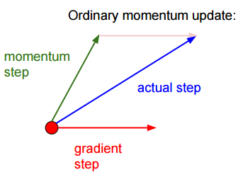
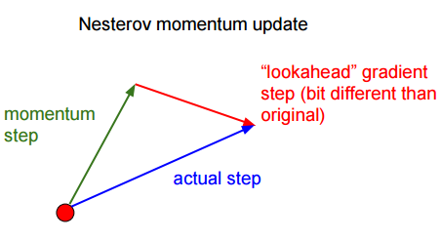
Nesterov Momentum update

Slide 18
Momentum vs Nestrov Momentum
This is the Nestrov
moemntum

Slide 19

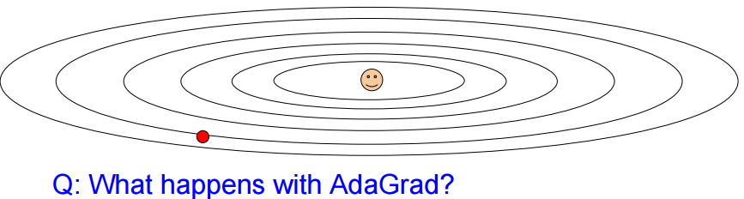
Adagrad
Normalizes the gradients differently for each parameter

Slide 20
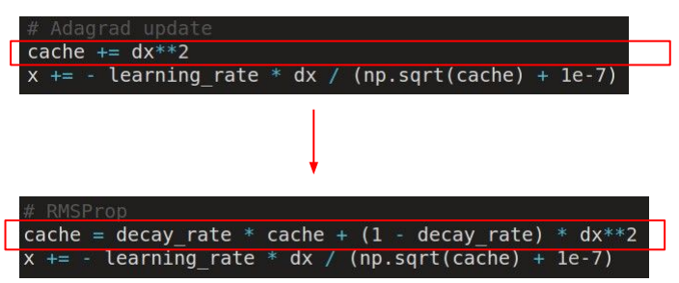
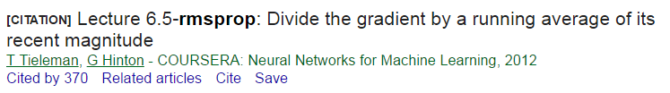
RMSPROP
[Tieleman, Hinton, 2012]

Slide 21
Adagrad vs RMSPROP
Notice Adagrad becomes
too slow at the end.

Slide 22

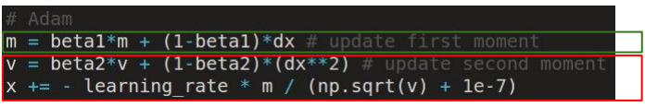
Adam
[Kingma and Ba, 2014]
(Incomplete, but close)
momentum
RMSPROP-like

Slide 23
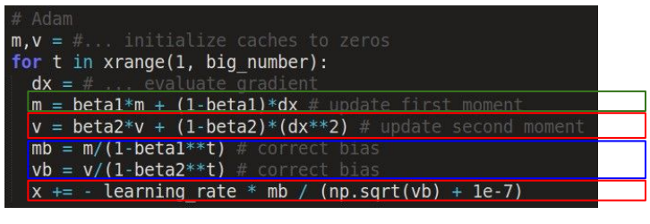
Adam
[Kingma and Ba, 2014]
momentum
Bias correction
RMSPROP-like
Bias correction:
Only relevant in the first few iterations (where t is small)
To compensate the bias the fact that m and v are initialized with 0 and need some time to “warm up”.

Slide 24
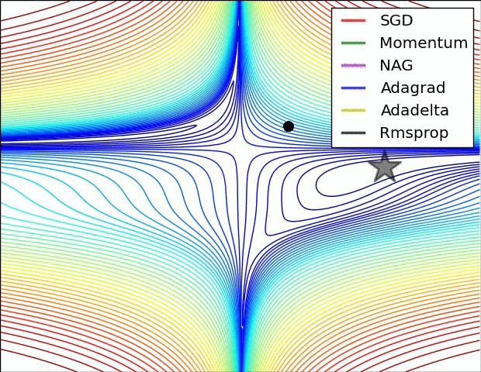
Updates

Slide 25

Non-Linearities

Slide 26
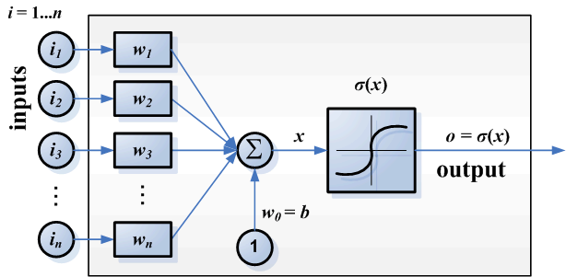
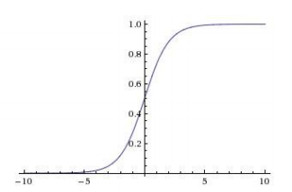
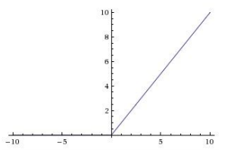
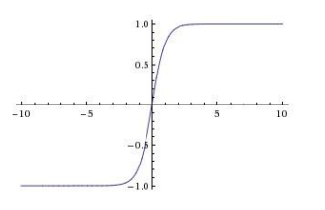
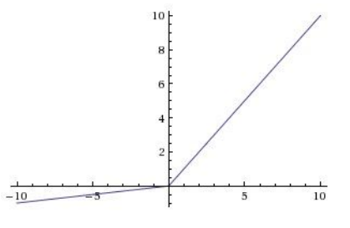
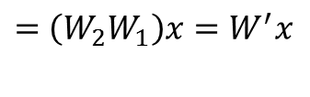
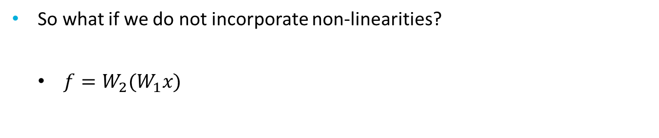
Non-linearity
So what if we do not incorporate non-linearities?
$f=W_{2}(W_{1}x)$
1st layer
$=$ $\left(W_{2}W_{1}\right)x=W^{′}x$
Still a linear transformation!!
2nd Layer
ReLu $max⁡(0, x)$
Sigmoid $σ\left(x\right)= \frac{1}{1+e^{−x}}$
Tanh $Tanh(x)$
Leaky ReLu $max⁡(x, 0.01x)$

Slide 27
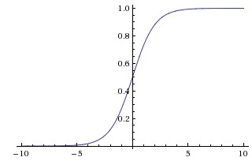
Activation functions - Sigmoid
Sigmoid $σ\left(x\right)= \frac{1}{1+e^{−x}}$
Squashes numbers to range [0,1]
Historically the most popular since they have nice interpretation as a saturating “firing rate” of a neuron
Problems:
Saturated neurons kill the gradients!

Slide 28
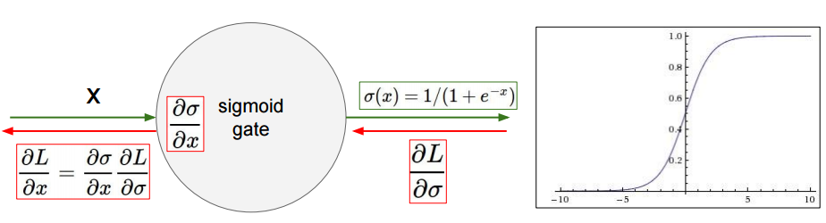
Killed Gradient
What happens when X = -10?
What happens when X = 10?

Slide 29
Activation functions - Sigmoid
Sigmoid $σ\left(x\right)= \frac{1}{1+e^{−x}}$
Squashes numbers to range [0,1]
Historically the most popular since they have nice interpretation as a saturating “firing rate” of a neuron
Problems:
Saturated neurons kill the gradients!
Data is not zero-centered.

Slide 30
What happens if all the inputs are positive?
what happens to the gradients in this case?
$$f(\sum_{i}{w_{i}}x_{i}+b)$$
$$w_{2}$$
Allowed gradient update direction
Allowed gradient update direction
$$w_{1}$$
Optimal
gradient
vector

Slide 31
Activation functions - Sigmoid
Sigmoid $σ\left(x\right)= \frac{1}{1+e^{−x}}$
Squashes numbers to range [0,1]
Historically the most popular since they have nice interpretation as a saturating “firing rate” of a neuron
Problems:
Saturated neurons kill the gradients!
Data is not zero-centered.
exp() is a bit expensive to compute

Slide 32
Activation function - tanh
Squashes numbers to range [-1,1]
Zero centered ☺
Still kills the gradients in the saturated regime! ☹

Slide 33
Activation functions - ReLU
Computes $f\left(x\right)=\max\left(0, x\right)$
Does not saturate (in + regime) ☺
Very computationally efficient ☺
Converges much faster than sigmoid/tanh in practice ☺
Still not zero-centered!
What happens to the gradient when x < 0 ?

Slide 34
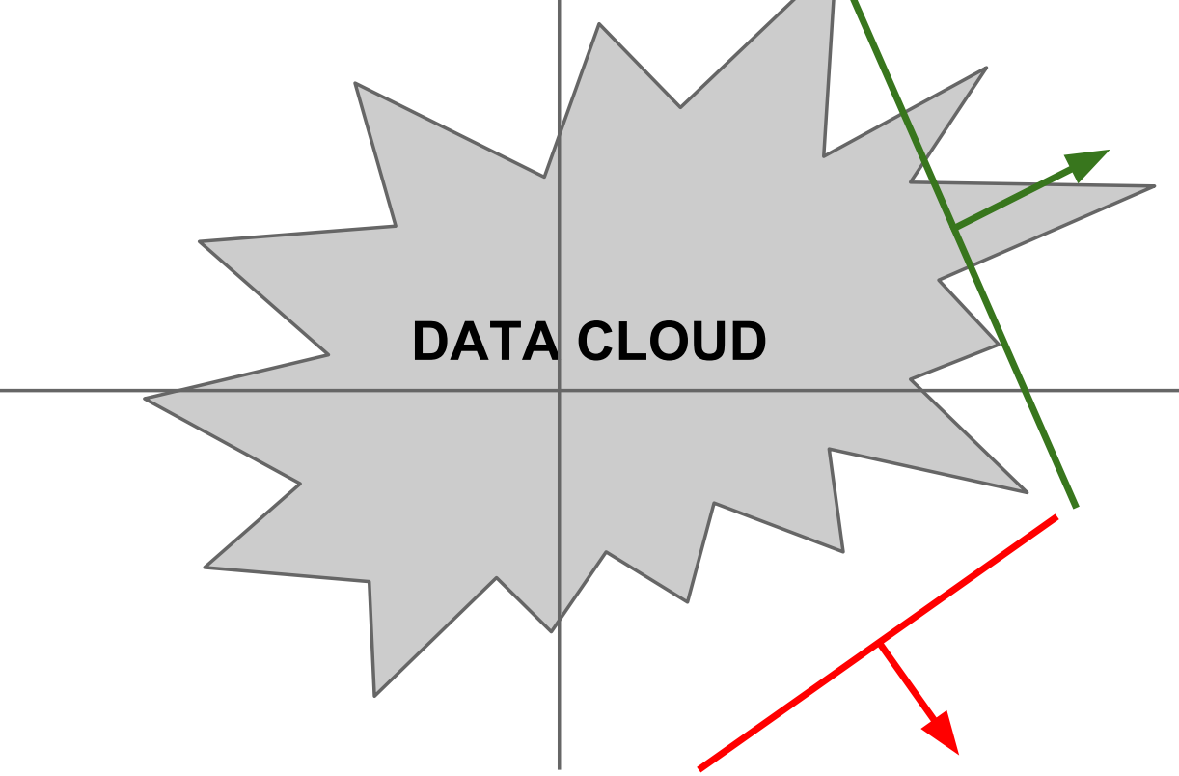
What happens to the gradients when x < 0?
$$x_{2}$$
Active ReLUs
$$x_{1}$$
Dead ReLUs (RIP)

Slide 35
Activation functions – Leaky ReLU
Computes $f\left(x\right)=max⁡(0.01x, x)$
Does not saturate
Computationally efficient
Converges much faster than sigmoid/tanh in practice!
Will not “die”! ☺
Paramteric ReLU (PReLU)
Computes $f\left(x\right)=max⁡(αx, x)$
Backprop into $α$as a parameter

Slide 36
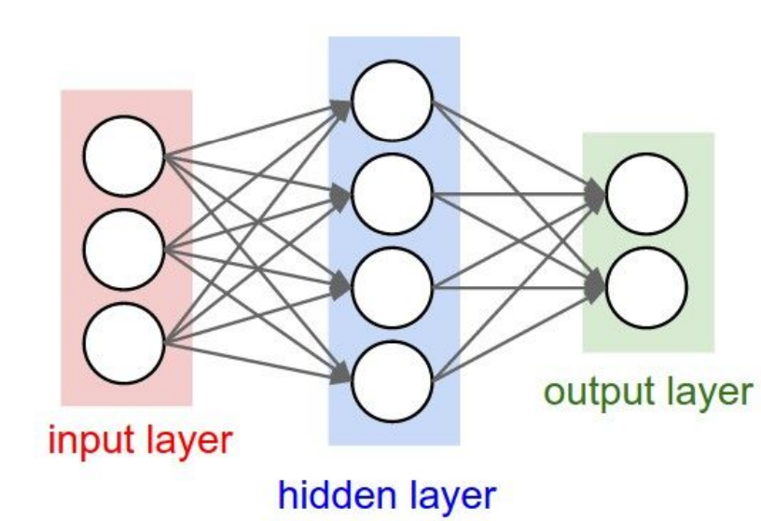
Weight initialization
Question: what happens when you initialize with 0s for all weights?
Initialize the weights with small random numbers (e.g. $w \sim N(0, 0.01)$ )

Slide 37
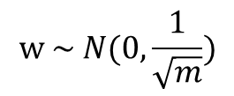
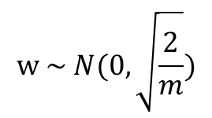
Weight initialization
Problem: Larger expected value for neurons with fan-in with larger variance!
$$w \sim N(0, \frac{1}{\sqrt{m}})$$
Xavier initialization
[Glorot et al., 2010]
Where $m$ is fan-in of the neuron the weight is connected to
Problem: expected value of neurons is also affected by output
of previous layer. ReLUs kill half of the data and thus halves
the variation of data:
$$w \sim N(0, \sqrt{\frac{2}{m}})$$
[He et al., 2015]

Slide 38
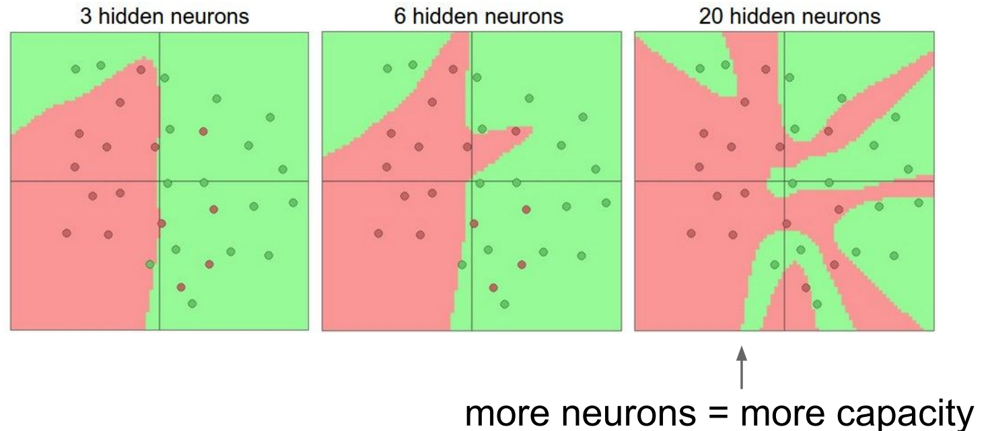
Neurons in hidden layer
Demo = http://cs.stanford.edu/people/karpathy/convnetjs/demo/classify2d.html

Slide 39
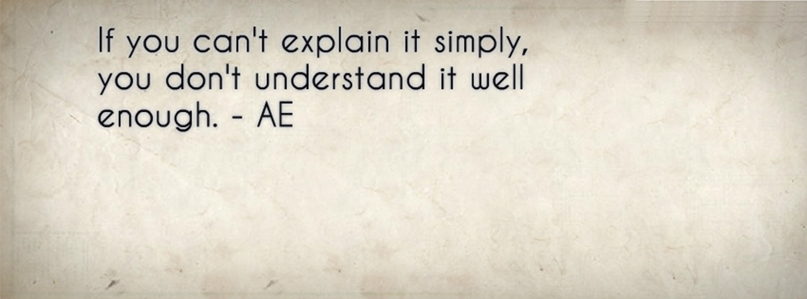
Regularization

Slide 40

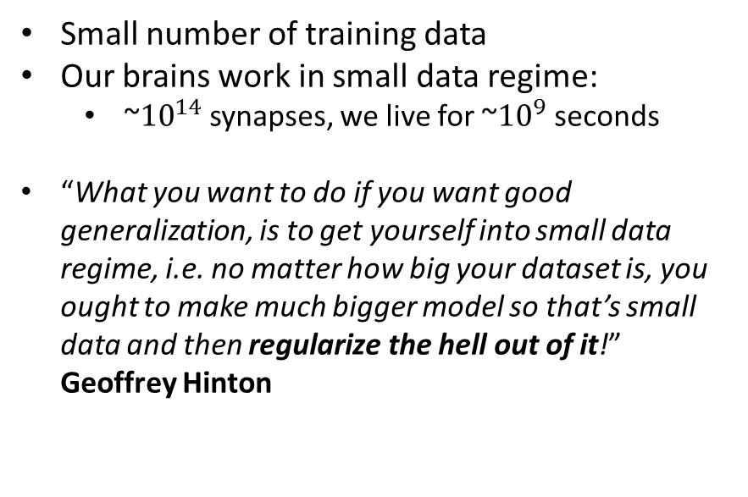
Small data regime
Small number of training data
Our brains work in small data regime:
~${10}^{14}$ synapses, we live for ~${10}^{9}$ seconds
“What you want to do if you want good generalization, is to get yourself into small data regime, i.e. no matter how big your dataset is, you ought to make much bigger model so that’s small data and then regularize the hell out of it!” Geoffrey Hinton

Slide 41
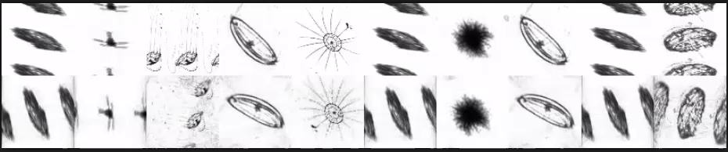
Preventing overfitting
Data augmentation
Translation
Rotation
Rescaling
Flipping
….

Slide 42
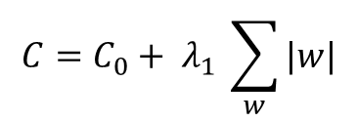

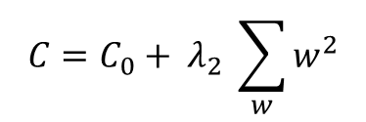
Regularization
Weight decay
$L_{1}$ regularization
$L_{2}$ regularization
$$C=C_{0}+ λ_{1} \sum_{w}{|w|}$$
$$C=C_{0}+ λ_{2} \sum_{w}{w^{2}}$$
$λ′s$ seek a compromise between small weights and fitting the training data (possibly with large weights)

Slide 43
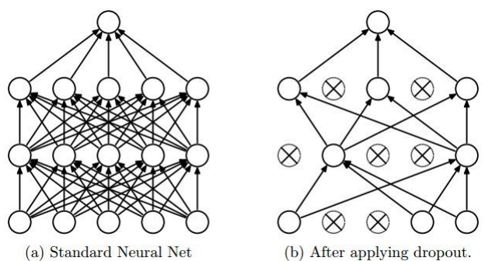
Dropout
[Srivastava et al., 2014]
Another technique to prevent overfitting:
Question: How could it possibly be a good idea?!
Question: Does it make any sense to do dropout at testing time?!!
Be careful! Handle the difference in training and testing time distribution

Slide 44
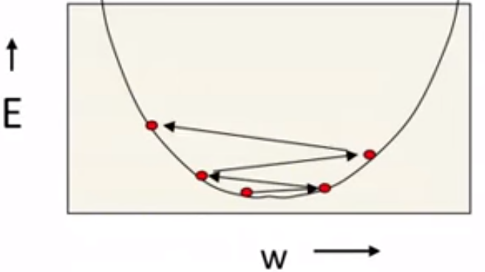
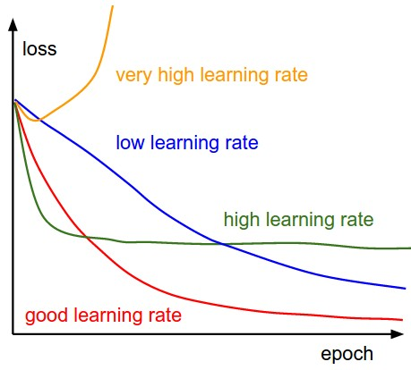
Learning Rates:
Learning rate is an important parameter:
To low: very slow convergence
Too high: No convergence!
Tip: Decay your learning rate as you
go forward on your training

Slide 45
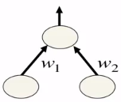






Normalizing the data
$$w_{1}$$
c
0.1, 10 $\overset{⇒}{ } 2$
0.1, -10 $\overset{⇒}{ } 0$
$$w_{2}$$
$$w_{1}$$
Question: Why is it harder to optimize
elliptical cost structures?
1, 1 $\overset{⇒}{ } 2$
1, -1 $\overset{⇒}{ } 0$
$$w_{2}$$

Slide 46
Normalizing the data

Slide 47


Batch Normalization
[Loffe and Szegedy, 2015]
If using normalized responses makes sense, why not doing that for all of the
Intermediate Layers?
Do we necessarily want a unit Gaussian input to a layer?

Slide 48
Batch Normalization
[Loffe and Szegedy, 2015]
Question: People report that with batch normalization they rarely need drop-out.
Why?

Slide 49


Babysitting the network!
Loss
Chunk#
Different colors represent different epochs

Slide 50


Babysitting the network!

Slide 51

Babysitting the network!
Bad initialization!

Slide 52



Babysitting the network!
http://lossfunctions.tumblr.com/

Slide 53

Babysitting the network!
Big gap: Overfitting
=> Increase regularization
No gap => increase model
capacity

