Slide 1
Fiber Bundle Volume Measurement
Shun Gong^{1,2},Fan Zhang²,
Lauren J. O'Donnell²
Shanghai Changzheng Hospital, China
Brigham and Women’s Hospital, USA
sgong@partners.org
Notes:
Hello everyone, my name is Fan from BWH. I am going to present a tutorial about fiber bundle selection and scalar measurement. It is about how to do further processing after we obtain tractography.

Slide 2
Pre-requisite
This tutorial is a follow-up tutorial of the “Fiber Bundle Selection And Scalar Measurement” by Fan Zhang, PhD. Please go through this ahead, which is available at:
https://github.com/SlicerDMRI/slicerdmri.github.io/blob/master/docs/tutorials/FiberBundleSelectionAndScalarMeasurement.pptx
Notes:
This is a follow-up tutorial of the DTI tutorial by Sonia. A brief introduction, the DTI tutorial introduces how to do tensor estimation to obtain DTI, how to calculate the scalar tensor measurement such as FA, Trace from DTI, and how to do tractography.

Slide 3
Learning Objectives
The aim is to calculate the volume of the fiber bundle that passes through the Corpus Callosum(CC). Following this tutorial, you’ll be able to:
Fiber bundle to label map:
convert fiber bundles to label map;
2) Fiber bundle volume measurements:
calculate volume measurements from the fiber bundles.
Notes:
In this tutorial, I’ll introduce how to do some after-tractography processing. The first one is how to select fiber tracts passing through a region of interest. For example, given a label map of CC, we want to see the fibers passing through the CC. The second one is to calculate scalar measurements from the the selected fiber bundles. Like, how to compute the mean FA from the tracts of the CC.

Slide 4
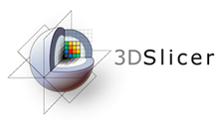
3D Slicer
The tutorial uses the 3DSlicer (Version 4.6.2 Stable Release) software available at
http://download.slicer.org
Disclaimer
It is the responsibility of the user of 3DSlicer to comply with both the terms of the license and with the applicable laws, regulations and rules. Slicer is a tool for research, and is not FDA approved.

Slide 5
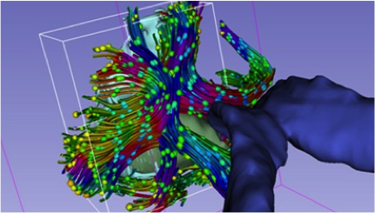
Slicer DMRI
An open-source project to improve and extend diffusion magnetic resonance imaging software in 3D Slicer:
http://slicerdmri.github.io Please read the Diffusion MRI Analysis tutorial to install SlicerDMRI:
https://github.com/SlicerDMRI/slicerdmri.github.io/blob/master/docs/tutorials/DiffusionMRIanalysis.pdf

Slide 6
Tutorial Data
Download sample data, at http://www.na-mic.org/Wiki/images/4/4c/FiberVolume_data.zip
The following data are provided:
Baseline image
Down sampled whole brain tractography (conducted as in the DWI tutorial and down-sampled to about 10000 fibers using Tractography Display module)
Corpus callosum label map (drawn as in the DWI tutorial)

Slide 7
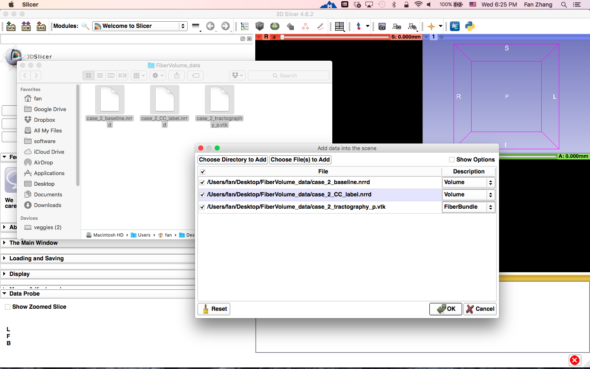
Load Data
Load all three files in the folder.
Drag and drop the files onto the viewer of the Slicer application
Load the tractography as FiberBundle
Click OK to load the dataset to Slicer
Notes:
First, let’s load a mrml file that includes the data we need in this tutorial.

Slide 8
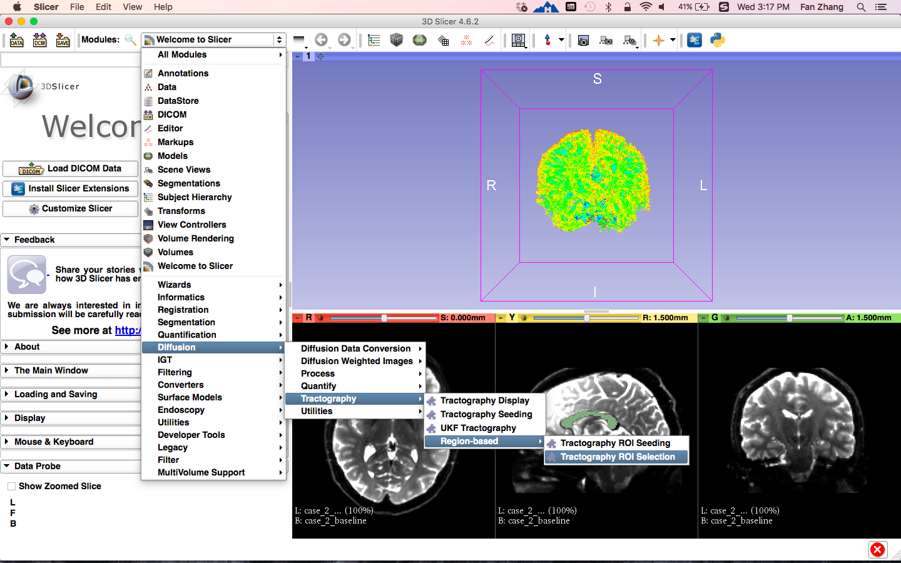
Tractography ROI Selection
Click on the Modules menu, then select Diffusion ->
Tractography -> Region-based -> Tractography ROI Selection
Notes:
Next step, let do the fiber bundle selection, go to the module FiberBundleLabelSelect under the category of Diffusion/tractography.

Slide 9
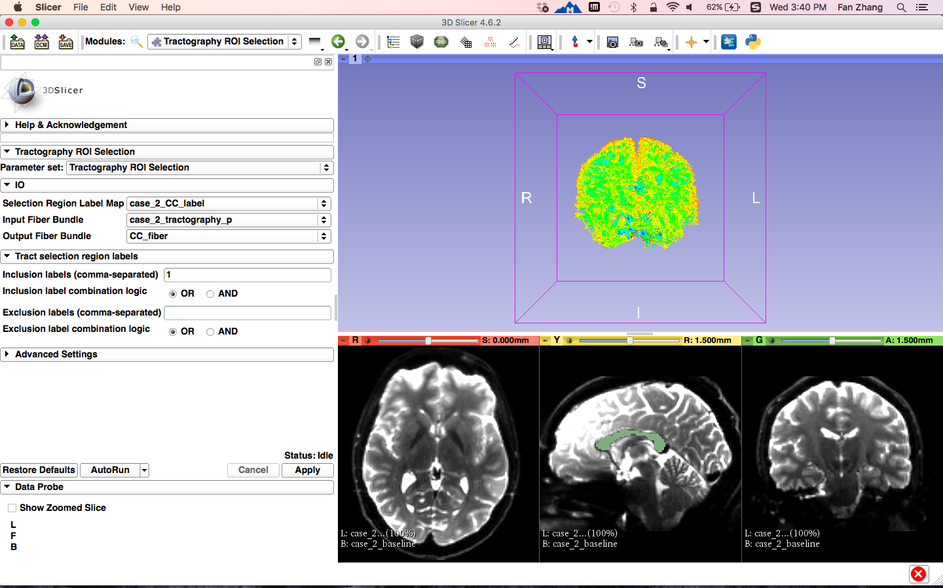
Single Label Selection
Set the Tractography ROI Selection
parameters:
- Selection Region Label Map: case_2_CC_label
- Input Fiber Bundle:
case_2_tractography_p
- Create and rename Output Fiber Bundle:
CC_fiber
- Inclusion labels: 1
Click the button Apply
Notes:
Set the parameters, Input Label Map: fa-label, Input Fiber Bundle, whole_brain_tractography , Output Fiber Bundle: bundle_label1_include, - Labels to include: 1
Notice, here we use the label map of fa-label, which contains the different regions we just obtained, not the whole brain mask.
And we want to see the fibers passing through the entire CC, so here we set the parameter of Labels to include to 1.
Then click apply to do the selection.

Slide 10
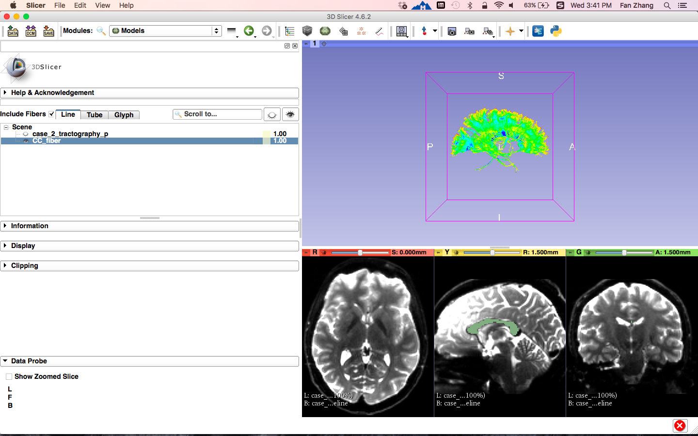
Single Label Selection
Select the module Models
Check Include Fibers
Check the visibility of CC_fiber only
The fiber bundle from the whole brain tractography that passes through Corpus Callosum(CC) is displayed
Notes:
Let go the Models module to see the selection results. In the 3D viewer, we have the bundle selected.

Slide 11
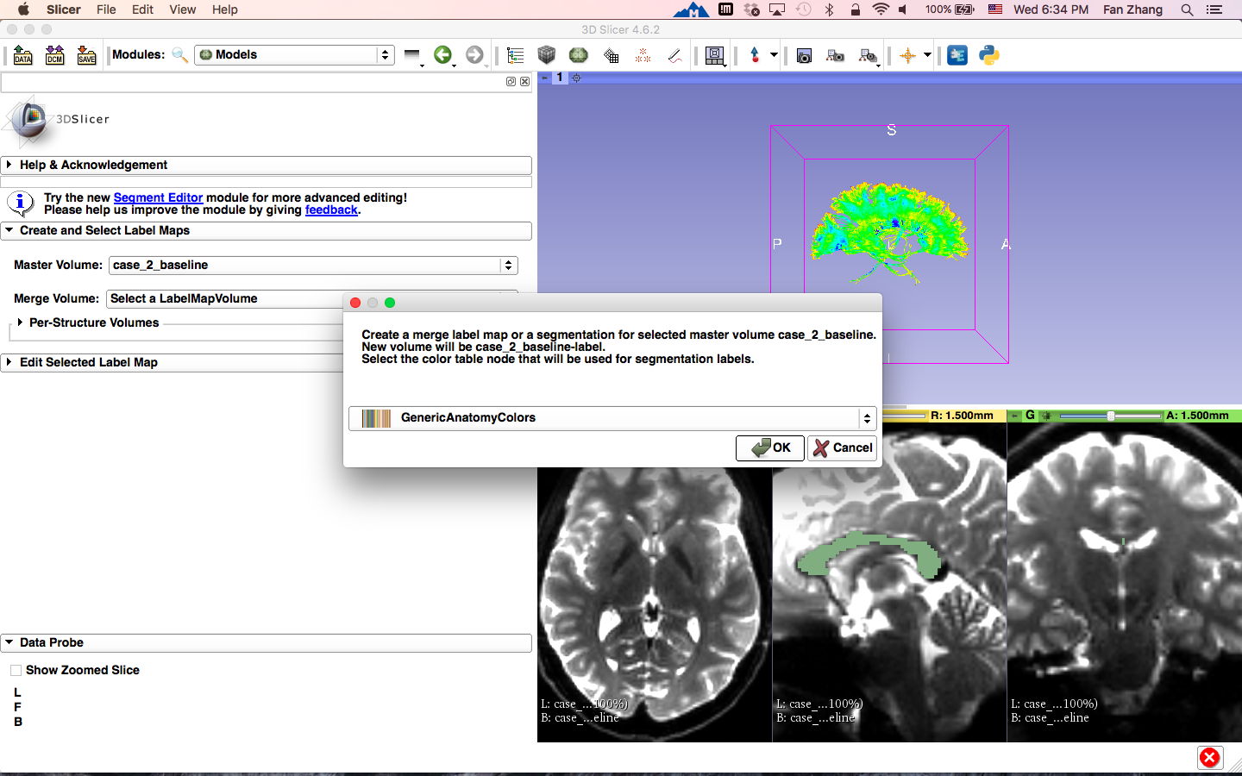
Fiber bundle to label map
Select the module Editor
The ‘SlicerApp-real’ window appears. Select the label map GenericAnatomyColors and click OK.
Notes:
Le’s save all fibers we just obtained and we finish the fiber bundle selection part.

Slide 12
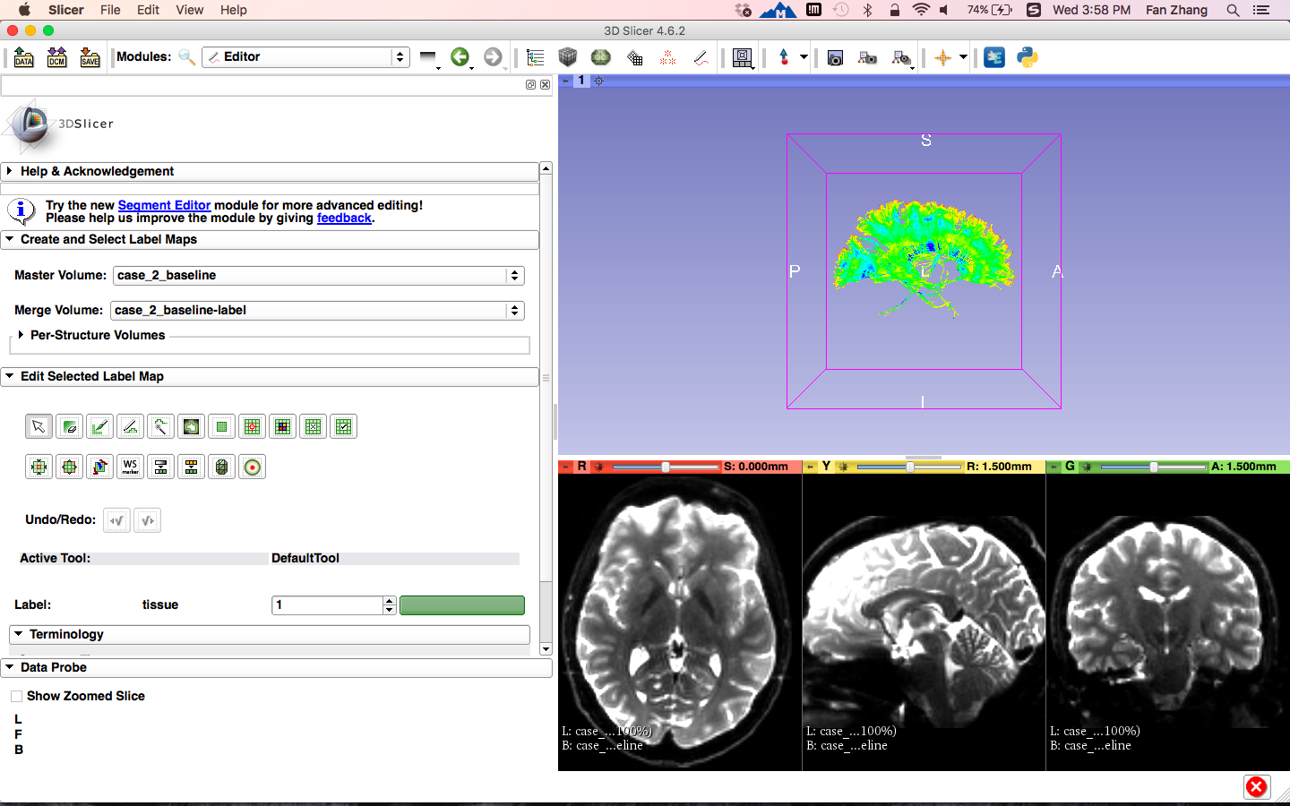
Fiber bundle to label map
Create and Select Label Maps:
- Master Volume: case_2_baseline
- Merge Volume: case_2_baseline-label
Notes:
Le’s save all fibers we just obtained and we finish the fiber bundle selection part.

Slide 13
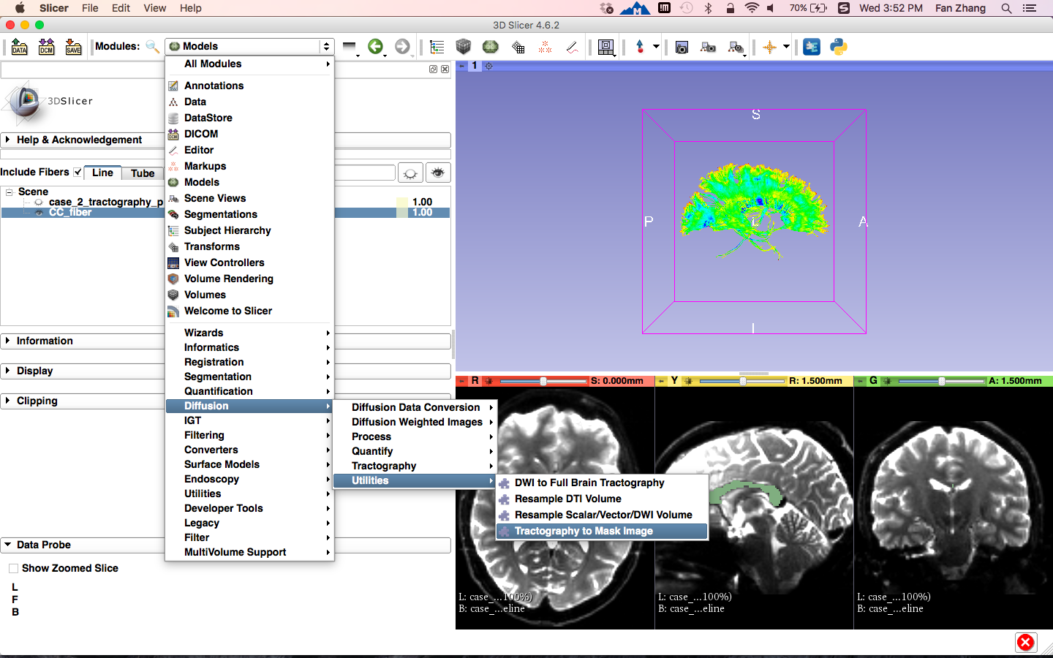
Fiber bundle to label map
Click on the Modules menu, then select Diffusion ->
Tractography -> Utilities-> Tractography to Mask Image
Notes:
Le’s save all fibers we just obtained and we finish the fiber bundle selection part.

Slide 14
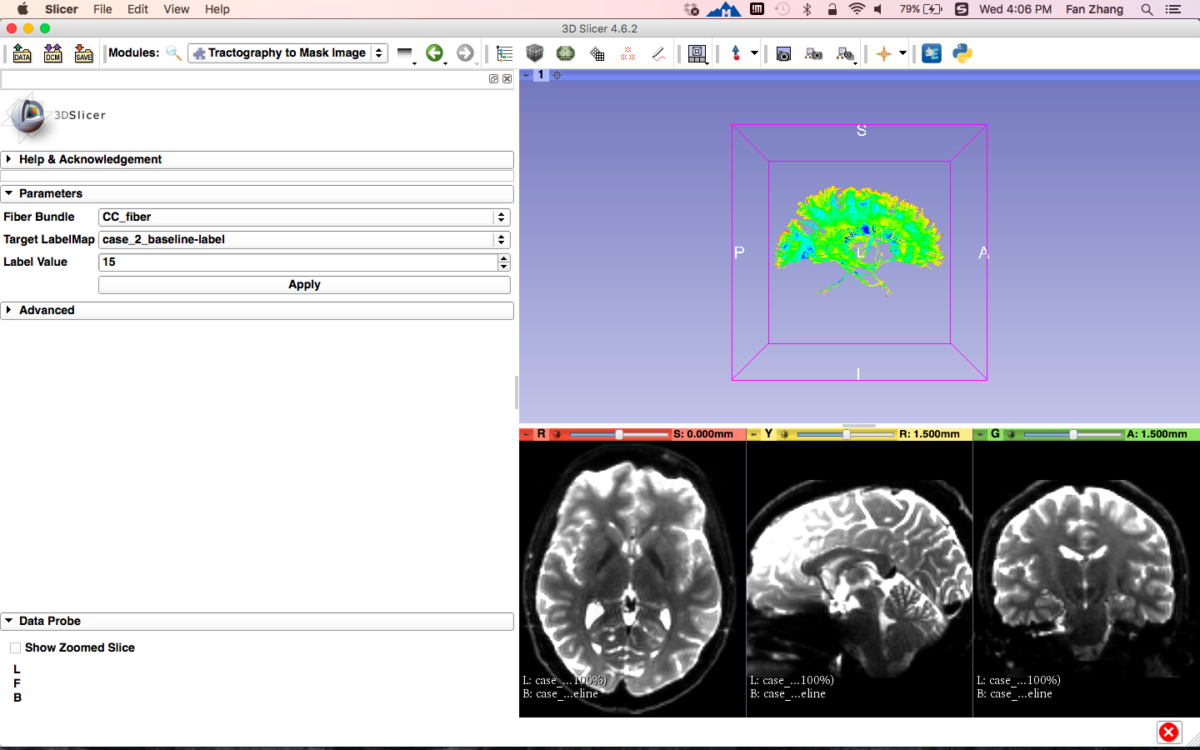
Fiber bundle to label map
Set the Parameters:
- Fiber Bundle: CC_fiber
- Target LabelMap:
case_2_baseline-label
- Label Value: 15
Click the button Apply
Notes:
Le’s save all fibers we just obtained and we finish the fiber bundle selection part.

Slide 15
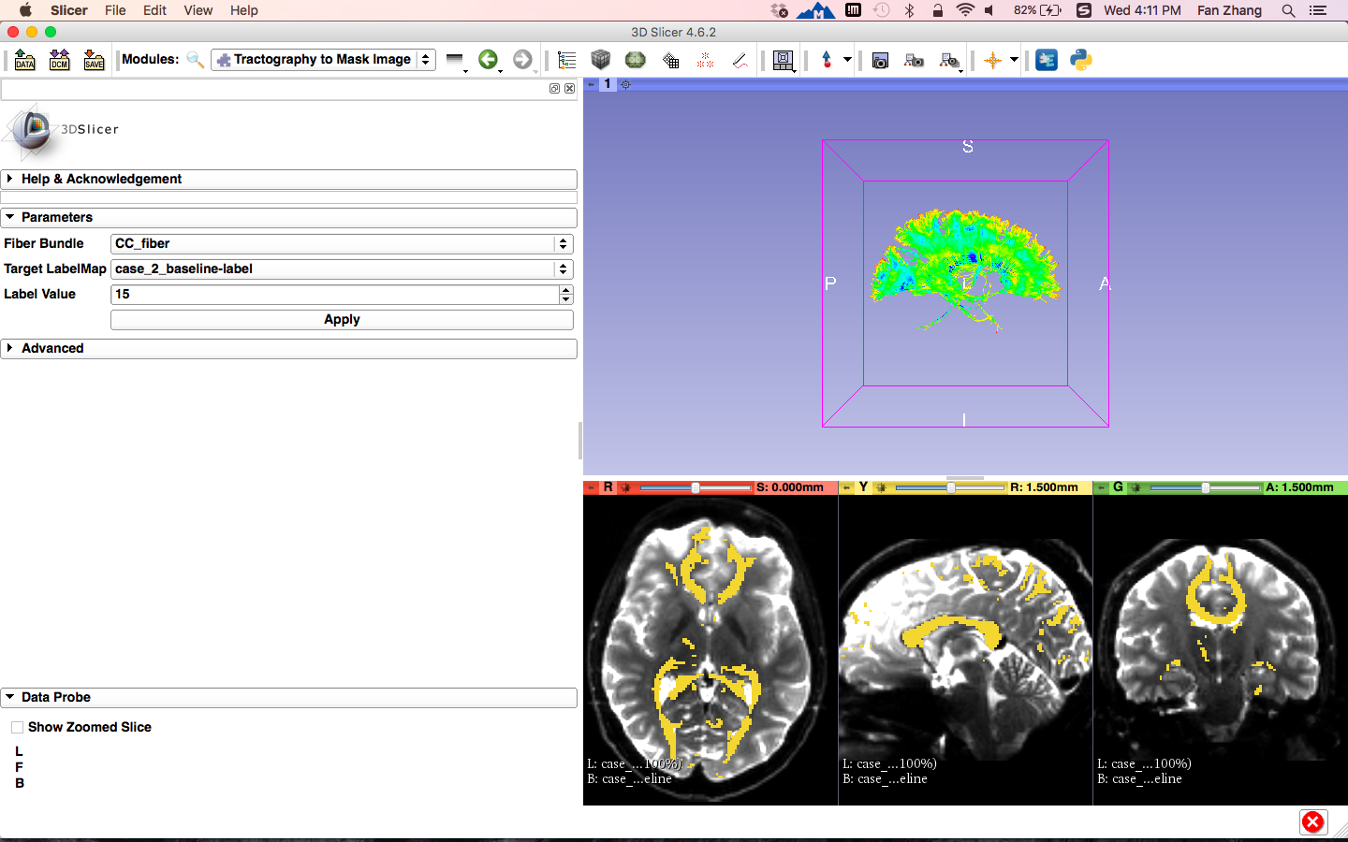
Fiber bundle to label map
The fiber bundle that passes through Corpus Callosum(CC) to label map is displayed
Notes:
Le’s save all fibers we just obtained and we finish the fiber bundle selection part.

Slide 16
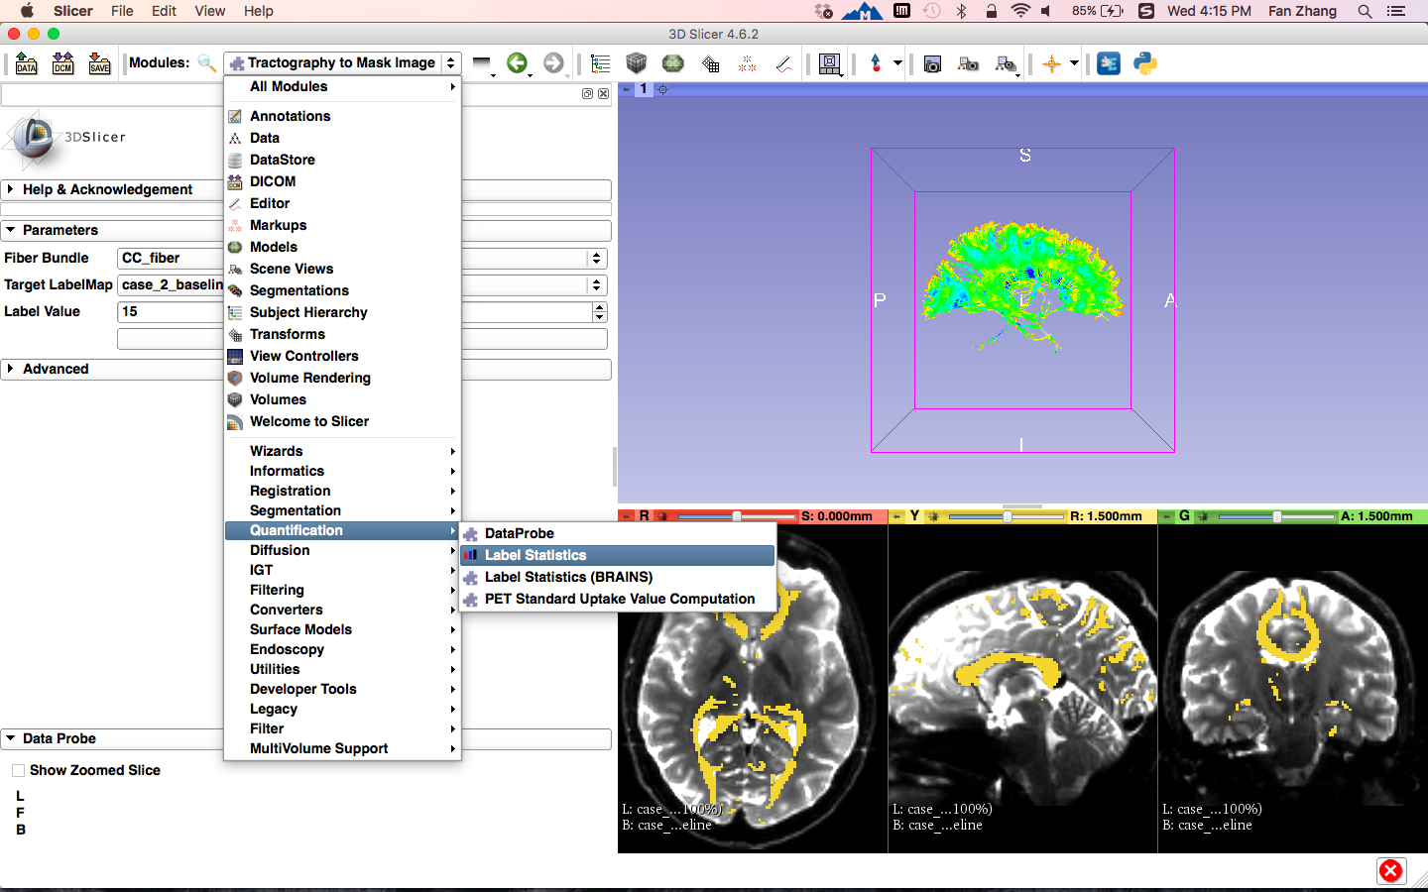
Fiber bundle volume measurements
Click on the Modules menu, then select Quantification -> Label Statistics
Notes:
Then let’s go to the scalar measurement part, with the module FiberTractScalarMeasurement under tractography category.

Slide 17
Fiber bundle volume measurements
Set the Parameters:
- Grayscale Volume: case_2_baseline
- Label Map: case_2_baseline-label
Click the button Apply
Notes:
Then let’s go to the scalar measurement part, with the module FiberTractScalarMeasurement under tractography category.

Slide 18
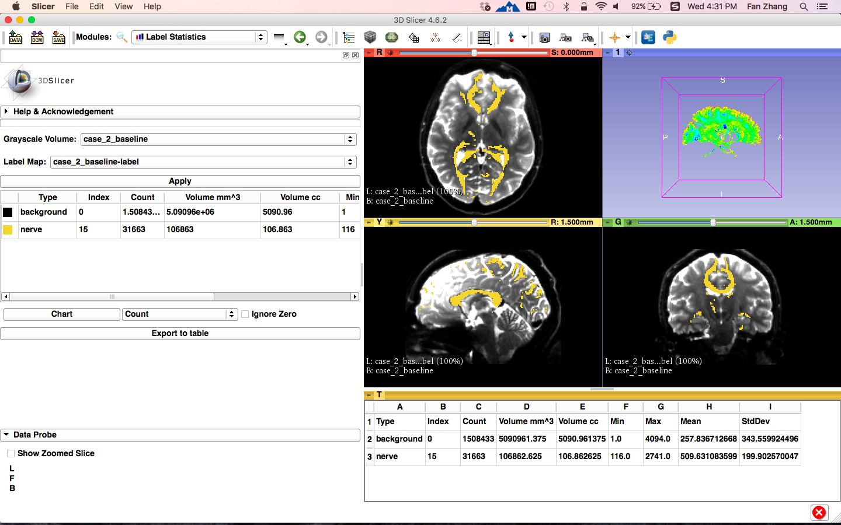
Fiber bundle volume measurements
The Volume of the fiber bundle that passes through Corpus Callosum(CC) to label map is displayed
Click the button Export to table
Notes:
Then let’s go to the scalar measurement part, with the module FiberTractScalarMeasurement under tractography category.

Slide 19
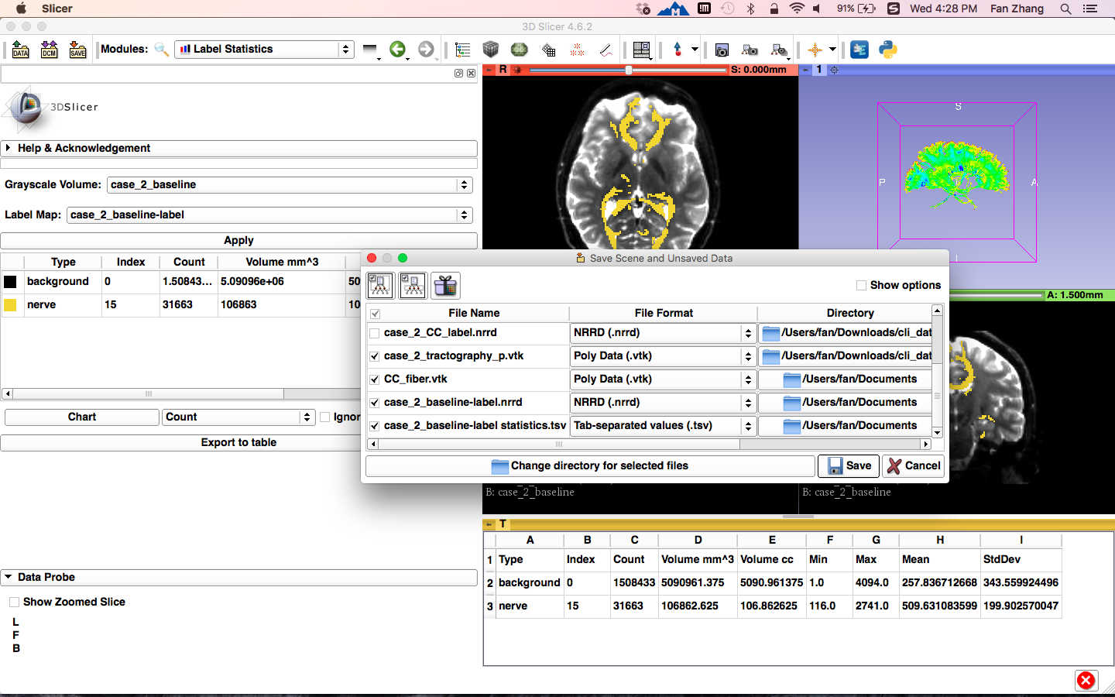
Save the Results
Click the button SAVE
Click Change directory for selected files and select a folder to store the results
Check the results obtained above
Click the button Save
Notes:
Le’s save all fibers we just obtained and we finish the fiber bundle selection part.

Slide 20
Conclusion
This tutorial guided you through converting fiber bundle to label map and measuring fiber bundle volume for conducting further tractography processing.

Slide 21
Acknowledgments
Shanghai Changzheng Hospital, China, CSC/NSFC/STCSM
China Scholarship Council
National Nature Science Foundation of China
Science and Technology Commission of Shanghai Municipality
Open Source Diffusion MRI Technology For Brain Cancer Research
NIH U01CA199459
National Center for Image Guided Therapy (NCIGT)
NIH P41EB015898
Neuroimage Analysis Center (NAC)
NIH P41EB015902

