Slide 1
Chest Imaging Platform (CIP)
Applied Chest Imaging Laboratory
Boston, Massachusetts. USA
Slicer Modules Examples

Slide 2
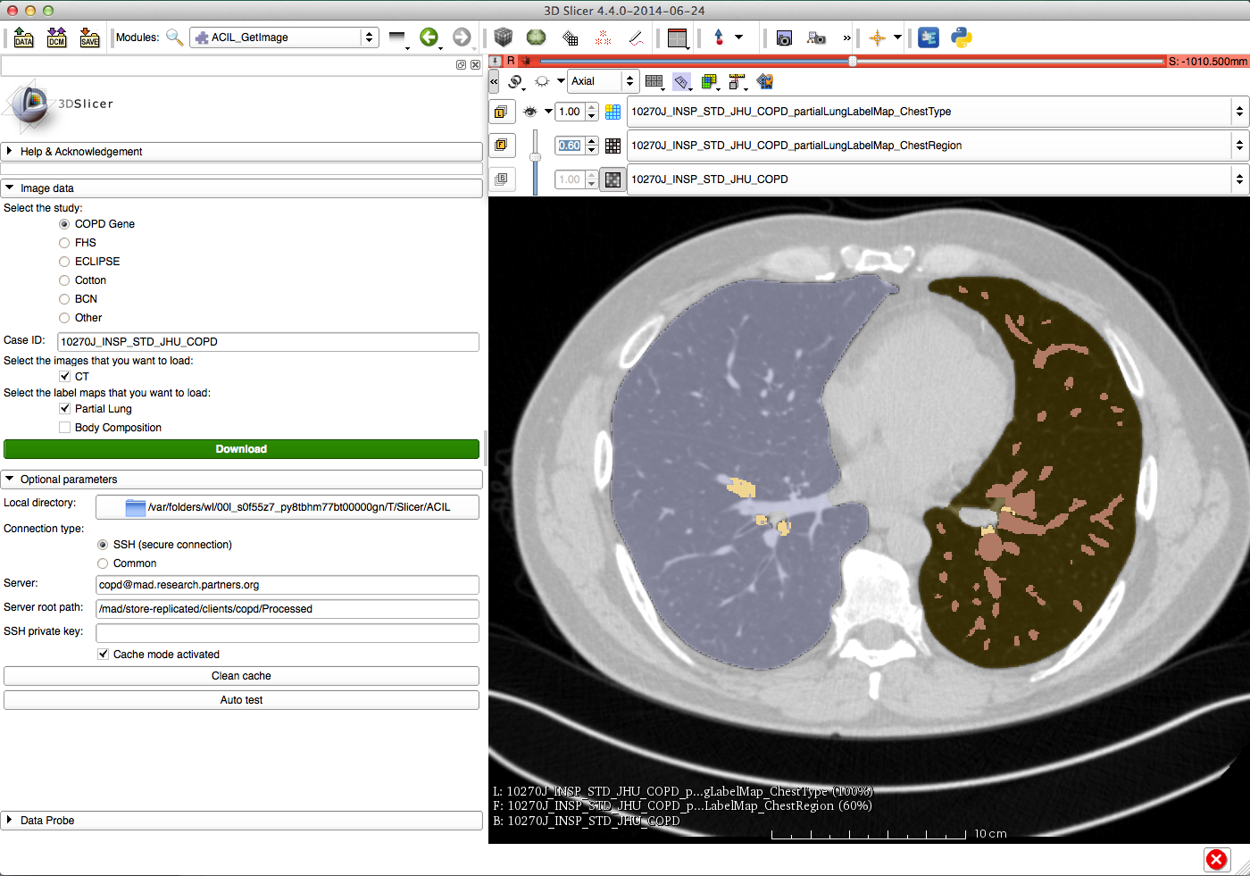
Slicer modules: Get Image
Quick images download from SSH server
Automatic label map splitting
Based on our name conventions
Work in Unix (authorized host) or Windows mode (SSH key as a parameter)

Slide 3
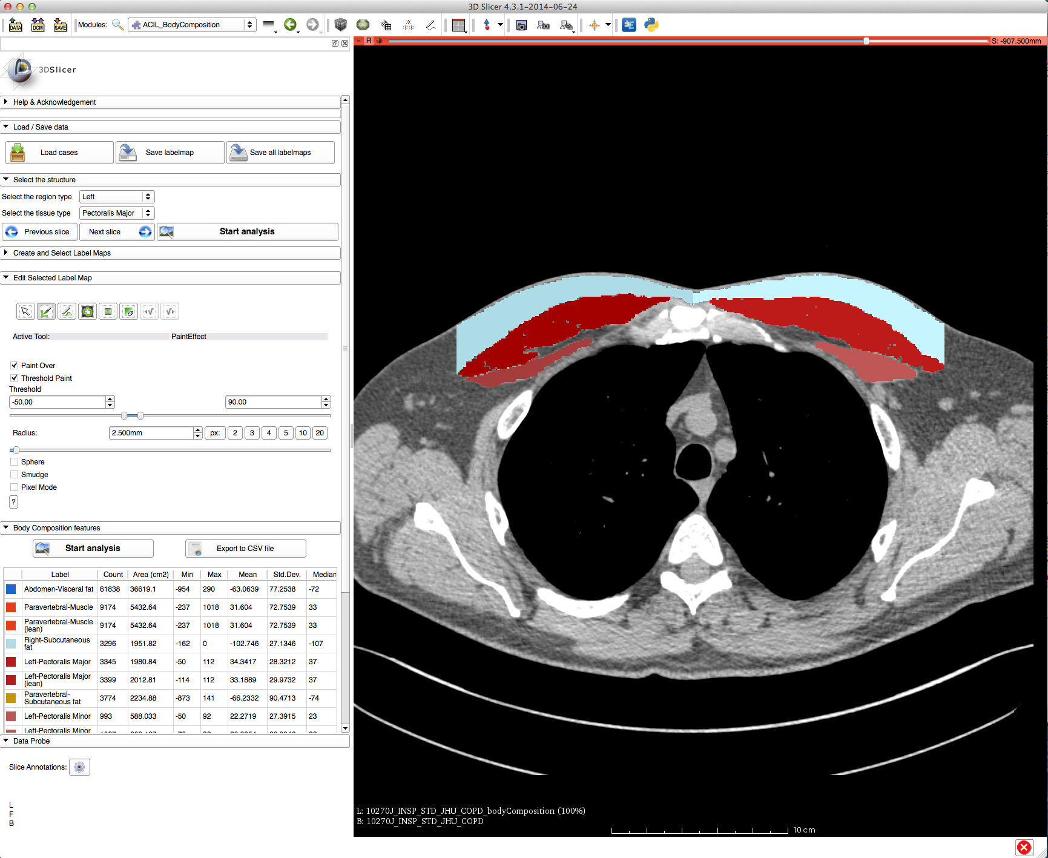
Slicer modules: Body Composition
Quick visualization of the results of CIP algorithms to segment different chest structures (muscle, fat, etc.)
Customization of the Slicer Editor for edition of label maps
Fast analysis of different structures from the label map
Fast shortcut to load and save volumes with label maps

Slide 4
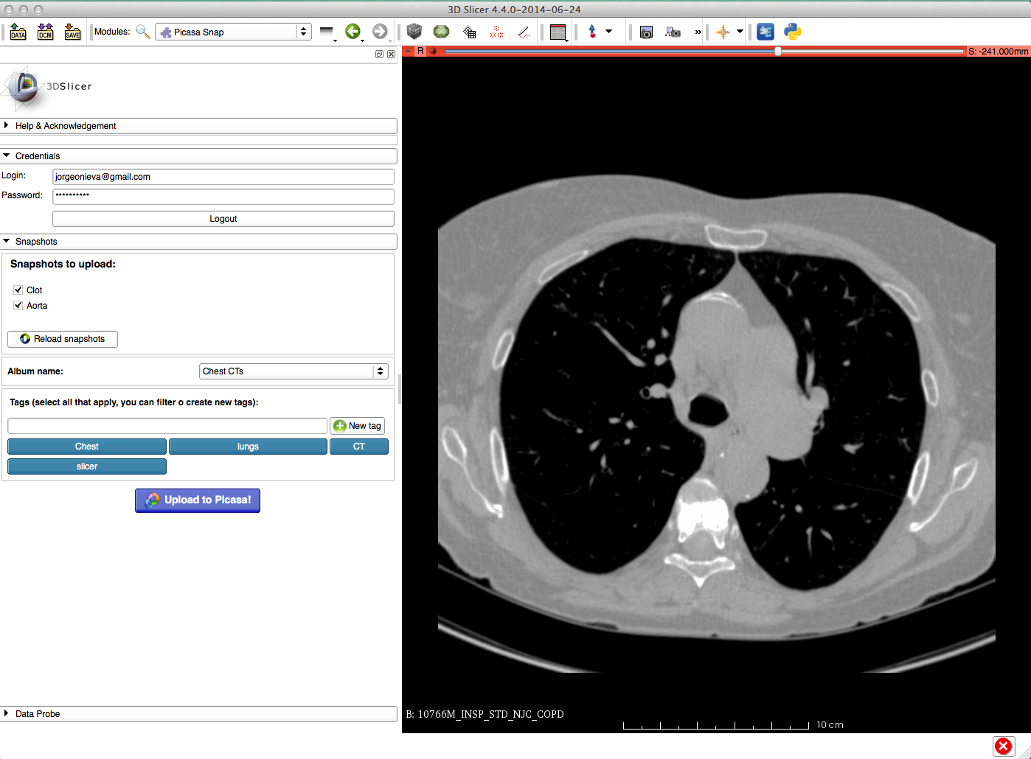
Slicer modules: Picasa Snap
Upload Slicer snapshots to a Picasa album
Synchronism with Scene, avoiding duplicate uploads
Assign tags to the snapshots and create new tags directly
Pick your album
Auto login if desired

