Slide 1
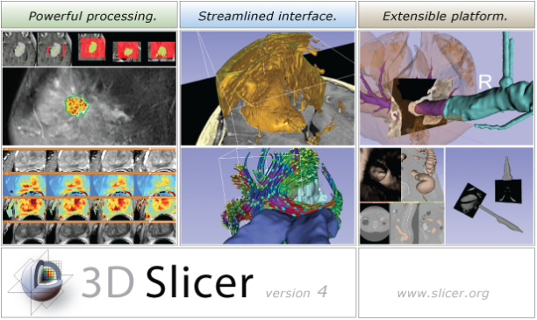
3D Slicer is free, open source software for visualization and image analysis on Windows, Linux and Mac OSX.
Segmentation
Volume Rendering
Measurement
Multi-Modality Registration
Diffusion Tractography
Compare View and Crosshairs
DICOM I/O and Networking
Image-Guided Therapy

