Slide 1
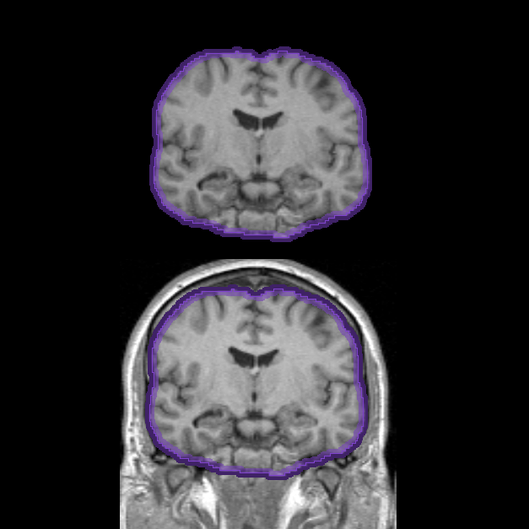
Skull Stripper Extension
Jim Miller
GE Research

Slide 2
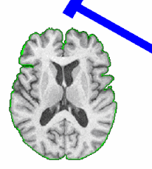
Part of a NA-MIC Collaboration Grant
PAR-07-249: R01EB006733 Development and Dissemination of Robust Brain MRI Measurement Tools
PI - Dinggang Shen, UNC
NA-MIC versions of
HAMMER
White matter lesion detection for MS

Slide 3
Skull Stripping
Standard step in many neuro applications
  Removes anatomy not relevent to the analysis
  Improves robustness
Preliminary results for grant used FSL
  Needed a skull stripper with a NA-MIC compatible license

Slide 4
Skull Stripper Method
Similar to BET
Deformable model
Fuzzy tissue classification
Tested on OASIS database
  DICE comparison to BET 0.948
Xiaodong Tao ; Ming-Ching Chang; A skull stripping method using deformable surface and tissue classification. Proc. SPIE 7623, Medical Imaging 2010: Image Processing, 76233L (March 12, 2010); doi:10.1117/12.844061.

Slide 5
Skull Stripper Extension
Single CLI module
Not a complete neuro analysis workflow
Packaged for re-use

Slide 6
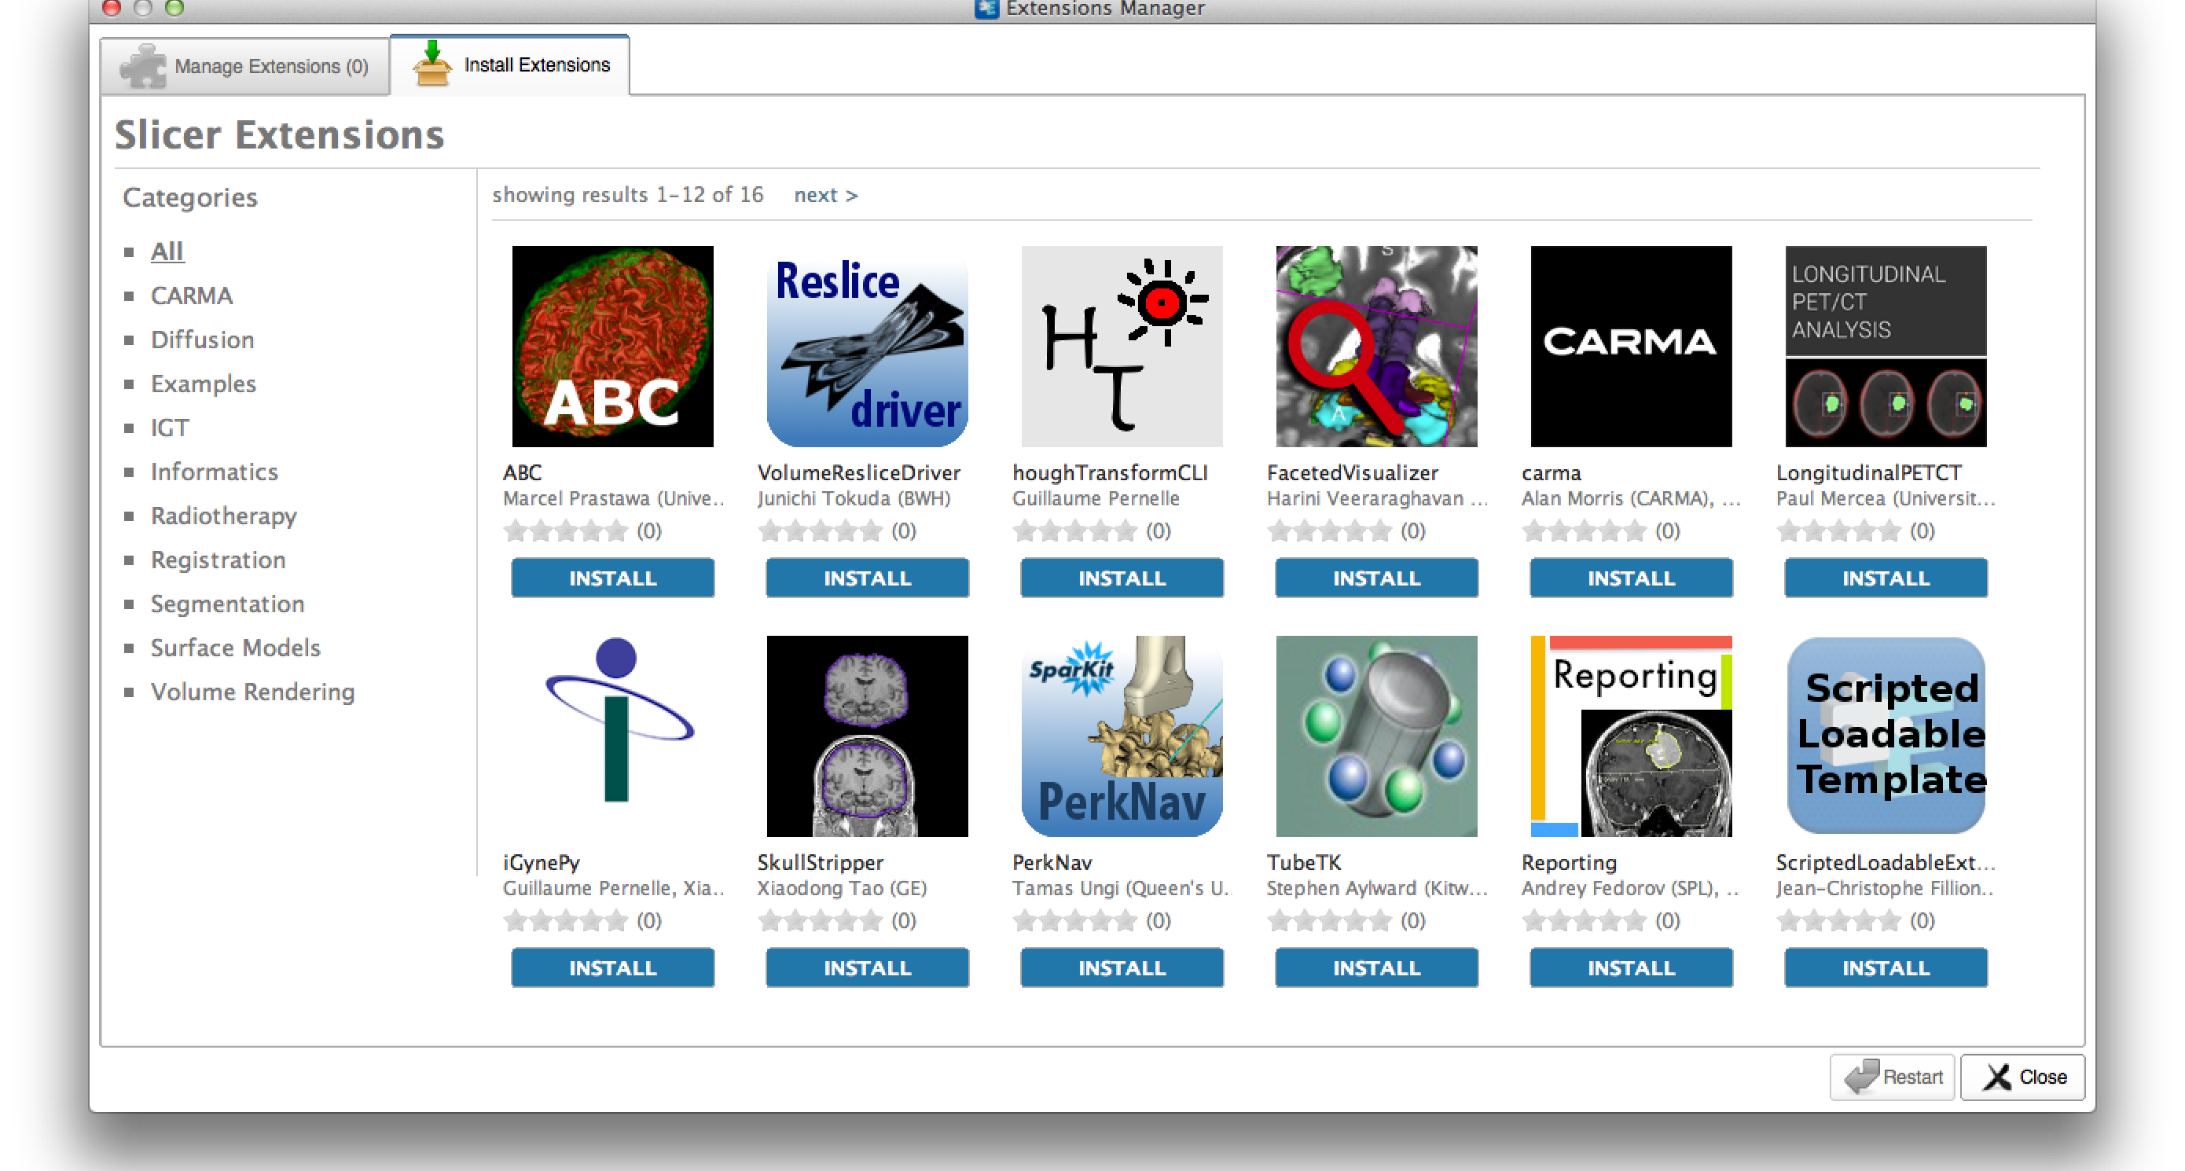
Extensions manager

Slide 7
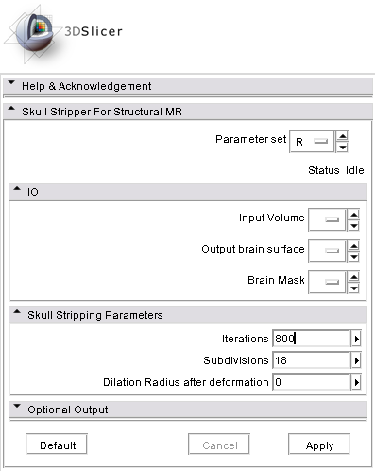
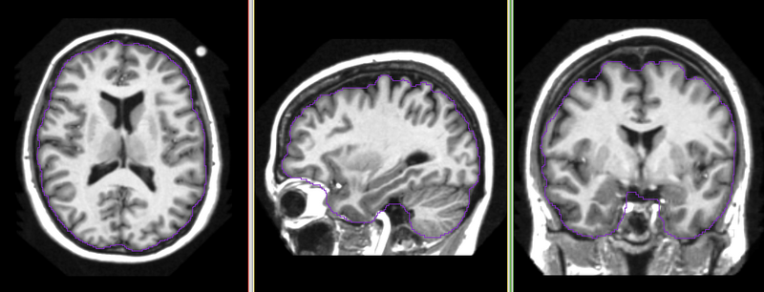
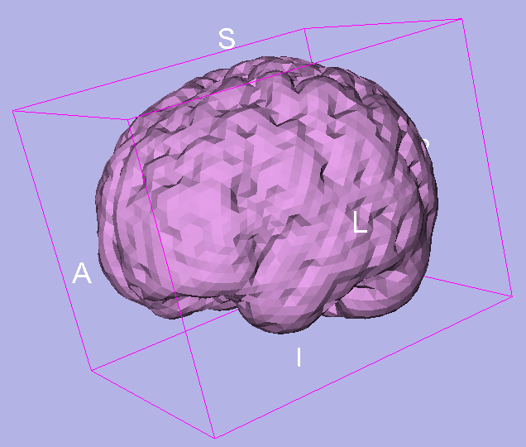
Skull Stripper Module

