Slide 1
Algorithms Organization
Martin Styner – UNC
Polina Golland – MIT
Guido Gerig – Utah
Allen Tannenbaum – Georgia Tech
Ross Whitaker – Utah

Slide 2
Algorithms Organization
Monthly t-cons
Annual Algorithms retreat
  Coordination with engineering
Project weeks (semi-annual)
Other one-off NA-MIC events
  DTI shoot out, Registration retreat
DBPs point of contact
Engineering t-cons as needed

Slide 3
Algorithms – Utah I
Nonparametric estimators and multiatlas segmentation
  Head and neck cancer–MGH
Longitudinal shape analysis
  Huntington’s disease–Iowa
Globally-optimal Bayesian segmentation of heart wall
  Afib–Utah

Slide 4
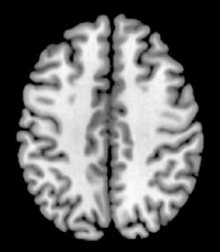
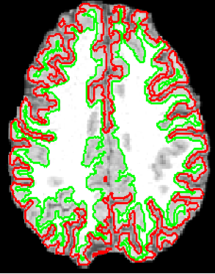
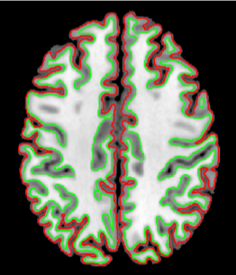
Multi-Atlas Segmentation
New, input image (“test image”)
Label fusion
K Similar images: via registration + metric
Segmented image
Database of Segmented Images (“training”)

Slide 5
Strategy
Segmentation of images from database of examples: regression problem
Segmentation (s)
Image/pixel data (f)

Slide 6
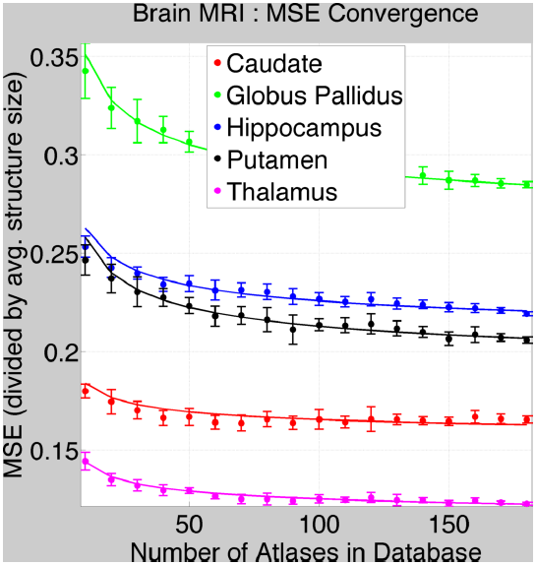
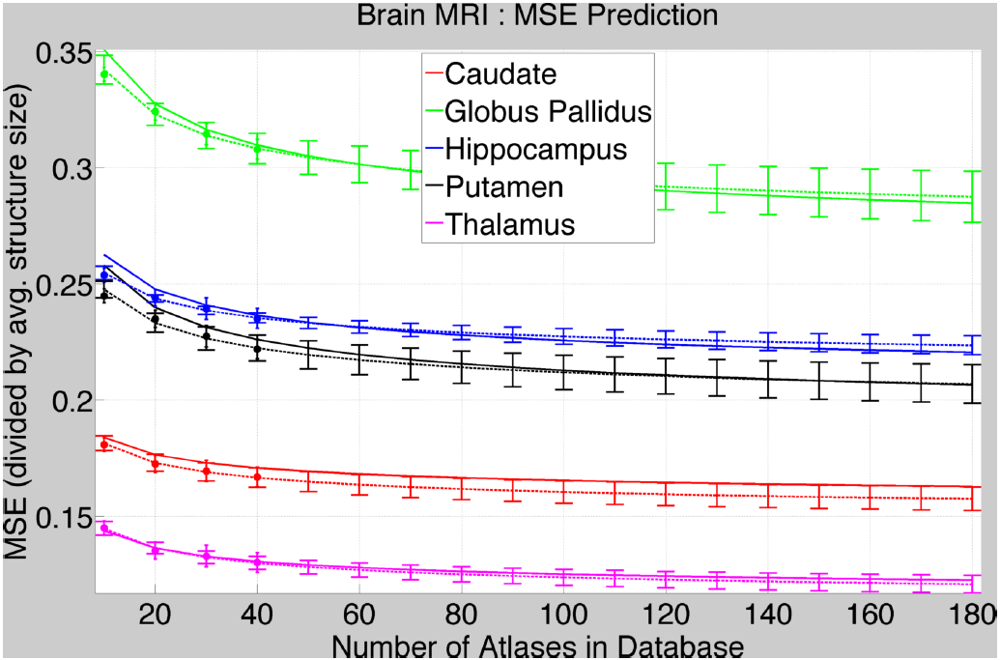
Results
Asymptotically 11% error

Slide 7

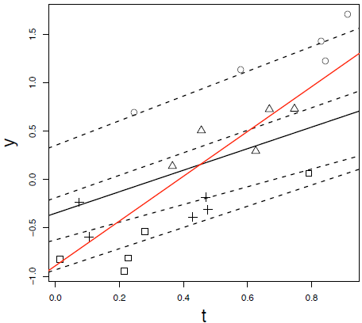


Linear Mixed-Effects Model [Laird, Ware. Biometrics 1982]
Popular choice to model univariate longitudinal data
~
~
where,
y_{i} → i^{th} observation
x_{i} → i^{th} explanatory variable
α → group/population parameters
b_{i} → i^{th} individual parameters
є_{i} → i^{th} perturbation from group
global/population trend [ ]
α → group [slope, intercept]
i^{th} individual trend [ ]
b_{i} → individual [slope, intercept]
perturb
to get
x
Legend:
+ individual observations individual trends
regression trend mixed-effects trend
Notes:
Background: univariate longitudinal analysis, Laird and Ware mixed-effects model (overview)

Slide 8
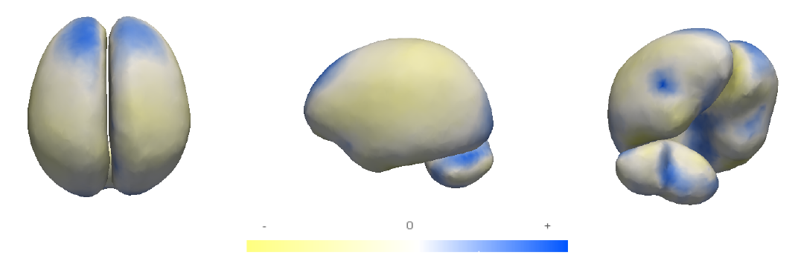
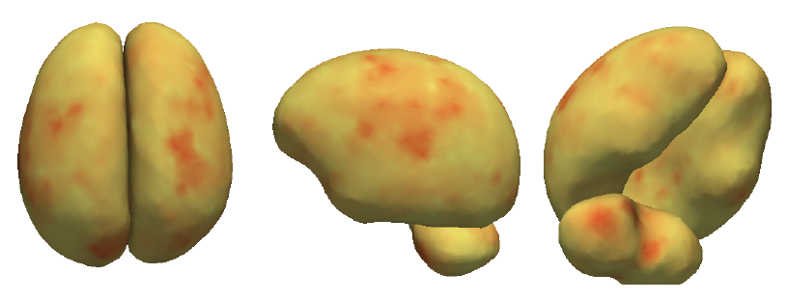

Clinical Study
Fixed-Effects color-coded by fixed-effect slope [α]
Random Effects color-coded by variance of individual random-effect slopes [b_{i}]
Notes:
Clinical results: fixed- and random-effects visualized, explanation about how these plots compliment each other

Slide 9
Bayesian Formulation of LA Segmentation (DCE-MRI)

Slide 10
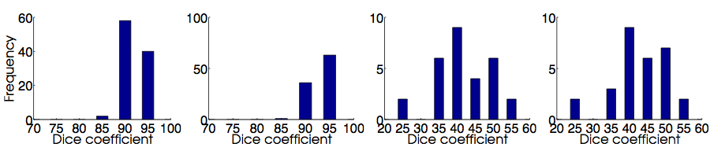
LA Segmentation Results

