Slide 1
Core 1 Introduction
Overall structure
Groups/investigators
Algorithms and engineering
Algorithms goals and DBPs
Aims and preliminary results

Slide 2
Core 1 Structure
Core 1a – Algorithms
New methodologies to address DBPs
Implementations of algorithms
NA-MIC kit ready/compatible
Coordination with DBPs data/needs/engineering
Core 1b – Engineering
Software infrastructure
End-user applications
More from Will Schroeder…

Slide 3
The Algorithms PIs
Martin Styner – UNC
Polina Golland – MIT
Guido Gerig – Utah
Allen Tannenbaum – Georgia Tech
Ross Whitaker – Utah

Slide 4
Organizational Details
Annual Algorithms retreat
Coordination with engineering
Project weeks (semi-annual)
Other one-off NA-MIC events
DTI shoot out, Registration retreat
DBPs point of contact
Engineering t-cons as needed

Slide 5
Algorithms in the Renewal
Personalized medicine
Patient-specific analysis of images
Challenges
Sequences of images of the same patient
Patients with pronounced pathologies
Anatomy with high geometric variability

Slide 6
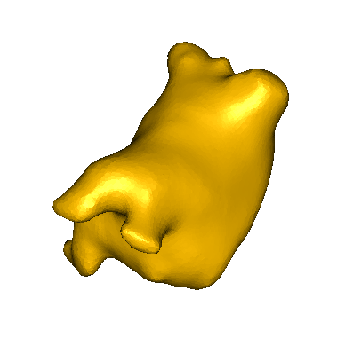
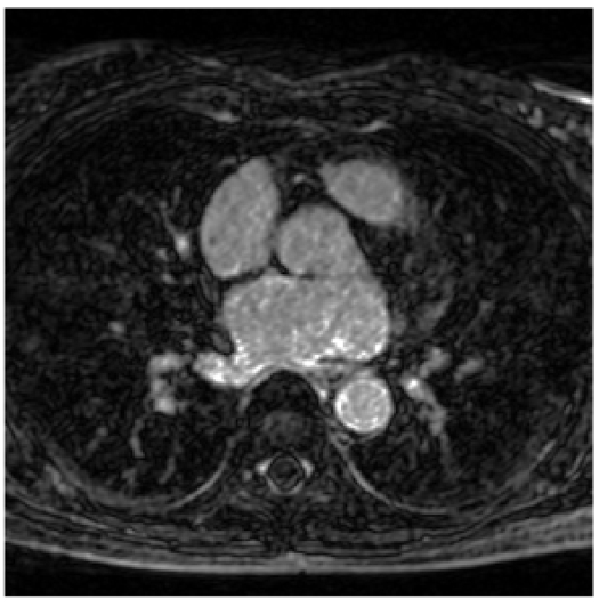
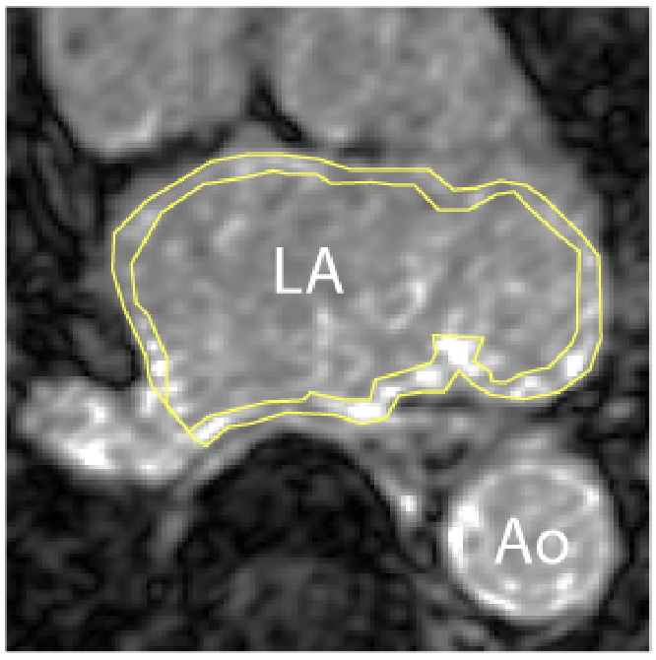
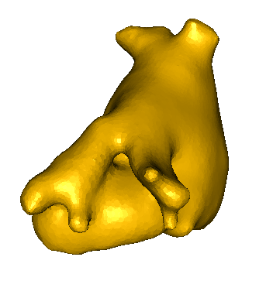
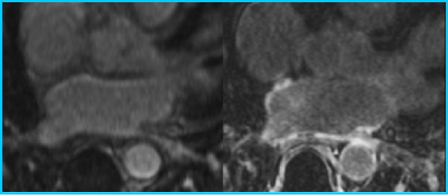
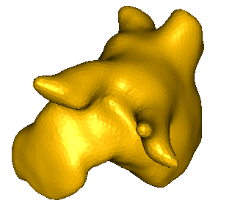
Atrial Fribulation

Slide 7
Huntington’s Disease
Baseline
Year 1

Slide 8
Head & Neck Cancer

Slide 9
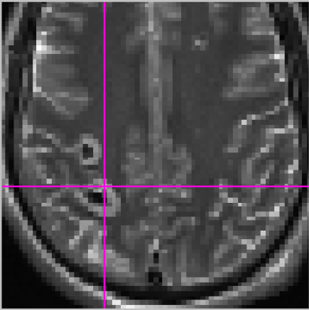
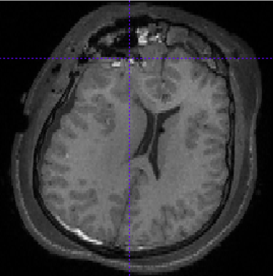
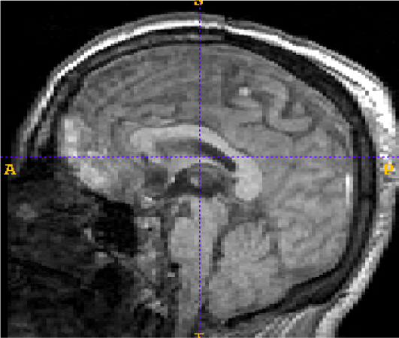
Traumatic Brain Injury

Slide 10
Algorithms – Aims
Statistical models of anatomy and pathology
Polina Golland
Geometric correspondence
Allen Tannenbaum
User interactive tools for segmentation
Guido Gerig
Longitudinal and time-series analysis
Martin Styner

