Slide 1

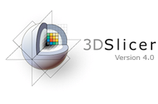


The 3DSlicer open-source platform for segmentation, registration, quantitative imaging and 3D visualization of biomedical image data
Sonia Pujol, Ph.D.
Brigham and Women’s Hospital, Harvard Medical School
Director of Training,
National Alliance for Medical Image Computing (NA-MIC)
Neuroimage Analysis Center (NAC)

Slide 2
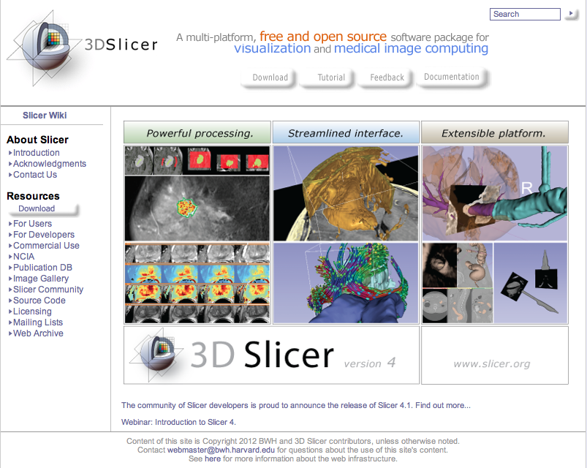
3DSlicer

Slide 3
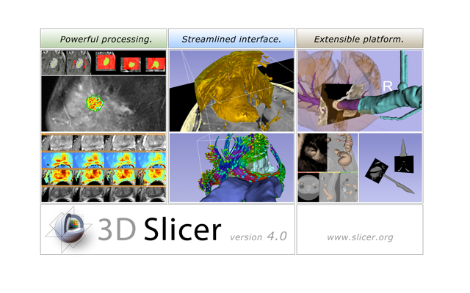
3DSlicer
Slicer is a freely available open-source application for viewing, analyzing and interacting with biomedical imaging data

Slide 4
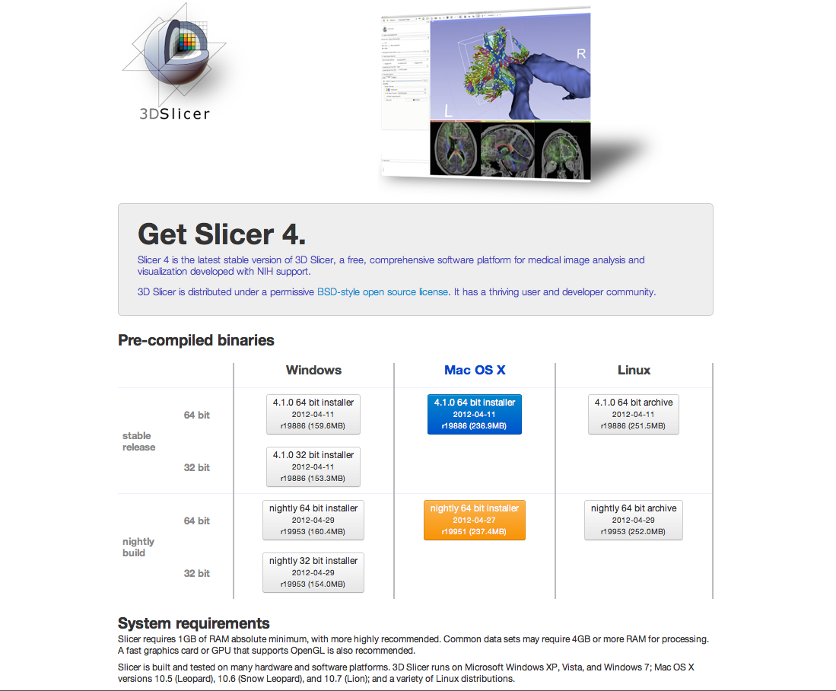
3DSlicer
Slicer is a freely available open-source application for viewing, analyzing and interacting with biomedical imaging data
Slicer is a multi-platform software on Windows, Linux, and Mac

Slide 5
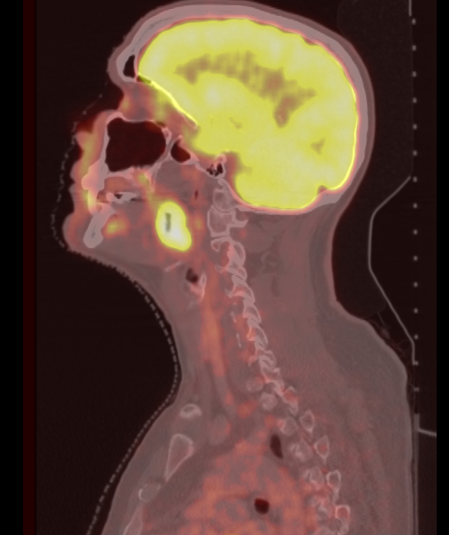
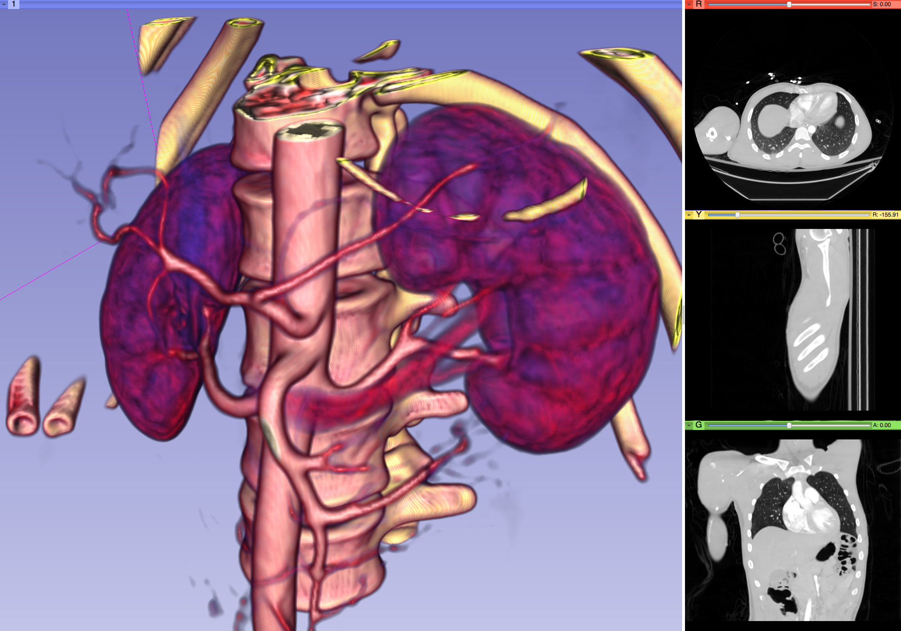
3DSlicer
Slicer is a freely available open-source application for viewing, analyzing and interacting with biomedical imaging data
Slicer is a multi-platform software on Windows, Linux, and Mac
Slicer is a multi-institutional effort mainly supported by the National Institute of Health

Slide 6
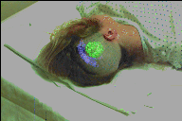

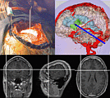
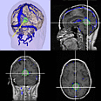
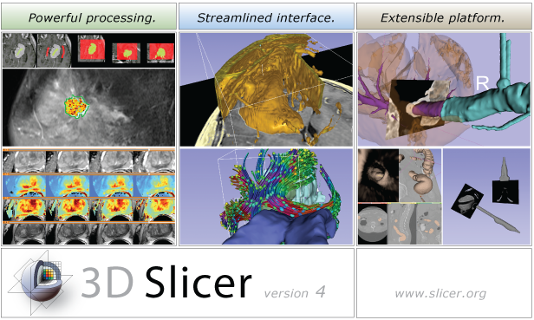
Slicer 16th year Anniversary
1997: Slicer started as a Master’s thesis between the Surgical Planning Lab (Harvard) and the Computer Science and Artificial Intelligence Laboratory (CSAIL) at MIT
2013: International open-source platform developed through a multi-institution effort
P.I. Prof. Ron Kikinis, BWH, Harvard
Image Courtesy of the CSAIL, MIT

Slide 7
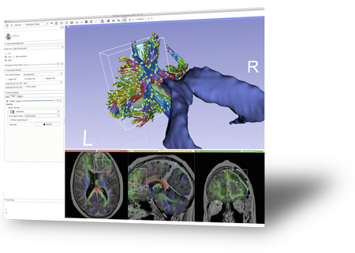
Slicer License
Slicer is distributed under a BSD-style license agreement with no restriction on use
Slicer is not FDA-approved nor CE-marked
3D Slicer bridges the
“valley of death” for
subject specific analysis

Slide 8
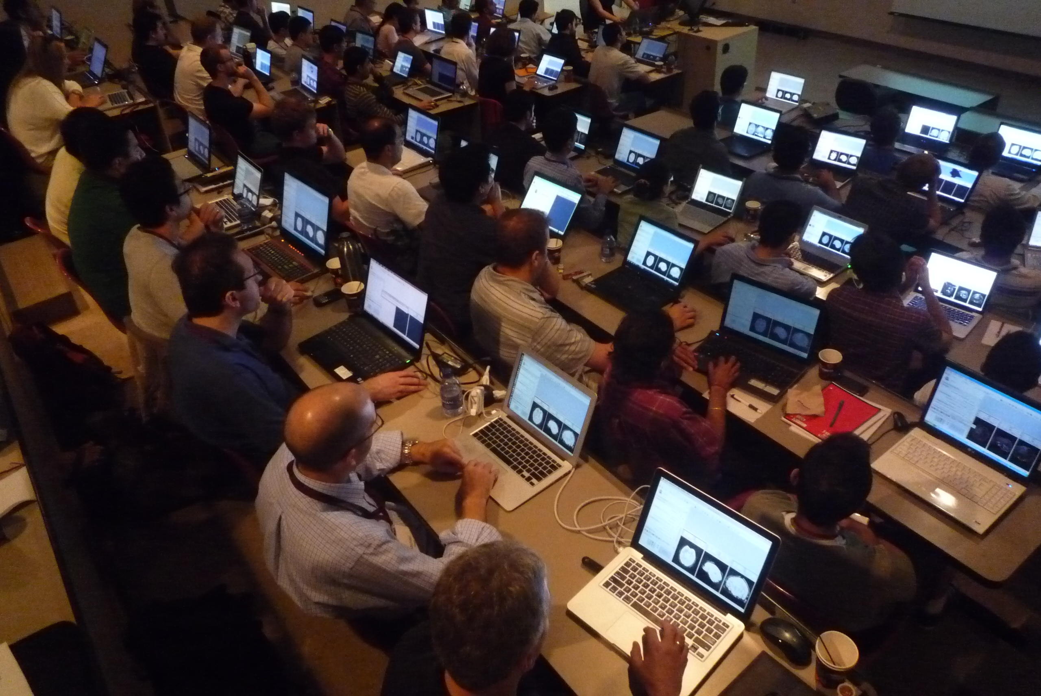
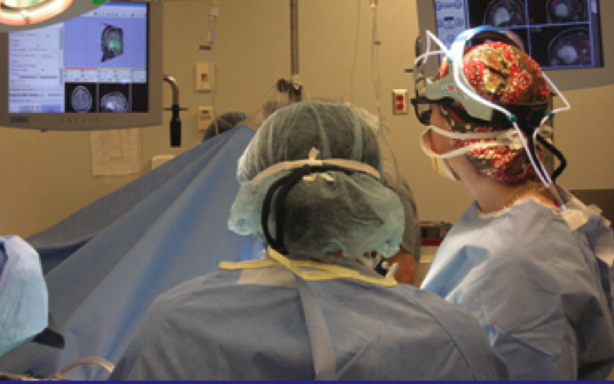
An interdisciplinary platform
An open-source environment for software developers
An end-user application for clinical investigators and scientists
A software platform that is both easy to use for clinical researchers and easy to extend for programmers

Slide 9
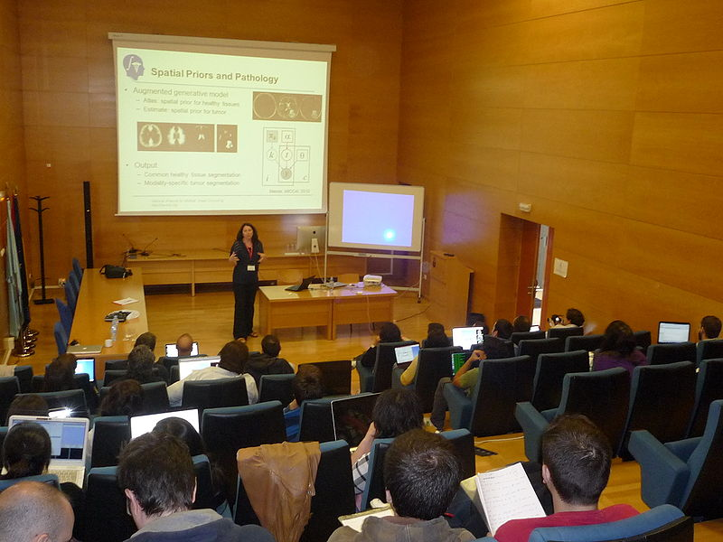
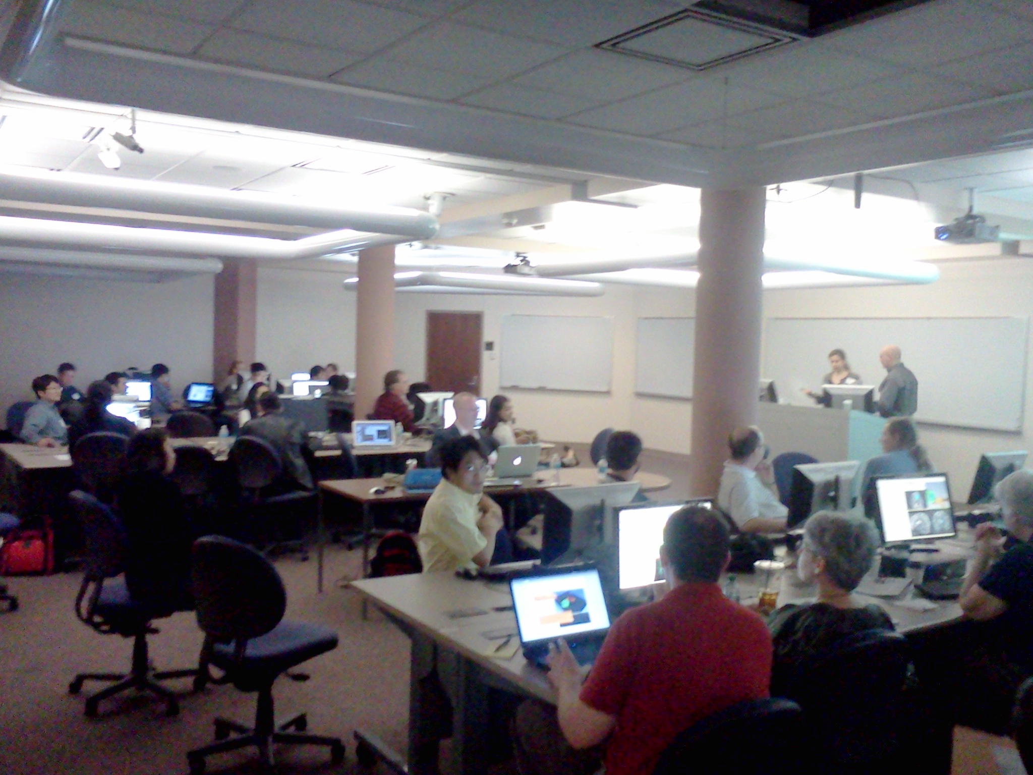

Slicer Is Open
Madrid 2012
Open Science
=
Open Source
+
Open Data
+
Open Community
Iowa City, USA 2012
Courtesy R. Kikinis

Slide 10
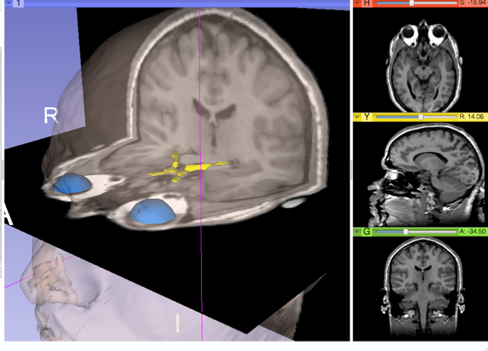
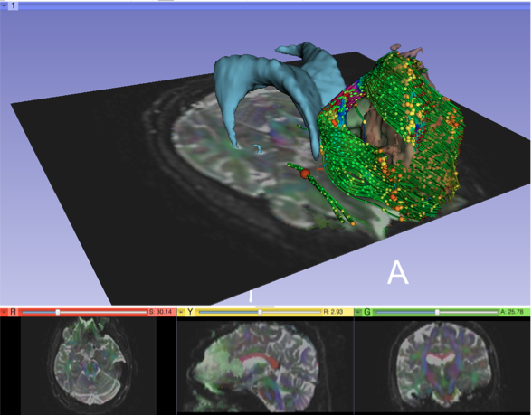
Slicer Open Community
80 authorized developers contributing to the source code
>700 subscribers on user and developer mailing list
> 55,000 downloads of Slicer4 since November 2011

Slide 11
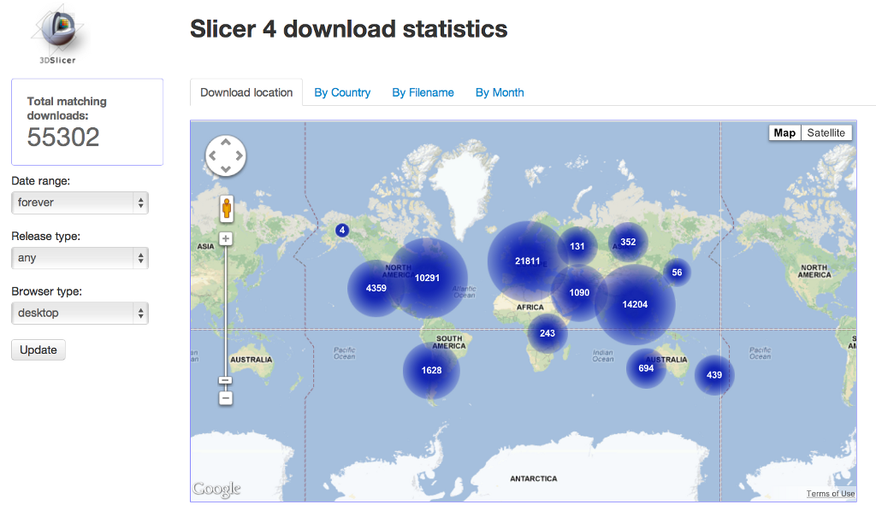
Nov.2011-March.2013 Download

Slide 12
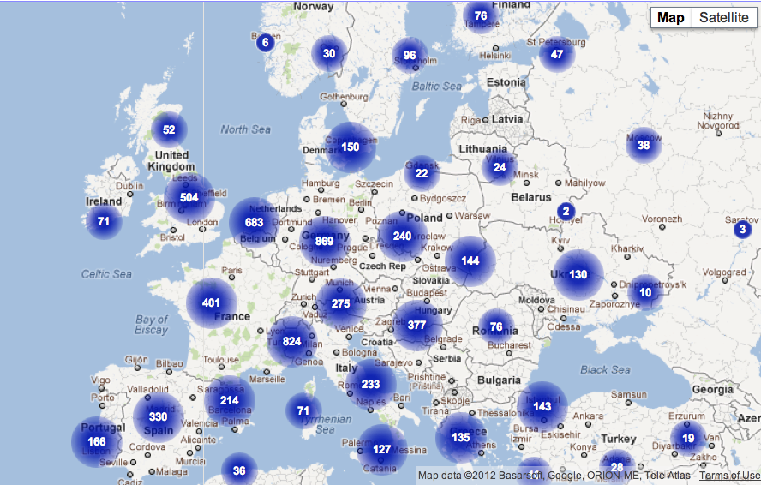
Slicer4 downloads in Europe

Slide 13
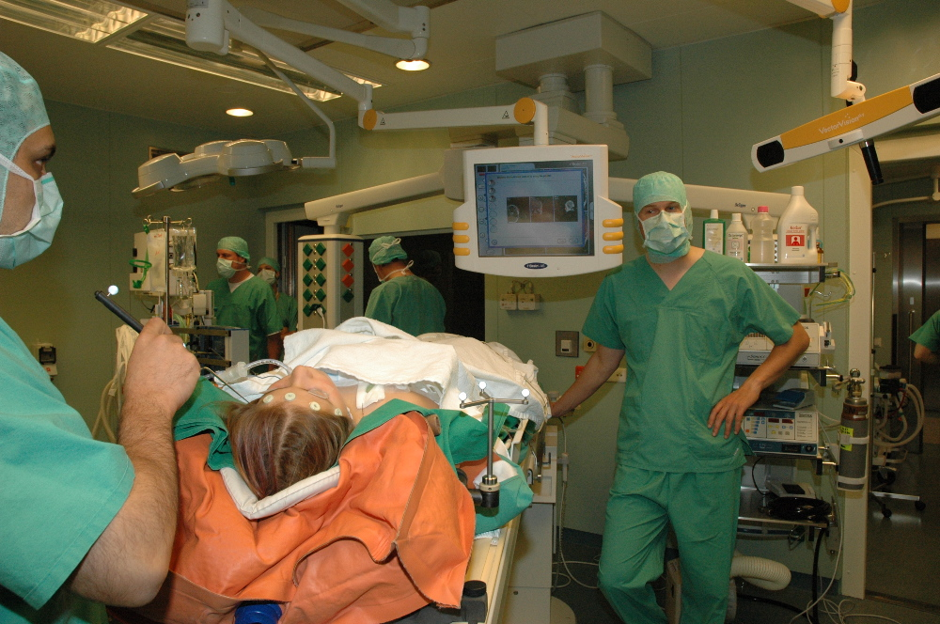
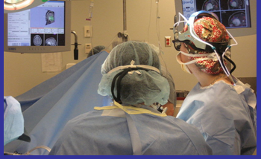
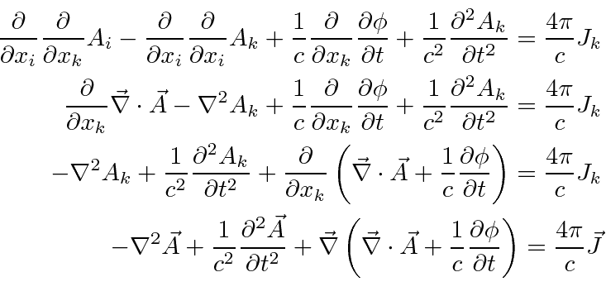
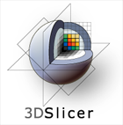
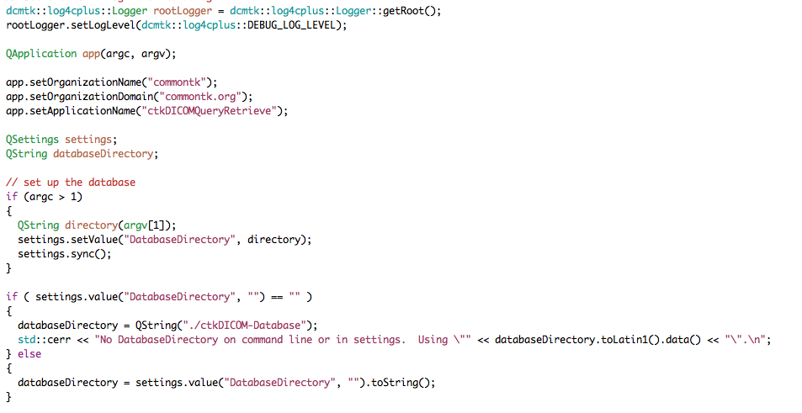
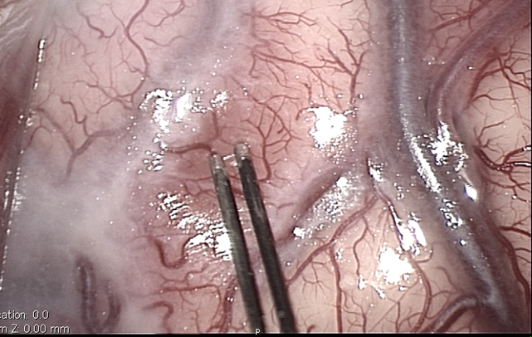
Bridging the gap to accelerate translational research
Image courtesy of Arya Nabavi, MD
Algorithm Development
Problem solving
Bridging the communication gap requires a collaborative environment that fosters exchange of specialized knowledge and expertise between clinical researchers and scientists.

Slide 14
Slicer is 16 year old
Every 4-5 year: Slicer versions: Major architectural, functional and GUI redesign
Every 6 month: Within each version, updated release
Every day!: Binary installation packages to access bleeding-edge functionality

Slide 15
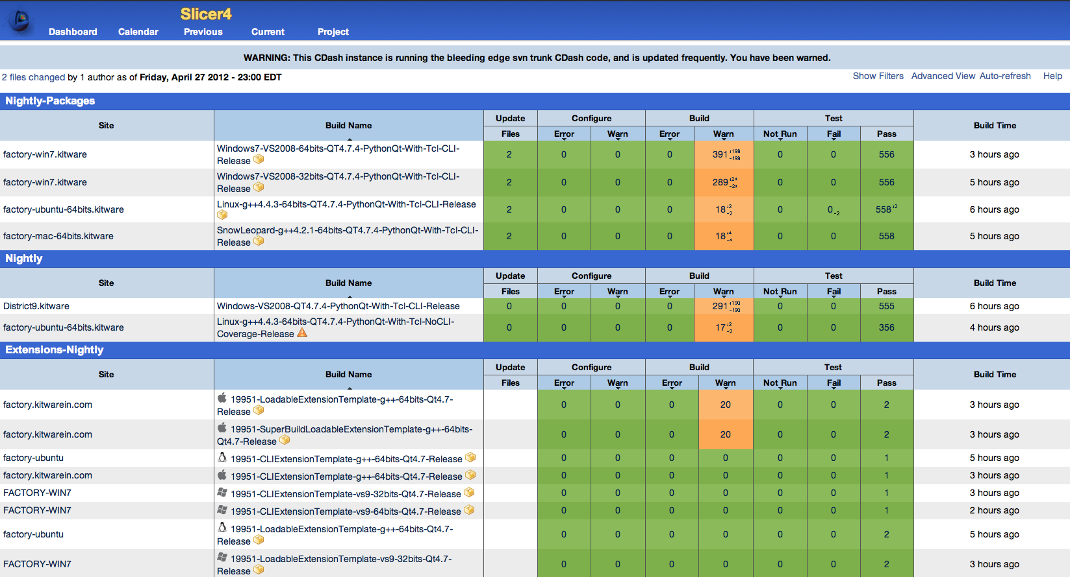
Slicer is built every night
Slicer is under active development: built every night on every platform

Slide 16
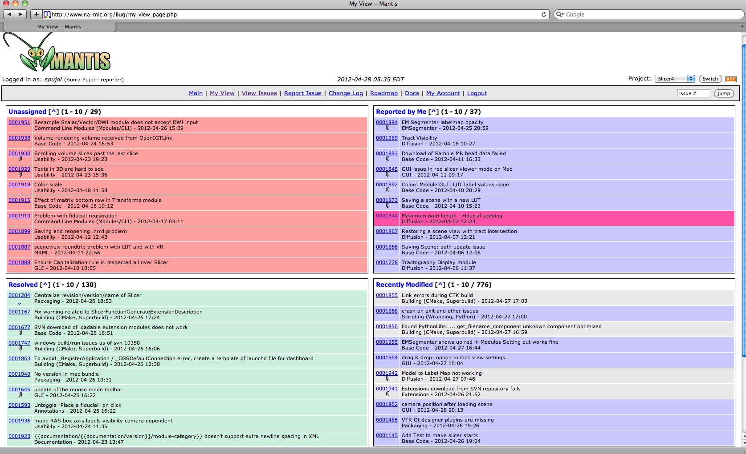
Slicer Bug Tracker

Slide 17
Interoperability with software package and libraries
Open-science and open-community philosophy
File Format compatibility
Complementary aspects of different open-source software on specialized functionalities

Slide 18
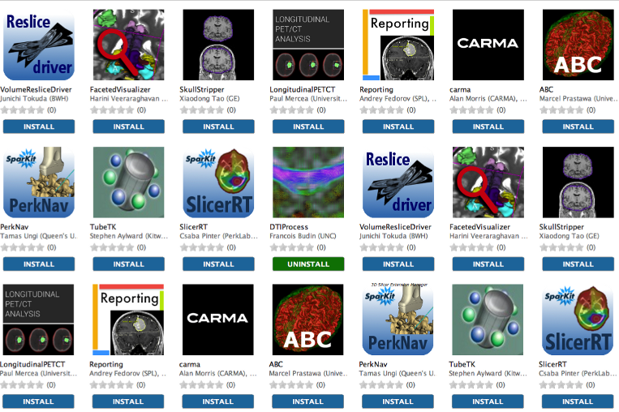
Slicer Extension Manager
Slicer is Extensible through plugins
Slicer Extension Catalog offers the possibility to the user to download additional Slicer modules

Slide 19
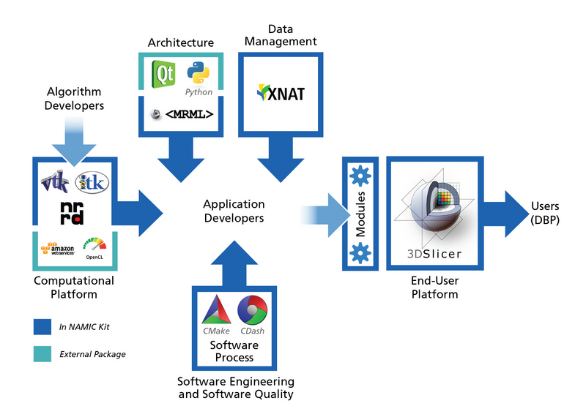
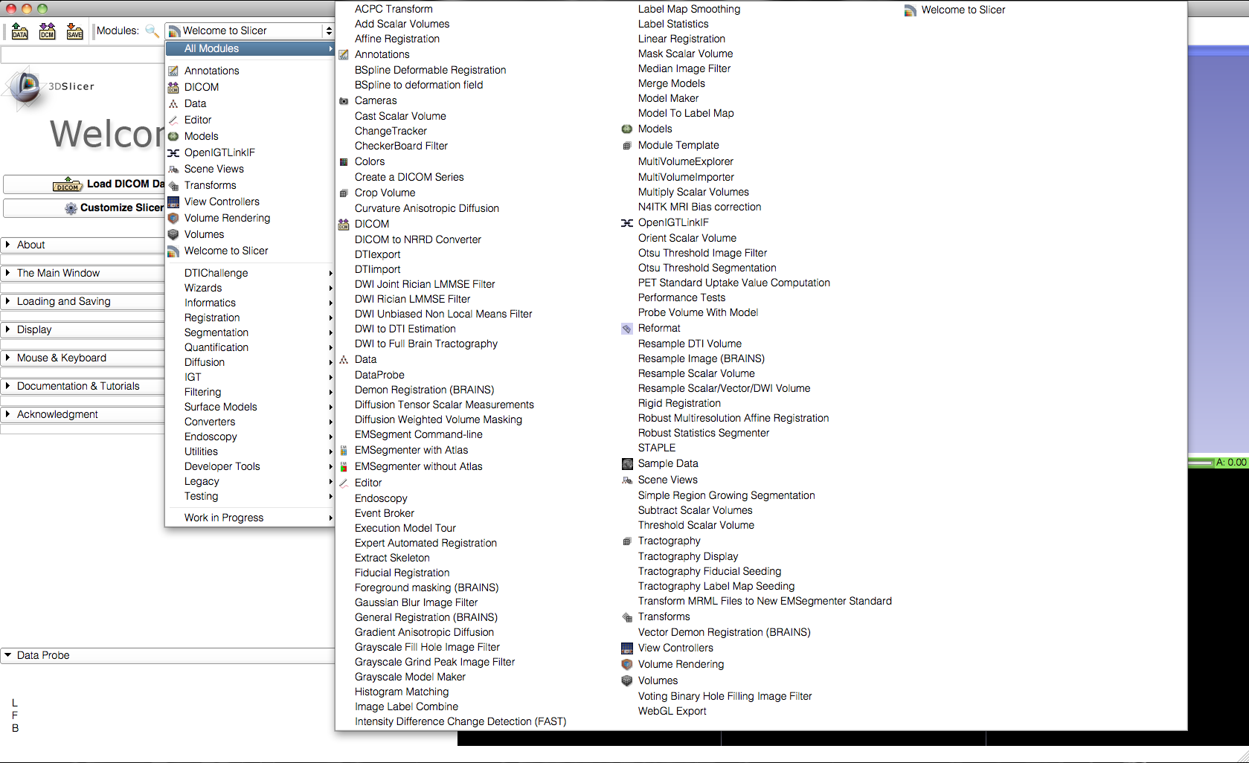
Core Functionalities
Slicer4 core functionalities include 108 modules, and represent 700,000 lines of code

Slide 20
Core Functionalities
Visualization
Segmentation
Registration
Reconstruction
Diffusion
Image Guided Therapy
Quantification
Reporting

Slide 21
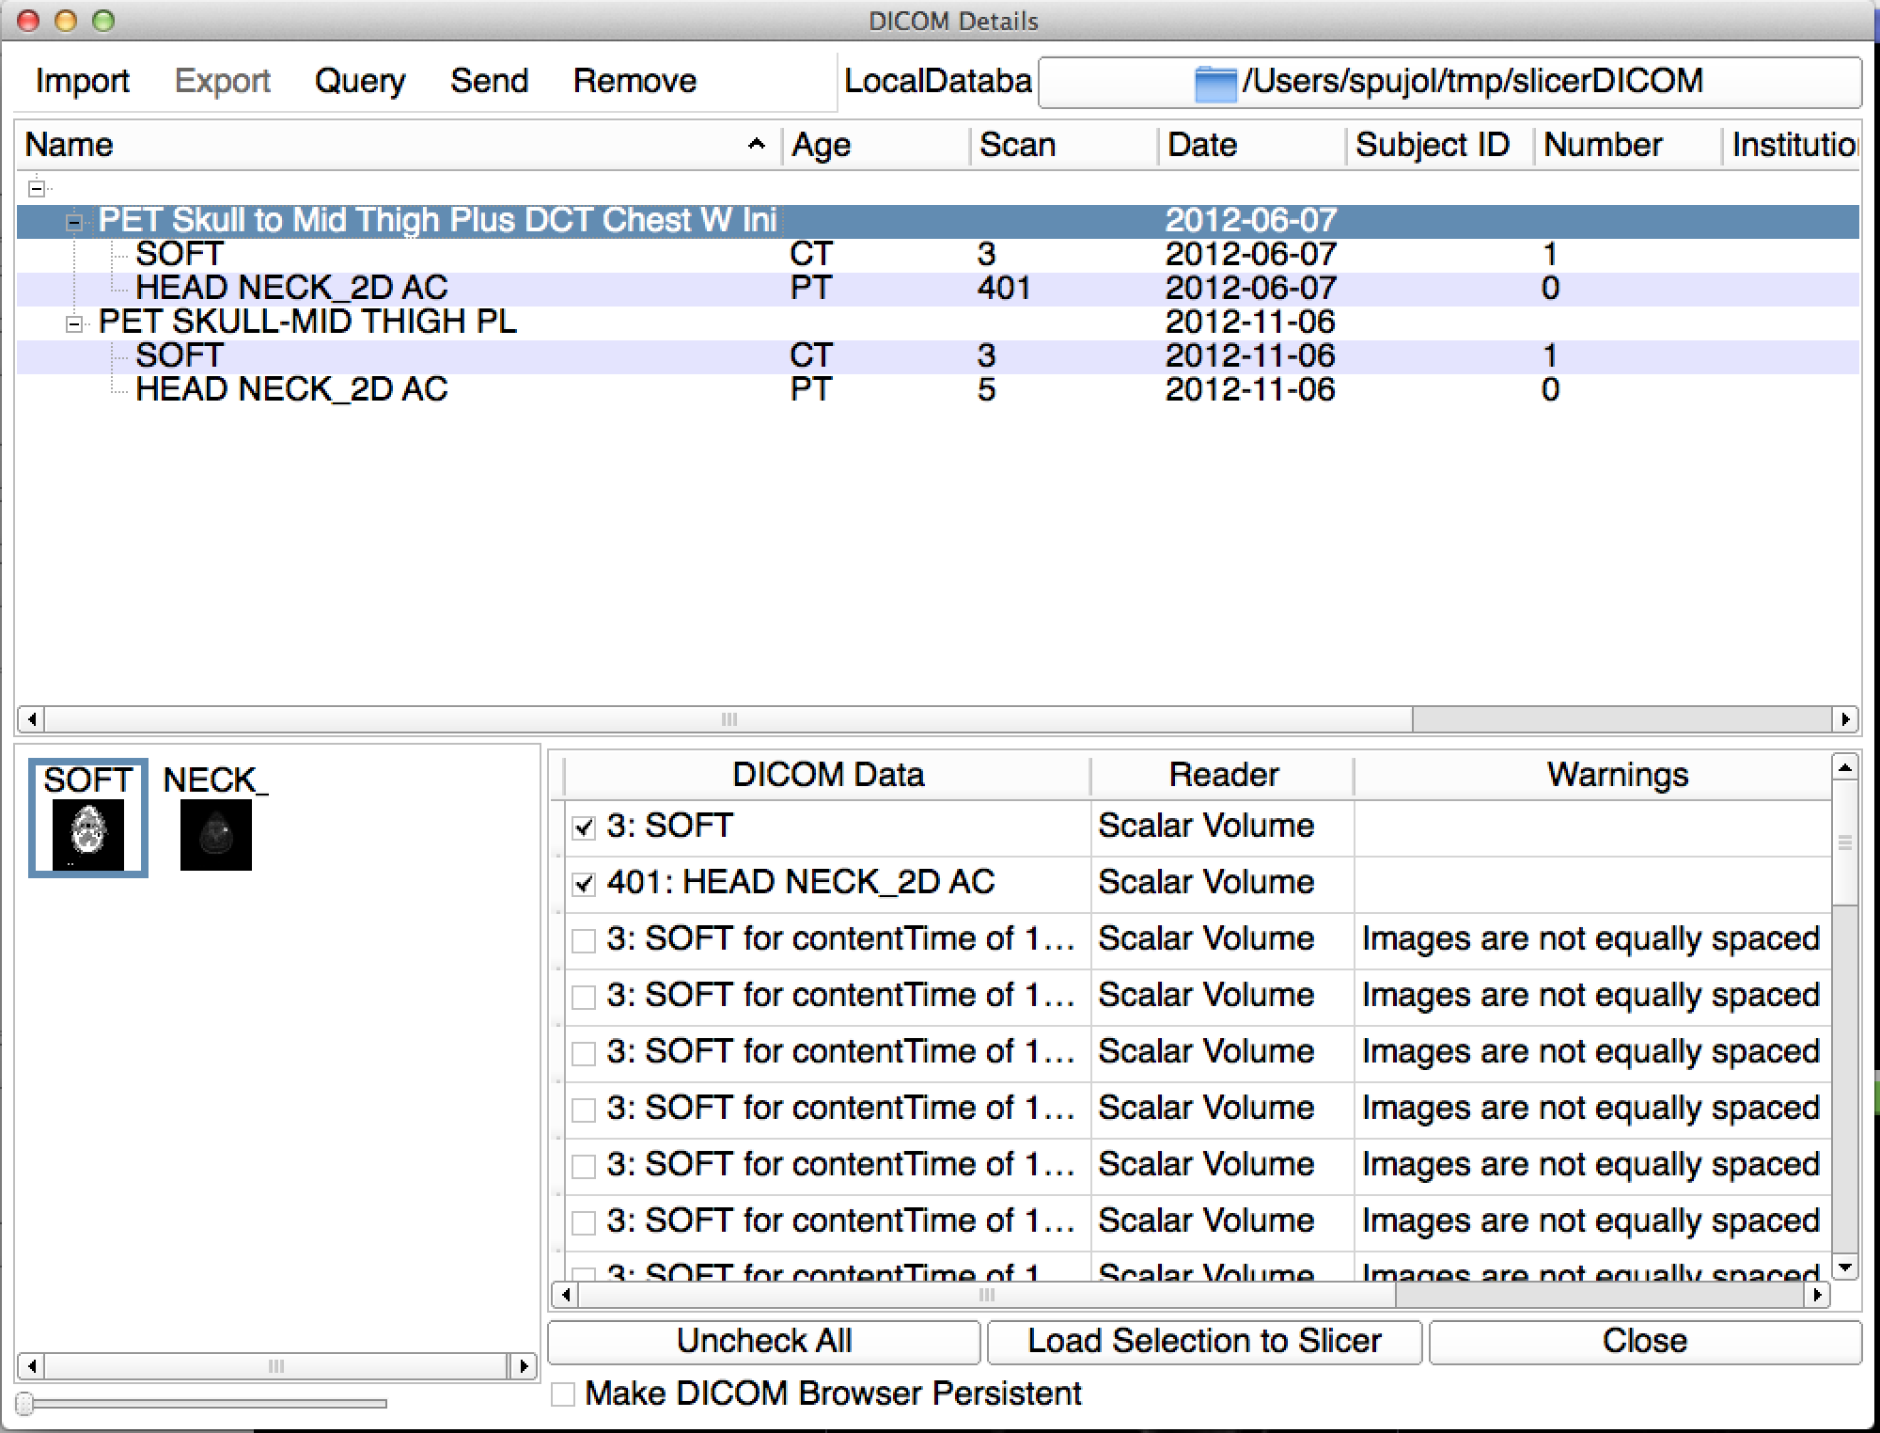
DICOM module

Slide 22
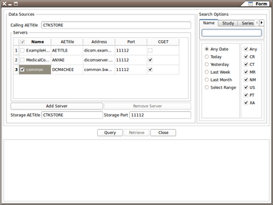
DICOM module
Interface Between DICOM and Slicer
  Core DICOM Parsing in DCMTK/CTK
  Data Pre-Cached in Database
  MRML Manipulation in Slicer Module Logic
Patient/Study/Series Browser
  Offers Slicer Interpretation of Selected Data
  Multiple Interpretations where DICOM Data is Ambiguous

Slide 23
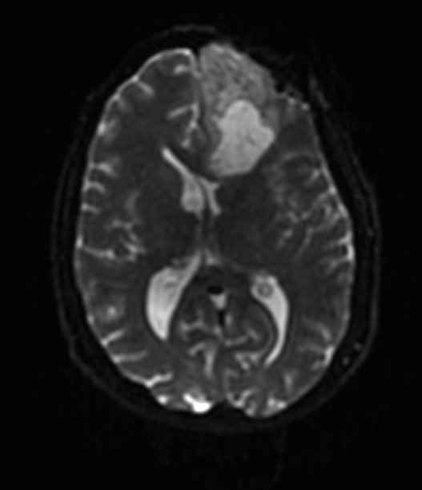
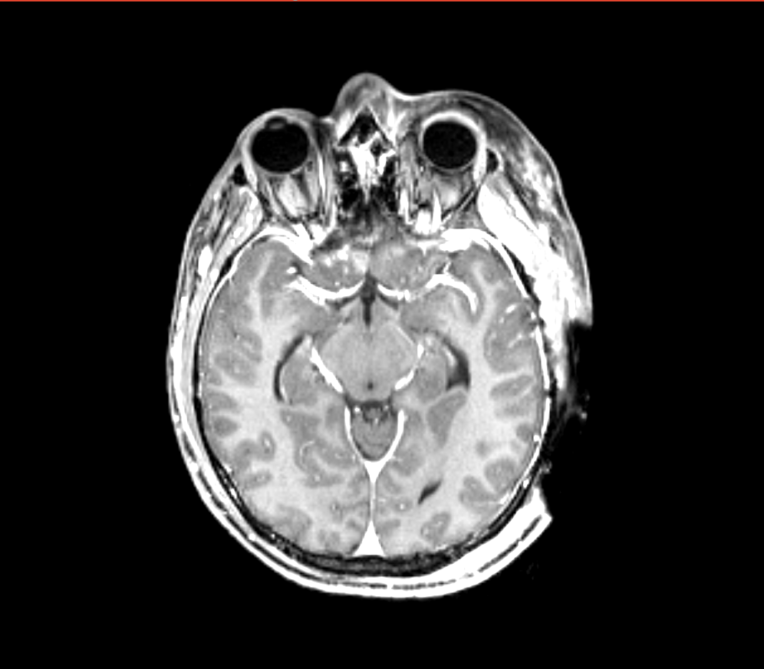
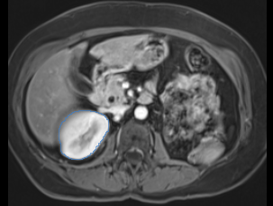
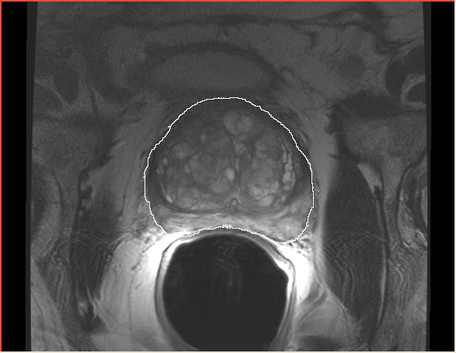
Slicer applications
Driving Biological Projects leading to the development of new tools
Applied science oriented toward subject specific analysis in the presence of pathology
Example: Image-guided therapy

Slide 24
Slicer use in clinical research environment
AMIGO, BWH, Boston, USA (DTI)
Slicer RT – Canada
(ECR 2013 IMAGINE Session, ‘SlicerRT – 3D Slicer based open-source toolkit for radiation therapy research’. Pinter et al)
Quantitative Image Network collaboration with German Cancer Research Institute (PET/CT)

Slide 25

AMIGO, Brigham and Women’s Hospital, Boston, MA

Slide 26
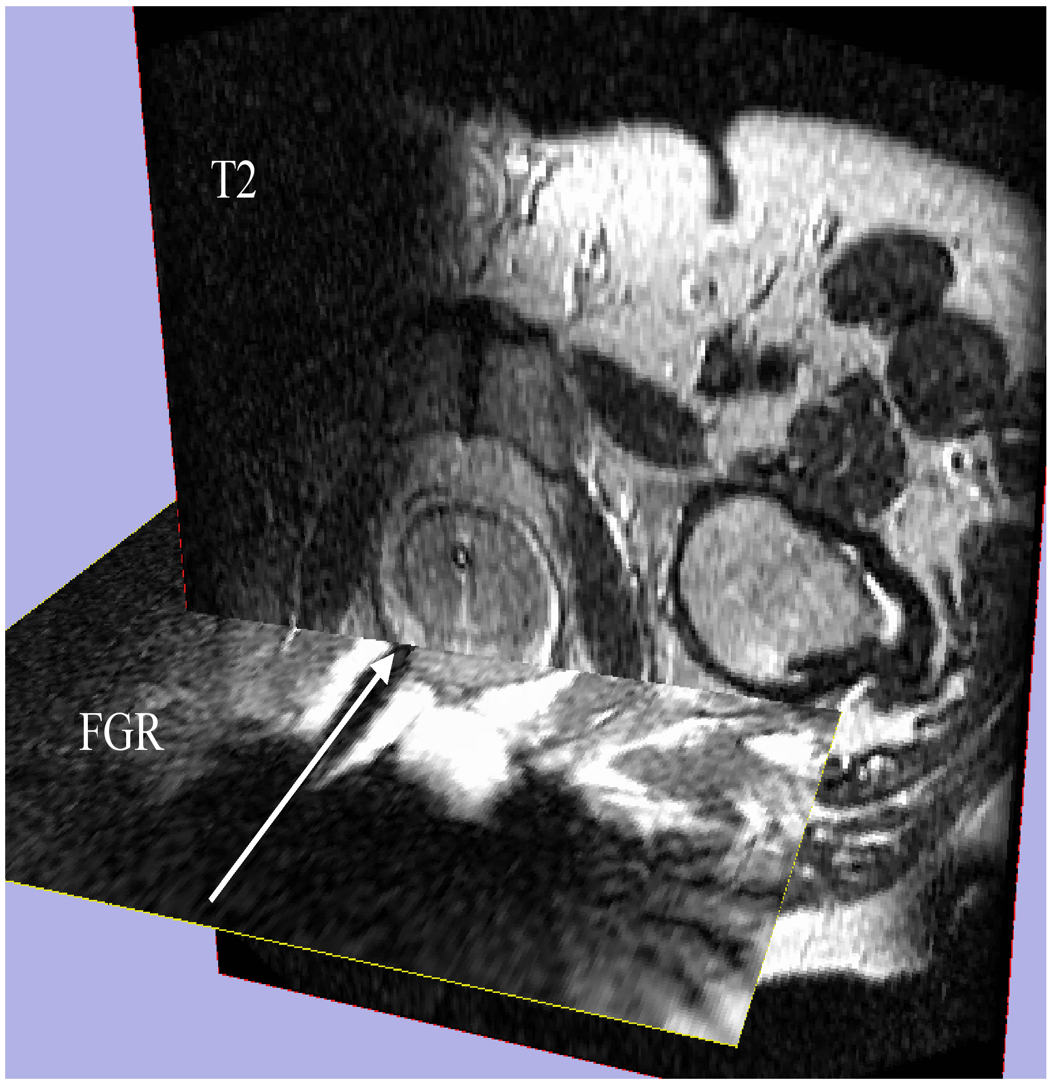
Image-Guided Therapy
Image-guided therapy
for prostate interventions:
Brachytherapy Planning
Navigation for Biopsy
Haker SJ, Mulkern RV, Roebuck JR, Barnes AS, Dimaio S, Hata N, Tempany CM.: Magnetic resonance-guided prostate interventions. Top Magn Reson Imaging. 2005 Oct;16(5):355-68.
Image Courtesy of Steven Haker, PhD and Clare Tempany, MD

Slide 27
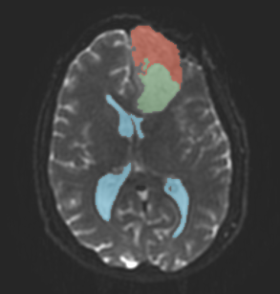
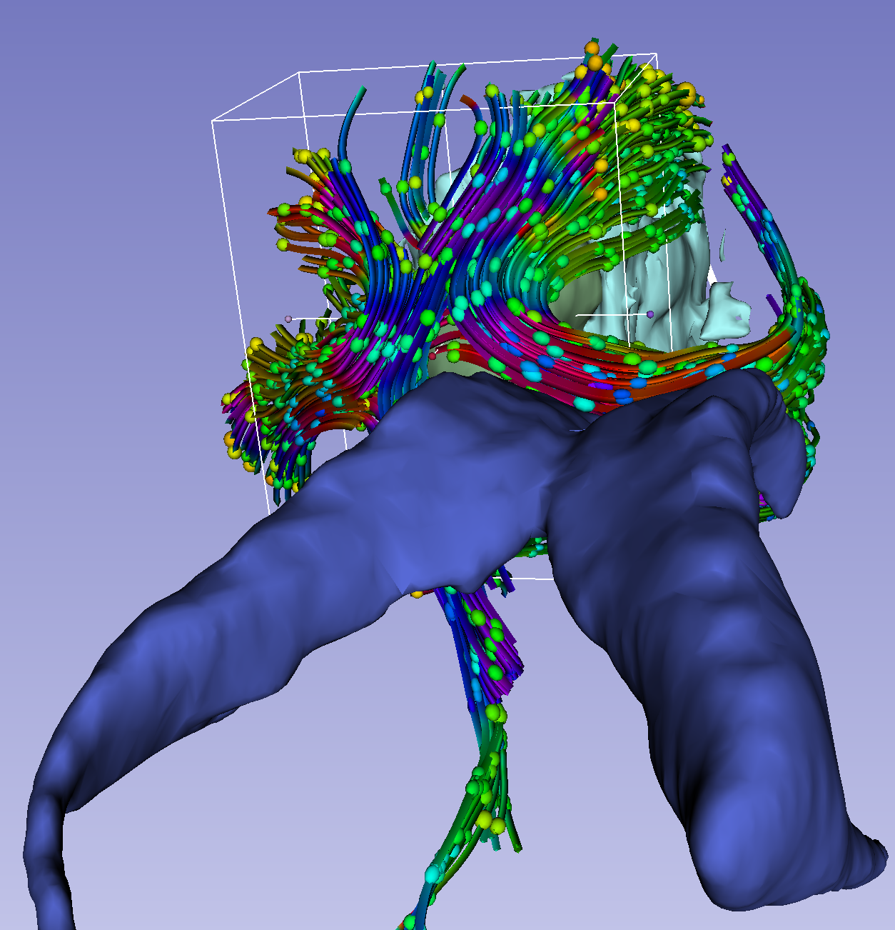
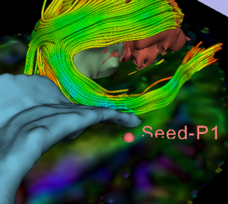
Neurosurgical planning
Slicer modules used for
DWI denoising
T1/T2/DTI Registration
Tumor Segmentation
Tractography with Labelmap Seeding
Tractography with Fiducial Seeding
Image courtesy R.Kikinis

Slide 28
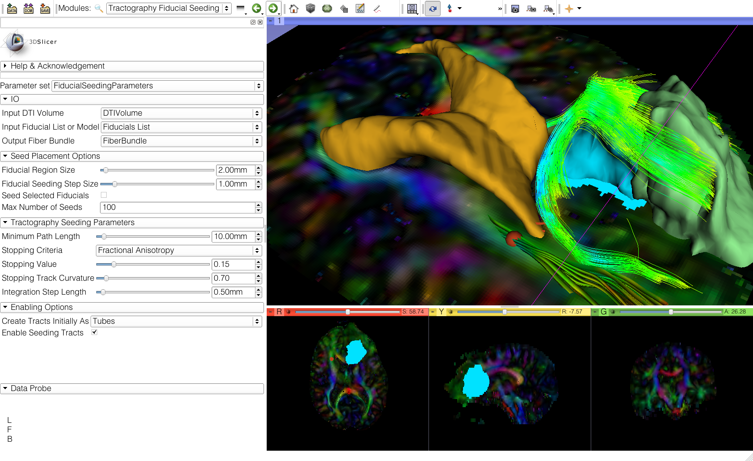
Fiducial Seeding
Example of on-the-fly exploration of white matter structures in the contralateral side of the tumor

Slide 29
Bridging the gap to accelerate translational research
GAP
Image courtesy of Arya Nabavi, MD
Algorithm Development
Problem solving

Slide 30
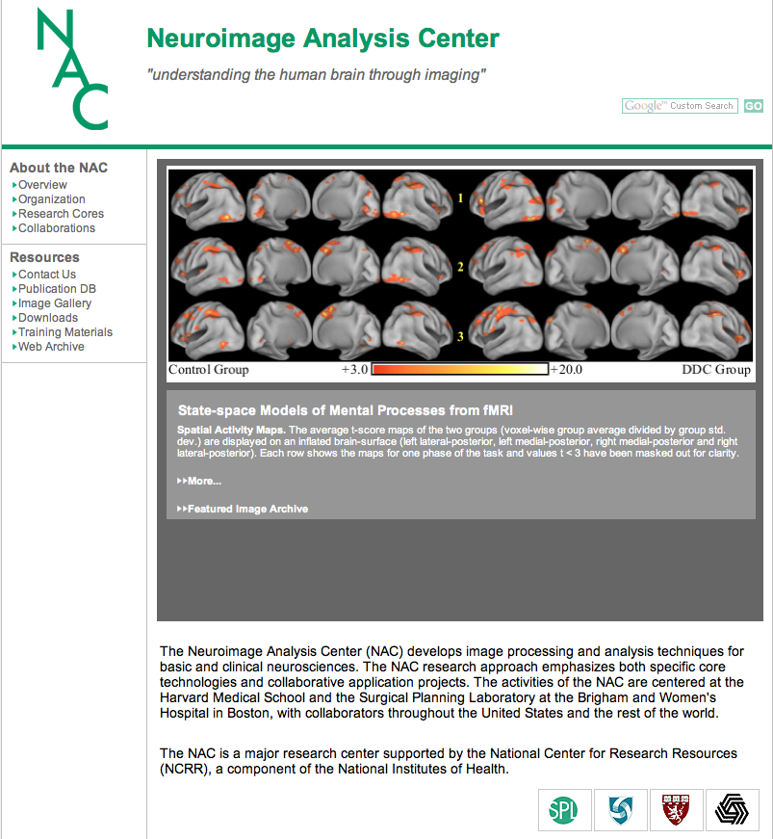
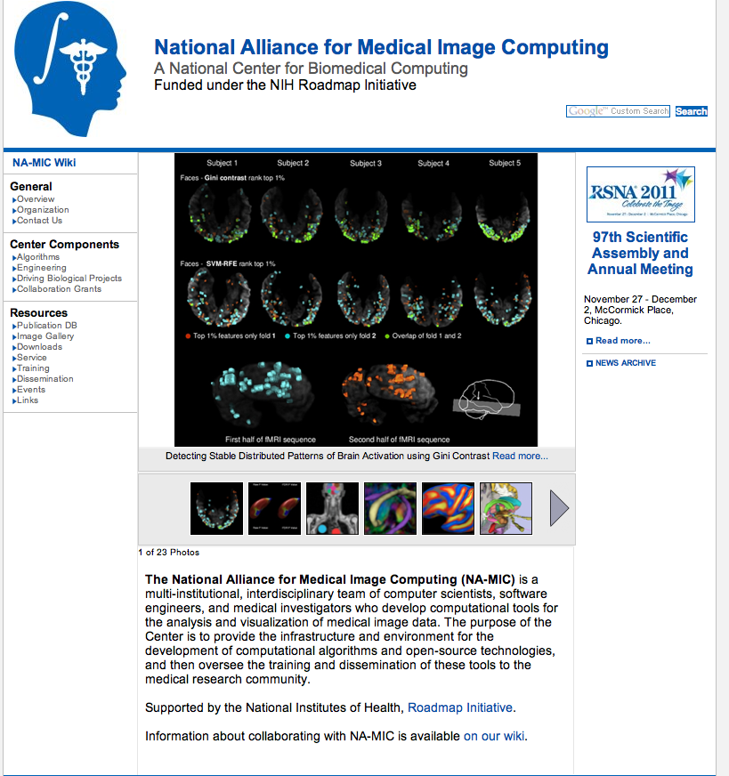
Slicer Training History: 2005-2013
Training Core Component of two major NIH-funded consortia: the National Alliance for Medical Image Computing (NA-MIC) and the Neuroimage Analysis Center (NAC) (P.I. Ron Kikinis)
Accelerating the translation of new technology into new skills of scientists and clinical investigators

Slide 31
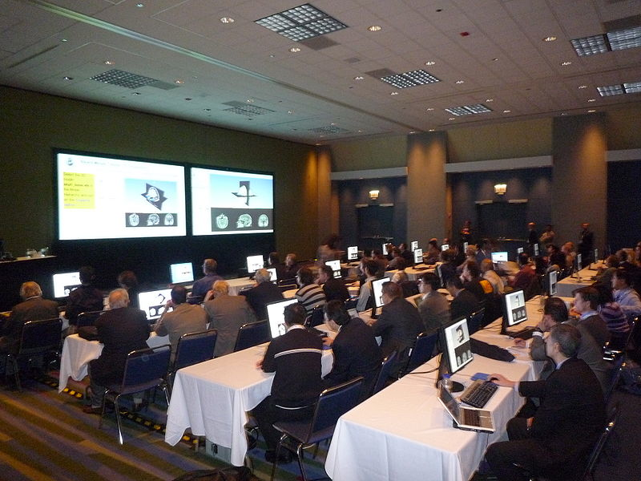
Slicer Training Workshops
1-2 day hands-on events
Thematic
  DTI
  Image-guided therapy
  3D Visualization for radiological applications
  PETCT SUV Computation
15-25 all-level participants

Slide 32
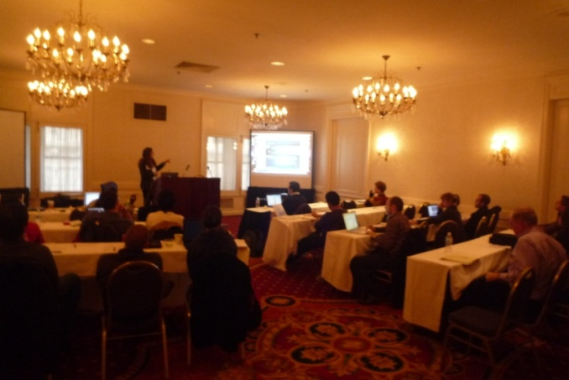
Slicer Training Events
Hands-on courses at major international conferences
  RSNA 2008, 2009, 2010, 2011, 2012, 2013
  MICCAI 2008, 2009, 2010, 2011, 2012, 2013
  SfN 2009, 2011
  SPIE 2012, 2013
  CAOS 2010
  CARS 2010, 2012, 2013
  etc…
SfN, 2009
RSNA, 2009
RSNA, 2010

Slide 33

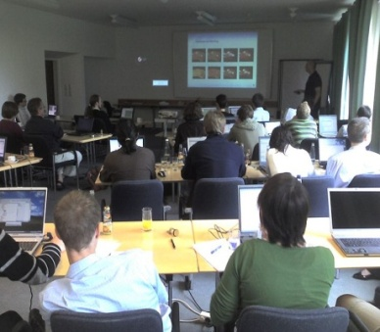
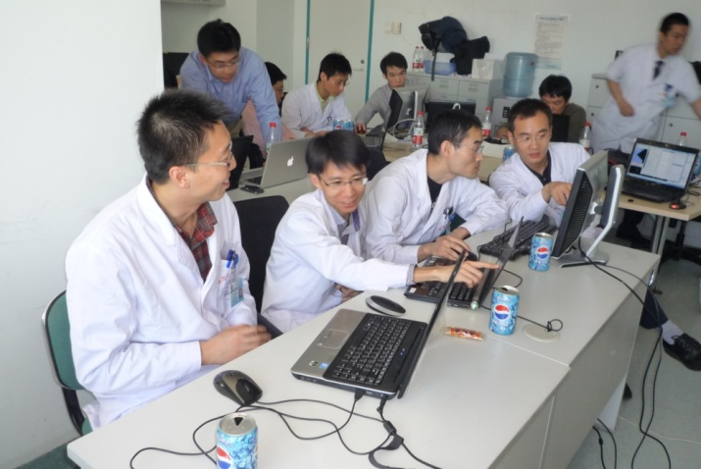
Slicer Training Events
Invited workshops at international venues:
  PLA General Hospital, Beijing, China,
  Tokyo Women’s Medical University, Japan
  IHK Akademie Westerham, Munich, Germany
  Rey Juan Carlos Universidad, Spain
Tokyo, 2010
Munich, 2008
Beijing, 2010
Hiroshima, 2011

Slide 34


Project Weeks
Bi-annual week of hands-on programming
Practical exchange of idea and experience
2010: 126 international attendees, 71 projects, 8 countries (Austria, England, France, Germany, Italy, Japan)
17 project weeks in the US since 2005

Slide 35
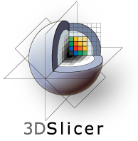
Conclusion
Slicer is an open-source research platform for the rapid development of biomedical image analysis tools.
Slicer community is open community with contributors from all over the world
Slicer is a versatile platform for translational research and subject specific analysis of biomedical image data

Slide 36
Acknowledgments
National Alliance for Medical Image Computing
NIH U54EB005149
Neuroimage Analysis Center
NIH P41RR013218

