Slide 1
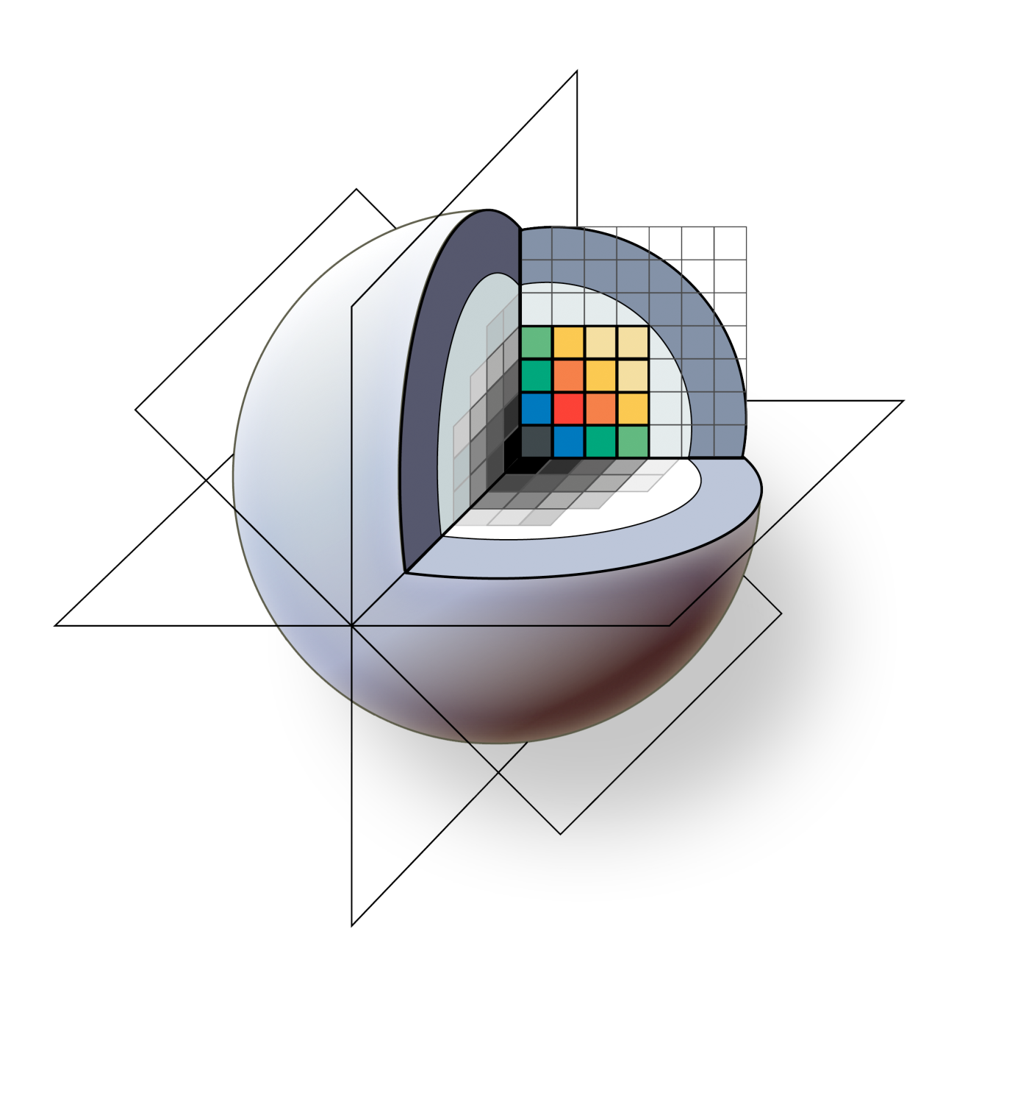

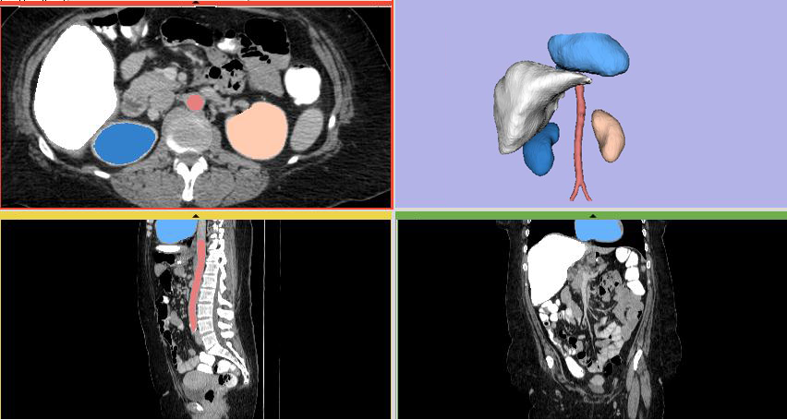
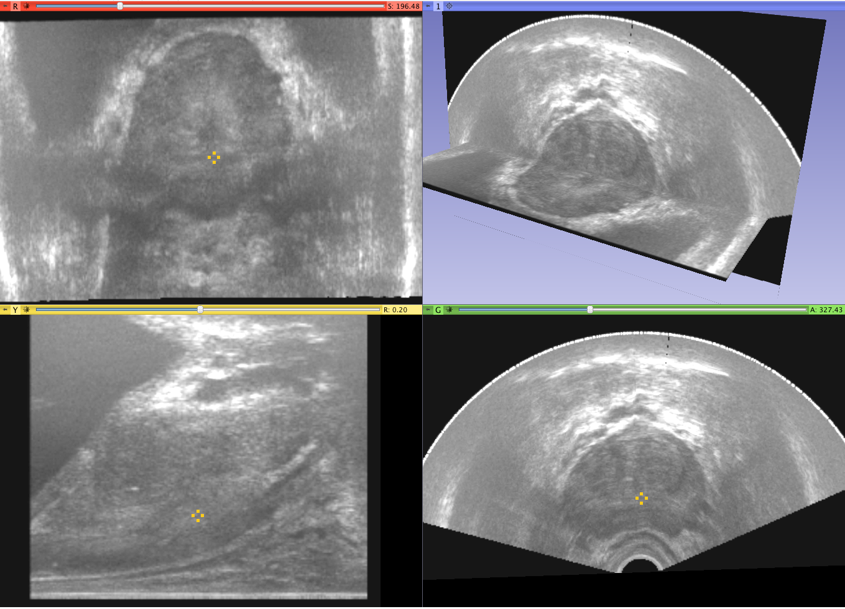
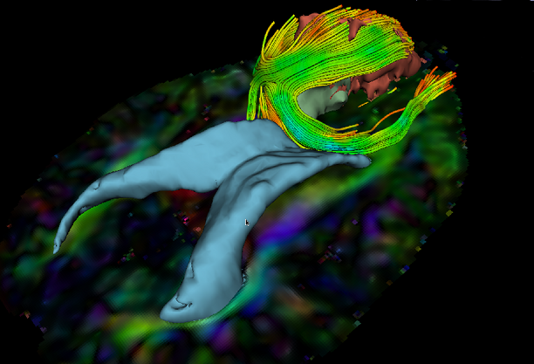
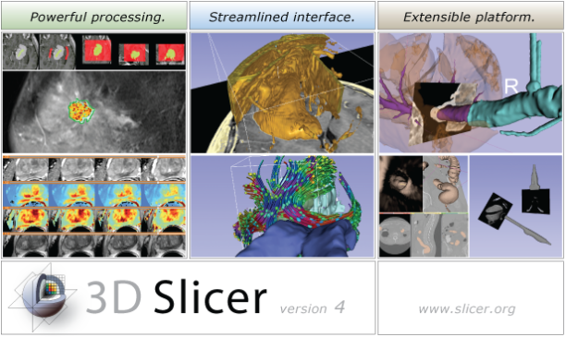
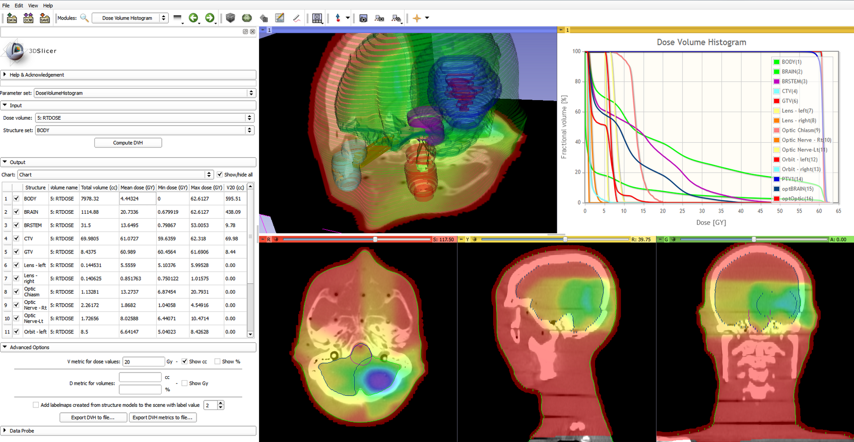



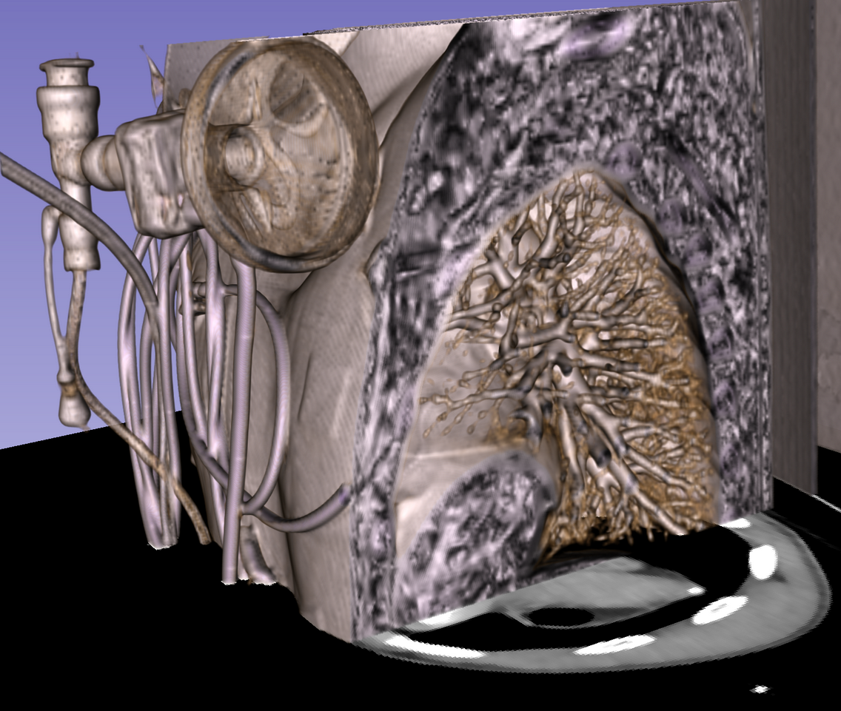


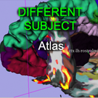
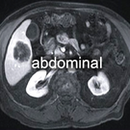
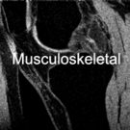
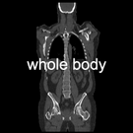
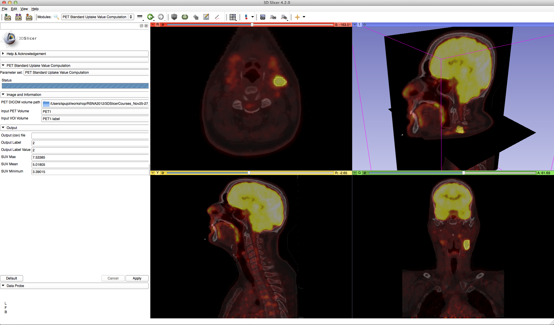
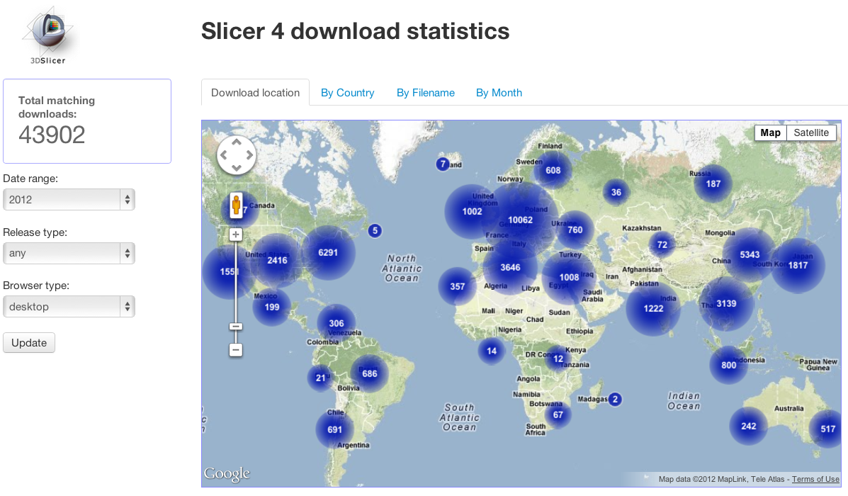
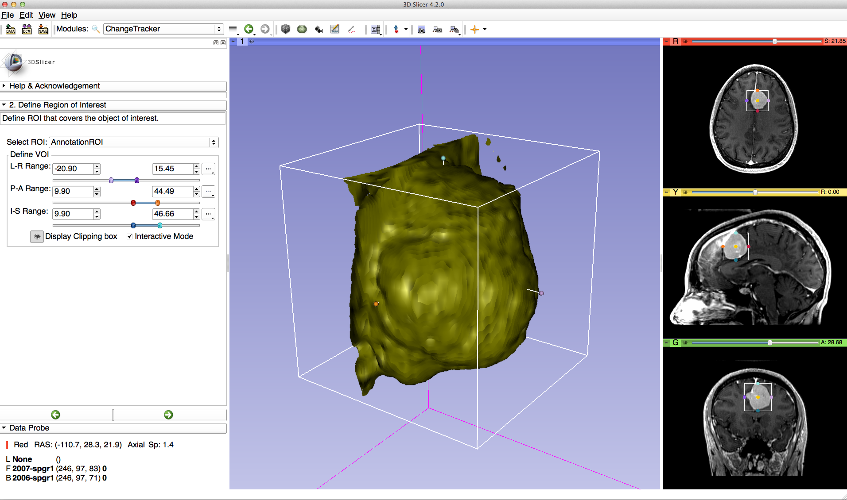
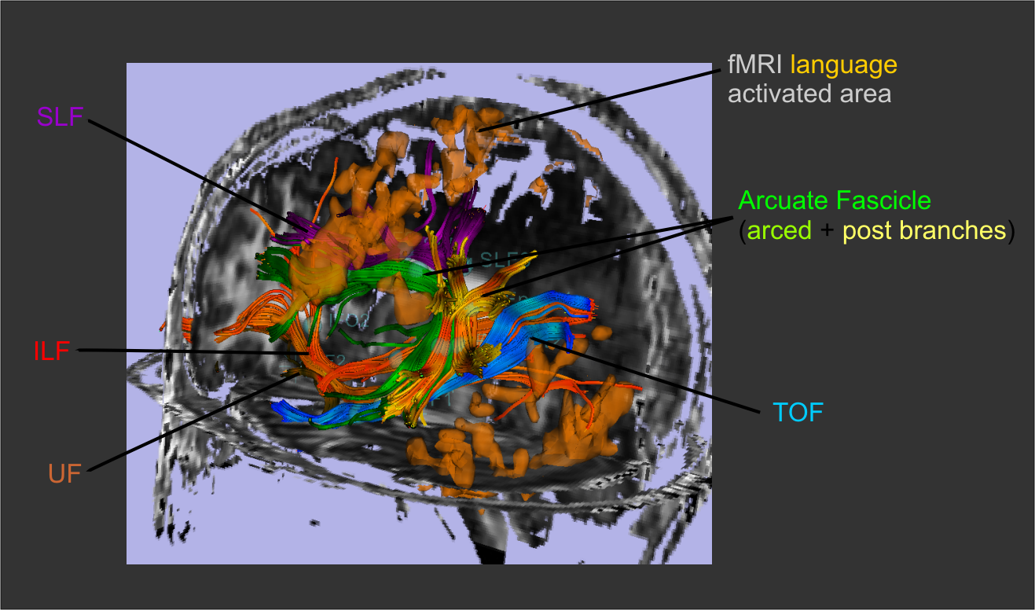
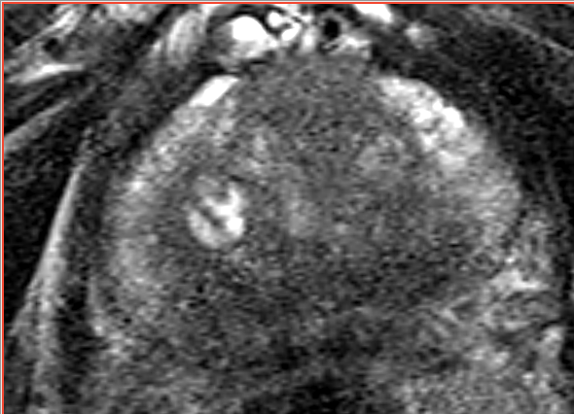
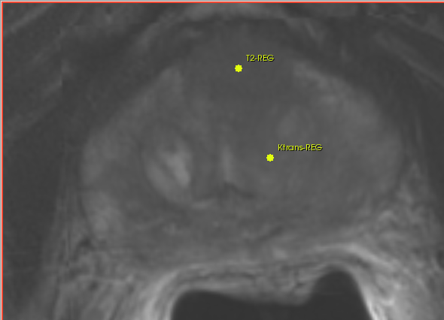
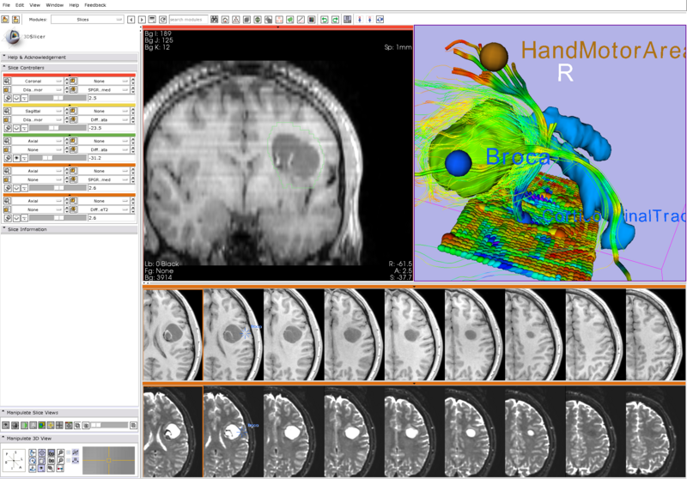
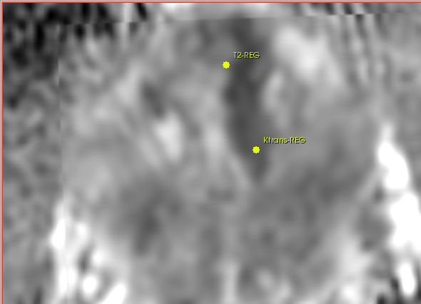
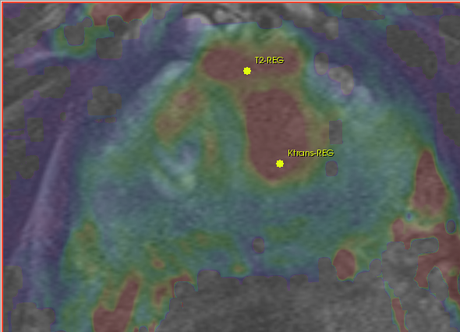
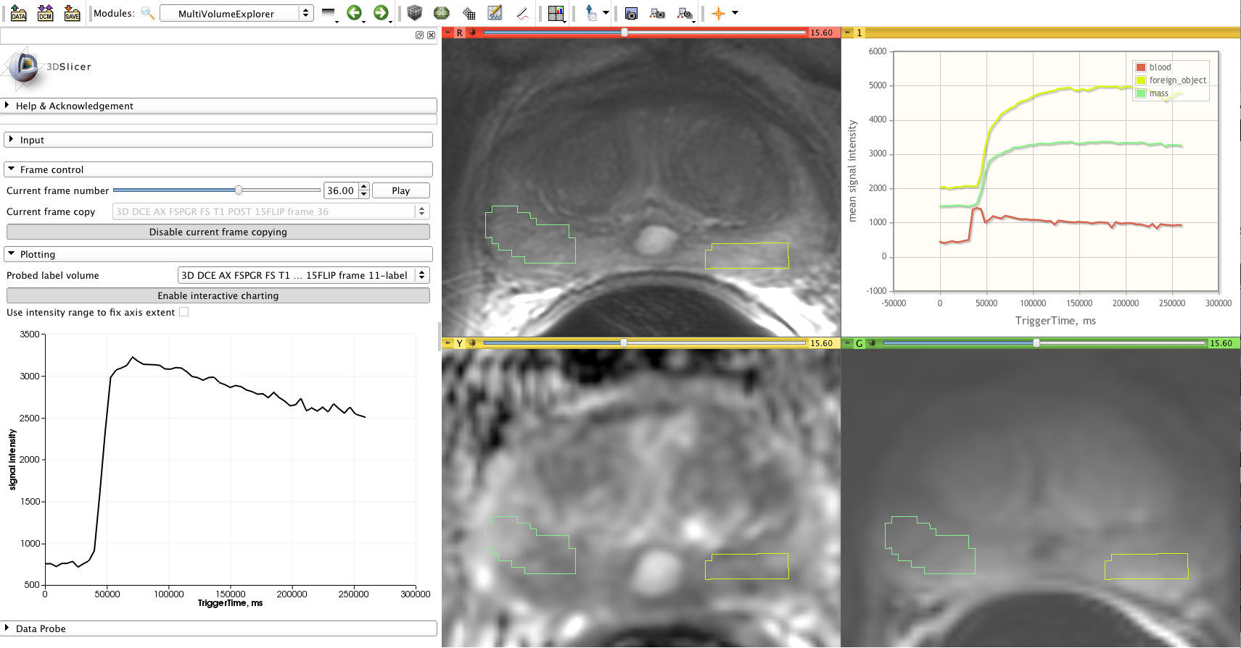
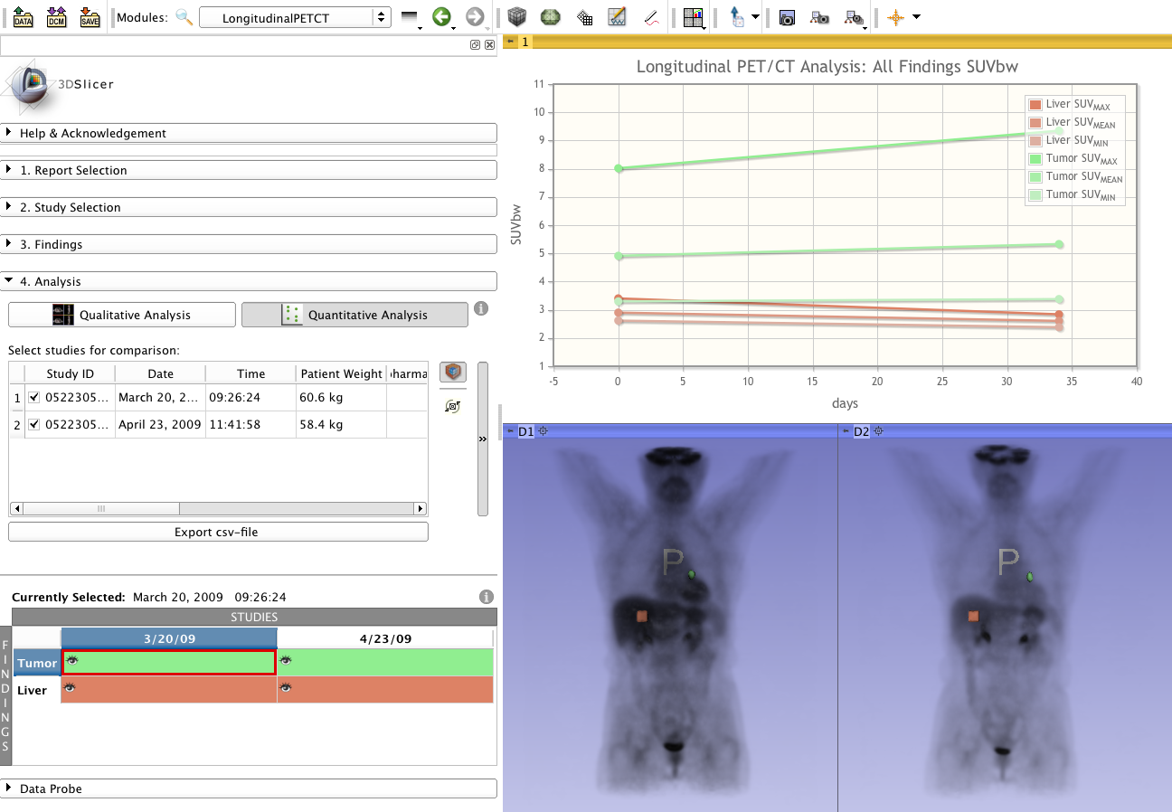
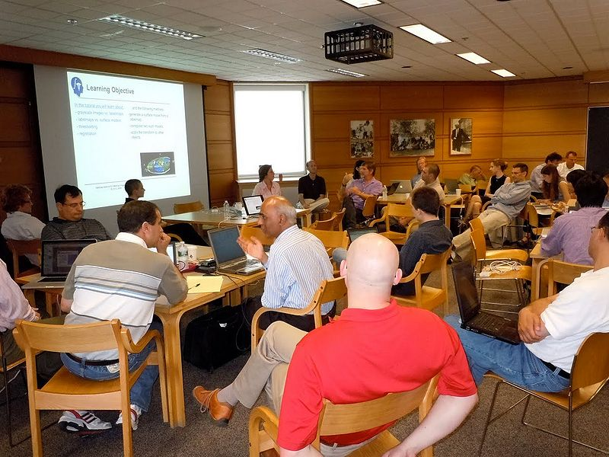
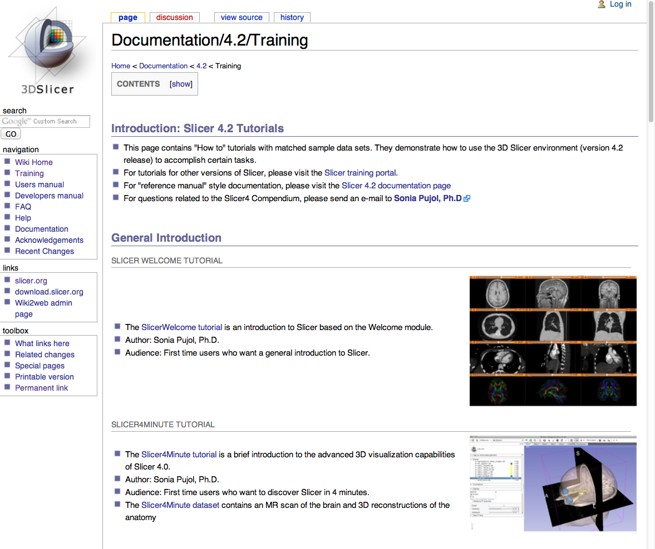
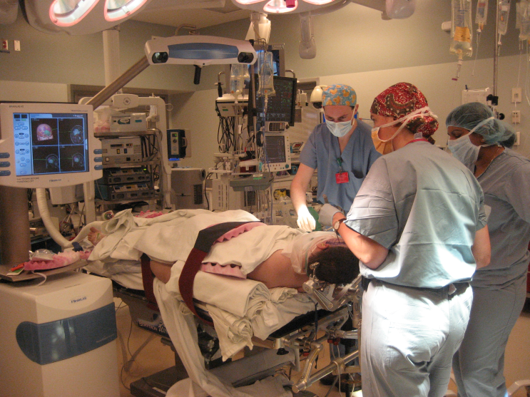
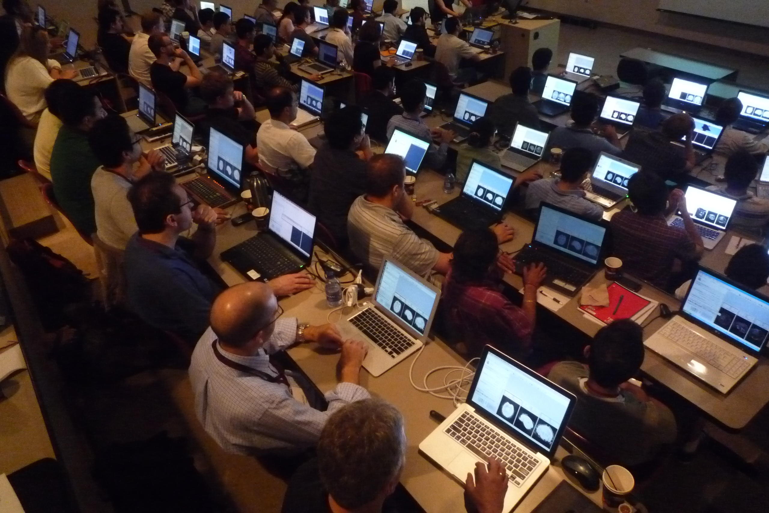
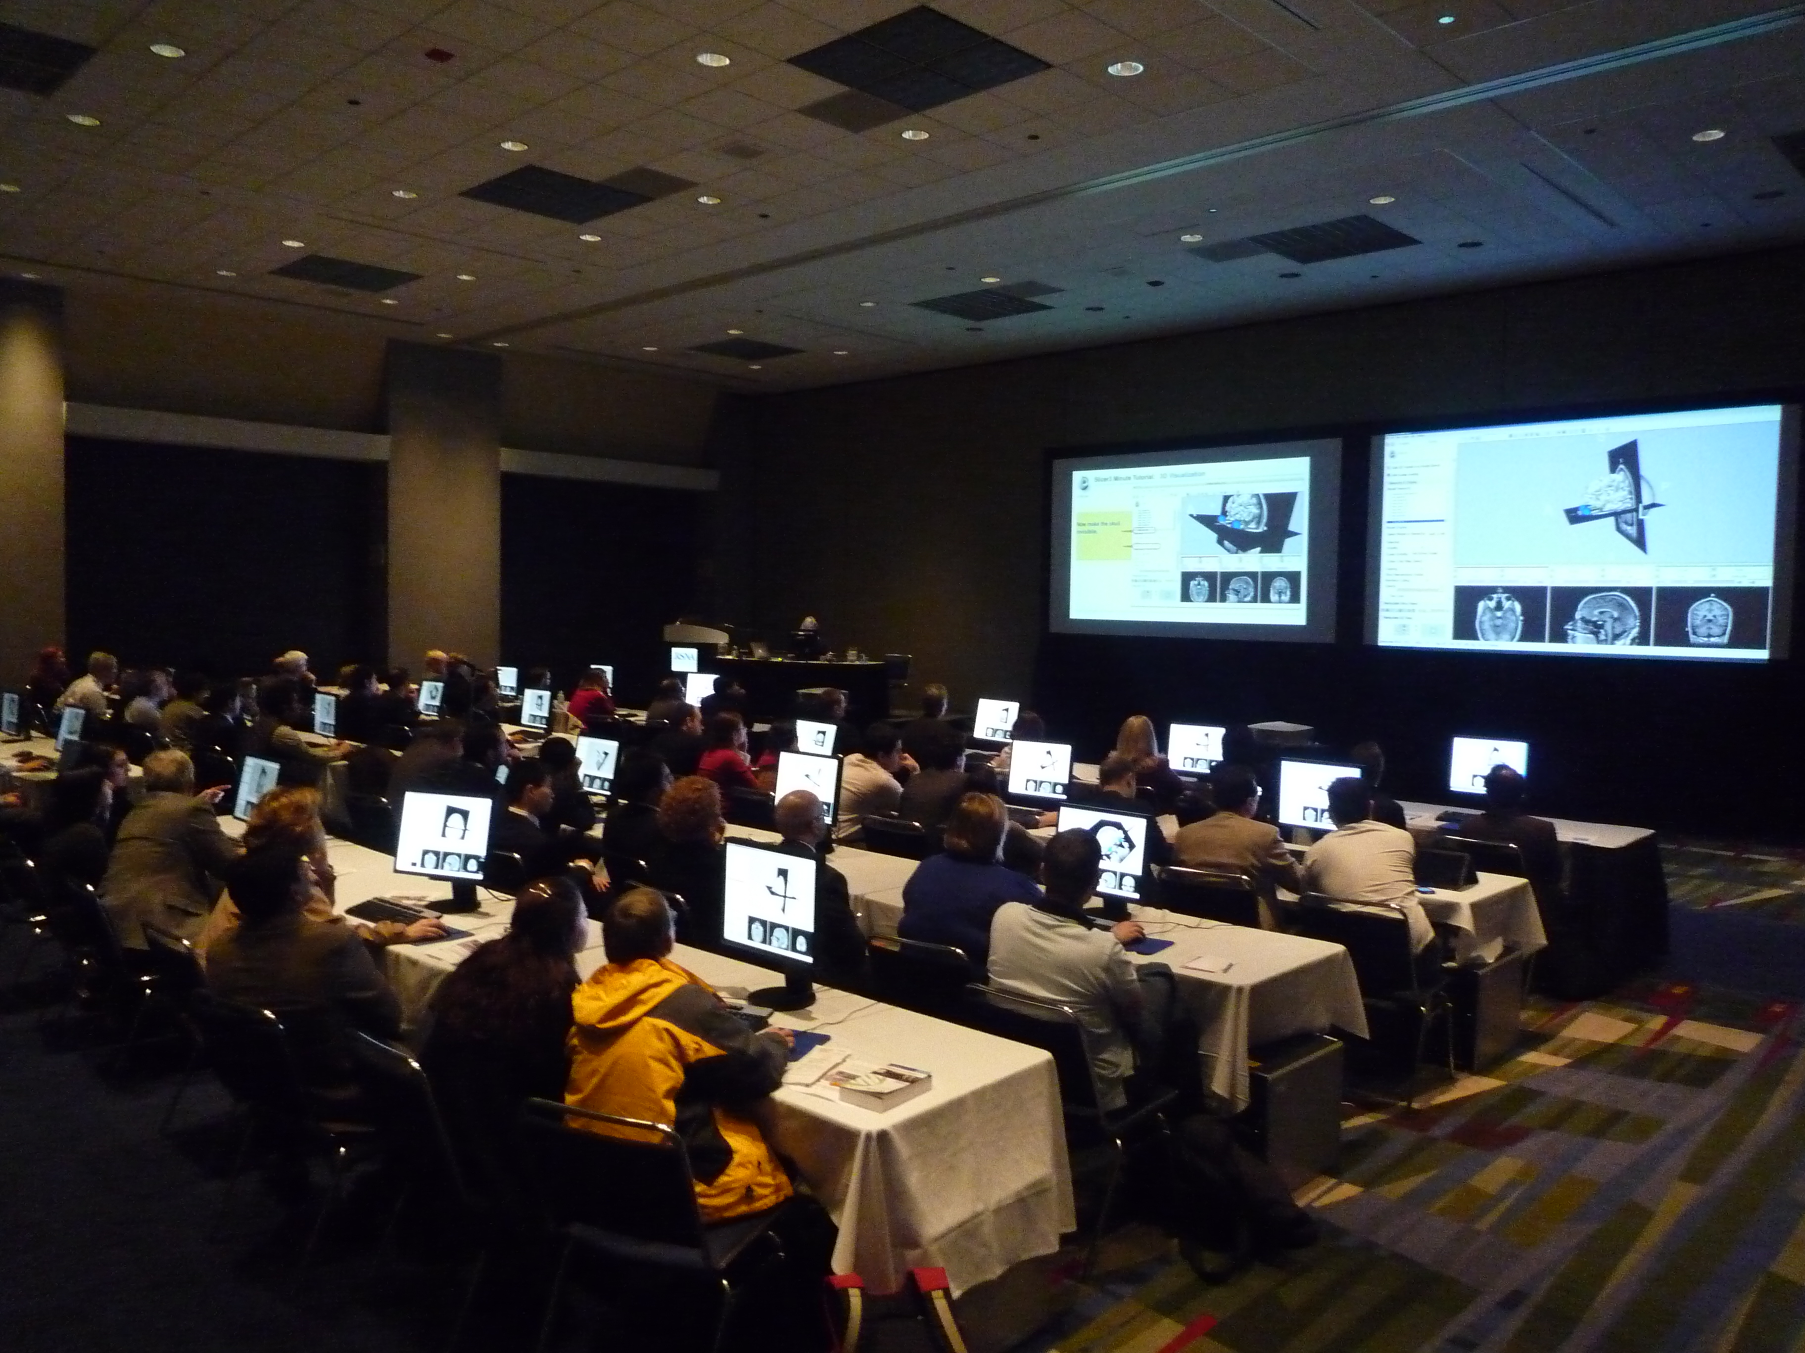








RSNA 2012 Quantitative Imaging Reading Room
3D Slicer: An Open Source Platform for Segmentation, Registration,
Quantitative Imaging, and 3D Visualization of Multi-Modal Image Data
Sonia Pujol, Ph.D., Steve Pieper, Ph.D., Andriy Fedorov, Ph.D., Ron Kikinis, M.D.
Surgical Planning Laboratory, Brigham and Women’s Hospital, Harvard Medical School, Boston MA
About 3D Slicer
Segmentation & Registration
Multi-modality Visualization
3D Slicer is a multi-platform, free and open source software package for visualization and medical image computing.
The software platform is community created for the purpose of subject specific medical image analysis and visualization. Slicer includes support for:
Segmentation is required for defining features of interest in imaging data for quantification and analysis.
A combined visualization of multiple imaging modalities and derived data can provide clinician scientists with an integrated understanding of anatomy and pathology.
3D Slicer has a variety of interactive and automated segmentation methods:
support for manual contouring and editing
region growing and level sets
graph cuts with gesture support
skull stripping and hierarchical brain segmentation for morphological studies
The desktop application provides interactive visualization of the results and an intuitive GUI.
Support of 2-, 3- and 4-D image data visualization (reformats, volume rendering)
modality-independent (MR, CT, PET, US and more)
DICOM data exchange interoperability
parameter maps and VOIs
surface models & glyphs
measurement tools & annotations
charts
Multi-modality imaging including, MRI, CT, US, nuclear medicine, and microscopy
Multi organ from head to toe
Bidirectional interface for devices
Expandable and interfaced to multiple toolkits
Robust Statistics Segmenter module supports simultaneous segmentations of multiple structures in 3D.
Deterministic tractography result produced with the Tractography Label Map and Interactive Seeding.
Timeseries analysis and multi-subject analysis require registration of imaging data acquired at different times, on different scanners, and across modalities.
Visualization of 3D reconstructed transrectal ultrasound of the prostate. Reconstruction performed using Public Library for Ultrasound imaging (PLUS) (Perk lab)https://www.assembla.com/spaces/plus/wiki
Slicer was initiated as a masters thesis project between the Surgical Planning Laboratory at the Brigham and Women's Hospital and the MIT Artificial Intelligence Laboratory in 1998. Over the last decade, Slicer has been supported by an active community of academic and research partners, enabled by the funding from the National Institutes of Health. The software was downloaded over 43,000 times in 2012 alone, and has been referenced in hundreds of academic publications. The latest version of the software – 3D Slicer 4.2 – has been released in November 2012.
License: Slicer binaries and source code are available under a BSD-style, free open source licensing agreement under which there are no reciprocity requirements, no restrictions on use, and no guarantees of performance. Slicer leverages a variety of toolkits and software methodologies that have been labeled the NA-MIC kit. Please see http://wiki.na-mic.org/Wiki/index.php/NA-MIC-Kit for more information.
Slicer provides a variety of registration methods and resources to support versatile applications:
Deformation models: rigid, affine, non-rigid, fluid
Algorithm types: fiducial-, surface-, intensity-based
Image types: scalar, vector, tensor
Google “na-mic registration documentation” for the extensive collection of Slicer registration cases and recipes
Screenshot of the Dose Volume Histogram (DVH) module developed by SparKit project. The DVH module compute metrics (left) and DVH curves (top-right). Input dose, CT, and structure set data is displayed in the 3D viewer (top-center) and slice viewers (bottom-right). SparKit is a project funded by An Applied Cancer Research Unit of Cancer Care Ontario with funds provided by the Ministry of Health and Long-Term Care and the Ontario Consortium for Adaptive Interventions in Radiation Oncology (OCAIRO) to provide free, open-source toolset for radiotherapy and related image-guided interventions.
Some of the registration applications covered in the 3D Slicer extensive Registration Case Library.
Quantitative Analysis
Clinical Research Applications
Community, Learning & Support
A free and open source platform can improve access to standard methods of image quantification and facilitate development and validation of new imaging biomarkers.
3D Slicer has been used in clinical research, with IRB clinical protocols appropriately created and managed. In image-guided therapy (IGT) research, Slicer is frequently used to construct and visualize collections of MRI data that are available pre- and intra-operatively, and to display the tracked spatial position of surgical instruments.
To support user and developer communities and the effective translation of tools into the clinical research setting, the 3D Slicer Project provides many outreach materials and activities.
Hands-on Training Workshops
Tutorial Materials & datasets
Reference Style Documentation
Active user and developer mailing lists (>700 subscribers)
Project week events for Developers
Active user community (>30,000 downloads per year)
3D Slicer includes tools to quantify:
PET/CT studies (SUV body weight)
Tumor growth (experimental)
Tumor response to treatment (measurements for RECIST)
DCE-MRI (pharmacokinetics)
Image-Guided Neurosurgery
MRI-Guided Prostate Cancer Biopsy
A
B
ChangeTracker wizard implements a framework for quantification and visualization of small changes in hyper-intensive lesions in MRI.
3D Slicer has been used extensively for brain tumor resection planning and guidance during the surgery.
Integration of 3D Slicer with the surgical navigation BrainLab system allows to track surgical instruments in real-time, and transfer the position to 3D Slicer. This enables intra-operative context-dependent visualization of the critical structures in the proximity of the surgical tool.
This project is a joint collaboration between BWH, Yale University and BrainLab.
Targeted MRI guided prostate cancer biopsy attempts to improve the biopsy precision while reducing the number of tissue samples that need to be collected. This is achieved by first using diagnostic multi-parametric MRI to highlight the suspicious areas. The biopsy procedure takes place in the MR bore. Deformable registration is used to fuse the diagnostic image data to the intra-procedural configuration of the gland.
Since 2008, 3D Slicer has been used for MRI visualization and fusion, target planning, deformable registation, and needle trajectory planning (ProstateNav module) in over 55 MRI-guided biopsy cases at Brigham and Women’s Hospital (PI Dr. Clare Tempany).
Shown are intra-procedural T2 MRI, and pre-procedural T2, ADC and a pharmacokinetic map registered to intra-procedural image, with the biopsy targets selected.
C
D
Visualization of multi-parametric prostate MRI dataset that includes dynamic contrast-enhanced (DCE) DWI and T2-weighted MRI. Interactive plotting of the signal intensity over time is provided by Slicer MultiVolume support infrastructure.
Longitudinal PET/CT analysis extension (new in Slicer 4.2) integrates ROI segmentation, PET Standard Uptake Value (SUV) quantification and versatile visualization of multiple timepoints into a single processing workflow.

