Slide 1

NAMIC UNC Site Update
Site PI: Martin Styner
UNC Site NAMIC folks: C Vachet, G Roger, JB Berger, R Janardhana, Y Li, M Farzinfar, A Gupta, S Kim, B Paniagua, M Niethammer, ICsapo

Slide 2
NAMIC Activities at UNC
Image Analysis
  DTI Quality Control via orientation entropy
  DTI Registration with pathology
  Longitudinal atlases with intensity changes
  DWI atlas (two tensor tractography)
  Fiber tract analysis framework
Shape Analysis
  Interactive surface correspondence
  Longitudinal shape correspondence
  Normal consistency in surface correspondence
Validation
  Human-like DTI/DWI software phantom
  DTI tractography challenge MICCAI 2012
TBI
HD
Methods
Engineering

Slide 3
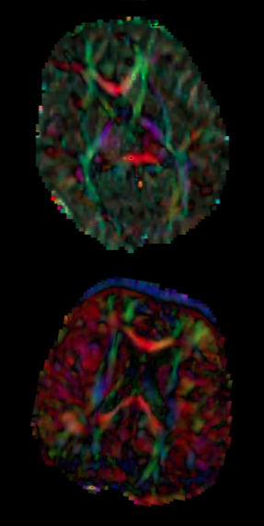
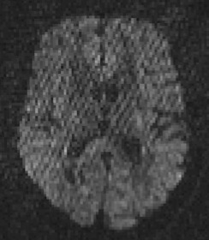
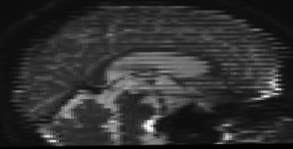
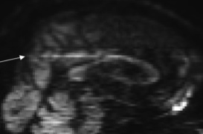
DTI QC I – DTIPrep
  Collab: Utah II, HD DBP
  DTI/DWI noise, artifact rich
  consistent QC needed
  Existing DWI based QC
    Eddy current & motion correction
  Residual artifacts:
    dominant direction artifact

Slide 4
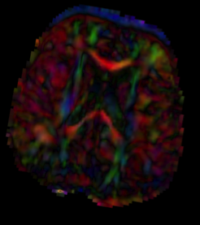
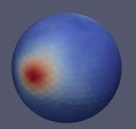
DTI QC II - Entropy
  Entropy of orientation/principal direction
    Directional distribution over the image
  “Acceptable” range of entropy values
    Detection & rejection of whole DTI
    Lower entropy => directional artifact
    Higher entropy => noise/motion
  Correction: Remove DWIs
    Leave-one-out scheme
    Can rescue data, increases signal contrast
  ISBI submission, applied to 200+ datasets

Slide 5
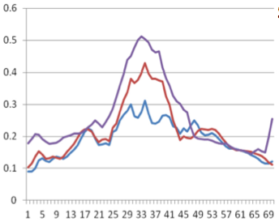

DTI Registration - Norm
Deformable registration of DTI data
Best methods use tensor (Wang et al 11)
  Collab: Utah II, HD DBP
Presence of pathology/development
  Tensor metric needs normalization
  Orientation unchanged, shape is normalized
  3D Histogram/CDF of λ_{i}
  Applied to neurodevelopment
    5-10% error reduction (FA)
    Visual improvement
ISBI submission
Reg 0y to 1y
FA profile
Splenium

Slide 6
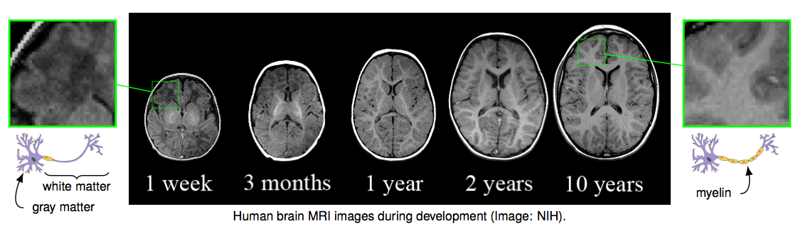
Longitudinal Atlas I
Deformable 4D atlas registration
Collab: Utah II, HD DBP
Current: assume no change in intensity
Novel: estimate/model change in intensity
Application: Neurodevelopment, TBI, HD

Slide 7
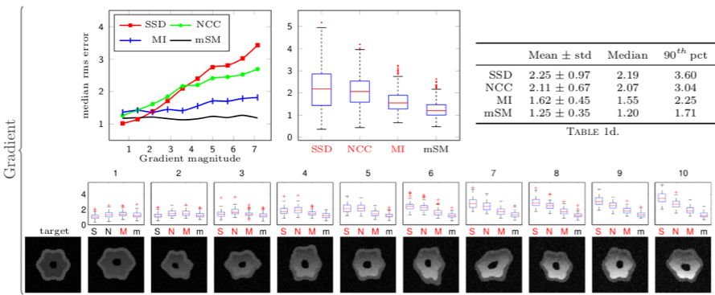
Longitudinal Atlas II
Intensity-model based registration metric
Alternate estimation
  Local intensity model
  Deformable registration parameters
Tested on simulation data & normal brain data
  Significantly better than current metrics

Slide 8
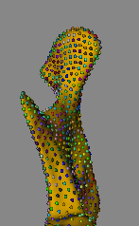
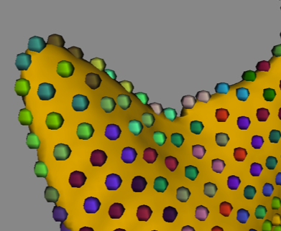
Shape Analysis
Joint SPHARM-Particle (SPIE MI 12 talk)
Longitudinal correspondence (Utah I & II)
Correspondence in folded, thin objects
  Lateral ventricle, mandible
  Particles can flip sides
  Geodesic distance particles (Utah/Datar)
  Surface normal agreement in entropy (UNC)
    Principal Nested Sphere’s approach
Next step: Interactive correspondence
HD, TBI applications

Slide 9
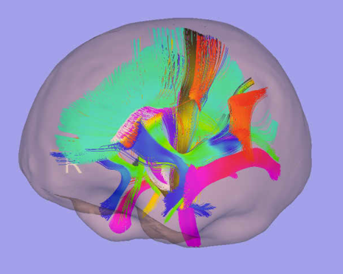
Validation: Tractography I
Soft/hardware DTI phantoms not realistic
  Collab: Utah II, Training core
  Goal: Create human brain like phantom
Inspiration: MNI-Brainweb
  Use real data to create a synthetic phantom
    Estimate fiber anatomy from real data
    Estimate brain morphometry population
  Sample/simulate brain morphometry
  Apply morphometry to fiber anatomy
  Compute DWI from simulated fiber anatomy
Evaluate tractography vs known ground truth

Slide 10
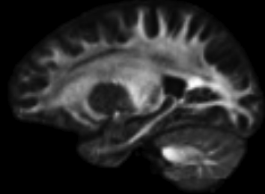
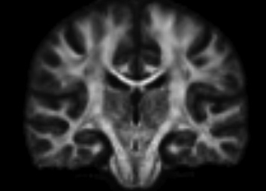
Validation: Tractography II
MICCAI 2012 workshop
Simulate
  Noise levels
  DWI resolution
  Gradient sampling scheme
Evaluate
  General correctness
  Reliability to replication, noise, resolution, sampling scheme
Future: Simulate pathology, tumors, TBI

Slide 11
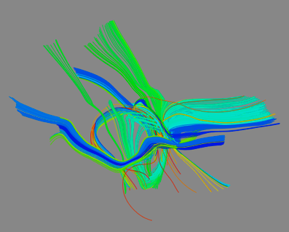
Papers & Tools
Shape: 2 statistical, 7 application and 4 method
Zhu et al. FADTTS: functional analysis of diffusion tensor tract statistics. NeuroImage 2011 Jun.;56(3):1412–25.
Looi et al . Shape analysis of the neostriatum in subtypes of frontotemporal lobar degeneration: neuroanatomically significant regional morphologic change. Psychiatry research 2011 Feb.;191(2):98–111.
Datar et al. Geometric correspondence for ensembles of non regular shapes. MICCAI 2011;14(Pt 2):368–75.
DWI/DTI: 1 statistical, 1 application and 4 method
Wang et al. DTI registration in atlas based fiber analysis of infantile Krabbe disease. NeuroImage 2011 ;55(4):1577–86.
Slicer compatible tools on NITRC:
  DTI QC tool: DTIPrep
  DTI Registration: DTI-Reg Slicer Module
  Fiber tract processing: FiberViewerLight
  DTI atlas based fiber analysis: DTI Fiber Tract Statistics
  NAMIC Shape analysis: SPHARM-PDM Toolbox
Thanks to all UNC and NAMIC folks!

Slide 12
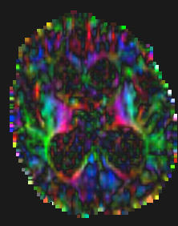
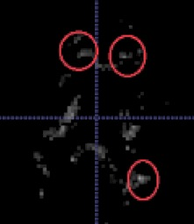
DTI Reg II – Features
TBI/Tumor/HD, large pathology
  Deformation too large for current methods
Idea: Detect fiber crossing features to drive registration
  Features from full brain tractography
  Crossing fibers where:
    In white matter
    Fiber number is high
    Fiber dispersion is high
  Current stage
    Local maxima for landmarks

Slide 13

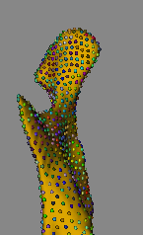
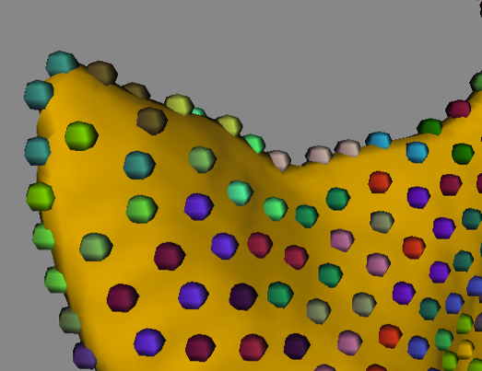
Shape Analysis II
Curved, thin objects (ventricles)
  Particles can flip sides
  Geodesic distance based particles (Utah/Datar)
  Surface normal agreement in entropy (UNC)
    Principal Nested Sphere’s approach
    Implementation in testing phase
Pre-surgery model
Post-surgery model

