Slide 1
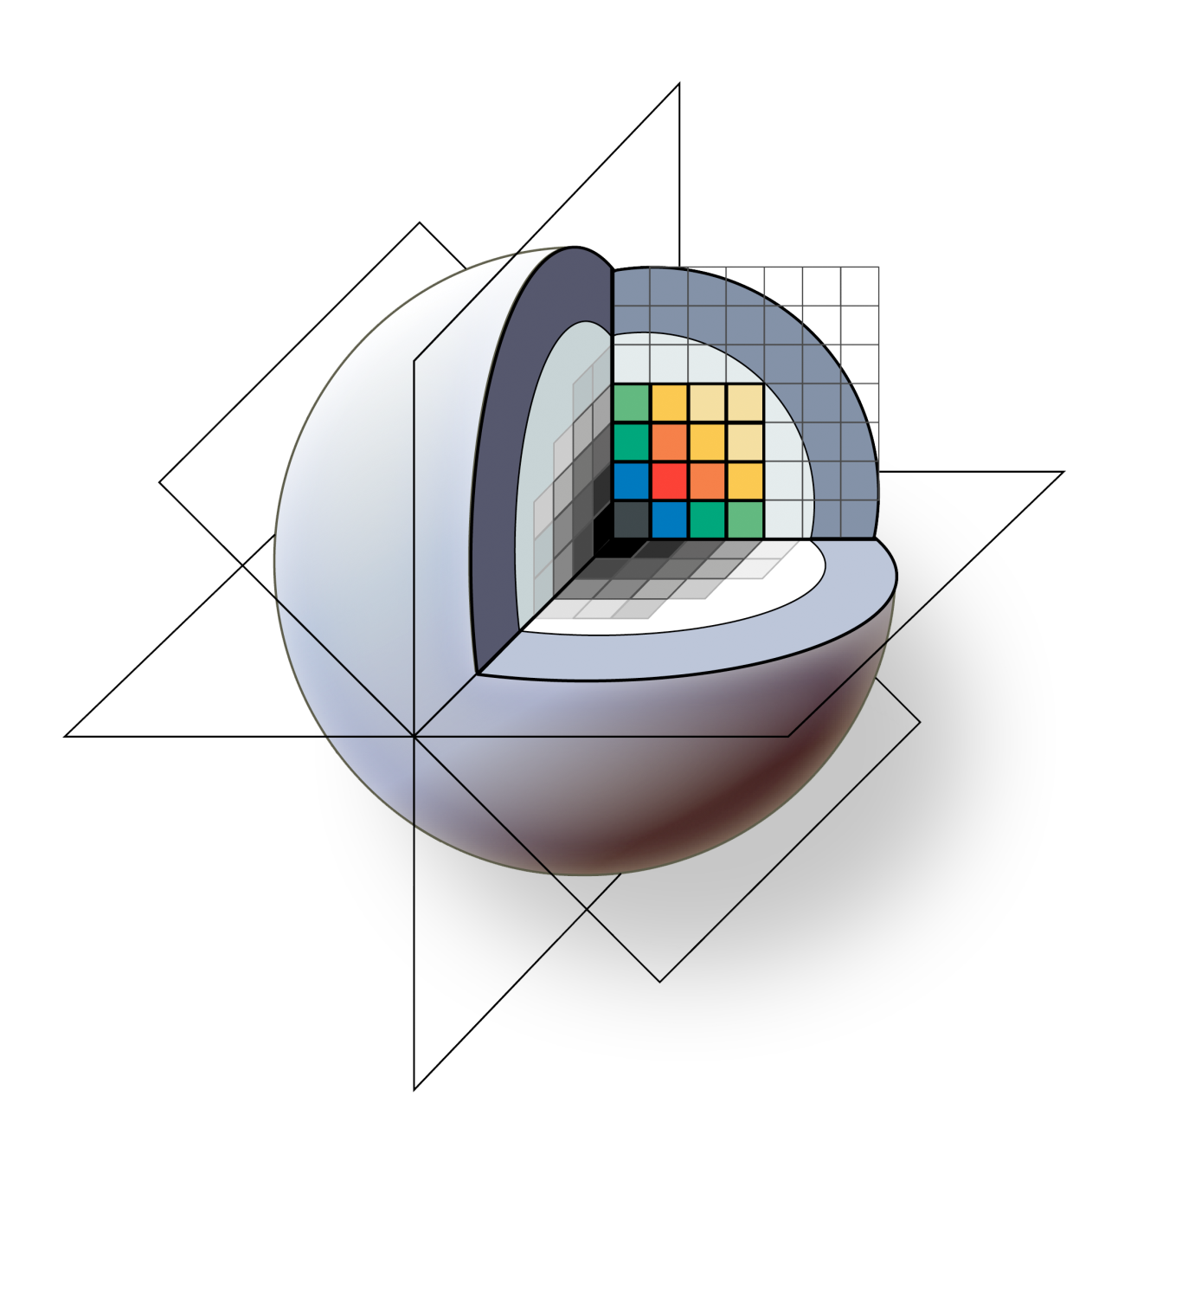

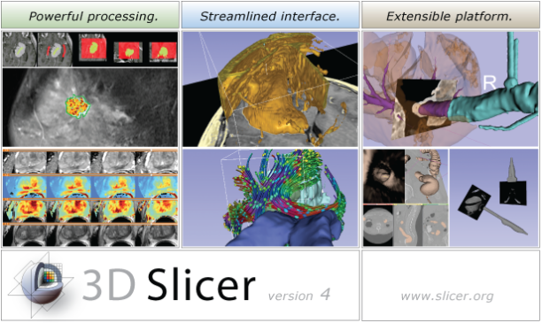
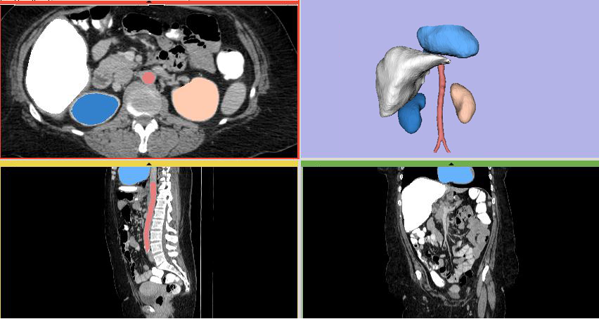
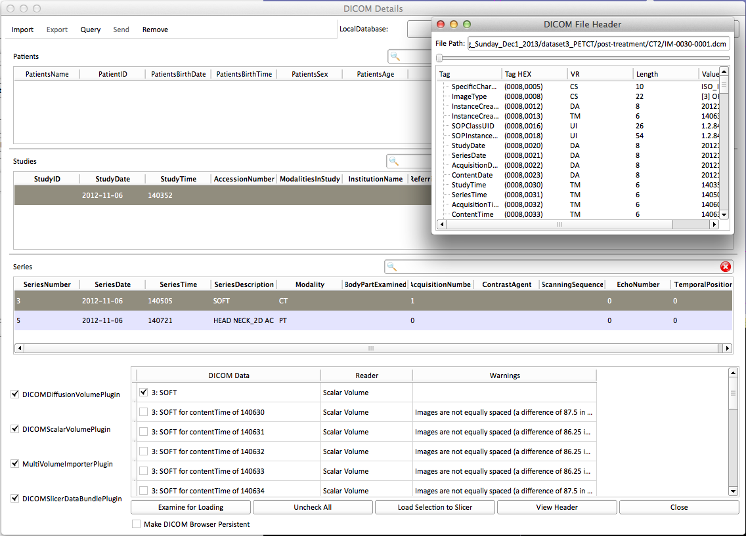
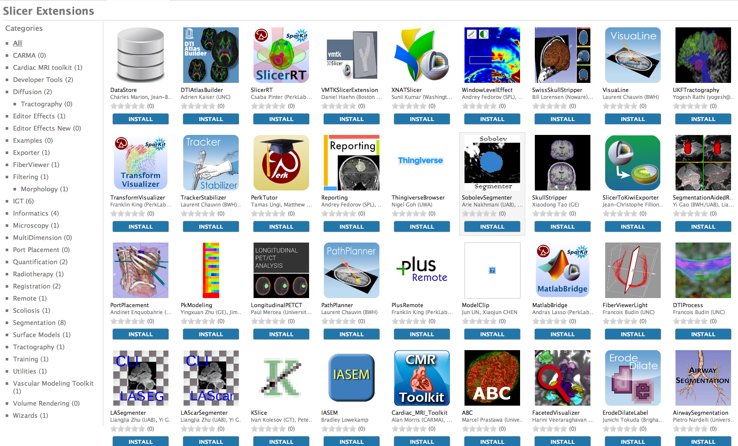
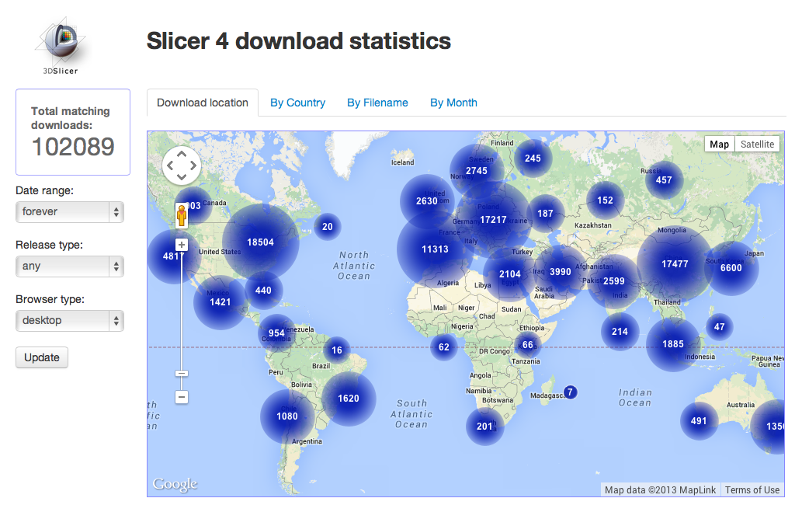



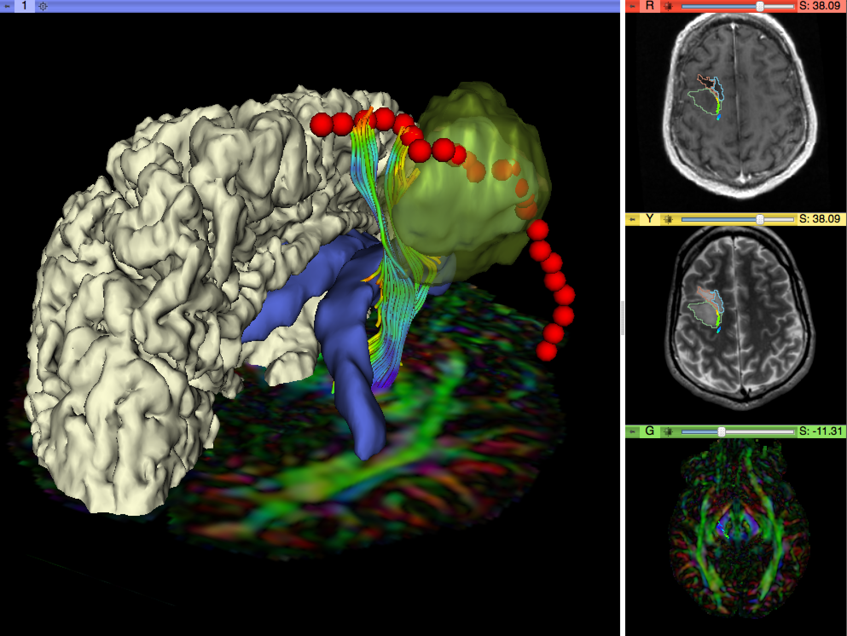
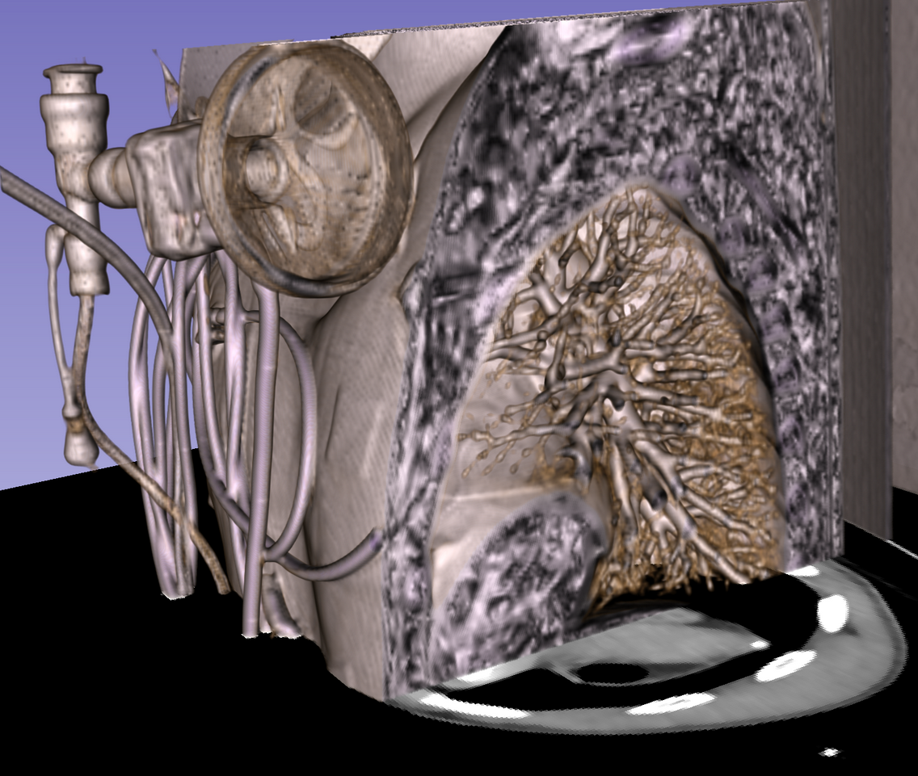
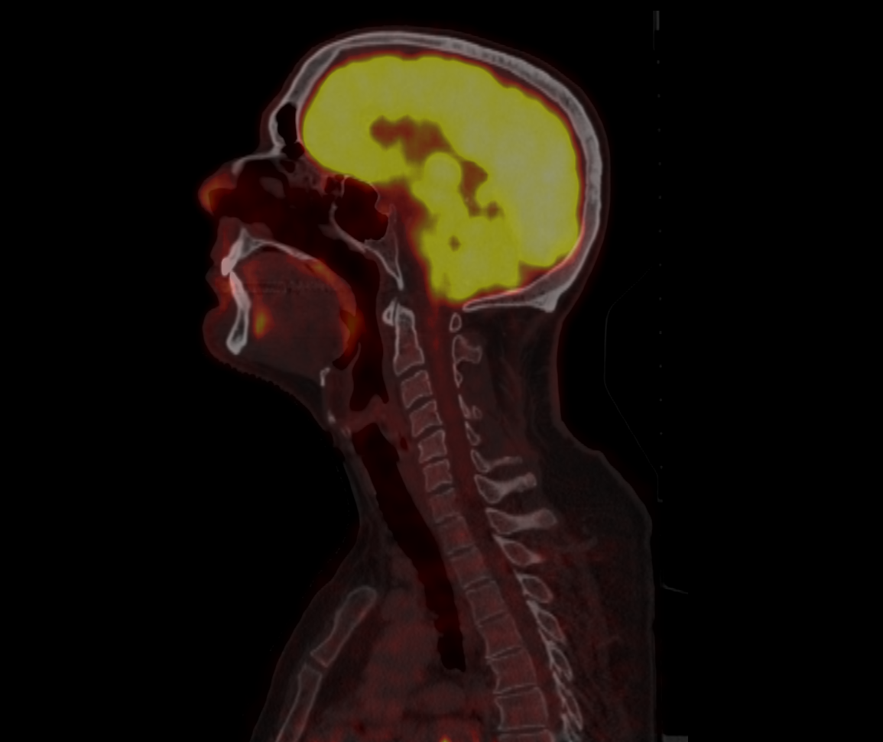
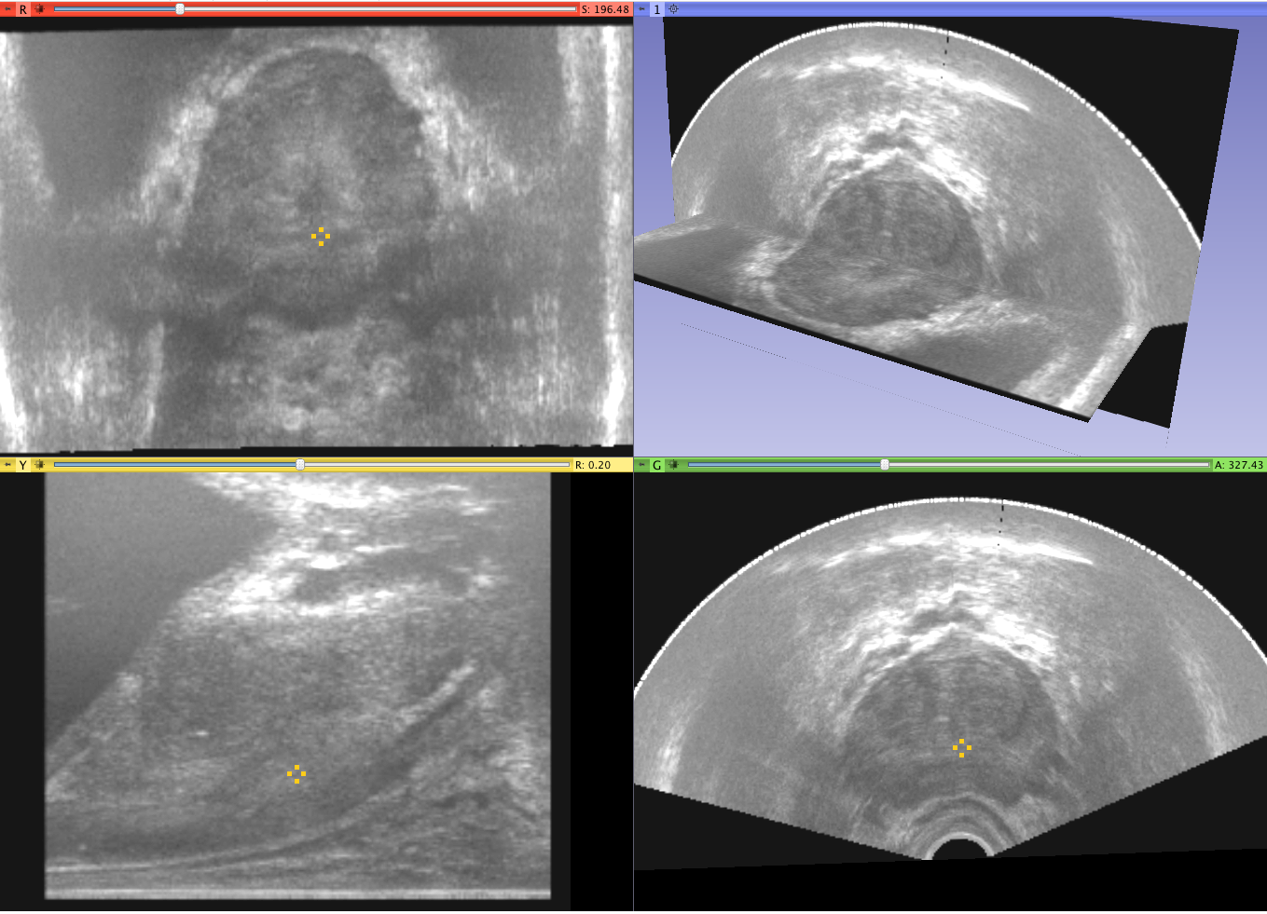


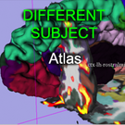
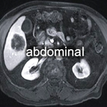
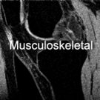
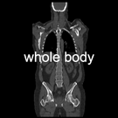
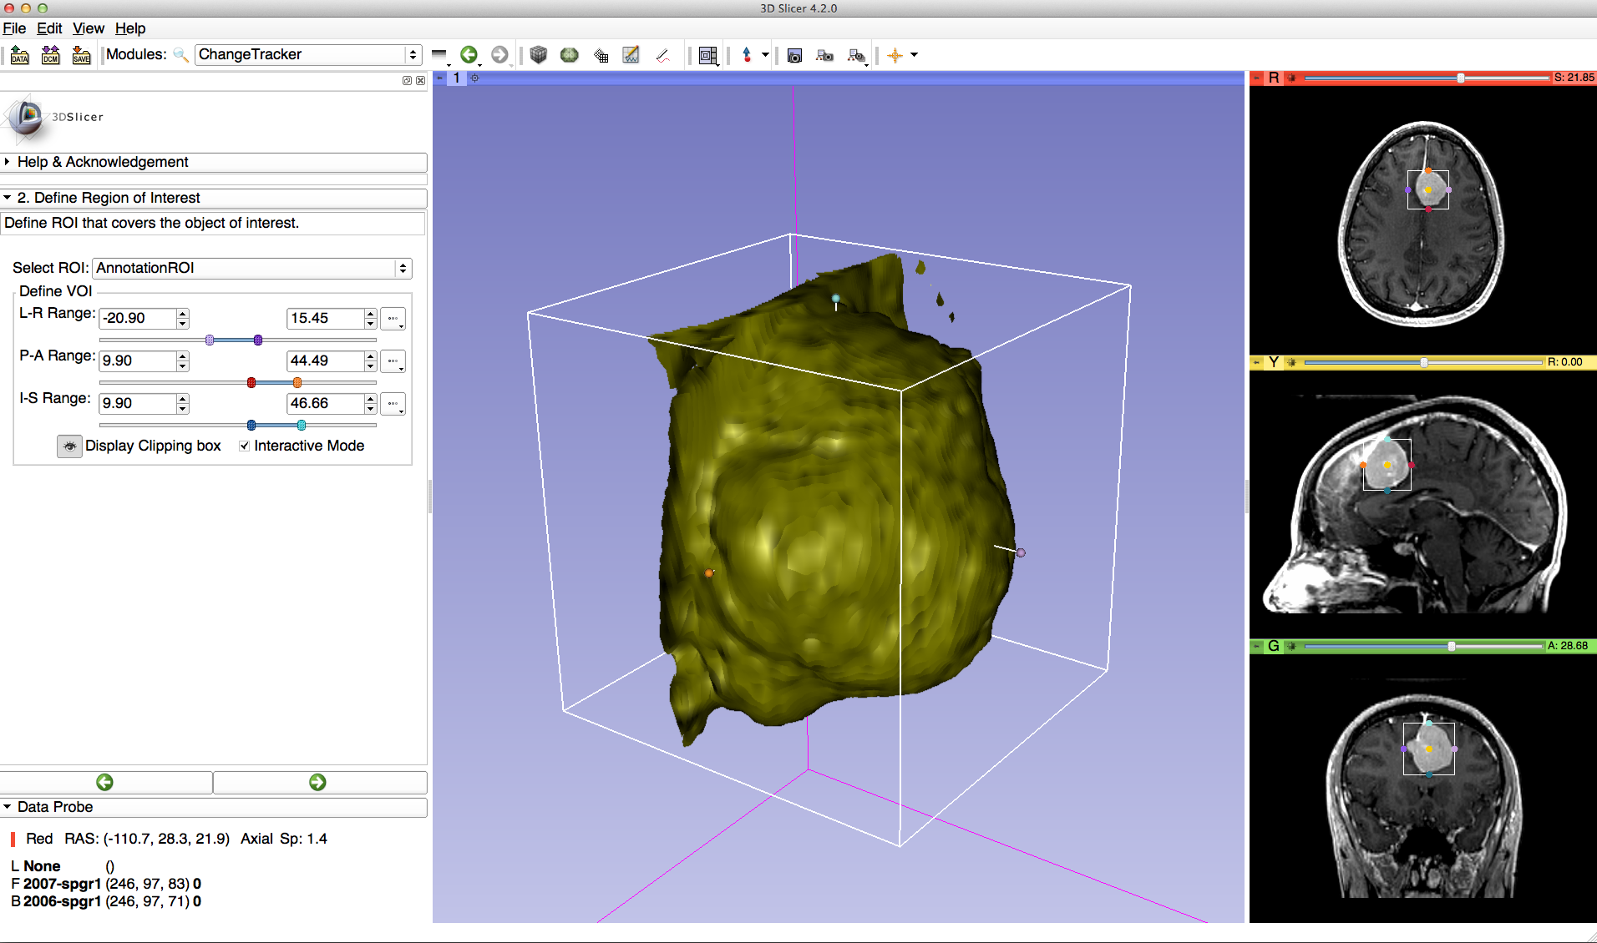
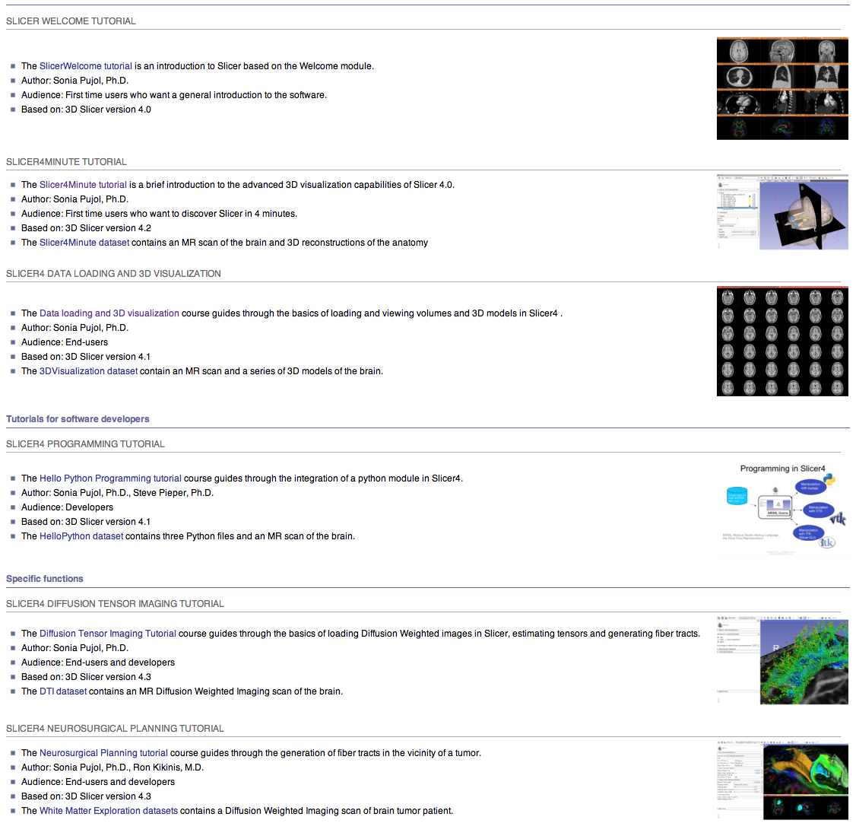
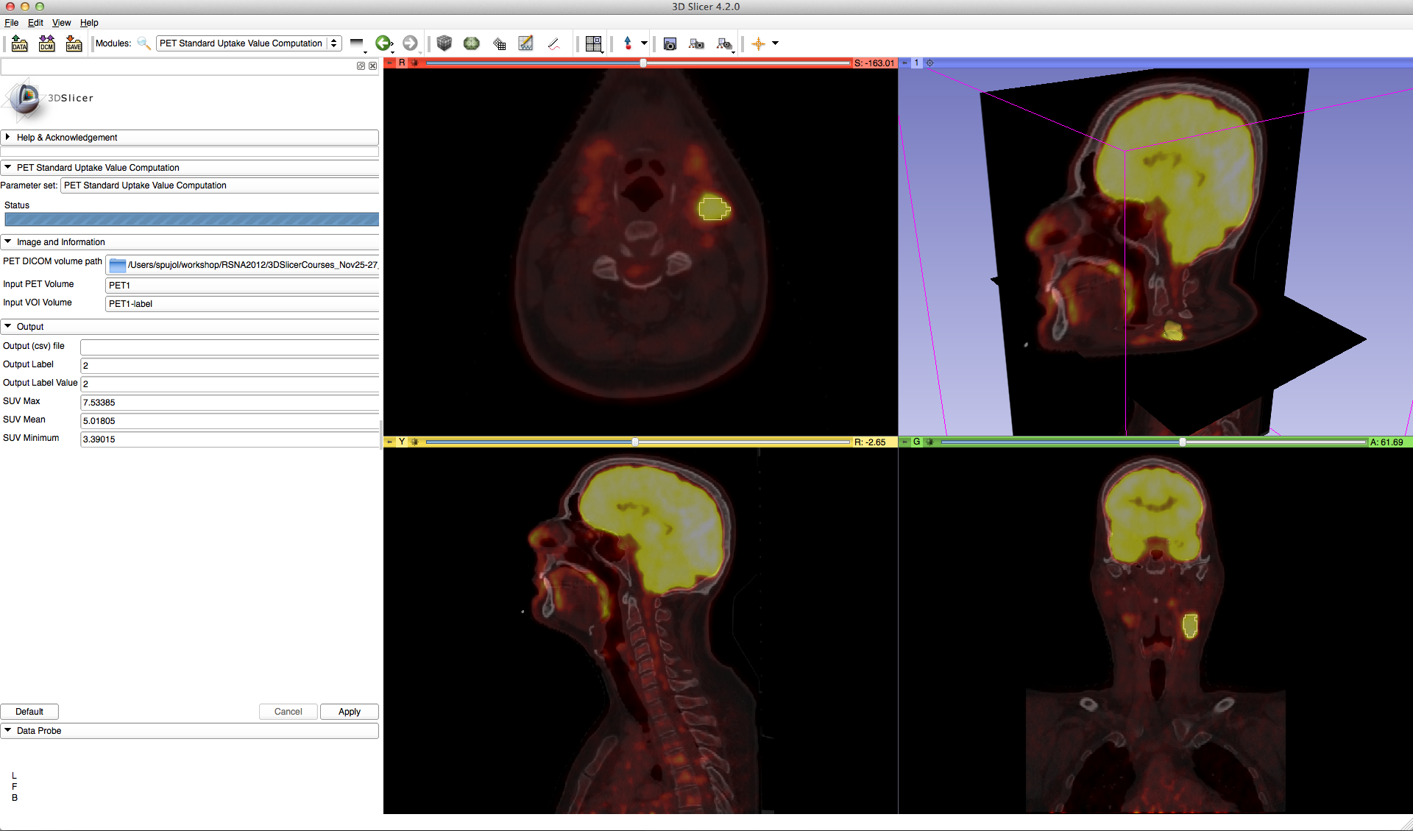
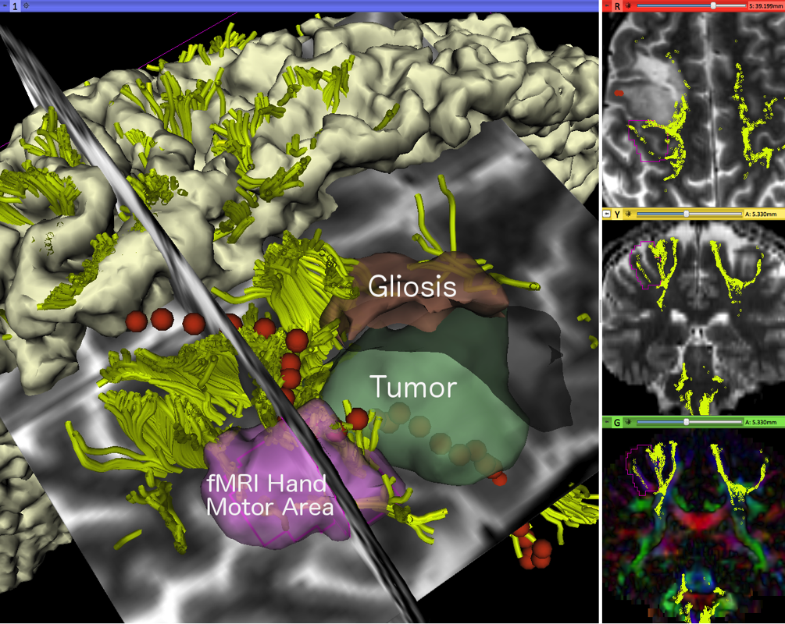
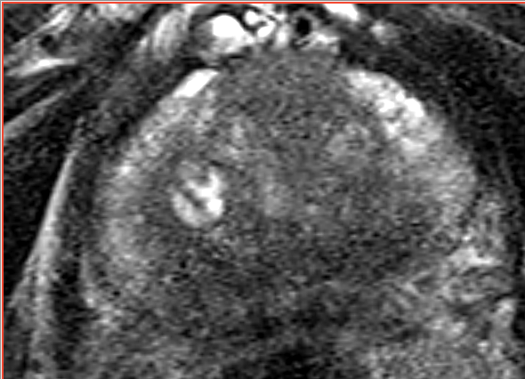
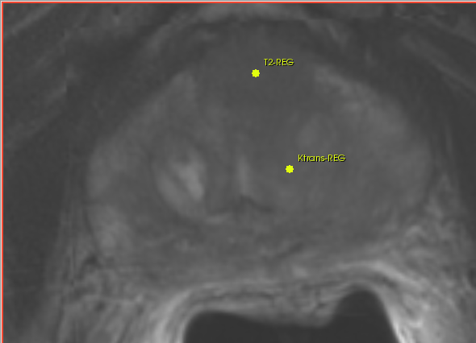
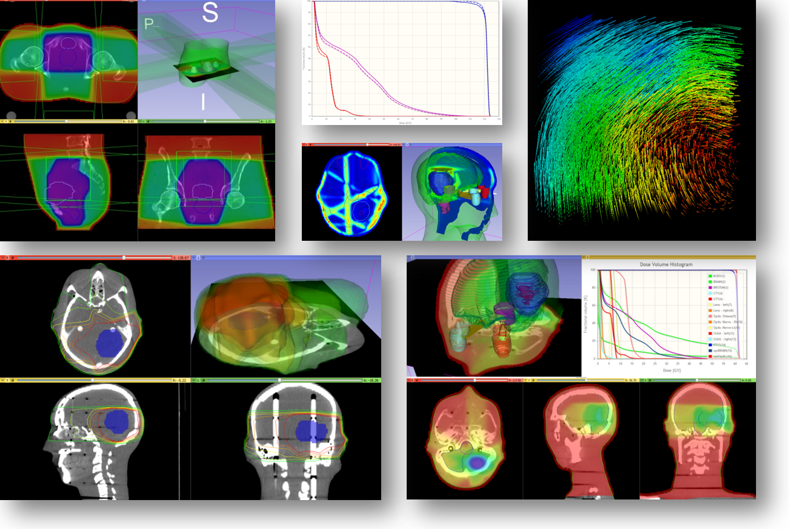
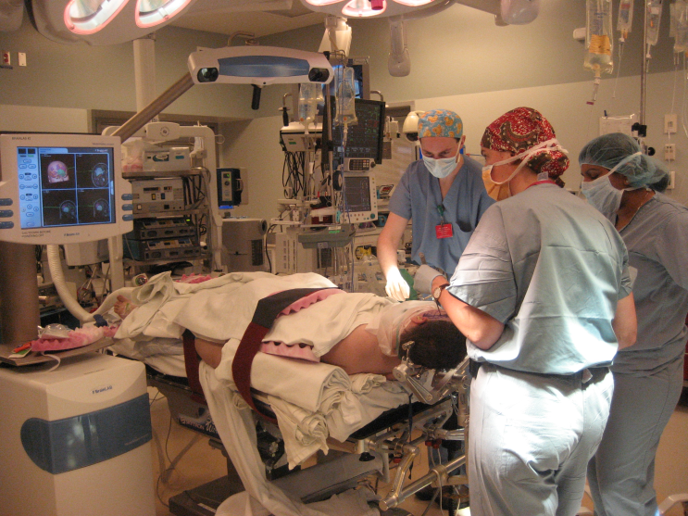
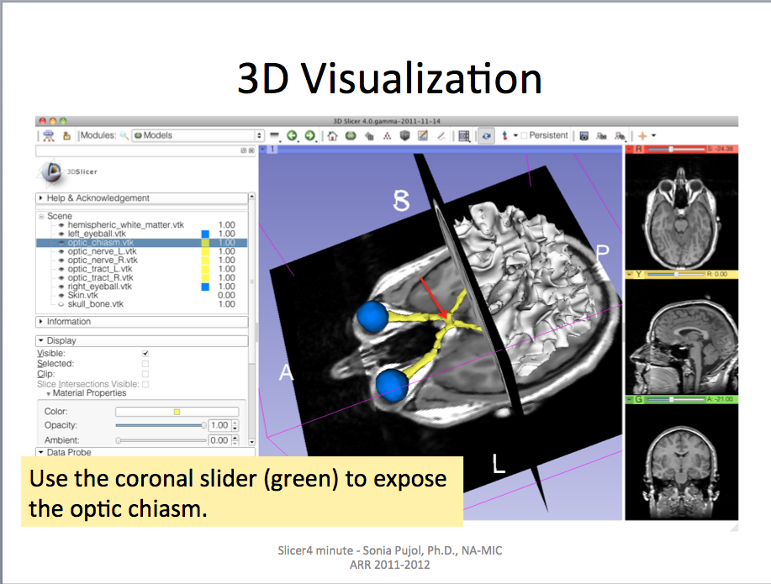
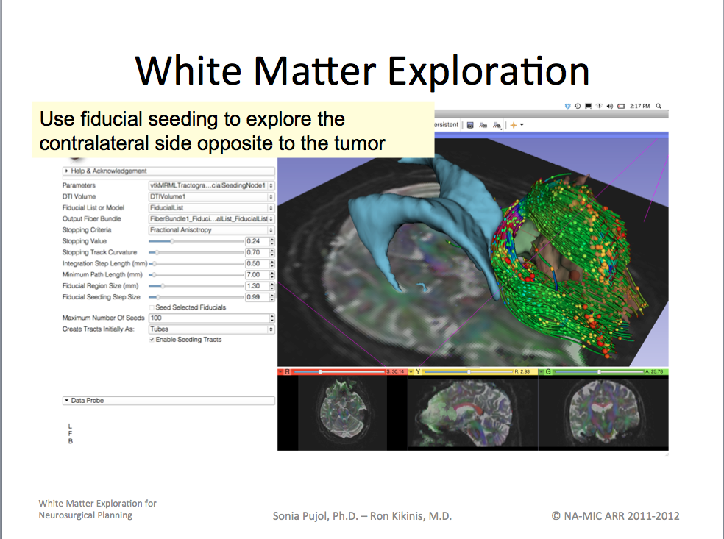
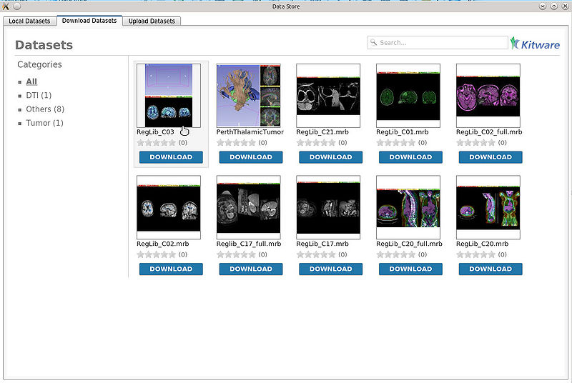
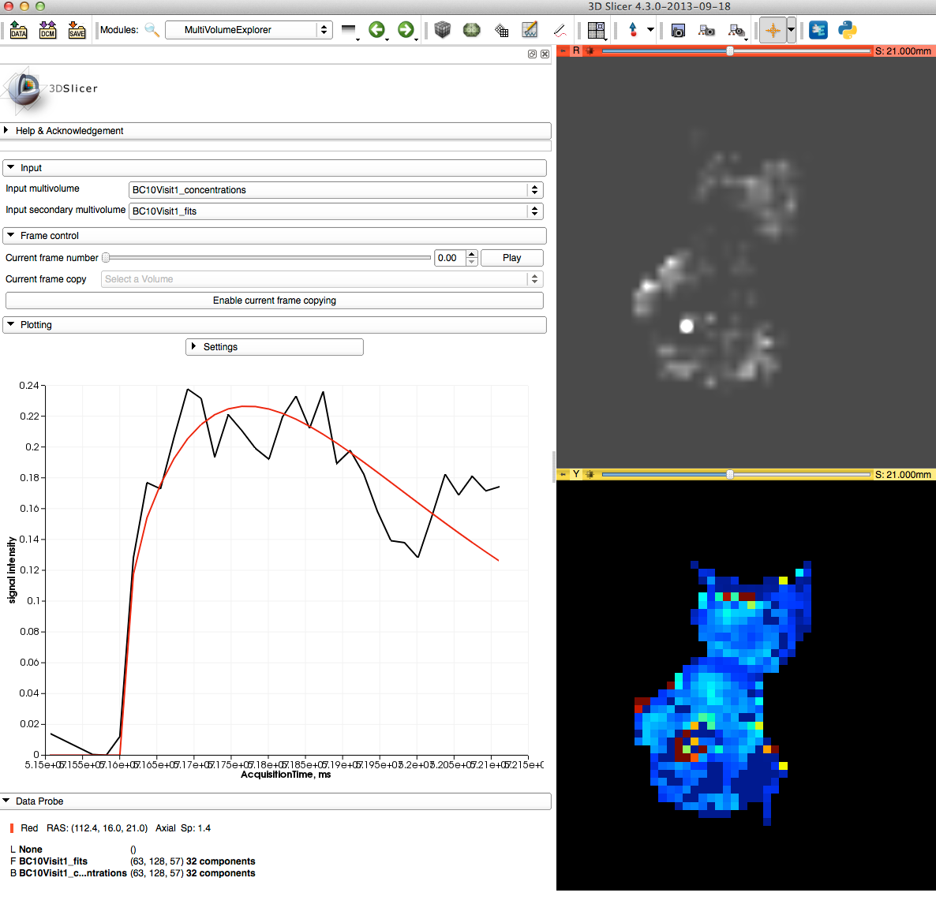
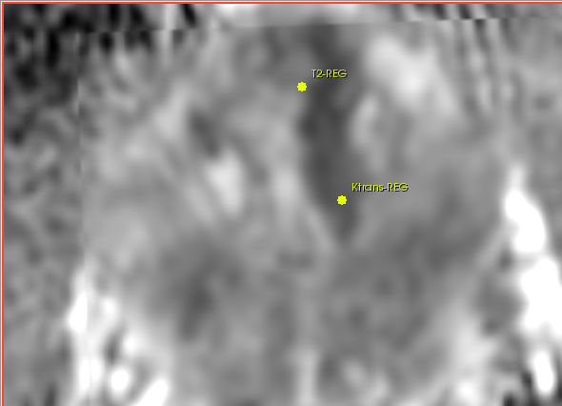
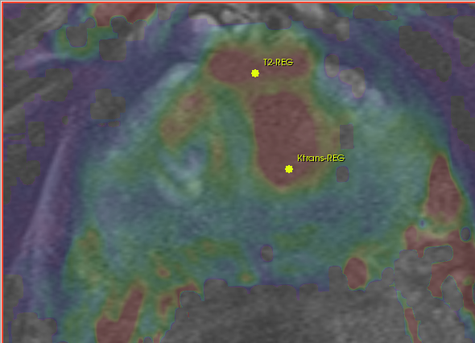
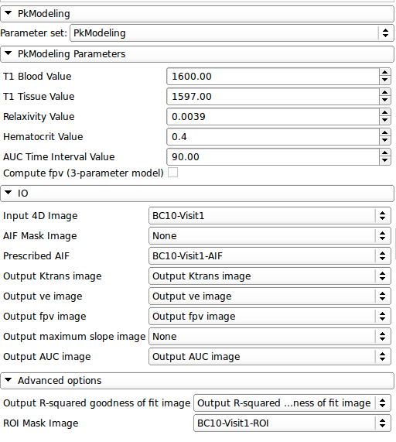
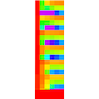
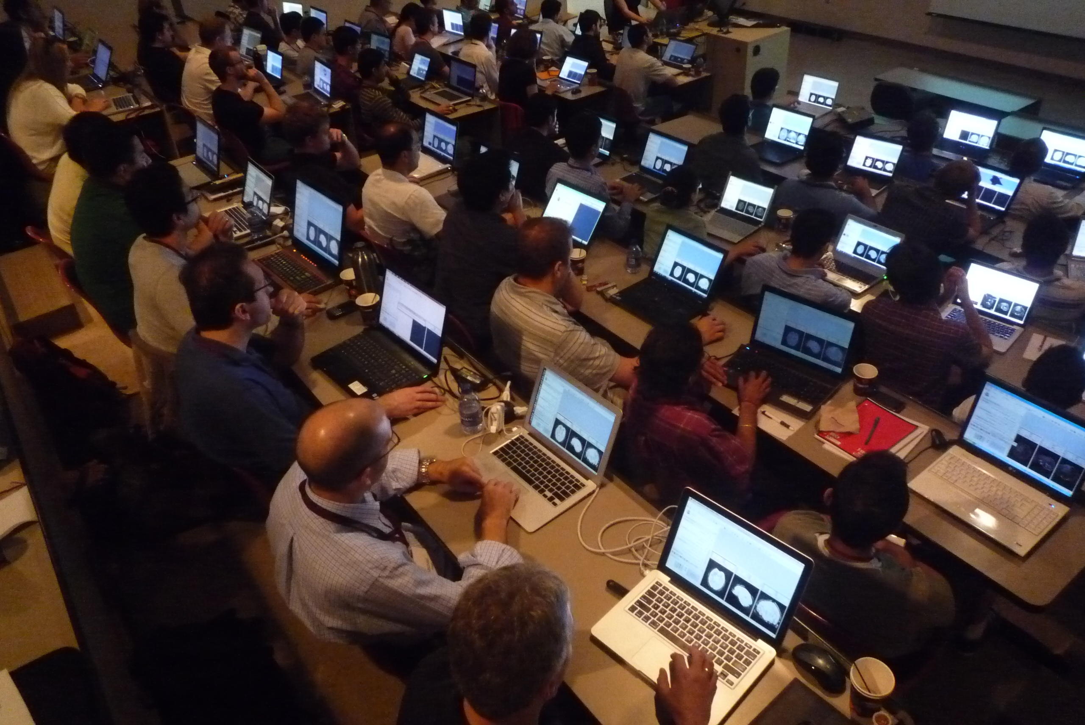
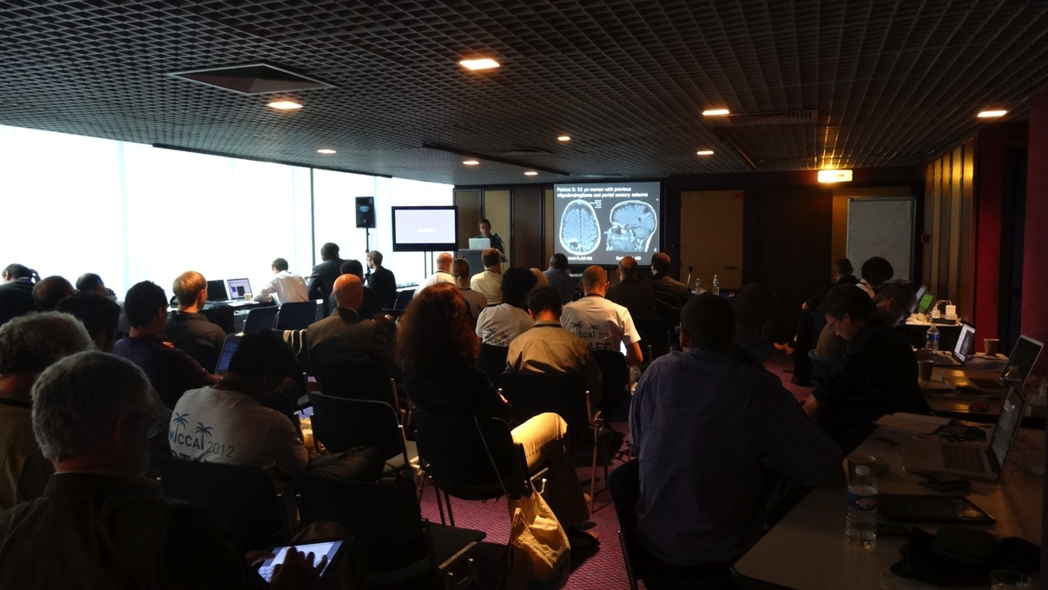
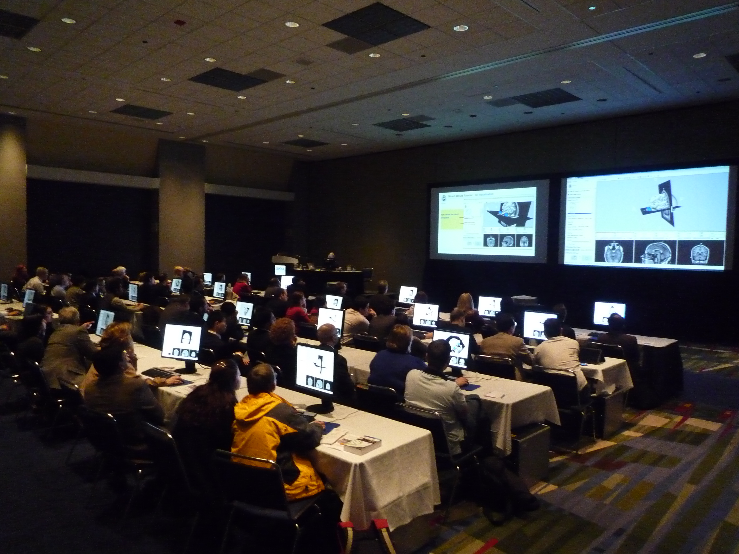






RSNA2013 Quantitative Imaging Reading Room
The 3DSlicer Open Source Software Platform for Segmentation, Registration,
Quantitative Imaging, and 3D Visualization of Multi-Modal Image Data
Sonia Pujol, Ph.D., Steve Pieper, Ph.D., Andriy Fedorov, Ph.D., Ron Kikinis, M.D.
About 3D Slicer
Segmentation & Registration
Multi-modality Visualization
3D Slicer is a multi-platform, free, open source and extensible software package for visualization and medical image computing.
Segmentation is required for defining features of interest in imaging data for quantification and analysis.
3D Slicer integrates standard radiological viewing capabilities for MR, CT, PET and Ultrasound data in multiple image file formats, including DICOM. A combined visualization of multiple imaging modalities and derived data can provide clinician scientists with an integrated understanding of anatomy and pathology.
The software platform is community created for the purpose of subject specific medical image analysis and visualization.
Multi-modality imaging including, MRI, CT, US, nuclear medicine, and microscopy
Multi organ from head to toe
Bidirectional interface for devices
Expandable and interfaced to multiple toolkits
3D Slicer has a variety of interactive and automated segmentation methods:
support for manual contouring and editing
region growing and level sets
graph cuts with gesture support
skull stripping and hierarchical brain segmentation for morphological studies
The desktop application provides interactive visualization of the results and an intuitive GUI.
Support of 2-, 3- and 4-D image data visualization (reformats, volume rendering)
modality-independent (MR, CT, PET, US and more)
DICOM data exchange interoperability
parameter maps and VOIs
surface models & glyphs
measurement tools & annotations
charts
History: Slicer was initiated as a Masters thesis project between the Surgical Planning Laboratory at the Brigham and Women's Hospital and the MIT Artificial Intelligence Laboratory in 1998. Slicer has been downloaded over 100,000 thousand times worldwide. A variety of publications were enabled by the Slicer software. A new, completely re-architected version of Slicer was developed and released in 2007. Subsequently, version 3.2 was released in May of 2008, version 3.4 was released in May of 2009, version 3.6 of Slicer was released in November of 2010, version 4.0 was released in November of 2011, version 4.1 was released in June of 2012, version 4.2 was released in November 2012. The newest version of Slicer is version 4.3.
Timeseries analysis and multi-subject analysis require good registration of imaging data acquired at different times, on different scanners, and across modalities.
The Slicer Extension Manager allows the integration of special-purpose code to the platform.
Slicer also provides a variety of registration methods and resources to support versatile applications:
Deformation models: rigid, affine, non-rigid, fluid
Algorithm types: fiducial-, surface-, intensity-based
Image types: scalar, vector, tensor
Google “na-mic registration documentation” for the extensive collection of Slicer registration cases and recipes
DICOM widget
License: Slicer executables and source code are available under a BSD-style, free open source licensing agreement under which there are no reciprocity requirements, no restrictions on use, and no guarantees of performance. Slicer leverages a variety of toolkits and software methodologies that have been labeled the NA-MIC kit. For more information, please visit http://wiki.na-mic.org/Wiki/index.php/NA-MIC-Kit.
Disclaimer: 3D Slicer is not FDA approved or CE marked, and is for research use only.
Some of the registration applications covered in the 3D Slicer extensive Registration Case Library.
Deterministic DTI tractography in a neurosurgical case.
GPU-based Volume Rendering of CT scan of the thorax
PET/CT combined visualization
Transrectal ultrasound of the prostate performed using Public Library for Ultrasound imaging (PLUS) https://www.assembla.com/spaces/plus/wiki
Quantitative Analysis
Clinical Research Applications
Community, Learning & Support
Many hundreds of imaging biomarkers are used in clinical practice, drug discovery and development. A free and open source platform can improve access to standard methods of image quantification and rapidly translate experimental methods into the clinical research setting for validation and refinement.
To support user and developer communities and the effective translation of tools into the clinical research setting, the 3D Slicer Project provides many outreach materials and activities including:
3D Slicer has been used in clinical research, with IRB clinical protocols appropriately created and managed. The extensible architecture of the software allows the development of specialized packages such as SlicerRT for radiotherapy research, and SlicerIGT for image-guided therapy.
In image-guided therapy (IGT) research, Slicer is frequently used to construct and visualize collections of MRI data that are available pre- and intra-operatively, and to display the tracked spatial position of surgical instruments.
3D Slicer includes tools to quantify:
PET/CT studies (SUV body weight)
Tumor growth (experimental)
Tumor response to treatment (measurements for RECIST)
DCE-MRI (pharmacokinetics)
Hands-on Training Workshops
Tutorial Materials & datasets
DataStore extension for easy upload and download from database of anonymed datasets
Reference Style Documentation
User and developer mailing lists
Project week events for Developers
Image-Guided Neurosurgery
MRI-Guided Prostate Cancer Biopsy
Radiotherapy Research
A
B
3D Slicer has been used extensively for brain tumor resection planning and guidance during the surgery.
Integration of 3D Slicer with the surgical navigation BrainLab system allows to track surgical instruments in real-time, and transfer the position to 3D Slicer. This enables intra-operative context-dependent visualization of the critical structures in the proximity of the surgical tool.
This project is a joint collaboration between BWH, Yale University and BrainLab.
Targeted MRI guided prostate cancer biopsy attempts to improve the biopsy precision while reducing the number of tissue samples that need to be collected. This is achieved by first using diagnostic multi-parametric MRI to highlight the suspicious areas. The biopsy procedure takes place in the MR bore. Deformable registration is used to fuse the diagnostic image data to the intra-procedural configuration of the gland.
3D Slicer is used for MRI visualization and fusion, target planning, deformable registation, and needle trajectory planning (ProstateNav module).
Shown are intra-procedural T2 MRI (A), and pre-procedural T2, ADC and a pharmacokinetic map (B,C,D) registered to intra-procedural image, with the biopsy targets selected.
SlicerRT was implemented as an extension of 3D Slicer for Radiotherapy Research. The feature set of SlicerRT was defined through consensus discussions with a large pool of RT researchers, including both radiation oncologists and medical physicists. Slicer RT functionalities include importing and loading DICOM-RT data, computing and displaying dose volume histograms, creating accumulated dose volumes, comparing dose volumes, visualizing isodose lines and surfaces.
C
D

