Slide 1
Utah II: NAMIC Methodologies and Tools for Longitudinal Image Analysis
Guido Gerig, Marcel Prastawa, Sylvain Gouttard, Stanley Durrleman, Bo Wang, James Fishbaugh, Anuja Sharma
SCI Institute, University of Utah
Jack van Horn, Paul M. Vespa, Andrei Irimia
UCLA LONI, Neurosurgery, Neurology
Hans Johnson, University of Iowa
Joseph Piven, Heather Hazlett, UNC Chapel Hill

Slide 2
NAMIC Activities Utah II
Motivation spatiotemporal image analysis:
Increasing use of longitudinal/serial imaging for prediction, diagnosis and assessment of disease progression and therapeutic success.
Personalized health care (PHC): Individual trajectories/profiles.
Current analysis: Independent processing of serial data.
Need: Tools for joint processing of (3D,t) data → 4D Analysis.
Utah II: 4D image analysis for longitudinal image data:
4D segmentation of acute/follow-up incl. lesions
4D shape analysis
4D tract-based analysis of
4D segmentation of serial image data

Slide 3
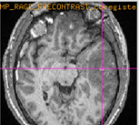
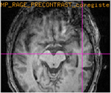
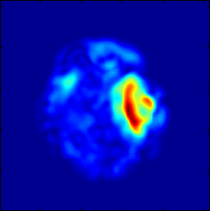
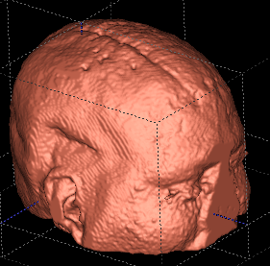
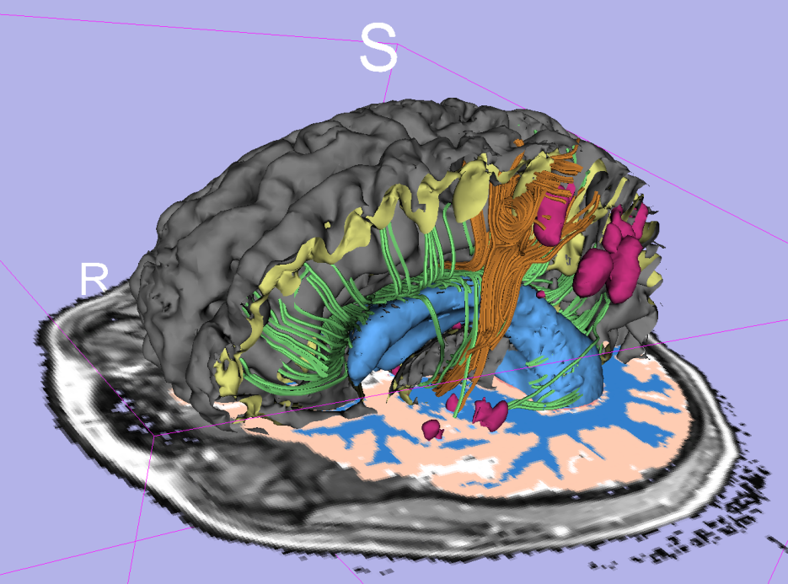
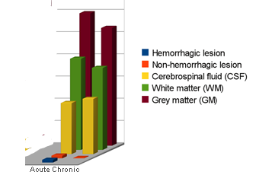
Patient-Specific Segmentation of Longitudinal MR Images of TBI
Methodology and tool for efficient segmentation of brain anatomy and lesions from multimodal MRI with minimal user input.
Joint segmentation of acute & chronic image data → Assessment of change due to rehabilitation.
acute
chronic
change map
Quantitative description of change
impact
3D modeling/vis.

Slide 4
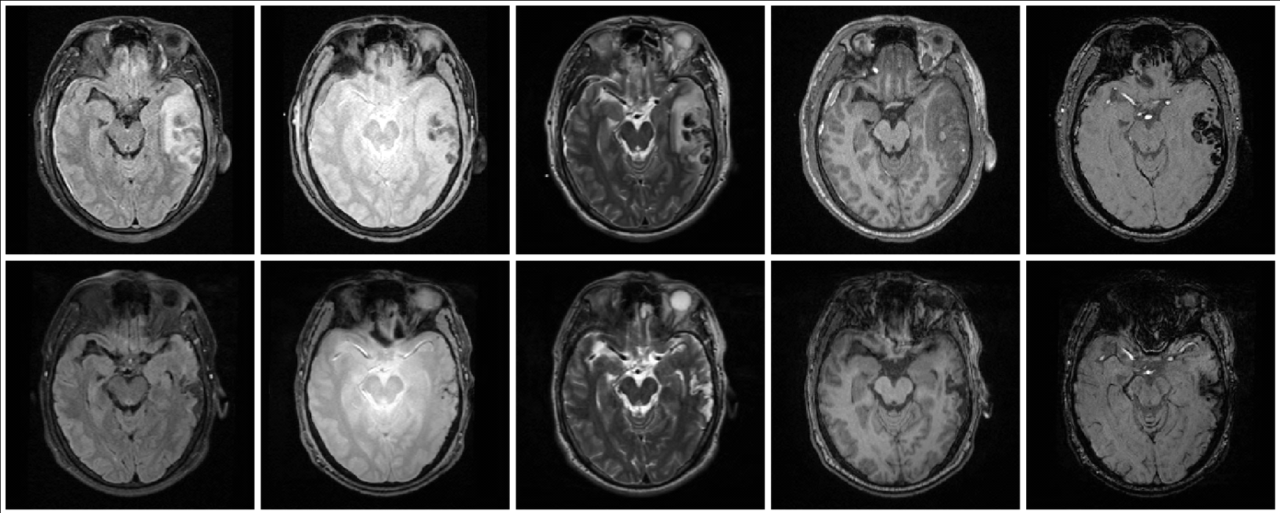
TBI Pathology multimodal MRI
FLAIR GRE T2 T1 SWI
acute
chronic (+3-6 months)
Acute images
- Non-hemorrhagic lesion/edema
- Hemorrhagic lesion/bleeding
- Extracerebral lesion
- Diffuse axonal injury
Chronic images
- Lesion (Non-hemorrhagic)
- Necrosis
- Bleed

Slide 5
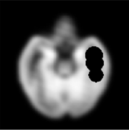
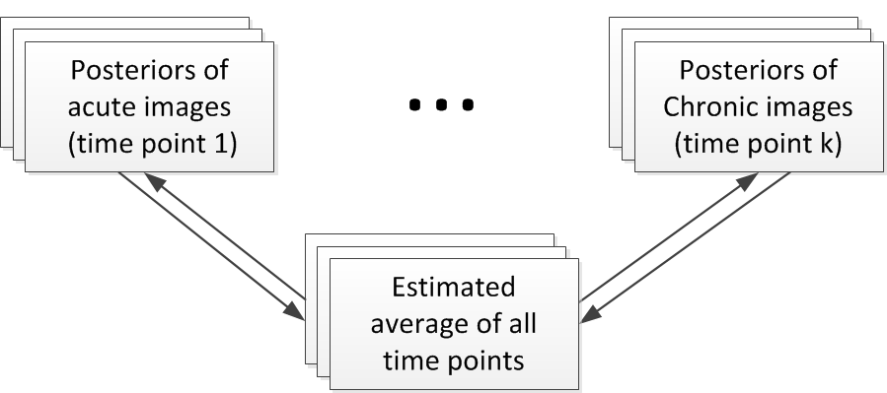
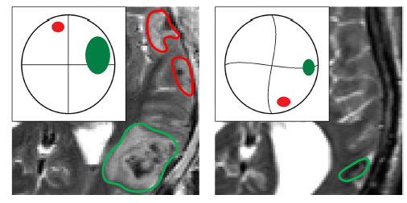
Methodology
Expert initialization of primary lesion sites and types:
Challenge: Lesions deform, disappear & appear. Construction of persona-lized spatiotemporal atlas using diffeomorphic and non-diffeomorphic components.

Slide 6
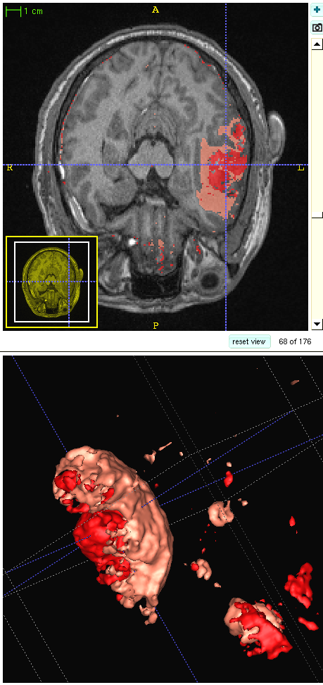
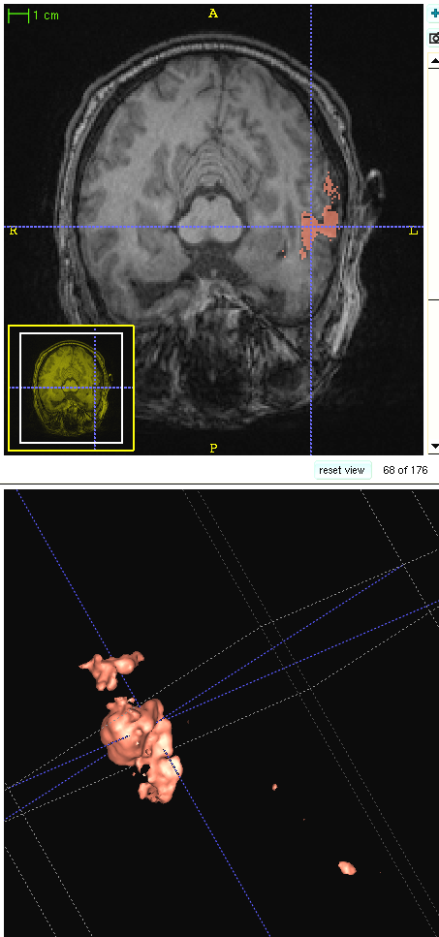
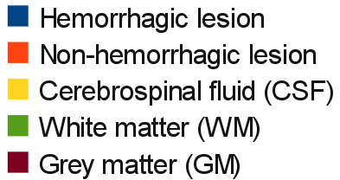
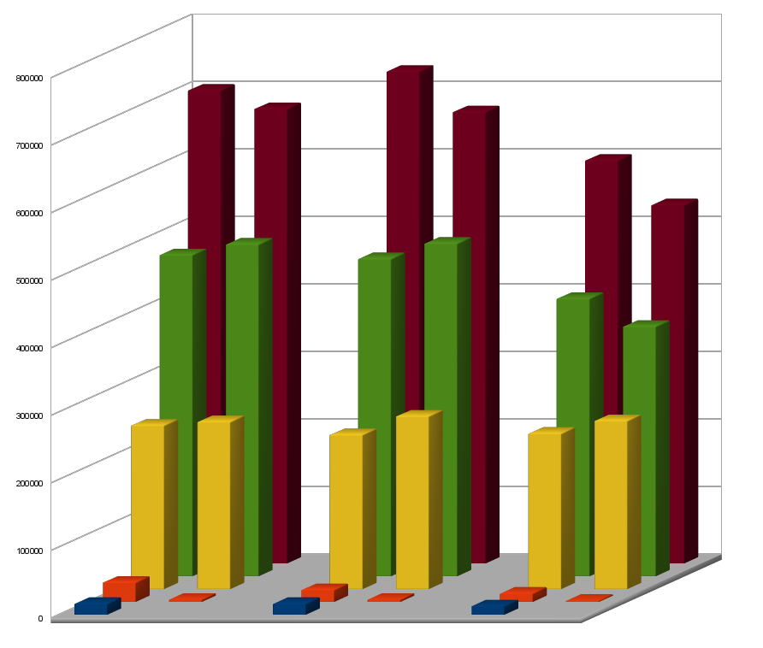
Preliminary Results 3 Cases
Acute Chronic

Slide 7
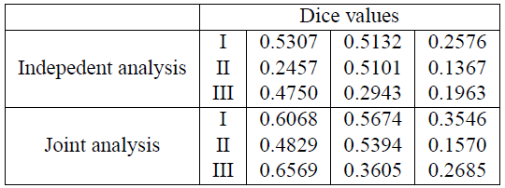
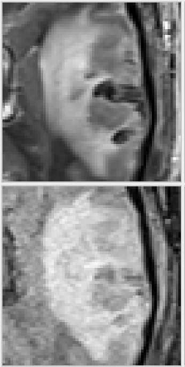
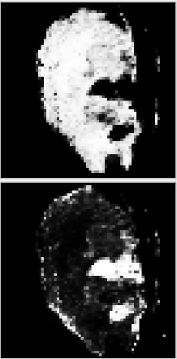
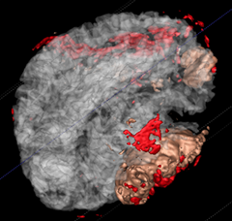
Validation: Automated versus Expert Labeling
ANHL AHL CL
Dice overlap values comparing new 4D method and the supervised segmentation to the manual segmentation:
ANHL is acute non-hemorrhagic lesion
AHL is acute hemorrhagic lesion
CL is chronic lesion
Please note low Dice values due to small lesions with complex shape.

Slide 8
Longitudinal Shape Modeling
Concept: Given a set of discrete shapes, interpolate a continuous growth model via shape regression.
Assumption: Evolution of biological tissue is inherently smooth in space and time. Growth is nonlinear, locally varying process.
Method: Continuous flow of diffeomorphisms via correspondence-free “currents” (Younes, Durrleman). Cost function = Data Matching + Regularity.
Durrleman, Pennec, Trouve, Gerig, MICCAI ‘09
Fishbaugh, Durrleman, Gerig, MICCAI ’11
Fishbaugh, Durrleman, Gerig, SPIE ’12
Sadeghi, Prastawa, Gilmore, Lin, Gerig, IEEE Asilomar 2010

Slide 9
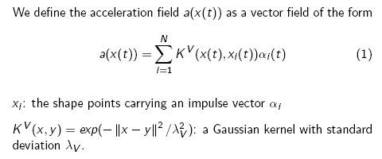
4D Shape Regression
From discrete 3D shapes (6m,12m,24m) to continuous 4D shape model

Slide 10
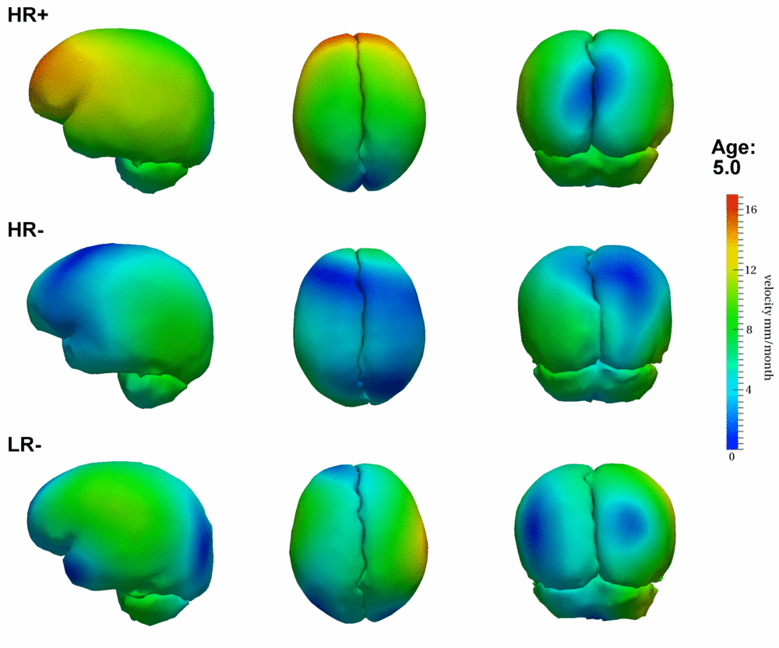
4D Growth Profiles
Autism Research Collab. former NAMIC DBP UNC (Piven, Hazlett)
HR+: High risk infant ADOS pos.
HR-: High risk infants ADOS neg.
LR-: Low risk healthy infants
Autism Research Collaboration former DBP UNC (Piven, Hazlett)

Slide 11
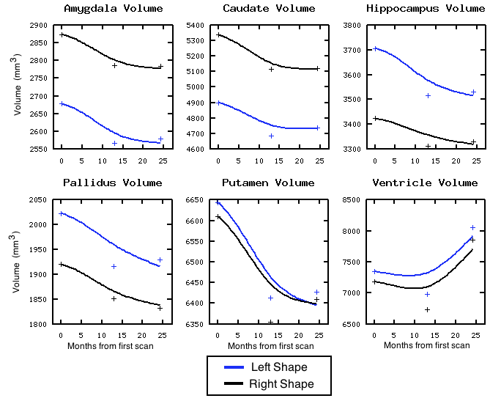
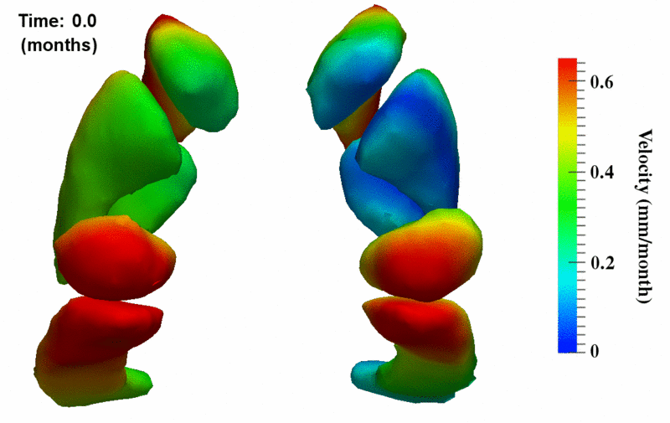
Clinical Application: Neurodegeneration in Huntington Disease
Continuous individual subjects’ growth models
Quantitative information derived from 4D shapes
Colllaboration Hans Johnson, U-Iowa

Slide 12
Tract-Based Longitudinal Modeling of DWI/DTI data
Spatial tract model:
FA(s)
FA
Spatio-temporal model:
FA(s,t)
time

Slide 13
Spatiotemporal Model
Modeling FA age 0 – 3 years (10 subjects).
Non-parametric kernel regression along tracts.
Temporal changes captured by logistic function (initial fct., growth rate, asymptote → statistics
Submitted ISBI ’12, tests with HD DTI data in progress

Slide 14
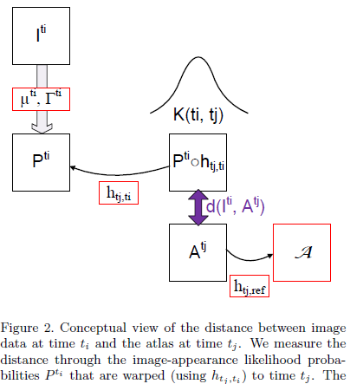
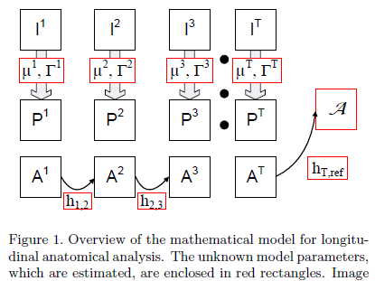
Spatiotemporal anatomical models: Joint 4-D Segmentation, Registration & Atlas Estimation

Slide 15
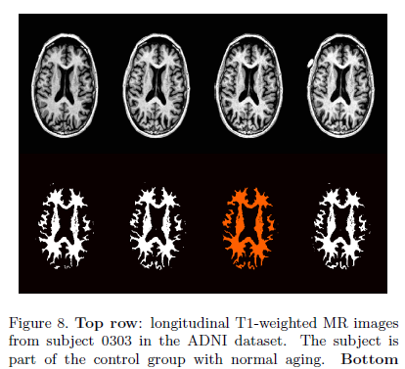
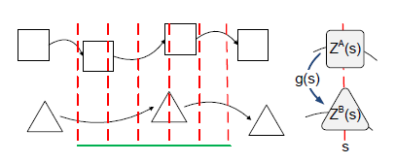
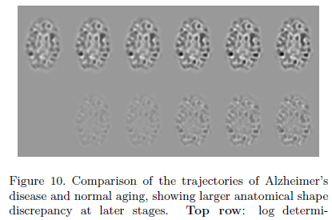
Application: Long. ADNI Data
Prastawa, Awate, Joshi, Gerig, MMBIA ‘12

Slide 16
Summary
Publications:
Methodology:
Prastawa, Awate, Joshi, Gerig, MMBIA ’12
Gouttard, Kubicki, Gouttard, Gerig, SPIE ‘12
Fishbaugh, Durrleman, Gerig, SPIE ‘12
Wang, Prastawa, Irimia, Chambers, Vespa, Van Horn, Gerig, SPIE ‘12
Fishbaugh, Durrleman, Gerig, MICCAI ’11
Durrleman, Prastawa, Gerig, Joshi, IPMI ‘11
Collaborative Res. and Clinical Applications:
Vachet et al., SPIE ‘012
Irimia et al., J Neurotrauma. Nov. 2011
Zhu et al., FADTTS, Neuroimage. 2011
Wang et al., Neuroimage. 2011
Hazlett et al., Arch Gen Psychiatry. 2011
Gerig, Oguz, Gouttard, ,, Styner, Frontiers, 2011
Knickmeyer et al., Twin Res Hum Genet. 2011
Workshops:
MICCAI ‘11 DTI Challenge
Tools:
Slicer plug-in ‘ABC’
ITK Toolkit DTI validation
NITRIC tool tract-based statistics
Prototype ITK-C++ 4D segmentation
Prototype ITK-C++ 4D shape regression
Prototype ITK-C++ 4D brain and pathology segmentation

