Slide 1
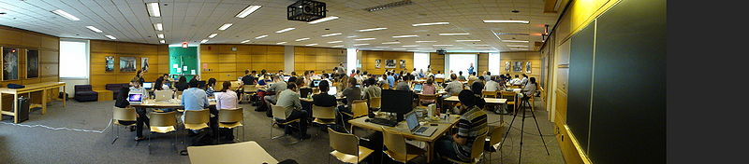
Dissemination Update
16th Project Week: Salt Lake City, Utah, January 2013 80 attendees: 17 academic institutions, 4 companies 54 Projects: TBI, Atrial Fibrillation, Slicer 4 Extensions, Huntington’s Disease, Head and Neck Cancer, Stroke, IGT, Radiation Therapy, Medical Robotics, Infrastructure Engineering
17th Project Week: MIT, Summer June 2013 104 attendees: 22 academic institutions, 13 companies 75 Projects: Huntington’s Disease, TBI, Atrial Fibrillation and Cardiac Image Analysis, Radiation Therapy, IGT and Device Integration with 3D Slicer, COPD, and Infrastructure Engineering
Tina Kapur, Ph.D., Co-PI Steve Pieper, Ph.D., Co-PI
National Alliance for Medical Image Computing
http://www.na-mic.org
© 2011 All Rights Reserved

Slide 2
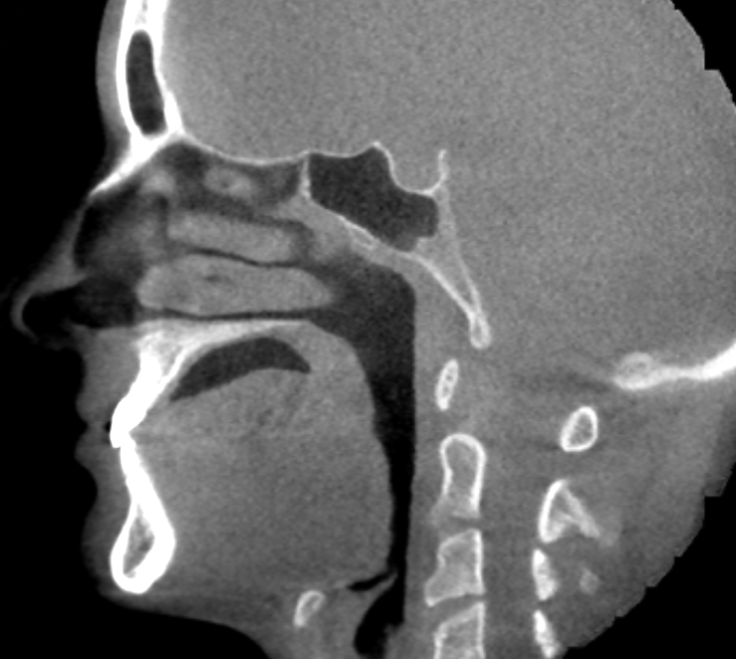
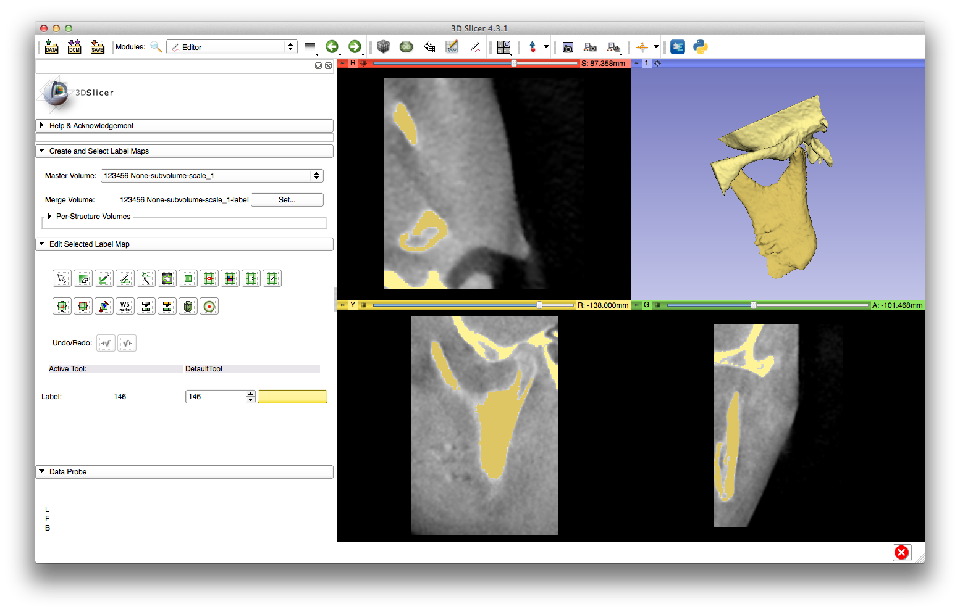
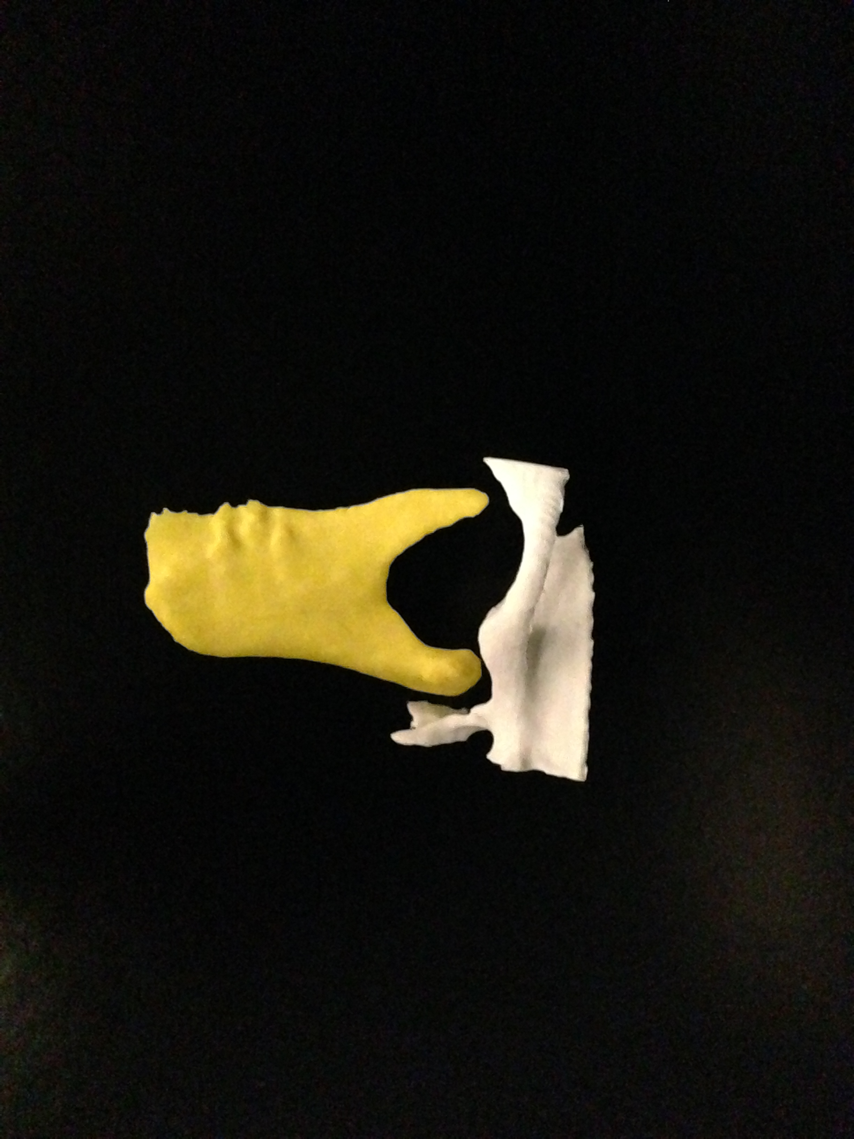
Tutorial: Preparing Data for 3D Printing
Cone Beam CT: Skull
3D Printed Models:
Temporal Bone and Mandible
Download Tutorial:
http://www.youtube.com/watch?v=MKLWzD0PiIc
Tutorial and Slide courtesy of Nabgha Farhat, Brigham and Women’s Hospital
Acknowledgements: P41EB015898, P41EB015902, U54EB005149

Slide 3
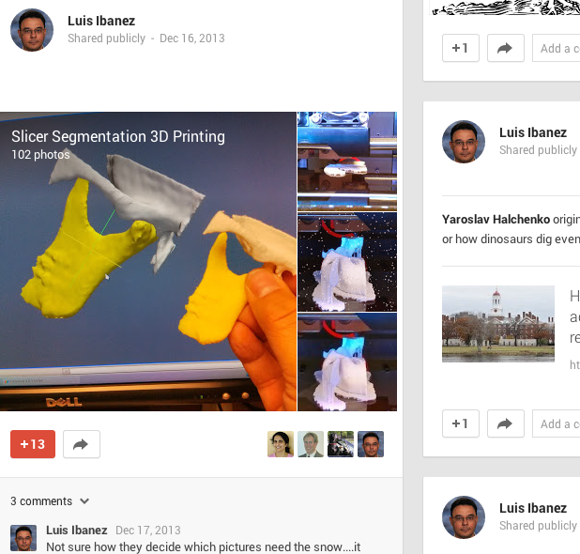
3D Printing Tutorial on Google Plus
Tutorial and Slide courtesy
Nabgha Farhat
Brigham and Women’s Hsp
P.S. 4 Luis

