Slide 1
SlicerRT extension for image-guided radiation therapy research
Csaba Pinter¹, Andras Lasso¹, An Wang², David Jaffray², and Gabor Fichtinger¹
¹Laboratory for Percutaneous Surgery, Queen’s University, Canada
²University Health Network, Toronto, ON, Canada

Slide 2
SparKit project overview
Goal: provide open-source platform for translational clinical research, mainly cancer
Funding by Cancer Care Ontario till 2016
PI & co-PI: Gabor Fichtinger (Queen’s), David Jaffray (Toronto UHN), Terry Peters (Robarts)
Themes:
  SlicerRT: radiotherapy toolkit for 3D Slicer
  SlicerIGT: Image-guided therapy with 3D Slicer

Slide 3
SlicerRT theme overview
Motivation:
  commercial treatment planning
  software: closed, expensive
  existing research tools
  (CERR, PLUNC,
  dicompyler, etc): limited
Goal:
  “hub” for RT data analysis
  and comparison
  Free, open-source, BSD
  license
Approach:
  leverage existing tools and
  parallel efforts
3D Slicer
RT import (DICOM)
Visualization (volumes, models, 2D/3D, etc.)
Processing (registration, segmentation, etc.)
Analysis
(error metrics, measurements, image fusion, etc.)
RT-specific analysis (dose comparison, DVH, …)
RT export (DICOM, Matlab, …)
Notes:
Use 3DSlicer as platform
DICOM-RT data import: mapping RT data structures to existing 3DSlicer data types
Utilize existing 3DSlicer features: registration, visualization, ...
Develop missing RT-specific functionalities: DVH analysis, ...
Export results to commercial treatment planning system or research software (Matlab, etc.)

Slide 4
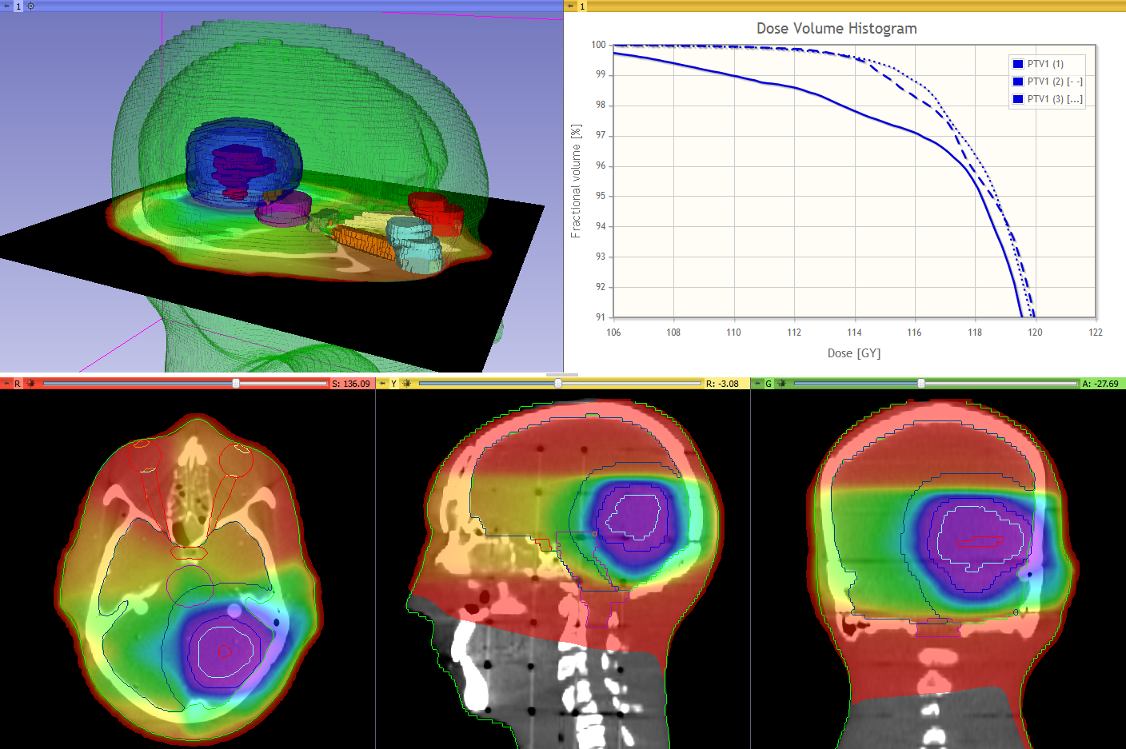
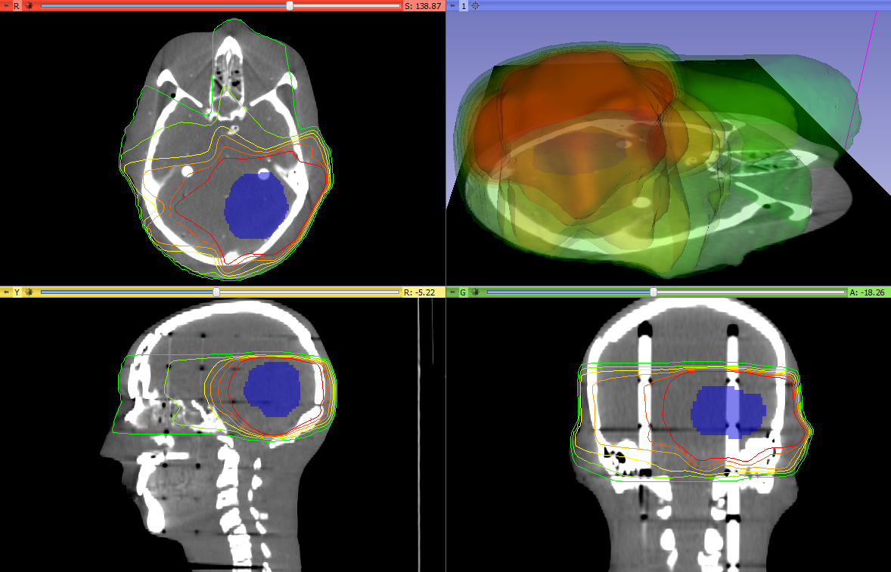
SlicerRT features overview
DICOM-RT import
Contours
Dose Volume Histogram
Dose Accumulation
Dose Comparison (gamma)
Isodose contours / surfaces
Plastimatch
  BSpline registration
  Landwarp registration
Experimental modules
  Contour Comparison
  Contour Morphology
  Proton Dose
  Matlab interface module

Slide 5
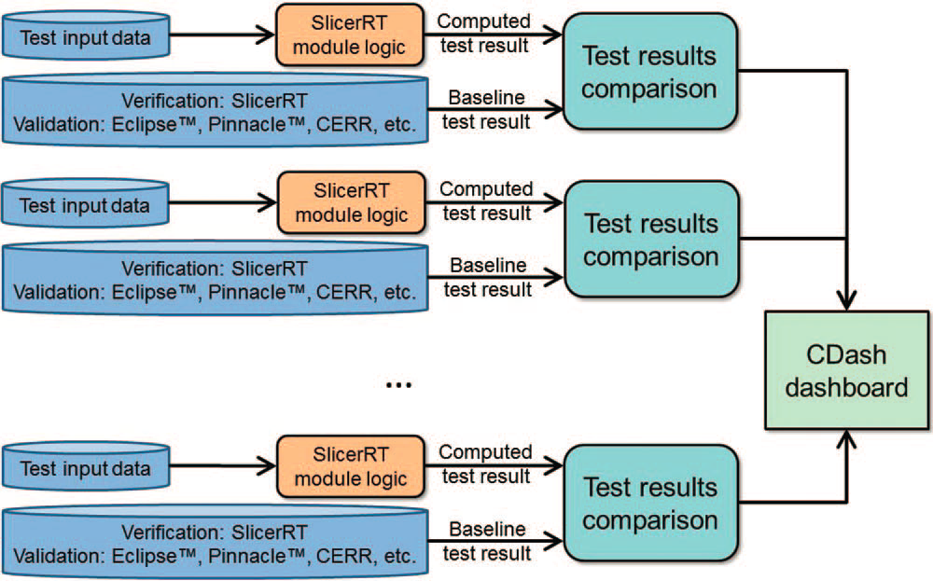
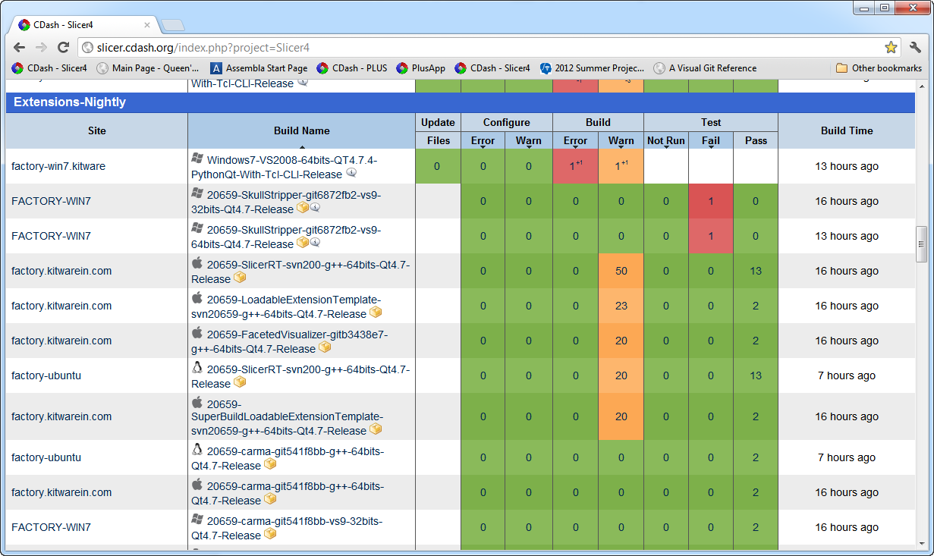
Verification and validation
Extensive automatic testing done on multiple platforms
Validated against other software packages (Pinnacle, CERR, …)
Automatic test infrastructure for automatic verification and validation
Test results reported to the web-based dashboard
http://slicer.cdash.org/index.php?project=Slicer4

Slide 6

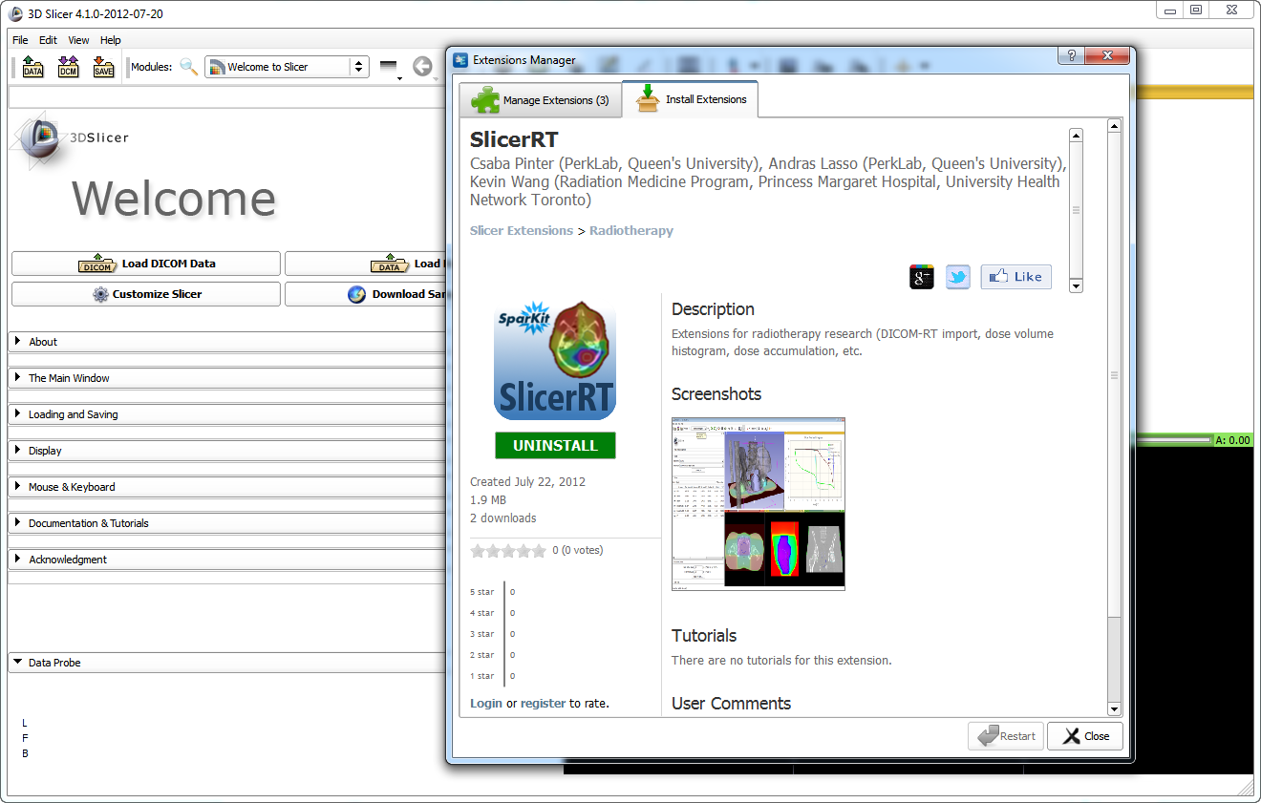
SlicerRT extension for 3D Slicer
Collection of RT-specific modules, includes
Distributed as a 3D Slicer extension: can be downloaded, installed, upgraded using the extension manager in Slicer
SlicerRT extension in the 3D Slicer app store (free)

Slide 7
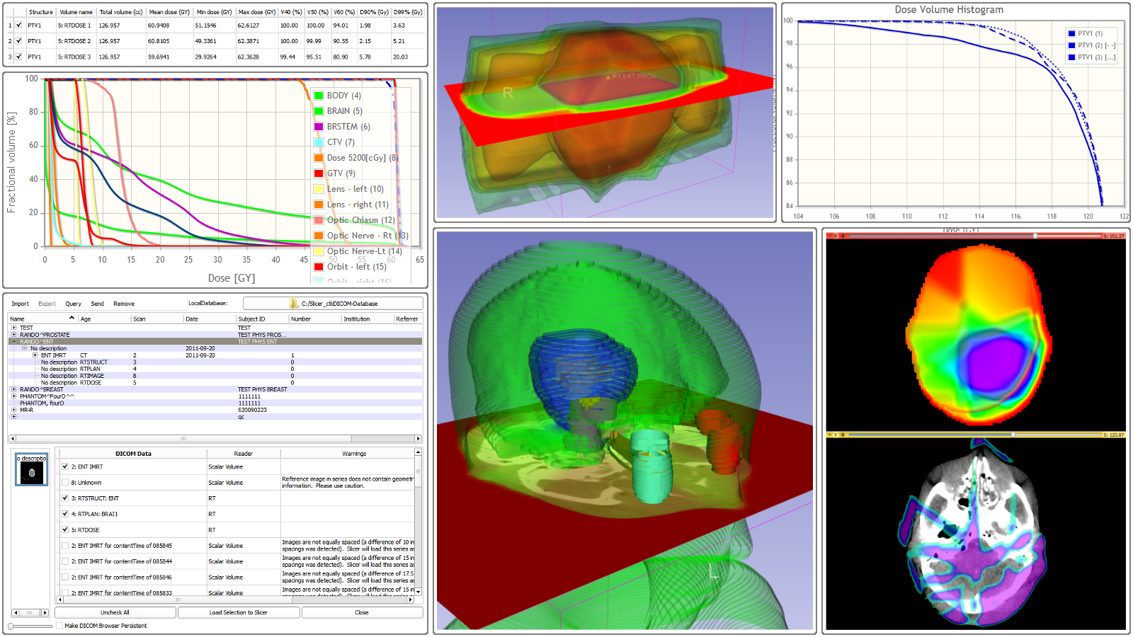
Thank you!
Overview paper: Csaba Pinter, Andras Lasso, An Wang, David Jaffray, and Gabor Fichtinger, “SlicerRT: Radiation therapy research toolkit for 3D Slicer”, Med. Phys. 39 (10), October 2012
Project homepage: https://www.assembla.com/spaces/slicerrt/
Contact: Andras Lasso (lasso@cs.queensu.ca)

