Slide 1
How To Integrate DTIPrep Into Diffusion-Weighted Image Pre-Processing
Joy T. Matsui
University of Iowa, Image Processing Lab
joy-matsui@uiowa.edu
NA-MIC Tutorial Contest: Summer 2011
© 2011, All Rights Reserved

Slide 2
Acknowledgements
National Alliance for Medical Image Computing
NIH U54EB005149
Members of the UNC Neuro Image and Research Analysis Laboratories
Zhexing Liu, Cheryl Dietrich, Joseph Blocher, Mahshid Farzinfar, Martin Styner
General Electric Global Research Center
Xiaodong Tao
Members of the University of Iowa Image Processing Lab
Hans Johnson, Mark Scully, Vince Magnotta
© 2011, All Rights Reserved

Slide 3
References
This tutorial is based on information from the following resources:
http://www.nitrc.org/docman/?group_id=283
http://www.nitrc.org/plugins/mwiki/index.php/dtiprep:MainPage
http://www.nitrc.org/plugins/mwiki/index.php/dtiprep:MainPage
http://www.slicer.org/slicerWiki/index.php/Modules:DicomToNRRD-3.6
© 2011, All Rights Reserved

Slide 4
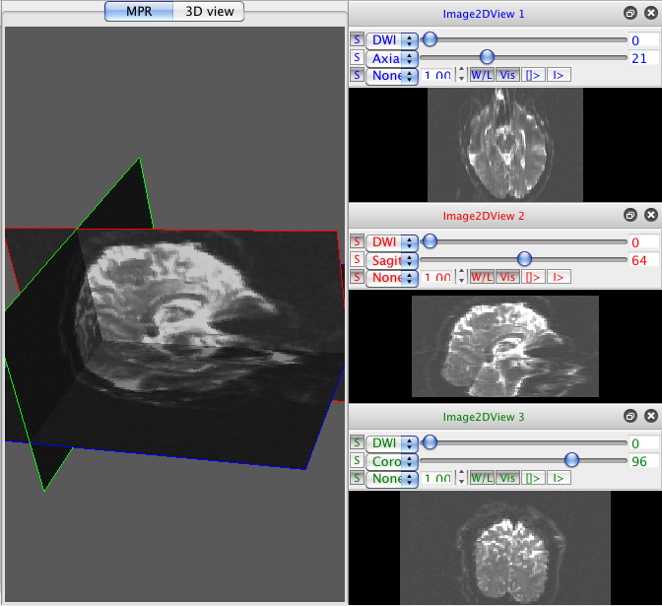
Learning Objective
The goal of this tutorial is to demonstrate how to apply DTIPrep to diffusion-weighted imaging (DWI) data as an automatic quality control (QC) step in a DWI data processing pipeline.
[picture to illustrate
the learning objective]
© 2011, All Rights Reserved

Slide 5
Pre-requisite tutorials
Data Loading & 3D Visualization tutorial
Author: Sonia Pujol, PhD
http://www.slicer.org/slicerWiki/images/2/2e/Slicer3_DataLoadingAndVisualization_UCSF2010_SoniaPujol.pdf
Diffusion Tensor Imaging tutorial
Author: Sonia Pujol, PhD
http://www.slicer.org/slicerWiki/images/3/35/DiffusionMRITutorial_UCSF2010_SoniaPujol.pdf
© 2011, All Rights Reserved

Slide 6
Material
This tutorial requires the installation of the Slicer 3.6, DTIPrep, and DicomToNrrdConverter, and the tutorial dataset. They are available at the following locations:
Slicer download page
http://www.slicer.org/pages/Downloads/
DicomToNrrdConverter and DTIPrephttp://www.nitrc.org/plugins/mwiki/index.php/dtiprep:DTIPrepCompilation
Tutorial dataset: DTIPrep_TutorialContestSummer2011.zip
[Add a link to the tutorial dataset]
© 2011, All Rights Reserved

Slide 7
Platforms
Mac Darwin
Linux 64
© 2011, All Rights Reserved

Slide 8
Overview of tutorial
Part 1: Using DicomToNrrdConverter to convert DWI DICOM files to NRRD file format
Part 2: Initial visual inspection of data
Part 3: Using the DTIPrep GUI for automatic quality control checking of DWI NRRD file
Part 4: Visual re-inspection of DTIPrep QC results
Part 5: Using DTIPrep as a command line tool
© 2011, All Rights Reserved

Slide 9
Overview of tutorial
Part 1: Using DicomToNrrdConverter to convert DWI DICOM files to NRRD file format
Part 2: Initial visual inspection of data
Part 3: Using the DTIPrep GUI for automatic quality control checking of DWI NRRD file
Part 4: Visual re-inspection of DTIPrep QC results
Part 5: Using DTIPrep as a command line tool
© 2011, All Rights Reserved

Slide 10
DicomToNrrdConverter
DicomToNrrdConverter is used here to create the input NRRD file for DTIPrep. It can be used in Slicer or as a command line tool.
Help can be derived at the command line by typing:
Complete documentation for DicomToNrrdConverter can be found here:
http://www.slicer.org/slicerWiki/index.php/Modules:DicomToNRRD-3.6
DicomToNrrdConverter --help
© 2011, All Rights Reserved

Slide 11
DicomToNrrdConverter
In general, use of the DicomToNrrdConverter command line tool is recommended since it has options for trouble-shooting problematic DICOM files. The command line tool will be demonstrated in this tutorial.
© 2011, All Rights Reserved

Slide 12
DicomToNrrdConverter
Change into the DTIPrep_TutorialContestSummer2011 directory:
Type the following command to convert the DICOM directory to a NRRD file:
cd DTIPrep_TutorialContestSummer2011
DicomToNrrdConverter --inputDicomDirectory DICOM --outputVolume DTIPrepInput.nhdr
© 2011, All Rights Reserved

Slide 13
DicomToNrrdConverter
DicomToNrrdConverter will output the following information about your scan to the terminal:
Scanner vendor (Siemens, Philips, GE)
Mosaic or non-mosaic format
Order of DICOM images (slice or volume interleaving)
Measurement frame
Voxel spacing
Space directions
Number of 3D volumes and slices per volume
© 2011, All Rights Reserved

Slide 14
DicomToNrrdConverter
DicomToNrrdConverter will detect baseline images and check if the magnitude of each non-baseline gradient direction coordinate vector is appropriate for its b value.
Baseline image terminal output
Non-baseline image terminal output with b value of 1000
© 2011, All Rights Reserved

Slide 15
Overview of tutorial
Part 1: Using DicomToNrrdConverter to convert DWI DICOM files to NRRD file format
Part 2: Initial visual inspection of data
Part 3: Using the DTIPrep GUI for automatic quality control checking of DWI NRRD file
Part 4: Visual re-inspection of DTIPrep QC results
Part 5: Using DTIPrep as a command line tool
© 2011, All Rights Reserved

Slide 16
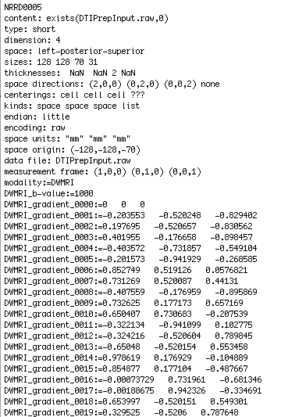
Visual inspection
The first step in inspecting DicomToNrrdConverter outputs (DTIPrepInput.nhdr and DTIPrepInput.raw.gz in this case) is to look at the NRRD header file. Check the following features for accuracy:
Image size
Slice thickness
b value(s)
Number of baseline images
Gradient direction vector coordinates
© 2011, All Rights Reserved

Slide 17
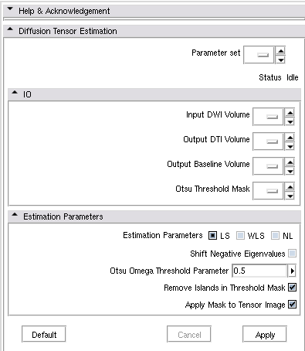
Visual inspection
The next step in inspecting DicomToNrrdConverter outputs is a superficial check of gradient direction orientations via the tensor image.
Load DTIPrepInput.nhdr into Slicer. Use the Diffusion Tensor Estimation module with thefollowing parameters:
Input DWI Volume: DTIPrepInput.nhdr
Output DTI Volume: Create New DiffusionTensorVolume
Output Baseline Volume: Create New Volume
Otsu Threshold Mask: Create New Volume
Estimation Parameters: defaults
© 2011, All Rights Reserved

Slide 18
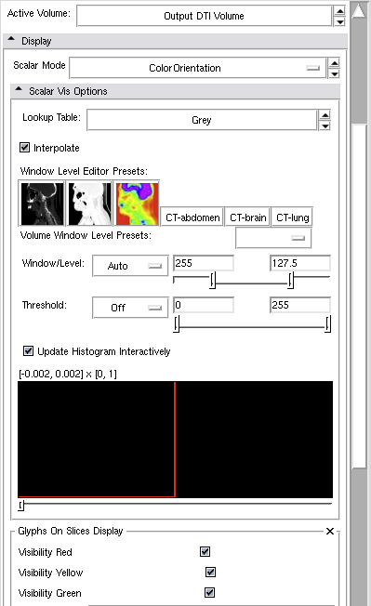
Visual inspection
Once the Diffusion Tensor Estimation module is finished running, change the Volumes module to display the Output DTI Volume as the Active Volume.
Use the following settings:
Scalar Mode: ColorOrientation
Glyphs On Slices Display: check all boxes (Visibility Red, Visibility Yellow, Visibility Green)
© 2011, All Rights Reserved

Slide 19
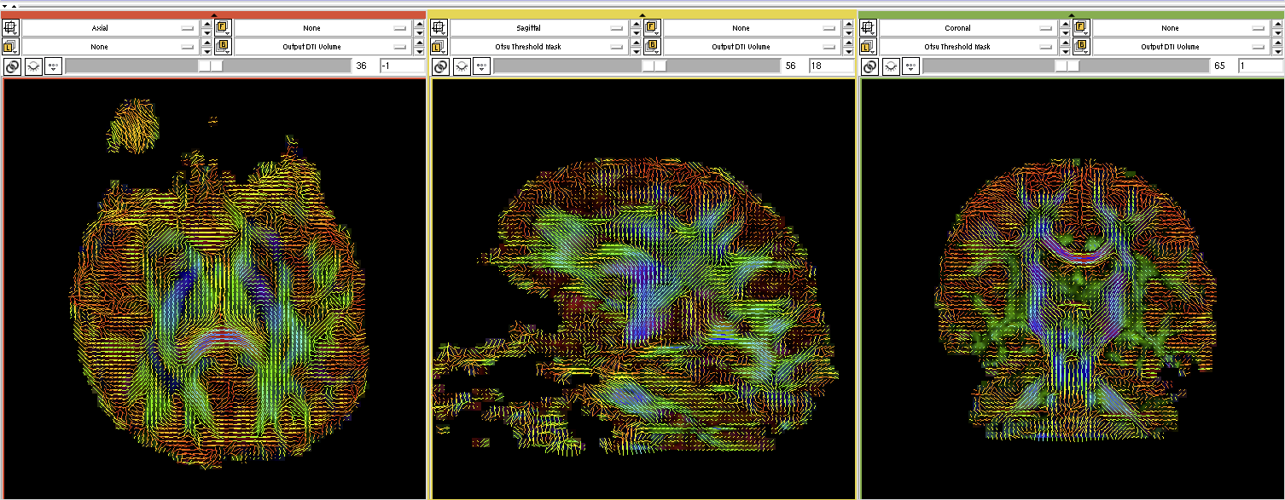
Visual inspection
Change viewer bars to display only the Output DTI Volume with the color glyphs.
The glyph orientation will reflect the general direction of diffusion at that voxel. To provide a reference point: notice how the corpus callosum contains a large number of blue left-to-right glyphs. We recommend using this maximum eigenvalue view to get a general feel if the diffusion gradient direction coordinates in the NRRD file are correct.
© 2011, All Rights Reserved

Slide 20
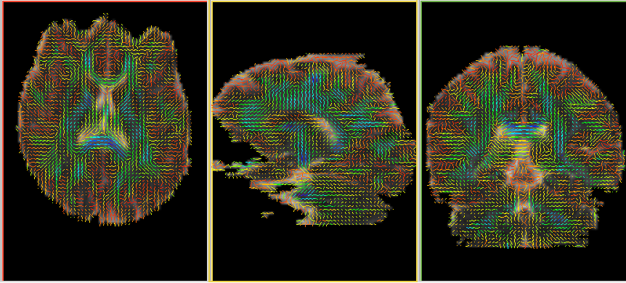
Visual inspection
In the event your diffusion gradient direction coordinates are not accurate, the glyph orientations are generally counterintuitive. Here is an example of a blatantly bad data set, where the green glyphs are oriented perpendicular what they should be. Incorrect diffusion gradient directions in the DICOM element tags are often the cause of this problem.
© 2011, All Rights Reserved

Slide 21
Visual inspection
Some of the following visual inspection steps can also be done in Slicer. They will instead be done here in the DTIPrep GUI to highlight all of DTIPrep’s features.
Full documentation for DTIPrep can be found here:
http://www.nitrc.org/plugins/mwiki/index.php/dtiprep:MainPage
© 2011, All Rights Reserved

Slide 22
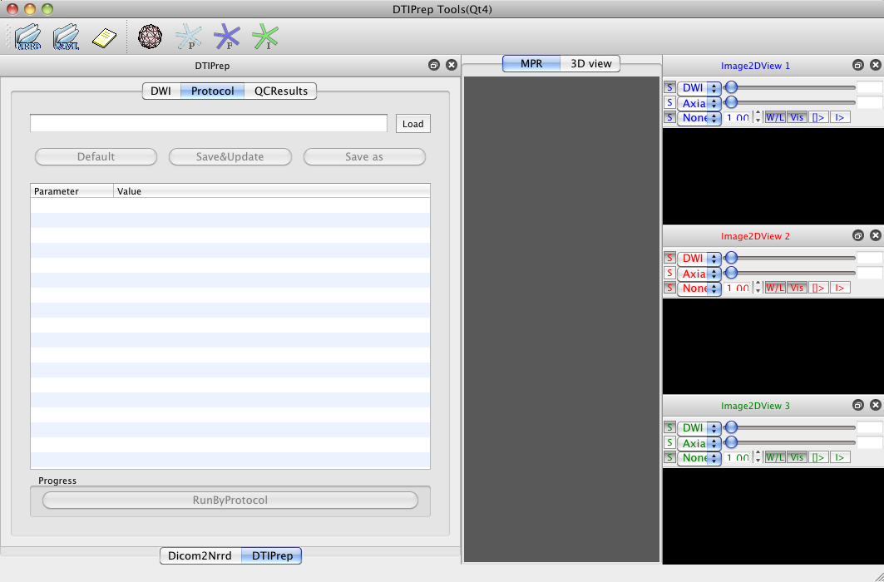
Visual inspection
Launch the DTIPrep GUI with the following command:
DTIPrep
© 2011, All Rights Reserved

Slide 23
Visual inspection
Load a NRRD file by clicking the NRRD icon in the top left corner.
Select DTIPrepInput.nhdr to load the DWI image in the axial, coronal, and sagittal views. Click the MPR tab to turn it blue and bring all views into the main window.
© 2011, All Rights Reserved

Slide 24
Visual inspection
The following are clicks/keys that manipulate the DWI image in the main window view:
Roll mouse scroll wheel forward/backwards over images to increase/decrease their sizes
Click mouse, hold click and drag mouse forward/backwards over images to darken/brighten window level
Click mouse, hold click and drag mouse left/right over images to change contrast
r - bring 3D view back to center
f - zoom in on 3D view
w - remove views from 3D view
s - bring back views in 3D view
© 2011, All Rights Reserved

Slide 25
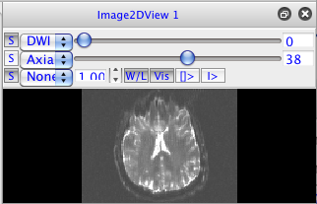
Visual inspection
Use the scrolling circles on each view to scroll through DWI volumes (top scroller) and 3D volume slices (bottom scroller).
© 2011, All Rights Reserved
Notes:
Add image with image in GUI

Slide 26
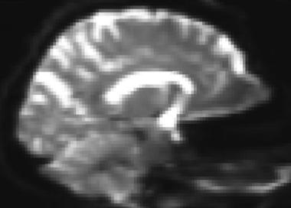
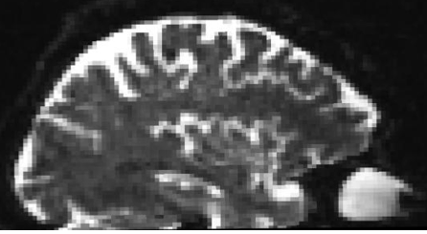
Visual inspection
Inspect degree of brain coverage. Here are examples of good and bad coverage. Degree of coverage will determine the types of analyses that can be done on the data (i.e. full coverage is necessary for atlas building).
Good coverage
Bad coverage
© 2011, All Rights Reserved

Slide 27
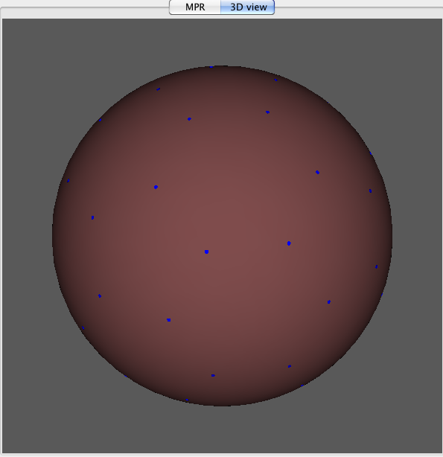
Visual inspection
Inspect the distribution of diffusion directions sampled in the DWI scan to be sure they are homogeneous. Click on the 3D view tab, followed by the sphere and F (blue star) icons.
A sphere with dots (that represent the unit vectors of each diffusion gradient direction projected onto a unit sphere) will appear in the 3D View.
© 2011, All Rights Reserved

Slide 28
Overview of tutorial
Part 1: Using DicomToNrrdConverter to convert DWI DICOM files to NRRD file format
Part 2: Initial visual inspection of data
Part 3: Using the DTIPrep GUI for automatic quality control checking of DWI NRRD file
Part 4: Visual re-inspection of DTIPrep QC results
Part 5: Using DTIPrep as a command line tool
© 2011, All Rights Reserved

Slide 29
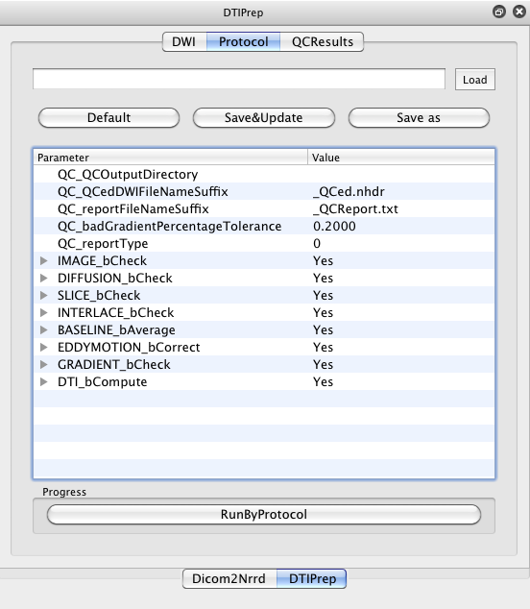
DTIPrep: GUI
Since this is the first time DTIPrepInput.nhdr is being loaded into DTIPrep, a new data acquisition protocol (automatic QC checking parameters) must be defined.
Click the Protocol tab.
Click the Default button to bring up the default automatic QC checking parameters.
© 2011, All Rights Reserved

Slide 30
DTIPrep: GUI
Note: The checking parameters used in this tutorial will be the DTIPrep default settings. These default settings were originally designed for neonatal DWI data. It is possible to change the checking parameters by double clicking on the list elements. A complete description of all checking parameters can be found here:
http://www.nitrc.org/plugins/mwiki/index.php/dtiprep:DTIPrepQCConfigurations
© 2011, All Rights Reserved

Slide 31
DTIPrep: GUI
Since we want to see how many gradients will be excluded in this scan, double click 0.2000 next to QC_badGradientPercentageTolerance and change it to 0.5000.
Click the Save as button to bring up the dialog box to save the automatic QC checking parameters to an xml file as “Protocol.xml.”
© 2011, All Rights Reserved

Slide 32
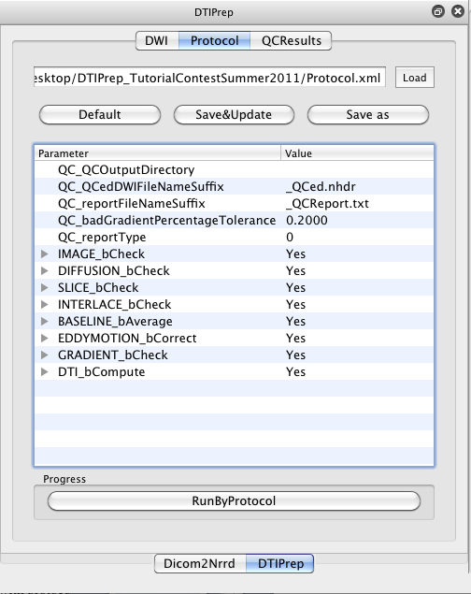
DTIPrep: GUI
The GUI is now ready to begin automatic QC checking. Click RunByProtocol to begin checking.
© 2011, All Rights Reserved

Slide 33
DTIPrep: GUI
DTIPrep will output its status to the terminal. DTIPrep will proceed through 7 main steps that will PASS or FAIL:
Image information check
Diffusion information check
Slice-wise checking
Interlace-wise checking
Baseline averaging
Eddy-current and head motion artifacts correcting
Gradient-wise checking
© 2011, All Rights Reserved

Slide 34
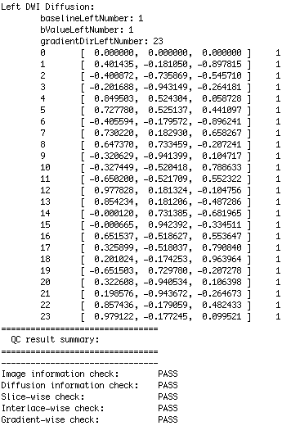
DTIPrep: GUI
When DTIPrep finishes running, it will display a summary report in the terminal listing the checking steps that passed and/or failed.
© 2011, All Rights Reserved

Slide 35
DTIPrep: GUI
The results of the automatic QC checking are now ready for viewing. Click on the QCResults tab to display the results table.
The QCResults will list which gradients failed QC and at what step. Gradients that passed QC are also listed, along with their alterations (i.e. coregistration to baseline)
© 2011, All Rights Reserved

Slide 36
DTIPrep: GUI
One of the gradients removed from the sample data set was Gradient #2 by the Slicewise checking step. That is indicated in the GUI report on the left and the image that was excluded can be inspected on the right. In this case, slices 14 through 20 in gradient 2 did not pass QC and were thus excluded.
© 2011, All Rights Reserved

Slide 37
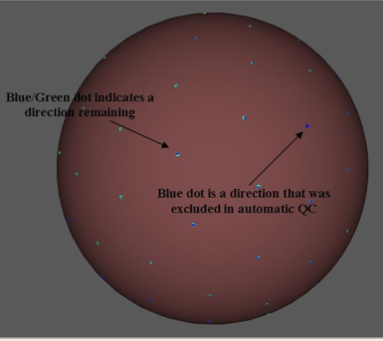
DTIPrep: GUI
Switch to 3D View to view how the gradient direction projections on a unit sphere changed. Click the sphere, F, and I icons.
The F (blue) represents gradients before QC and I (green) represents gradients left after QC. Note any unevenness in spatial distribution.
© 2011, All Rights Reserved

Slide 38
DTIPrep: GUI
The QCResults obtained in the GUI are outputted to an xml file:
DTIPrepInput.nhdr_XMLQCResult.xml
DTIPrep also outputs a new NRRD file that only contains gradients that passed QC and a text file report describing the actions DTIPrep took during the QC process:
DTIPrepInput_QCed.nhdr
DTIPrepInput_QCed.raw.gz
DTIPrepInput_QCReport.txt
© 2011, All Rights Reserved

Slide 39
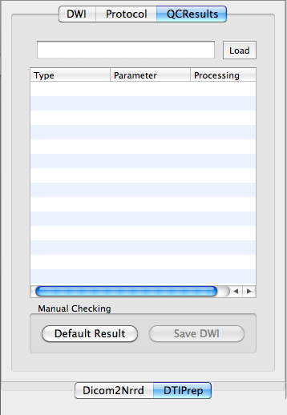
DTIPrep: GUI
The QCResults.xml file (DTIPrepInput.nhdr_XMLQCResult.xml) can be reloaded into the GUI re-review via one of two ways:
Click the yellow icon in the upper left corner and choose the QCResult.xml file
Click the QCResults tab, followed by the Load icon to bring up a dialog box to select the QCResult.xml file
© 2011, All Rights Reserved

Slide 40
Overview of tutorial
Part 1: Using DicomToNrrdConverter to convert DWI DICOM files to NRRD file format
Part 2: Initial visual inspection of data
Part 3: Using the DTIPrep GUI for automatic quality control checking of DWI NRRD file
Part 4: Visual re-inspection of DTIPrep QC results
Part 5: Using DTIPrep as a command line tool
© 2011, All Rights Reserved

Slide 41
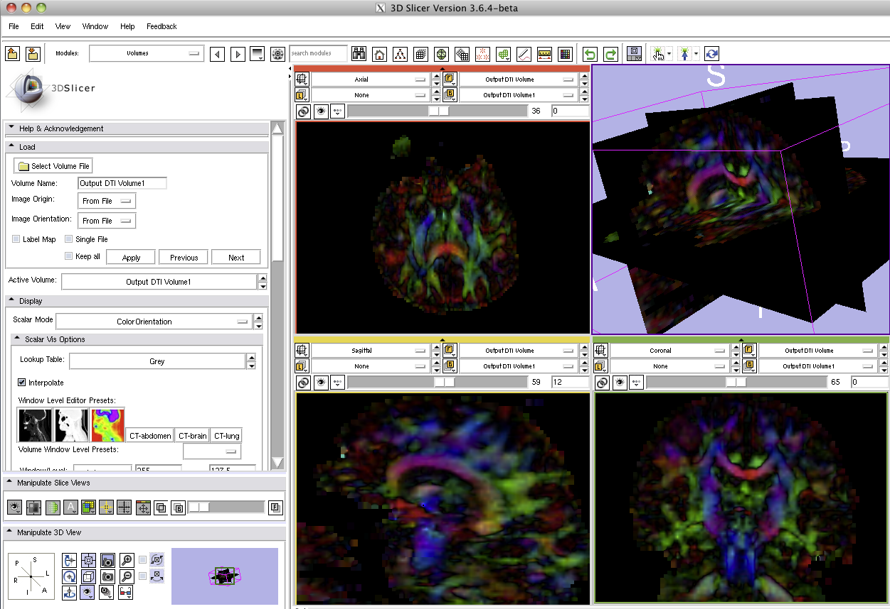
Visual re-inspection
Load both DTIPrepInput.nhdr and DTIPrepInput_QCed.nhdr files into Slicer. Compute tensor images for each image and set the Scalar Mode to ColorOrientation for both in the Volumes module. Compare color orientation maps derived from NRRD files before and after using DTIPrep.
© 2011, All Rights Reserved

Slide 42
Visual re-inspection
One can note the difference in color orientation maps before and after processing with DTIPrep.
Before DTIPrep
After DTIPrep
© 2011, All Rights Reserved

Slide 43
Overview of tutorial
Part 1: Using DicomToNrrdConverter to convert DWI DICOM files to NRRD file format
Part 2: Initial visual inspection of data
Part 3: Using the DTIPrep GUI for automatic quality control checking of DWI NRRD file
Part 4: Visual re-inspection of DTIPrep QC results
Part 5: Using DTIPrep as a command line tool
© 2011, All Rights Reserved

Slide 44
DTIPrep: Command line
Running DTIPrep from the command line(validating against a previously created data acquisition protocol file)
Running DTIPrep from the command line (generate a new data acquisition protocol file based on input NRRD file)
Running DTIPrep from the command line (generate a new data acquisition protocol file from the input NRRD file AND begin validation)
DTIPrep --DWINrrdFile < DWIFileName > --xmlProtocol < xmlFileName > --check --outputFolder < OutputFolder >
DTIPrep --DWINrrdFile < DWIFileName > --xmlProtocol < xmlFileName > --default --outputFolder < OutputFolder >
DTIPrep --DWINrrdFile < DWIFileName > --xmlProtocol < xmlFileName > --default --outputFolder < OutputFolder >

Slide 45
Conclusion
DTIPrep can be a useful tool for automated quality control of diffusion-weighted images.

Slide 46
Acknowledgements
National Alliance for Medical Image Computing
NIH U54EB005149
Members of the UNC Neuro Image and Research Analysis Laboratories
Zhexing Liu, Cheryl Dietrich, Joseph Blocher, Mahshid Farzinfar, Martin Styner
General Electric Global Research Center
Xiaodong Tao
Members of the University of Iowa Image Processing Lab
Hans Johnson, Mark Scully, Vince Magnotta
© 2011, All Rights Reserved

