Slide 1
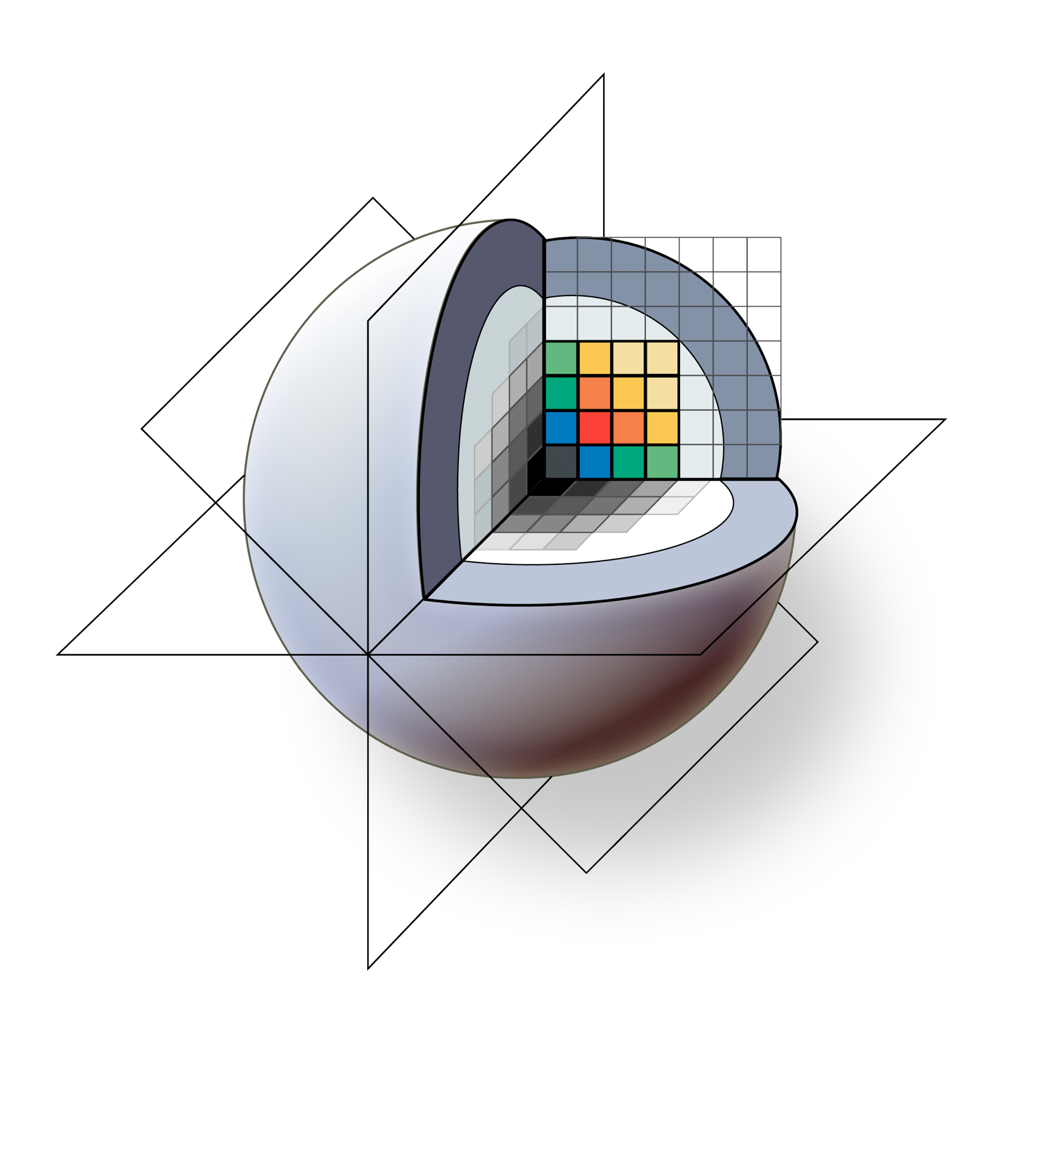
3D Slicer: A Free, Open Source and Extensible Platform For Medical Image Analysis and Visualization
Sonia Pujol, Ph.D., Steve Pieper, Ph.D., Andriy Fedorov, Ph.D., Ron Kikinis, M.D.
Surgical Planing Laboratory, Brigham and Women’s Hospital
Harvard Medical School

Slide 2
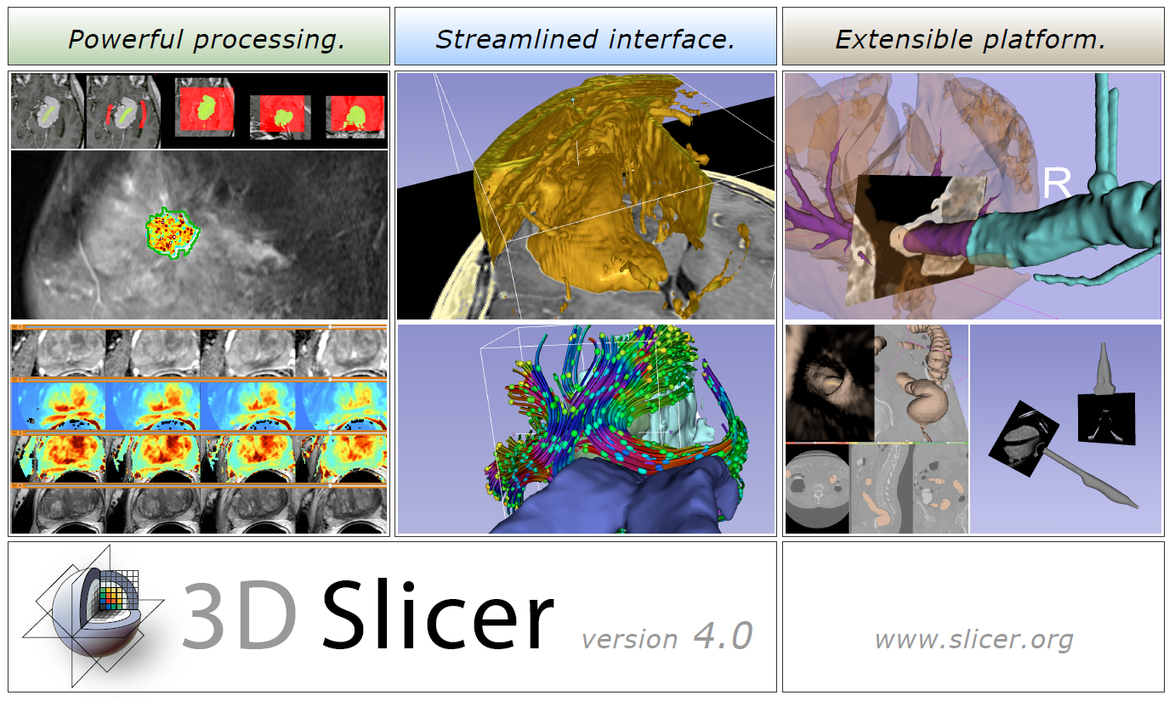
3D Slicer: An overview
3D Slicer is a multi-platform, free and open source software package for visualization and medical image computing.
www.slicer.org
Notes:
(Content slide)

Slide 3
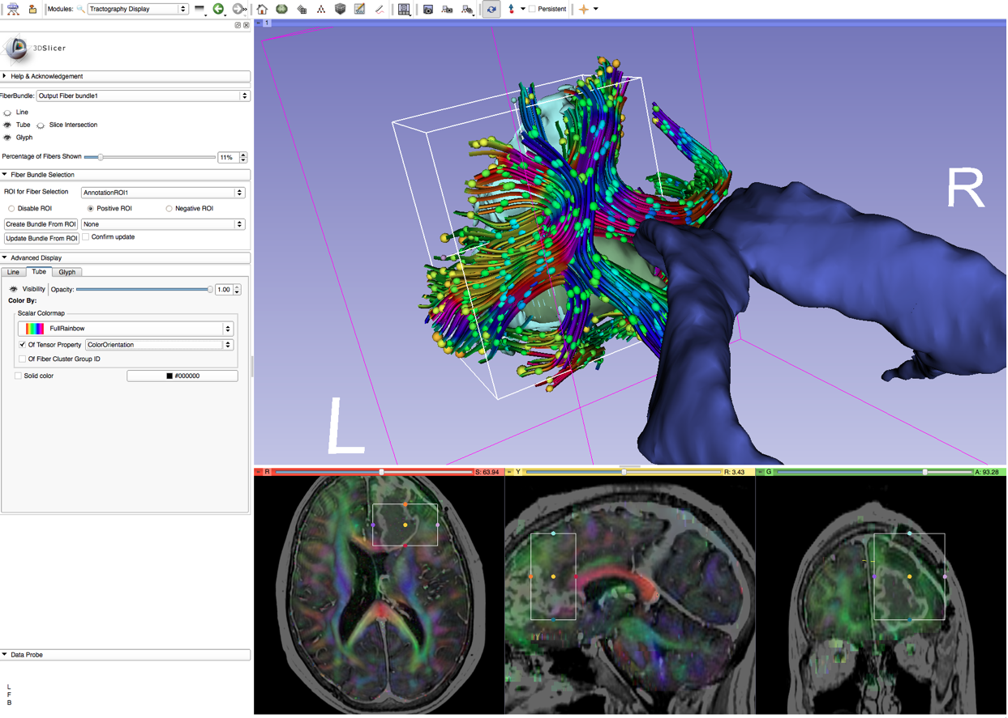
3D Slicer: An overview
The software platform is community created for the purpose of subject specific medical image analysis and visualization. Slicer includes support for:
Multi-modality imaging including, MRI, CT, US, nuclear medicine, and microscopy
Multi-organ from head to toe
Bidirectional interface for devices and scanners
Expandable and interfaced to multiple toolkits
Using an ROI to crop streamlines from a whole brain tractography. The streamlines display color by orientation, the ellipsoids are displaying fractional anisotropy.

Slide 4
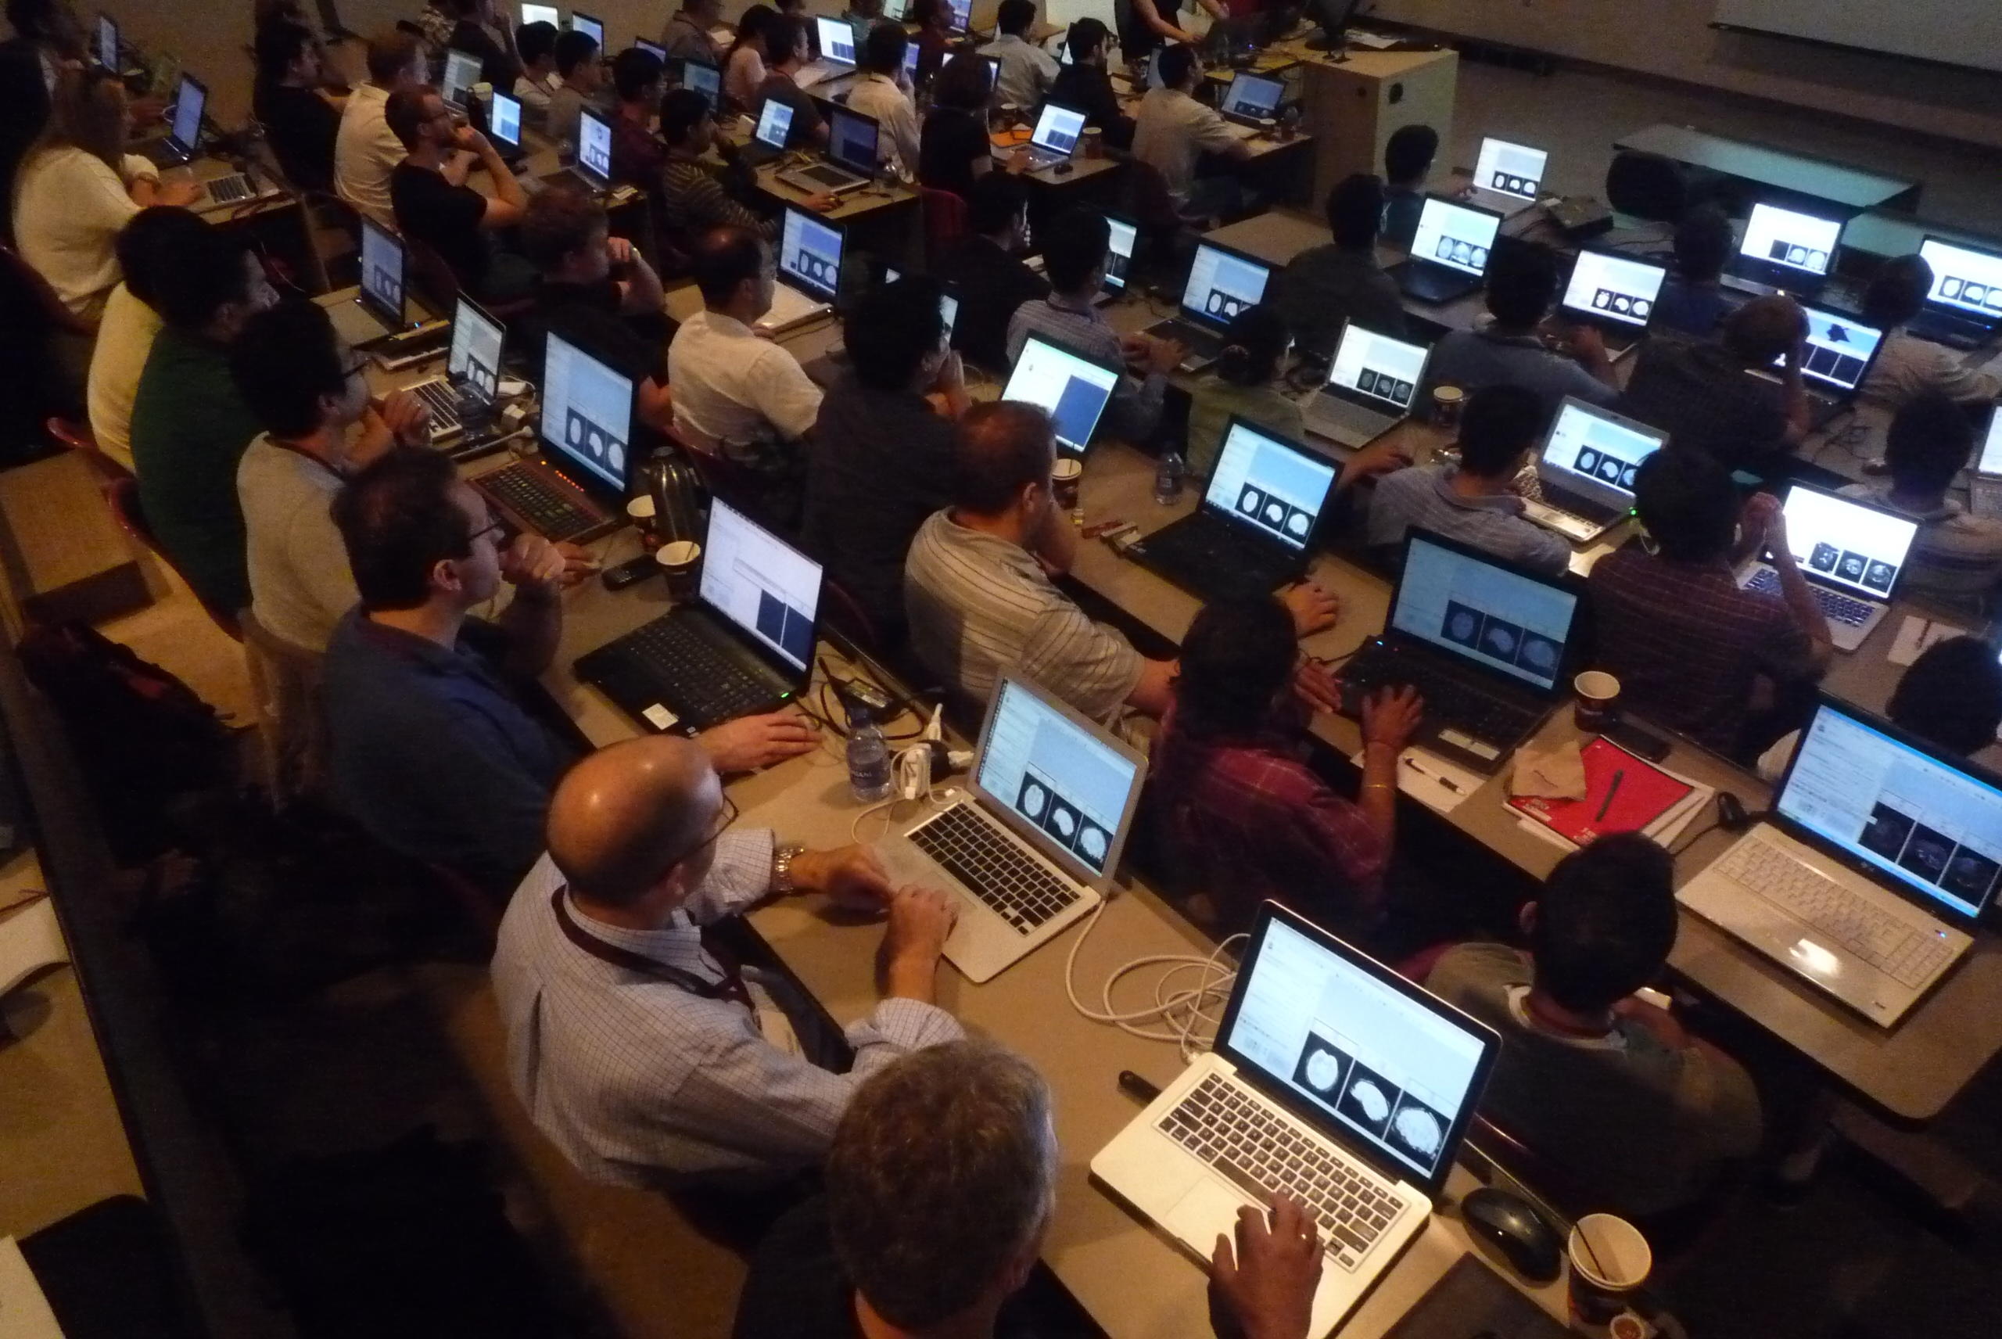
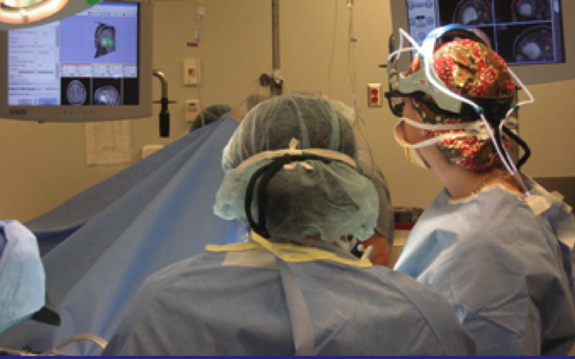
Translational research
An open-source environment for software developers
An end-user application for clinical investigators and scientists
3D Slicer: an open-source platform for
translating innovative algorithms into
clinical research applications

Slide 5

3D Slicer: An overview
Types of users:
Algorithm researchers (who work within 3DSlicer's development environment and with associated toolkits)
Biomedical engineers (who rely on 3DSlicer's interactive enironment and scripting capabilities)
Application scientists (who use 3DSlicer as a desktop application and turnkey system)
Core use scenarios:
Longitudinal and multi-channel dataset analysis
Individual and group analysis
Real-time control and tracking in the operating theater
Neurosurgical planning and guidance

Slide 6
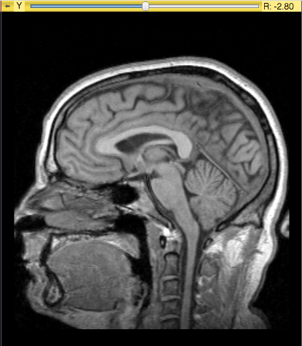


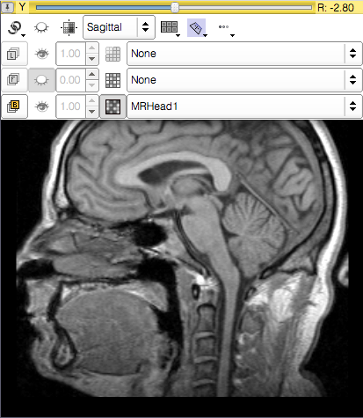


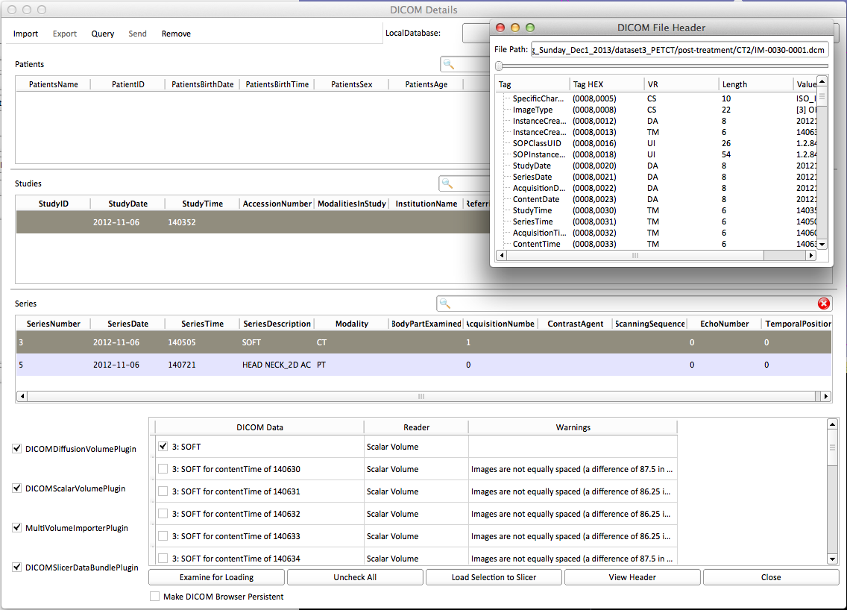
3D Slicer: What’s different in 4.3?
Qt-based GUI
Streamlined user- and developer-level interfaces
Improved DICOM support
64-bit support for all platforms

Slide 7




3D Slicer: What has not changed?
Free Open Source Software
  Free to use both in academic and commercial projects
NA-MIC Kit foundation tools and robust software development practices
Cross-platform portability: Win / Mac / Linux
Support of user and developer communities

Slide 8
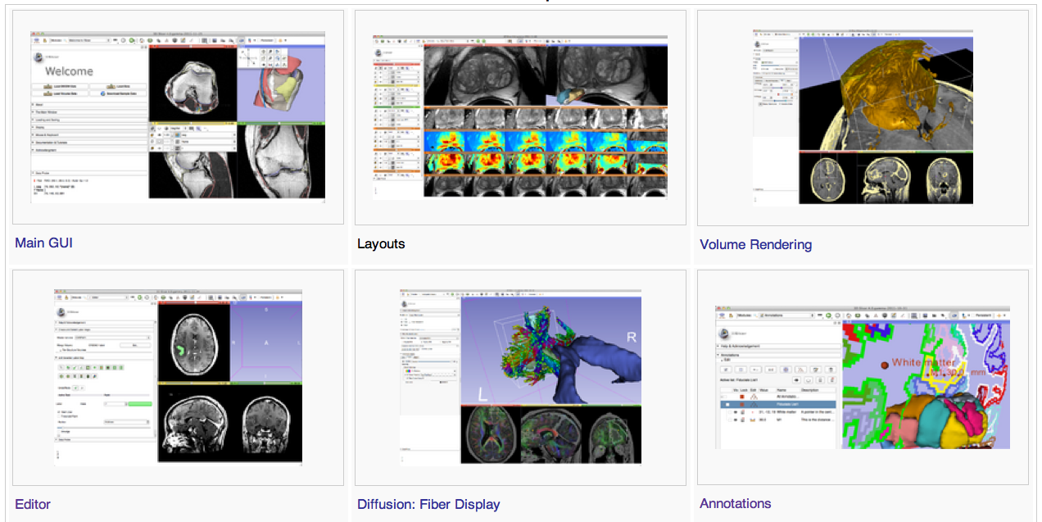
3D Slicer: Version 4 Highlights

Slide 9
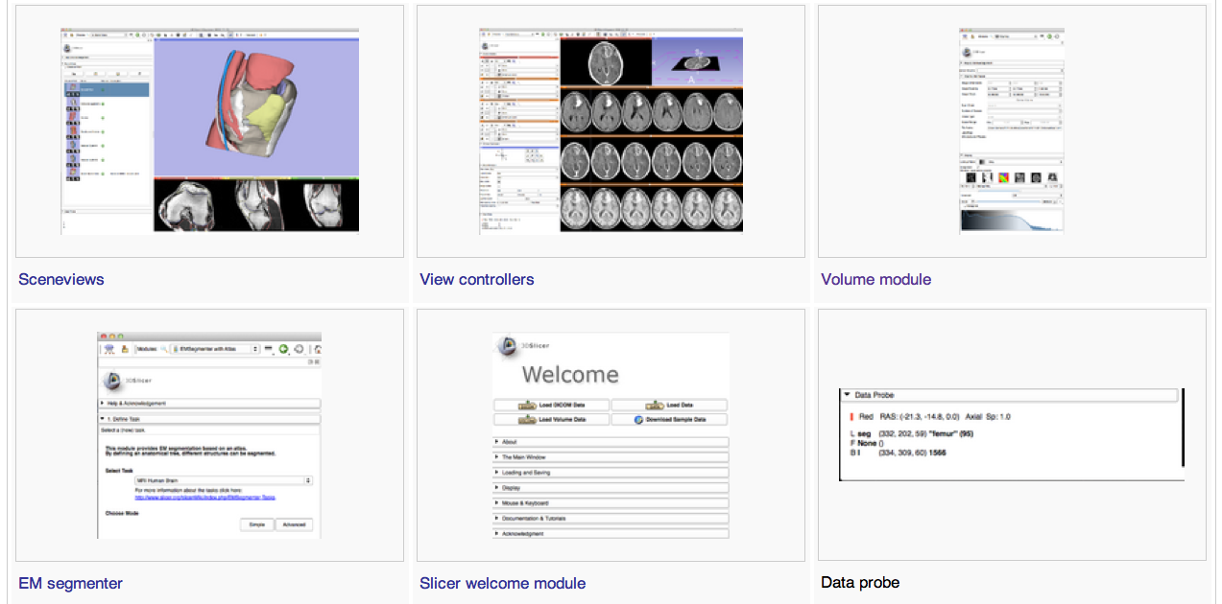
3D Slicer: Version 4 Highlights

Slide 10
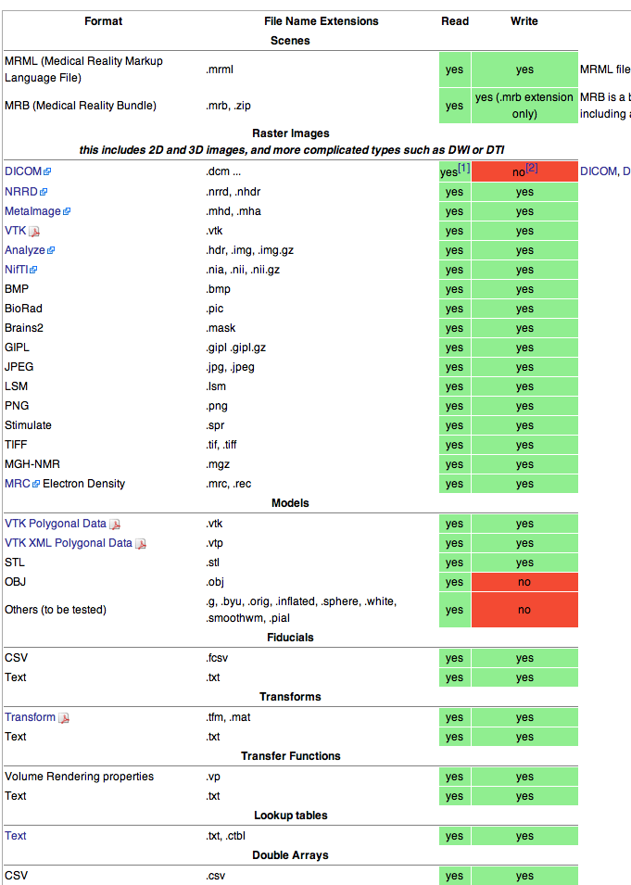
3D Slicer: File Formats
Slicer supports multiple images file formats including DICOM

Slide 11
3D Slicer: DICOM Networking

Slide 12
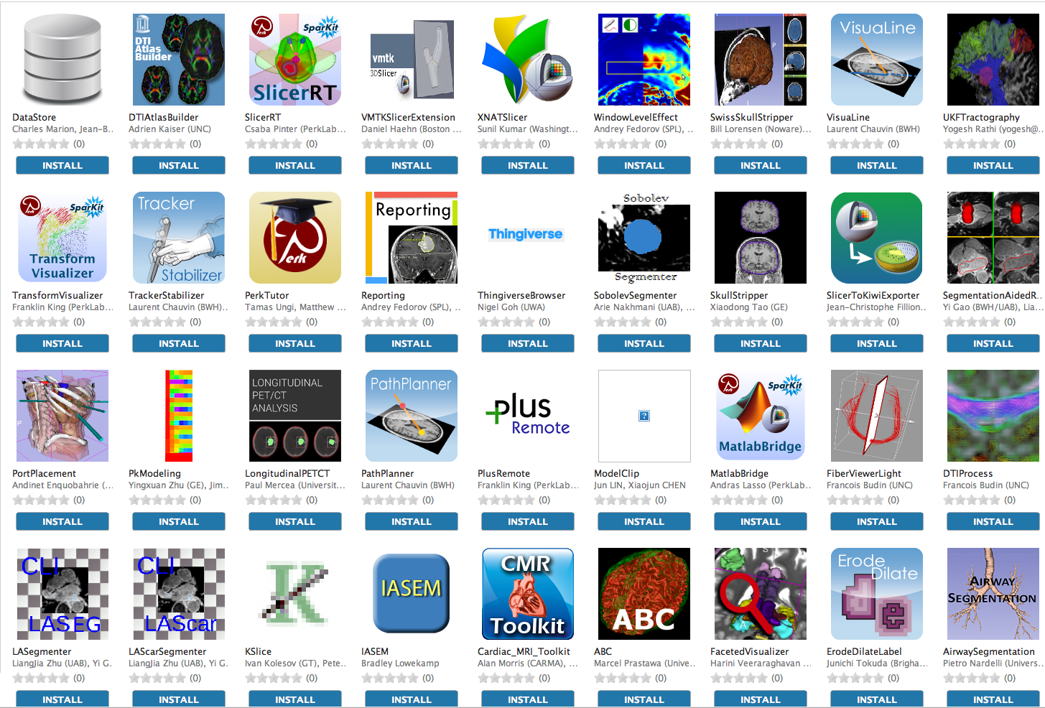
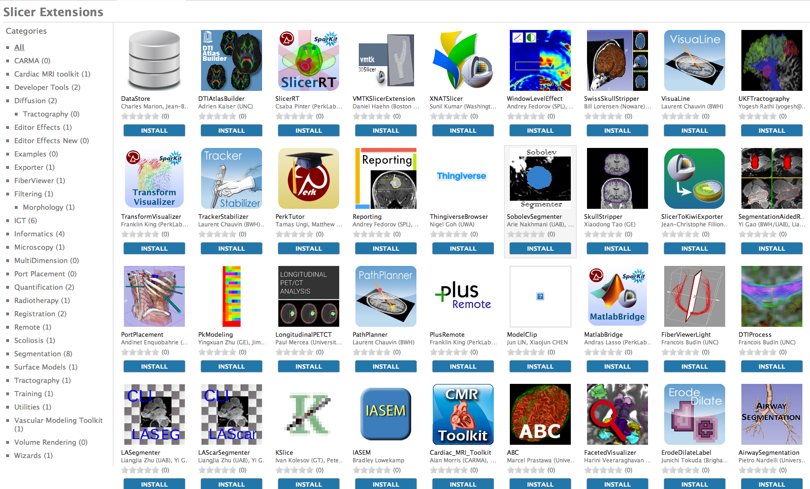
3D Slicer:Extension Manager
3D Slicer supports plug-ins called Slicer extensions available from the Extension Manager
Allows end-users to select extensions useful to them, without having to download the entire extension archive.
Built Nightly with Slicer

Slide 13
3D Slicer: What extensions afford...
Keep the base package “lean and mean”
Modules have individual identity
  Per-module web site, svn, downloads, mailing lists, wiki…
Users can customize their own subset of tools
Easy to download compatible extensions
  Analogous to Firefox extensions
  Integrate extension builds into developer/nightly/release processs
NITRC Supplement to NA-MIC providing additional infrastructure (Neuroimaging Informatics Tools and Resources Clearinghouse)
  NITRC can host neuroimaging projects (gforge implementation)

Slide 14
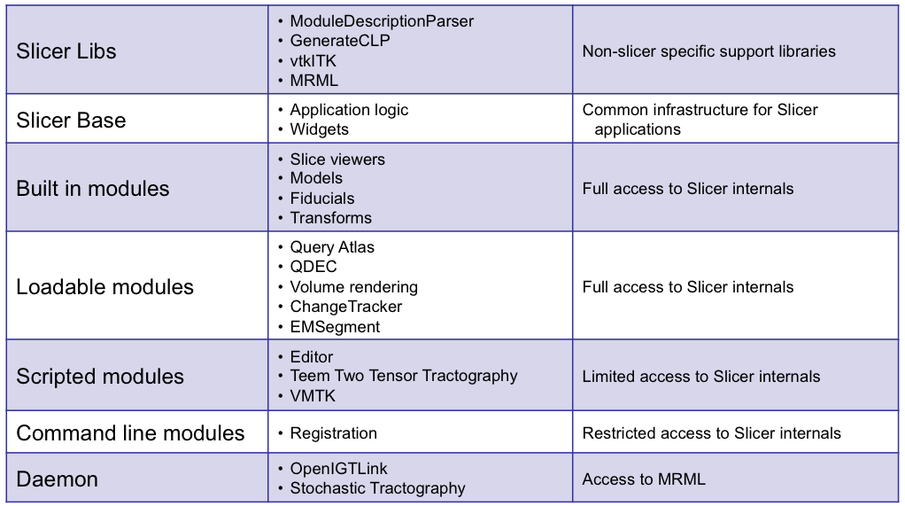
3D Slicer: Integration options

Slide 15
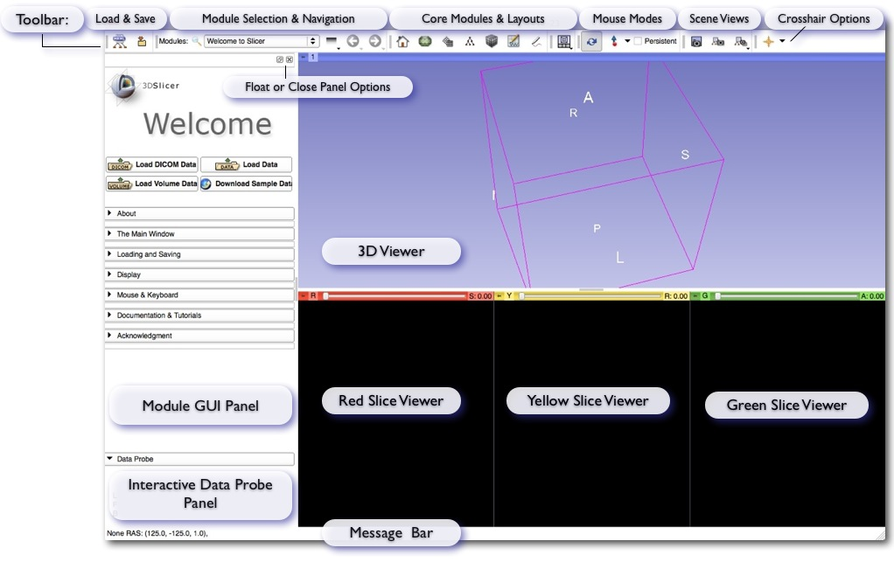
3D Slicer: Application Interface
User-centered design:
User guidance and feedback incorporated into design process where possible
Qt-based thin GUI layer
Presentation layer independent of application logic & state
Architecture supports scripting (Python) and command-line use

Slide 16
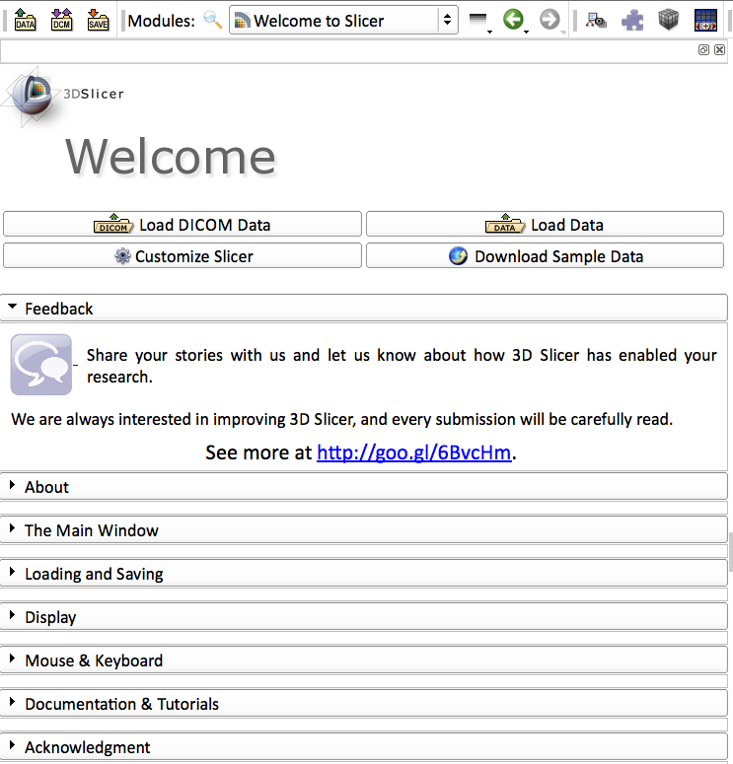
3D Slicer: Quick Start for New Users
Greetings and guidance from Slicer’s Welcome Module
Default start-up module for new users:
Brief friendly overview of the application interface
Describes core modules
Describes basic data loading and saving
Provides tips for adjusting data display
Describes how to change layouts
Points users to more detailed resources
and more...

Slide 17
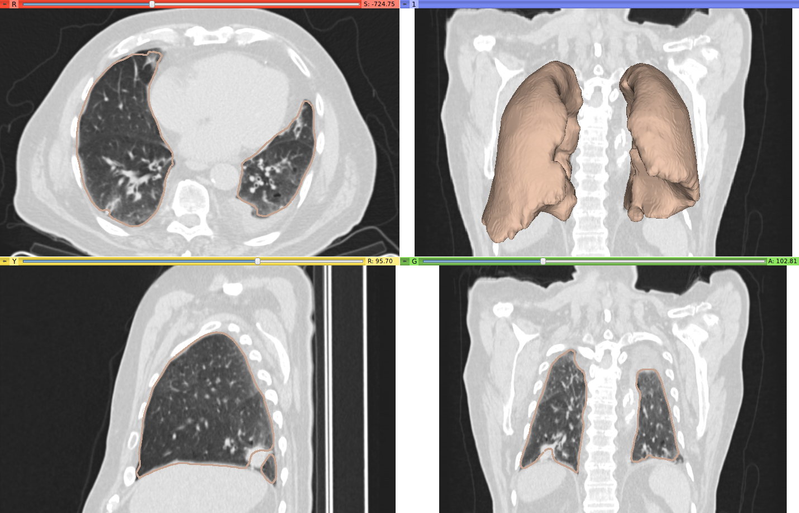
3D Slicer: Segmentation Tools
Segmentation is required for defining features of interest in imaging data for quantification and analysis.
3D Slicer has a variety of interactive and automated segmentation methods:
Editor Module for manual contouring and editing
region growing and level sets
graph cuts with gesture support
EM-segmentation
hierarchical brain segmentation for morphological studies

Slide 18
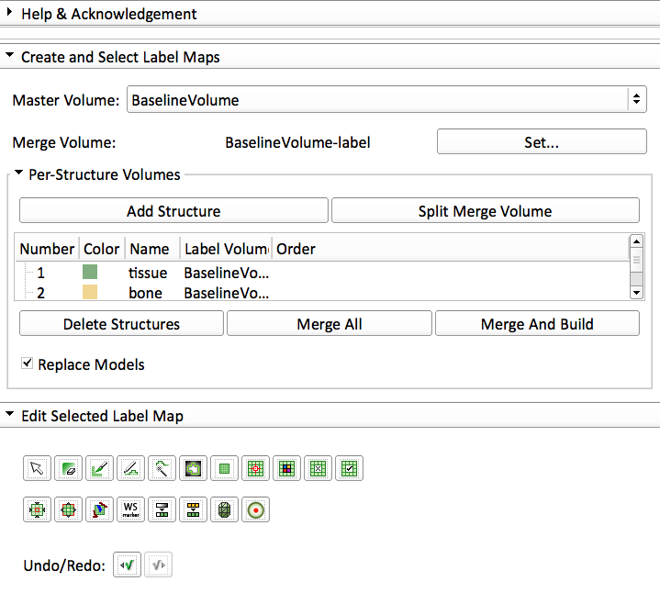







3D Slicer: Interactive Editor
Tools for manual segmentation & model building
Tools include:
  Paint
  Erase
  Draw
  Rectangle
  Level Tracing
  Change Label
  Identify Islands
  Remove Islands
  Save Island
  Identify Island
  Erode
  Dilate
  Model Maker
  Fast Marching
  GrowCutSegmentation
  WandEffect
  WatershedFromMarkerEffect Undo / Redo

Slide 19
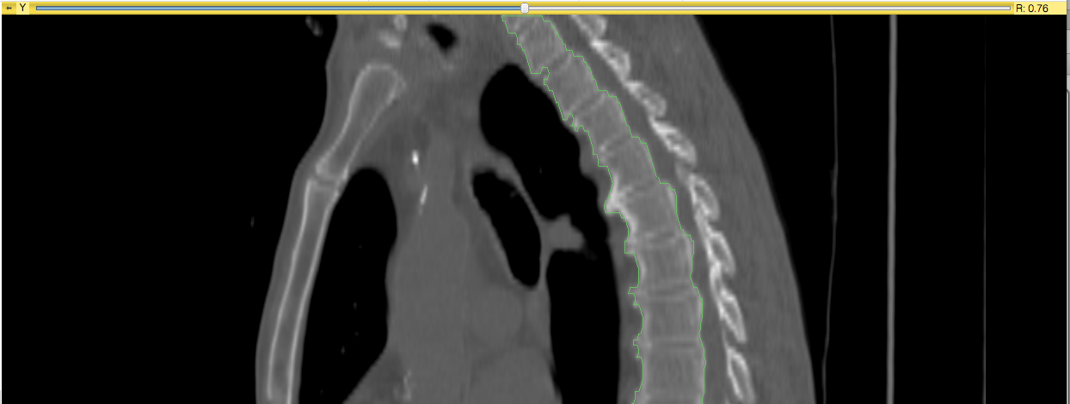
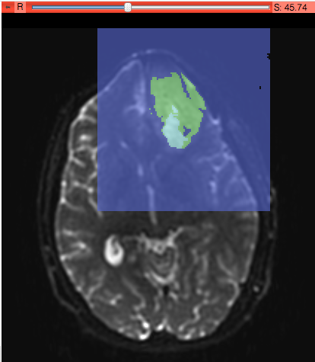
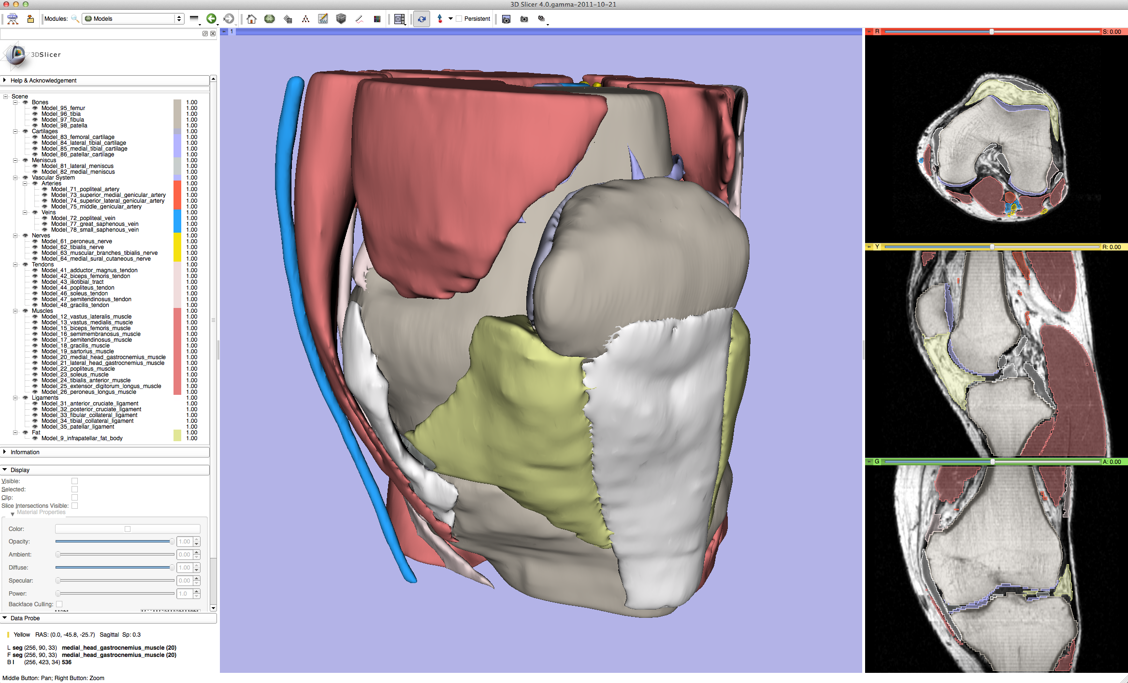
3D Slicer: Interactive Editor
Tools for manual and automated segmentation, 3D model building

Slide 20
3D Slicer: Registration Tools

Slide 21
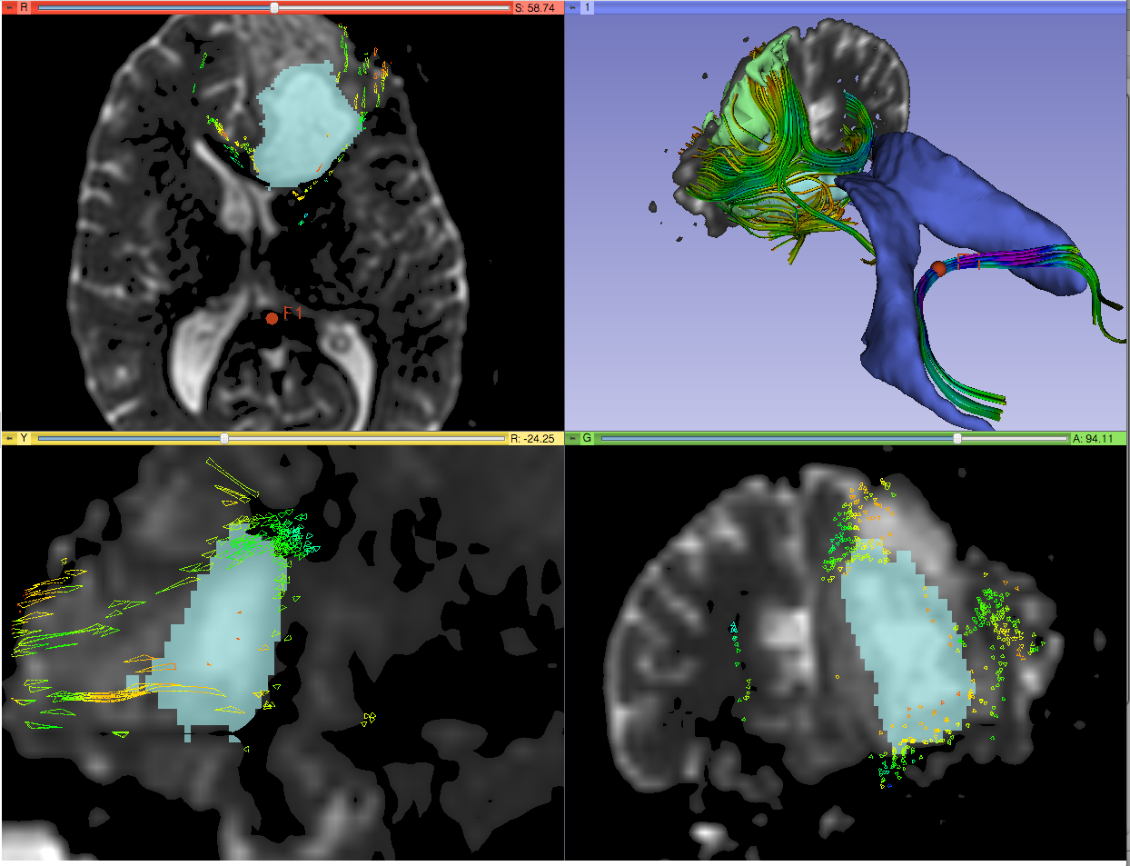
3D Slicer: Tractography Tools

Slide 22
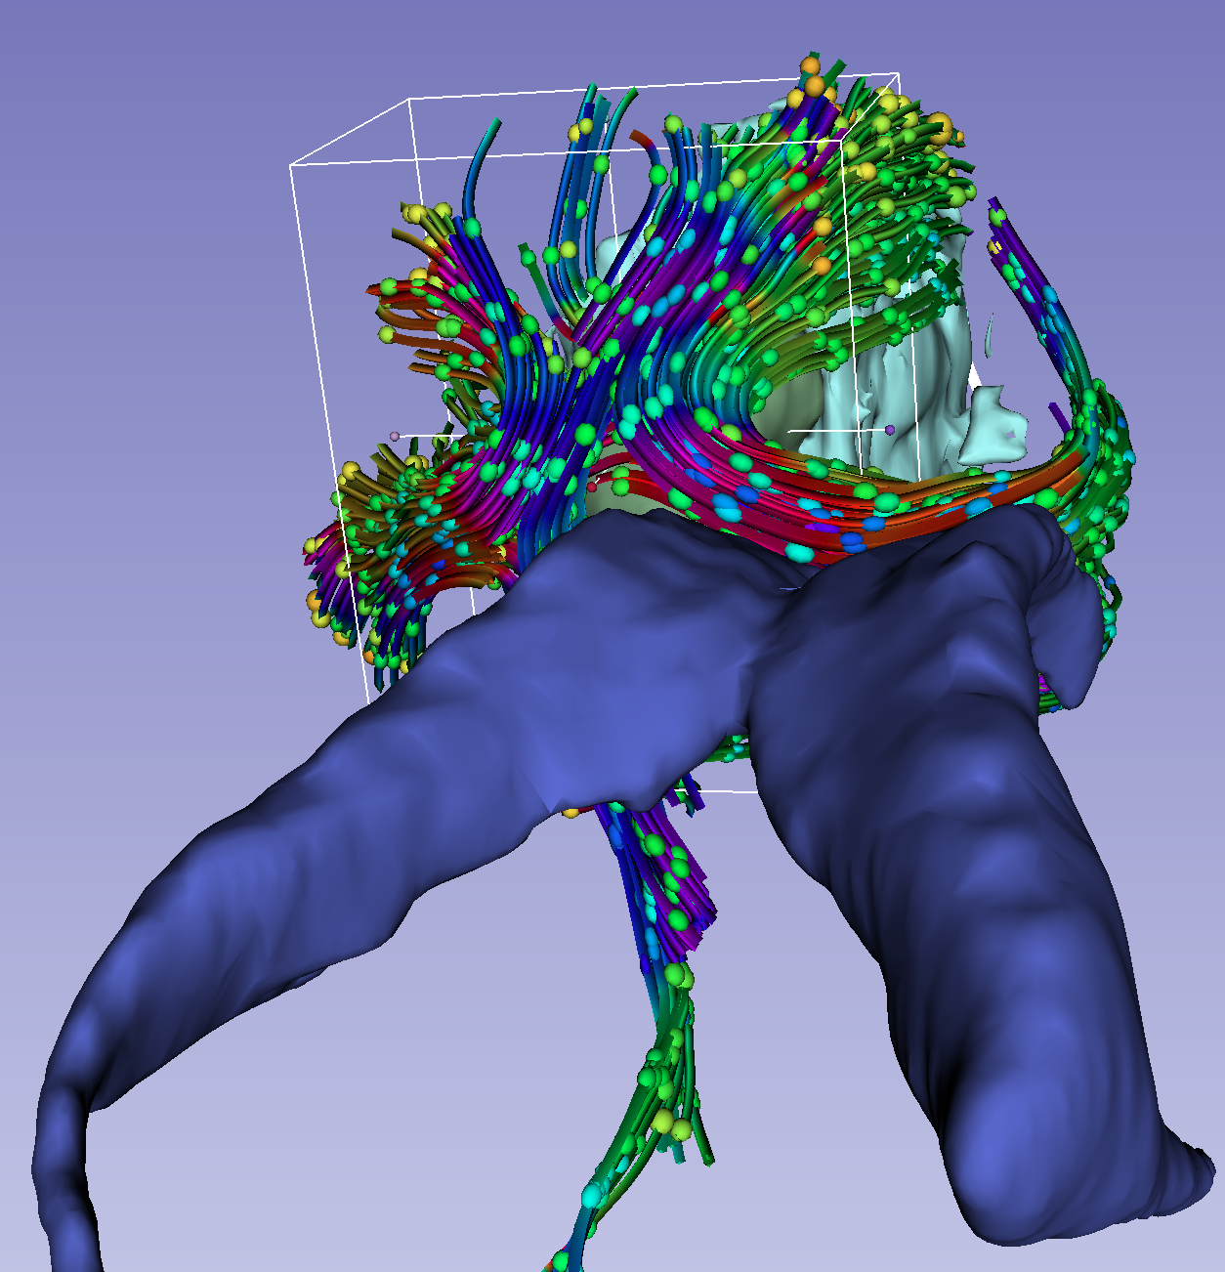
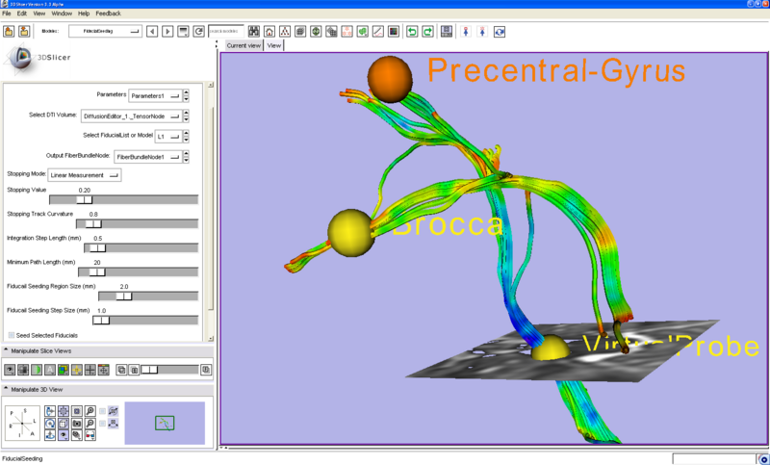
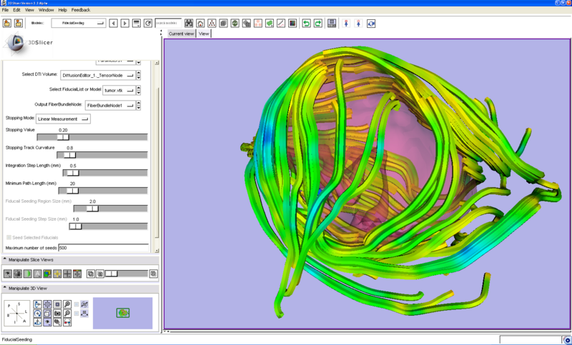
3D Slicer: Tractography Tools
Seeding tracks from:
Labels (segmentations)
fiducial markers (points) or ROIs – interactive seeding
3D models

Slide 23
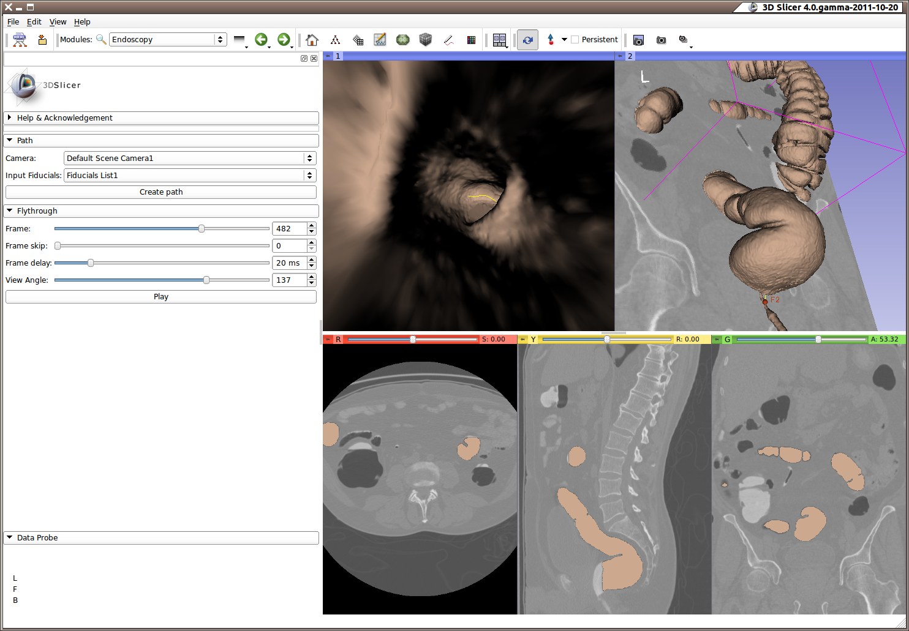
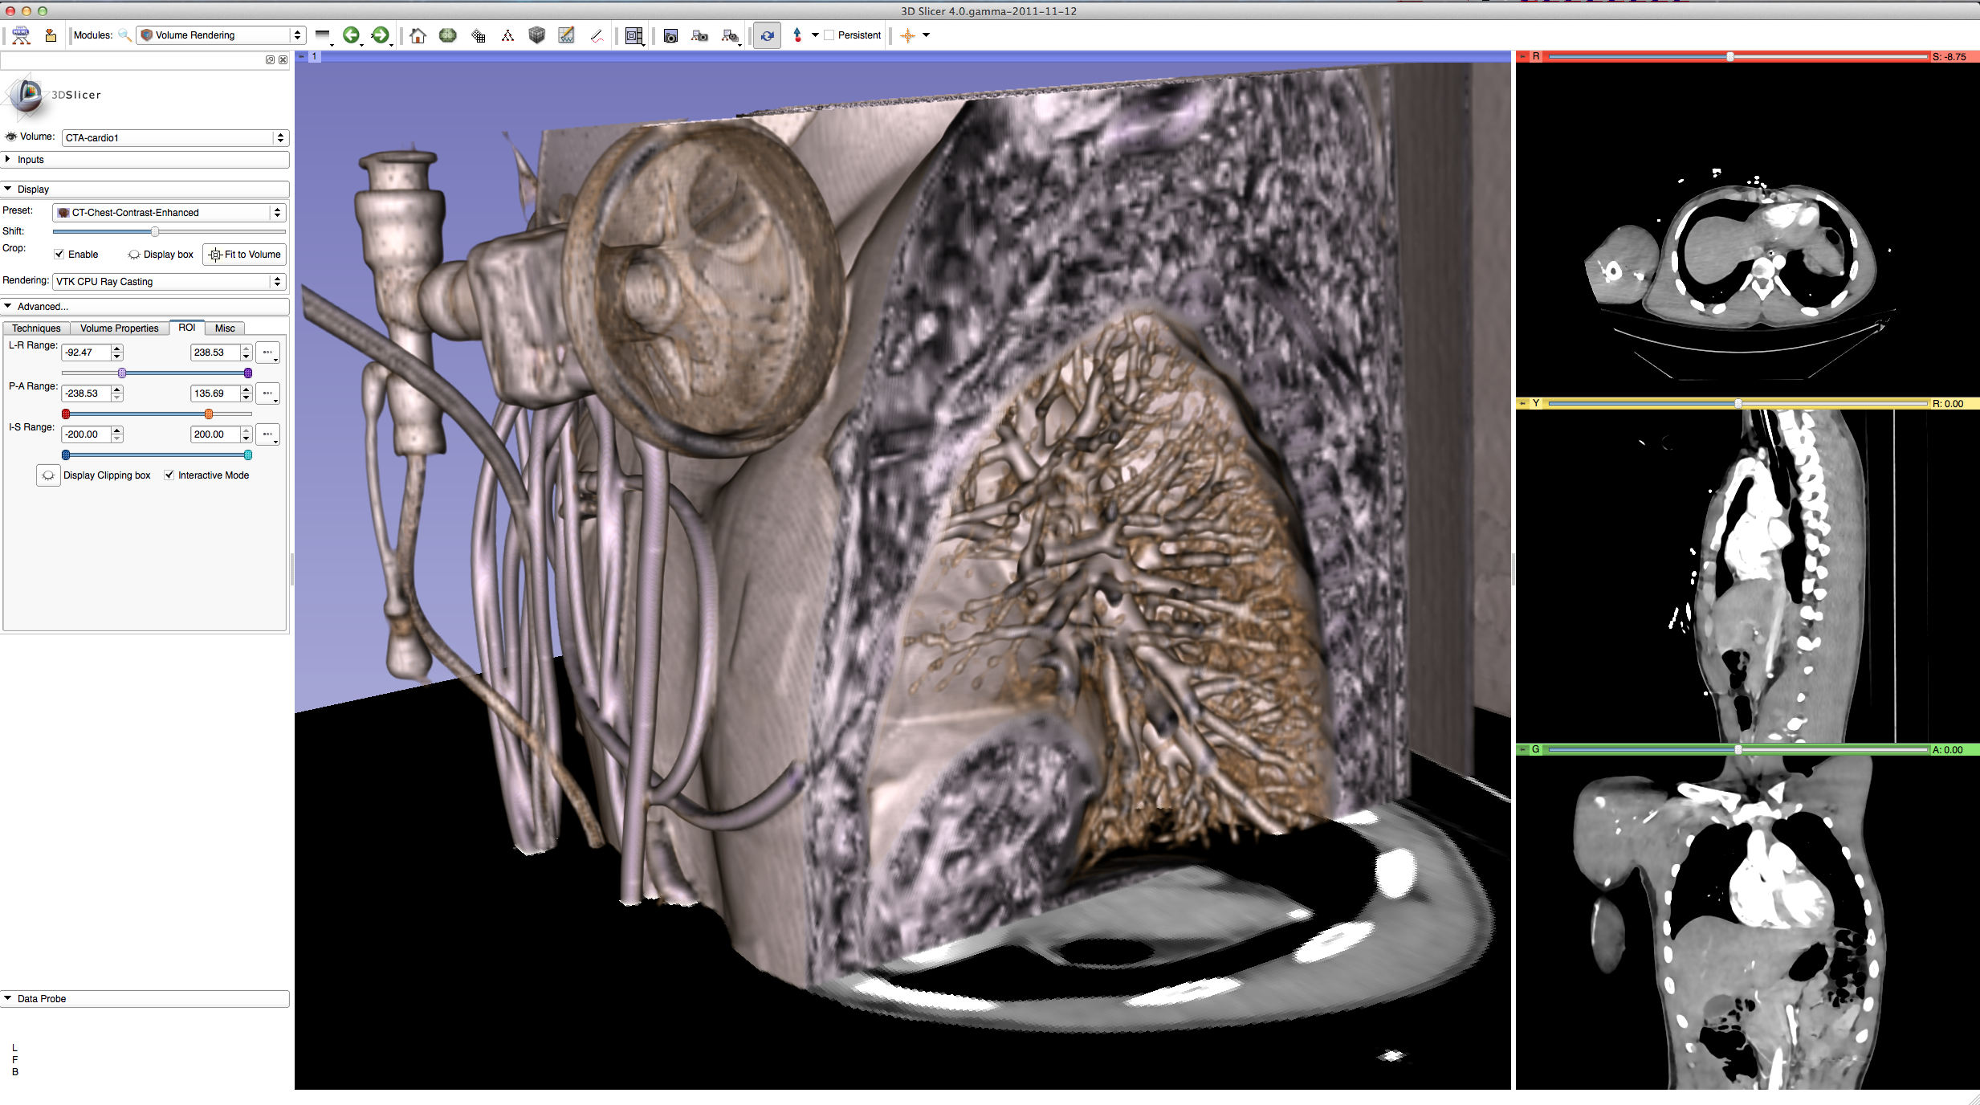
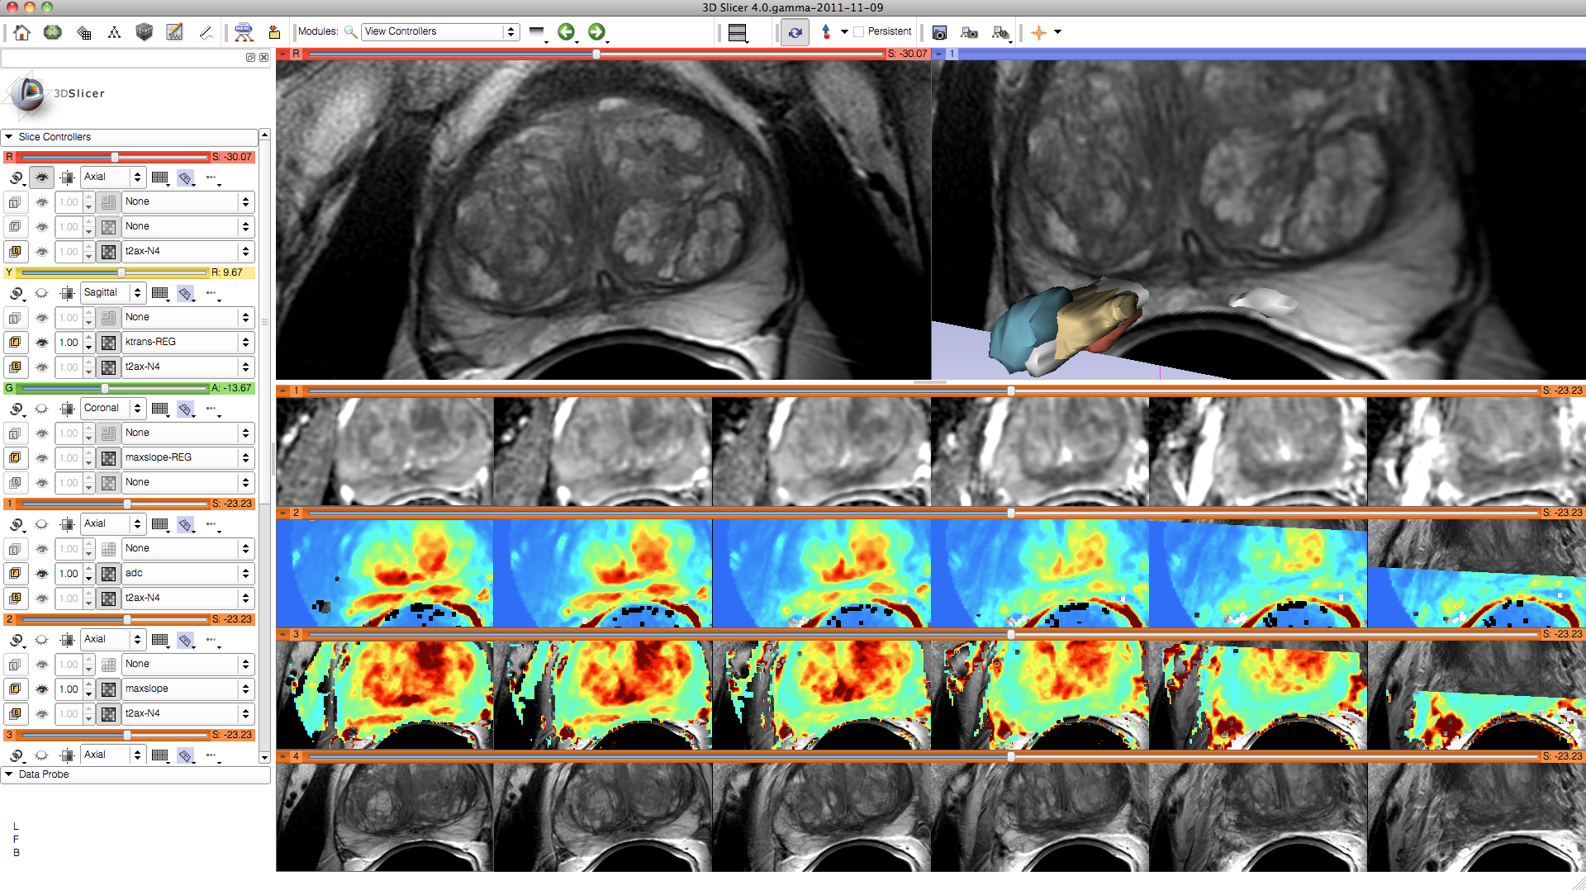
3D Slicer: Layouts
A variety of standard and specialized layouts are available including:
Lightbox view
Wide-screen layouts
Study comparison view
Dual 3D view
Large slice viewer
and others...

Slide 24
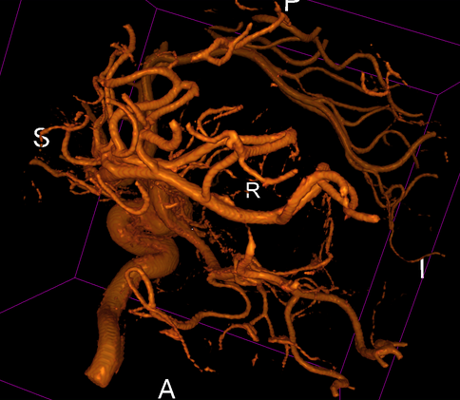
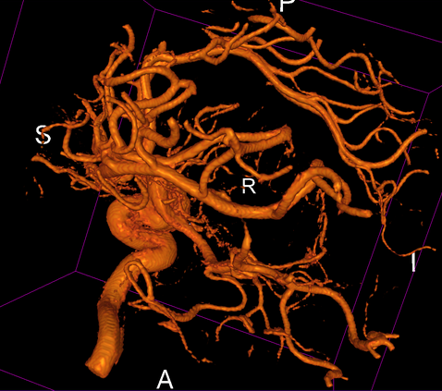
3D Slicer: Volume Rendering
Rendering Methods
VTK CPU Ray Casting
  Uses the CPU for volume rendering,
  is parallelized and can take advantage of multi-core capabilities.
  Uses level-of-detail approach where low resolution is rendered while moving, and high resolution is rendered once motion ceases.
  Allows zbuffer compositing with texture map cross sections and non-transparent triangulated surface model.
VTK GPU Ray Casting
  Uses GPU accelerated ray caster.
  Allows z-buffer compositing with non-transparent polygon models only.
  This is currently working on Linux and Win32, but not on Mac
VTK OpenGL 3D Texture Mapping
  Uses texture mapping approach to volume rendering
  compared to the two render methods above, it has slightly lower performance and slightly coarser appearance.
NCI GPU Ray Casting
  This is a GLSL-based ray caster with several experimental mapping techniques.
  No z-buffer compositing with polygon models.
  Good performance and quality.
  No hardware restrictions on this method

Slide 25
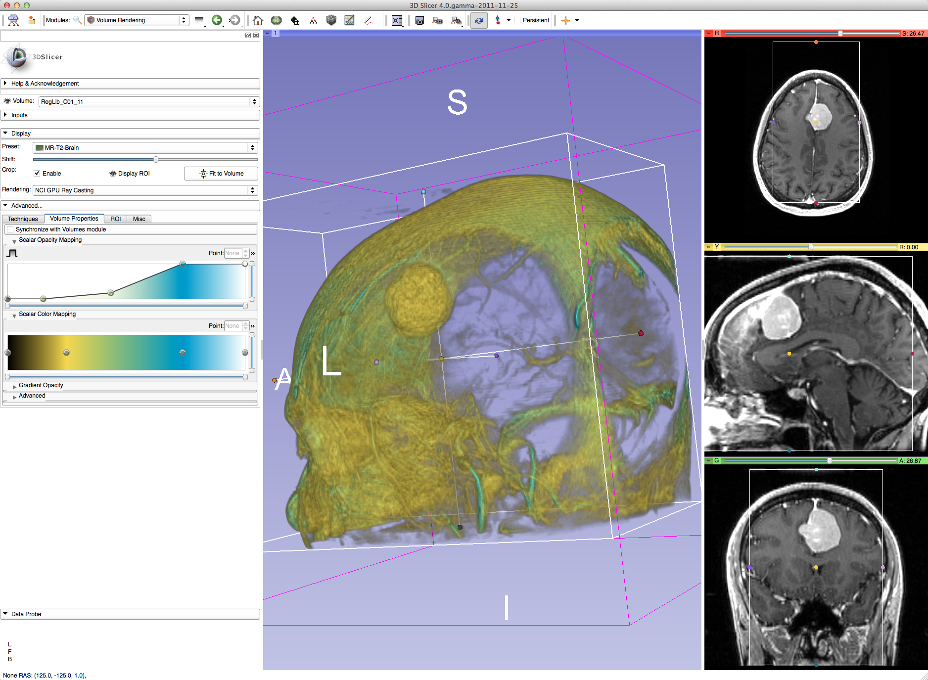
3D Slicer: Volume Rendering
Grayscale and labelmap volumes can be volume rendered, with interactive region of interest definition.
  Dedicated GPUs with dedicated GPU memory are recommended for GPU accelerated methods.

Slide 26
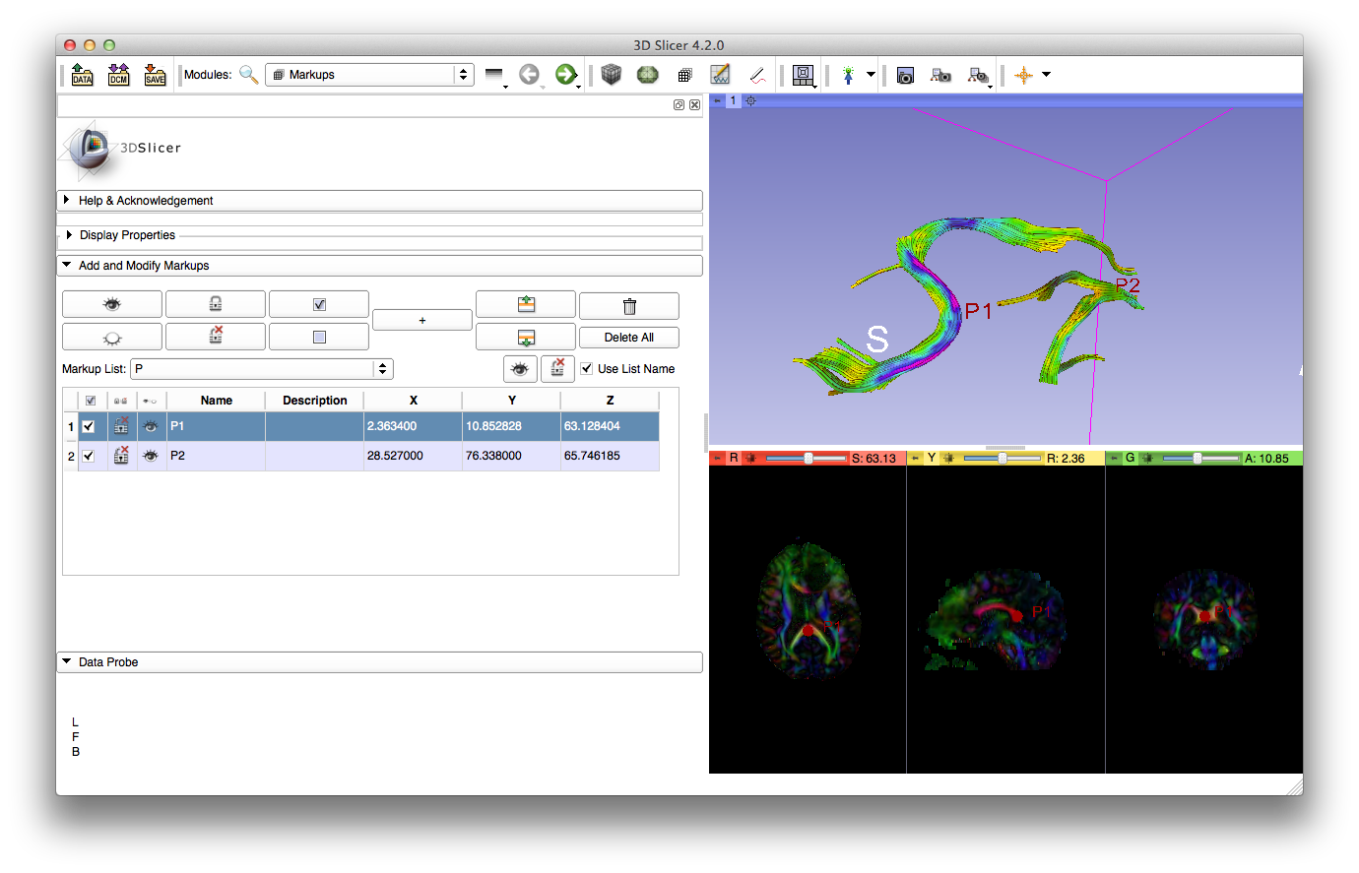
3D Slicer:Markups

Slide 27
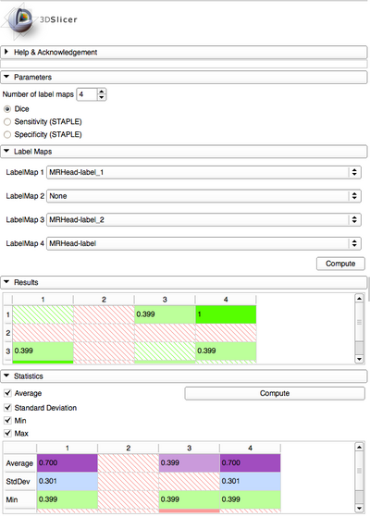

3D Slicer: Dice Coefficient
The DiceComputation module computes Dice Similarity Coefficient of overlap to quantitatively compare several registered segmented volumes.

Slide 28
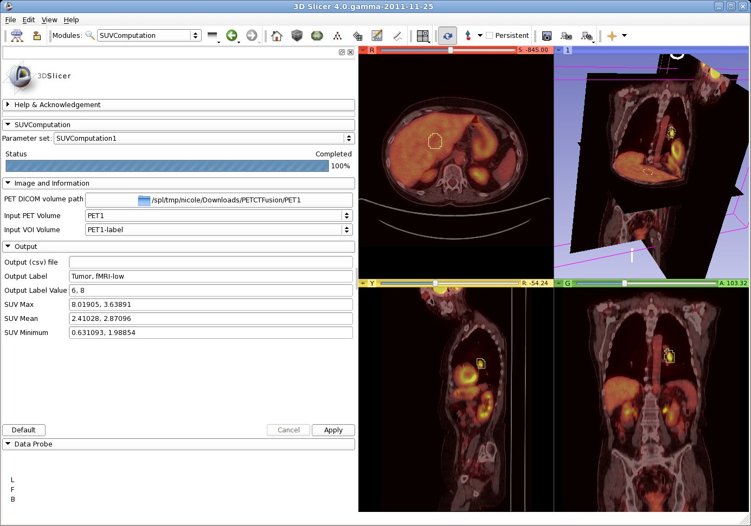
3D Slicer: PET/CT SUV computation
Combined visualization of structural and colorized functional images
VOIs defined in Slicer’s Editor Module
extracted DICOM study parameters used in computation
Computation of Standardized Uptake Value (based on patient body weight) per VOI.

Slide 29
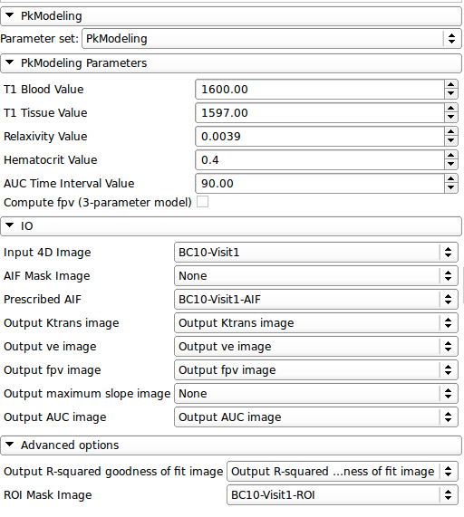
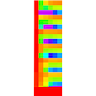
3D Slicer:PkModeling
PkModeling (Pharmacokinetics Modeling) calculates quantitative parameters from Dynamic Contrast Enhanced DCE-MRI images.

Slide 30
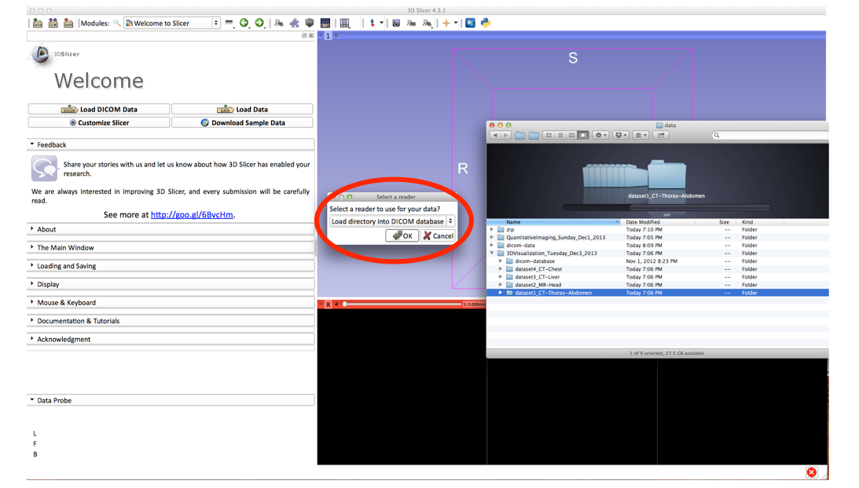
3D Slicer: Drag and Drop
Drag & Drop multiple files (e.g. data, scenes, mrb files etc.) and folders on the application will bring up the Add Data dialogue with the corresponding documents
A Medical Reality Bundle (Mrb) file is an archive file that contains a mrml scene file and all data for loading into Slicer4.

Slide 31
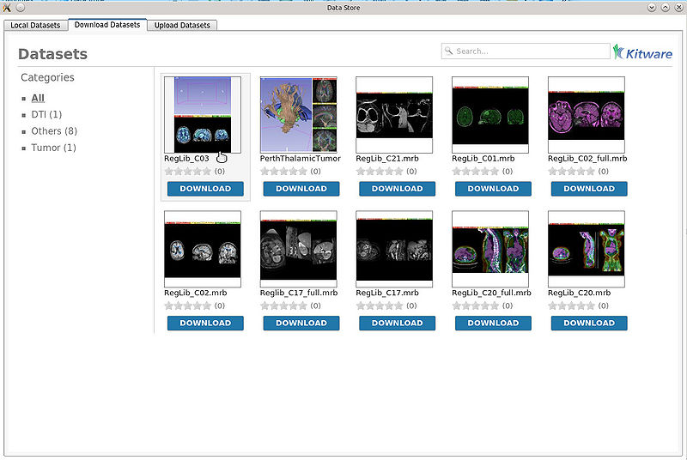
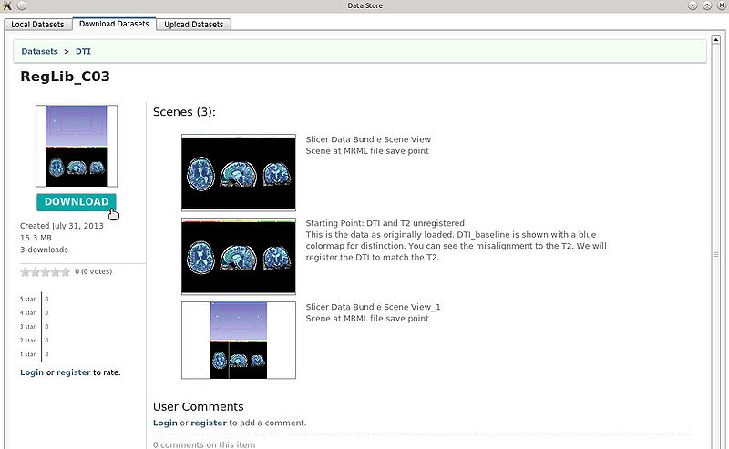
3D Slicer:DataStore
The Data Store extension allows an user to easily upload and download dataset files.
Browse and search datasets in a remote database
Download, Review and comment the datasets
Upload new datasets

Slide 32
3D Slicer: Image-Guided Therapy
3D Slicer has been used in clinical research, with IRB clinical protocols appropriately created and managed.
In image-guided therapy (IGT) research, Slicer is frequently used to construct and visualize collections of MRI data that are available pre- and intra-operatively, and to display the tracked spatial position of surgical instruments.

Slide 33
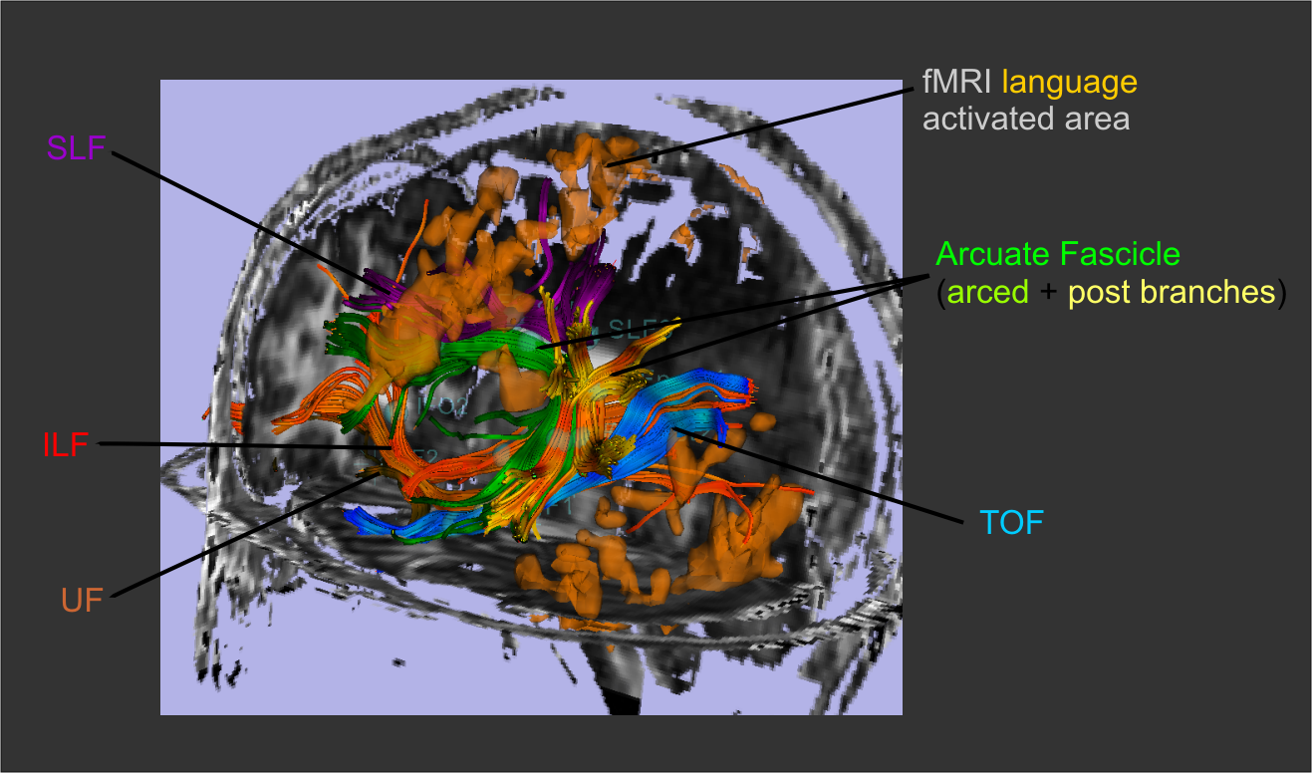
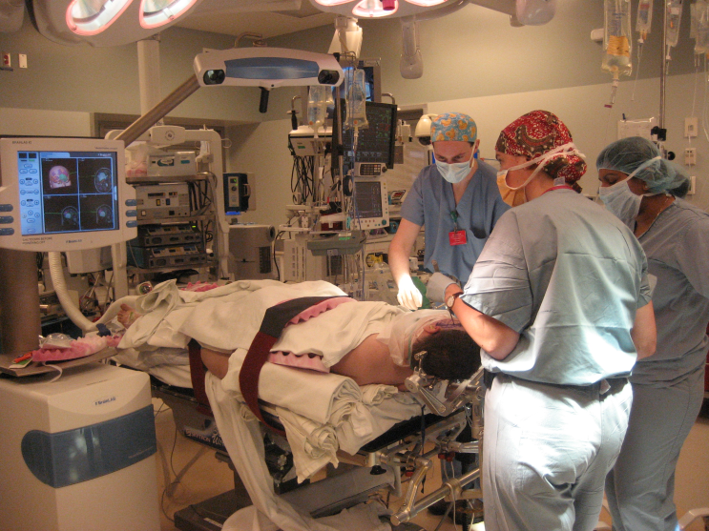
3D Slicer: Image-Guided Therapy
3D Slicer has been used extensively for brain tumor resection planning and guidance during surgery.
Integration of 3D Slicer with the surgical navigation BrainLab system allows to track surgical instruments in real-time, and transfer the position to 3D Slicer.
This project is a joint collaboration between BWH, Yale University and BrainLab.

Slide 34
3D Slicer: Image-Guided Therapy

Slide 35
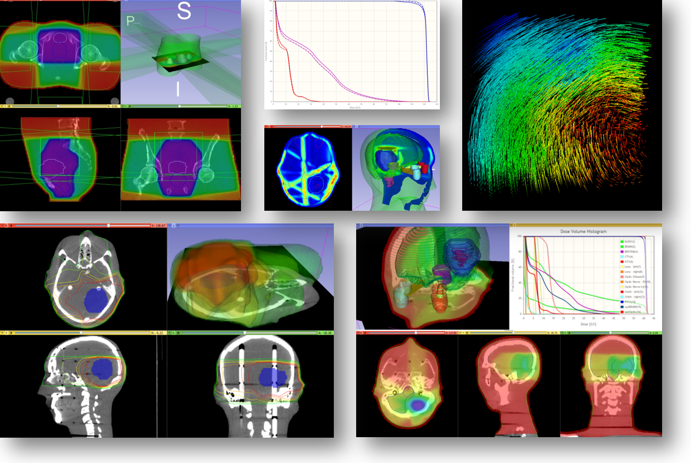
SlicerRT: Radiation Therapy
Features
  DICOM-RT import
  RT-specific analysis:
  Dose Accumulation
  Dose Comparison (gamma)
  Isodose contours / surfaces
  Contour Comparison
  Contour Morphology
  Plastimatch
  BSpline registration
  Landwarp registration
Overview paper: Csaba Pinter, Andras Lasso, An Wang, David Jaffray, and Gabor Fichtinger, “SlicerRT: Radiation therapy research toolkit for 3D Slicer”, Med. Phys. 39 (10), October 2012
Project homepage: https://www.assembla.com/spaces/slicerrt/
Contact: Andras Lasso (lasso@cs.queensu.ca)
Laboratory for Percutaneous Surgery – Copyright © Queen’s University, 2013

Slide 36
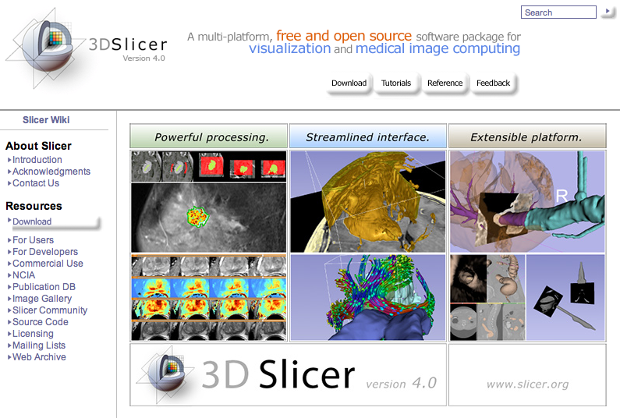
3D Slicer: Get the software
http://www.slicer.org

Slide 37
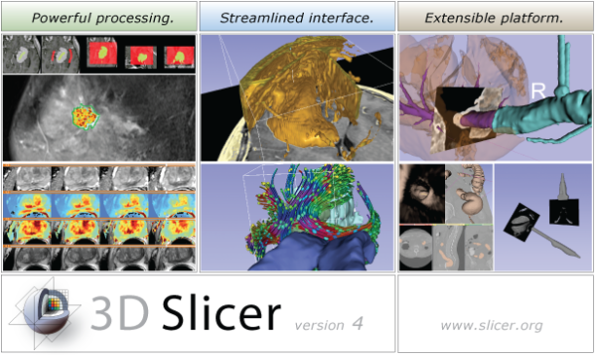
3D Slicer: Find Tutorials & More
http://www.slicer.org

Slide 38
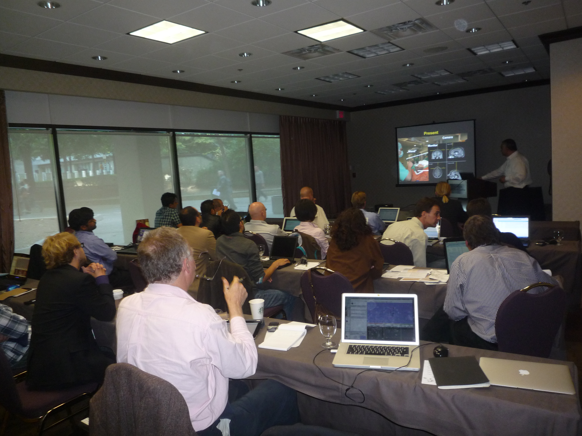
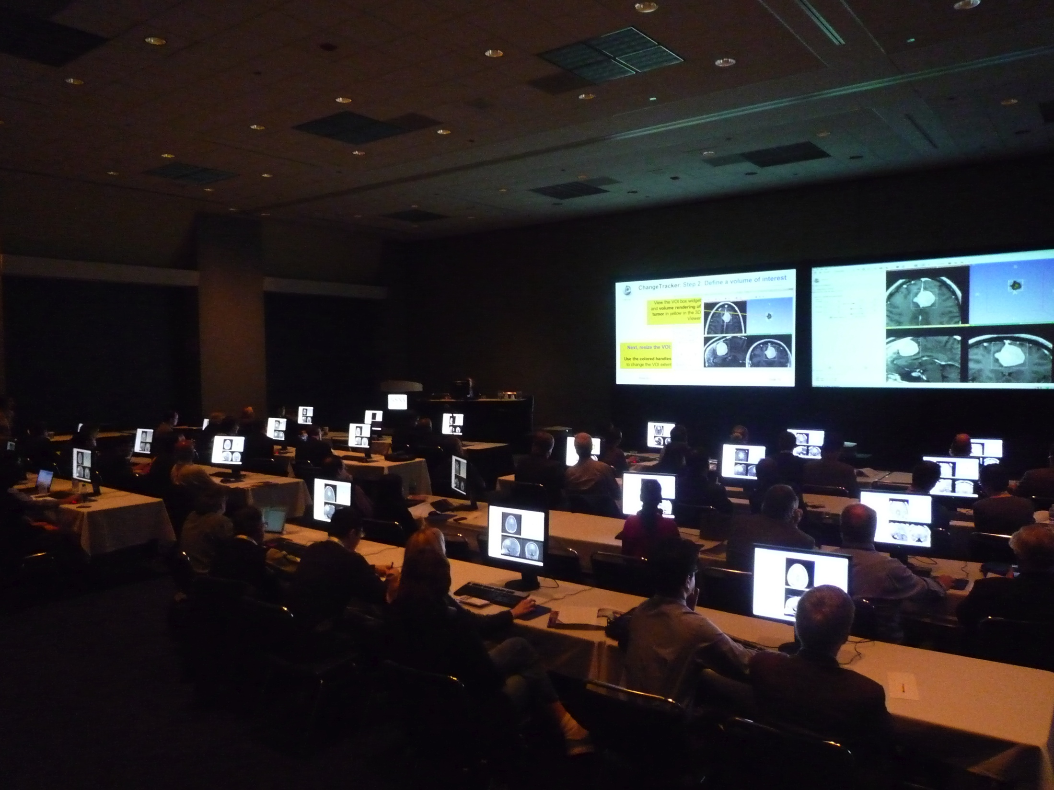
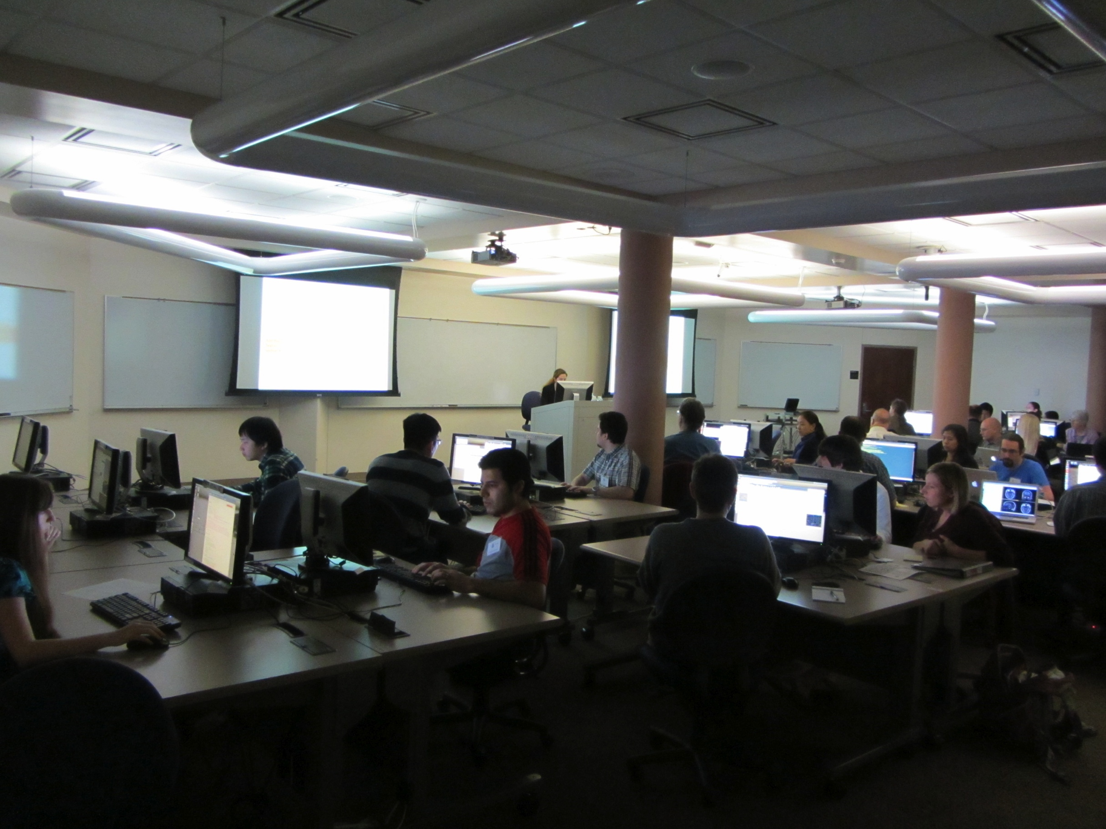
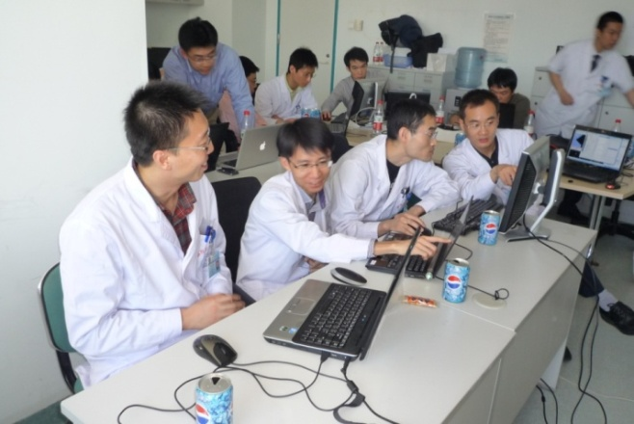
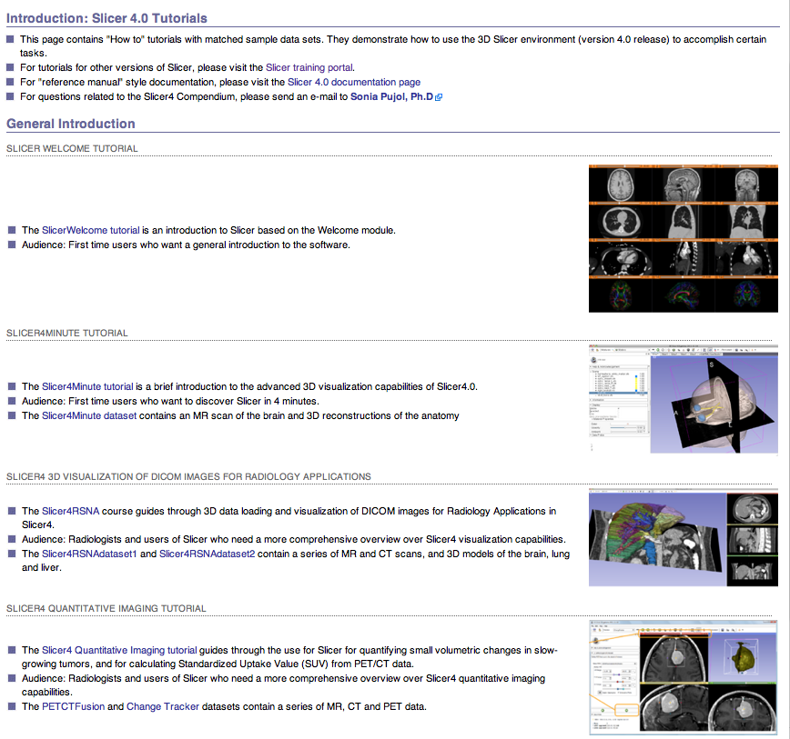
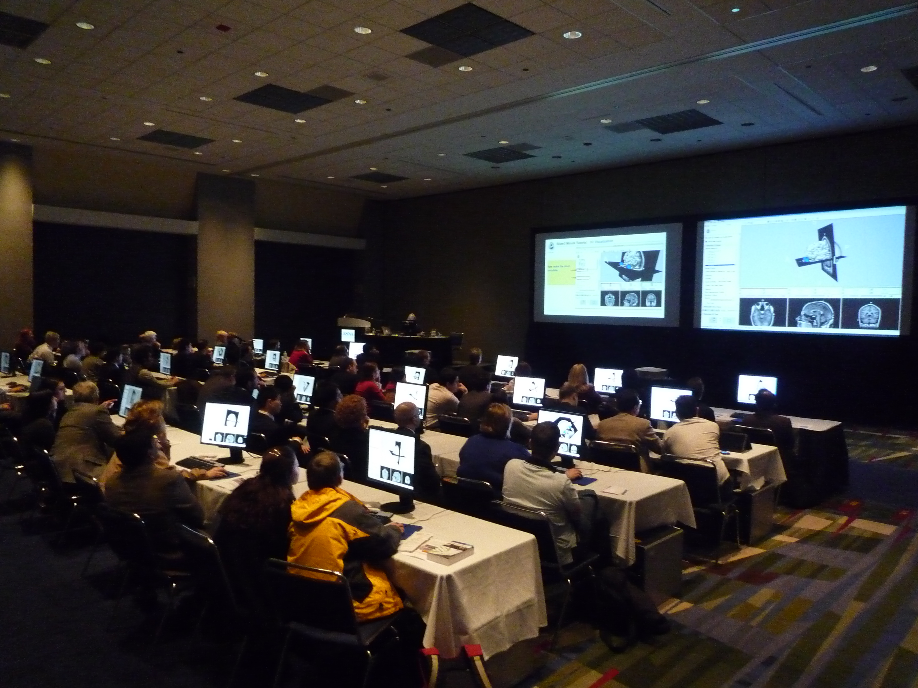
3D Slicer: Attend a workshop
HST.583 Life Cycle of Medical Imaging Lab, Harvard-MIT Division of Health Science and Technology (Sept.10)
MICCAI DTI Tractography Challenge, Nice, France, (Oct.1st)
3D Visualization of DICOM images for Radiology Applications, Hands-on course, RSNA 2012, Chicago (Nov.28)
Quantitative Medical Imaging for Research and Practice, Hands-on course, RSNA 2013, Chicago, (Nov.25)
3D Slicer Booth, Quantitative Imaging Reading Room, RSNA 2012, Chicago (Nov.25-30)
HST.583 Diffusion Tensor Imaging Lab, Harvard-MIT Division of Health Science and Technology (Dec.3)
3D Slicer Hands-on workshop, Psychiatry Neuroimaging Lab, Boston, MA (Dec.10)
DTI Hands-on course, SPIE 2013, San Diego, Ca (Feb.5)
3D Slicer demos, IMAGINE session, European Congress of Radiology, ECR 2013, Vienna, Austria (March 7-11)
Imaging in Neuroscience hands-on course, Harvard Catalyst 3D Slicer hands-on workshop, Tokyo, Japan (April 9)
3D Slicer hands-on workshop, Iwate, Japan (April 10)
3D Slicer invited lecture, AAPM New England Chapter Summer meeting, Portsmouth, NH (May 31)
3D Slicer Hands-on workshop, BWH, Boston, (June 14)
Image-Guided Therapy Workshop, CARS 2013, Heidelberg, Germany (June 30)
BRAINSCamp hands-on workshop, Iowa City (August 1st)
MICCAI 2013 DTI Tractography Challenge, Nagoya, Japan MICCAI 2013 CTK Programming Tutorial, Nagoya, Japan
3D Slicer Neurosurgery workshop, PLA General Hospital, Beijing, China (Sept.29)
3D Visualization of DICOM images for Radiology Applications, Hands-on course, RSNA 2013, Chicago (Dec.1)
3D Slicer Booth, Quantitative Imaging Reading Room, RSNA 2013, Chicago (Dec.1-6)
Quantitative Medical Imaging for Research and Practice, Hands-on course, RSNA 2013, Chicago, (Dec.3)\
22 workshops Slicer workshops worldwide (June 2012-October 2013
http://wiki.na-mic.org/Wiki/index.php/Training:Slicer
http://wiki.na-mic.org/Wiki/index.php/Events

Slide 39








3D Slicer: Attend a workshop
2005-2012: Over 2,000 clinical researchers and scientists trained
http://wiki.na-mic.org/Wiki/index.php/Training:Slicer
http://wiki.na-mic.org/Wiki/index.php/Events

Slide 40

3D Slicer: Information for Developers
www.slicer.org/pages/DeveloperOrientation

Slide 41

3D Slicer: Acknowledgements
Major Sponsors & Contributors

