Slide 1
NAMIC Activities – Utah
Image/Shape Analysis
  Volumetric tractography and DTI atlases
  Robust correspondences for shape
  Longitudinal shape analysis
Segmentation
  Globally optimal surface estimation
  Fast, feature/shape-based image lookup
Registration
  Robust metrics for image match
  Nonsmooth regularizers
HD
AF
HNC
TBI

Slide 2
Volume Tractography
DTI Atlases to define ROIs
  Goodlet et al.
Volumetric tractography for white matter regions
  Fletcher et al.
Group analysis on volumetric regions

Slide 3
Robust Shape Correspondences
Datar et al. 2011
  Statistics of points and normals
  Geodesic distances for point-to-point interactions

Slide 4
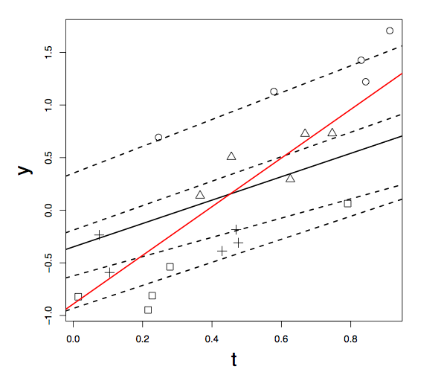
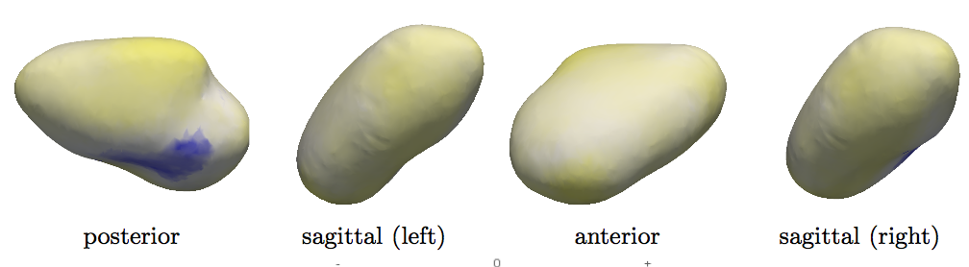

Longitudinal Shape Parameterization with T. Fletcher, M. Datar
Mixed effects model
  Hierarchical–properly accounts for staggered/missing data in individuals
Left atrium trend – before and after ablation

Slide 5
Segmentation
Graph-based image segmentation
Represent surfaces a min-cut in properly ordered graph
  Liu et al. 2009
Challenges
  Objective functions that capture features, smoothness, coupled surfaces
  Generalizations to 3D shapes

Slide 6
Graph-Based Segmentation

Slide 7
Fast Nearest Neighbor Lookup
Problem: from a large database of images, most similar images combine to form best segmentation
  Label voting or nonparametric modeling paradigm
  Especially important for heterogeneous data
    Head&neck, cardiac
How to find similar shapes?
  Deformation (slow)
  Feature-based query (fast)

Slide 8
Feature-Based Lookup
Strategy
  Detect features and compare hierarchically
    Pyramid matching (Grauman 2006)

Slide 9
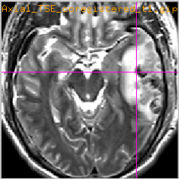
Robust Image Registration
Applications
  Correspondence or coordinate system for comparing different individuals or times
    E.g. longitudinal TBI, Afib before and after ablation
  Segmentation from atlases or label voting
    E.g. head and neck, endocardium from DCE
Challenges
  Nonsmooth transformations
    Singularities, tearing, sliding
  Outliers/mismatches

Slide 10
Registration Formulation
Strategy
  Image match: apply robust versions of image metric (e.g. other norms)
  Regularization: norms and operators that allow for nonsmooth (noninvertable) transformations
Issues
  Well posedness
  Optimization

Slide 11
Registration Example

