Slide 1
MIT Algorithms
Polina Golland
MIT Computer Science and Artificial Intelligence Laboratory

Slide 2
Project overview
Non-parametric segmentation
Exemplar-based priors
Brain connectivity modeling
Joint models of anatomical and functional connectivity
Huntington’s disease
Models of pathology evolution
Segmentation and time series modeling
Traumatic brain injury

Slide 3
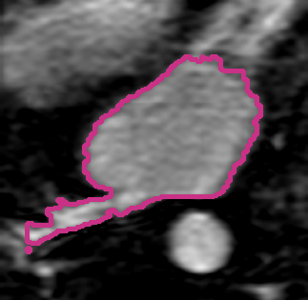
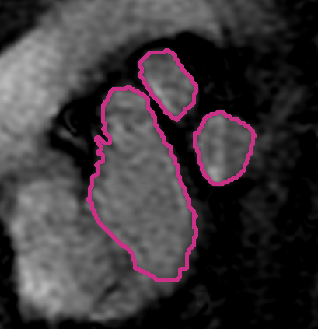
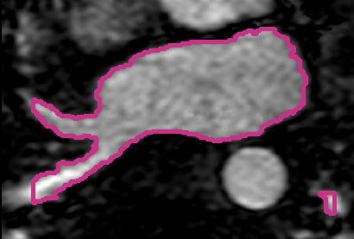
Non-Parametric Segmentation
Generative model for label fusion
Segmentation algorithms
Applications: brain, left atrium of the heart
Volume Overlap
Sabuncu ‘09, ‘10; Depa ‘10

Slide 4
Efficient Label Fusion
Pre-align all training images
Use one registration to align new image
Perform label fusion
Depa ‘11

Slide 5
Going Forward
Common coordinate frame
Understand reduction in accuracy
Registration uncertainty
Interesting theoretical connections
Application to radiotherapy planning
Main challenge: accurate registration
Registration in the presence of pathology and artifacts

Slide 6
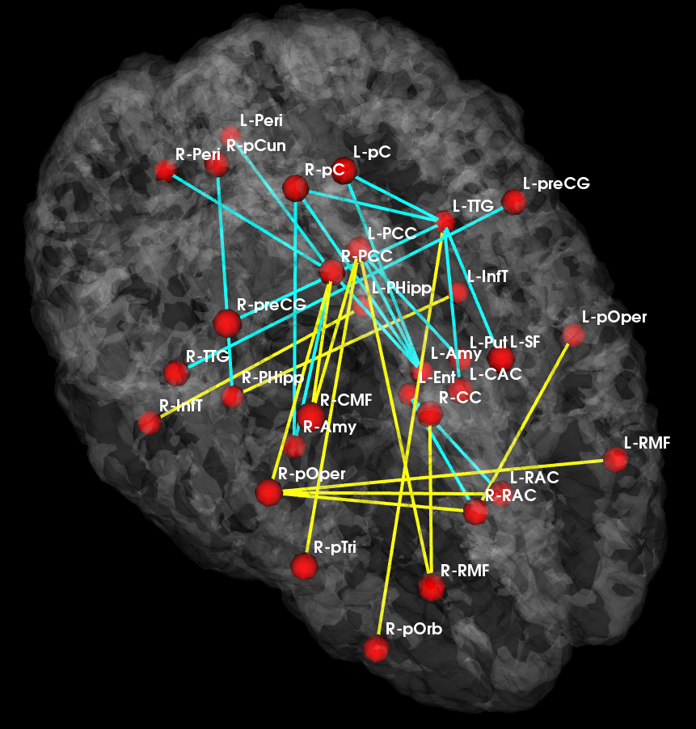
Brain Connectivity Modeling
Joint model for anatomical and functional connectivity
Latent group connectivity template
Signal likelihood shared across subjects
Application to population studies
Changes in the connectivity template
Reduced
Increased
_{Control Template}
_{Disease Template}
Venkataraman ‘10, ‘12

Slide 7
Current and Future Directions
A model of disease foci
Region-based model of connectivity changes
From connection-based to region-based
Going forward
Application to a broad range of diseases, including HD

Slide 8
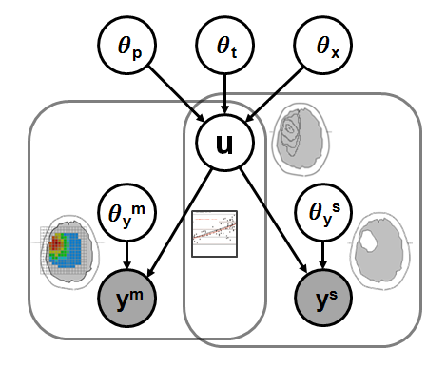




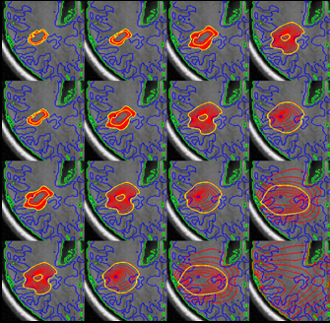
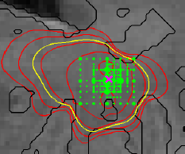
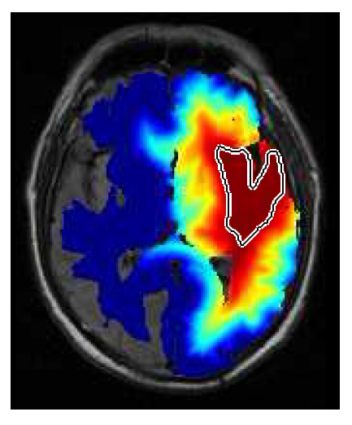
Evolution of Pathology
Physical model of evolution
Diffusion reaction, proliferation
Statistical model of imaging
Segmentations and spectroscopy
Output: model parameters and prediction
Menze ‘10, ‘11

Slide 9
Conclusions
Methodological developments
Exemplar-based segmentation
Connectivity analysis
Segmentation and evolution of pathology
DBP challenges
Registration in the presence of pathology
Connection between physiological models and image analysis
Going forward
Joint work with the DBPs

