Slide 1
Algorithms Organization
Ross Whitaker – Utah
Polina Golland – MIT (Kayhan B.)
Guido Gerig – Utah
Martin Styner – UNC
Allen Tannenbaum – Georgia Tech

Slide 2
Presentations
Highlights from the 10-year project
Recent advances
Clinical/biomedical impact

Slide 3
Diffusion Tensor Imaging
Structure, function, connectivity, and schizophrenia
  Shenton/Harvard
  Potkin/Irvine
Technical challenges
  Data preprocessing
  Robust tools for analysis

Slide 4
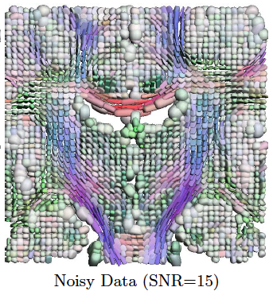
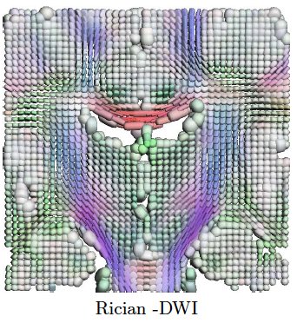
DTI Technical Development
Denoising
  Basu, et al., MICCAI, 2006
Susceptibility artifacts
  Tao, et al., IPMI 2009
Segmentation
  Fletcher et al., IPMI, 2007

Slide 5
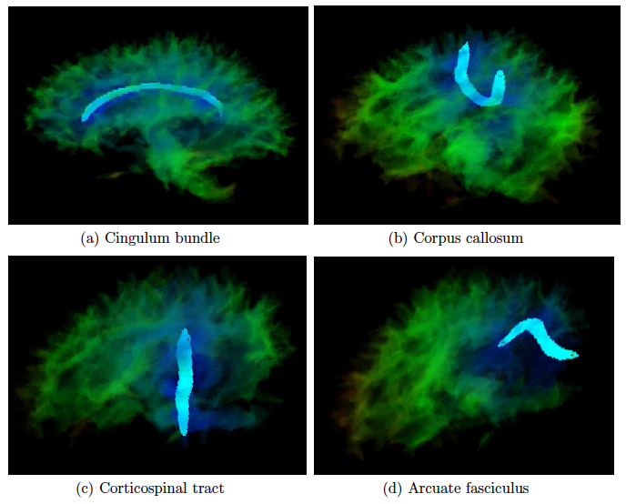
DTI Segmentation
Volumetric tractography
Volumetric paths between ROIs
  A collection of shortest paths
  User interaction, visualization, GPU implementations

Slide 6
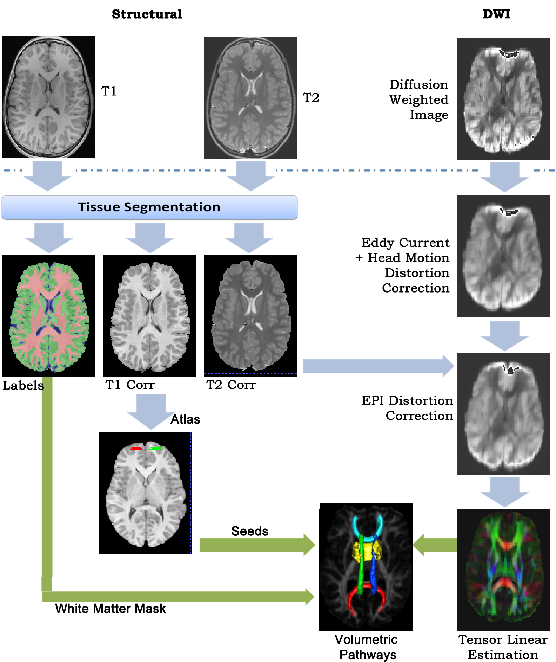
NA-MIC DTI Analysis
Ancillary grant: Lainhart/Fletcher – DTI analysis in autism
  Scientific results
    Arcuate fasciculus in autism, Fletcher et al, Neuroimage, 2010.
    Longitudinal Heschl's gyrus in autism, Prigge et al., 2013.
  Software pipeline
Broader impact
    Cardenas et al., J Neuroimaging, 2013. (UCSF)

Slide 7
Statistical Shape Modeling
DBPs
  Shenton/Schizophrenia
  Piven/Autism
  MacLeod/Marrouche
Robust, general methods for shape analysis
Software
  ShapeWorks

Slide 8
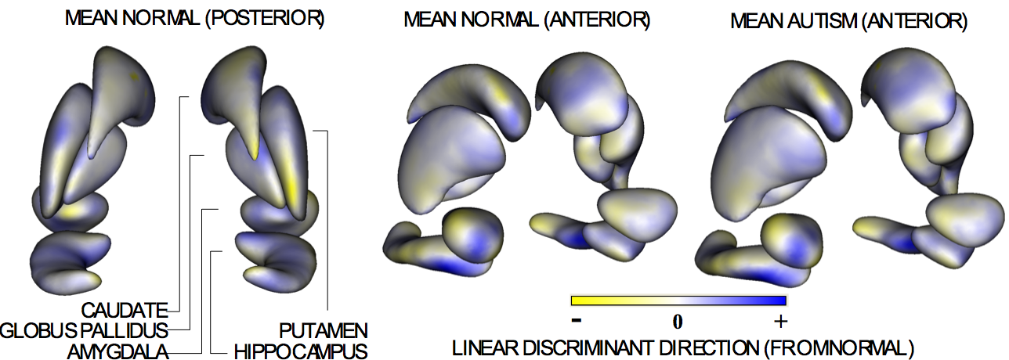
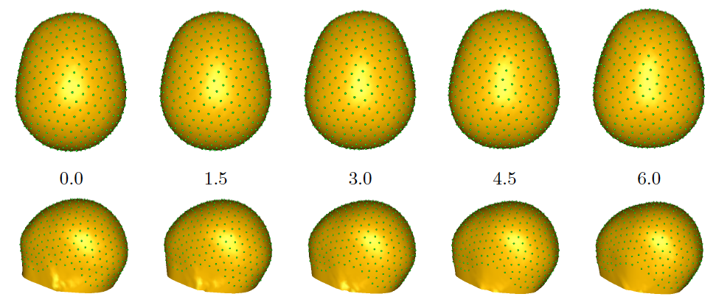
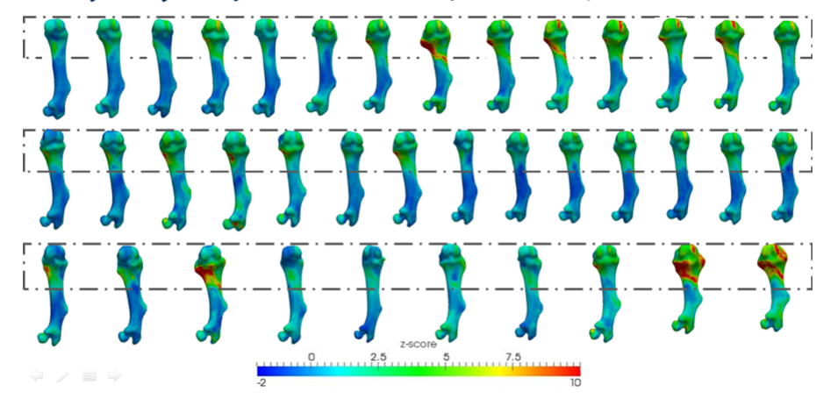
Technology for Shape Analysis
Correspondence/parameterization
Hypothesis testing
Regression
Longitudinal analysis
Scientific results
  Harris et al., J. of Ortho. Res., 2013
  Jones et al., J. of Ortho. Res., 2013

Slide 9
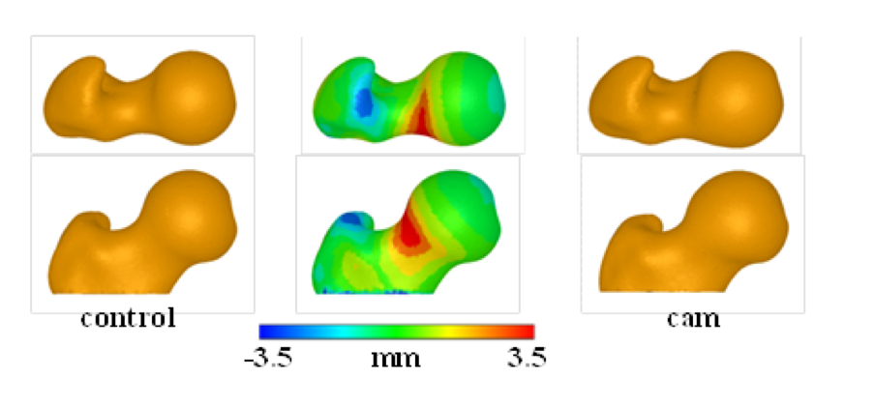
NA-MIC Ancillary Grant
Anderson: shape analysis in hip pathoanatomy (ongoing)
  Shape analysis in hip biomechanics
  Diagnosis and treatment planning
  Database of parameterized hip models

Slide 10
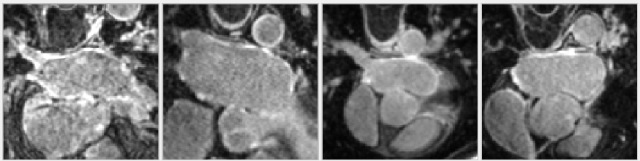
Segmentation
DBPs
  Sharp/Chen, Head and Neck Cancer
  MacLeod/Marrouche, Afib
Robust tools for “difficult” segmentation problems
  Low SNR
  High shape variability

Slide 11
Bayesian Formulation of LA Segmentation (DCE-MRI)

Slide 12
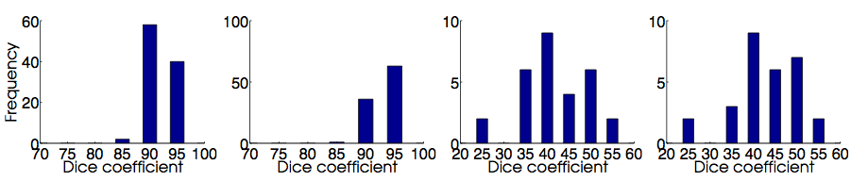
LA Segmentation Results

Slide 13
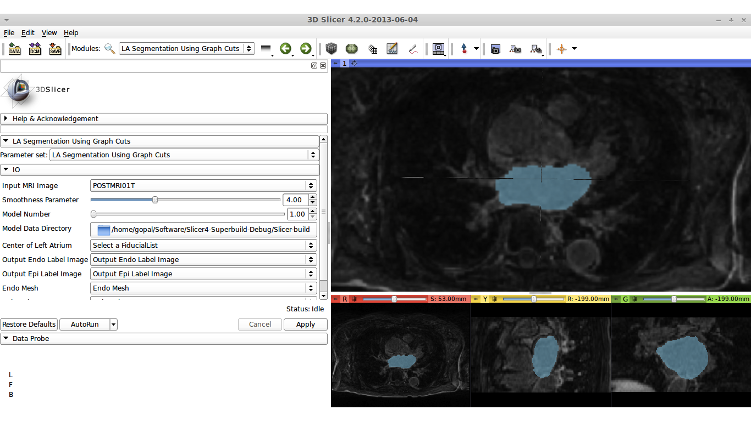
Slicer Module

