Slide 1
Core 1b – Engineering
Highlights, Aims and Architecture
Will Schroeder
Kitware

Slide 2
The Engineering Core Perspective
Develop a national computing infrastructure for image analysis to be used in biomedical research and leading-edge clinical research and practice.
.
The Engineering team
  develops software applications,
  delivers computational platforms, and
  establishes software engineering practices for algorithm researchers and for clinical hypothesis formation and testing
  Works closely with the DBPs and Algorithms Core to deliver effective solutions
Produces the NA-MIC Kit

Slide 3
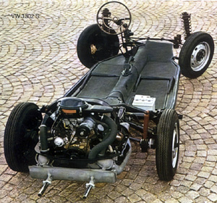
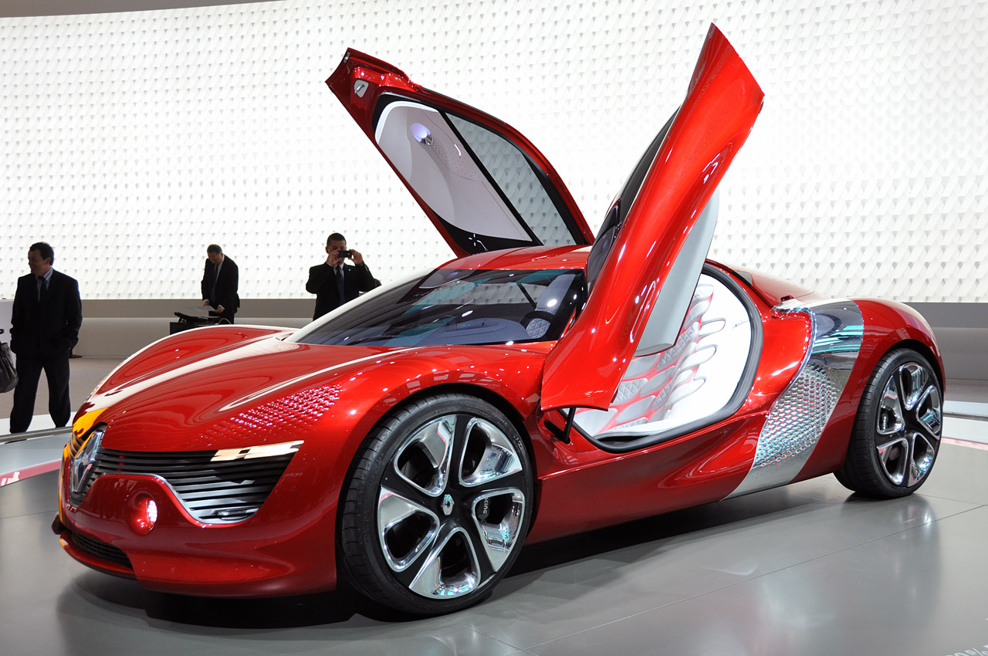


Major Accomplishments
Developed internationally community of researchers, developers and users
Producing a supporting tool suite, the NAMIC Kit, with significant worldwide impact on medical image computing

Slide 4
First Six Years
Assembled base components of NA-MIC Kit
  VTK, ITK, Teem, CMake/CTest, Tcl
Extended base components
  Image orientation, diffusion imagery
  New platforms and improved engineering process
Broadened NA-MIC Kit Foundation
  Slicer 3
  XNAT, Grid Wizard Enterprise, BatchMake
  CPack, CDash

Slide 5
Impact
http://www.na-mic.org/Wiki/index.php/NA-MIC-Kit
Package | Lines of code | Person years | Price tag at 100k per person year
Slicer | 1,270,816 | 361 | $36,122,644
KWW | 207,208 | 54 | $ 5,406,516
VTK | 1,853,529 | 538 | $53,808,076
ITK | 848,383 | 237 | $23,719,173
CMake / CTest / CPack | 323,454 | 86 | $8,590,888
CDash | 78,226 | 19 | $1,897,060
XNat | 200,985 | 51 | $5,149,987
Total | 4,782,601 | 1346 | $134,694,344

Slide 6
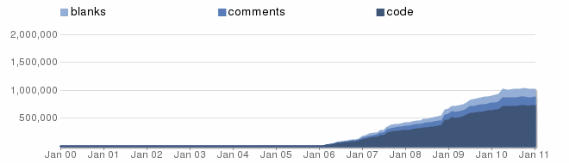
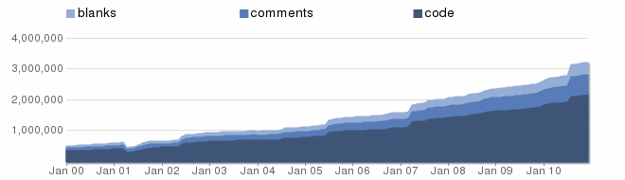
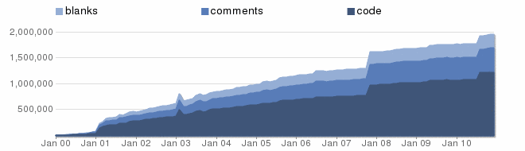
Impact (2)
Ohloh.net
Slicer
VTK
ITK

Slide 7
Impact (3)
Downloads (past year, very approximate)
Does not include CVS/SVN/git/Cygwin/etc. access
Slicer
  5,000
VTK
  20,000
ITK
  18,000
CMake
  63,000

Slide 8
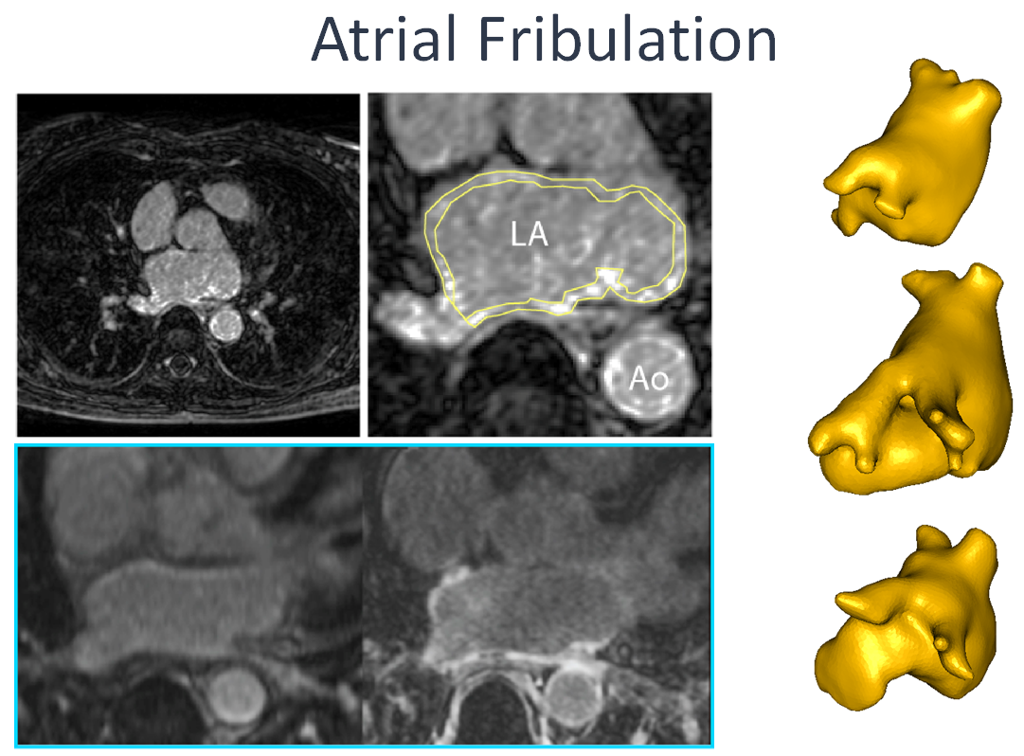
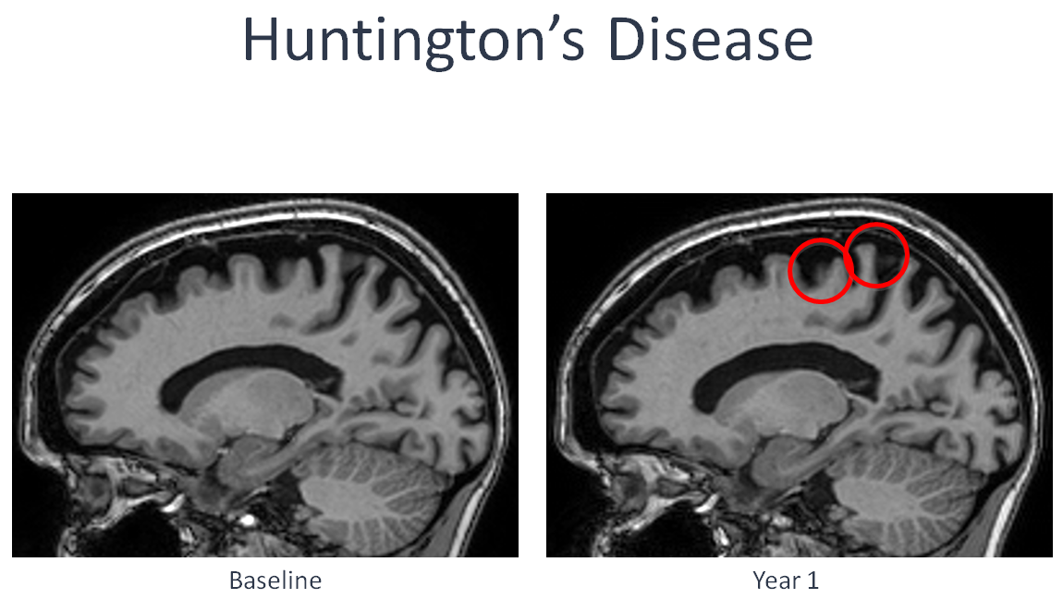
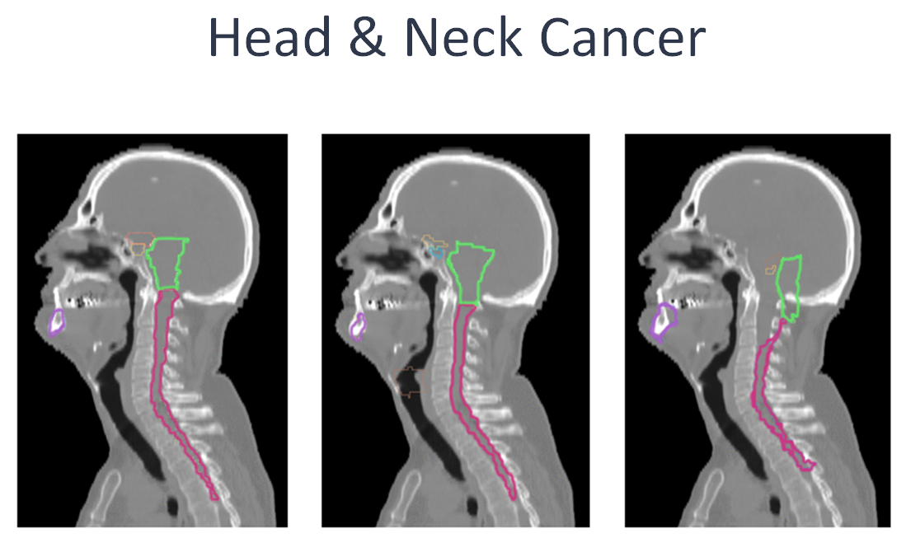
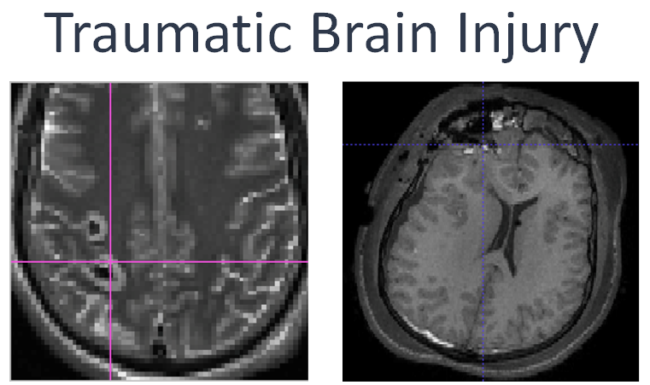
Driving Challenges

Slide 9
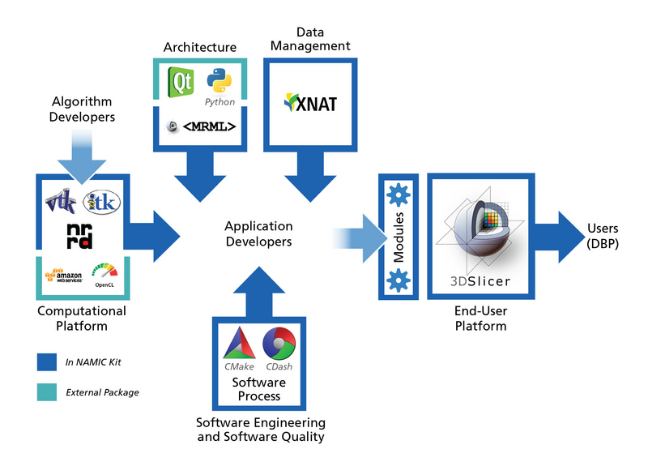
NA-MIC Kit Overview

Slide 10
Engineering Core Presentations
Aim 1: Architecture: Will Schroeder
Aim 2: End User Platform: Steve Pieper
Aim 3: Computational Platform: Jim Miller
Aim 4: Data Management Platform: Jeff Grethe
Stephen Aylward
Aim 5: Software Process: Stephen Aylward

Slide 11
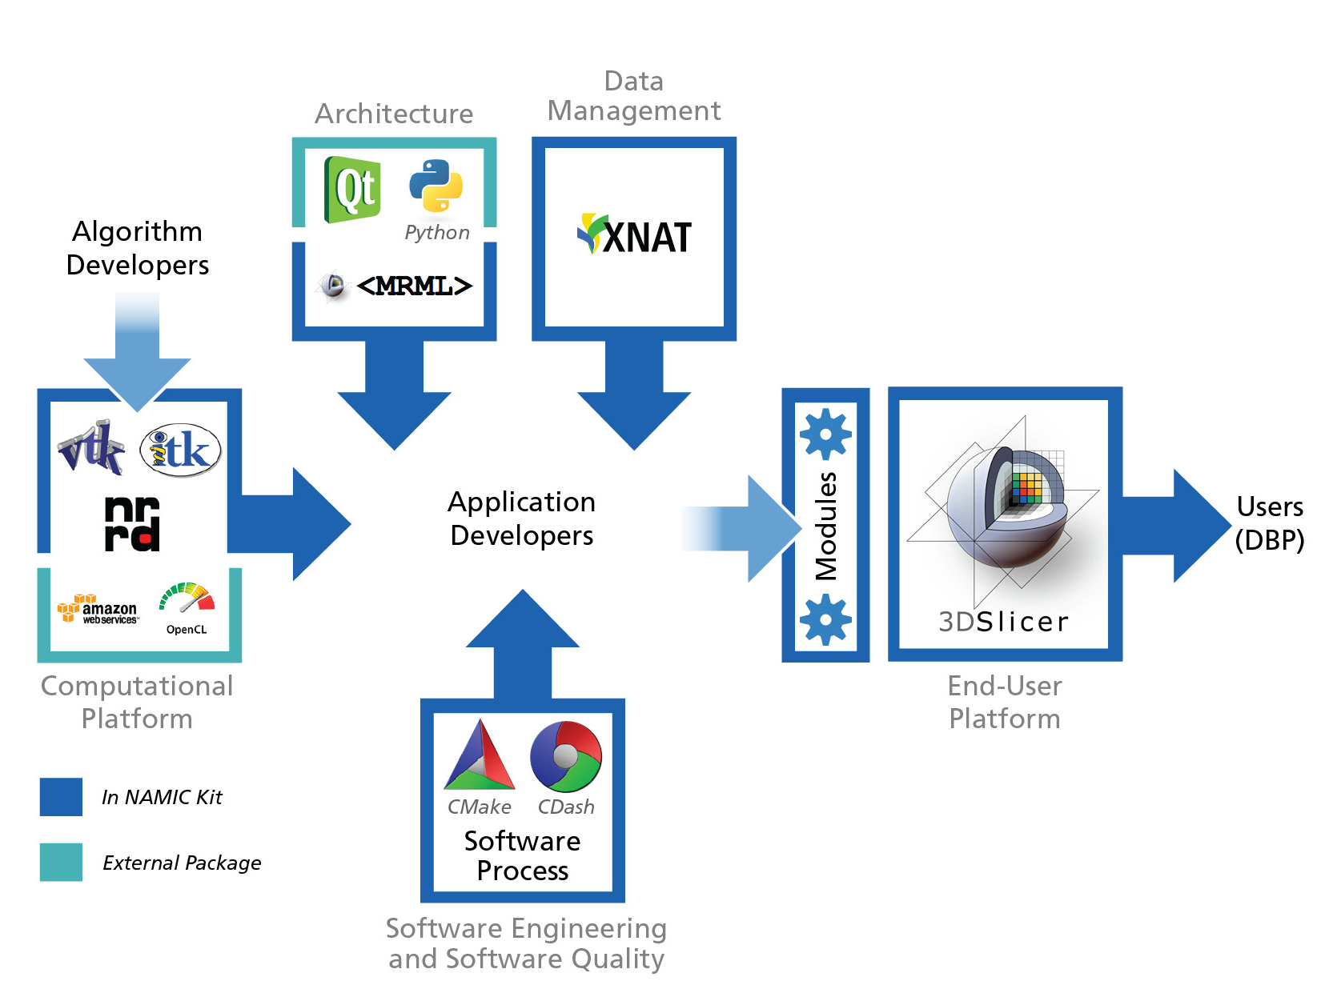
Core 1b – Engineering
5 Aims / 5 Platforms
Architecture – tools, operating paradigms, reporting mechanisms, integration points
End-user platform – interactive methods and information visualization for longitudinal analysis, exploratory data analysis, and translational research
Computational platform – stream processing, cloud computing, statistical analysis, informatics, machine learning
Data management – non-imaging and derived data, DICOM and cloud services
Software engineering and software quality – navigable timeline for revision control, build, test, documentation and release
1
4
3
2
5

Slide 12
Architecture
The architecture defines base components, services, and interfaces
The NA-MIC architecture defines how clinical researchers and algorithm developers interact with the system

Slide 13
New Capabilities
DBPs focus on patient-specific and longitudinal analysis of images
Support temporal and multi-modality
  Determine extent of disease
  Quantify change
Extend the NAMIC Kit for:
  Registration workflow in the presence of pathologies
  Interactive methods for rapid and accurate delineation of pathology boundaries
  Rich descriptors (size, structure, function) of ROIs
  Statistical methods for clustering and classifying mulitvariate measurements
  Develop interfaces to other clinical data resources

Slide 14
New Capabilities (cont.)
In conjunction with the Algorithms Core
Develop new data structures for managing multivariate time-series data
Create new interfaces to statistical libraries,
Implement new components for interactive analysis methods
that leverage accessible computing resources, e.g., GPUs and cloud computing.

Slide 15
On-going Adaptation
Recognize, accommodate, and where applicable, integrate on-going technical advances
ITK v4
VTK Informatics, interaction, rendering
CTK
Qt, Python, etc.

Slide 16
On-Going Efforts
Deploy these technologies:
Via high-quality platforms
To support our DBP’s and broader community
Delivering leading edge technology with our Algorithms Core partners

