Slide 1
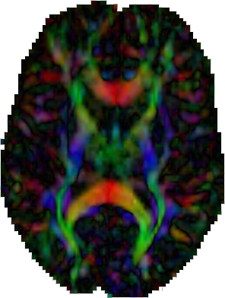
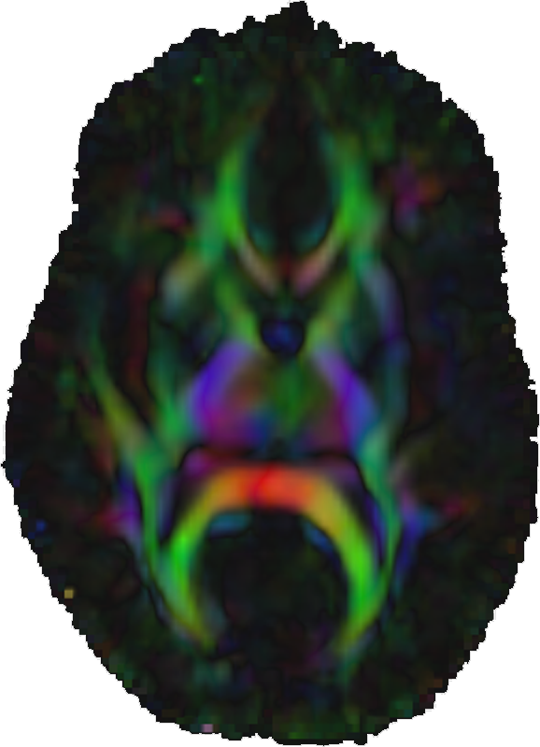
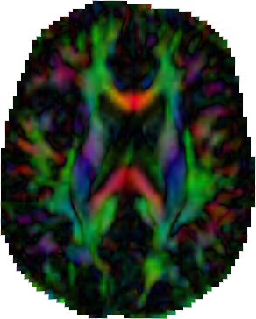
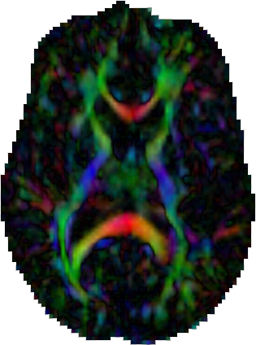
DTIAtlasBuilder
A tool to create an atlas from several DTI images
DTI Images
DTI Atlas
Adrien Kaiser
Neuro Image Research and Analysis Laboratories
University of North Carolina at Chapel Hill

Slide 2
Principle
The GUI
Basic Use
Add DTI images
Remove DTI images
Give an output folder
Optional: give a FA template
Compute the Atlas
Options
Overwriting
Affine Atlas
Diffeomorphic Atlas
Final Resampling
Load and Save
Quality Control
Software Configuration
Manual Configuration
Automatic Configuration
Load and Save
Command Line
Command Line options
No GUI mode
Grid Processing
Package
Data Organization
DTIAtlasBuilder online

Slide 3
Principle
This program will allow you to create an Atlas image as an average of several registered DTI images. The registration will be done in two steps :
Affine Registration with BRAINSFit
Non-Linear Registration with GreedyAtlas
A final step will apply the transformations to the DTI images so that the average can be computed.
Affine Registration
Non Linear Registration
Final Resampling
DTI Images
DTI Atlas

Slide 4
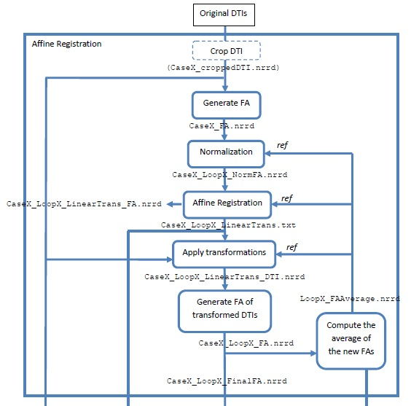
Principle
Affine Registration Part
Several loops:
Normalization and registration done with updated reference
Initial reference is first case or a template
Update reference is an average over all cases

Slide 5
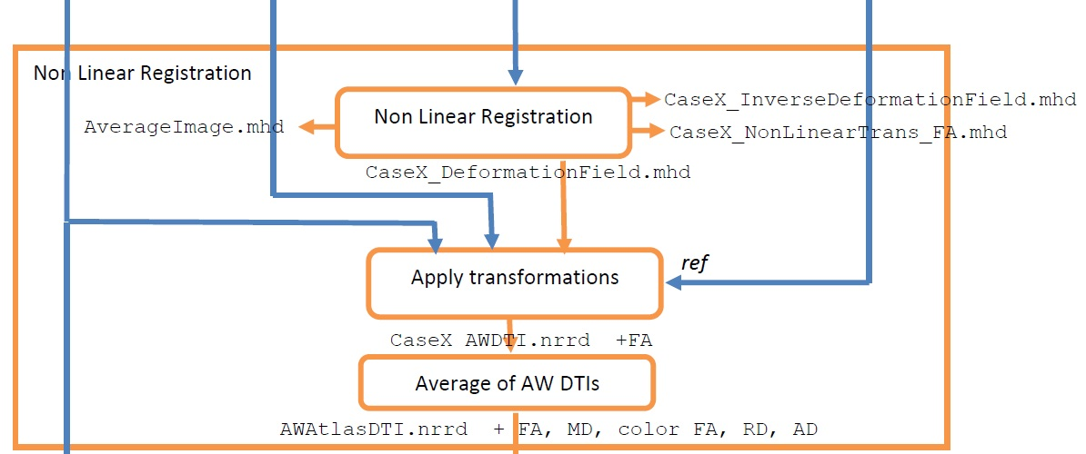
Principle
AtlasBuilding Pipeline : Non Linear Registration

Slide 6
Principle
Final Resampling Pipeline

Slide 7
GUI

Slide 8
Add DTI Images
Basic Use
Clicking the '+' button will allow you to select several DTI images, and add it to the central Cases box

Slide 9
Remove DTI Images
Basic Use
After having selected some images, you can remove them from the central Cases box by clicking the '-' button

Slide 10
Give an output folder
Basic Use
You need to give an output folder: A folder named "DTIAtlas" will be created in your output folder, and all the files generated by the program will be put in it (Data organization on slide 33)

Slide 11
Optional : Give a FA Template
Basic Use
As an option, you can give a scalar image (FA) as a template that will be used as reference for the affine registration with BRAINSFit in the first loop.
The values in this template image will be rescaled between 0 and 10 000 to avoid compatibility issues
If you do not give a template, the reference for the registration will be the first case, and then the FA average if there are loops.

Slide 12
Optional : Give a FA Template
Basic Use

Slide 13
Compute the Atlas
Basic Use
When you added cases and gave an output folder, you can compute the Atlas by clicking the "Compute" button. It will test the existence and type of the files and the folders and tell you if some files are not images or DTIs.

Slide 14
Overwriting
Options
The "Overwrite" option will allow you write the images anyway, over existing images if they were computed already.

Slide 15
Correcting Affine Atlas
Options
Initial Affine Transform :
CaseX_InitLinearTrans.nrrd in folder [OutputFolder]/DTIAtlas/1_Affine_Registration/
it will be used as an input for the Affine registration with BRAINSFit

Slide 16
Affine Atlas
Options
Safety margin => deformable registration has issues with images touching margins

Slide 17
Diffeomorphic Atlas
Options
The Diffeomorphic Atlas is the Atlas computed from the affine registered images to get the deformation fields from the affine space to the final atlas space.
These deformation fields will be applied to the original DTIs which will be used to compute the first DTI average.
You can choose the Scale Levels that you want for GreedyAtlas and also the options for the resampling and for the average computation.

Slide 18
Diffeomorphic Atlas
Options

Slide 19
Final Resampling
Options
Will be performed via DTI-Reg
Creates deformation fields from original to atlas space
Use BRAINS or ANTS

Slide 20
Final Resampling
Options

Slide 21
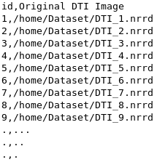
Load and Save
Save your parameters: In the « File » Menu, you can Save or Load a parameter file.
When you save the parameters, a .csv file with the dataset will automatically be created in the same directory than the parameter file.
Auto save: When you push the « Compute » button, the program will automatically save a parameter file (DTIAtlasBuilderParameters.txt) and a .csv dataset file (DTIAtlasBuilderDataset.csv) in [OutputFolder]/DTIAtlas.
It will also save a .csv file with the paths to all the interesting files generated, in this same folder (DTIAtlasBuilderResults.csv).
Save your Dataset into a CSV file so you can load it and use it again later.

Slide 22
Load and Save

Slide 23
Quality Control
By pushing one of the QC buttons, you will run MriWatcher to see the images at different steps of the compute, and check if the results are good.

Slide 24
Quality Control
Affine QC:
Affine registered FAs and last affine average computed
Deformable QC:
Deformably registered FAs and Diffeomorphic Atlas
Final QC:
Final DTI-Reg resampled FAs and final Atlas

Slide 25
Manual Configuration
Software Configuration
If you have your own version of the programs or if you need to use a particular version of it, you can write the path manually or click the button to search it.

Slide 26
Automatic Configuration
Software Configuration
By clicking the "Default" button, the program will automatically search all the programs in the PATH, and tell you if some of them are missing.

Slide 27
Automatic Configuration
Software Configuration
If you want to reset the path for one or more programs, just push the "R" button and it will search the corresponding program in the PATH.

Slide 28
Load and Save
Software Configuration
Save your configuration: In the « File » Menu, you can Save or Load a configuration file generated by the program.
You can set an environment variable manually with the name “DTIAtlasBuilderSoftPath” and contaning the path to a configuration file. It will be read at the beginning of the program to configure the softwares.
When opening the program, it will automatically search and load any file called “DTIAtlasBuilderSoftConfig.txt” in the directory where the executable is and in the current work directory.
So you can put this file in any of these folders and you will not have to set an environment variable to have to software automatically configured.

Slide 29
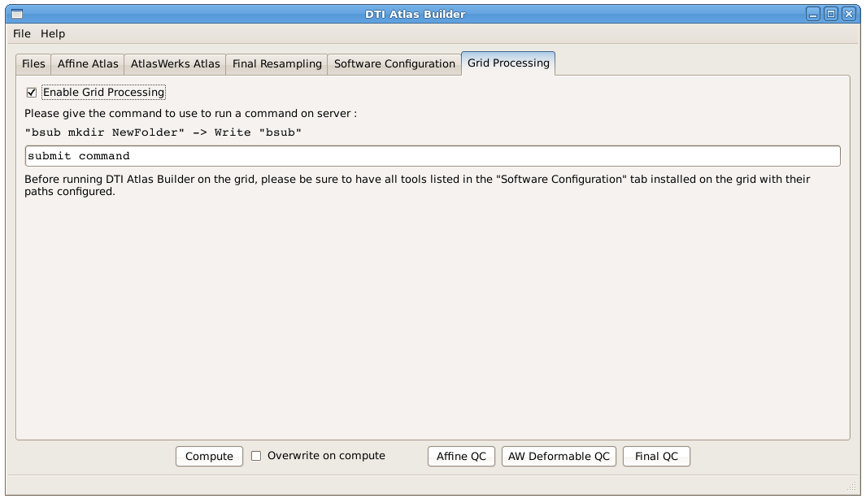
Grid Processing
If you have the possibility of using a grid processing, you can run DTI Atlas Builder on this grid by checking the corresponding box and providing the submit command for your grid. For each step of the pipeline, the commands for all the cases will be submitted at the same time, and the program will wait until all cases have been processed.

Slide 30
Data Organization
DTIAtlas
1_Affine_
Registration
2_NonLinear_
Registration
3_Diffeomorphic
_Atlas
4_Final_
Resampling
Dataset
.csv
Parameters
.txt
Results
.csv
Script
Loop0
LoopN
First Resampling
Second Resampling
…

