Slide 1
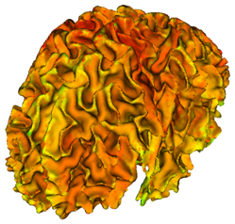
Cortical Thickness Analysis with Slicer
Martin Styner
UNC - Departments of Computer Science and Psychiatry
NIRAL, UNC IDDRC
Guido Gerig, Ipek Oguz, Josh Cates, Clement Vachet, Cedric Mathieu, Marc Niethammer

Slide 2
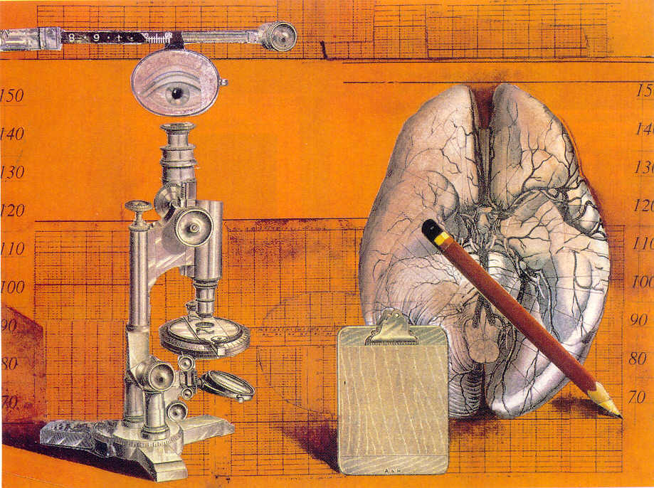
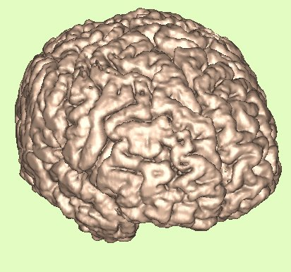
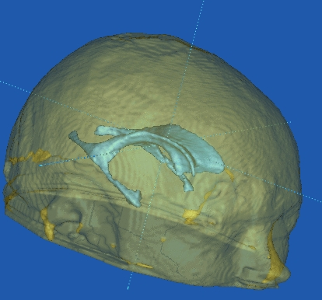
Motivation Neuroimaging
Morphometry⇔ Pathology
  Cortical Gray Matter thickness
Schizophrenia, Autism, Alzheimer’s, Huntington’s…
This talk:
  Cortical thickness examples
  Existing methods for cortical thickness
  NA-MIC/Slicer modules
  Future work

Slide 3
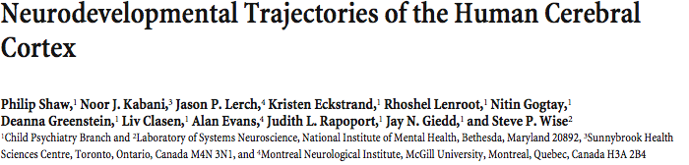
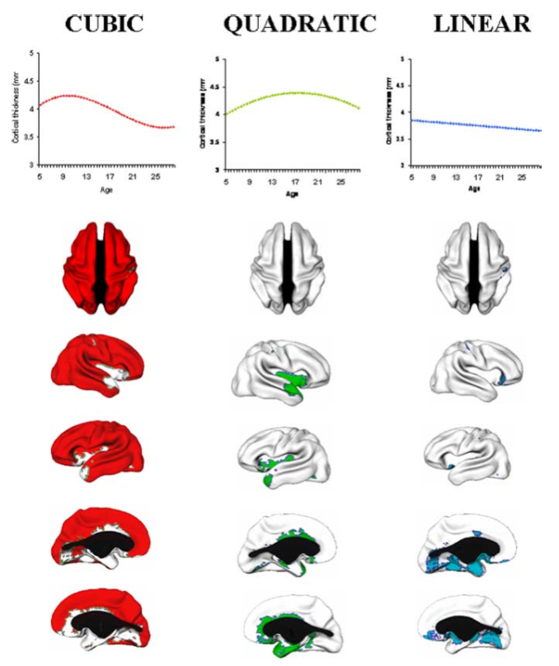
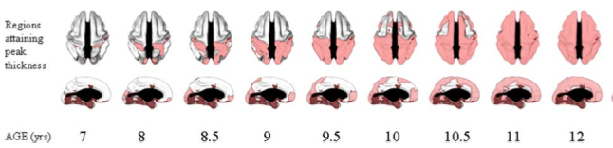

Slide 4
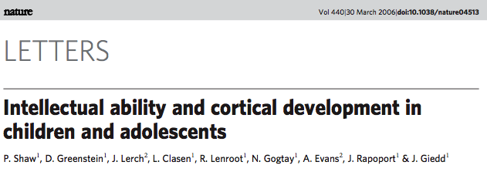
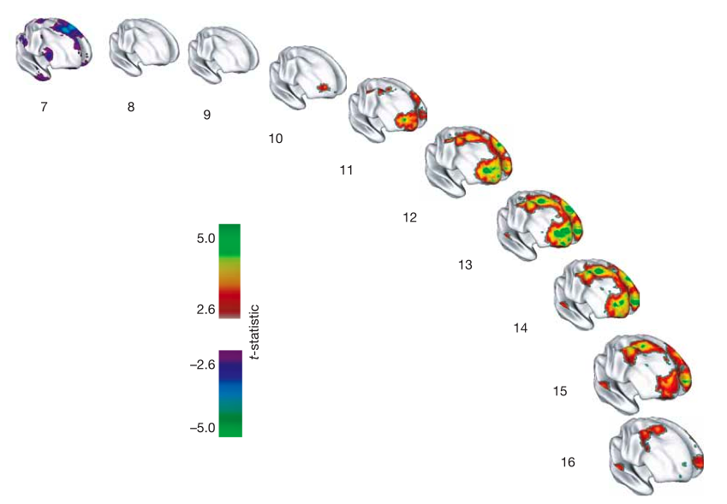
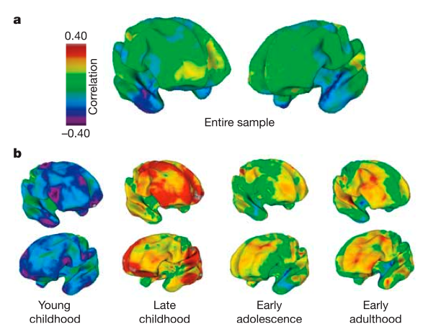

Slide 5
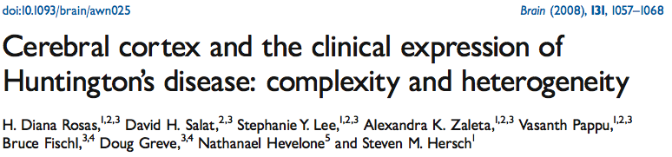
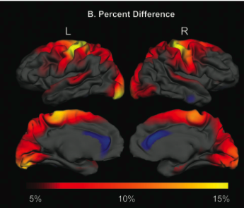
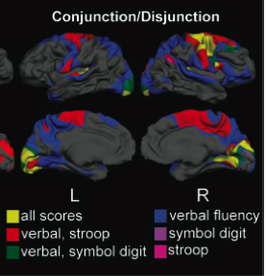
Cortical thinning
Correlation with cortical thinning

Slide 6
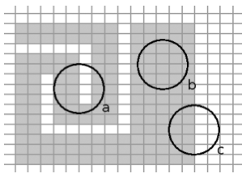
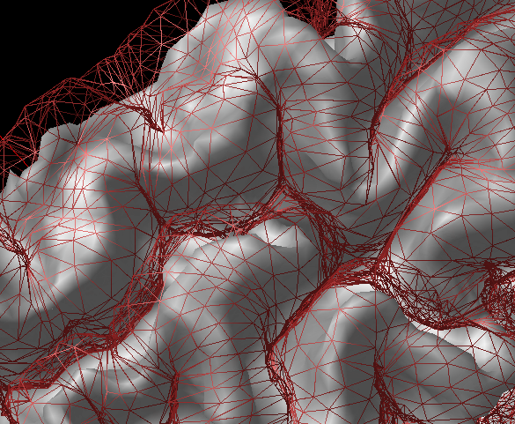
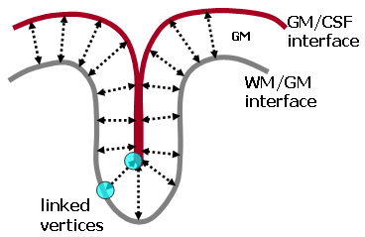
Existing Methods
Cortical thickness ≠ Graymatter density
  M Chung, TMI 2007, negatively correl.
Major methods
  BrainVoyager, Goebel
    Commercialized, Brain Innovation
  CLASP, Evans et al (MNI)
  FreeSurfer, Fischl et al (MGH)
  CRUISE, Tosun et al (JHU,UCLA,UCSF)

Slide 7
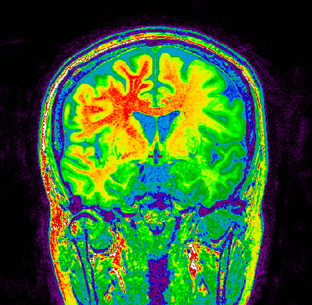
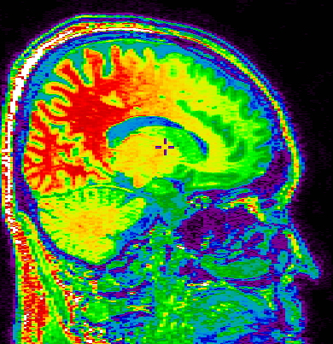
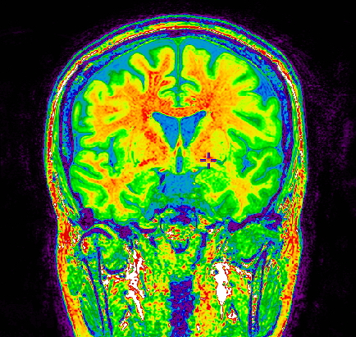
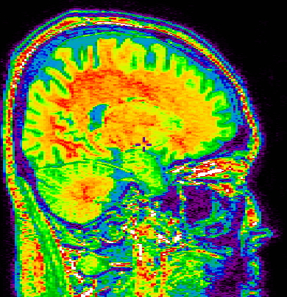
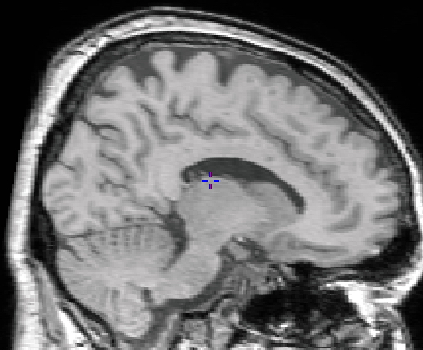
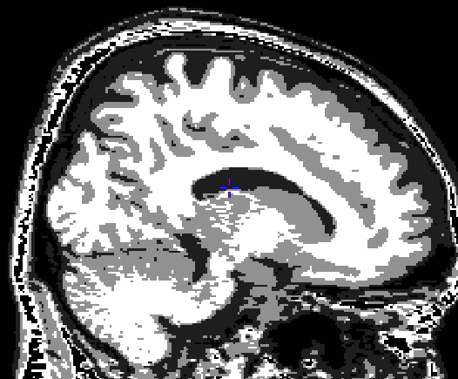
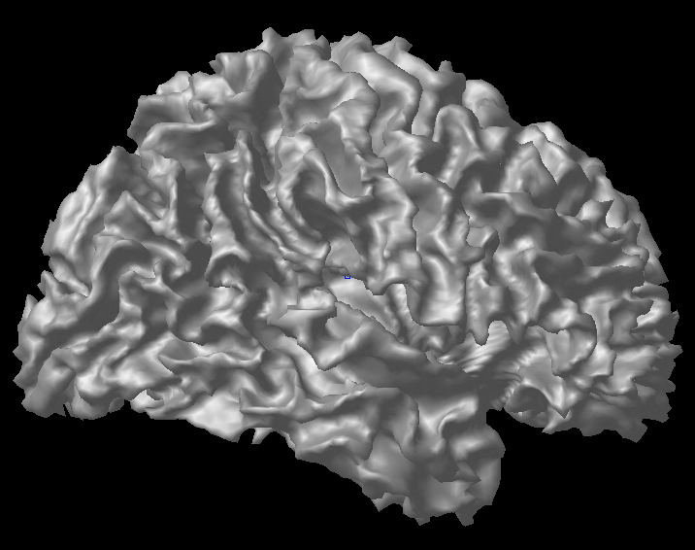
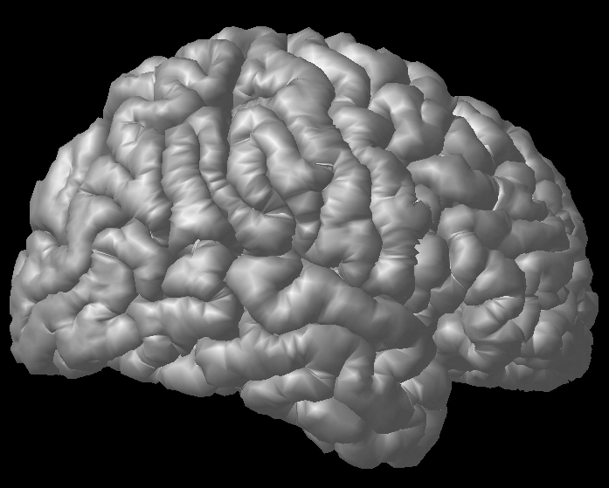
Image preprocessing & Cortical surface extraction
CLASP - MNI
Native
MR image
Intensity Non-uniformity
Correction
Spatial Normalization
to stereotaxic space
Tissue Classification
Cortical Surface Extraction
(CLASP algorithm)
Cortical thickness measurement
Notes:
Now, I talk about my second theme, cortical thickness analysis. This slide shows briefly procedure of cortical thickness measurement, it is made by Dr. Alan Evans in Montreal. Firstly, this pipeline got the raw brain image and corrected the intensity non-uniformity, because the image including intensity non-uniformity is able to get misclassifications such as thick or thin gray matter. Then, N3 program is able to correct the intensity non-uniformity. Then, Corrected image was registration to stereotaxic space. In this space, skull stripping and tissue classification was performed.
And next step, generate cortical surface. Firstly, the surface was made in white matter and gray matter interface. This white matter and gray matter interface surface expand to gray matter and CSF interface following with Laplace flow. Finally, I can measure the cortical thickness by subtracting between the vertex on outer boundary and on inner boundary. This thickness is measured in Stereotaxic space. Of course, I can obtain the native cortical thickness using inverse matrix.

Slide 8
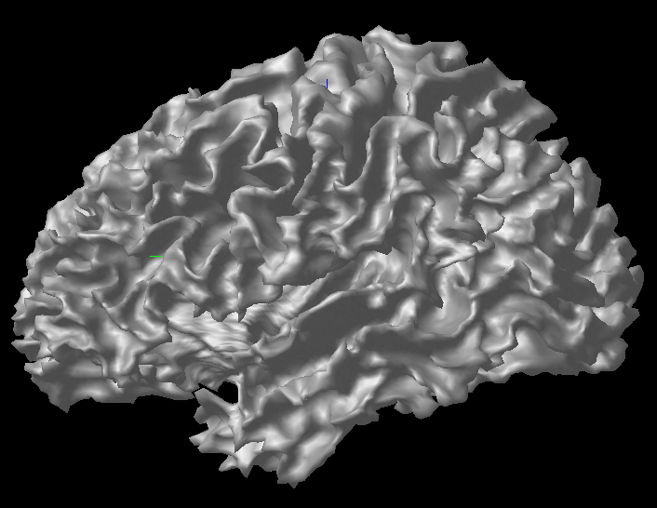
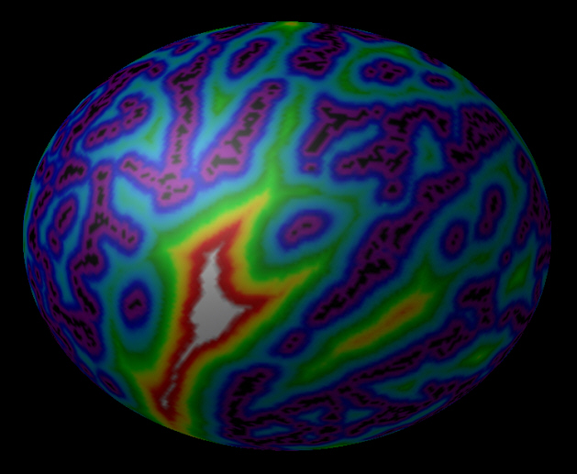
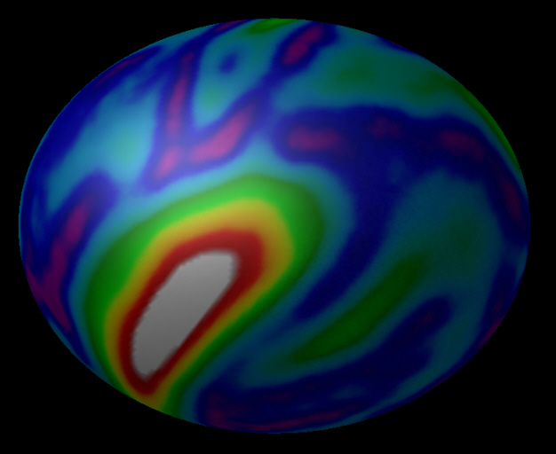
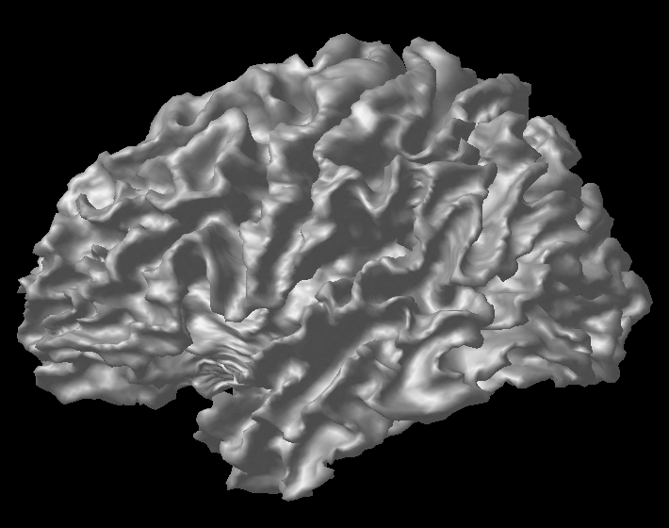
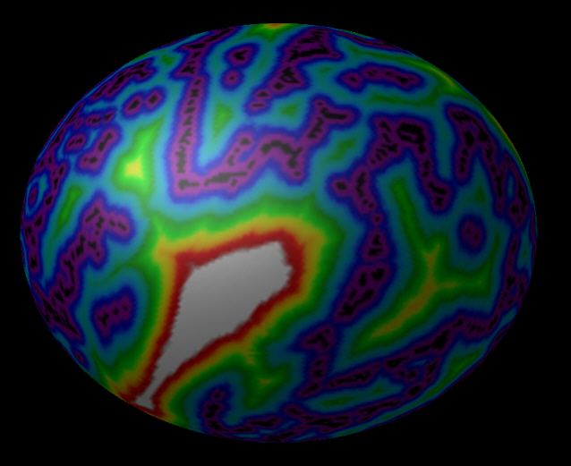
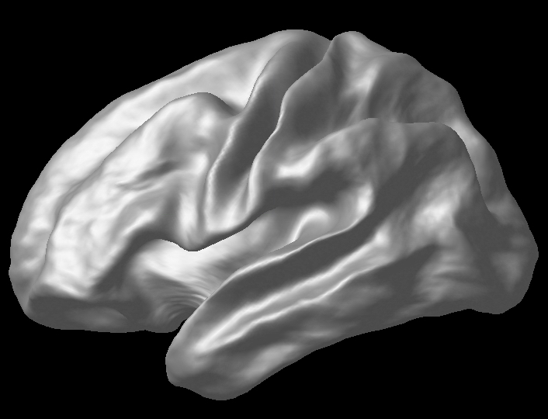
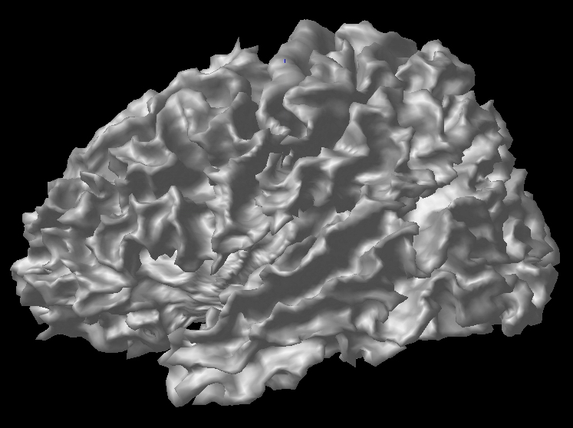
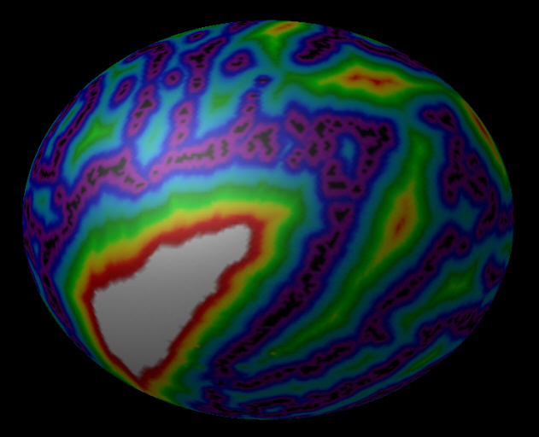
CLASP Correspondence
Nonlinear registration on 2D sphere surfaces
Spherical surface registration with sulcal depth map
Sulcal geodesic depth
Average sulcal depth
…
…
Notes:
Though I can obtain the cortical thickness, there is no correspondence between inter-subjects. So, sulcal pattern matching is able to make the correspondence. It is non-linear registration on 2D sphere surface using geodesic depth. The depth is geodesic distance between the sulcal top and sulcal fundus. After this non-linear registration step, I can have the correspondence among inter-subjects.

Slide 9
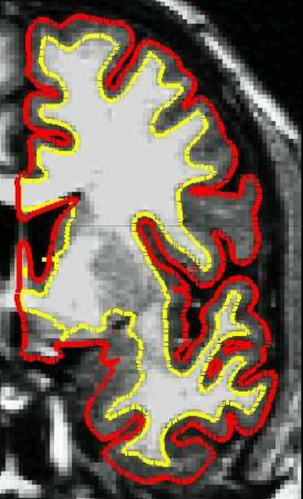
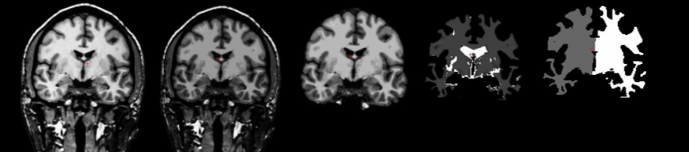
FreeSurfer
Similar preprocessing
  Different order of steps
WM from segmentation and topology correction
GM surface from evolution along T1 intensity gradient

Slide 10
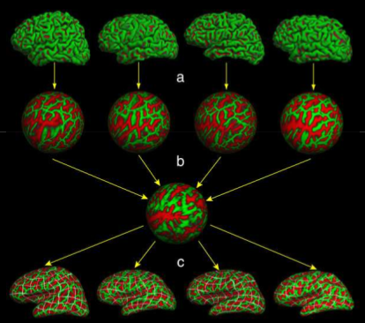
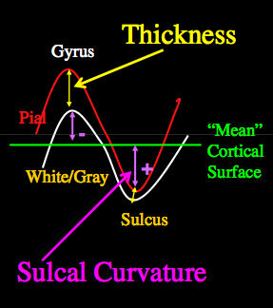
FreeSurfer Correspondence
Sulcal depth
Surface registration
to atlas

Slide 11
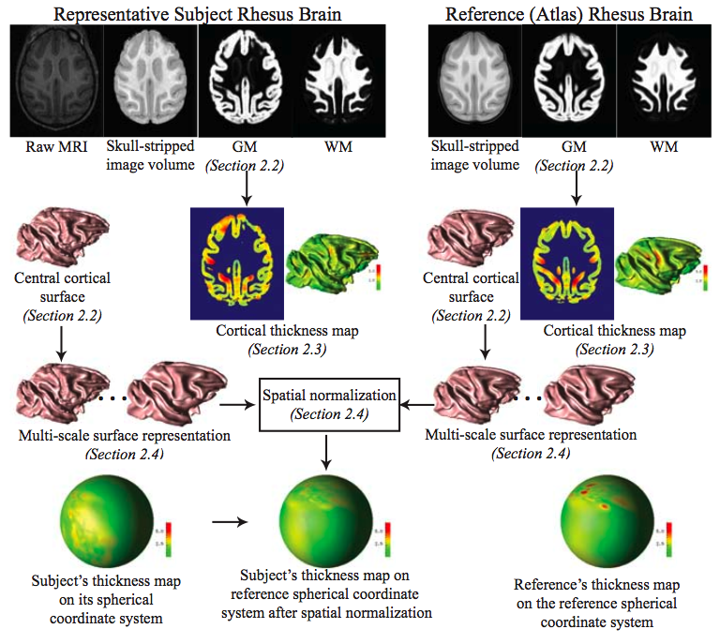
CRUISE Cortical Reconstruction Using Implicit Surface Evolution
Laplacian based
Cortical Thickness
Notes:
Can you talk a bit more here about Duygu’s method. Add the overview picture from the MICCAI paper in here.
Uses topology preserving tissue segmentation -> no need for costly topological corrections a la Freesurfer
Uses Koenderink shape/curvature features to compute correspondence
Make a full slide talking about Gaussian Kernel regression, maybe add some illustrations

Slide 12
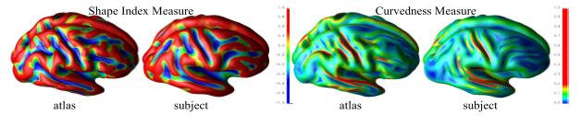
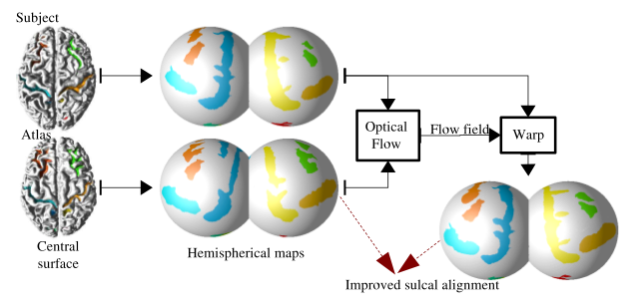
CRUISE Correspondence
Koenderink Shape Measures

Slide 13
Major Differences
Cortical topology
  Spherical topology needed?
  During or After WM/GM segmentation
Thickness measurement
  Closest point, skeleton based, deformation based and laplacian solution based
Cortical correspondence
  Many based on sulcal depth based or curvature
  Template vs Group-wise? Parametrization?

Slide 14
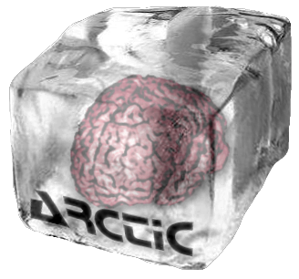
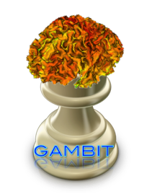
NAMIC Approach for CT
2 separate module pipelines
Regional/image based CT analysis:
  Template based registration, simple but stable, good for regional analysis
Local/surface based CT analysis
  Spherical topology, but tolerance against violations
  Group-wise correspondence
  Extensible generic framework that easily incorporates landmarks, connectivity, vessels, functional
  Full framework in open source, NAMIC Kit

Slide 15
Regional CT – Pipeline
Slicer external module (loadable via extension manager)
ARCTIC (Automatic Regional Cortical ThICkness)
Input: raw data (T1-w, T2-w, PD-w images)
Three steps in the pipeline:
1. Tissue segmentation
2. Regional atlas deformable registration
3. Cortical Thickness

Slide 16
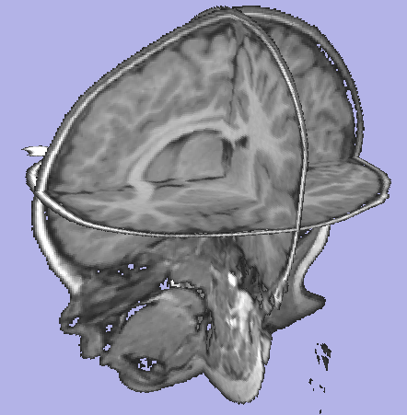
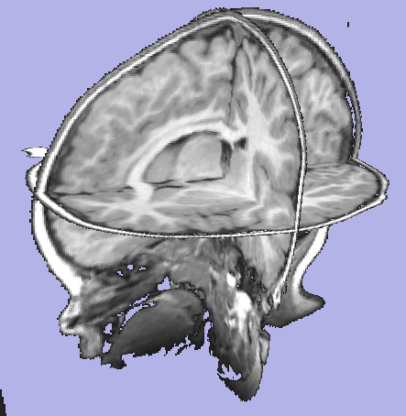
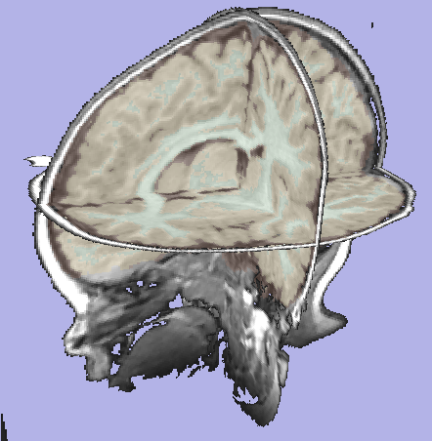
ARCTIC pipeline
Step 1: Tissue segmentation
Probabilistic atlas-based automatic tissue segmentation via an Expectation-Maximization scheme
Tool: itkEMS or ABC (Automatic Brain Classification on NITRC, UNC & UUtah)
T1w image
Corrected image
Label image

Slide 17
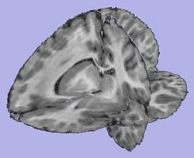
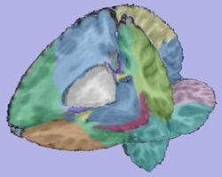
ARCTIC pipeline (2)
Step 2. Regional atlas deformable registration
2.1 Skull stripping using previously computed tissue
segmentation label image
Tool: SegPostProcess (UNC Slicer3 ext module)
2.2 T1-weighted atlas deformable registration using a B-spline pipeline registration
Tool: RegisterImages (Slicer3 modules)
2.3 Applying transformation to the parcellation map
Tool: ResampleVolume2 (Slicer3 module)

Slide 18
ARCTIC pipeline (3)
Step 3. Cortical Thickness
    Sparse asymmetric local cortical thickness
    Uses distance map based local maxima to correct for CSF/GM errors (akin to skeleton based CT)
    Tool: CortThick (UNC Slicer3 module)
Note: All the tools used in the pipeline are Slicer3 modules, some of them being UNC external modules. All can be run as command line and thus are scriptable

Slide 19
ARCTIC Validation
ARCTIC vs. Freesurfer:
Freesurfer’s tutorial dataset consisting of 40 healthy subjects, ranging in age from 18 to 93, Pearson correlation of the mean lobar CT’s
As is: Good correlation for parietal lobe, other lobes r < 0.7
When using Freesurfer’s WM/GM segmentation: all lobes r > 0.75
Also using Fressurfer’s parcellation: all lobes r > 0.85
Longitudinal autism study of 86 subjects aged 2-4 years.
FreeSurfer low success: <40% without, <70% manual intervention
ARCTIC: 98% success rate

Slide 20
GAMBIT: local CT analysis
Tissue segmentation
Group-wise Automatic Mesh-Based Analysis of Cortical Thickness(GAMBIT)
Similar processing to other local approaches
ROI segmentation
WM cortical image creation
Cortical thickness computation
WM cortical image post-processing
Genus 0 - WM image & surface creation
WM Image
fixing
Genus 0 - WM surface inflation
Sulcal depth computation
Particles initialization

Slide 21
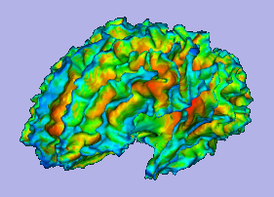
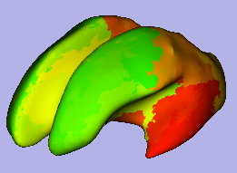
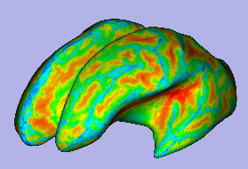
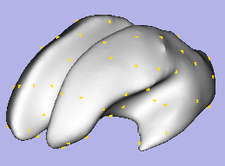
Inflation, Sulcal Depth and Particle Initialization
Sulcal Depthmap
Particle Placement
WM surface
98 Regions
Inflated surface
98 Particles at COG

Slide 22

Group-wise Correspondence
Template free
Correspondence over all surfaces
Minimum Description Length
  Davies et al
  Parametric framework
Entropy: Oguz & Cates
  UNC & Utah

Slide 23
Particle Approach (Cates & Oguz)
Point-based sampling of the surface
  Same number of particles per shape
  Very different from all other parametric approaches
Particles are ordered ➔ correspondence
Incorporates functions of position
  Local curvature, Sulcal depth, DTI connectivity

Slide 24

Entropy Tradeoff
Simultaneously maximize both the geometric accuracy and the statistical simplicity of the model
k: shape id
P: particle locations
Z: ensemble distribution
Ensemble entropy
(small = simple)
Surface entropy
(large = accurate)

Slide 25



Dealing with Cortical Geometry
Highly convoluted surface is a problem
  Particle correspondence computed on 3D image grid
Solution: run correspondence on inflated brain
  Convex move in, concave move out
CT
CT
SD

Slide 26

Experiments
9 healthy subjects
Correspondence metric: sulcal depth
Reduction of sulcal depth variance
Compare vs Freesurfer, same init

Slide 27


Open Source Framework
All BSD style open source
Slicer external modules for all individual steps
“Super” modules (ARCTIC and GAMBIT)
  Generates and run BatchMake script that calls steps
  Can be run local or on grid

Slide 28

Discussion & Future Work
Cortical thickness
  Important for neuroimaging studies
  Many tools, NAMIC cortical thickness
Next steps
  Regional CT: First study papers in review on cortical thickness in Autism (DPB II)
  Full Framework, testing, tutorials
  Cortical thickness in rodents
Cnt
FXS

