Slide 1
Image Processing Strategies
Image Biomarkers for Drug Discovery
Steve Pieper, PhD
Isomics, Inc.
http://www.isomics.com

Slide 2
Goals
Overview of Medical Image Computing
Issues
Solution Approaches
Example Projects from Current Research Activities
Emphasis on Custom Analysis Pipelines
Open Science / Open Source Software
Pointers to Additional Information

Slide 3
Outline
Background
Getting the Images
Organizing the Images
Working with the Images
Software
Examples
Tumor Change Tracking
Huntington’s Disease Tracking

Slide 4
Clinical Image Data
Retrospective Analysis Opportunities
Natural Disease Occurrence and Responses to Current Treatments
Existing Data, Low Cost to Acquire & Analyze
Full Clinical Context Difficult to Acquire
Multiple Databases in Different Departments
Inconsistent Data Formatting

Slide 5
Medical Image Informatics Bench to Bedside (mi2b2)
Builds on i2b2 (http://www.i2b2.org)
Institution-Wide Medical Records Databases: Demographics, Visits, Observations, Labs, Medications, Diagnoses, Procedures…
Query Software: Identify Patient Cohort
IRB Compliance Support
Adds PACS Access
Governed and Audited Access to Radiology Images
Exported to Research Analysis Compute Resources
4,000 Subject Baby Brain Study Underway
Normative Atlas of White Matter Development in Early Years of Life
First Example of Important Class of Research
Being Deployed at Harvard Hospitals with Catalyst
http://www.na-mic.org/Wiki/index.php/CTSC:ARRA_supplement

Slide 6
Multi-Center Image Collection
Considerations
Scanner Calibration of Sequences across Vendors and Models
Standardized Acquisition Protocols, Terminology, and Data Formats
Ongoing Calibration After Upgrades and Maintenance
Standardized Pipelines for Data Cleanup and Analysis
Statistical Methods for Identifying Site-Specific vs Subject Variability
Best Practices Cookbooks in MR
Biomedical Informatics Research Network (BIRN)
Guidelines for Structural, fMRI & dMRI
THPs (Traveling Human Phantoms) Very Valuable
http://www-calit2.nbirn.net/research/function
http://www-calit2.nbirn.net/research/morphometry

Slide 7
Organizing Images and Related Data
DICOM / PACS
“Native” Format for Medical Images
Often Does Not Support
Emerging Imaging Types
Derived and Non-Imaging Data
Open Image Informatics Tools
XNAT – http://www.xnat.org
Neuroimaging, fMRI…
MIPortal - http://cmir.mgh.harvard.edu/bic/miportal
Small Animal Imaging…
MIDAS - http://midas.kitware.com/
Digital Library…

Slide 8
Visualization: Seeing the Images
Displays to Enhance Interpretation
Interactivity for Rapid Assessment of Large Collections of Images
Specialized Modes to Emphasize Features of Interest
2D/3D Localized Changes
Statistical Maps of Group Differences
Display Conventions (Image Orientations, Color Coding, Interactive View Controls…)

Slide 9
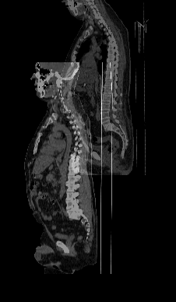
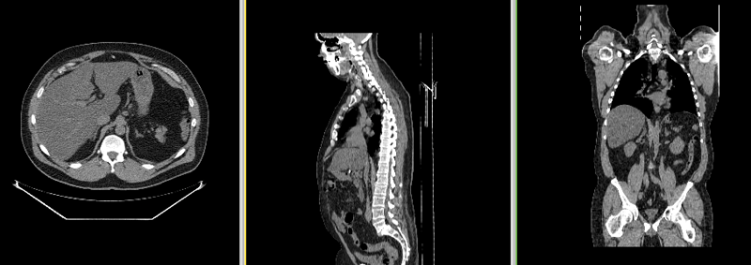
Registration: Change Detection
Identify Corresponding Anatomical Regions
Linear and Non-Linear Mappings
Control for Normal Changes
Pose in Scanner
Metabolic Differences (Digestive/Respiratory/Cardiac Cycles, Weight Gain/Loss…)
Scan Artifacts
Detect & Quantify Important Differences
Pathology Growth/Shrinkage
Functional Differences
Overall Atrophy, Edema, Other Responses…
NA-MIC Use Case Library
Dominik Meier, BWH
http://na-mic.org/Wiki/index.php/Projects:RegistrationDocumentation:UseCaseInventory

Slide 10
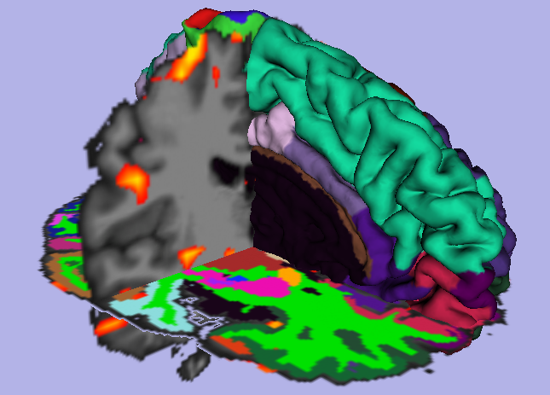
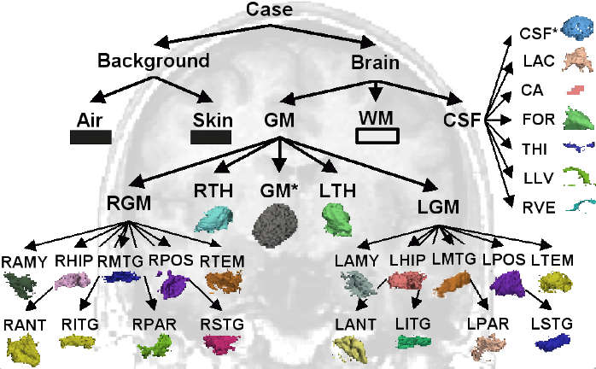
Segmentation: Anatomical Labeling
Image Driven Tissue Differentiation
Self-Referenced
Atlas-Based
Basis for Region-Specific Change Quantification
With Respect to Subject Baseline
With Respect to Population
Software
EMSegmenter, Kilian Pohl, University of Pennsylvania
FreeSurfer, Bruce Fischl et al, Massachusetts General Hospital
http://slicer.spl.harvard.edu/slicerWiki/index.php/Modules:EMSegmenter-3.6
http://surfer.nmr.mgh.harvard.edu/

Slide 11
User Intervention and QA
Fully Manual
Protocols for Measurement
User-Steered
Select Seed Point or Volume of Interest
Automated
Highly Dependent on Acquisition Quality
QA
Always Required to Detect and Fix the Failures of the Automated Methods
Always Required to Detect and Fix the Failures of the Human Operators

Slide 12
Image Processing Software
FDA Regulated Commercial Products
Optimized for Existing Clinical Procedures
Research Software
“Latest and Greatest”
Often Inconsistently Validated and Supported
Open Source Software
Many Varieties: Check License for Restrictions on Commercial Use (Not Truly “Open”)
Arguably Greatest Flexibility and Community Support

Slide 13
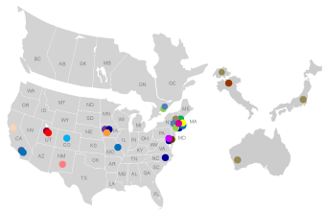
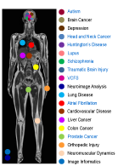
National Alliance for Medical Image Computing: http://www.na-mic.org
Over A Dozen Collaborating Institutions Delivering Open Platform
NIH Funded National Center for Biomedical Computing
Builds on Existing Open Software Technologies
http://itk.org http://vtk.org http://python.org http://slicer.org http://cmake.org http://qtsoftware.org
Provides Integration, Training, Support
Develops Custom Algorithms for Driving Biological Projects

Slide 14
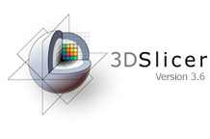
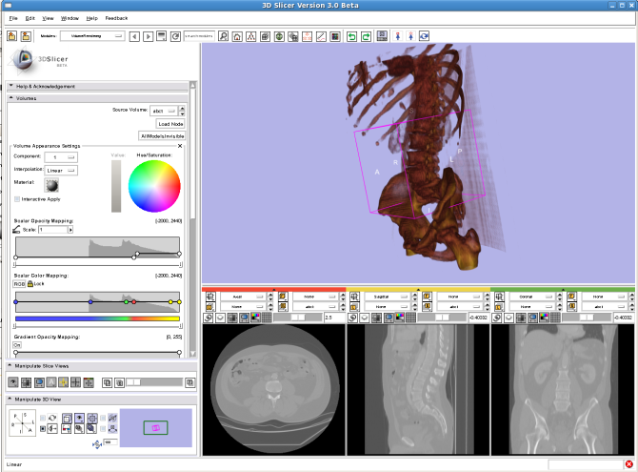
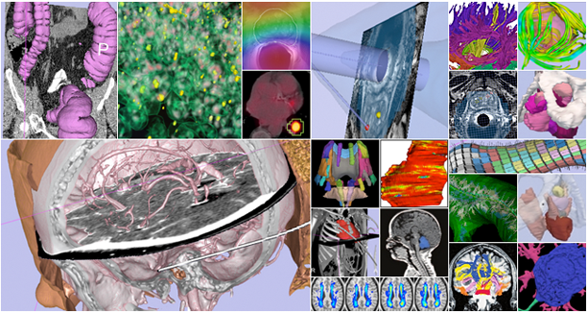
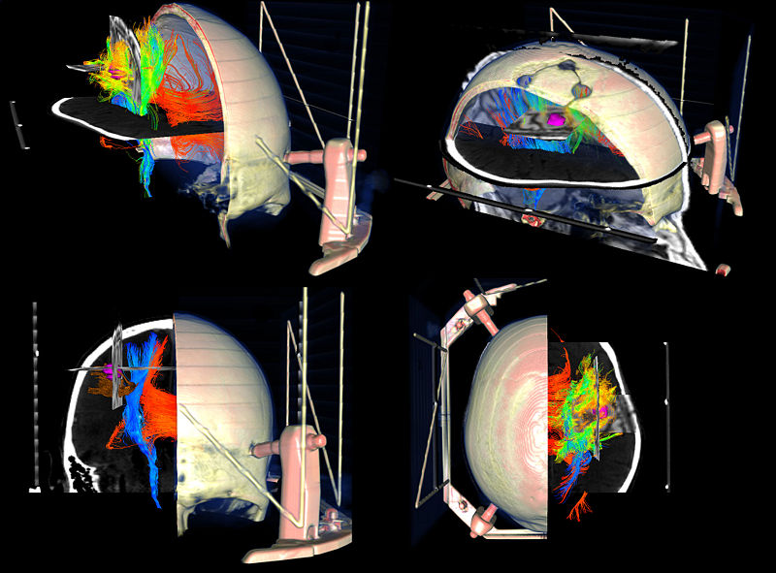
3D Slicer: http://slicer.org
Multi-OS End-User Application (Windows, Linux, Mac)
Medical Image Visualization and Analysis
Multi-Modal: CT, MR, fMRI, dMRI…
Integrated View: Images, Surfaces, Annotations, Devices…
Extensible Architecture
Dozens of Custom Modules
Application Specific Functionality
Fully Open and Non-Restrictive License
All Source Code Available
Can Be Used in Commercial or Proprietary Projects

Slide 15
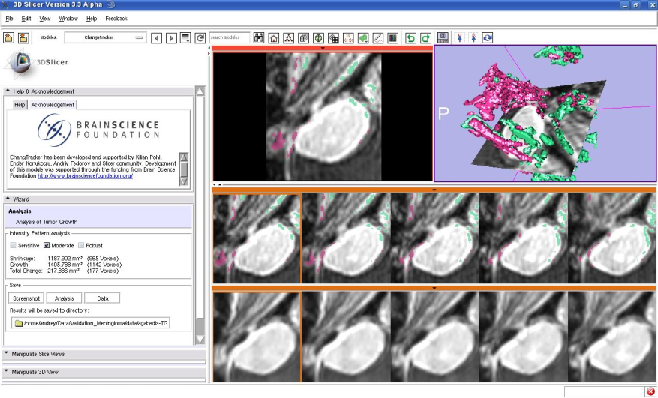
Change Tracker
3D Slicer Interactive Module
Workflow for Analysis of Small Volumetric Changes
Between Two Time Points
Same Acquisition Parameters
Investigators:
Kilian M Pohl, PhD – University of Pennsylvania
Ender Konukoglu, PhD – INRIA Sopia Antipolis
Andriy Fedorov, PhD – Brigham and Women’s Hospital
http://www.slicer.org/slicerWiki/index.php/Modules:ChangeTracker-Documentation-3.6

Slide 16
Evaluating Tumor Size and Shape
Established Techniques
Uni-dimenional or Bi-dimensional Measurements
RECIST (Response Evaluation Criteria in Solid Tumors)
Issues
May Fail to Detect or Quantify Small Changes
Difficult to Assess Volumetric Changes
Higher Sensitivity and Specificity Desired to Improve Statistical Power
Reduce Number of Subjects
Shorten Time Required for Significant Results
http://www.eortc.be/recist/documents/RECISTGuidelines.pdf

Slide 17
Example: Meningioma
Acquisition:
Axial 3D SPGR T1 Post-Gadolinium Scans (Voxel dimension: 0.94mm x 0.94mm x 1.20mm, FOV: 240mm, Matrix: 256 x 256)
Homogeneous Contrast Enhancement in Both Time Points
Baseline Radiologist’s Clinical Impression
Large Falcine Lesion is Identified
Measures 3.1 cm Anteroposteriorly, 3.05 cm from Side-to-Side, 3.5 cm in Height
Enhances Moderately on Post-Gadolinium Imaging
Follow-up Radiologist’s Clinical Impression
Left Frontal Lobe Mass Appears Unchanged on all Series
Measures 3.3 x 3.2 cm in Maximum Dimension
Enhances Moderately on Post-Gadolinium Imaging
SCAN1
Baseline: June 2006
SCAN2
Follow-up: June 2007

Slide 18
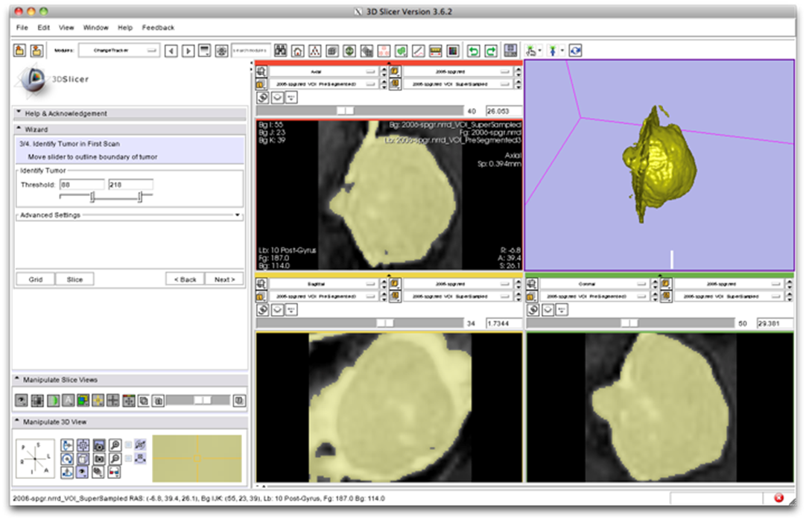
Steered Segmentation
Identify Volume of Interest
Select Enhancement Threshold

Slide 19
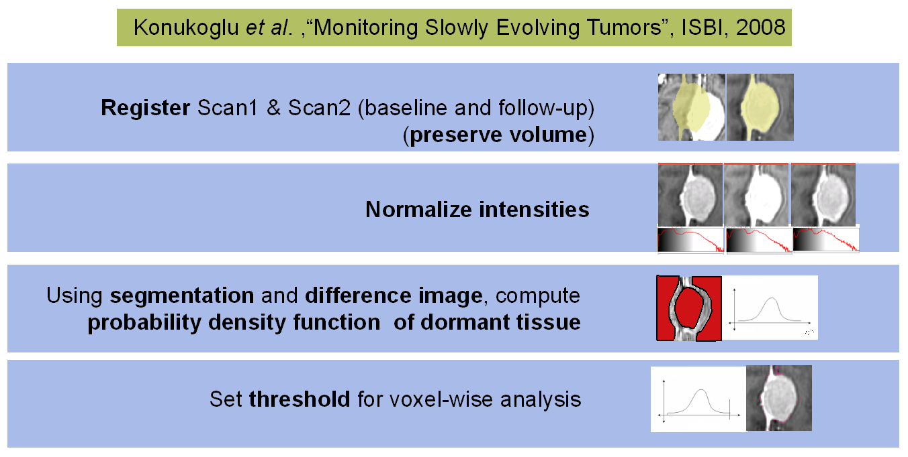
Time Point Correlation

Slide 20
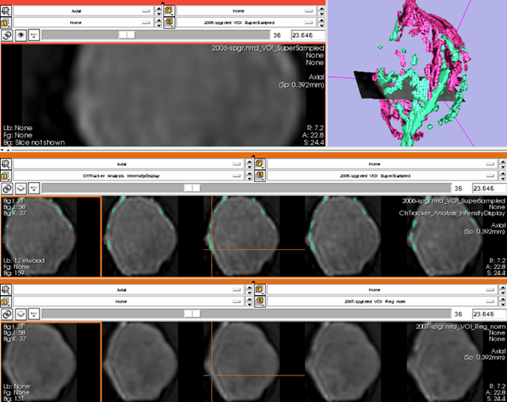
Integrated Visualization
3D Rendering of Volume Change: magenta = growth green = shrinkage
Aligned Slice Views
Linked Crosshair for Image Exploration

Slide 21
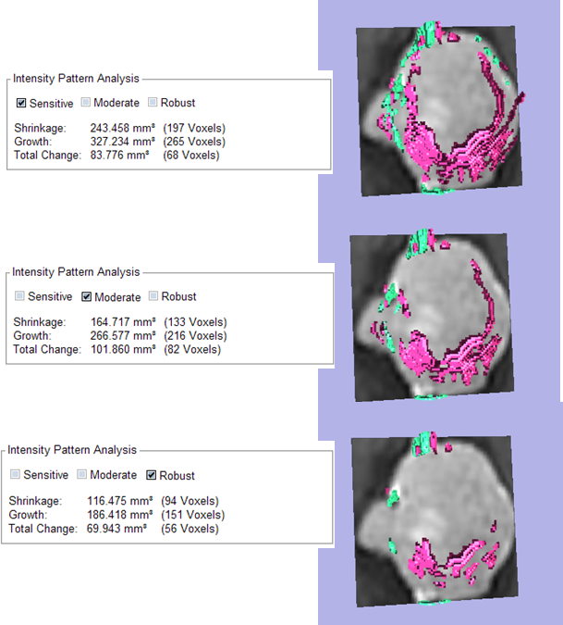
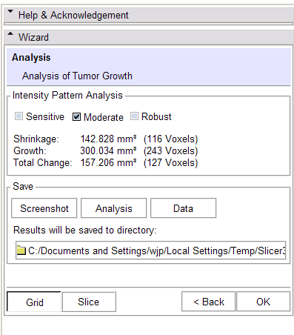
Pattern Analysis and Quantification

Slide 22
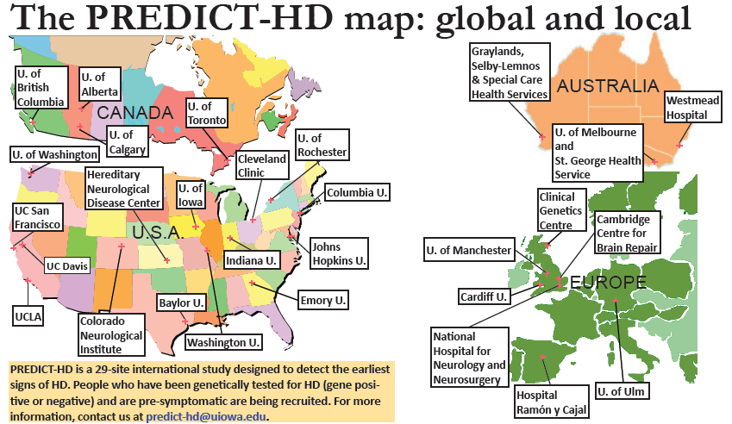
PredictHD
Genetic and Imaging Study
Detect Early Signs of Huntington’s Disease
NA-MIC Collaboration with
Hans Johnson and Colleagues at University of Iowa
http://www.predict-hd.net/

Slide 23
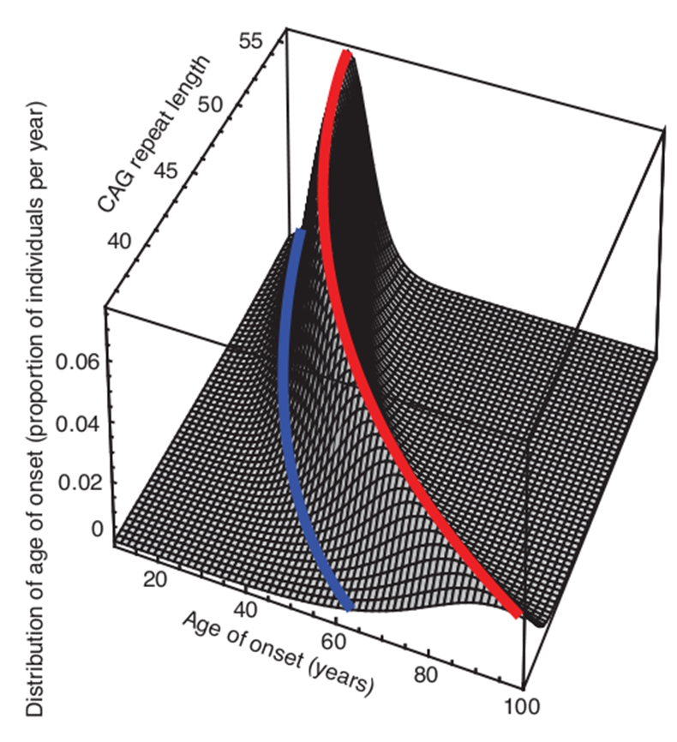
Motivations
HD is a Neurodegenerative Disease
Affects Muscle Coordination, Behavior, and Cognitive Function
Causes Severe Debilitating Symptoms by Middle Age
Genetic Markers (CAG) Identify At-Risk Individuals
Brain Atrophy at Time of Death is Obvious and No Doubt Precedes Diagnosis
High-Risk Treatments (such as Implantable Drug Delivery Systems) Must be Weighed Against Likely Disease Progression

Slide 24
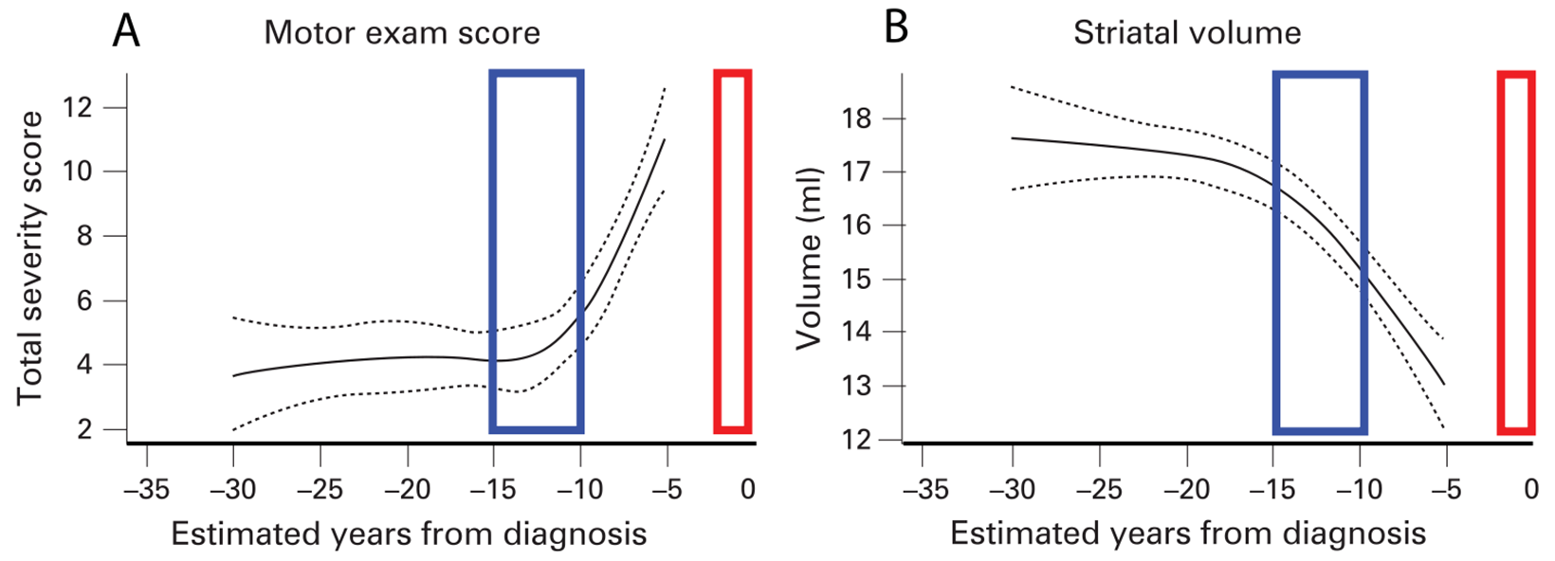
Regional Brain Volume and White Matter Integrity Changes May Even Precede Clinical Symptoms
Accurate Detection Requires:
Well Calibrated Acquisitions
Robust Analysis Pipelines
Registration
Segmentation
Diffusion Analysis

Slide 25
TRACK-HD Stage 1 HD Subject
Baseline Scan

Slide 26
TRACK-HD Stage 1 HD Subject
Year 1 Scan

Slide 27
TRACK-HD Stage 1 HD Subject
BSI Overlay
Tissue loss
Tissue gain
Atrophy Rate: 1.9% Premanifest Rate: 0.7% Control Rate: 0.2%

Slide 28
TRACK-HD Premanifest A Subject: voxel-compression mapping
12-month atrophy
24-month atrophy
Contraction ≤ 20%
Expansion ≥ 20%

Slide 29
24-month voxel-compression mapping
Control
PreA
HD2

Slide 30
Change in WM vs controls (n=96)
PreHD-A (55)
PreHD-B (42)
HD1 (50)
HD2 (27)

Slide 31
Summary
Medical Image Computing
Powerful Tool Quantify Changes Due to Disease and Treatment
Careful Attention is Required
Acquisition, Processing, and Interpretation
Resources
Published Best Practices
Freely Available Tools

