Slide 1
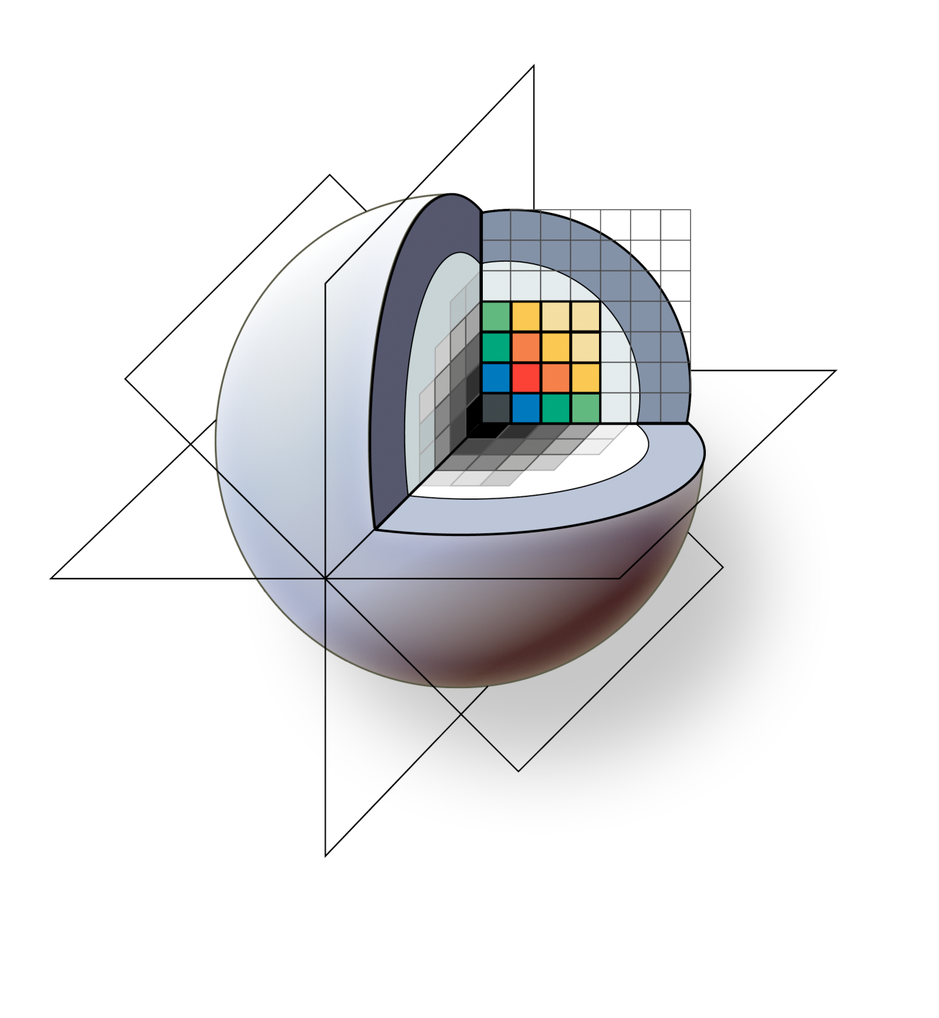
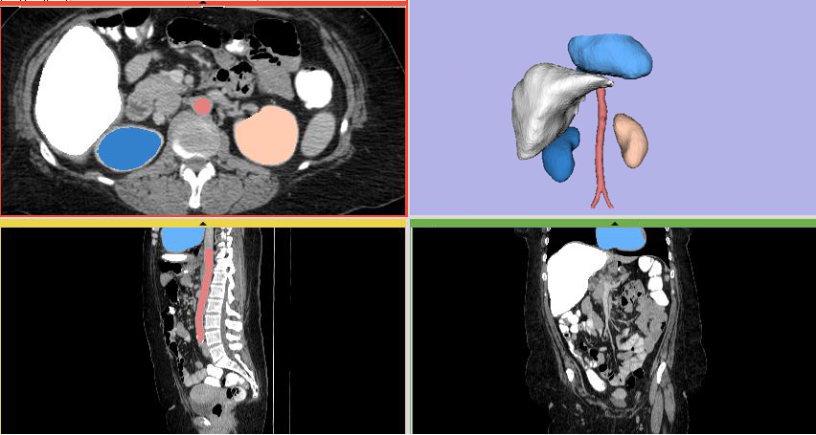
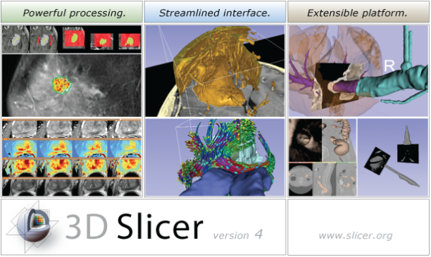
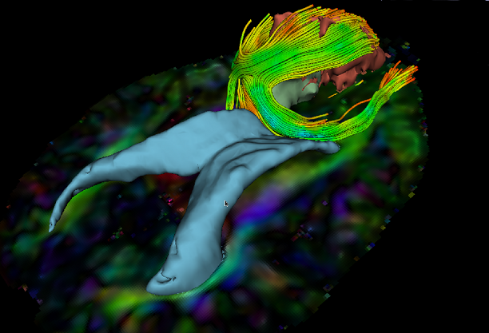
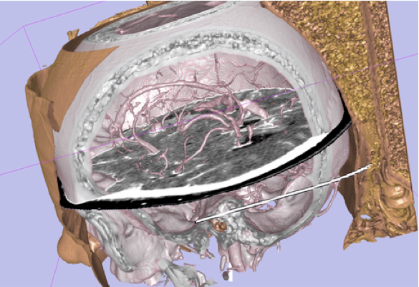
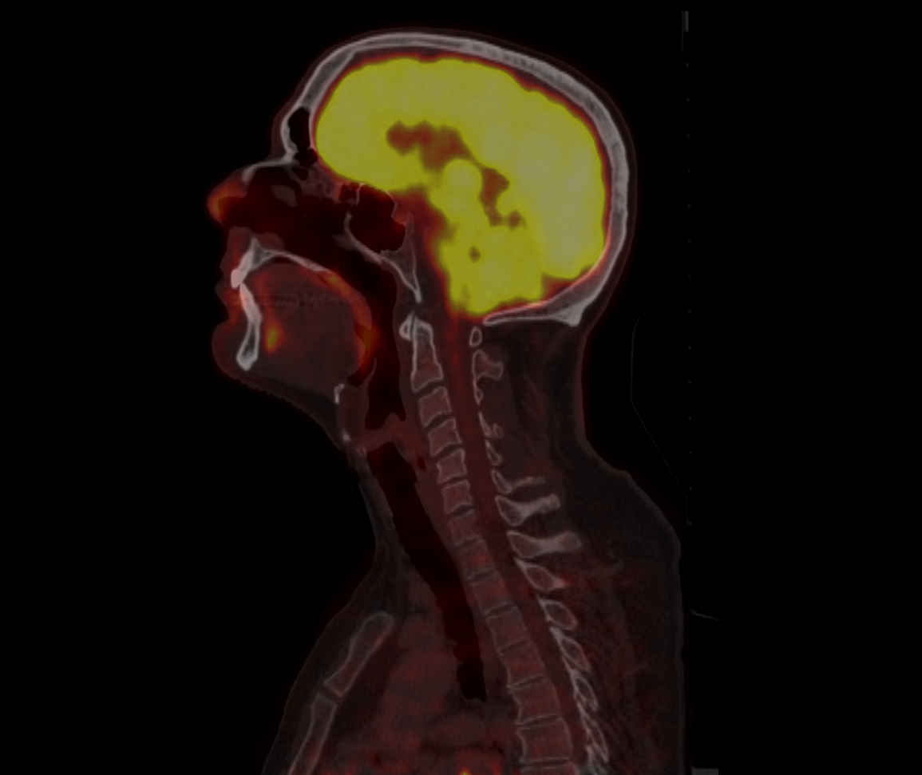
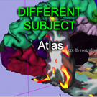
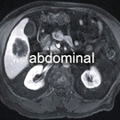
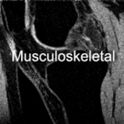
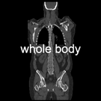
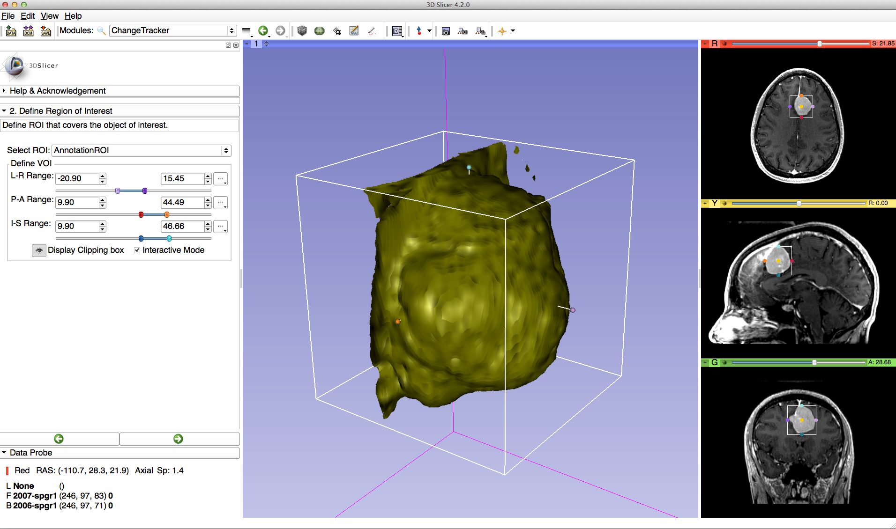
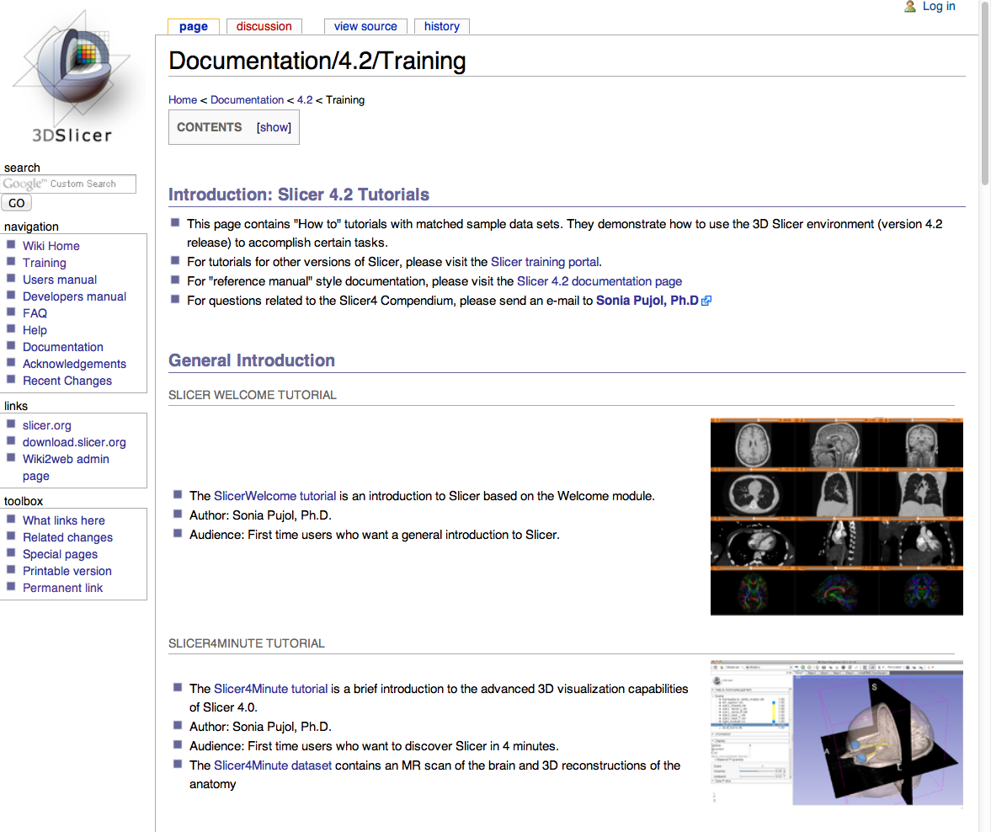
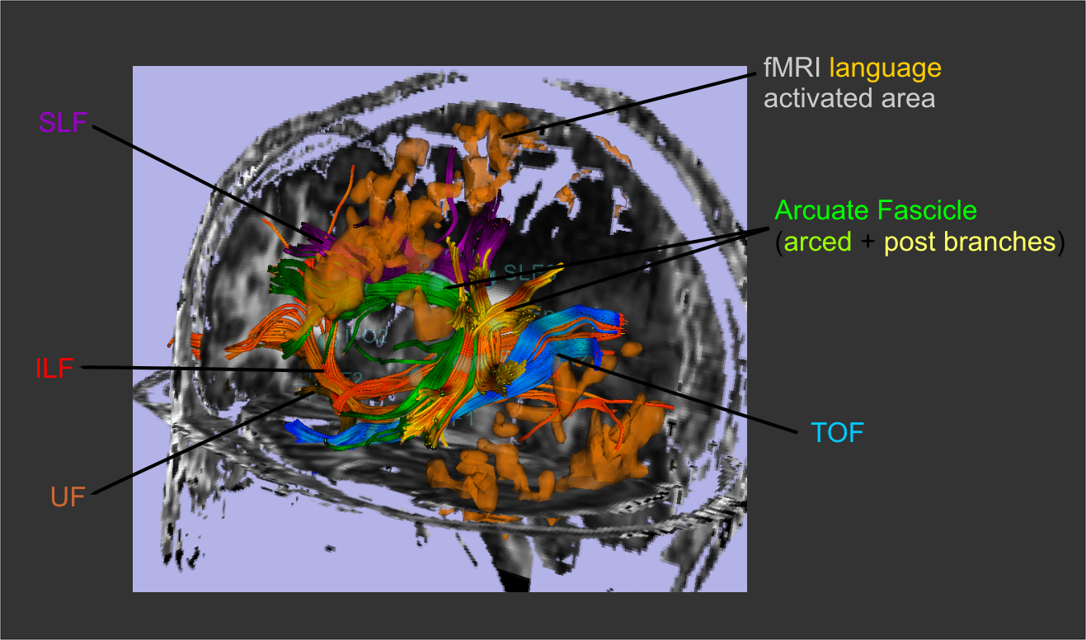
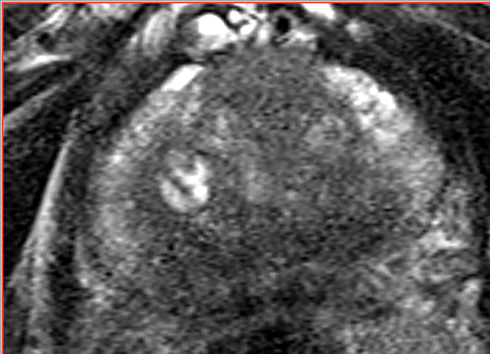
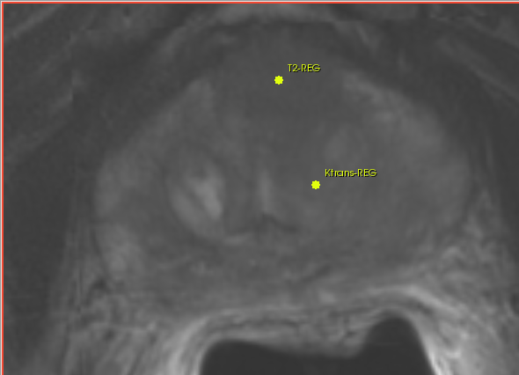
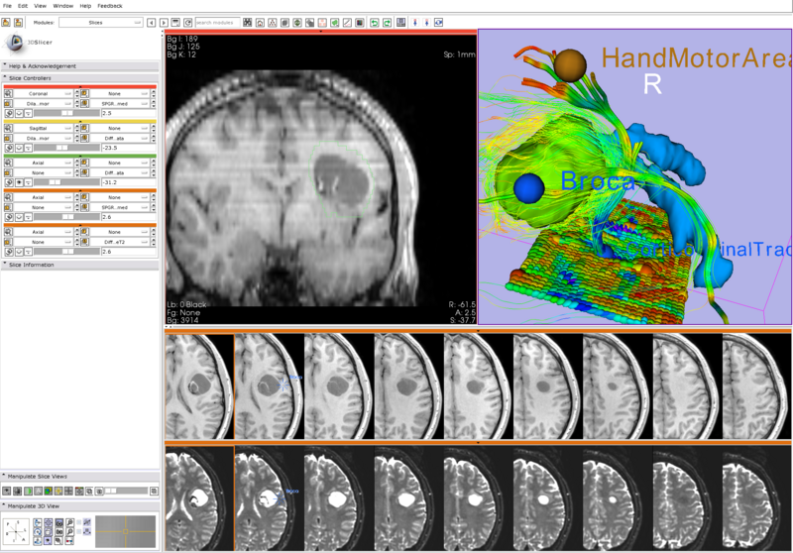
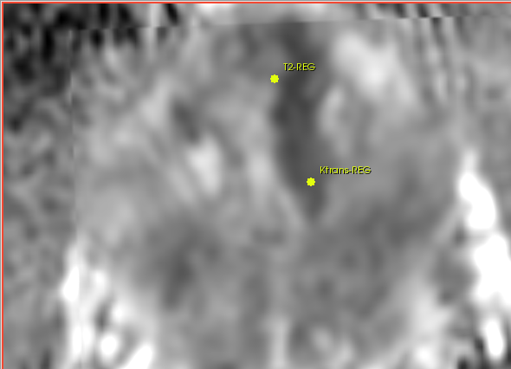
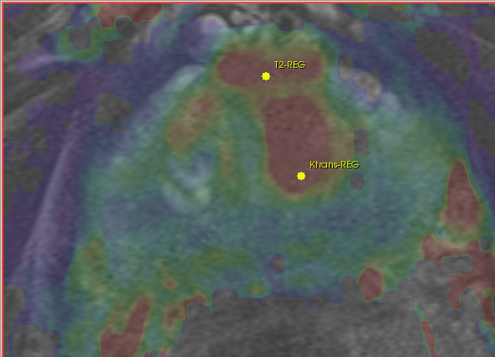
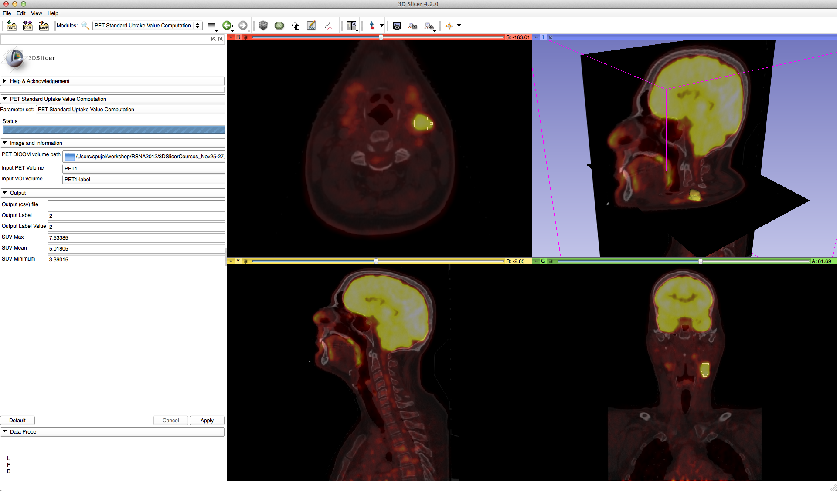
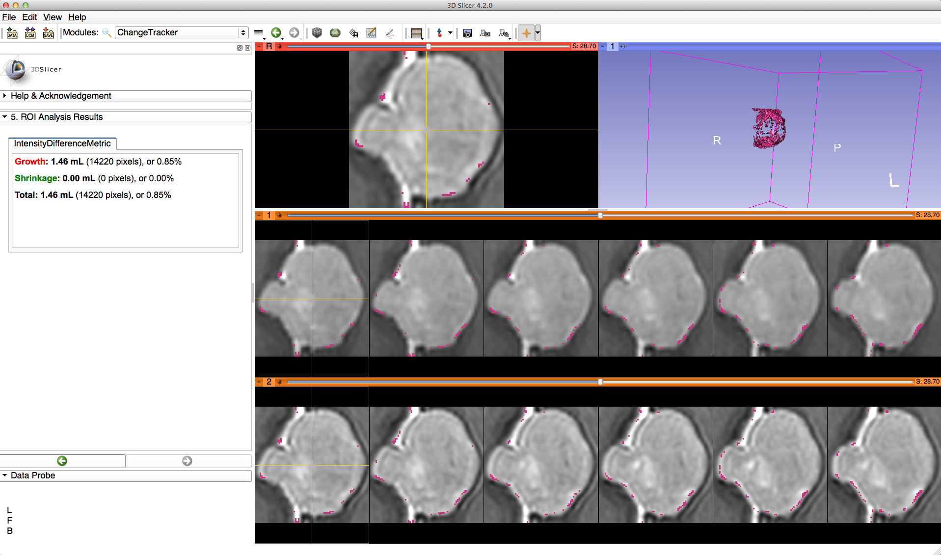
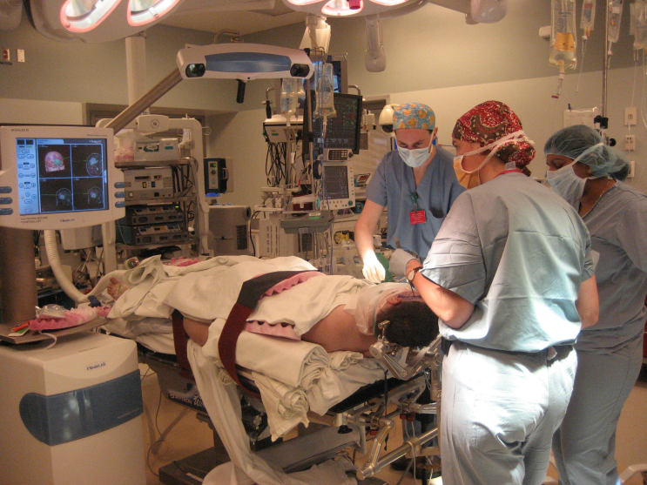
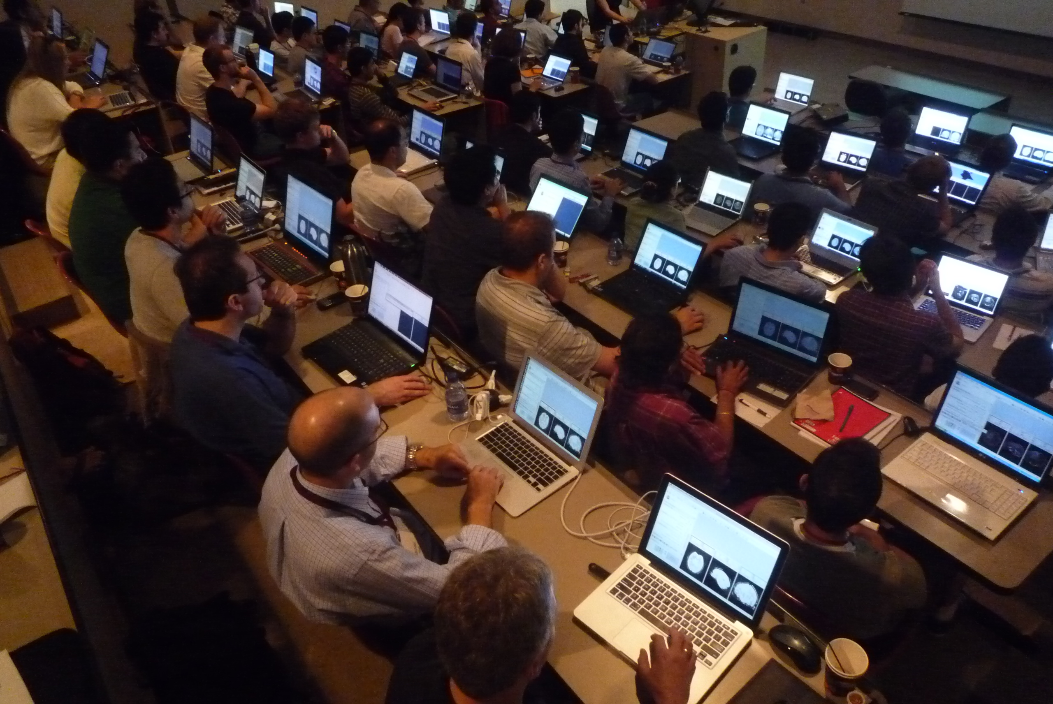
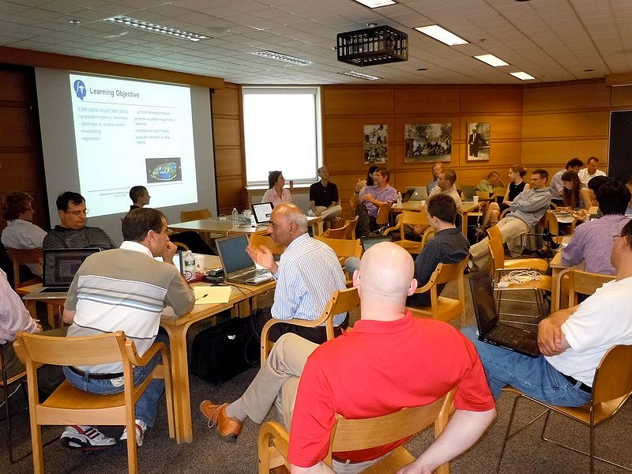
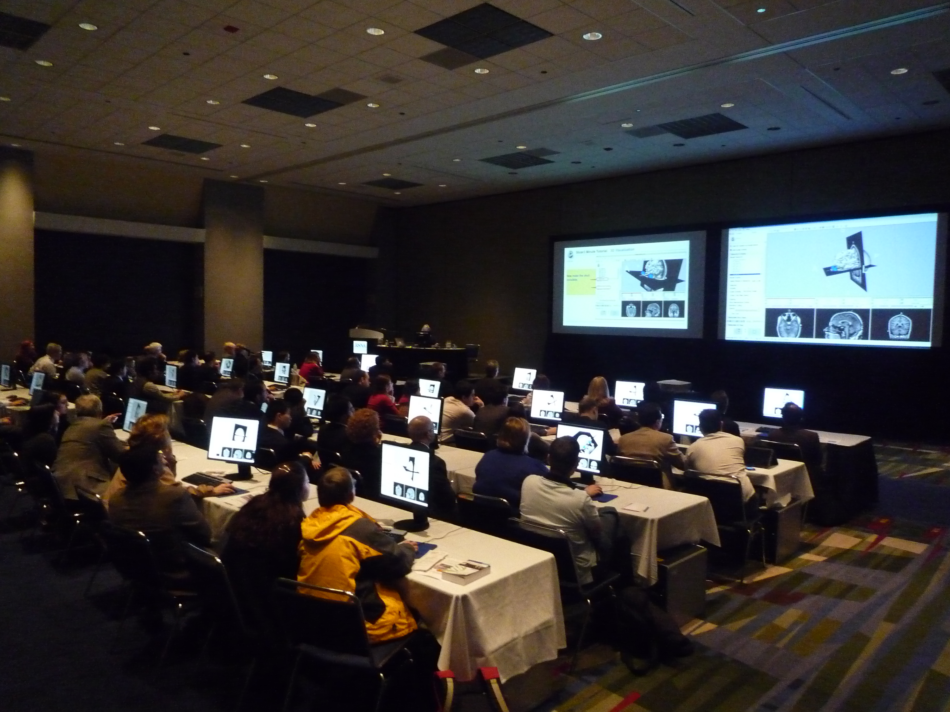
RSNA2012 Quantitative Imaging Reading Room
3DSlicer: An Open Source Platform for Segmentation, Registration,
Quantitative Imaging, and 3D Visualization of Multi-Modal Image Data
Sonia Pujol, Ph.D., Steve Pieper, Ph.D., Andriy Fedorov, Ph.D., Ron Kikinis, M.D.
About 3D Slicer
Segmentation & Registration
Multi-modality Visualization
3D Slicer is a multi-platform, free and open source software package for visualization and medical image computing.
Segmentation is required for defining features of interest in imaging data for quantification and analysis.
A combined visualization of multiple imaging modalities and derived data can provide clinician scientists with an integrated understanding of anatomy and pathology.
The software platform is community created for the purpose of subject specific medical image analysis and visualization. Slicer includes support for:
3D Slicer has a variety of interactive and automated segmentation methods:
support for manual contouring and editing
region growing and level sets
graph cuts with gesture support
skull stripping and hierarchical brain segmentation for morphological studies
The desktop application provides interactive visualization of the results and an intuitive GUI.
3D Slicer offers a suite of layouts and the ability to visualize many types of data including:
greyscale volumetric data
parameter maps and VOIs
surface models & glyphs
measurement tools & annotations
tracking devices
Fast new hardware accelerated volume rendering is available in 3D Slicer version 4.2
Multi-modality imaging including, MRI, CT, US, nuclear medicine, and microscopy
Multi organ from head to toe
Bidirectional interface for devices
Expandable and interfaced to multiple toolkits
Timeseries analysis and multi-subject analysis require good registration of imaging data acquired at different times, on different scanners, and across modalities.
Slicer’s CompareView layout is used to facilitate visualization of multimodal MRI of the prostate
History: Slicer was initiated as a masters thesis project between the Surgical Planning Laboratory at the Brigham and Women's Hospital and the MIT Artificial Intelligence Laboratory in 1998. Slicer has been downloaded many thousand times. A variety of publications were enabled by the Slicer software. A new, completely re-architected version of Slicer was developed and released in 2007. Subsequently, version 3.2 was released in May of 2008, version 3.4 was released in May of 2009, version 3.6 of Slicer was released in November of 2010, version 4.0 was released in November of 2011, version 4.1 was released in June of 2012. The newest version of Slicer is version 4.2.
License: Slicer executables and source code are available under a BSD-style, free open source licensing agreement under which there are no reciprocity requirements, no restrictions on use, and no guarantees of performance. Slicer leverages a variety of toolkits and software methodologies that have been labeled the NA-MIC kit. Please see http://wiki.na-mic.org/Wiki/index.php/NA-MIC-Kit for more information.
Slicer also provides a variety of registration methods and resources to support versatile applications:
Deformation models: rigid, affine, non-rigid, fluid
Algorithm types: fiducial-, surface-, intensity-based
Image types: scalar, vector, tensor
Google “na-mic registration documentation” for the extensive collection of Slicer registration cases and recipes
Some of the registration applications covered in the 3D Slicer extensive Registration Case Library.
Deterministic tractography result produced with the Label Seeding or Fiducial Seeding modules.
With VTK version 5.6, fast new hardware accelerated volume rendering is available in 3D Slicer Version 3.6. (Hardware accelerated volume rendering requires nVidia drivers, and is available on Windows and Linux only.)
Quantitative Analysis
IGT and Other Success Stories
Learning & Support
Many hundreds of imaging biomarkers are used in clinical practice, drug discovery and development. A free and open source platform can improve access to standard methods of image quantification and rapidly translate experimental methods into the clinical research setting for validation and refinement.
3D Slicer has been used in clinical research, with IRB clinical protocols appropriately created and managed. In image-guided therapy (IGT) research, Slicer is frequently used to construct and visualize collections of MRI data that are available pre- and intra-operatively, and to display the tracked spatial position of surgical instruments.
To support user and developer communities and the effective translation of tools into the clinical research setting, the 3D Slicer Project provides many outreach materials and activities including:
3D Slicer includes tools to quantify:
PET/CT studies (SUV body weight)
Tumor growth (experimental)
Tumor response to treatment (measurements for RECIST)
DCE-MRI (pharmacokinetics)
Slicer Hands-on Training Workshops
Slicer Tutorial Materials & datasets
Slicer Reference Style Documentation
Slicer mailing lists
Project week events for Developers
Image-Guided Neurosurgery
MRI-Guided Prostate Cancer Biopsy
A
B
3D Slicer has been used extensively for brain tumor resection planning and guidance during the surgery.
Integration of 3D Slicer with the surgical navigation BrainLab system allows to track surgical instruments in real-time, and transfer the position to 3D Slicer. This enables intra-operative context-dependent visualization of the critical structures in the proximity of the surgical tool.
This project is a joint collaboration between BWH, Yale University and BrainLab.
Targeted MRI guided prostate cancer biopsy attempts to improve the biopsy precision while reducing the number of tissue samples that need to be collected. This is achieved by first using diagnostic multi-parametric MRI to highlight the suspicious areas. The biopsy procedure takes place in the MR bore. Deformable registration is used to fuse the diagnostic image data to the intra-procedural configuration of the gland.
3D Slicer is used for MRI visualization and fusion, target planning, deformable registation, and needle trajectory planning (ProstateNav module).
Shown are intra-procedural T2 MRI (A), and pre-procedural T2, ADC and a pharmacokinetic map (B,C,D) registered to intra-procedural image, with the biopsy targets selected.
C
D

