Slide 1
Some Aspects of Medical Image Registration
Marc Niethammer
CS/BRIC
February 20, 2014

Slide 2
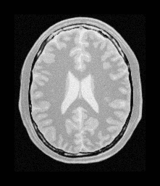
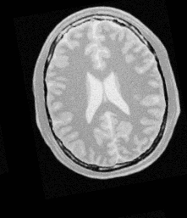
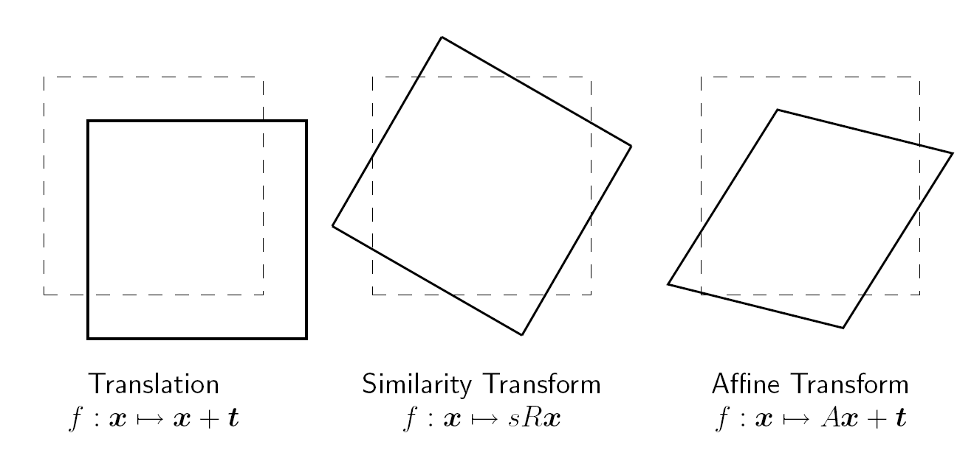
The sad reality: with a bit of hyperbole
Image Registration
State of Affairs
Registration works really well when there is not much to register!
Similar
images
☑
Simple
transforms
However, in reality deformations are often more complex.
➔ Need for general deformable registration methods.

Slide 3
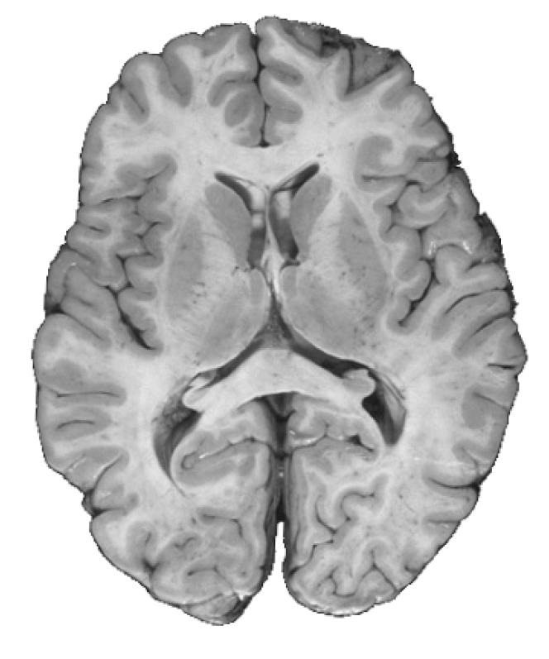
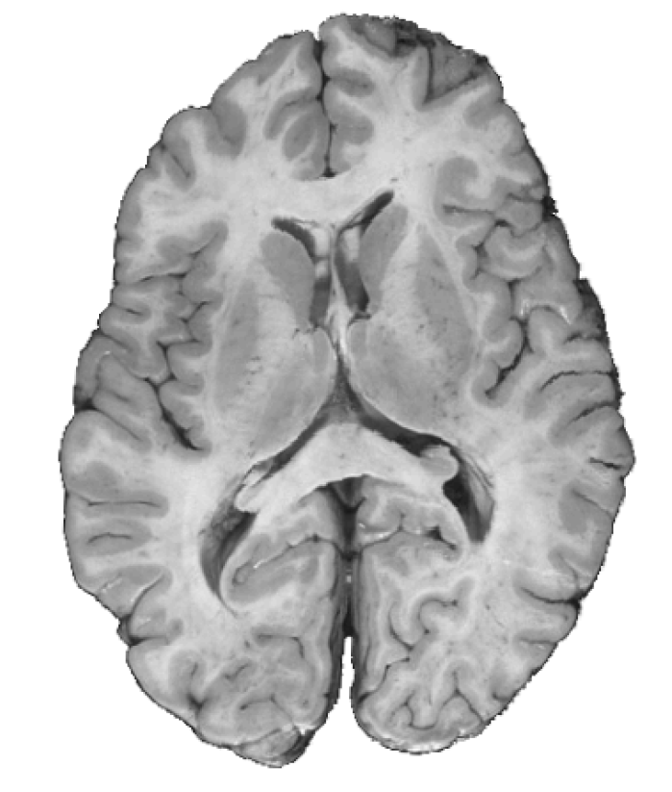
Why is Deformable Image Registration Hard?
Image Registration
Motivation
Goal: Spatial alignment of two images (beyond affine).
?
Source Image
Target Image
minimize Irregularity of transformation + image mismatch

Slide 4

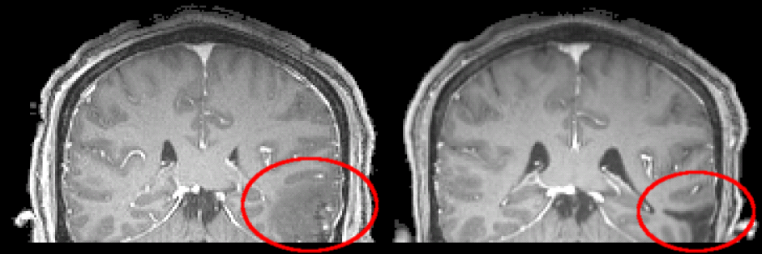
Why is Deformable Image Registration Hard?
Image Registration
Motivation
Problem 1: Unsuitable deformation models
Does your brain, leg, heart, …
behave like a fluid?
Should it between two subjects?
Image: classicwatersolutions.com
Problem 2: Unsuitable similarity measures
What if images have
different appearances?
Problem 3: Unsuitable numerical solutions
Problem 4: How trustworthy is my solution?

Slide 5
Why is Deformable Image Registration Hard?
Image Registration
Motivation
A: affine, NP: non-parametric (elastic, fluid, …)
Within subject (WS); between subject (BS); with pathology (P)
model realism
A-WS
A-P
A-BS
A-WS
A-BS
A-P
NP-WS
model robustness
model complexity
NP-BS
NP-P
NP-BS
NP-WS
NP-P
model realism

Slide 6
What can be done about it?
Image Registration
Aim
model realism
NP-WS
model robustness
model complexity
NP-BS
NP-P
NP-BS
NP-WS
NP-P
model realism
Increasing robustness by
increasing model realism.
Decreasing complexity
while increasing realism.
Let’s look at some examples next …

Slide 7
Similarity Measures

Slide 8
Standard Similarity Measures
Similarity Measures
Overview
Standard similarity measures
  SSD
  Normalized cross correlation
  Mutual information
Fail if there is no clear correspondence (pathologies)
Not problem-specific
Do typically not exploit population or longitudinal information
May overall be too restrictive!

Slide 9
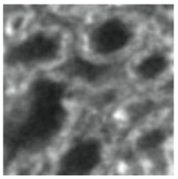
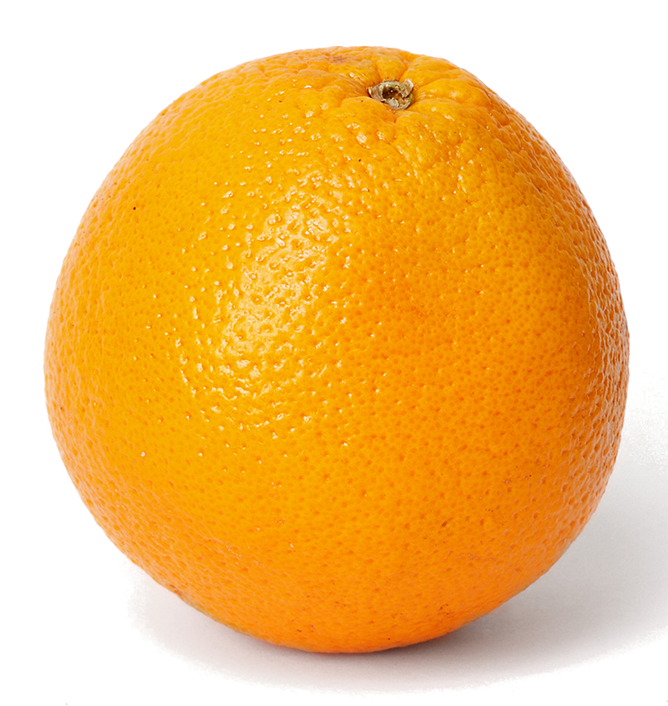
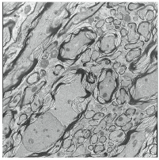
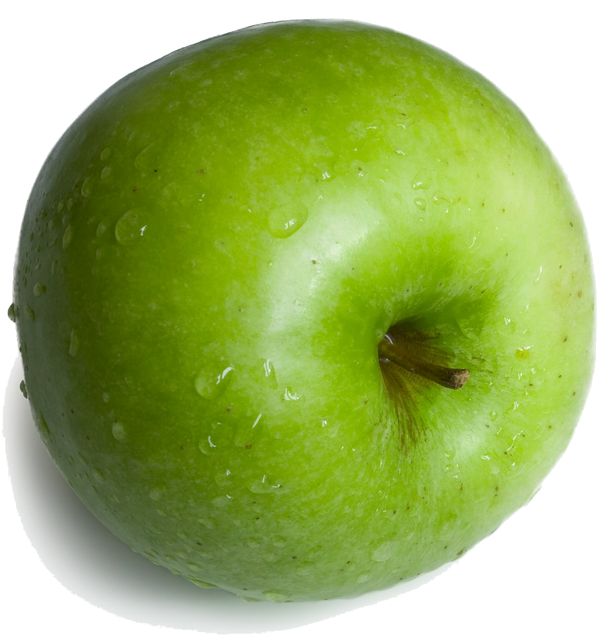
Registration for Correlative Microscopy
Similarity Measures
Correlative Microscopy
Registration is hard if landmarks are not available
B
A’
?
Possible solution: Image Analogies (from graphics)

Slide 10
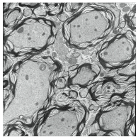
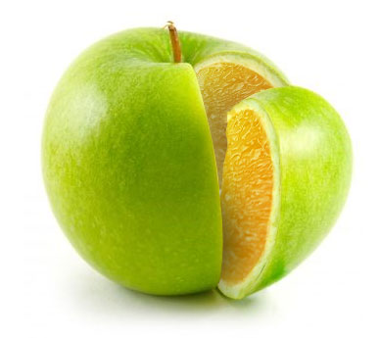
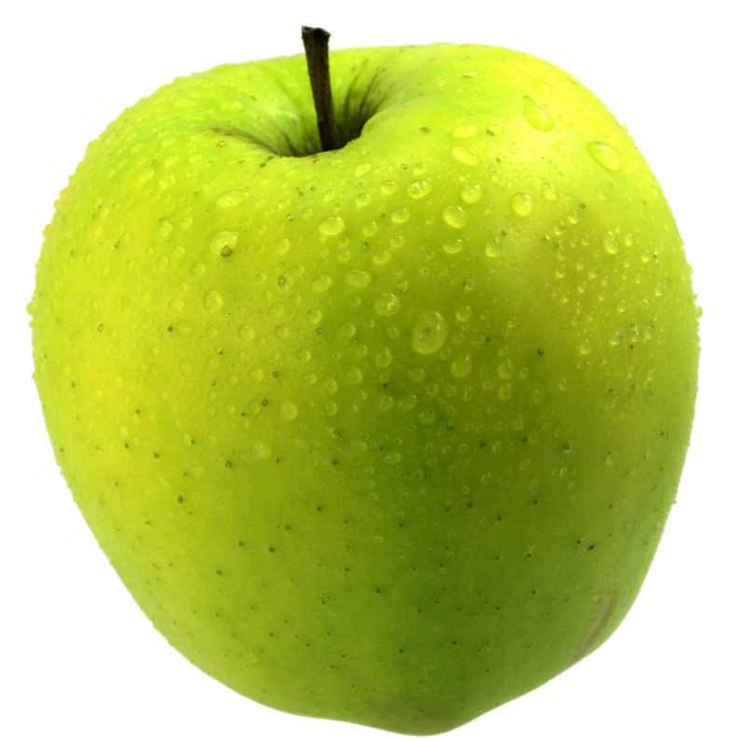
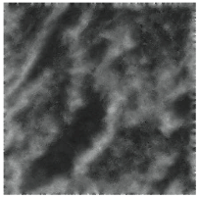
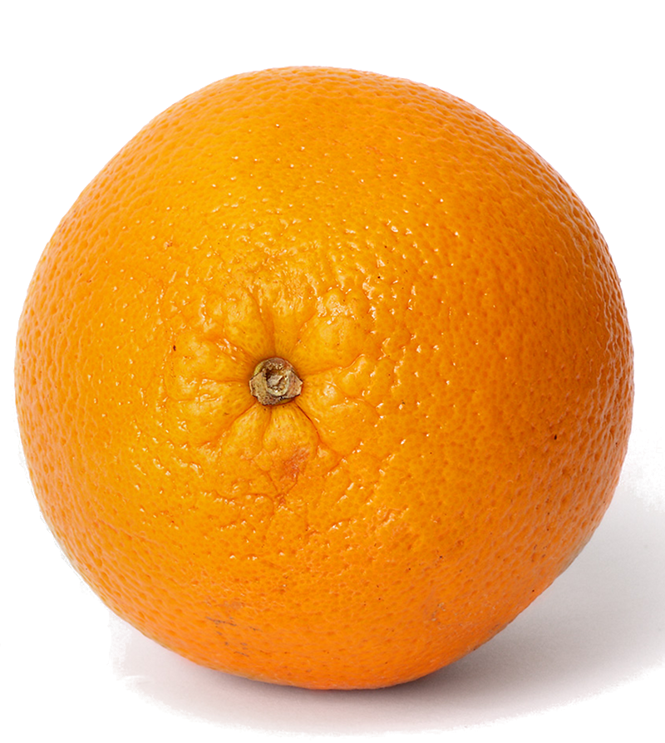
Registration for Microscopy: Image Analogies
Similarity Measures
Correlative Microscopy
Solution approach:
Image Analogies:
A
B
A’
B’
learned
A’ relates to B’
A’ relates to B’
unknown

Slide 11
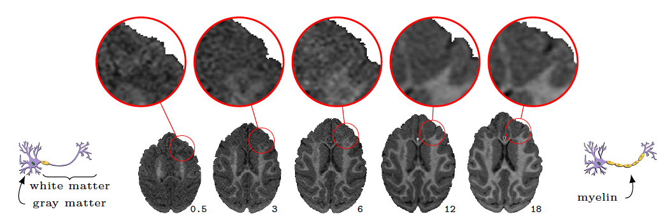
Modelling of Appearance Changes
Similarity Measures
Contrast Inversion
Normal brain development (macaque)
Locally changing image intensities cause problems for
image similarity measures (SSD, mutual information, …)

Slide 12
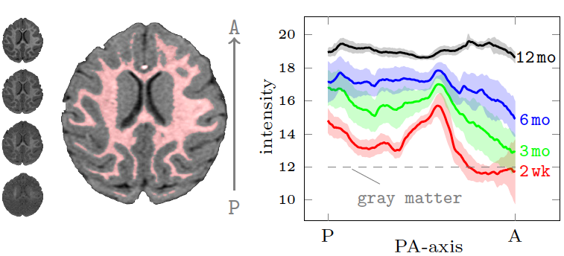
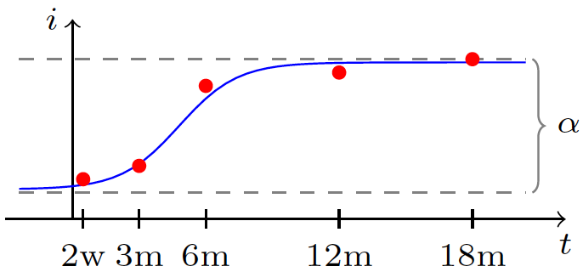
Modeling of Appearance Changes
Similarity Measures
Contrast Inversion
Normal temporal change (for a macaque monkey)
Proposed registration method
imposes a simple logistic
model locally.
Exploits longitudinal information.

Slide 13
Beyond Classical Similarity Measures
Similarity Measures
Overview
Problem-specific similarity measures
  Can learn mapping between modalities
  Can use longitudinal information
  Can use population information to be robust
  with respect to pathologies
Chances are that for complex models this will still not work.
Interactivity as discussed yesterday could be a good option.
Most straightforward models for similarity measures:
  Add landmark constraints
  Cost-function masking

Slide 14
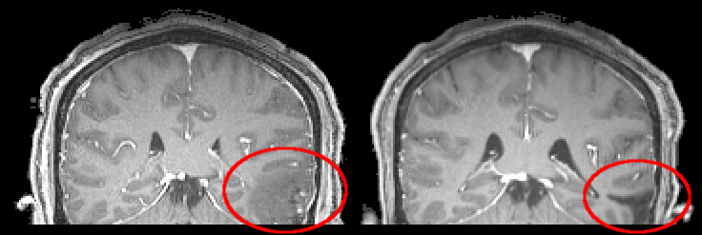
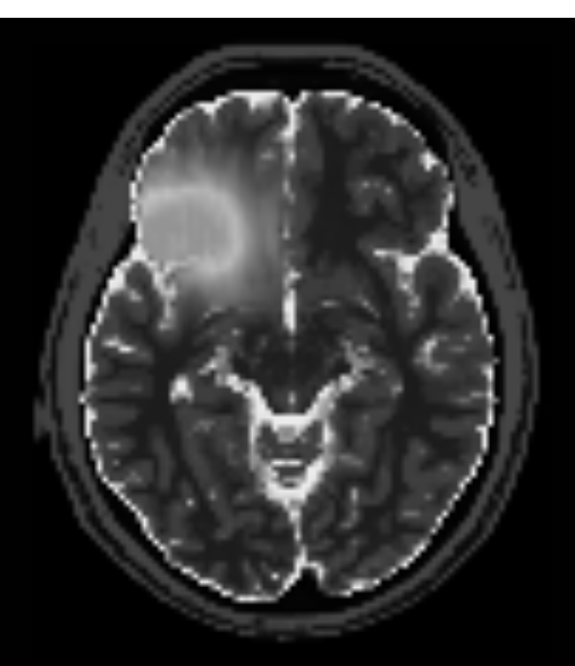
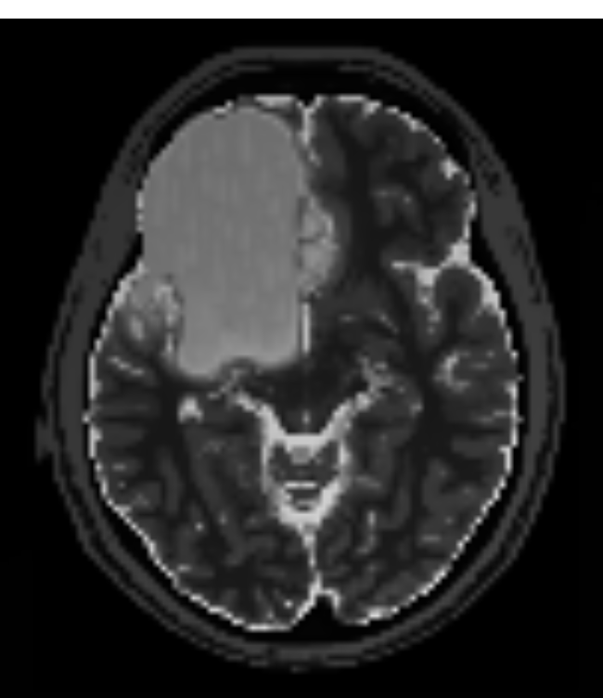
Fancy Cost-Function Masking
Similarity Measures
Geometric Metamorphosis
Traumatic brain injury
(real data)
Brain tumor
(simulated data)
Developed method estimating two deformations, capturing
global brain deformations and local changes in appearance.

Slide 15
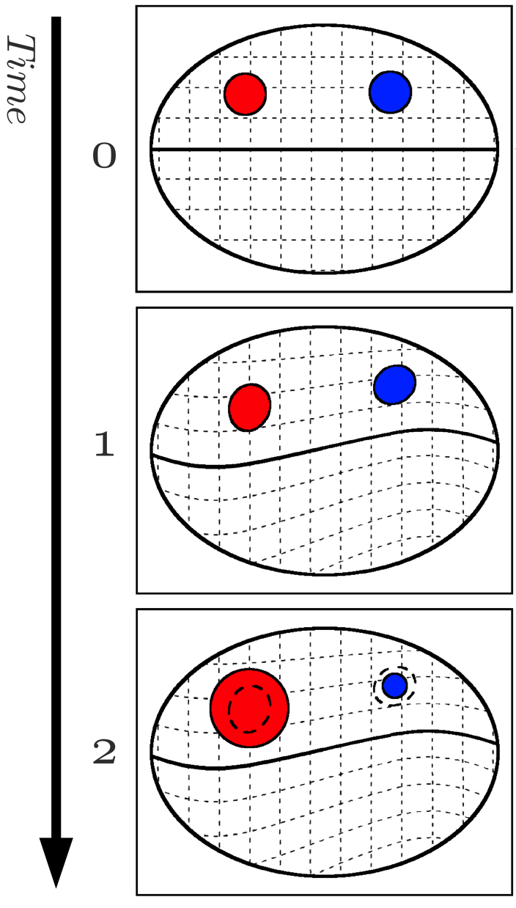

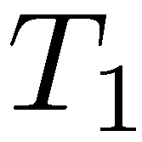

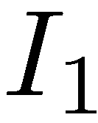
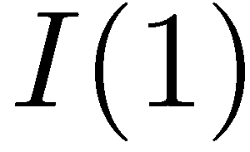
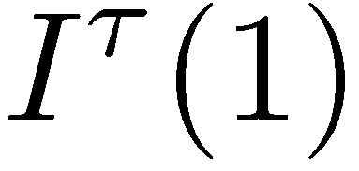
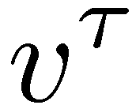
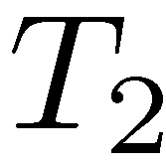
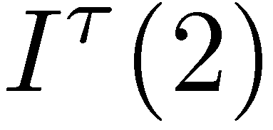
Composition of two deformations
Similarity Measures
Geometric Metamorphosis
image
mask
Global background
deformation
matched to
Change of
geometric model
matched to

Slide 16


Image Composition
Similarity Measures
Geometric Metamorphosis
Image area gets “consumed”
cannot be used for matching
Growing
Image composition model
Shrinking
Image area gets “exposed”
cannot be used for matching
Notes:
Image similarity maybe on a separate slide. (Check for time.)
Subheader for image similarity. Color code growing and shrinking with T_2 and I^\tau(1).
Say that image composition artificially creates 1-1 correspondence.

Slide 17
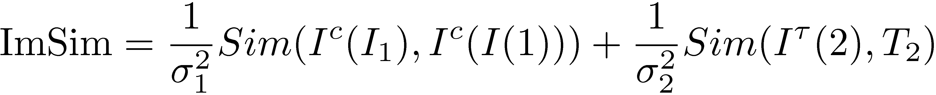
Image Similarity
Geometric Metamorphosis
Our Solution Approach
Image composition model
alignment of corresponding
image regions
alignment of
masks
Use your favorite similarity measure (CC,MI,SSD,…)

Slide 18
Image Similarity
Similarity Measures
Overview
This is probably too complex a model in practice.
Standard cost-function masking may suffice.
Research question: “Can you discover regions that should
be masked by performing an initial faulty registration,
fixing it by manual corrections and then determining what
in the similarity measure tries to move the result away
from the desired registration.”
Seems to have a flavor of sensitivity analysis.

Slide 19
Deformation Models

Slide 20
Standard Deformation Models
Deformation Models
Overview
Standard deformation models
  Parametric (rigid, affine, b-spline)
  Non-parametric: elastic, fluid, etc.
Assume globally valid transformation model.
Potentially good enough for some applications,
but certainly not 100% realistic.
May overall be too simplistic!

Slide 21
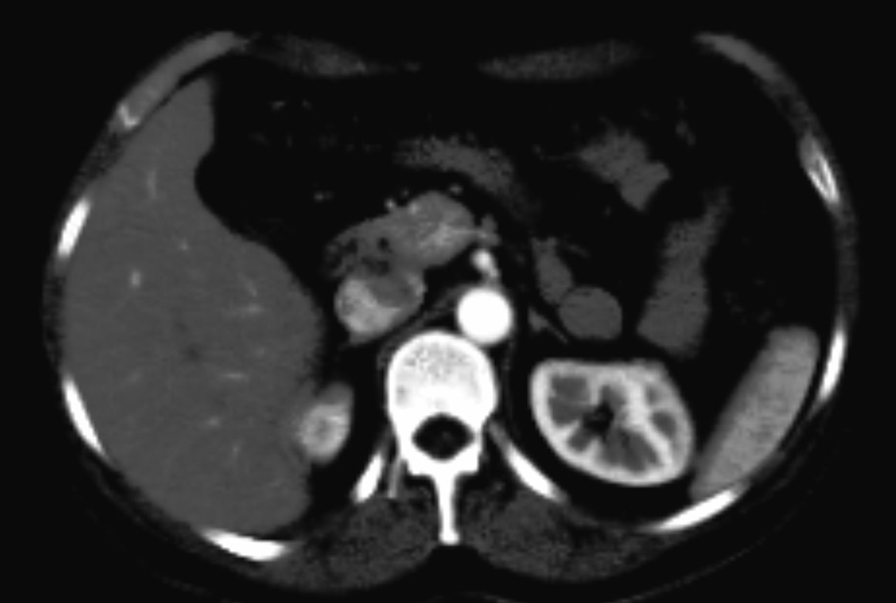
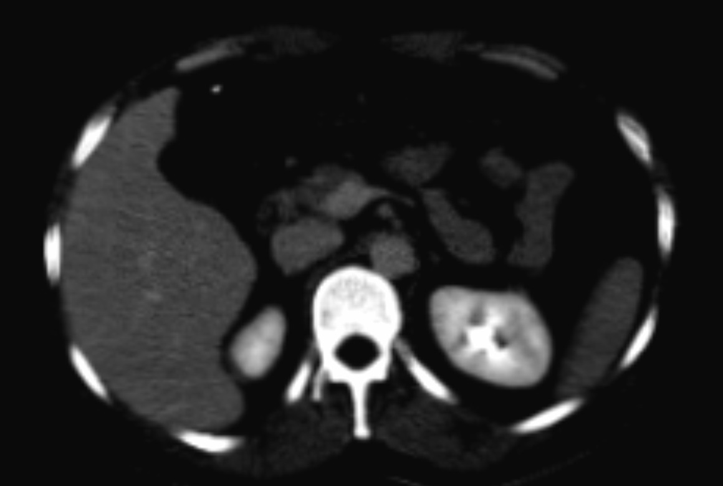
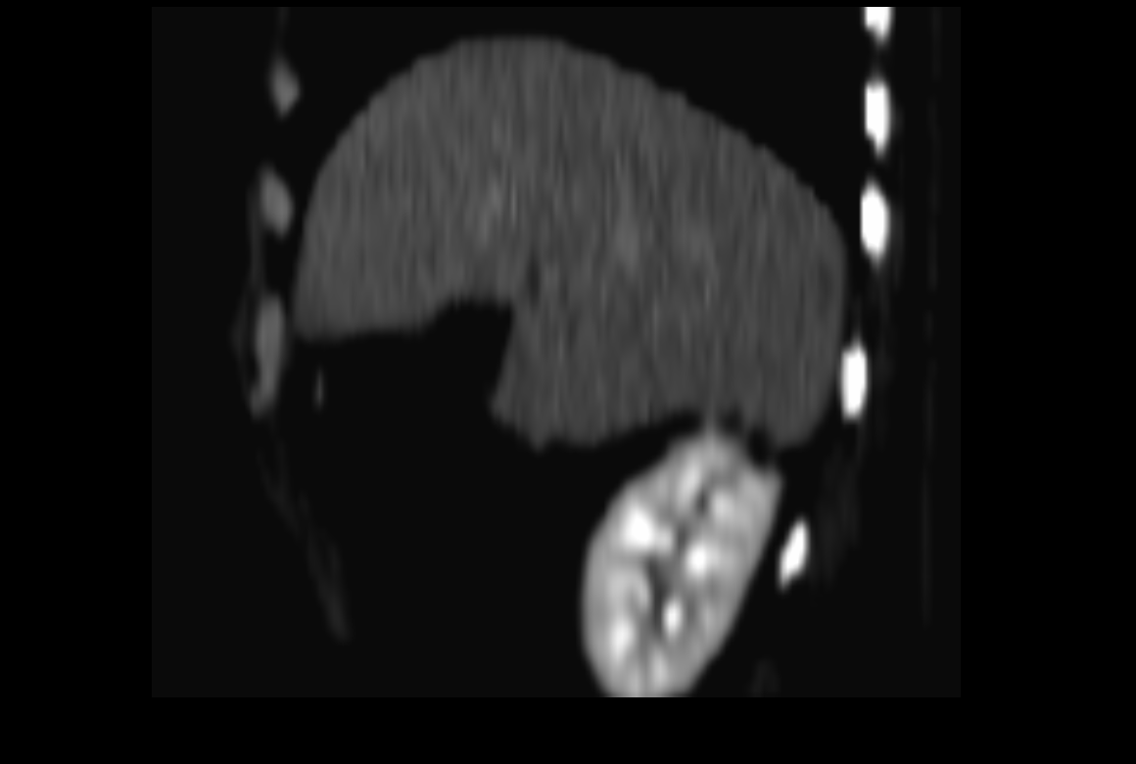
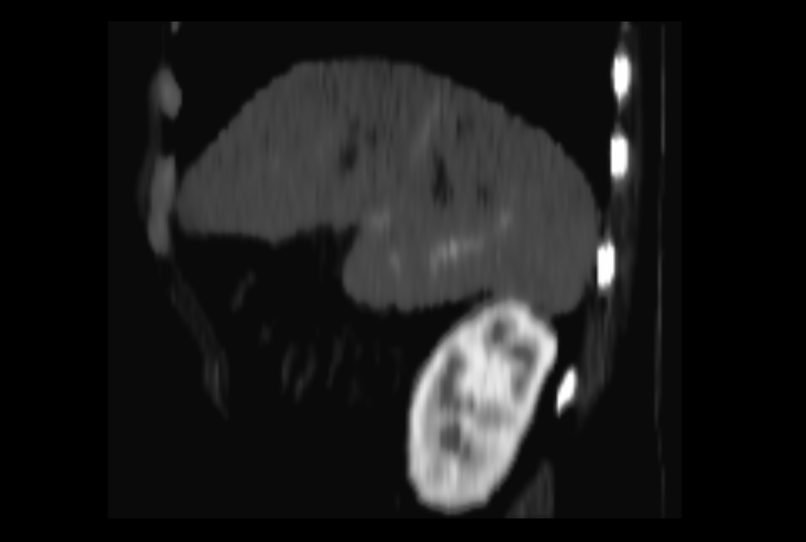
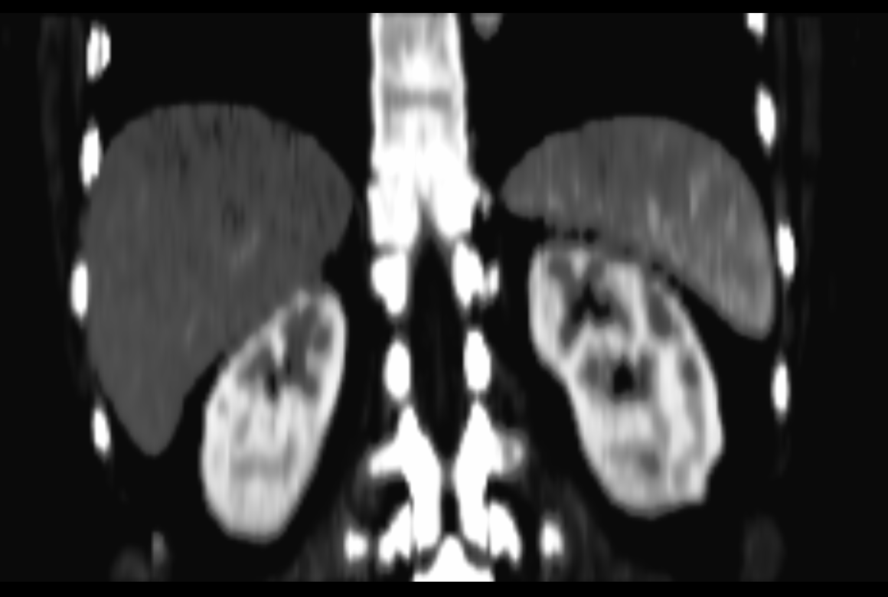
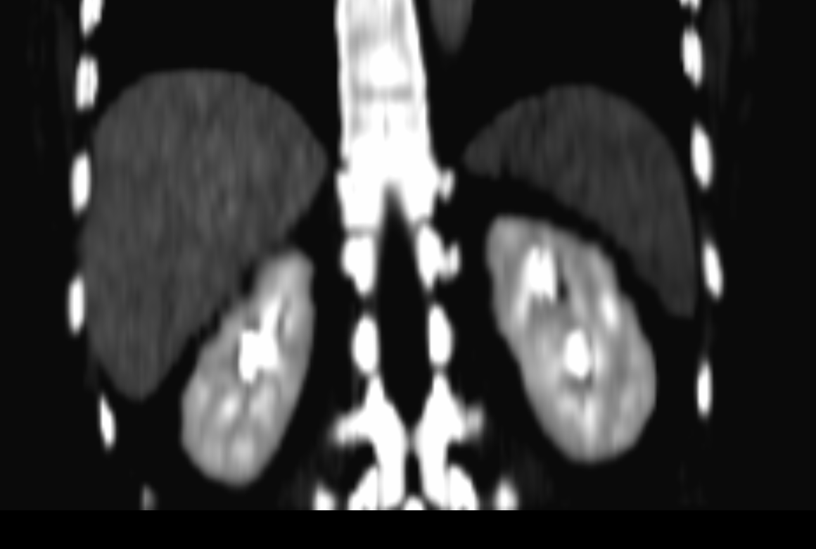
Deformation Model: Sliding
Deformation Models
Sliding
Problem: Standard non-parametric registration methods
enforce unrealistic global smoothness.
Developed method based on anisotropic regularization,
specifically modeling for improved registration realism.
Joint work with Danielle Pace and Stephen Aylward.

Slide 22
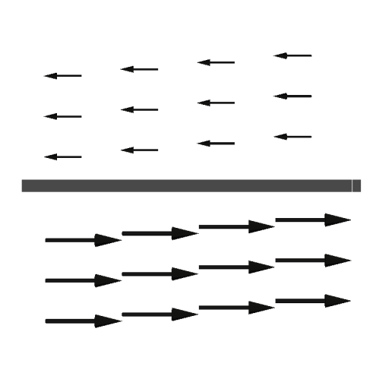
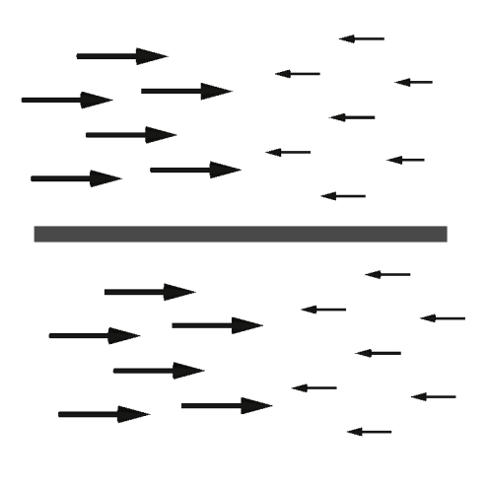
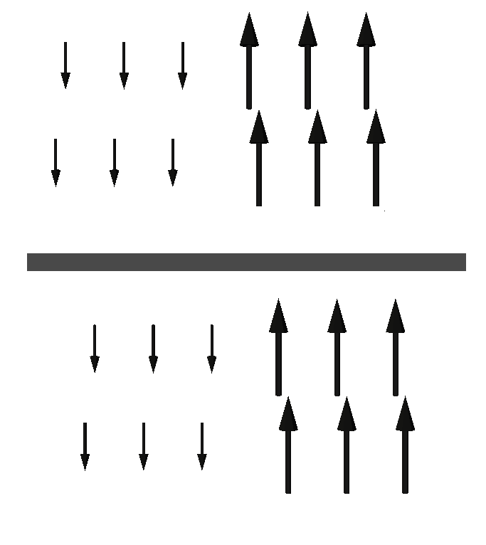
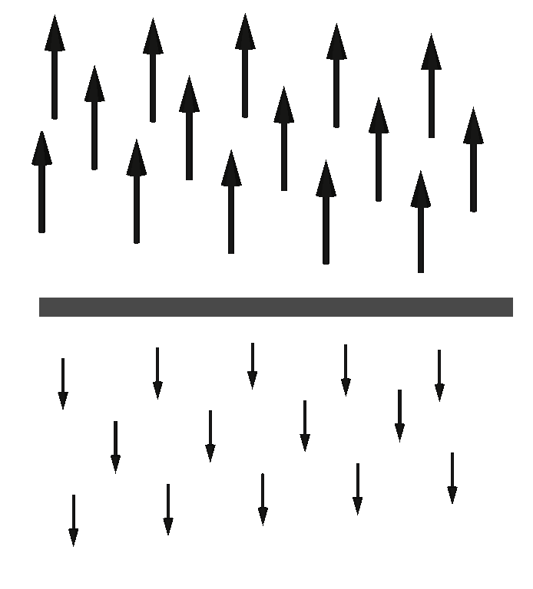
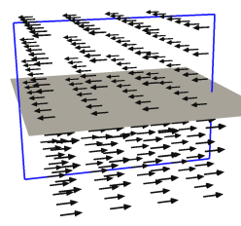
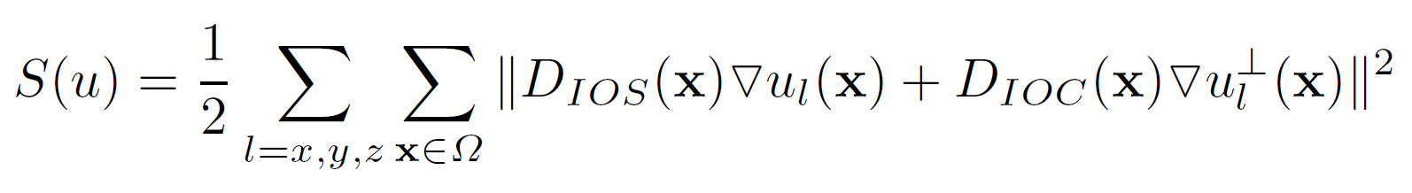
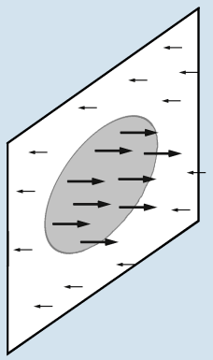
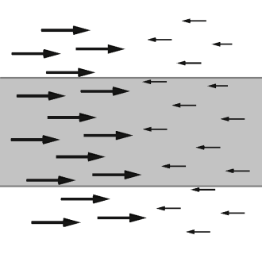
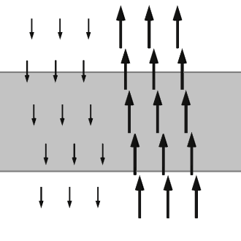
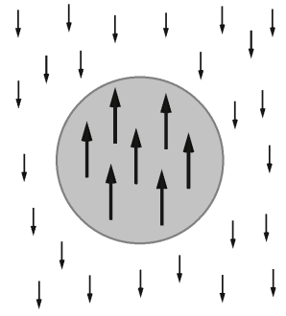
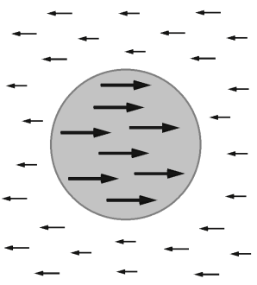
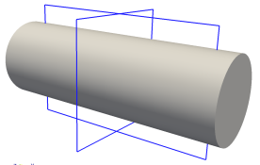
Locally-adaptive Regularization
Deformation Models
Sliding
Sliding
Discontinuities in tangential components along normal direction
Intra-organ smoothing
Smooth along tangential direction
Inter-organ coupling
Smooth normal components along normal direction
Diffusion tensors

Slide 23
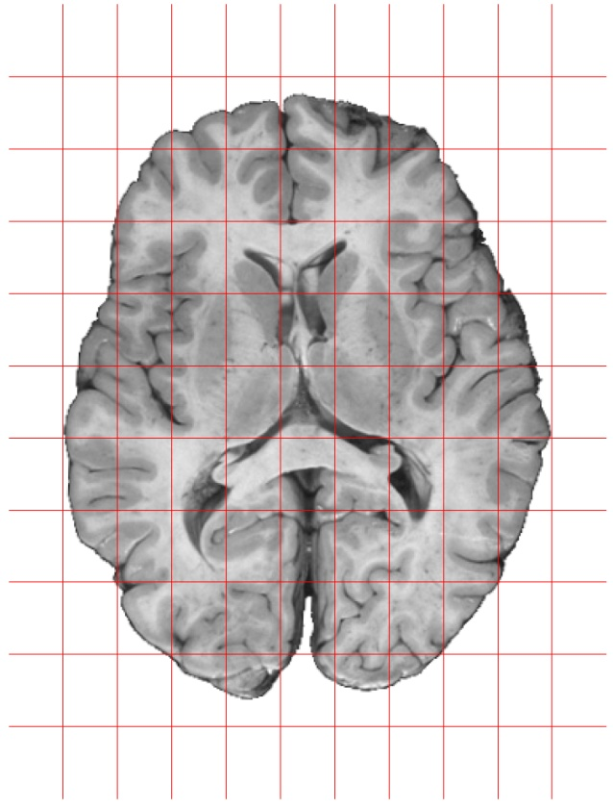
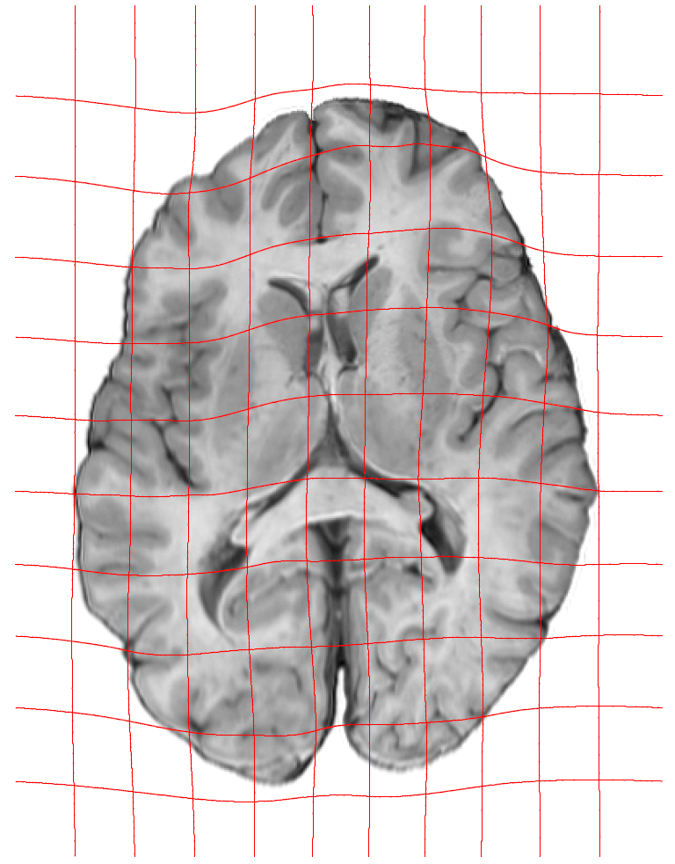


Deformation Model: LDDMM
Deformation Models
LDDMM
Large Displacement Diffeomorphic Metric Mapping (LDDMM)
?
Optimal control
problem.
Goal: Estimate optimal spatio-temporal velocity field to flow
one image into the other.
Hard problem: Millions of unknowns ➔ need gradient!

Slide 24
Deformation Model: LDDMM
Deformation Models
LDDMM
Large Displacement Diffeomorphic Metric Mapping (LDDMM)
Constrained optimization
greatly simplifies the
derivation of optimality
conditions!
?
Optimal control formulation (=constrained optimization)
➔ opens possibility for more realistic models
This is what most people in the field do now!

Slide 25
Deformation Model: LDDMM
Image Registration
LDDMM
Large Displacement Diffeomorphic Metric Mapping (LDDMM)
Constrained optimization
greatly simplifies the
derivation of optimality
conditions!
?
This is probably one of the most complex registration
formulations. But interesting for mathematical properties and
also as a model problem for more sophisticated
data-assimilation approaches.

Slide 26



Longitudinal Data: Within and Between Subjects
Deformation Models
Overview
Image-to-Image Registration
Geodesic Regression
?
Time-Series Modeling
Spline Models

Slide 27

Piece-wise linear vs. piece-wise geodesic
Deformation Models
Piece-wise geodesic approach
Piecewise Linear (Piecewise LDDMM-Geodesic for Images)
Problem: Not a generative model, possible over-fitting.
“Less flexible models” are likely much more realistic here.

Slide 28


Dealing with Longitudinal Data: the Scalar Case
Deformation Models
Linear Regression
Linear Regression
Population Mean
average
Multiple linear regressions
“Average of linear regressions”

Slide 29
Dealing with Longitudinal Data
Deformation Models
Overview
Geodesic Regression
Transport
Want a generative model
Want to change spaces
(e.g., atlas or other subject)
How to formulate the regression problem with images?

Slide 30

Geodesic Regression
Deformation Models
Geodesic Regression
Linear regression can be formulated as an
optimal control problem with 2nd order dynamics.

Slide 31


Linear Regression as a Dynamical System
Deformation Models
Geodesic Regression
Explicit model
Dynamic
formulation

Slide 32

Linear Regression as a Dynamical System
Deformation Models
Geodesic Regression
Initial point free:
y-intercept
slope

Slide 33




Transitioning to more Complex Data
Deformation Models
Geodesic Regression
1) Requires an initial value formulation of the registration:
What is the equivalent to the 2nd order model?
State equation
Initial conditions
2) Requires a measure of distance:
What is the equivalent to ?
3) Requires a gradient with respect to the initial conditions
How to compute for more complex system?
We can do this for images, diffeomorphisms,
or also linear dynamical systems!

Slide 34


Transitioning to the Image-Valued Case
Deformation Models
Geodesic Regression
1) Requires an initial value formulation of the registration:
Shooting equations (describing a geodesic)
LDDMM energy
(optimal control formulation)
KKT conditions (constrained optimization)
LDDMM optimality conditions
(i.e., gradient = 0)
Joint work with F. X. Vialard
This is a line!

Slide 35


Transitioning to the Image-Valued Case
Deformation Models
Geodesic Regression
1) Requires an initial value formulation of the registration:
Shooting equations (describing a geodesic)
LDDMM energy
(optimal control formulation)
KKT conditions (constrained optimization)
LDDMM optimality conditions
(i.e., gradient = 0)
This describes a geodesic!

Slide 36
Transitioning to the Image-Valued Case
Deformation Models
Geodesic Regression
2) Requires a measure of distance:
These are the
required distances
L₂ distance or defined also by registration.

Slide 37
Transitioning to the Image-Valued Case
Deformation Models
Geodesic Regression
3) Requires a gradient with respect to the initial conditions
Gradient ≈ initial conditions of adjoint to geodesic equations:
Gradient ≈ adjoint
for t=0.
What does this mean?
Intuitively: Allows computation of how initial conditions
should change with respect to final conditions.

Slide 38
Transitioning to the Image-Valued Case
Deformation Models
Geodesic Regression
3) Requires a gradient with respect to the initial conditions
LDDMM energy
(optimal control formulation)
KKT conditions (constrained optimization)
LDDMM optimality conditions
(i.e., gradient = 0)
Shooting equations
KKT conditions (constrained optimization)
Optimality conditions
of the optimality conditions
Shooting and
adjoint equations

Slide 39



Shooting Example
Deformation Models
Shooting
“Happiness by registration”
The full transformation is encoded by the initial conditions!

Slide 40

Shooting Example
Deformation Models
Shooting
“Happiness extrapolated”
This allows for extrapolation.

Slide 41


Geodesic Regression: True Longitudinal Data
Deformation Models
Geodesic Regression
For small changes,
geodesic regression achieves
a good approximation.
Unregistered
GR

Slide 42
Shortcomings of Geodesic Regression
Deformation Models
Simplified Geodesic Regression
Recall what we achieved so far:
Reformulation of least-squares
as a dynamical system
allowed extension to image-valued case.
Disadvantages:
  requires numerical solution
  requires in principle registration for residuals
  (unless analytical solutions are known)
  COSTLY

Slide 43

Reinterpretation of Geodesic Regression
Deformation Models
Simplified Geodesic Regression
Can we find a simplified (approximate) geodesic regression?
Can we find yet another reformulation of LS?

Slide 44

Reinterpretation of Geodesic Regression
Deformation Models
Simplified Geodesic Regression
Assume we know a point on the regression line

Slide 45

Reinterpretation of Geodesic Regression
Deformation Models
Simplified Geodesic Regression
We can compute the slope of the regression line …
by appropriately averaging the slopes wrt. the base point

Slide 46


Simplified Geodesic Regression
Deformation Models
Simplified Geodesic Regression
We can compute the slope of the regression line …
by appropriately averaging the slopes wrt. the base point
The slope is
which can be computed wrt. any
base point

Slide 47


Approximation
Deformation Models
Simplified Geodesic Regression
Can do the same for images.
Results in simple averaging
of initial momenta
(=the Lagrangian multipliers)
Approximation allows for efficient computation of the
regression solution approximating geodesic distances.

Slide 48

Synthetic Example
Deformation Models
Simplified Geodesic Regression
Time-series
Regression
result
This can also be done with metamorphosis …

Slide 49


Deformation + Appearance: Metamorphosis
Deformation Models
Metamorphosis
Standard Image Registration
Image Metamorphosis
?
…
Assumes 1-1 correspondence
Registration and blending

Slide 50

Texture Metamorphosis
Deformation Models
Metamorphosis
Allows for nice simultaneous warping and blending
Can be used for texture blending
Developed optimal-control-based numerical methods.
➔ Shooting method.
Time-series formulation.
Towards more realistic registrations w/ appearance change.

Slide 51

Time-series Formulation
Deformation Models
Metamorphic Geodesic Regression
Same approximate way as before: average initial momenta
image
time series
shooting
result
momenta
Shooting now captures spatial and intensity changes. Example?

Slide 52

Example toy result (to demonstrate feasibility)
Deformation Models
Metamorphic Geodesic Regression
simplified
geodesic
regression
simplified
metamorphic
geodesic
regression
young
old
Demonstrated feasibility of metamorphic regression solutions.
➔ Model likely too simplistic; more realistic models feasible.

Slide 53
Uncertainty Estimation

Slide 54
Motivation for Image Segmentation
Uncertainty Quantification
Motivation
Motivation:
Image segmentation methods typically do not address segmentation uncertainty.

Slide 55


Motivation for Image Segmentation
Uncertainty Quantification
Motivation
Motivation:
Image segmentation methods typically do not address segmentation uncertainty.
How much can I trust my segmentation? Unclear!

Slide 56
Motivation for Image Registration
Uncertainty Quantification
Motivation
Motivation:
Image registration methods typically do not address segmentation uncertainty.

Slide 57


Motivation for Image Registration
Uncertainty Quantification
Motivation
Motivation:
Image registration methods typically do not address segmentation uncertainty.
How much can I trust my registration? Unclear!

Slide 58



Motivation for General Image Analysis Problem
Uncertainty Quantification
Motivation
Cross-sectional area ➔
Depth➔
All processing steps have uncertainties.
How should we deal with those? Unclear!

Slide 59
General
Uncertainty Quantification
Motivation
Quantifying uncertainty is very important.
While there is some work in this area, I would say that
overall it is greatly neglected …
Great opportunity to do something about it!

Slide 60

Some Future Research Directions
Future Directions
What else there is to do
Towards more realistic deformation models
  Appearance Changes / Pathologies / Development
  Learning from Limited Data
Time-Series and Longitudinal Data
  Higher Order Models
  Transport
  Dynamic Imaging
Uncertainty Estimation
  Registration & Segmentation
Multimodal Imaging
  Learning of Similarities
Image: wikipedia

Slide 61
Questions
Questions
Questions
Questions?

