Slide 1
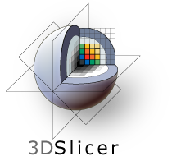
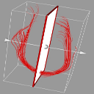
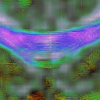
Slicer DTI Extensions
How to use the UNC set of DTI Slicer Extensions
Neuro Image Research and Analysis Laboratories
University of North Carolina at Chapel Hill

Slide 2
Download Slicer
Install Slicer
Start Slicer
Extension Manager
Install the DTI Extensions
Uninstall an Extension
Use the Extensions

Slide 3
Download Slicer
Go to:
http://download.slicer.org

Slide 4
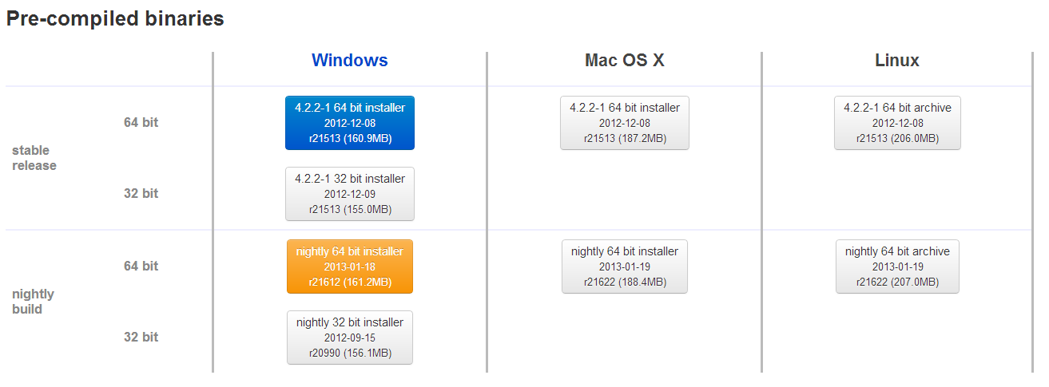
Download Slicer
Click on the stable release for the platform you need : Windows, Mac or Linux
The version name is: Slicer4.2.2-1 2012-12-08 r21513

Slide 5
Install Slicer
Windows:
When the download will be done, the installer will launch and Slicer will be installed on your computer
Mac:
As the .dmg file has been downloaded, uncompress it and move it the the « Applications » folder
Linux:
Unzip the .tar.gz file just downloaded and copy the extracted folder wherever you need it.

Slide 6
Start Slicer
On Windows and Mac, start Slicer from wherever it has been installed
On Linux, launch the Slicer exectuable from the folder where the archive has been uncompressed

Slide 7
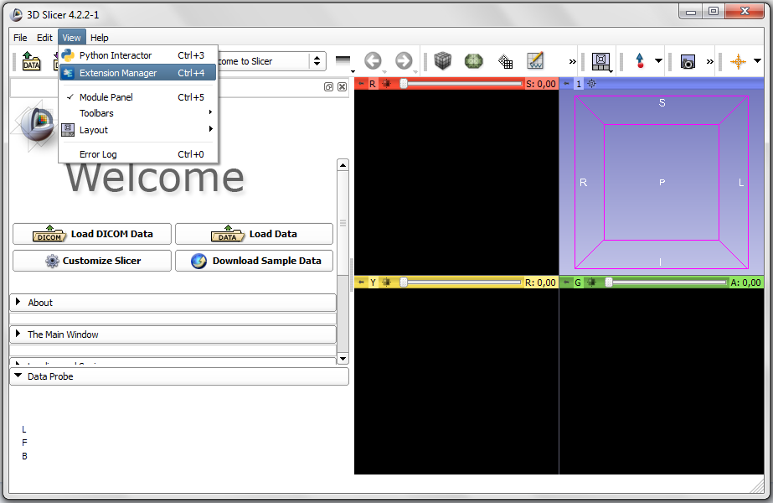
Extension Manager
Open the Extension Manager in View -> Extension Manager

Slide 8
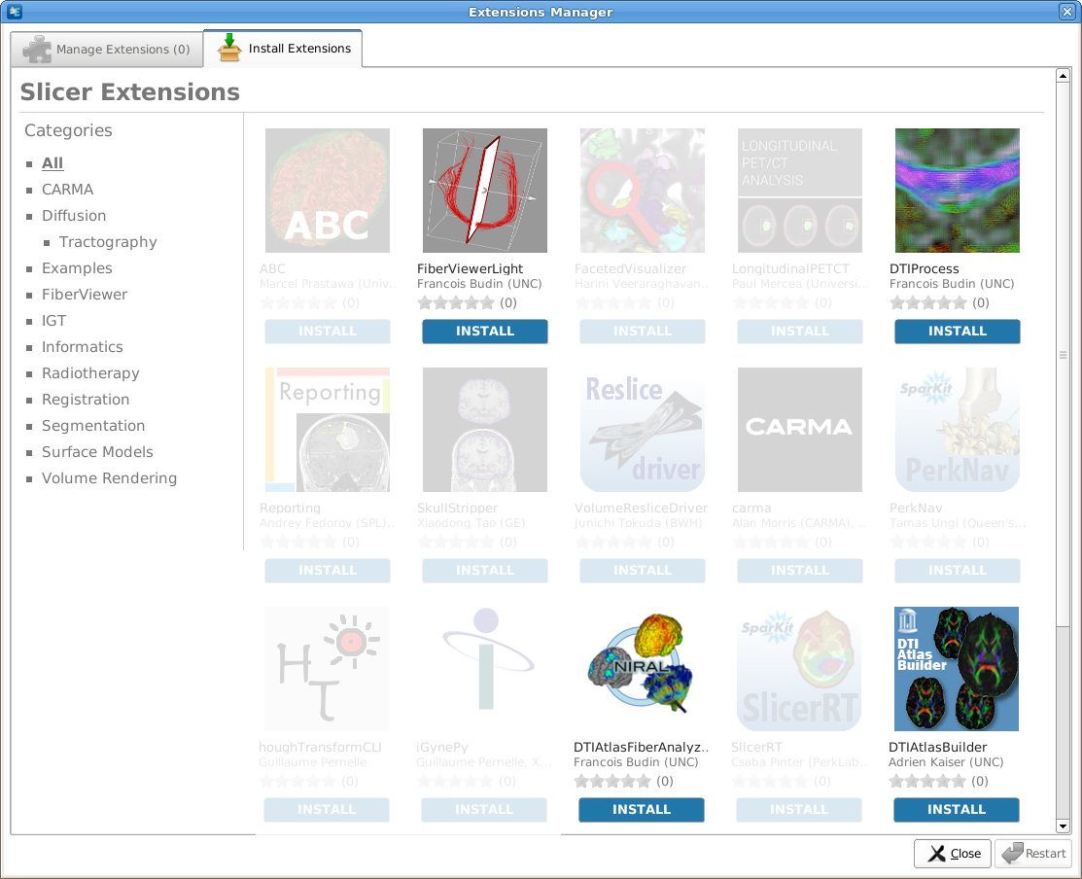
Install the DTI Extensions
To install an extension, click on the blue « INSTALL » button
The DTI Extension developped at UNC are:
FiberViewerLight
DTIProcess
DTIAtlasFiberAnalyzer
DTIAtlasBuilder

Slide 9
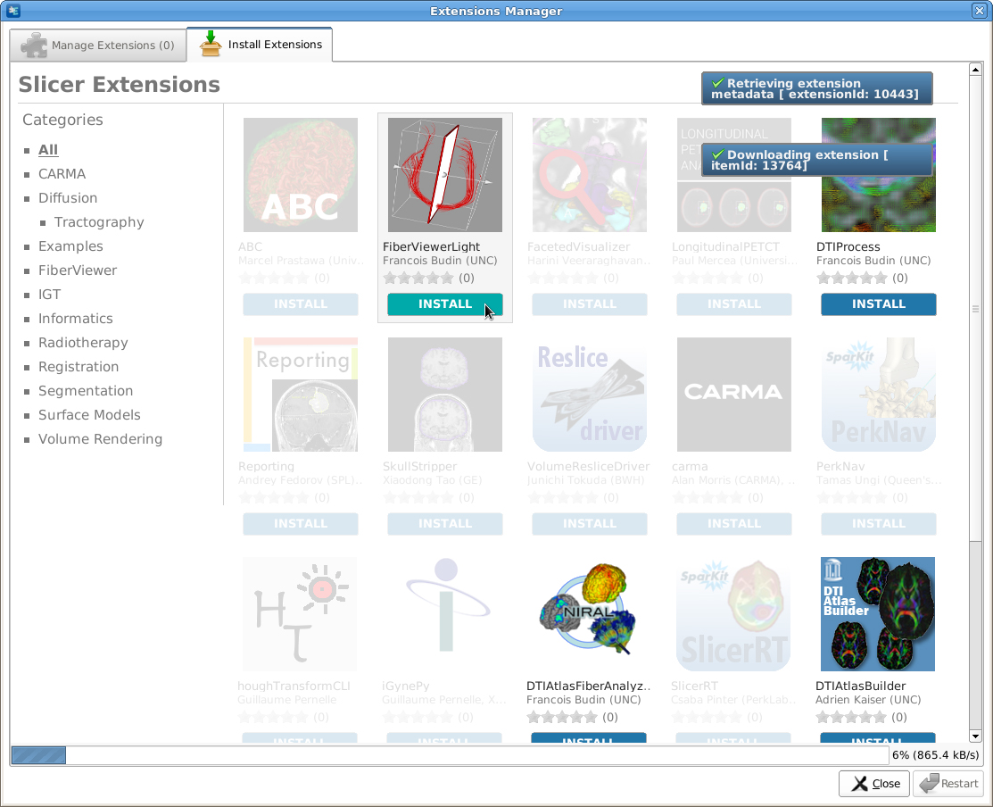
Install the DTI Extensions
The extension will be downloaded and you will need to restart Slicer.
When restarted, you will find the installed extension in the module list.

Slide 10
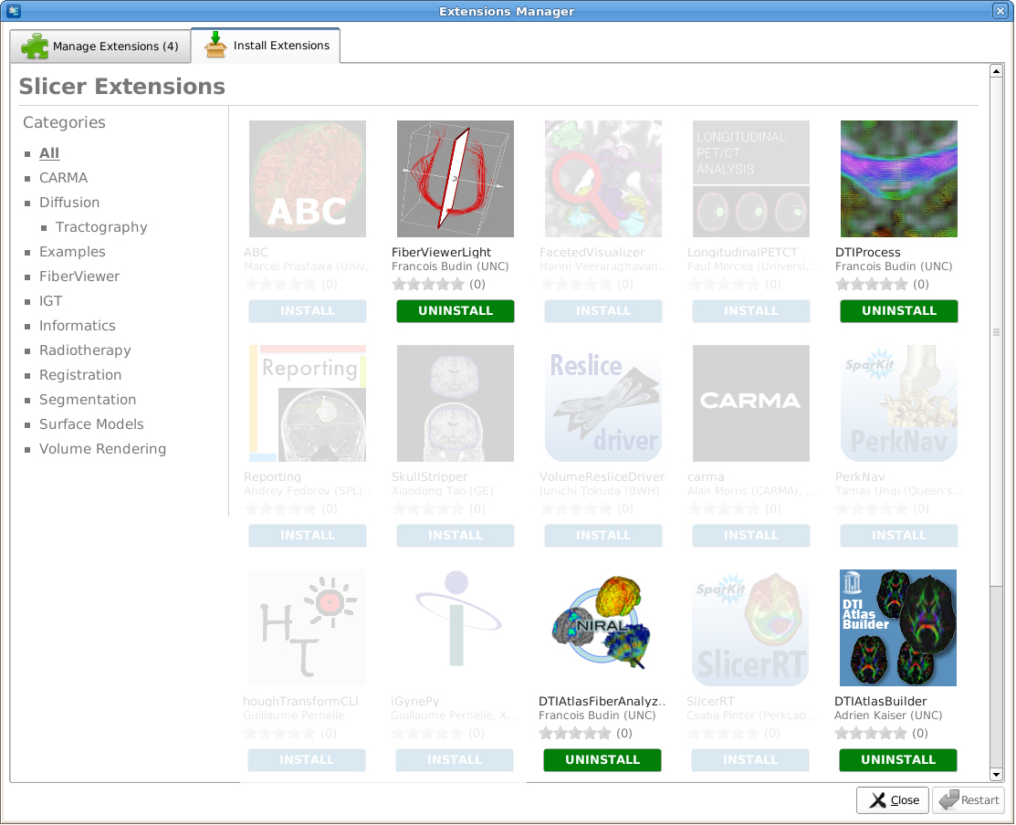
Uninstall an Extension
You can uninstall an extension you do not need in the Extension Manager (View -> Extension Manager),
by clicking the green « UNINSTALL » button.

Slide 11
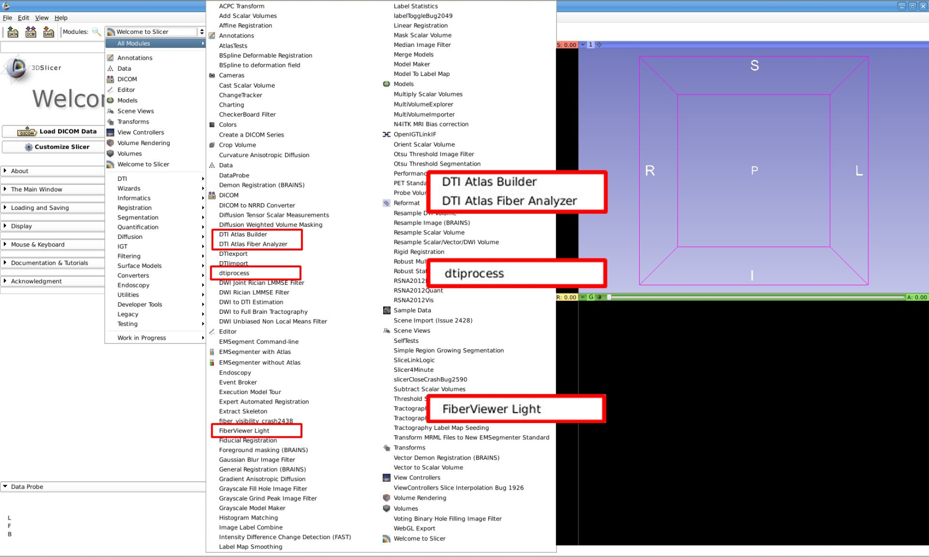
Use the Extensions
You will now find the extensions just installed in the list of all modules:

