Slide 1
BRAINSCut
Human brain segmentation for volumetric measures
EUN YOUNG (REGINA) KIM
BIOMEDICAL ENGINEERING DEPT.
2011 Nov 02
Notes:
Generally….

Slide 2
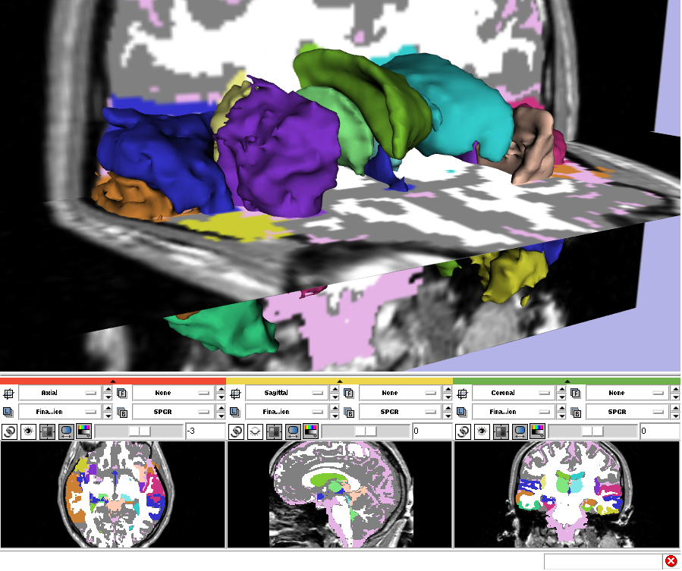
Motivation
MR Images are broadly used for Disease Research : Schizophrenia, Alzheimer, Huntington’s Disease, Parkinson’s, isolated clefts of the lip or palate, and many others
Currently, Manual tracing method of MR Image is regarded as a gold standard for the analysis.
  Labor intensive task
  Inconsistency
  Large scale data from multi-site
Development of Reliable Auto-segmentation Method is Mandatory.
Image from “http://www.slicer.org/slicerWiki/images/f/ff/EMSegment31Structures.png”
Notes:
It is Labor intensive task.
It takes several hours to identify one structure of one subject.
And it also suffers from inconsistency its measurements.
The measurements varied by different experts for a same subject.
And even same expert for a same scan, the measurements can be varied by day to day.
So manual segmentation method is impractical and improper to use these days large amount of data from multi sites.

Slide 3
Motivation
Existing ANN application* **
  Developed and trained several years ago with old data set
Existing ANN application* ** improved with
  newly adapted feature
  Multi modality images
  simultaneous training strategy
* Magnotta et al. Measurement of Brain Structures with Artificial Neural Networks: Two-and Three-dimensional Application Radiology (1999)
* Powell et al. Registration and machine learning-based automated segmentation of subcortical and cerebellar brain …. NeuroImage (2008)

Slide 4
Goal
Reliable Auto-segmentation
  Robustness
    against noise of an image
      e.g. inhomogeneous of MRI intensity
    against anatomical variability ranging from severely diseased to normal healthy control.
  Accuracy
    Measurement accuracy should be achieved in compare to the a gold standard, ‘manual segmentation’
  Consistency
    linear relationship between automated method and manual segmentation
Notes:
Robust segmentation method should deal with noise of the image and anatomical variability.

Slide 5
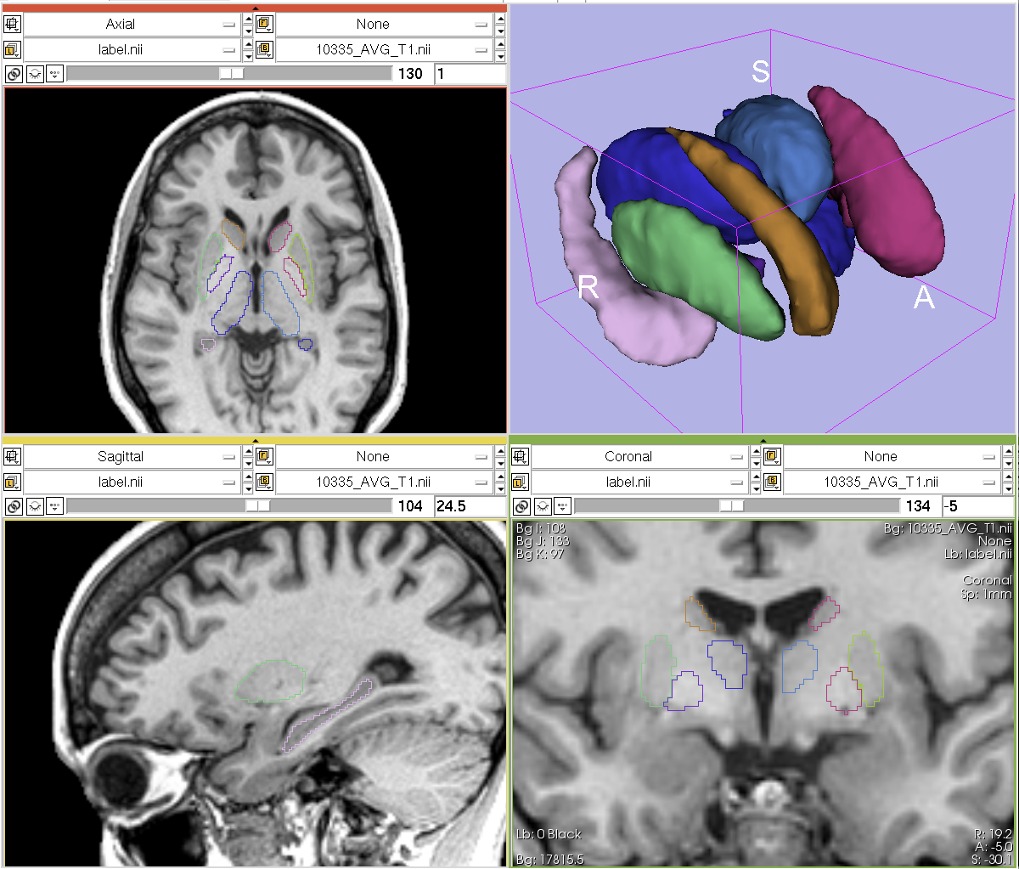
Background
General Overview of Machine Learning
  (Symbolic vs. Connectionist Perspective)
More Background of Connectionist Perspective: Artificial Neural Net
Notes:
In order to understand ANN, the
Here I am going to start with Background.
After talking about brief overview of Machine learning, which includes Symbolic and Connectioniest perspective, the more background on connectionist perspective, which Artificial Neural net follows will be discussed in more detail.

Slide 6
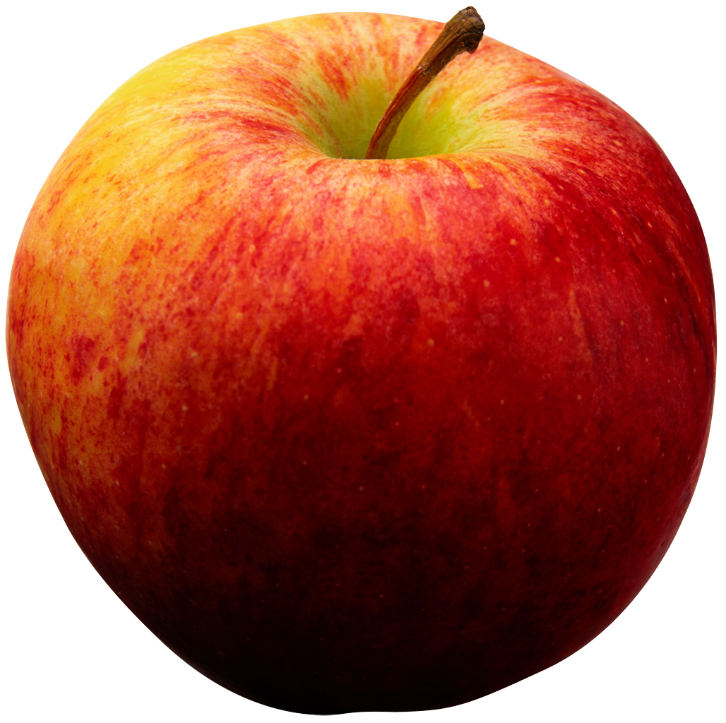
Background: Artificial Intelligence
Symbolic vs. Connectionist
  How to represent and organize data well enough!?
Organized with information
Red is-a Color
Simple Data Table
Name is-a Red
Type | Name
Object | Apple
Color | Red
Color | Yellow
Object | Banana
Object | Fruit
Color | Blue
Q: What is name of red fruit??
Name is-a Apple
Color is-a Red
Apple is-a Fruit
Notes:
Artificial Intelligence is the study of ‘intelligent machine’, so that machine can generate right answer to a given problem.
It starts from symbolic perspective research.
They more focused on how to represent data well enough so that the machine can give right answer to us.
So rather than representing data like this simple table, they represent data in more detail by giving relational or hierarchical information.
In this way when the machine gets a query like ‘what is name of red fruit?’. It can retrieve relative and necessary information and form a right answer, ‘apple’.

Slide 7
Background: Machine Learning
Symbolic vs. Connectionist
  Simulate the functioning of the human brain biologically
n_{i-1}
o
n_{i}
o
Σ
Σ
f_{a}()
n_{i+1}
o
Biological Neuron
Perceptron
Artificial Neural Network
Notes:
Connectionists, however, more focused on how to simulate functioning of the human brain biologically.
To mimic the human brain functioning, they invented a computational unit called ‘perceptron’ which can analogous to the neuron of human brain.
There are three analogies between biological neuron and perceptrons.
Just as neuron gets its signal from dendrite and propagate to the axon in the form of potential, the machine neuron, ‘perceptron’ gets its signal from input and propagate to the output in the form of numbers.
Another analogy is in their summarizing mechanism of signal. As neuron has action potential to decide its firing status from its inhibitory or excitatory neuron signals, the perceptron has ‘activation function’ to decide output extent based on input signals.
The last analogy can be made for their connections. For biological neuron, millions of neuron connected each other to exchange their signal to make a decision. In the same way, the several perceptrons connected each other complicatedly to form right answer for a given input pattern.
This connection of perceptron is called ‘artificial neural network’

Slide 8
Background: ANN Architecture
Two layered architecture
Multi-layered architecture
Hidden Layer 1
Hidden Layer 1
Hidden Layer n
Hidden Layer n
Input Layer
Input Layer
Input Layer
Output Layer
Output Layer
Output Layer
Notes:
This shows the basic architecture for artificial neural network, abbreviation is ANN.
The left is the simplest ANN architecture only with input and output layer,
The right side is for the advanced ANN architecture with one or more than hidden layer between input and output layer.

Slide 9

Background : ANN
y
y
Group A: | •
Group B: | °
x
x
`Perceptron Convergence Theorem’ by Rosenblatt et al (1963) : Guarantees that
the perceptron will find a correct solution with large enough number of training
for linearly separable problems
Practical data does NOT provide the condition.
Minsky and Papert [1969] : Multilayer network generally solves any given problem.
ANN is a `General Approximator’ any given mapping function for desired accuracy
independently by Kurt Hornix [1989] and Cybenko [1989] independently.`
Notes:
The simplest architecture from the previous slide guarantees to that it will solve a linearly separable problem.
Multi-layered architecture is to solve a non-linearly separable problem.
But the convergence is not guaranteed any more unfortunately.
Despite of the fact it is not guaranteed to solve those problems, it is well known fact that it generally solves the most of pattern recognition problem, and more than that Kurt and Cybenko independently proved that the linear combination of input and sigmoid function is general approximator for any given mapping with any desired accuracy.
Since the Multi-ANN with one hidden layer and sigmoid activation function meets this criteria, it can be viewed as a mapping approximator for a given input and output pattern

Slide 10
Background : ANN Learning
Hidden Layer 1
Hidden Layer n-2
Input Layer
Output Layer
Feed Forward Data
g_{i}
Back Propagating Learning
Figure: Feed forward, fully connected network with Back propagation Algorithm
Notes:
So ANN learning procedure is the adjustment process of weights between layers to match input and output patterns.
For given input and output pattern, it will find optimal nodes’ weights by iterative process.
It starts from random guess with very small random nodes’ weights.
After input pattern is fed on the input layer, it produce guessed output with those initial random weights.
Then, the differences between guessed output and target output will back propagate to adjust weights for the next better guess.
This iterative process goes on until it converges to the desired status.
To use backpropagation algorithm, the feed forward and fully connected network has to be used.

Slide 11
Method
General Work Flow
Input Features
Validation and verification method
Notes:
This connection perspective is what is running in the background of the iteration process which I will get to in a few min.
Starting with general work flow to construct desired ANN model, we will discuss about input features, which were carefully selected, and our validation and verification method.

Slide 12
Preprocessing from BRAINS Tool
BRAINS
Constellation Detector
Spatial Alignments
BRAINSABC
Bias Field Correction
BRAINSCut
Sub-Cortical Structure Segmentation
Posterior probability of Tissue
Pre-processing For BRAINSCut

Slide 13
Method : Basic Work Flow
Create Training Data
: Ordered ( Input, Output ) Pattern
Learning (Training) of ANN
Testing by applying
Optimization
Notes:
The basic work flow is like this
We begin with creating training data, which is a set of ordered input and output pattern, so that ANN can learn our pattern.
The learning process of ANN. Let the ANN to learn about our pattern.
And testing process with new data set to see how close enough its results are.
This procedure were iteratively done to find optimized ANN model for our segmentation process.

Slide 14
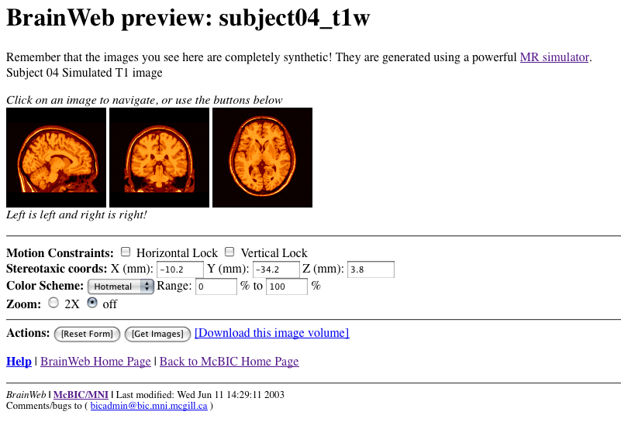
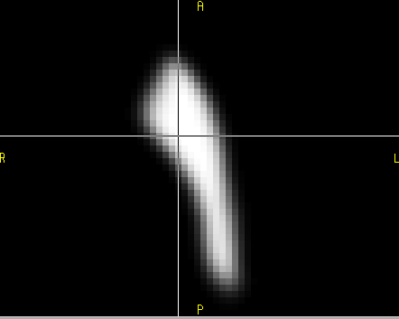
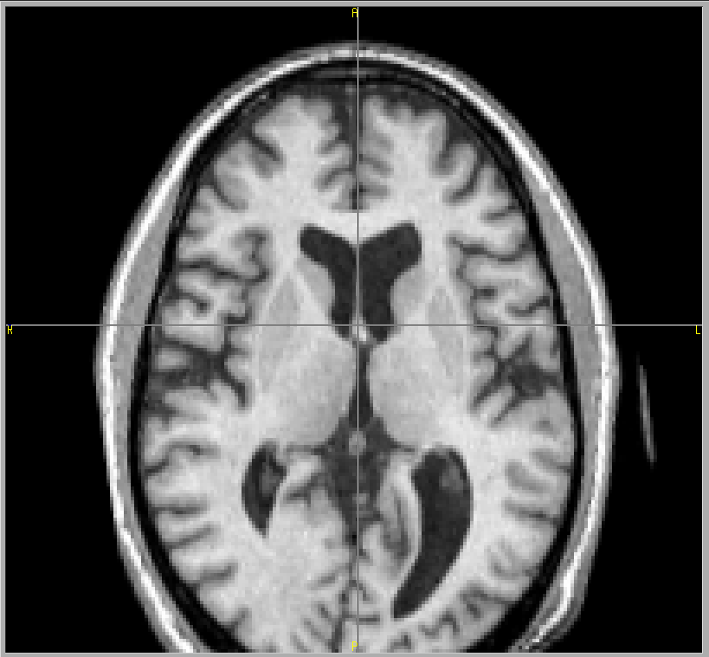
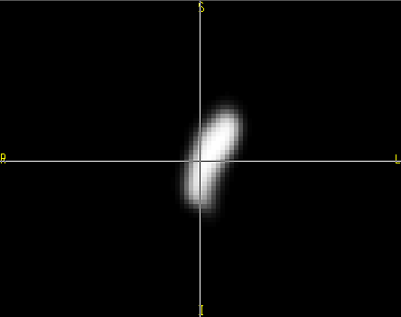
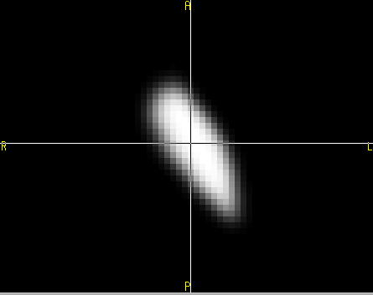
Method: Input Feature Vector
Images
  Brain Atlas
  Prior
  Multi-modality Images
  Feature Enhanced Images
Features
  Location
  Neighborhood
  Candidates
Pure CSF
Pure Grey Matter
Pure White Matter
etc
CSF
Grey Matter
White Matter
etc
0
10
70
130
190
250
255
Notes:
Input feature vector were carefully selected by using those images; brain atlas, prior,…..
Detailed description will be discussed from now.

Slide 15
Method: Input Feature Vector
Images
  Brain Atlas
    MNI
  Prior
  Multi-modalities
  Feature Enhanced
Features
http://www.bic.mni.mcgill.ca/brainweb/
Notes:
Brain atlas from BrainWeb of Mcgill University, were used to provide common spatial template for registration.
This BrainWeb atlas is the commonly used for research as a atlas.

Slide 16
Method: Input Feature Vector
Images
  Brain Atlas
  Prior (16 subjects)
    Manual data
    Registering
    Averaging
  Multi-modalities
  Feature Enhanced
Features
Right Caudate
Left Putamen
Spatial Probability Density Image
Left Globus
Notes:
Priors are spatial probability maps for each region of interest.
Each prior is generated from manually traced binary image of 18 subjects.
It is created by averaging of 18 subjects prior after registering onto the atlas space.
Each prior has values between zero and one, the voxel location with a value of one is highly possible to be a structure, and probability goes down as it approaches to zero for the voxel location.

Slide 17
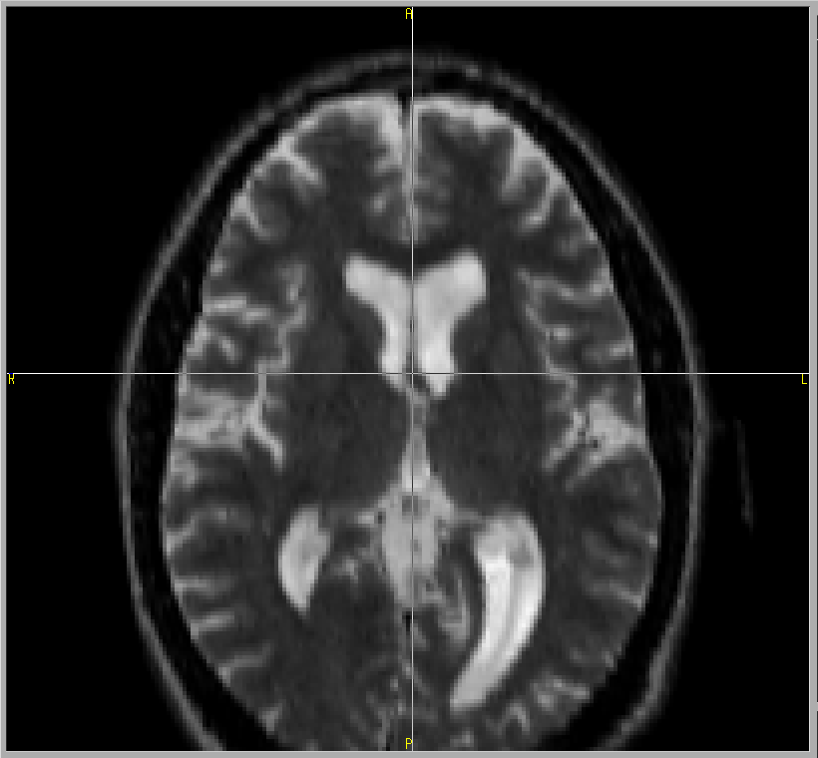
Method: Input Feature Vector
Images
  Brain Atlas
  Prior
  Multi-modalities
    T1-weighted
    T2-weighted
  Feature Enhanced
Features
T1-weighted Image
T2-weighted Image
Notes:
Multi-modality MR images were used as input images, including T1 and T2 weighted images.
These two different modalities gives complimentary information for different tissues.
Generally, the T1 image provide more contrast between grey and white matter and T2 weighted image is good to see boundaries for CSF(Cerebrospinal fluid)

Slide 18
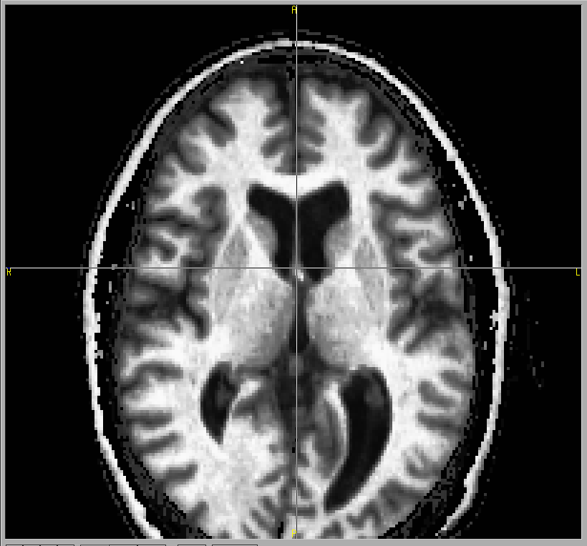
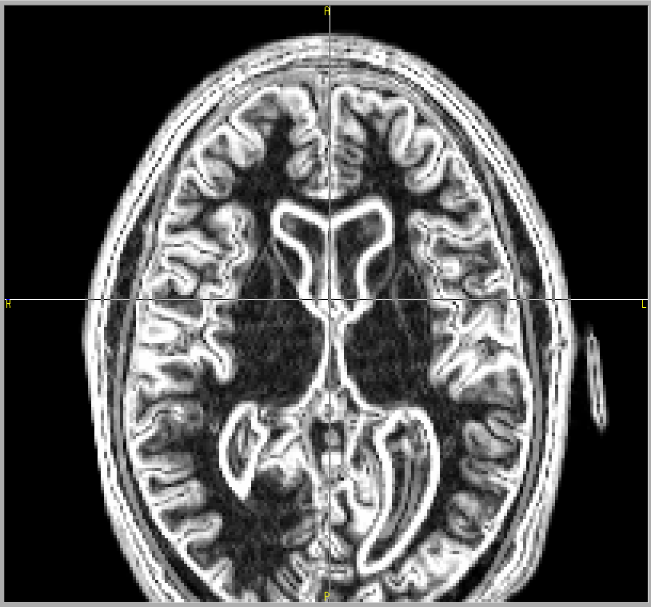
Method: Input Feature Vector
Images
  Brain Atlas
  Prior
  Multi-modalities
  Feature Enhanced
    Tissue Classified
    Mean of Grad.
Features
Tissue Classified image*
Mean of Gradient Magnitude
Pure CSF
Pure Grey Matter
Pure White Matter
etc
CSF
Grey Matter
White Matter
etc
0
10
70
130
190
250
255
* Harris, G., Andreasen, N.C., Cizadlo, T., Bailey, J.M., Bockholt, H.J., Magnotta, V.A., Arndt, S., 1999. Improving tissue
classiﬁcation in MRI: a three-dimensional multispectral discriminant analysis method with automated training
class selection. Journal of Computer Assisted Tomography 23 . 1 , 144 (1) 154.
Notes:
More on those multi-modality images, we employed two more feature enhanced image from those multi-modal images to provide more information to the ANN.
Tissue classified image, which is developed by Greg Harris, is to provide normalized distribution for different tissue types across different subjects.
So ANN can have general idea how each tissue types generally distributed for any scans.
Mean of gradient image is a simply mean of each T1 and T2 images’ gradient descents magnitude.
Since the gradient descents magnitude is commonly used to see boundary information, and the two different modalities provide different boundary information, the combining two information will give more information of boundaries for our region of interest.

Slide 19
Method: Input Feature Vector
Images
Features
T1-weighted Image
T2-weighted Image
Tissue Classified image
Mean of Gradient Magnitude
Notes:
Now from those four images, including 2 multi-modal MR images and two feature enhanced images, we are going to extract feature vectors to be fed on to the ANN input layer.
By registering those priors, which is located on the atlas space now, to the subjects image space, we decide which voxel we are going to use as a feature vector.
The voxel location with a value of prior more than zero will be extracted for feature vectors.

Slide 20
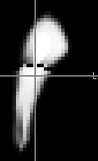
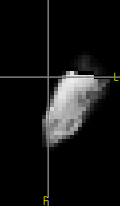
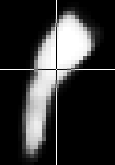
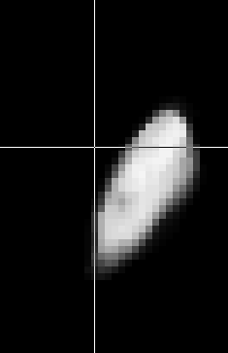
Method: Input Feature Vector
z
Images
Features
  Location
  Neighborhood
  Candidates
z
θ
z
Original Definition
θ
φ
φ
ρ
ρ
Modified Definition
Modified spherical coordinate system
Notes:
First feature is a location information in the form of spherical coordinate system.
Instead of using original definition of spherical coordinate system, we modified a little bit to take account of symmetry of brain structures.
The definition of the rho remains as it is, which is distance from origin, however the theta and phi were modified to have symmetrical definition to the up-and-down and left-to-right.
This work is done because we found that ANN failed to identify left and right structures at the same time because of those non-symmetry definitions of location.

Slide 21
Method: Input Feature Vector
Images
Features
  Location
  Neighborhood
  Candidates
Neighbors along the Gradient Descents
Notes:
Neighborhood information also given to the ANN.
Instead of using orthogonal definition of neighborhood, we used neighborhoods along the gradient descents direction based on priors.
This method has two big advantages.
One is the fact that it can reduce amount of data has to be processed in the ANN because it only takes two directional neighborhood along the gradient descents from in and out instead of using 6 directional orthogonal neighbors.
The other advantage is from its directional consistency across the structure definition.
Since the neighborhood extracted along the gradient descents, it can provide consistent directional pattern regardless of its location.

Slide 22
Method: Input Feature Vector
Images
Features
  Location
  Neighborhood
  Candidates
( 1, 0 )
( 0, 1 )
( 1, 0 )
( 1, 1 )
Candidates Vector based on Priors
Notes:
Last feature is the candidates vector, which is simply Boolean vector based on priors.
Instead of giving probability information, which might cause segmentation result simply driven by registered prior information, the candidates vector were introduced.
Based on registered prior, the vector decide if the voxel location is possible to be a structure.
As we can see from the slides, if there are two region of interest, green and blue structures.
Candidates vector will have true value for the voxel with more than zero probability in the prior.

Slide 23
Method: Output Vector and Training
Boolean Vector
Expanded for Simultaneous Training
( 0, 0 )
( 0, 1 )
( 1, 0 )
( 0, 1 )
Notes:
Now we have to tell what is the right answer given input feature.
Output vector, which is right answer, were created based on manually traced binary images.
So solid line represents the region of interest by human rater.
The middle voxel, which were candidates for both of green and blue structures, were happened to be blue structure based on manually segmented data.

Slide 24
Method : Training
Hidden Layer
Input Layer
z
ρ
θ
Output Layer
φ
Notes:
After creating a set of input and output pattern, which is called training data set, the learning process finally can be started.
The iterative process of learning will go on enough time frame, so that ANN model can learn about our pattern.
We recorded ANN connections and error terms every 100 iterations to see how it goes until it learns pattern completely.

Slide 25
Method : Over fitting
error
Train Error Function
Performance Error Function
Optimally Trained Point
Train time
Notes:
This is how ideal graph for error term versus train time point.
The solid line is training error term, which we can observe that it nicely converges to the certain point as training time increases.
What we did to find optimally trained point after acquiring converged ANN model, we applied ANN model of each time points to the new test data set, and also compute error terms.
Test data set also created in a same way of training data set, which is input and output pattern, but at this time, the known answer, which is output vector, is not for adjusting weights, but just see how it works well.
As the dotted line represent the test data set’s error term, it also decreased until some time point, and then increases rapidly.
This minimum point of performance error, which appeared after training convergence occurred, is regarded as an optimally trained point.
Common explanation for the rapid increasing of testing data set is that the ANN model started to memorize a certain pattern instead of generalize a given problem to produce right answer.

Slide 26
Validation and Verification
Mean and Variance
Relative Overlap and Similarity Index
Pearson’s Correlation
Intraclass Correlation (Fless & Shrout[1979], McGraw & Wong[1996] )
  Agreement
  Consistency
MS_{J} Mean square error between judges
MS_{S} Mean square error between subjects
MS_{E} Mean square error
K Number of Judges
N Number of Subjects
Notes:
For those optimized model, we applied on the 8 test set and compute some validation and verification measures.
Mean and variance is to have quick idea how it closely segment structures to the manual traced data.
If it is not deviated from manual segmentation, we proceed further investigation.
Relative overlap and similarity index were computed for volumetric overlap.
And three correlation coefficient were computed; Pearson’s correlation, and intraclass correlation.
Pearson’s correlation is widely used statistics providing interclass linearity.
Intraclass correlation is for see how two different raters are similar in their measurement.
Out of numerous definition of ICC, we follows the Fless and shrout definition, and identifying right ICC measures followed the flow chart of McGraw and Wong’s.

Slide 27
result
Result with newly adapted Features
Result with threshold for neighboring structures
Result with Simultaneously Trained ANN
Notes:
First is for improvement of performance of newly adapted features and followed by threshold method for neighboring structures, and lastly the simultaneously trained ANN for all the sub-cortical structures.

Slide 28
Result
Manual expert traced training sets and validation sets defined
  16 subjects used for training
  8 subjects used for validation
Trial Cases
  By Different number of hidden nodes
    ( HN =50,60,70, and 80)
  By Different distance along the gradient descents
    ( Grad=1 and 2 )
Notes:
Segmentation result presented here run on the 8 test set, with manually traced binary images to be compared.

Slide 29
Result: Individually Trained ANN
Error function to see convergence, HN=60, Grad=1
Notes:
We can see that every training converged nicely from the error graph.
Performance error does not show that the theoretical behavior here.

Slide 30
Result: Individually Trained ANN
ICC measures consistency(red), agreement(blue) and RO for Optimal Threshold , HN=60, Grad=1
Notes:
This is the measurement graph of the relative overlap and ICC versus threshold value.
These graphs are investigated to find right threshold value, which is analogous to the action potential of the biological neuron.
By looking at the Relative overlap and ICC agreement value, which is blue line at the bottom row, we concluded that the threshold value of 0.4 can be used for action potential for our segmentation.
The ICC consistency, which is red, shows that, however, even if we choose the value a little bit deviated from 0.4, the ANN will produce the consistent result to the human rater.
The ICC agreement says that if what we want is the absolute agreement, it is better to use 0.4 as a threshold.

Slide 31
Result: Individually Trained ANN
Summary of Result, HN=60, Grad=1
Notes:
This is summary for individually trained ANN with newly adapted features.
The blue line is for reference, which is perfect matched line between manual and automated segmentation and the red is fitted line.
Fless and Shrout said that the ICC value above 0.75 is good for general application.
Except for putamen, most of structures show that the high correlation between automated method and manual segmentation.
Especially, the hippo campi and thalamus segmentation result were extraordinary, which is about 0.9.

Slide 32
Method : Threshold
Threshold for neighboring structures
  Mutually Exclusive each other
  Fully defined for in-between space
{
, T > threshold
0 , Otherwise
,where A_{r} is ANN output for region of interest
Notes:
New threshold method adapted to provide more sound definition of each structures.
The individually trained net does not have ability to draw a line precisely between neighboring structures.
More on that, the ANN signal decreases a lot those in-between regions because they cannot decide which structure it has to belong.
To overcome this problem, we applied new threshold method.
This is by summing up all the regions of interest ANN signal, and then threshold it.
For those survived voxel after threshold, it is assigned to be a structure with the largest signal.

Slide 33
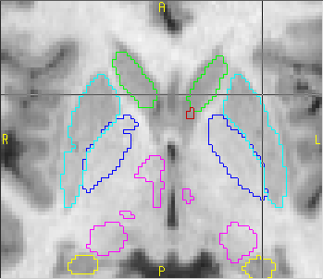
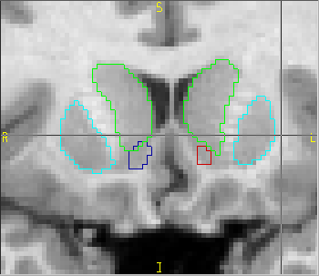
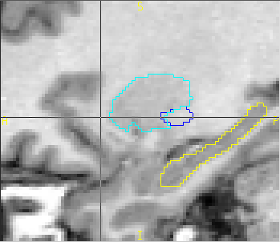
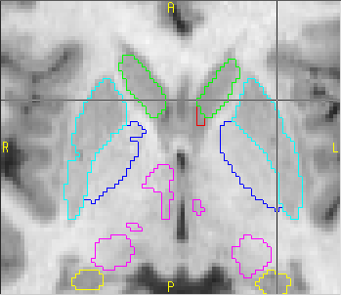

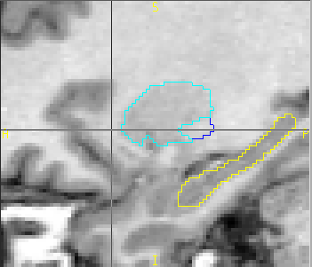
Result using Threshold for neighboring structures
Before Threshold
After Threshold
Notes:
This is improved segmentation after the threshold method
We can see that the holes were filled between structures, and cleaned up those overlaped areas.

Slide 34
Result: Simultaneously Trained ANN
Take account natural biological Definition of Structure
  Disjointed
  No gaps between structures

Slide 35
Result: Simultaneously Trained ANN

Slide 36
Result: Simultaneously Trained ANN

Slide 37
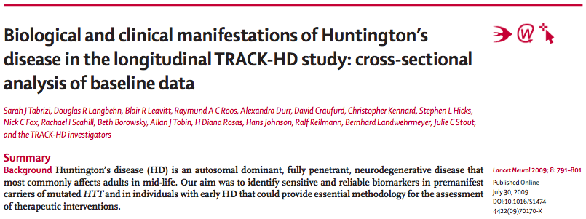
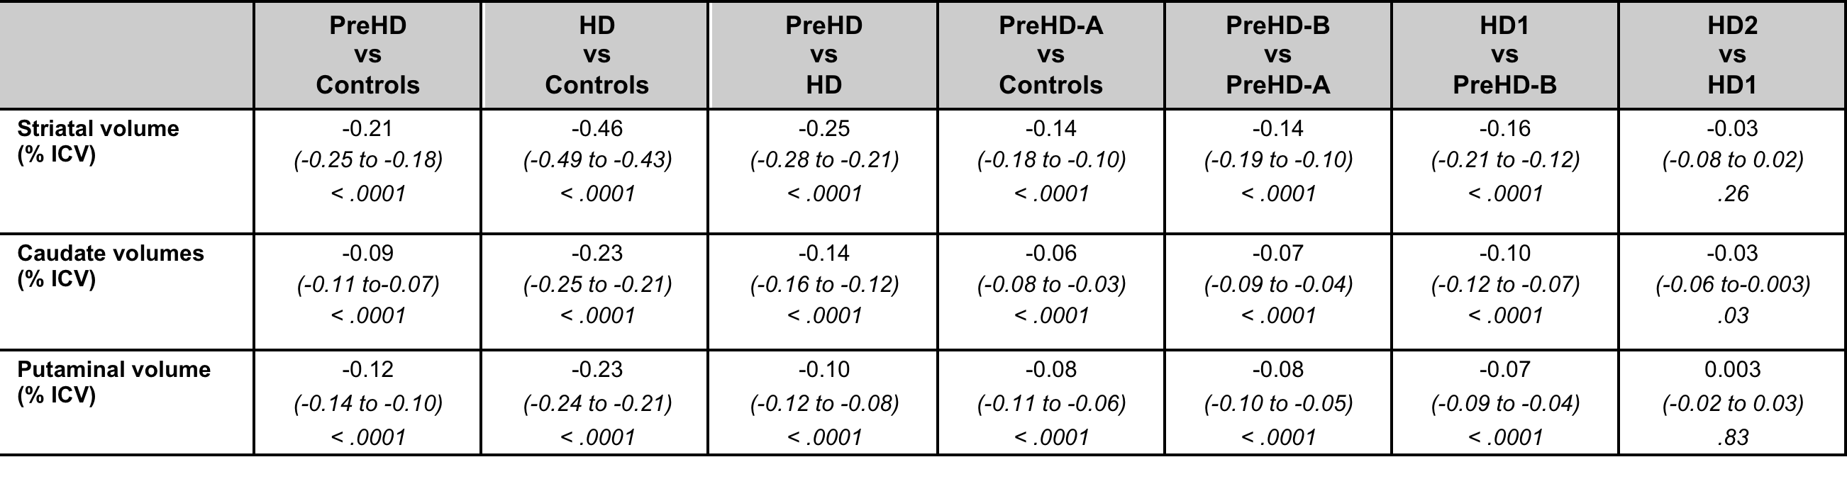
Application of ANN for Caudate & Putamen
Notes:
This multicentre study collected 3 Tesla MRI between January 2008 and September 2008. Blinded analyses were done on the baseline cross-sectional data from 366 individuals: 123 controls, 120 premanifest (pre-HD) individuals, and 123 patients with early HD.
An early single-net version of the BRAINSCut algorithm was used to identify both Caudate and Putamen volumes for all the subjects.
Significant differences were identified between all the groups except the two advanced disease groups.
366 subject images acquired in JAN. 2008
Publication available July 30, 2009

Slide 38
Very Recent results?
Data quality has improved 1.5T to 3.0T
Pre-Processing improves
Therefore,
BRAINSCut improves… …

Slide 39
Development cycle
Manual Traces
Validation with Statistics
BRAINSCut Training
Validation with Experts

Slide 40
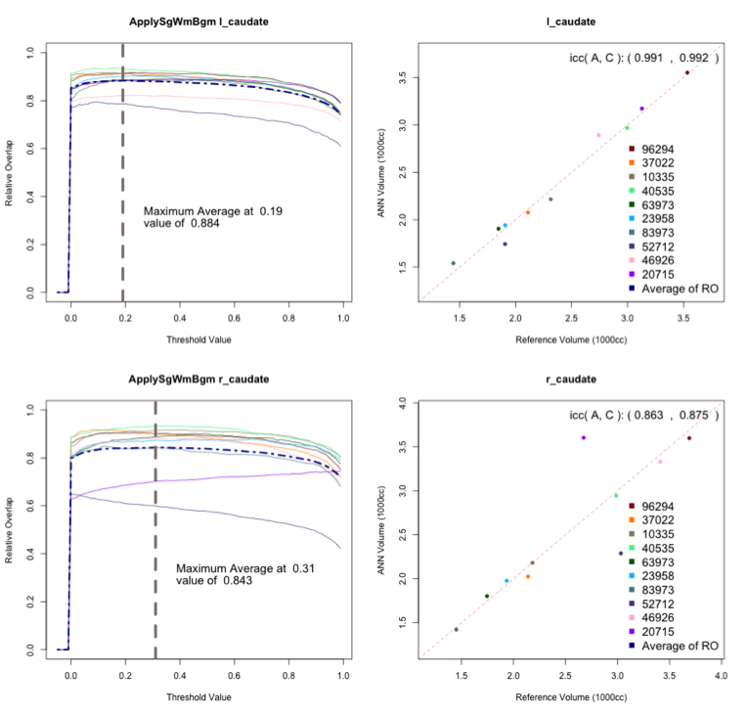
BRAINSCut: Caudate

Slide 41
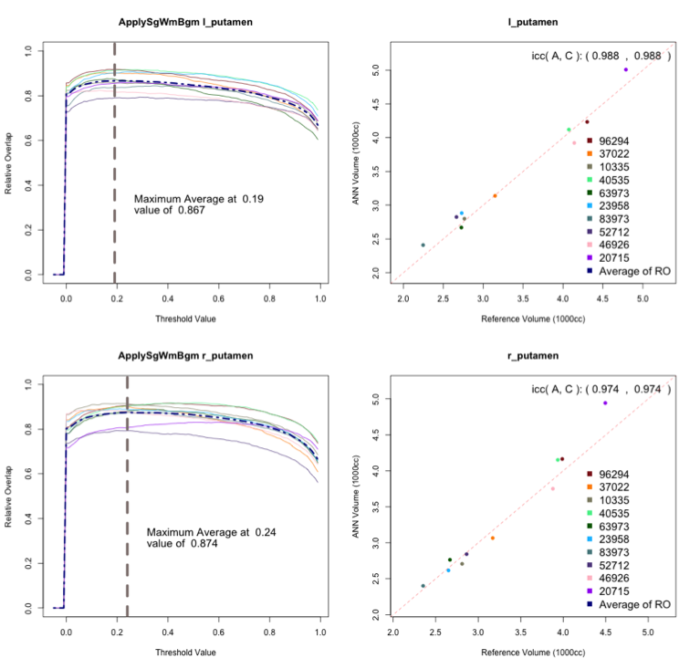
BRAINSCut: Putamen

Slide 42
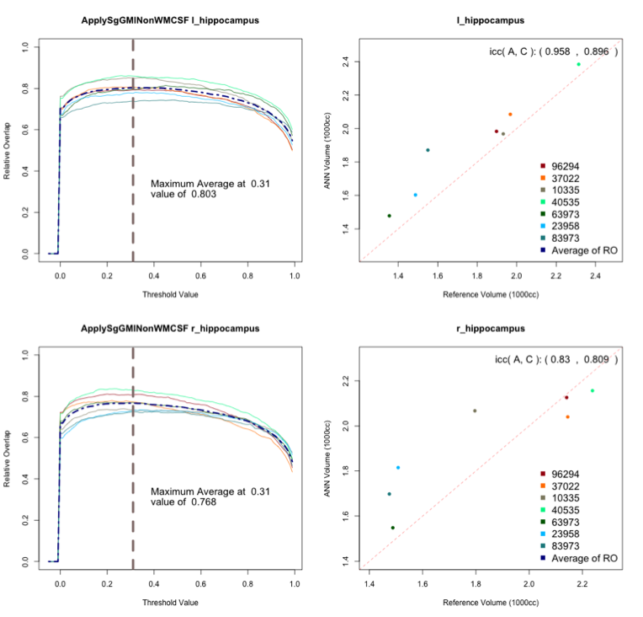
BRAINSCut: Hippocampus

Slide 43
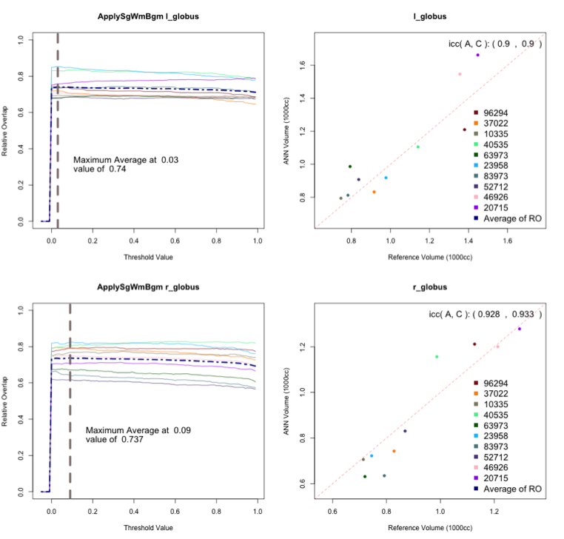
BRAINSCut: Globus

Slide 44
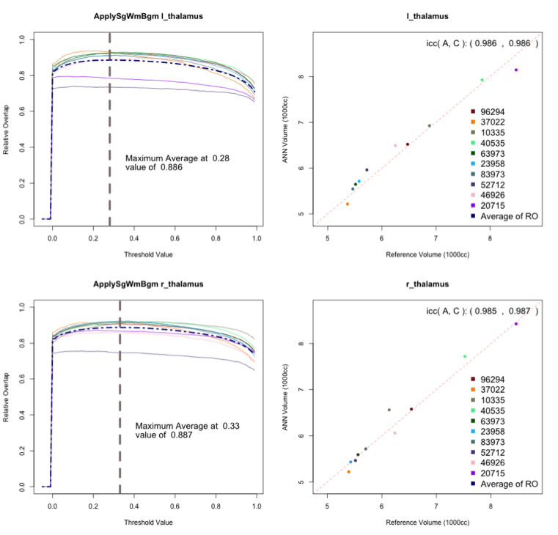
BRAINSCut: Thalamus

Slide 45
Acknowledgement
Prof. Hans J. Johnson
BRAINS Imaging Developers!
PINC laboratory!

Slide 46
Questions?!

