Slide 1
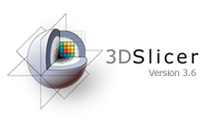
2011 AAPM 3D Slicer Users Group Meeting
NTCP Investigation with Deformable Registration and Dose Warping
Z Saleh¹ *, A Apte¹ , G Sharp² , S Rao¹, N Lee¹, J Deasy¹
(1) Memorial Sloan Kettering Cancer Center, New York, NY
(2) Massachusetts General Hospital, Boston, MA

Slide 2
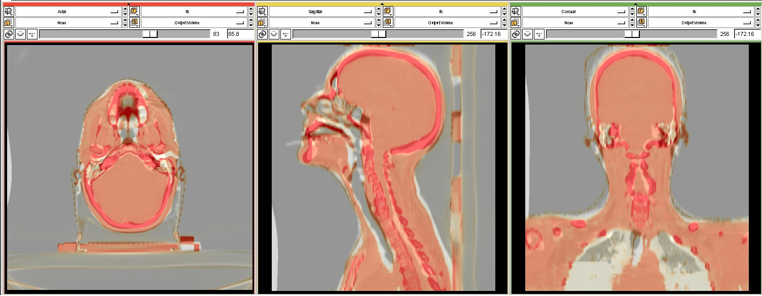
We propose a new technique to spatially correlate organ/tissue sub-volumes sensitivity to irradiation based on a voxel-by-voxel basis by deforming doses from a patient cohort onto a single anatomic frame of reference (a ‘reference human’).
The figure illustrates the deformation of a patient CT (color enhanced) onto a reference CT (Grey). A good agreement is achieved in the head & Neck region using the b-spline DIR algorithm in Plastimatch.

Slide 3
Material
36 patients with Head & Neck cancer of the Oropharynx on the right side.
Treated with definitive IMRT between 1/04 and 4/09 at MSKCC with a median follow up of 34 months (6-68).
12 patients (33%) have chronic trismus (Grade >= 1) according to the CTCAE version 4.0.

Slide 4
Method
Muscles of mastication; The masseter (M), temporalis (T), lateral pterygoid (LP) and medial pterygoid (MP) were delineated on axial CT treatment planning images.
CT scans were deformed onto a single “Reference Human” using B-spline method for deformable image registration available in Plastimatch.
Dose warping was performed using the B-spline transformation files.
CT scans, structures, and prescription dose distributions were exported into DICOM and then imported into the Computational Environment for Radiotherapy Research (CERR) for further analysis

Slide 5
Work flow
CTScan [1..35]
RTDose [1..35]
RTDose_{w} [1..35]
DVF [1..35]
Def.
Regis.
Ref CTScan
+ RTDose_{w} [1..35]
Dose
warping
CERR import
Ref CTScan

Slide 6
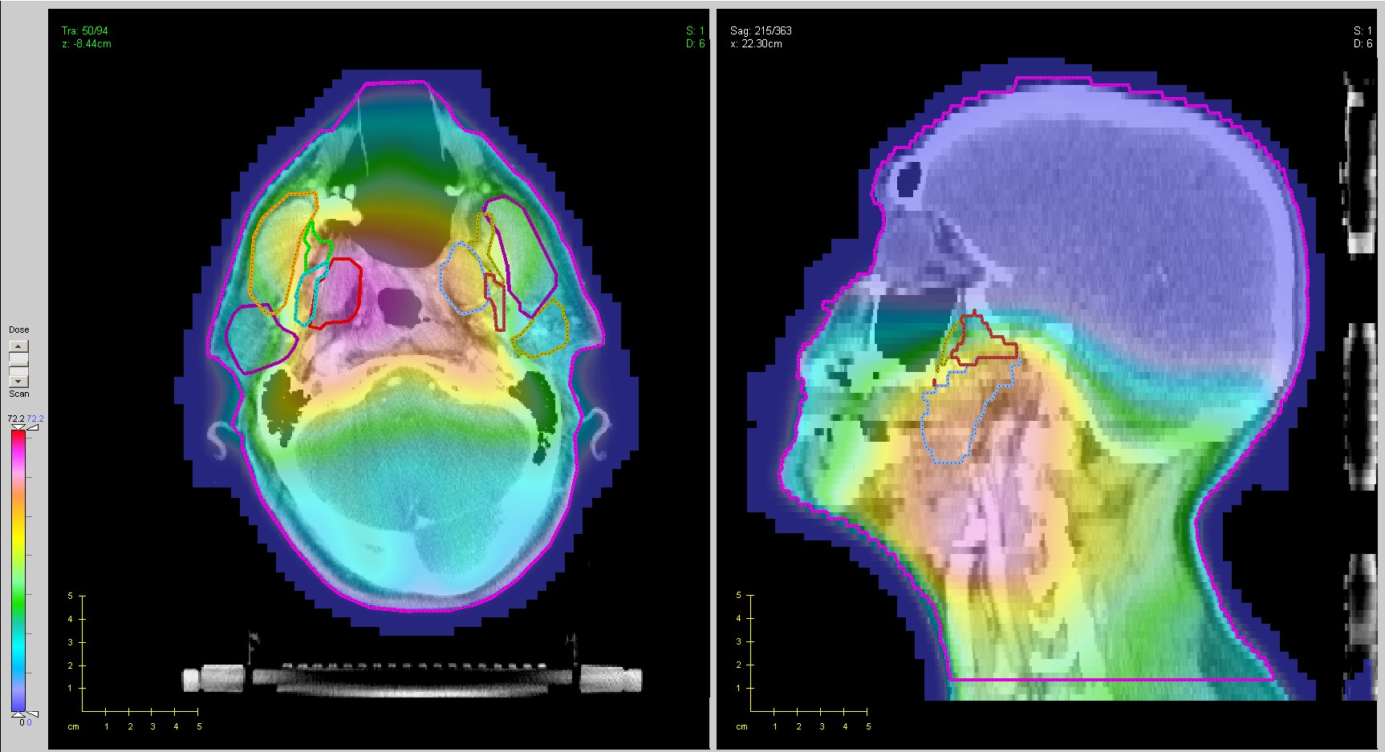
Cohort Mean Dose Map
Temporalis
Masseter
Masseter
Parotid
Lateral
Pterygoid
Lateral
Pterygoid
Medial
Pterygoid
Medial
Pterygoid
(a)
(b)
The figure shows the mean dose distribution of the warped doses. A higher mean dose is received by the right side as expected since the tumor happened to be on the right side.

Slide 7
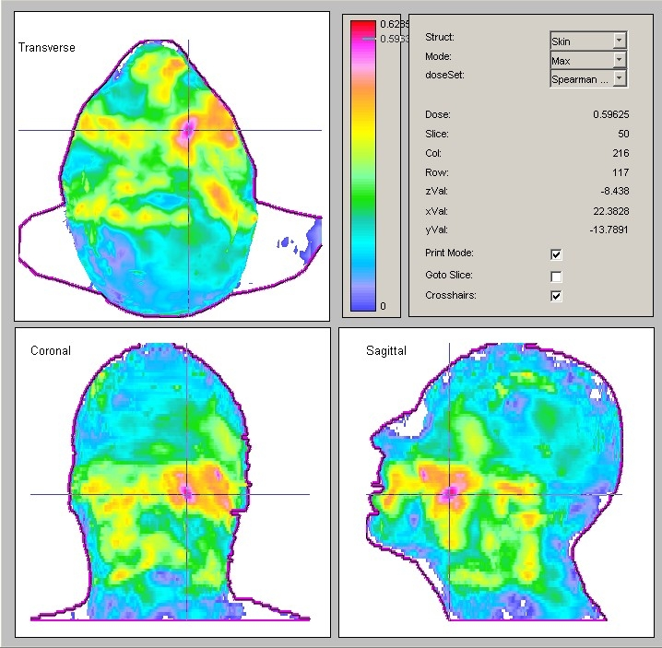
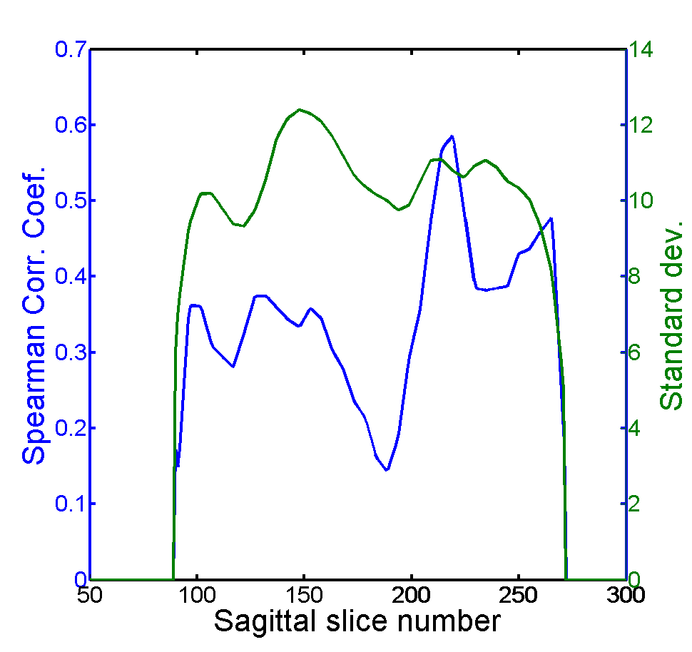
Spearman Correlation Map
Maximum intensity projection of the 3D Spearman corr. coef. along the transverse and sagittal view as shown in panels (a) & (c) respectively. Panel (b) shows a line intensity profile of Spearman coef. and std-dev along the black solid line on the left.
(a)
(b)
(c)

Slide 8
Conclusion
This new approach identified a Spearman correlation ‘hot spot’ (Rs=0.6) which is considerably higher than the value achieved with the logistic regression model (Rs=0.41).
This novel technique provides a new approach to dosimetrically understand toxicity and identify entirely new OARs.
This analysis was made possible by using 3D Slicer/Plastimatch/CERR/DREES

Slide 9
References
Slicer 3D [http://www.slicer.org/]
Plastimatch [http://plastimatch.org/]
CERR [http://www.cerr.info/about.php]
DREES [http://code.google.com/p/drees/]

