Slide 1
Tsunami in the Procedure Room the Growing Challenge of Managing Data in Image Guided Interventions and Surgery

Slide 2
Tsunami in the Procedure Room, the Growing Challenge of Managing Data in Image Guided Interventions and Surgery
Ron Kikinis M.D.
Robert Greenes Distinguished Director of Biomedical Informatics, Dept. of Radiology, BWH
Professor of Medical Image Computing, FB 3, Uni Bremen
Professor of Radiology, Harvard Medical School
Founding Director, Surgical Planning Laboratory, Brigham and Women’s Hospital
Institutsleiter, Fraunhofer MEVIS
Principal Investigator, National Alliance for Medical Image Computing, and Neuroimage Analysis Center,
Collaboration Director, National Center for Image Guided Therapy

Slide 3
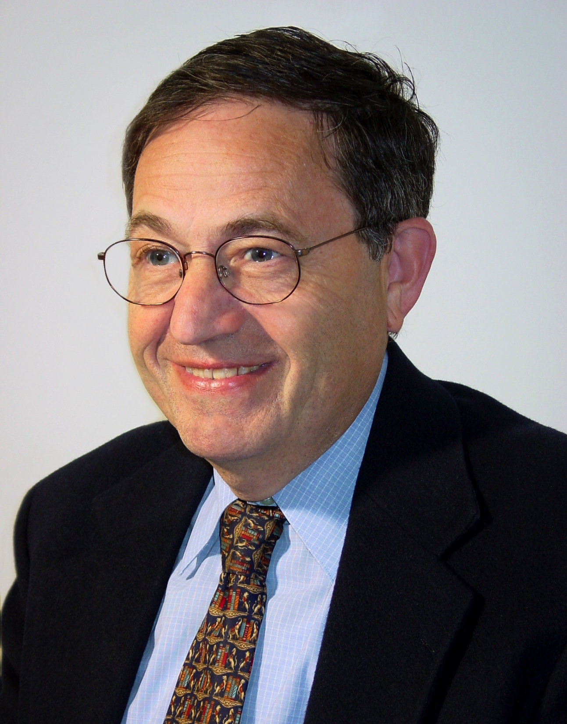
In Memoriam Ferenc A. Jolesz
May 21, 1946 – December 31, 2014
Mentor and friend
"Ferenc A. Jolesz" by Michael Halle

Slide 4
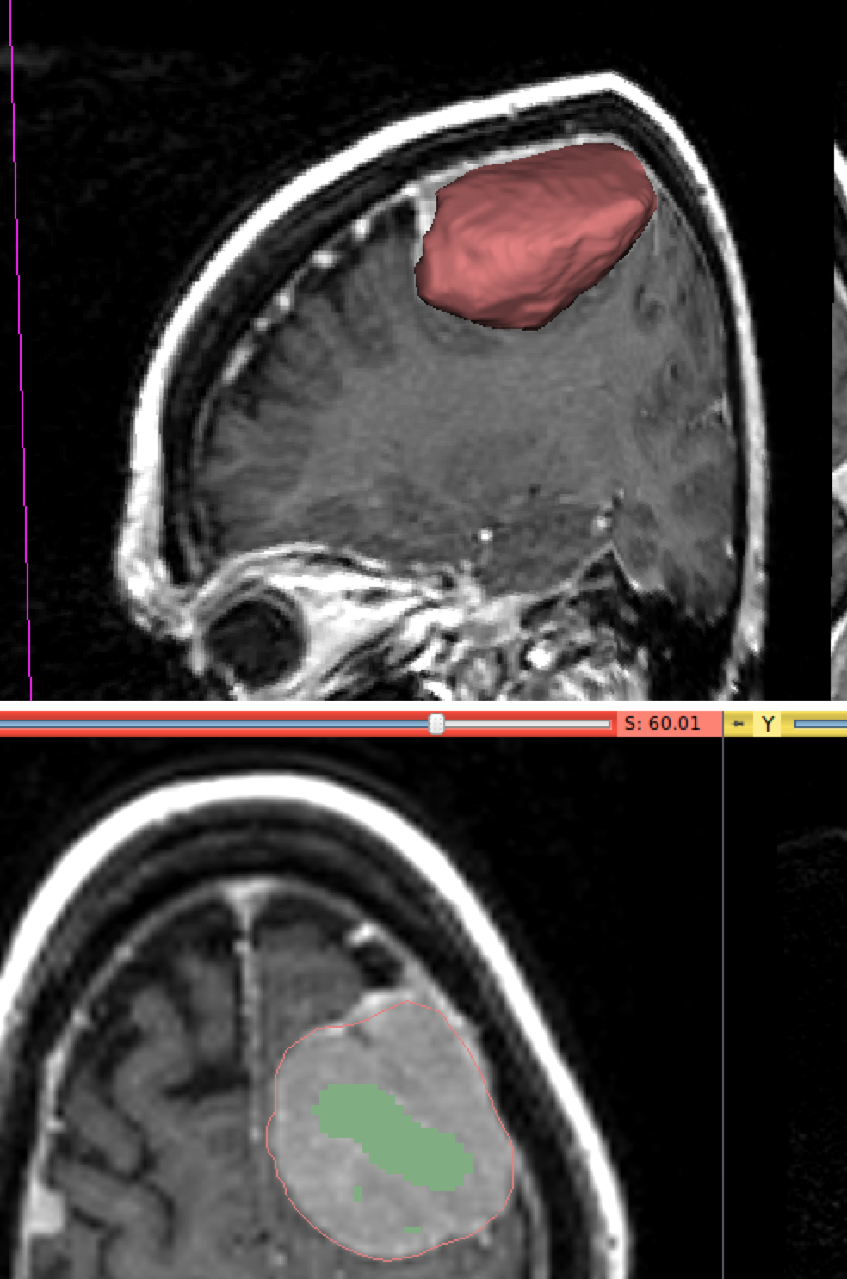
What is MIC
Goal: extraction of clinically relevant information and knowledge from medical images using computational methods such as:
image segmentation
image registration
image-based physiological modeling
visualization
http://wiki.slicer.org/slicerWiki/index.php/Documentation/Nightly/Modules/RobustStatisticsSegmenter
result
initialization
before
MIC=Medical Image Computing
after
Volume rendering
https://en.wikipedia.org/wiki/Medical_image_computing
http://wiki.slicer.org/slicerWiki/index.php/Documentation:Nigh tly:Registration:RegistrationLibrary:RegLib_C14

Slide 5
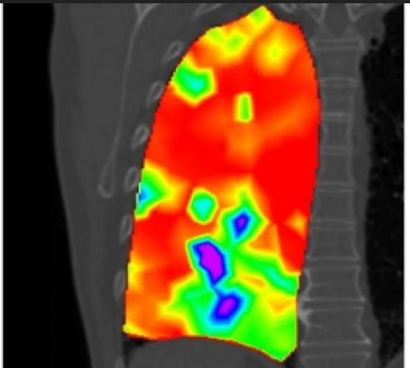
Increasing Importance of MIC
More applications
Discovery, Diagnosis
Therapy monitoring
More data and complexity
Gigabytes to terabytes
fMRI, molecular imaging, dMRI, 4DUS
More modalities
Risholm P., Ross J., Washko G.R., Wells III W.M. Probabilistic Elastography: Estimating Lung Elasticity. Inf Process Med Imaging. 2011;22:699-710. PMID: 21761697. PMCID: PMC3249413.

Slide 6
The Need For Standards
In every procedure room there are devices from many vendors
We need vendor neutral standards for exchange of data, metadata and provenance information
DICOM working group 24 is an important activity in this domain (see H. Lemke’s talk later today)

Slide 7
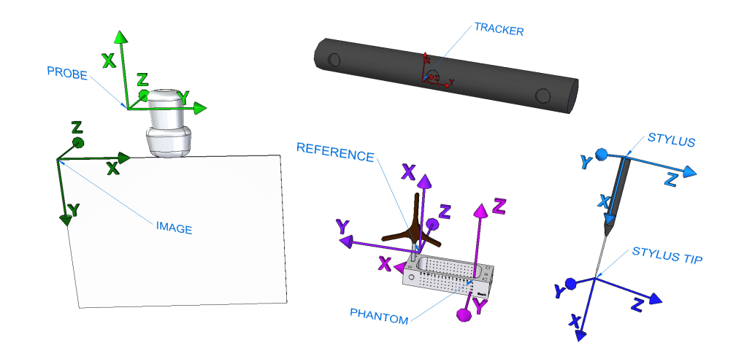
IGT: Complexity without standards
CT IMAGE
FIDUCIALS
STYLUS TIP
US PROBE
US IMAGE
STYLUS REF
NEEDLE TIP
TRACKER
NEEDLE REF
Courtesy G. Fichtinger et al.

Slide 8
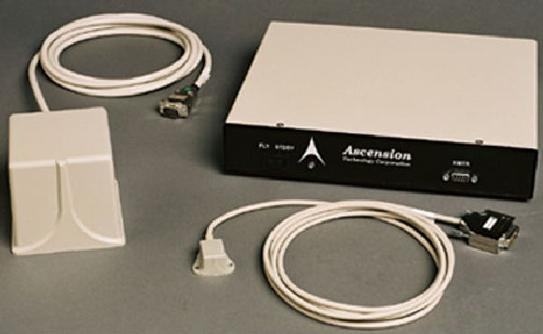
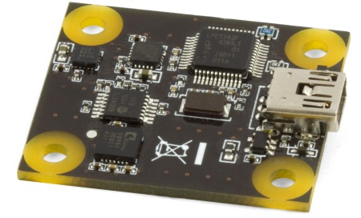
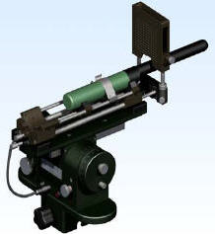
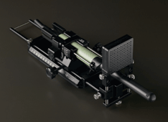
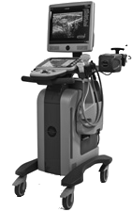
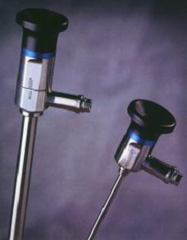
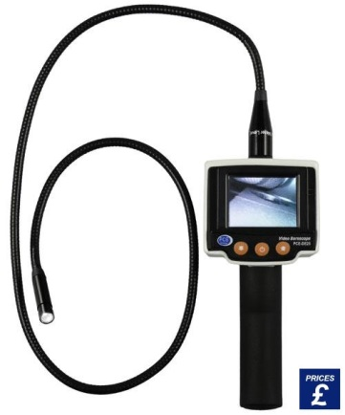
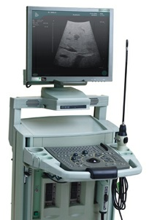
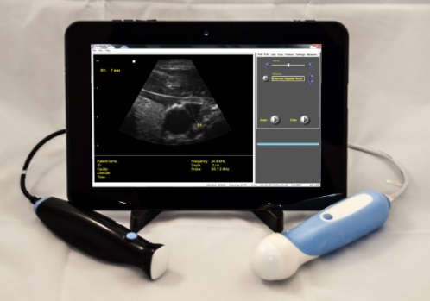
Plurality of devices and vendors
Courtesy G. Fichtinger et al.

Slide 9
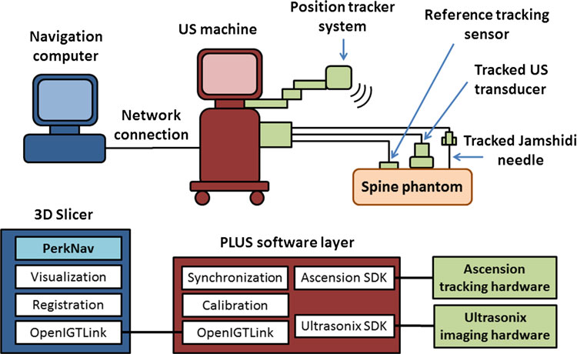
Image-Guided Therapy Platforms
Open source, used worldwide in 86 countries
SlicerIGT: 24,000 module downloads (past 12 mo)
PLUS: 1,300 build downloads (past 12 mo)
Lasso A, Heffter T, Pinter C, Rankin A, Ungi T, Fichtinger G, PLUS: open-source toolkit for ultrasound-guided intervention systems, IEEE Transactions on Biomedical Engineering, Vol. 61, Issue 10, pp. 2527 – 2537, 2014

Slide 10
What Can We Learn From Other Fields?
How to handle metadata and provenance?
Neuroscience MIC in Neuroimaging
A long tradition of ad hoc solutions
Cancer: Quantitative Imaging Network (QIN)
Funded by NCI
ITCR is parallel effort to work on the informatics side
QIICR work on mapping ad hoc solutions into standards space (DICOM)

Slide 11
MIC in Neuroscience
NA-MIC: National Alliance for Medical Image Computing http://www.na-mic.org
Huntington’s Disease
Hans Johnson, Ph.D.
Courtesy H. Johnson

Slide 12
What is Huntington’s Disease?
http://en.wikipedia.org/wiki/Huntingtons_disease
Huntington's disease (HD) is a neurodegenerative genetic disorder that affects muscle coordination and leads to cognitive decline and psychiatric problems.
It typically becomes noticeable in mid-adult life (between 35 and 44 years ).
The Huntingtin gene provides the genetic information for a protein that is also called "huntingtin". Expansion of a CAG (cytosine-adenine-guanine) triplet repeat-stretch within the Huntingtin gene results in a mutant form of the protein, which gradually damages cells in the brain
Life expectancy in HD is generally around 20 years following the onset of visible symptoms.

Slide 13
HD Background
NA-MIC: National Alliance for Medical Image Computing http://www.na-mic.org
MR detectable
Clinical symptoms
Courtesy H. Johnson

Slide 14
TRACK-HD Stage 1 HD Subject!
Baseline Scan
NA-MIC: National Alliance for Medical Image Computing http://www.na-mic.org
Courtesy H. Johnson

Slide 15
TRACK-HD Stage 1 HD Subject!
Year 1 Scan
NA-MIC: National Alliance for Medical Image Computing http://www.na-mic.org
Courtesy H. Johnson

Slide 16
Specific Aims
NA-MIC: National Alliance for Medical Image Computing http://www.na-mic.org
Perform individualized longitudinal shape change quantification from multi-modal data.
Complete full brain Diffusion Tensor Imaging tractography analysis.
Courtesy H. Johnson

Slide 17
Organize and Process the Data
Massive amounts of complex data and processing streams require
Databases for data and processes
Repositories of methods and parameters
Provenance tracking

Slide 18
Predict HD Data Management
NA-MIC: National Alliance for Medical Image Computing http://www.na-mic.org
Courtesy H. Johnson
National Alliance for Medical Image Computing http://www.na-mic.org
38 subjects

Slide 19
NiPype A large catalog of tools with a uniform Python interface
NA-MIC: National Alliance for Medical Image Computing http://www.na-mic.org
• Batch processing
– Distributed processing plugins
– Reruns affect updated/edited node connections ONLY!
• Uniform node creation
– Stable and consistent API
– Nipype’s Function node allows easy integration of CLI tools
• Pipeline complexity
– Iterables, MapNodes
– Nested workflows
Image source: Gorgolewski K et al., (2011) Nipype: a flexible, lightweight and extensible neuroimaging data processing framework in Python. Front. Neuroinform. 5:13.
Courtesy H. Johnson

Slide 20
NA-MIC: National Alliance for Medical Image Computing http://www.na-mic.org
National Alliance for Medical Image Computing http://www.na-mic.org
Morphometry Pipeline based on NyPipe
Courtesy H. Johnson

Slide 21
Management System
NA-MIC: National Alliance for Medical Image Computing http://www.na-mic.org
Metadata is of increasing importance:
Parameters
Provenance
Status
al Alliance for Medical Image Computing
Courtesy H. Johnson

Slide 22
Tracking Sub-Cortical Structures
NA-MIC: National Alliance for Medical Image Computing http://www.na-mic.org
BRAINSCut
Developed
• Caudate
• Putamen
• Thalamus New structure
• Hippocampus
On going
• Globus
• Accumbens
• And more…
Courtesy H. Johnson

Slide 23
Joint modeling of subcortical structures
NA-MIC: National Alliance for Medical Image Computing http://www.na-mic.org
Hum Brain Mapp. 2014 Mar;35(3):792-809
Courtesy H. Johnson

Slide 24
What We Can Learn
Neuroimaging research in neuroscience faces similar problems
Many data streams
Inconsistent acquisitions
Ad-hoc solutions (such as nrrd, nifty and mha file formats)produce a struggle with metadata
Easier (but not easy):
Timelines of years
“Only” MRI, few other modalities

Slide 25
Quantitative Image Informatics
for Cancer Research (QIICR): Mapping Ad Hoc Solutions into Standards
Andrey Fedorov, PhD and Ron Kikinis, MD
Brigham and Women’s Hospital Harvard Medical School, Boston, MA
fedorov@bwh.harvard.edu

Slide 26
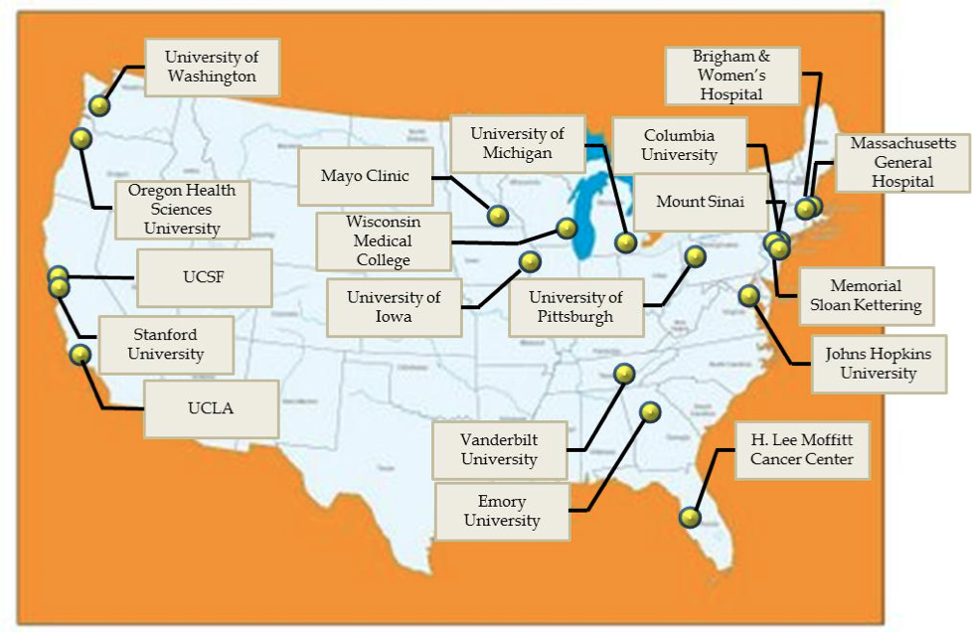
NCI Quantitative Imaging Network (QIN)
“The network is designed to promote research and development of quantitative imaging methods for the measurement of tumor response to therapies in clinical trial settings, with the overall goal of facilitating clinical decision making.”
QIN as of March 2014
http://imaging.cancer.gov/programsandresources/specializedinitiatives/qin

Slide 27
QIN challenges
Data sharing
Site-specific solutions
Limited support of common formats
no agreement what that format should be
No repositories of annotated image data
Tool sharing
Tools are generally developed for internal use
Different levels of maturity
Not always open source
Individual sites are not tasked with the development of the platform to facilitate sharing

Slide 28
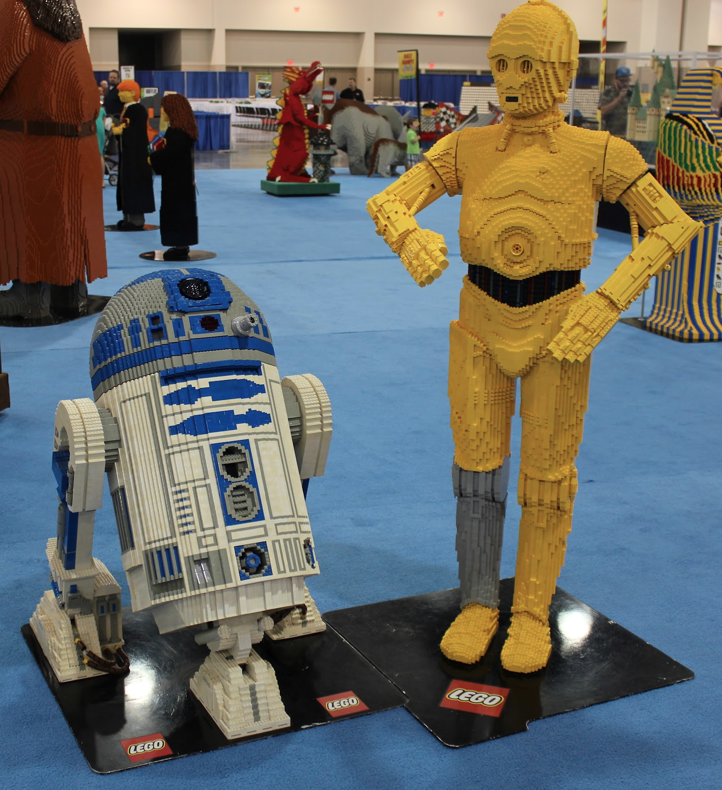
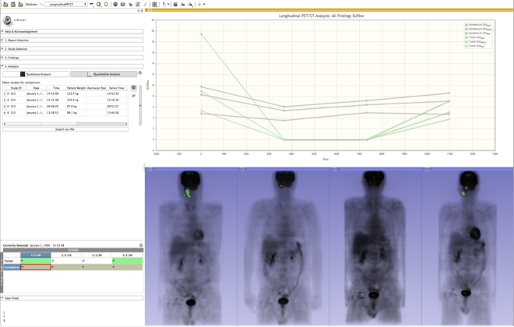
QIICR: Solutions and tools
Clinical researcher is the target user
Standardize on 3D Slicer as the delivery platform
Implement missing “building blocks” as needed
segmentation
advanced analysis
...
Integrate “building blocks” into end-to-end solutions
Standardize on DICOM for input images and output results serialization
vs
Mercea P, Fedorov A, Pieper S, Beichel R, Park M-A, Hainer J, Kijewski MF, Horky L, Kikinis R, Dickhaus H. Quantification of longitudinal tumor changes using PET imaging in 3D Slicer. In Proc. of Computer Assisted Radiology and Surgery, 2013. Int J CARS 2013 (8) (Suppl 1):S285-S286.
Pohl K, Konukoglu E, Novellas S, Ayache N, Fedorov A, Wells WM, Talos IF, Golby A, Kikinis R, Black PM. A New Metric for Detecting Change in Slowly Evolving Brain Tumors: Validation in Meningioma Patients. Neurosurgery, 2011, 68(1 Suppl Operative), pp.225-233.

Slide 29
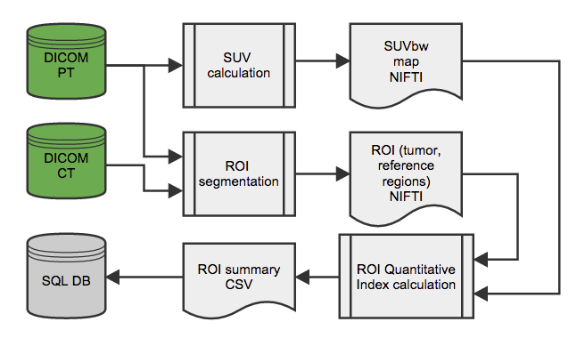
Simplified Iowa QIN workflow (pre-QIICR)

Slide 30
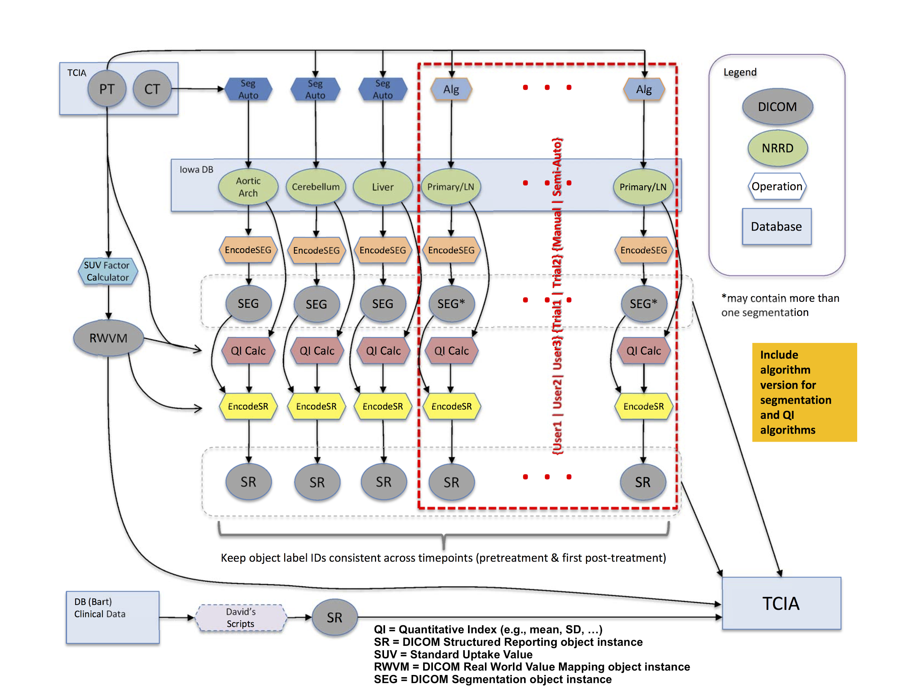
Managing Complexity Using a Standards Based Approach

Slide 31
What We Can Learn
Converting ad hoc solutions to standards based solutions is hard work
Benefits are mostly long term (portability, usability past the current graduate student)
Lack of easily accessible reference implementations results in lack of adoption of standards

Slide 32
The Process of Translation
Technological prototype
Tools for biomedical research
Clinical tools
Can it be done?
Innovative, not robust, usually single developer
Should it be done?
Usability, robustness, portability and openness
For every patient
FDA approved, supported, closed source

Slide 33
Translation
Problem: The valley of death
Lack of incentives for translation from prototype to biomedical tool
Scientist: Doesn’t help my academic promotion
NIH reviewers: Not innovative
Companies: Too risky because it is not proven
Solution: A mountain of opportunities
3D Slicer was evolved by the NAMIC community to make translation easier
Easy-to-use generic capabilities like display, I/O and common algorithms
Low barriers for extension and distribution

Slide 34
Research and Medical Product
Research:
Lower barrier for scientific exchange
Reproduction of results by others is a critical part of the scientific method
Good match by FOSS (free open source software)
Medical product:
Certification process and resulting liabilities need to be funded
User interface,training and documentation
Closed source is the only model

Slide 35
Comparing Platforms
3D Slicer
Free open source software (free beer and free speech)
Not certified
Well suited for basic research and early translation
MeVisLab
Free for research, non free for commercial use
Certified
Well suited for translation and commercialization

Slide 36
Towards Standards in the OR
OpenIGTLink, a vendor neutral API
The API is open but drivers can be open or closed
Allows co-existence of open and closed systems
NIH just funded a project to integrate/map OpenIGTLink with DICOM

Slide 37
Subject Specific Analysis
Quick and good enough is better than slow and perfect!
Image processing problems cannot be compensated by adding subjects (you have only one)
Interactive work is the norm
"Ron's rules for tools" is an informal set of rules that developers should keep in mind when working on interactive tools for translational clinical research. If you follow them, you will create tools that many people will use.
You make it, I break it.
Your tool does not exist, until it works on my laptop with my data.
I am lazy. I do not like to move the mouse or to type.
No more than one simple parameter.
I have Attention deficit disorder: Make your algorithm fast.

Slide 38
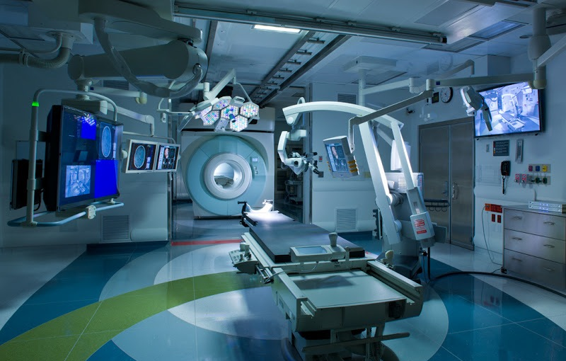
AMIGO @ BWH: F. Jolesz, PI
NCIGT: National Center for Image Guided Therapy http://www.ncigt.org
Courtesy J. Jagadeesan

Slide 39
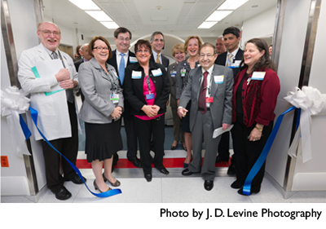
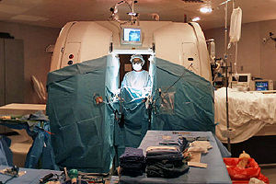
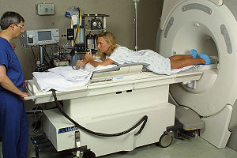
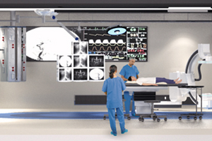
AMIGO : 20 years in the making
AMIGO represents the latest step in IGT research at BWH started in the early 1990’s
1991
BWH Image-guided Therapy program founded by Ferenc Jolesz
Introduction of world’s first inter-operative MR magnet: MRT ‘double-donut’
1994
BWH develops first MR-guided Focused Ultrasound (MRgFUS) system
2005
Creation of NIH-funded National Center for Image Guided Therapy
IGT applications expand to other advanced imaging modalities
2011
AMIGO: First suite to offer the full array of advanced imaging modalities in one operating theater (MRI, PET/CT, 3D US, Fluoro, Angio)
MRT
MRgFUS
NCIGT
AMIGO
Since the early/mid-1990’s, over 100 interoperative MRIs and close to 100 MRgFUS systems have been installed throughout the world
Training and technology dissemination: eg, 3D slicer
A clinical and translational test bed for multi-modal IGT
Slide courtesy T. Kapur

Slide 40
830 Procedures in AMIGO 08/31/2011-05/29/2015
Neurosurgery | 150
MR and Ultrasound Guided Brain Tumor Resections | 98
MR Guided Transsphenoidal Resections for Pituitary Tumors | 22
MR Guided Deep Brain Stimulation Electrodes Placements | 16
MR Guided Laser Brain Tumor Ablations | 9
MR Guided Skull Base Surgery | 4
MR Guided Epilepsy Electrode Placement | 1
Pelvic Biopsy, Ablation, Brachytherapy | 334
MR Guided Prostate Biopsies | 228
MR and Ultrasound Guided Gynecologic Cancer Brachytherapy | 87
MR and Ultrasound Guided Prostate Brachytherapy | 8
MR Guided Cryoablations of Prostate Tumors | 7
MR Guided Biopsy of Penile Tumor | 1
PET/CT Guided Penile Biopsy | 1
PET/CT Guided Cryoablation of Pelvic Tumor | 1
MR Guided Biopsy & Cryoablation of Pelvis | 1
Thoracic Surgery, Biopsy, Ablation | 72
Video Assisted Thoracoscopic surgeries (iVats) | 28
Breast Lumpectomies | 16
PET/CT Guided Lung Biopsies | 10
Cardiac EP Ablations | 7
PET/CT Guided Microwave Ablations of Lung Tumors | 7
PET/CT Guided Cryoablations of Lung or Rib Tumors | 3
MR Guided Cryoablation of Metastatic Paraspinal Tumors | 1
Skeletal Biopsy & Ablation | 10
MR Guided Cryoablation of Spine Tumor | 4
PET/CT Guided Biopsy of Spine Tumor | 3
MR Guided Cryoablation of Degenerative Spine Disease | 2
MR Guided Biopsy of Femoral Tumor | 1
Abdominal Tumor Ablation & Biopsy | 249
MRI Guided Cryoablations of Liver or Kidney Tumors | 157
PET/CT Guided Microwave Ablations of Liver or Kidney Tumors | 35
MR Guided Biopsies of Liver or Kidney Tumors | 33
PET/CT Guided Cryoablations of Liver or Kidney Tumors | 24
Head and Neck Surgery | 15
Parathyroidectomies/Hemithyroidecotmies | 5
MR Guided Cryotherapy of Head & Neck Tumor | 5
PET/CT Guided Biopsy of Head & Neck Tumor | 2
MR Guided Face Transplant Intervention | 2
MR Guided Biopsy of Head & Neck Tumor | 1
http://ncigt.org/pages/AMIGO
http://brighamandwomens.org/research/amigo/default.aspx
https://www.youtube.com/watch?v=HNLB5Xcf3Co

Slide 41
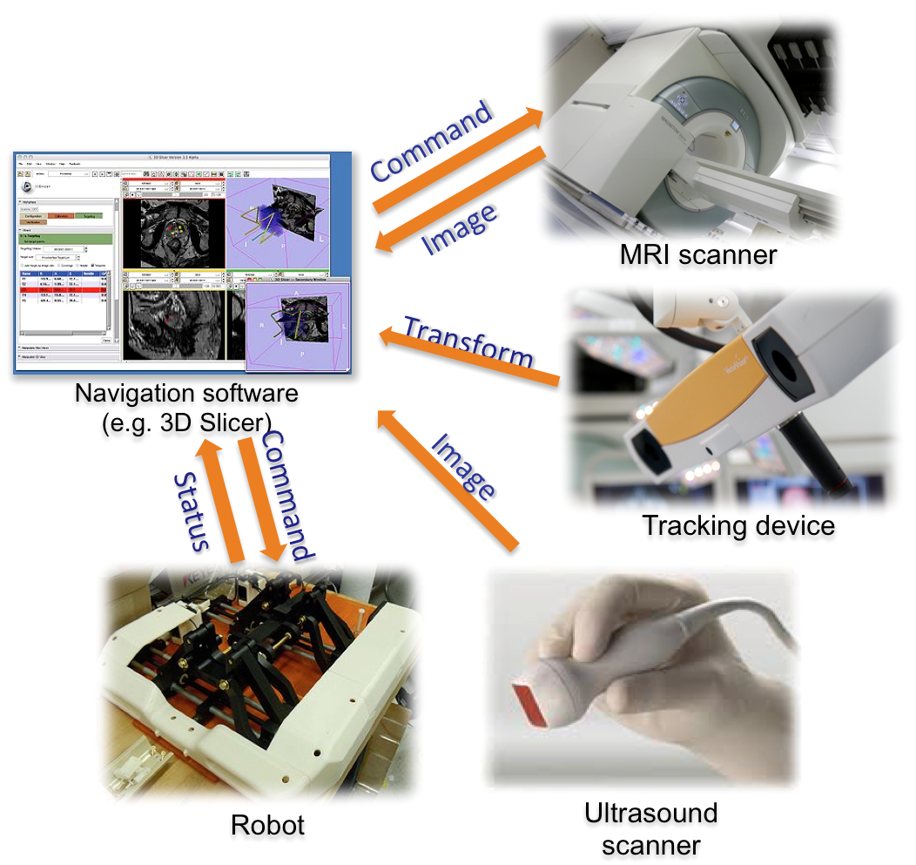
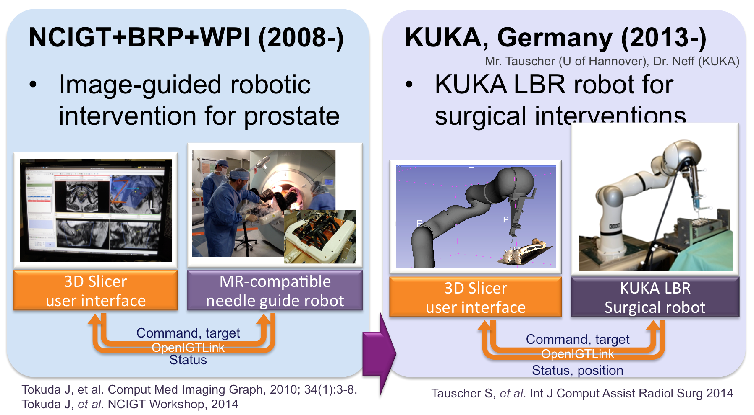
OpenIGTLink Real-time Communication In The OR
Slide courtesy J. Tokuda

Slide 42
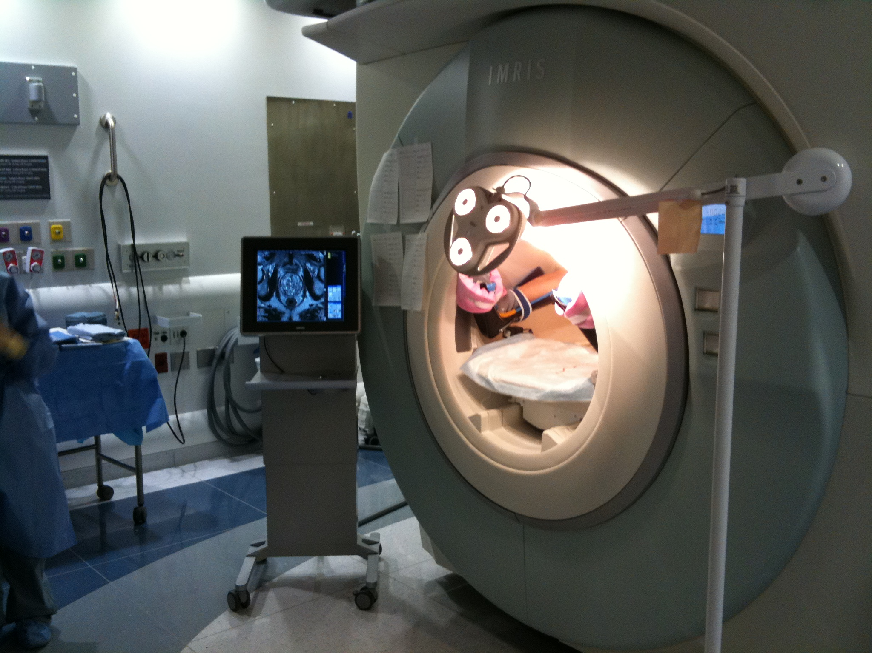
Controlling Devices
Use an iPhone to control scan plane acquisition
Smartphone
Scanner Room
Command
Image
WiFi Router
MRI Scanner
Command
Image
OpenIGTLink Proxy
Console Room
Command
Image
MRI Host Computer
MRI Hardware
Tokuda J., et al. CARS 2012, June 27-30, Pisa Italy

Slide 43
US Tracking: 2011: Bench
Movie courtesy Ungi, Lasso, Fichtinger

Slide 44
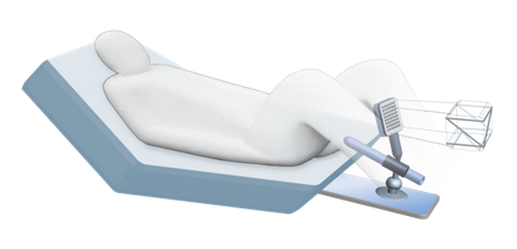
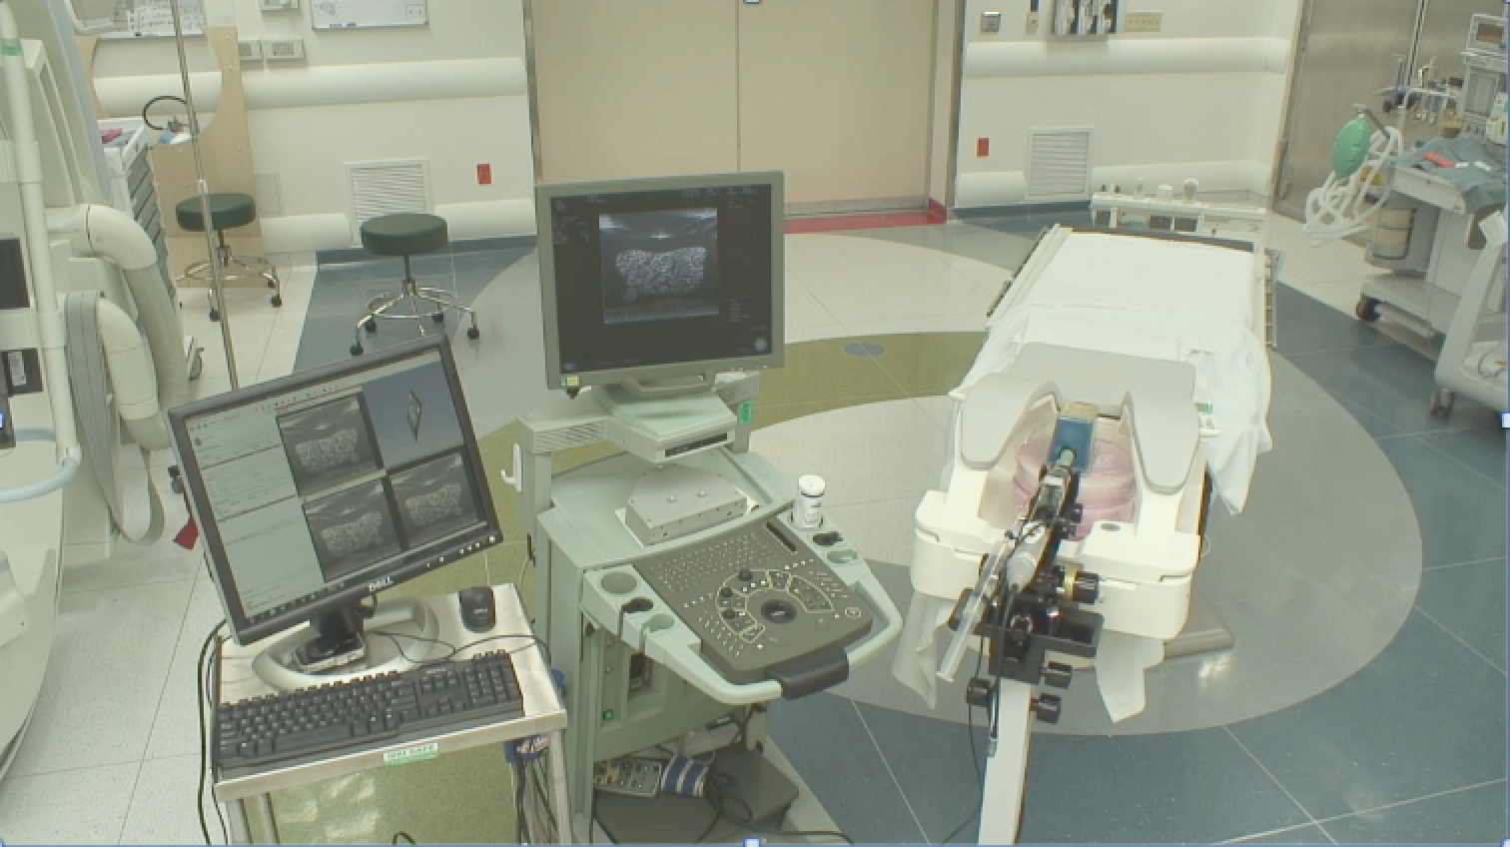
US Tracking 2012: To Bedside
Research setup in AMIGO showing BK ProFocus and TRUS BK 8848 transrectal probe with orientation spatial sensor, interfaced to 3DSlicer via PlusServer library and OpenIGTLink.
Sketch courtesy Wendy Plesniak
A. Fedorov et al.

Slide 45
Thanks For Your Attention
Questions and comments?
http://www.slicer.org

