Slide 1
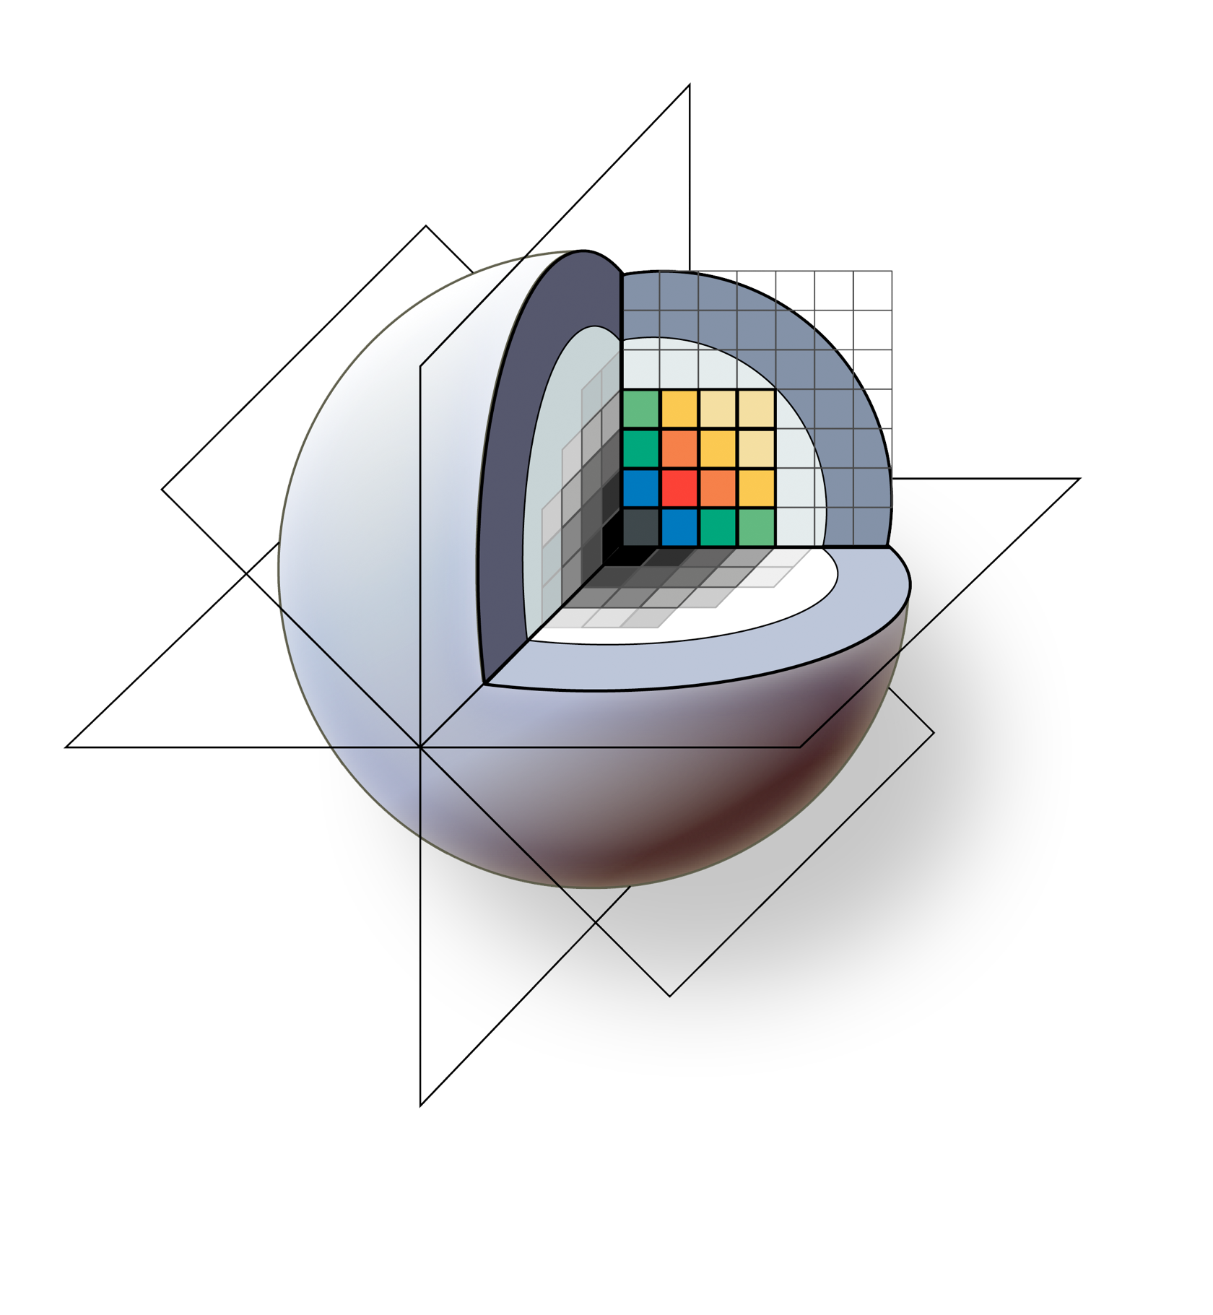
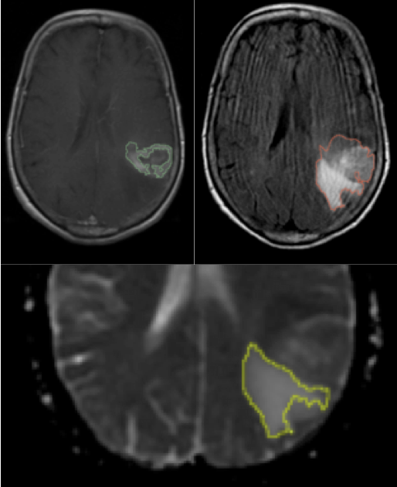
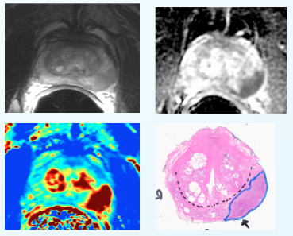
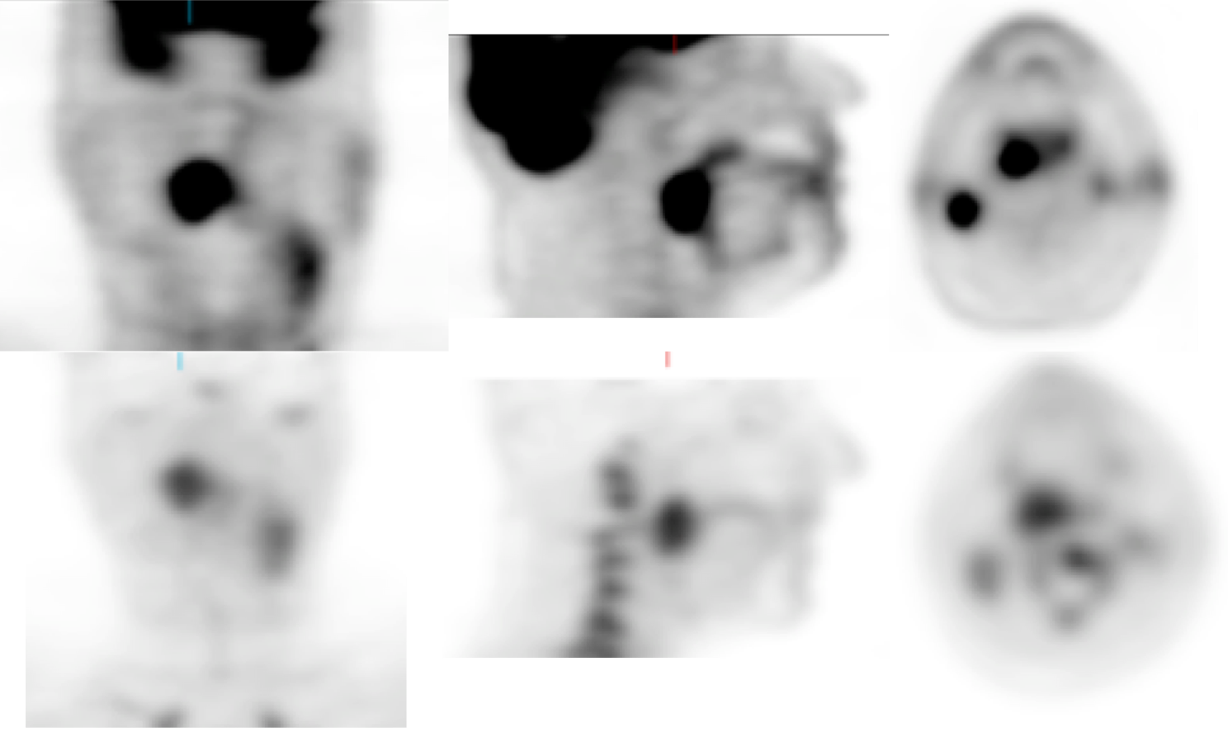
3D Slicer and QIN
http://qiicr.org U01 CA180918
Quantitative Image Informatics for Cancer Research (QIICR)
Support the needs of the active project in NCI Quantitative Imaging Network (QIN):
processing workflows, data and tool sharing
brain cancer (MGH)
head and neck cancer (U. of Iowa)
prostate cancer (BWH)
Investigate the use of DICOM for results sharing
longitudinal and multi-modality analysis
segmentation and registration results
structured reporting and custom templates

